Slide 1
Dr. Andy Woods
Senior Pastor – Sugar Land Bible Church
President – Chafer Theological Seminary

Slide 2
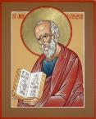
Answering Ten Questions
What is the title – Revelation of Jesus Christ
Who wrote it? – John
Where was it written from? – Patmos
To Whom was it written? – The Seven Churches
When was it written? – A.D. 95
How is it organized (outline)? – 3 part outline
How was it delivered – Seven steps
Why was it written? – Encouragement and holiness
What is it about? – Jesus’ final victory
What makes the book different? – OT relationship

Slide 3
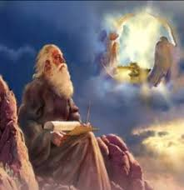
Prologue (Rev. 1:1-8)
Title (1a)
Chain of Communication (1b-2)
Blessing (3)
Author (4a)
Audience (4b)
Greeting (4c)
Source (4d-5a)
Subject (5b-8)

Slide 4
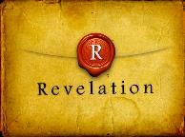
Revelation 1:19
“Therefore write the things which you have seen, and the things which are, and the things which will take place after these things [meta tauta].”

Slide 5
Revelation 1:19
Seen (Chapter 1)
Are (Chapters 2–3)
After these things (Chapters 4–22)

Slide 6
Revelation 1:19
Seen (Chapter 1)
Are (Chapters 2–3)
After these things (Chapters 4–22)

Slide 7
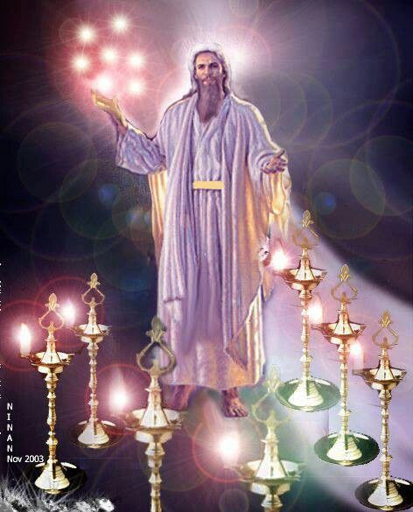

Slide 8
Revelation 1:19
Seen (Chapter 1)
Are (Chapters 2–3)
After these things (Chapters 4–22)

Slide 9
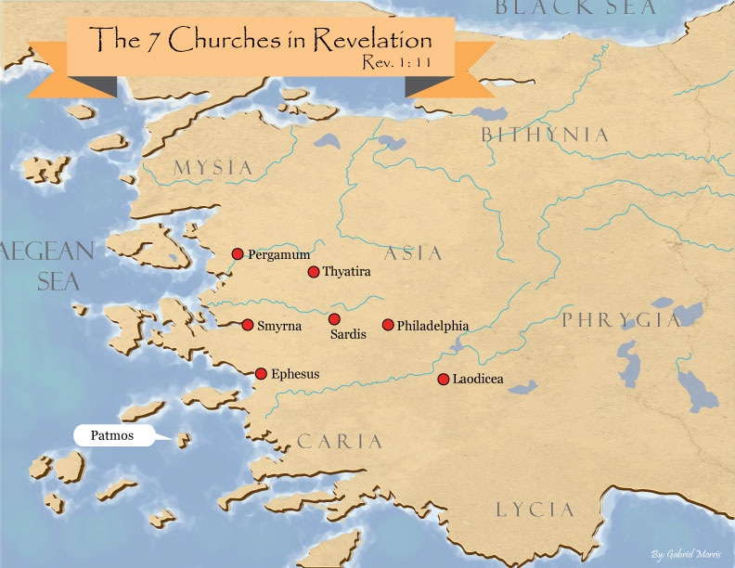

Slide 10
DESCRIPTION OF THE SEVEN CHURCHES Revelation 2‒3
CHURCH | SCRIPTURE | DESCRIPTION
Ephesus | 2:1-7 | Loveless
Smyrna | 2:8-11 | Persecuted
Pergamum | 2:12-17 | Compromised
Thyatira | 2:18-29 | Corrupt
Sardis | 3:1-6 | Dead
Philadelphia | 3:7-13 | Missionary
Laodicea | 3:14-22 | Man-centered

Slide 11
Revelation 1:19
Seen (Chapter 1)
Are (Chapters 2–3)
After these things (Chapters 4–22)

Slide 12
Revelation 1:19
“Therefore write the things which you have seen, and the things which are, and the things which will take place after these things [meta tauta].”

Slide 13
Revelation 4:1
“After these things [meta tauta] I looked, and behold, a door standing open in heaven, and the first voice which I had heard, like the sound of a trumpet speaking with me, said, ‘Come up here, and I will show you what must take place after these things [meta tauta].’”

Slide 14
“After These Things” (Rev. 4‒22)
Before the Tribulation (4‒5)
During the Tribulation (6‒19)
After the Tribulation (20‒22)
Kingdom (20:1-10)
Great White Throne Judgment (20:11-15)
Destruction of the Earth (21:1)
New Heaven and New Earth (21‒22)

Slide 15
“After These Things” (Rev. 4‒22)
Before the Tribulation (4‒5)
During the Tribulation (6‒19)
After the Tribulation (20‒22)
Kingdom (20:1-10)
Great White Throne Judgment (20:11-15)
Destruction of the Earth (21:1)
New Heaven and New Earth (21‒22)

Slide 16
Comparing Revelation 4 & 5
Chapter | Revelation 4 | Revelation 5
God-head Member | Father | Son
Role | Creator | Redeemer
Reason for Worship | Role in Creation (4:11) | Role in Redemption (5:9, 12)

Slide 17
Preview (Rev. 4:1-11)
Summons to Heaven (4:1)
Sights in Heaven (4:2-8)
Song of Heaven (4:9-11)
Willmington. Outline Bible, 759

Slide 18
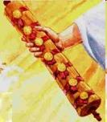
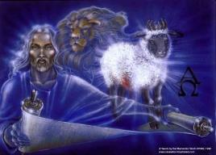
Revelation 5:1-14
An observation (5:1)
A question (5:2)
An investigation (5:3)
A lamentation (5:4)
A consolation (5:5a)
A manifestation (5:5b-6)
A reception (5:7)
A reaction (5:8-14)
Willmington. Outline Bible, 760

Slide 19
Revelation 5:1-14
An observation (5:1)
A question (5:2)
An investigation (5:3)
A lamentation (5:4)
A consolation (5:5a)
A manifestation (5:5b-6)
A reception (5:7)
A reaction (5:8-14)
Willmington. Outline Bible, 760

Slide 20
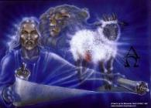
VIII. A reaction (5:8-14)
4 living creatures & 24 elders (5:8-10)
Worshippers (8)
Worship (9-10)
Angels & 24 elders (5:11-12)
Worshippers (11)
Worship (12)
Every created thing (5:13)
Worshippers (13a)
Worship (13b)
4 living creatures & 24 elders (5:14)
4 living creatures (14a)
24 elders (14b)

Slide 21
VIII. A reaction (5:8-14)
4 living creatures & 24 elders (5:8-10)
Worshippers (8)
Worship (9-10)
Angels & 24 elders (5:11-12)
Worshippers (11)
Worship (12)
Every created thing (5:13)
Worshippers (13a)
Worship (13b)
4 living creatures & 24 elders (5:14)
4 living creatures (14a)
24 elders (14b)

Slide 22
VIII. A reaction (5:8-14)
4 living creatures & 24 elders (5:8-10)
Worshippers (8)
Worship (9-10)
Angels & 24 elders (5:11-12)
Worshippers (11)
Worship (12)
Every created thing (5:13)
Worshippers (13a)
Worship (13b)
4 living creatures & 24 elders (5:14)
4 living creatures (14a)
24 elders (14b)

Slide 23
VIII. A reaction (5:8-14)
4 living creatures & 24 elders (5:8-10)
Worshippers (8)
Worship (9-10)
Angels & 24 elders (5:11-12)
Worshippers (11)
Worship (12)
Every created thing (5:13)
Worshippers (13a)
Worship (13b)
4 living creatures & 24 elders (5:14)
4 living creatures (14a)
24 elders (14b)

Slide 24
Revelation 4:4
“Around the throne were twenty-four thrones; and upon the thrones I saw twenty-four elders sitting, clothed in white garments, and golden crowns on their heads.”

Slide 25
Revelation 5:9-10
“ ⁹ And they sang a new song, saying, ‘Worthy are You to take the book and to break its seals; for You were slain, and purchased for God with Your blood men from every tribe and tongue and people and nation. ¹⁰ You have made them to be a kingdom and priests to our God; and they will reign upon the earth.’”

Slide 26
Twenty-Four Elders (Rev. 4:4; 5:8-10)
Church
Crowned (2:10)
Resurrected (4:4)
Clothed in White (3:5)
Redeemed (5:8-10)
Global (5:9; Matt. 28:19)
Enthroned (3:21)
Elders (1 Tim. 3:1-7)
Kingdom of Priests (Rev. 1:6)
Twenty-four (Rev. 1:6)

Slide 27
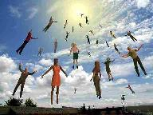
When Will the Rapture Take Place Relative to the Tribulation Period?
Pre-tribulation rapture theory
Mid-tribulation rapture theory
Post-tribulation rapture theory
Pre-wrath rapture theory
Partial rapture theory

Slide 29
Revelation 5:9-10
“ ⁹ And they sang a new song, saying, ‘Worthy are You to take the book and to break its seals; for You were slain, and purchased for God with Your blood men from every tribe and tongue and people and nation. ¹⁰ You have made them to be a kingdom and priests to our God; and they will reign upon the earth.’”

Slide 30
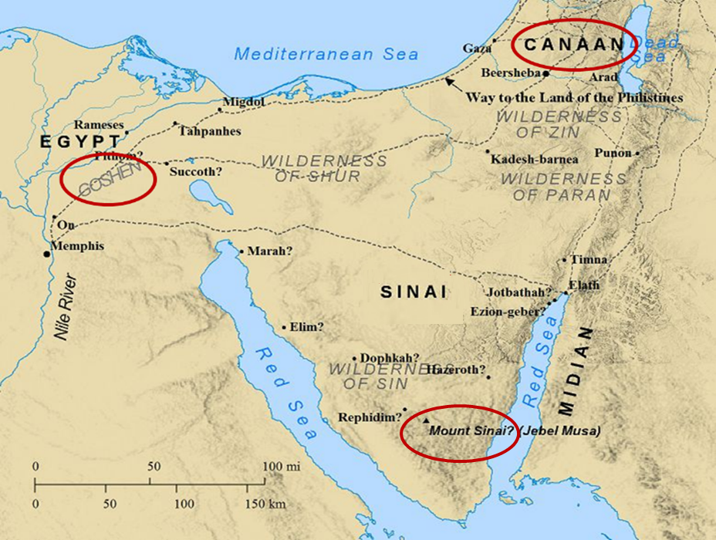

Slide 31
Exodus 15:13, 17
^{13 “}In Your lovingkindness You have led the people whom You have redeemed; In Your strength You have guided them to Your holy habitation…¹⁷ You will bring them and plant them in the mountain of Your inheritance, The place, O Lord, which You have made for Your dwelling, The sanctuary, O Lord, which Your hands have established.”

Slide 32
Revelation 5:9-10 (NKJV)
⁹ “And they sang a new song, saying: ‘You are worthy to take the scroll, And to open its seals; For You were slain, And have redeemed us to God by Your blood Out of every tribe and tongue and people and nation, ¹⁰ And have made us kings and priests to our God; And we shall reign on the earth.’”

Slide 33
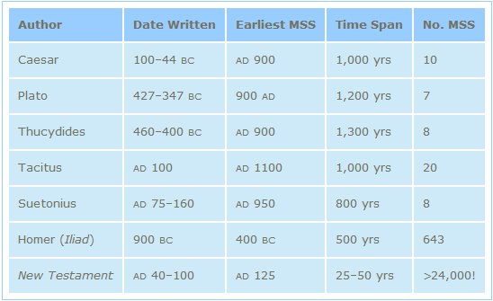
http://creationrevolution.com/2012/05/should-we-trust-the-bible/

Slide 34
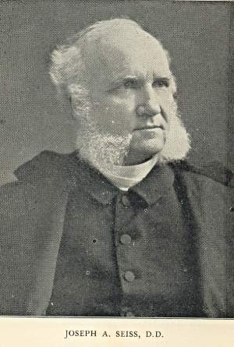
J.A. Seiss Seiss, J. A. (1901). The Apocalypse: A Series of Special Lectures on the Revelation of Jesus Christ with Revised Text (Eighth Edition, Vol. 1). New York: Charles C. Cook.
“Ηγὸρασας ἠμᾶς. Some critics and expositors have rejected this ἠμᾶς (us), for the reason that it is omitted in the Codex Alexandrinus, and in the Ethiopic verson; though the latter is not much more than a loose paraphrase. The Codex Sinaiticus, however, which was discovered in 1860, and which is of equal antiquity and authority with the Codex Alexandrinus, contains it. The Codex Basilianus, in the Vatican, contains it. The Latin, Coptic or Memphitic, and Arminian, which are of great value, contain it.”

Slide 35
J.A. Seiss Seiss, J. A. (1901). The Apocalypse: A Series of Special Lectures on the Revelation of Jesus Christ with Revised Text (Eighth Edition, Vol. 1). New York: Charles C. Cook.
“And so do all other MSS. and versions. And to discredit it, simply and only because it does not appear in that one single Codex of Alexandria, is most unreasonable and unjust to the weight of authority for its retention. Dr. Tregelles, on full examination, was firmly convinced of its right to a place in the text, before the Codex Sinaiticus appeared; and the presence of this ἠμᾶς in that MS., ought to settle the question of its genuineness forever. The evidences from the context, also argue powerfully for a construction which necessarily embraces it, whether expressed or not. We regard it as indubitably genuine.”

Slide 36
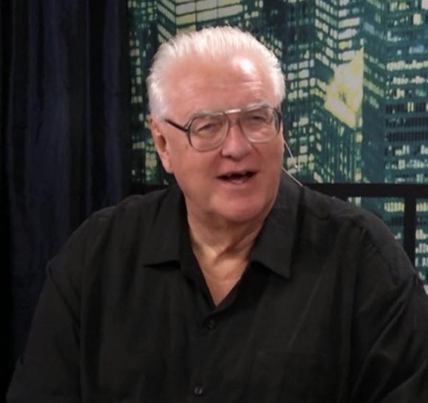
David Hocking
David Hocking, The Book of Revelation: Understanding the Future (Tustin, CA: Hope For Today Publications, 2014), 271.
“The Greek manuscripts (that we have today) of the passage in Revelation 5:9 are 24 in number, and 23 of them read “US” ‒ only Codex Alexandrinus differs in this regard.”

Slide 37
David Hocking
David Hocking, The Book of Revelation: Understanding the Future (Tustin, CA: Hope For Today Publications, 2014), 276-77.
“You maybe asking ‒ ‘what difference does it make, and why go to all the trouble that is listed above?’ The answer is quite important: The King James reading of the text clearly teaches that church-age believers (represented by the 24 elders in heaven) are singing a song about their own redemption, and since the 24 elders are in heaven all during the tribulation ‒ the correct view of Bible prophecy as to the rapture of the church-age believers (Jew and Gentile) is that they are removed BEFORE the tribulation begins! Our response is simple ‒ PRAISE THE LORD!”

Slide 38
2. Worship (Rev. 5:9-10)
Redemption (5:9)
The Coming Kingdom (5:10)

Slide 39
2. Worship (Rev. 5:9-10)
Redemption (5:9)
The Coming Kingdom (5:10)

Slide 40
Revelation 5:9-10
“ ⁹ And they sang a new song, saying, ‘Worthy are You to take the book and to break its seals; for You were slain, and purchased for God with Your blood men from every tribe and tongue and people and nation. ¹⁰ You have made them to be a kingdom and priests to our God; and they will reign upon the earth.’”

Slide 41
Revelation 5:9-10
“ ⁹ And they sang a new song, saying, ‘Worthy are You to take the book and to break its seals; for You were slain, and purchased for God with Your blood men from every tribe and tongue and people and nation. ¹⁰ You have made them to be a kingdom and priests to our God; and they will reign upon the earth.’”

Slide 42
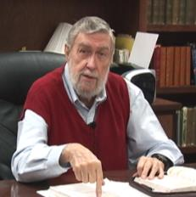
Jay Adams
Competent to Counsel, 70.
“But counselors, as Christians, are obligated to present the claims of Christ. They must present the good news that Christ Jesus died on the cross in the place of His own, that He bore the guilt and suffered the penalty for their sins. He died
that all whom the Father had given to Him might come unto Him and have life everlasting. As a reformed Christian, the writer believes that counselors must not tell any unsaved counselee that Christ died for him, FOR THEY CANNOT SAY THAT. No man knows except Christ Himself who are His elect for whom He died." [emphasis mine]

Slide 43
2. Worship (Rev. 5:9-10)
Redemption (5:9)
The Coming Kingdom (5:10)

Slide 44
Revelation 1:6; 5:10
“and He has made us to be a kingdom, priests to His God and Father—to Him be the glory and the dominion forever and ever. Amen…You have made them to be a kingdom and priests to our God; and they will reign [basileuō] upon the earth [gē].”

Slide 46
VIII. A reaction (5:8-14)
4 living creatures & 24 elders (5:8-10)
Worshippers (8)
Worship (9-10)
Angels & 24 elders (5:11-12)
Worshippers (11)
Worship (12)
Every created thing (5:13)
Worshippers (13a)
Worship (13b)
4 living creatures & 24 elders (5:14)
4 living creatures (14a)
24 elders (14b)

Slide 47
VIII. A reaction (5:8-14)
4 living creatures & 24 elders (5:8-10)
Worshippers (8)
Worship (9-10)
Angels & 24 elders (5:11-12)
Worshippers (11)
Worship (12)
Every created thing (5:13)
Worshippers (13a)
Worship (13b)
4 living creatures & 24 elders (5:14)
4 living creatures (14a)
24 elders (14b)

Slide 48
Twenty-Four Elders (Rev. 4:4)
Church
Crowned (2:10)
Clothed in White (3:5)
Redeemed (5:8-10)
Enthroned (3:21)
Elders (1 Tim. 3:1-7)
Kingdom of Priests (Rev. 1:6)
Twenty-four (Rev. 1:6)

Slide 49
VIII. A reaction (5:8-14)
4 living creatures & 24 elders (5:8-10)
Worshippers (8)
Worship (9-10)
Angels & 24 elders (5:11-12)
Worshippers (11)
Worship (12)
Every created thing (5:13)
Worshippers (13a)
Worship (13b)
4 living creatures & 24 elders (5:14)
4 living creatures (14a)
24 elders (14b)

Slide 50
VIII. A reaction (5:8-14)
4 living creatures & 24 elders (5:8-10)
Worshippers (8)
Worship (9-10)
Angels & 24 elders (5:11-12)
Worshippers (11)
Worship (12)
Every created thing (5:13)
Worshippers (13a)
Worship (13b)
4 living creatures & 24 elders (5:14)
4 living creatures (14a)
24 elders (14b)

Slide 51
VIII. A reaction (5:8-14)
4 living creatures & 24 elders (5:8-10)
Worshippers (8)
Worship (9-10)
Angels & 24 elders (5:11-12)
Worshippers (11)
Worship (12)
Every created thing (5:13)
Worshippers (13a)
Worship (13b)
4 living creatures & 24 elders (5:14)
4 living creatures (14a)
24 elders (14b)

Slide 52
VIII. A reaction (5:8-14)
4 living creatures & 24 elders (5:8-10)
Worshippers (8)
Worship (9-10)
Angels & 24 elders (5:11-12)
Worshippers (11)
Worship (12)
Every created thing (5:13)
Worshippers (13a)
Worship (13b)
4 living creatures & 24 elders (5:14)
4 living creatures (14a)
24 elders (14b)

Slide 53
VIII. A reaction (5:8-14)
4 living creatures & 24 elders (5:8-10)
Worshippers (8)
Worship (9-10)
Angels & 24 elders (5:11-12)
Worshippers (11)
Worship (12)
Every created thing (5:13)
Worshippers (13a)
Worship (13b)
4 living creatures & 24 elders (5:14)
4 living creatures (14a)
24 elders (14b)

Slide 54
VIII. A reaction (5:8-14)
4 living creatures & 24 elders (5:8-10)
Worshippers (8)
Worship (9-10)
Angels & 24 elders (5:11-12)
Worshippers (11)
Worship (12)
Every created thing (5:13)
Worshippers (13a)
Worship (13b)
4 living creatures & 24 elders (5:14)
4 living creatures (14a)
24 elders (14b)

Slide 55
VIII. A reaction (5:8-14)
4 living creatures & 24 elders (5:8-10)
Worshippers (8)
Worship (9-10)
Angels & 24 elders (5:11-12)
Worshippers (11)
Worship (12)
Every created thing (5:13)
Worshippers (13a)
Worship (13b)
4 living creatures & 24 elders (5:14)
4 living creatures (14a)
24 elders (14b)

Slide 56
Conclusion

Slide 57
Revelation 5:1-14
An observation (5:1)
A question (5:2)
An investigation (5:3)
A lamentation (5:4)
A consolation (5:5a)
A manifestation (5:5b-6)
A reception (5:7)
A reaction (5:8-14)
Willmington. Outline Bible, 760

Slide 58
VIII. A reaction (5:8-14)
4 living creatures & 24 elders (5:8-10)
Worshippers (8)
Worship (9-10)
Angels & 24 elders (5:11-12)
Worshippers (11)
Worship (12)
Every created thing (5:13)
Worshippers (13a)
Worship (13b)
4 living creatures & 24 elders (5:14)
4 living creatures (14a)
24 elders (14b)

Slide 59
“The Lord bless you and keep you; the Lord make his face shine on you and be gracious to you; the Lord turn his face toward you and give you peace.” (NIV)

