Slide 1
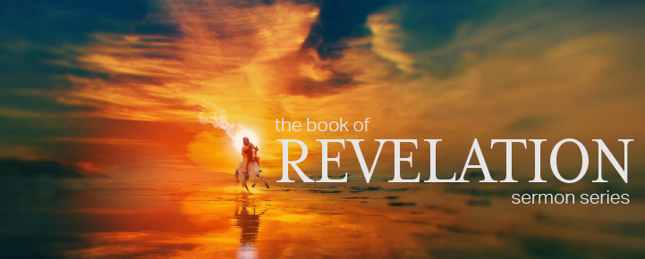

Dr. Andy Woods
Senior Pastor – Sugar Land Bible Church
President – Chafer Theological Seminary

Slide 2
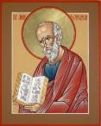
Answering Ten Questions
What is the title – Revelation of Jesus Christ
Who wrote it? – John
Where was it written from? – Patmos
To Whom was it written? – The Seven Churches
When was it written? – A.D. 95
How is it organized (outline)? – 3 part outline
How was it delivered – Seven steps
Why was it written? – Encouragement and holiness
What is it about? – Jesus’ final victory
What makes the book different? – OT relationship

Slide 3

Prologue (Rev. 1:1-8)
Title (1a)
Chain of Communication (1b-2)
Blessing (3)
Author (4a)
Audience (4b)
Greeting (4c)
Source (4d-5a)
Subject (5b-8)

Slide 4

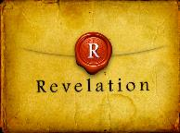
Revelation 1:19
“Therefore write the things which you have seen, and the things which are, and the things which will take place after these things [meta tauta].”

Slide 5

Revelation 1:19
Seen (Chapter 1)
Are (Chapters 2–3)
After these things (Chapters 4–22)

Slide 6
Revelation 1:19
Seen (Chapter 1)
Are (Chapters 2–3)
After these things (Chapters 4–22)

Slide 7
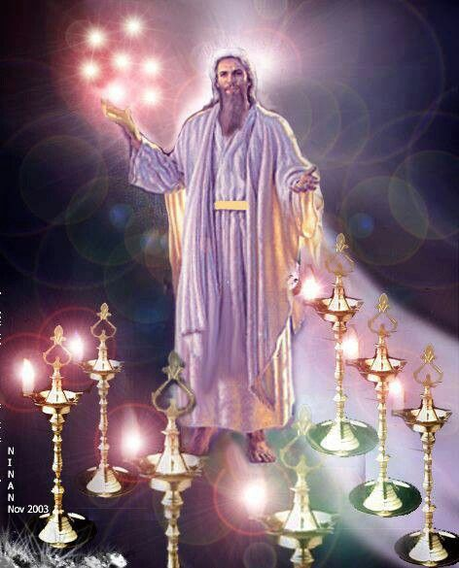

Slide 8
Revelation 1:19
Seen (Chapter 1)
Are (Chapters 2–3)
After these things (Chapters 4–22)

Slide 9



Slide 10
DESCRIPTION OF THE SEVEN CHURCHES Revelation 2‒3
CHURCH | SCRIPTURE | DESCRIPTION
Ephesus | 2:1-7 | Loveless
Smyrna | 2:8-11 | Persecuted
Pergamum | 2:12-17 | Compromised
Thyatira | 2:18-29 | Corrupt
Sardis | 3:1-6 | Dead
Philadelphia | 3:7-13 | Missionary
Laodicea | 3:14-22 | Man-centered

Slide 11
Revelation 1:19
Seen (Chapter 1)
Are (Chapters 2–3)
After these things (Chapters 4–22)

Slide 12
Revelation 1:19
“Therefore write the things which you have seen, and the things which are, and the things which will take place after these things [meta tauta].”

Slide 13
Revelation 4:1
“After these things [meta tauta] I looked, and behold, a door standing open in heaven, and the first voice which I had heard, like the sound of a trumpet speaking with me, said, ‘Come up here, and I will show you what must take place after these things [meta tauta].’”

Slide 14
“After These Things”
(Rev. 4‒22)
Before the Tribulation (4‒5)
During the Tribulation (6‒19)
After the Tribulation (20‒22)
  Kingdom (20:1-10)
  Great White Throne Judgment (20:11-15)
  Destruction of the Earth (21:1)
  New Heaven and New Earth (21‒22)

Slide 15
“After These Things”
(Rev. 4‒22)
Before the Tribulation (4‒5)
During the Tribulation (6‒19)
After the Tribulation (20‒22)
  Kingdom (20:1-10)
  Great White Throne Judgment (20:11-15)
  Destruction of the Earth (21:1)
  New Heaven and New Earth (21‒22)

Slide 16
Comparing Revelation 4 & 5
Chapter | Revelation 4 | Revelation 5
God-head Member | Father | Son
Role | Creator | Redeemer
Reason for Worship | Role in Creation (4:11) | Role in Redemption (5:9, 12)

Slide 17
Preview
(Rev. 4:1-11)
Summons to Heaven (4:1)
Sights in Heaven (4:2-8)
Song of Heaven (4:9-11)
Willmington. Outline Bible, 759

Slide 18

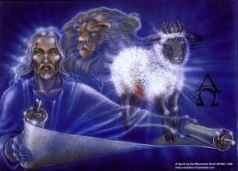
Revelation 5:1-14
An observation (5:1)
A question (5:2)
An investigation (5:3)
A lamentation (5:4)
A consolation (5:5a)
A manifestation (5:5b-6)
A reception (5:7)
A reaction (5:8-14)
Willmington. Outline Bible, 760

Slide 19
Revelation 5:1-14
An observation (5:1)
A question (5:2)
An investigation (5:3)
A lamentation (5:4)
A consolation (5:5a)
A manifestation (5:5b-6)
A reception (5:7)
A reaction (5:8-14)
Willmington. Outline Bible, 760

Slide 20
Genesis 1:26-28
²⁶ Then God said, “Let Us make man in Our image, according to Our likeness; and let them rule over the fish of the sea and over the birds of the sky and over the cattle and over all the earth, and over every creeping thing that creeps on the earth.” ²⁷ God created man in His own image, in the image of God He created him; male and female He created them. ²⁸ God blessed them; and God said to them, “Be fruitful and multiply, and fill the earth, and subdue it; and rule over the fish of the sea and over the birds of the sky and over every living thing that moves on the earth.”

Slide 21
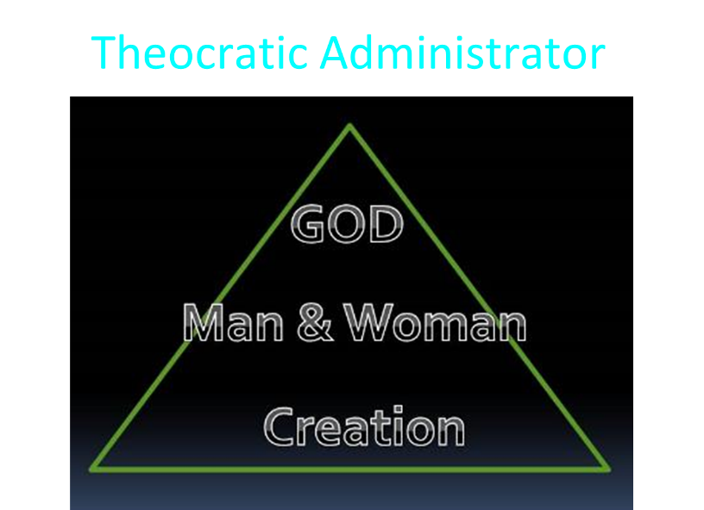

Slide 22
Revelation 5:1-14
An observation (5:1)
A question (5:2)
An investigation (5:3)
A lamentation (5:4)
A consolation (5:5a)
A manifestation (5:5b-6)
A reception (5:7)
A reaction (5:8-14)
Willmington. Outline Bible, 760

Slide 23
Revelation 5:1-14
An observation (5:1)
A question (5:2)
An investigation (5:3)
A lamentation (5:4)
A consolation (5:5a)
A manifestation (5:5b-6)
A reception (5:7)
A reaction (5:8-14)
Willmington. Outline Bible, 760

Slide 24
Revelation 5:1-14
An observation (5:1)
A question (5:2)
An investigation (5:3)
A lamentation (5:4)
A consolation (5:5a)
A manifestation (5:5b-6)
A reception (5:7)
A reaction (5:8-14)
Willmington. Outline Bible, 760

Slide 25
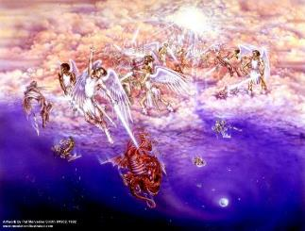
Satan as Ruler of this World
Job 1:7; 2:2
Luke 4:5-7
John 12:31; 14:30; 16:11
2 Corinthians 4:4
Ephesians 2:2
1 John 4:4; 5:19

Slide 26
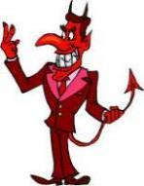
Names & Titles Demonstrating Satan’s Post-Fall, Earthly Authority
(Job 1:7; 2:2; Luke 4:5-8; Rom. 8:19-22)
Prince of this world (John 12:31; 14:30; 16:11)
God of this world (2 Cor. 4:4)
Prince and power of the air (Eph. 2:2)
Who the believer wrestles with (Eph. 6:12)
Roaring lion (1 Pet. 5:8)
Whole world lies in his power (1 John 5:19)

Slide 27
Divine Judgments (Gen. 3:14-19)
Serpent (3:14-15)
Woman (3:16)
Man (3:17-19)

Slide 28
Man (Gen. 3:17-19)
Painful labor (3:17-19a)
Death (3:19b)

Slide 29

Romans 8:19-23
¹⁹ “For the anxious longing of the creation waits eagerly for the revealing of the sons of God. ²⁰ For the creation was subjected to futility, not willingly, but because of Him who subjected it, in hope ²¹ that the creation itself also will be set free from its slavery to corruption into the freedom of the glory of the children of God. ²² For we know that the whole creation groans and suffers the pains of childbirth together until now. ²³ And not only this, but also we ourselves, having the first fruits of the Spirit, even we ourselves groan within ourselves, waiting eagerly for our adoption as sons, the redemption of our body.”

Slide 30
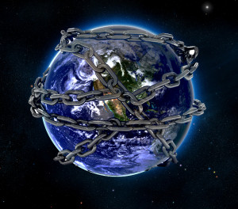

Slide 31
Revelation 5:1-14
An observation (5:1)
A question (5:2)
An investigation (5:3)
A lamentation (5:4)
A consolation (5:5a)
A manifestation (5:5b-6)
A reception (5:7)
A reaction (5:8-14)
Willmington. Outline Bible, 760

Slide 32
Revelation 5:5
and one of the elders said to me, “Stop weeping; behold, the Lion that is from the tribe of Judah, the Root of David, has overcome so as to open the book and its seven seals.”

Slide 33
Revelation 5:5
and one of the elders said to me, “Stop weeping; behold, the Lion that is from the tribe of Judah, the Root of David, has overcome so as to open the book and its seven seals.”

Slide 34
Twenty-Four Elders
(Rev. 4:4)
Church
  Crowned (2:10)
  Clothed in White (3:5)
  Redeemed (5:8-10)
  Enthroned (3:21)
  Elders (1 Tim. 3:1-7)
  Kingdom of Priests (Rev. 1:6)
  Twenty-four (Rev. 1:6)

Slide 35
Revelation 5:1-14
An observation (5:1)
A question (5:2)
An investigation (5:3)
A lamentation (5:4)
A consolation (5:5a)
A manifestation (5:5b-6)
A reception (5:7)
A reaction (5:8-14)
Willmington. Outline Bible, 760

Slide 36

VI. A Manifestation
(Rev. 5:5b-6)
Right tribe: Judah (5:5b)
Right lineage: Davidic (5:5c)
Right victory: Overcame (5:5d)
Right mission: Lamb (5:6)

Slide 37
VI. A Manifestation
(Rev. 5:5b-6)
Right tribe: Judah (5:5b)
Right lineage: Davidic (5:5c)
Right victory: Overcame (5:5d)
Right mission: Lamb (5:6)

Slide 38
Revelation 5:5
and one of the elders said to me, “Stop weeping; behold, the Lion that is from the tribe of Judah, the Root of David, has overcome so as to open the book and its seven seals.”

Slide 39
Messiah must be from the tribe of Judah
Genesis 49:10

Slide 40

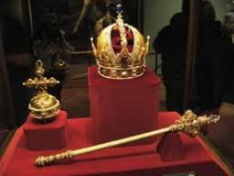
Genesis 49:10
“The scepter shall not depart from Judah, Nor the ruler’s staff from between his feet, Until Shiloh comes, And to him shall be the obedience of the peoples.”

Slide 41
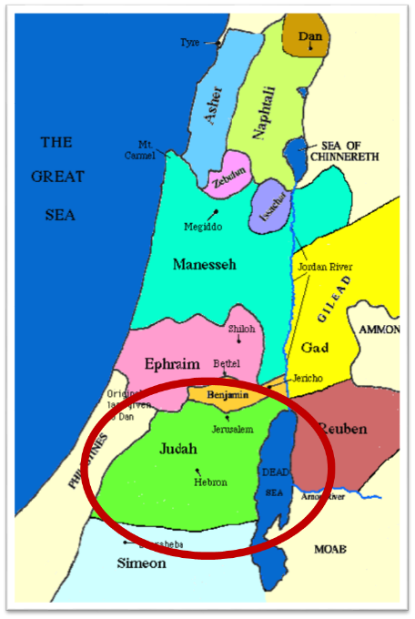

Slide 42
Messiah must be from the tribe of Judah
Genesis 49:10
Revelation 5:5

Slide 43
VI. A Manifestation
(Rev. 5:5b-6)
Right tribe: Judah (5:5b)
Right lineage: Davidic (5:5c)
Right victory: Overcame (5:5d)
Right mission: Lamb (5:6)

Slide 44
Revelation 5:5
and one of the elders said to me, “Stop weeping; behold, the Lion that is from the tribe of Judah, the Root of David, has overcome so as to open the book and its seven seals.”

Slide 45


Slide 46
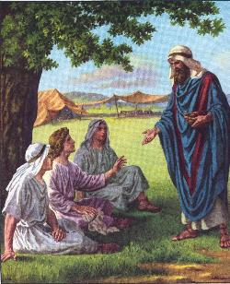
Messiah must be from the family of Jesse
Isaiah 11:1

Slide 47
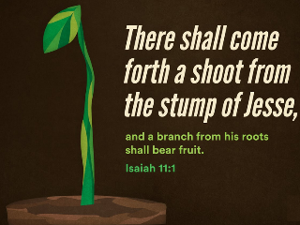
Isaiah 11:1
“Then a shoot will spring from the stem of Jesse, And a branch from his roots will bear fruit.”

Slide 48
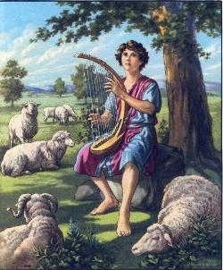
Messiah must be from the line of David
2 Samuel 7:16

Slide 49
2 Samuel 7:8, 16
“⁸ Now therefore, thus you shall say to My servant David, ‘Thus says the Lord of hosts, “I took you from the pasture, from following the sheep, to be ruler over My people Israel… ¹⁶ Your house and your kingdom shall endure before Me forever; your throne shall be established forever.”

Slide 50

2 Samuel 7:12-16
“When your days are complete and you lie down with your fathers, I will raise up your descendant after you, who will come forth from you, and I will establish his kingdom. ¹³ He shall build a house for My name, and I will establish the throne of his kingdom forever. ¹⁴ I will be a father to him and he will be a son to Me; when he commits iniquity, I will correct him with the rod of men and the strokes of the sons of men, ¹⁵ but My lovingkindness shall not depart from him, as I took it away from Saul, whom I removed from before you. ¹⁶ Your house and your kingdom shall endure before Me forever; your throne shall be established forever.” ¹⁷ In accordance with all these words and all this vision, so Nathan spoke to David.”

Slide 51
VI. A Manifestation
(Rev. 5:5b-6)
Right tribe: Judah (5:5b)
Right lineage: Davidic (5:5c)
Right victory: Overcame (5:5d)
Right mission: Lamb (5:6)

Slide 52

Revelation 5:5
and one of the elders said to me, “Stop weeping; behold, the Lion that is from the tribe of Judah, the Root of David, has overcome so as to open the book and its seven seals.”

Slide 53


John 16:33
“These things I have spoken to you, so that in Me you may have peace. In the world you have tribulation, but take courage; I have overcome [nikaō; perfect tense] the world.”

Slide 54

1 John 5:4-5
^{“4} For whatever is born of God overcomes the world; and this is the victory that has overcome the world—our faith. ⁵ Who is the one who overcomes the world, but he who believes that Jesus is the Son of God?”

Slide 55
1 John 4:4
“You are from God, little children, and have overcome [nikaō; perfect tense] them; because greater is He who is in you than he who is in the world.”

Slide 56

Romans 8:37
“But in all these things we overwhelmingly conquer [hypernikaō , present tense] through Him who loved us.”

Slide 57
VI. A Manifestation
(Rev. 5:5b-6)
Right tribe: Judah (5:5b)
Right lineage: Davidic (5:5c)
Right victory: Overcame (5:5d)
Right mission: Lamb (5:6)

Slide 58
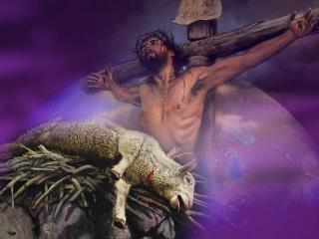
John 1:29
“The next day he saw Jesus coming to him and said, “Behold, the Lamb of God who takes away the sin of the world!”

Slide 59
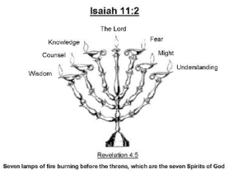
Isaiah 11:2
“The Spirit of the Lord will rest on Him, The spirit of wisdom and understanding, The spirit of counsel and strength, The spirit of knowledge and the fear of the Lord.”

Slide 60
Revelation 5:1-14
An observation (5:1)
A question (5:2)
An investigation (5:3)
A lamentation (5:4)
A consolation (5:5a)
A manifestation (5:5b-6)
A reception (5:7)
A reaction (5:8-14)
Willmington. Outline Bible, 760

Slide 61
Revelation 5:1-14
An observation (5:1)
A question (5:2)
An investigation (5:3)
A lamentation (5:4)
A consolation (5:5a)
A manifestation (5:5b-6)
A reception (5:7)
A reaction (5:8-14)
Willmington. Outline Bible, 760

Slide 62
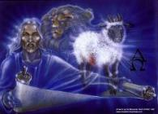
VIII. A reaction (5:8-14)
4 living creatures & 24 elders (5:8-10)
  Worshippers (8)
  Worship (9-10)
Angels & 24 elders (5:11-12)
  Worshippers (11)
  Worship (12)
Every created thing (5:13)
  Worshippers (13a)
  Worship (13b)
4 living creatures & 24 elders (5:14)
  4 living creatures (14a)
  24 elders (14b)

Slide 63
VIII. A reaction (5:8-14)
4 living creatures & 24 elders (5:8-10)
  Worshippers (8)
  Worship (9-10)
Angels & 24 elders (5:11-12)
  Worshippers (11)
  Worship (12)
Every created thing (5:13)
  Worshippers (13a)
  Worship (13b)
4 living creatures & 24 elders (5:14)
  4 living creatures (14a)
  24 elders (14b)

Slide 64
VIII. A reaction (5:8-14)
4 living creatures & 24 elders (5:8-10)
  Worshippers (8)
  Worship (9-10)
Angels & 24 elders (5:11-12)
  Worshippers (11)
  Worship (12)
Every created thing (5:13)
  Worshippers (13a)
  Worship (13b)
4 living creatures & 24 elders (5:14)
  4 living creatures (14a)
  24 elders (14b)

Slide 65
VIII. A reaction (5:8-14)
4 living creatures & 24 elders (5:8-10)
  Worshippers (8)
  Worship (9-10)
Angels & 24 elders (5:11-12)
  Worshippers (11)
  Worship (12)
Every created thing (5:13)
  Worshippers (13a)
  Worship (13b)
4 living creatures & 24 elders (5:14)
  4 living creatures (14a)
  24 elders (14b)

Slide 66
2. Worship
(Rev. 5:9-10)
Redemption (5:9)
The Coming Kingdom (5:10)

Slide 67
2. Worship
(Rev. 5:9-10)
Redemption (5:9)
The Coming Kingdom (5:10)

Slide 68
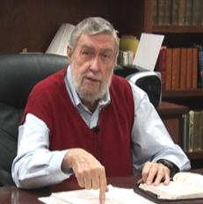
Jay Adams
Competent to Counsel, 70.
“But counselors, as Christians, are obligated to present the claims of Christ. They must present the good news that Christ Jesus died on the cross in the place of His own, that He bore the guilt and suffered the penalty for their sins. He died
that all whom the Father had given to Him might come unto Him and have life everlasting. As a reformed Christian, the writer believes that counselors must not tell any unsaved counselee that Christ died for him, FOR THEY CANNOT SAY THAT. No man knows except Christ Himself who are His elect for whom He died." [emphasis mine]

Slide 69
2. Worship
(Rev. 5:9-10)
Redemption (5:9)
The Coming Kingdom (5:10)

Slide 70
Revelation 1:6; 5:10
“and He has made us to be a kingdom, priests to His God and Father—to Him be the glory and the dominion forever and ever. Amen…You have made them to be a kingdom and priests to our God; and they will reign [basileuō] upon the earth [gē].”

Slide 71


Slide 72
VIII. A reaction (5:8-14)
4 living creatures & 24 elders (5:8-10)
  Worshippers (8)
  Worship (9-10)
Angels & 24 elders (5:11-12)
  Worshippers (11)
  Worship (12)
Every created thing (5:13)
  Worshippers (13a)
  Worship (13b)
4 living creatures & 24 elders (5:14)
  4 living creatures (14a)
  24 elders (14b)

Slide 73
VIII. A reaction (5:8-14)
4 living creatures & 24 elders (5:8-10)
  Worshippers (8)
  Worship (9-10)
Angels & 24 elders (5:11-12)
  Worshippers (11)
  Worship (12)
Every created thing (5:13)
  Worshippers (13a)
  Worship (13b)
4 living creatures & 24 elders (5:14)
  4 living creatures (14a)
  24 elders (14b)

Slide 74
Twenty-Four Elders
(Rev. 4:4)
Church
  Crowned (2:10)
  Clothed in White (3:5)
  Redeemed (5:8-10)
  Enthroned (3:21)
  Elders (1 Tim. 3:1-7)
  Kingdom of Priests (Rev. 1:6)
  Twenty-four (Rev. 1:6)

Slide 75
VIII. A reaction (5:8-14)
4 living creatures & 24 elders (5:8-10)
  Worshippers (8)
  Worship (9-10)
Angels & 24 elders (5:11-12)
  Worshippers (11)
  Worship (12)
Every created thing (5:13)
  Worshippers (13a)
  Worship (13b)
4 living creatures & 24 elders (5:14)
  4 living creatures (14a)
  24 elders (14b)

Slide 76
VIII. A reaction (5:8-14)
4 living creatures & 24 elders (5:8-10)
  Worshippers (8)
  Worship (9-10)
Angels & 24 elders (5:11-12)
  Worshippers (11)
  Worship (12)
Every created thing (5:13)
  Worshippers (13a)
  Worship (13b)
4 living creatures & 24 elders (5:14)
  4 living creatures (14a)
  24 elders (14b)

Slide 77
VIII. A reaction (5:8-14)
4 living creatures & 24 elders (5:8-10)
  Worshippers (8)
  Worship (9-10)
Angels & 24 elders (5:11-12)
  Worshippers (11)
  Worship (12)
Every created thing (5:13)
  Worshippers (13a)
  Worship (13b)
4 living creatures & 24 elders (5:14)
  4 living creatures (14a)
  24 elders (14b)

Slide 78
VIII. A reaction (5:8-14)
4 living creatures & 24 elders (5:8-10)
  Worshippers (8)
  Worship (9-10)
Angels & 24 elders (5:11-12)
  Worshippers (11)
  Worship (12)
Every created thing (5:13)
  Worshippers (13a)
  Worship (13b)
4 living creatures & 24 elders (5:14)
  4 living creatures (14a)
  24 elders (14b)

Slide 79
VIII. A reaction (5:8-14)
4 living creatures & 24 elders (5:8-10)
  Worshippers (8)
  Worship (9-10)
Angels & 24 elders (5:11-12)
  Worshippers (11)
  Worship (12)
Every created thing (5:13)
  Worshippers (13a)
  Worship (13b)
4 living creatures & 24 elders (5:14)
  4 living creatures (14a)
  24 elders (14b)

Slide 80
VIII. A reaction (5:8-14)
4 living creatures & 24 elders (5:8-10)
  Worshippers (8)
  Worship (9-10)
Angels & 24 elders (5:11-12)
  Worshippers (11)
  Worship (12)
Every created thing (5:13)
  Worshippers (13a)
  Worship (13b)
4 living creatures & 24 elders (5:14)
  4 living creatures (14a)
  24 elders (14b)

Slide 81
VIII. A reaction (5:8-14)
4 living creatures & 24 elders (5:8-10)
  Worshippers (8)
  Worship (9-10)
Angels & 24 elders (5:11-12)
  Worshippers (11)
  Worship (12)
Every created thing (5:13)
  Worshippers (13a)
  Worship (13b)
4 living creatures & 24 elders (5:14)
  4 living creatures (14a)
  24 elders (14b)

Slide 82
Conclusion

Slide 83
Revelation 5:1-14
An observation (5:1)
A question (5:2)
An investigation (5:3)
A lamentation (5:4)
A consolation (5:5a)
A manifestation (5:5b-6)
A reception (5:7)
A reaction (5:8-14)
Willmington. Outline Bible, 760

Slide 84

“The Lord bless you and keep you; the Lord make his face shine on you and be gracious to you; the Lord turn his face toward you and give you peace.” (NIV)

