Slide 1
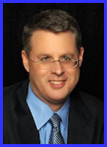
Ecclesiology Session 42
Dr. Andy Woods
Senior Pastor – Sugar Land Bible Church
President – Chafer Theological Seminary

Slide 2
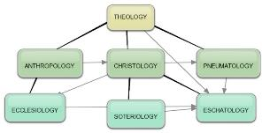
Areas of Systematic Theology
Prolegomena – Introduction
Theology – Study of God
Christology – Study of Christ
Pneumatology – Study of the Holy Spirit
Anthropology – Study of Man
Hamartiology – Study of sin
Soteriology – Study of salvation
Angelology – Study of angels
Ecclesiology – Study of the Church
Eschatology – Study of the end

Slide 3
Ecclesiology Overview
Definition
Universal vs. local
Word pictures
Origin
Israel – Church differences
Intercalation
Purposes
Activities
Government
Officers
Ordinances
Purity

Slide 4
Activities of the Local Church (Acts 2:41-47)
Doctrine (Acts 2:42)
Ordinances (Acts 2:41-42, 46)
Prayer (Acts 2:42)
Evangelism (Acts 2:47)
Worship (Acts 2:47)
Benevolence (Acts 2:44-45)
Fellowship (Acts 2:42, 46-47)

Slide 5
Ecclesiology Overview
Definition
Universal vs. local
Word pictures
Origin
Israel – Church differences
Intercalation
Purposes
Activities
Government
Officers
Ordinances
Purity

Slide 6
Local Church Government
Episcopalian/bishop rule – Acts 15:2, 6
Congregational rule – Acts 6:1-7
Presbyterian/elder rule – Acts 20:28; 1 Tim 5:17; 4:14

Slide 7
Local Church Government
Episcopalian/bishop rule – Acts 15:2, 6
Congregational rule – Acts 6:1-7
Presbyterian/elder rule – Acts 20:28; 1 Tim 5:17; 4:14

Slide 8
Ecclesiology Overview
Definition
Universal vs. local
Word pictures
Origin
Israel – Church differences
Intercalation
Purposes
Activities
Government
Officers
Ordinances
Purity

Slide 9
Local Church Officers
Elder
Qualifications (1 Tim 3:1-7; Titus 1:5-9)
Number (Jas 5:14)
Distinction among elders (1 Tim 5:17)
Duties
Removal (1 Tim 5:19)
Deacon
Definition (Acts 6:1-7)
Qualifications (1 Tim 3:8-13)

Slide 10
Acts 6:3
“Therefore, brethren, select from among you seven men of good reputation, full of the Spirit and of wisdom, whom we may put in charge of this task.”

Slide 11
Deacon Qualifications Acts 6:3
Believer
Men
Good reputation
Honest
Spirit-filled
Wise
Examples
Stephen (Acts 7)
Philip (Acts 8)
Exodus 18:21 – Men, God-fearers, truthful, haters of dishonest gain

Slide 12
Deacon Qualifications 1 Tim. 3:8-13
Men of dignity
Not double-tongued
Not addicted to much wine
Not fond of sordid gain
Holding to the mystery of the faith with a clear conscience
First tested
Beyond reproach
Husband of one wife
Good managers of their children & household

Slide 13
Deacon Qualifications 1 Tim. 3:8-13
Men of dignity
Not double-tongued
Not addicted to much wine
Not fond of sordid gain
Holding to the mystery of the faith with a clear conscience
First tested
Beyond reproach
Husband of one wife
Good managers of their children & household

Slide 14
Deacon Qualifications 1 Tim. 3:8-13
Men of dignity
Not double-tongued
Not addicted to much wine
Not fond of sordid gain
Holding to the mystery of the faith with a clear conscience
First tested
Beyond reproach
Husband of one wife
Good managers of their children & household

Slide 15
Deacon Qualifications 1 Tim. 3:8-13
Men of dignity
Not double-tongued
Not addicted to much wine
Not fond of sordid gain
Holding to the mystery of the faith with a clear conscience
First tested
Beyond reproach
Husband of one wife
Good managers of their children & household

Slide 16
Deacon Qualifications 1 Tim. 3:8-13
Men of dignity
Not double-tongued
Not addicted to much wine
Not fond of sordid gain
Holding to the mystery of the faith with a clear conscience
First tested
Beyond reproach
Husband of one wife
Good managers of their children & household

Slide 17
Deacon Qualifications 1 Tim. 3:8-13
Men of dignity
Not double-tongued
Not addicted to much wine
Not fond of sordid gain
Holding to the mystery of the faith with a clear conscience
First tested
Beyond reproach
Husband of one wife
Good managers of their children & household

Slide 18
Deacon Qualifications 1 Tim. 3:8-13
Men of dignity
Not double-tongued
Not addicted to much wine
Not fond of sordid gain
Holding to the mystery of the faith with a clear conscience
First tested
Beyond reproach
Husband of one wife
Good managers of their children & household

Slide 19
Deacon Qualifications 1 Tim. 3:8-13
Men of dignity
Not double-tongued
Not addicted to much wine
Not fond of sordid gain
Holding to the mystery of the faith with a clear conscience
First tested
Beyond reproach
Husband of one wife
Good managers of their children & household

Slide 20
Deacon Qualifications 1 Tim. 3:8-13
Men of dignity
Not double-tongued
Not addicted to much wine
Not fond of sordid gain
Holding to the mystery of the faith with a clear conscience
First tested
Beyond reproach
Husband of one wife
Good managers of their children & household

Slide 21
Deacon Qualifications 1 Tim. 3:8-13
Men of dignity
Not double-tongued
Not addicted to much wine
Not fond of sordid gain
Holding to the mystery of the faith with a clear conscience
First tested
Beyond reproach
Husband of one wife
Good managers of their children & household

Slide 22
Gender Restrictions
Women are the backbone of the church
Trinitarian example
Gender restrictions
Elder: 1 Tim 3:1-2; Titus 1:6 (2x); 1 Tim 2:11-14
Deacon
Yes: Acts 6:3; 1 Tim. 3:8, 10, 12
No: Rom. 16:1; 1 Tim. 3:11

Slide 23
Gender Restrictions
Women are the backbone of the church
Trinitarian example
Gender restrictions
Elder: 1 Tim 3:1-2; Titus 1:6 (2x); 1 Tim 2:11-14
Deacon
Yes: Acts 6:3; 1 Tim. 3:8, 10, 12
No: Rom. 16:1; 1 Tim. 3:11

Slide 24
Gender Restrictions
Women are the backbone of the church
Trinitarian example
Gender restrictions
Elder: 1 Tim 3:1-2; Titus 1:6 (2x); 1 Tim 2:11-14
Deacon
Yes: Acts 6:3; 1 Tim. 3:8, 10, 12
No: Rom. 16:1; 1 Tim. 3:11

Slide 25
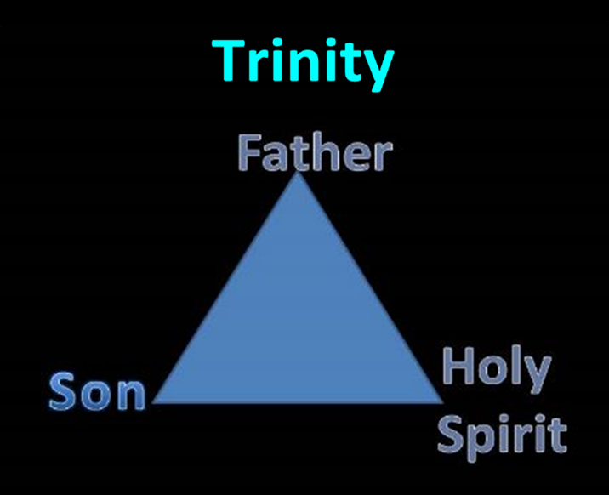

Slide 26
Genesis 1:26-28
²⁶ Then God said, “Let Us make man in Our image, according to Our likeness; and let them rule over the fish of the sea and over the birds of the sky and over the cattle and over all the earth, and over every creeping thing that creeps on the earth.” ²⁷ God created man in His own image, in the image of God He created him; male and female He created them. ²⁸ God blessed them; and God said to them, “Be fruitful and multiply, and fill the earth, and subdue it; and rule over the fish of the sea and over the birds of the sky and over every living thing that moves on the earth.”

Slide 27
1 Peter 3:7
“You husbands in the same way, live with your wives in an understanding way, as with someone weaker, since she is a woman; and show her honor as a fellow heir of the grace of life, so that your prayers will not be hindered.”

Slide 28
Gender Restrictions
Women are the backbone of the church
Trinitarian example
Gender restrictions
Elder: 1 Tim 3:1-2; Titus 1:6 (2x); 1 Tim 2:11-14
Deacon
Yes: Acts 6:3; 1 Tim. 3:8, 10, 12
No: Rom. 16:1; 1 Tim. 3:11

Slide 29
Gender Restrictions
Women are the backbone of the church
Trinitarian example
Gender restrictions
Elder: 1 Tim 3:1-2; Titus 1:6 (2x); 1 Tim 2:11-14
Deacon
Yes: Acts 6:3; 1 Tim. 3:8, 10, 12
No: Rom. 16:1; 1 Tim. 3:11

Slide 30
Gender Restrictions
Women are the backbone of the church
Trinitarian example
Gender restrictions
Elder: 1 Tim 3:1-2; Titus 1:6 (2x); 1 Tim 2:11-14
Deacon
Yes: Acts 6:3; 1 Tim. 3:8, 10, 12
No: Rom. 16:1; 1 Tim. 3:11

Slide 31
Gender Restrictions
Women are the backbone of the church
Trinitarian example
Gender restrictions
Elder: 1 Tim 3:1-2; Titus 1:6 (2x); 1 Tim 2:11-14
Deacon
Yes: Acts 6:3; 1 Tim. 3:8, 10, 12
No: Rom. 16:1; 1 Tim. 3:11

Slide 32
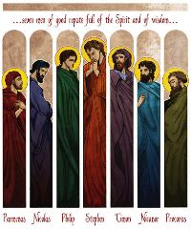
Acts 6:3
“Therefore, brethren, select from among you seven men of good reputation, full of the Spirit and of wisdom, whom we may put in charge of this task.”

Slide 33
Gender Restrictions
Women are the backbone of the church
Trinitarian example
Gender restrictions
Elder: 1 Tim 3:1-2; Titus 1:6 (2x); 1 Tim 2:11-14
Deacon
Yes: Acts 6:3; 1 Tim. 3:8, 10, 12
No: Rom. 16:1; 1 Tim. 3:11

Slide 34
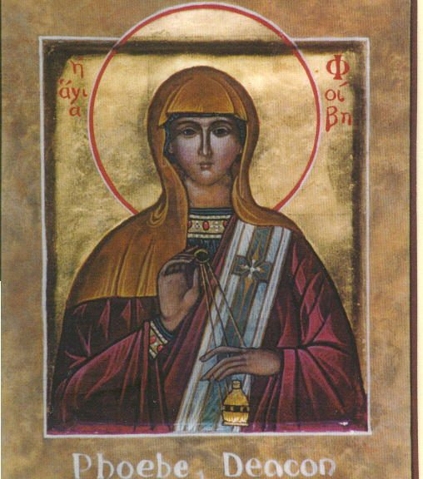
Romans 16:1
“I commend to you our sister Phoebe, who is a servant [διάκονος (diakonos)] of the church which is at Cenchrea.”

Slide 35
The NET Bible
Romans 16:1
“Or ‘deaconess.’ It is debated whether διάκονος (diakonos) here refers to a specific office within the church. One contextual argument used to support this view is that Phoebe is associated with a particular church, Cenchrea, and as such would therefore be a deacon of that church. In the NT some who are called διάκονος are related to a particular church, yet the scholarly consensus is that such individuals are not deacons, but ‘servants’ or ‘ministers’ (other viable translations for διάκονος).”

Slide 36
The New English Translation (NET) Bible
Romans 16:1
“For example, Epaphras is associated with the church in Colossians and is called a διάκονος in Col 1:7, but no contemporary translation regards him as a deacon. In 1 Tim 4:6 Paul calls Timothy a διάκονος; Timothy was associated with the church in Ephesus, but he obviously was not a deacon. In addition, the lexical evidence leans away from this view: Within the NT, the διακον- word group rarely functions with a technical nuance. In any case, the evidence is not compelling either way. The view accepted in the translation above is that Phoebe was a servant of the church, not a deaconess, although this conclusion should be regarded as tentative.”

Slide 37
1 Timothy 3:11
“Women [gynē] must likewise be dignified, not malicious gossips, but temperate, faithful in all things.”

Slide 38
Meaning of gynē in 1 Tim. 3:11
1 TIM. 3:11 | WIFE OF DEACON | DEACONESS
Example | “Wife”: Eph. 5:22 | “Woman”: Matt. 9:20
Advocate | Charles C. Ryrie | Thomas L. Constable
Problem | No corresponding requirement for elder’s wife (1 Tim. 3:1-7) | Disruption of the train of thought

Slide 39
Conclusion

Slide 40
Local Church Officers
Elder
Qualifications (1 Tim 3:1-7; Titus 1:5-9)
Number (Jas 5:14)
Distinction among elders (1 Tim 5:17)
Duties
Removal (1 Tim 5:19)
Deacon
Definition (Acts 6:1-7)
Qualifications (1 Tim 3:8-13)

Slide 41
Ecclesiology Overview
Definition
Universal vs. local
Word pictures
Origin
Israel – Church differences
Intercalation
Purposes
Activities
Government
Officers
Ordinances
Purity

