Slide 1
Dr. Andy Woods
Senior Pastor – Sugar Land Bible Church
President – Chafer Theological Seminary

Slide 2
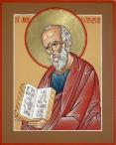
Answering Ten Questions
What is the title – Revelation of Jesus Christ
Who wrote it? – John
Where was it written from? – Patmos
To Whom was it written? – The Seven Churches
When was it written? – A.D. 95
How is it organized (outline)? – 3 part outline
How was it delivered – Seven steps
Why was it written? – Encouragement and holiness
What is it about? – Jesus’ final victory
What makes the book different? – OT relationship

Slide 3
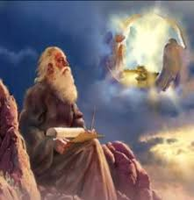
Prologue (Rev. 1:1-8)
Title (1a)
Chain of Communication (1b-2)
Blessing (3)
Author (4a)
Audience (4b)
Greeting (4c)
Source (4d-5a)
Subject (5b-8)

Slide 4
Revelation 1:19
“Therefore write the things which you have seen, and the things which are, and the things which will take place after these things [meta tauta].”

Slide 5
Revelation 1:19
Seen (Chapter 1)
Are (Chapters 2–3)
After these things (Chapters 4–22)

Slide 6
Revelation 1:19
Seen (Chapter 1)
Are (Chapters 2–3)
After these things (Chapters 4–22)

Slide 7
Revelation 1:19
Seen (Chapter 1)
Are (Chapters 2–3)
After these things (Chapters 4–22)

Slide 8
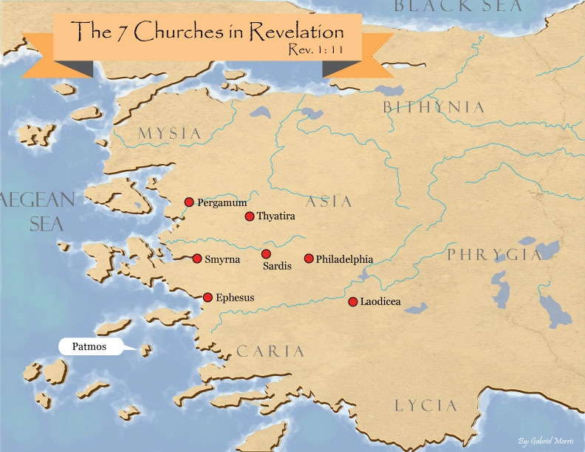

Slide 9
DESCRIPTION OF THE SEVEN CHURCHES Revelation 2‒3
CHURCH | SCRIPTURE | DESCRIPTION
Ephesus | 2:1-7 | Loveless
Smyrna | 2:8-11 | Persecuted
Pergamum | 2:12-17 | Compromised
Thyatira | 2:18-29 | Corrupt
Sardis | 3:1-6 | Dead
Philadelphia | 3:7-13 | Missionary
Laodicea | 3:14-22 | Man-centered

Slide 10
Revelation 1:19
Seen (Chapter 1)
Are (Chapters 2–3)
After these things (Chapters 4–22)

Slide 11
Revelation 1:19
“Therefore write the things which you have seen, and the things which are, and the things which will take place after these things [meta tauta].”

Slide 12
Revelation 4:1
“After these things [meta tauta] I looked, and behold, a door standing open in heaven, and the first voice which I had heard, like the sound of a trumpet speaking with me, said, ‘Come up here, and I will show you what must take place after these things [meta tauta].’”

Slide 13
“After These Things” (Rev. 4‒22)
Before the Tribulation (4‒5)
During the Tribulation (6‒19)
After the Tribulation (20‒22)
Kingdom (20:1-10)
Great White Throne Judgment (20:11-15)
Destruction of the Earth (21:1)
New Heaven and New Earth (21‒22)

Slide 14
“After These Things” (Rev. 4‒22)
Before the Tribulation (4‒5)
During the Tribulation (6‒19)
After the Tribulation (20‒22)
Kingdom (20:1-10)
Great White Throne Judgment (20:11-15)
Destruction of the Earth (21:1)
New Heaven and New Earth (21‒22)

Slide 15
Comparing Revelation 4 & 5
Chapter | Revelation 4 | Revelation 5
God-head Member | Father | Son
Role | Creator | Redeemer
Reason for Worship | Role in Creation (4:11) | Role in Redemption (5:9, 12)

Slide 16
Preview (Rev. 4:1-11)
Summons to Heaven (4:1)
Sights in Heaven (4:2-8)
Song of Heaven (4:9-11)
Willmington. Outline Bible, 759

Slide 17
Preview (Rev. 4:1-11)
Summons to Heaven (4:1)
Sights in Heaven (4:2-8)
Song of Heaven (4:9-11)
Willmington. Outline Bible, 759

Slide 18
I. Summons to Heaven (Rev. 4:1)
Vision (4:1a)
Voice (4:1b)
Willmington. Outline Bible, 759

Slide 19
Preview (Rev. 4:1-11)
Summons to Heaven (4:1)
Sights in Heaven (4:2-8)
Song of Heaven (4:9-11)
Willmington. Outline Bible, 759

Slide 20
II. Sights in Heaven (Rev. 4:2-8)
Heavenly Throne (4:2-3, 5a, 6a)
On the Throne (2-3a)
Above the Throne (3b)
Out of the Throne (5a)
Before the Throne (6a)
Items Around the Throne (4:4, 5b, 6b-8)
24 Elders (4)
7 Lamps (5b)
4 Living Creatures (6b-8)
Willmington. Outline Bible, 759

Slide 21
II. Sights in Heaven (Rev. 4:2-8)
Heavenly Throne (4:2-3, 5a, 6a)
On the Throne (2-3a)
Above the Throne (3b)
Out of the Throne (5a)
Before the Throne (6a)
Items Around the Throne (4:4, 5b, 6b-8)
24 Elders (4)
7 Lamps (5b)
4 Living Creatures (6b-8)
Willmington. Outline Bible, 759

Slide 22
II. Sights in Heaven (Rev. 4:2-8)
Heavenly Throne (4:2-3, 5a, 6a)
On the Throne (2-3a)
Above the Throne (3b)
Out of the Throne (5a)
Before the Throne (6a)
Items Around the Throne (4:4, 5b, 6b-8)
24 Elders (4)
7 Lamps (5b)
4 Living Creatures (6b-8)
Willmington. Outline Bible, 759

Slide 23
II. Sights in Heaven (Rev. 4:2-8)
Heavenly Throne (4:2-3, 5a, 6a)
On the Throne (2-3a)
Above the Throne (3b)
Out of the Throne (5a)
Before the Throne (6a)
Items Around the Throne (4:4, 5b, 6b-8)
24 Elders (4)
7 Lamps (5b)
4 Living Creatures (6b-8)
Willmington. Outline Bible, 759

Slide 24
1. Twenty-Four Elders (Rev. 4:4)
Church
Crowned (2:10)
Clothed in White (3:5)
Redeemed (5:8-10)
Enthroned (3:21)
Elders (1 Tim. 3:1-7)
Kingdom of Priests (Rev. 1:6)
Twenty-four (Rev. 1:6)

Slide 25
II. Sights in Heaven (Rev. 4:2-8)
Heavenly Throne (4:2-3, 5a, 6a)
On the Throne (2-3a)
Above the Throne (3b)
Out of the Throne (5a)
Before the Throne (6a)
Items Around the Throne (4:4, 5b, 6b-8)
24 Elders (4)
7 Lamps (5b)
4 Living Creatures (6b-8)
Willmington. Outline Bible, 759

Slide 26
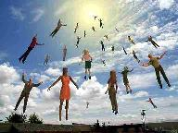
When Will the Rapture Take Place Relative to the Tribulation Period?
Pre-tribulation rapture theory
Mid-tribulation rapture theory
Post-tribulation rapture theory
Pre-wrath rapture theory
Partial rapture theory

Slide 28
II. Sights in Heaven (Rev. 4:2-8)
Heavenly Throne (4:2-3, 5a, 6a)
On the Throne (2-3a)
Above the Throne (3b)
Out of the Throne (5a)
Before the Throne (6a)
Items Around the Throne (4:4, 5b, 6b-8)
24 Elders (4)
7 Lamps (5b)
4 Living Creatures (6b-8)
Willmington. Outline Bible, 759

Slide 29
3. Four Living Creatures (Rev. 4:6b-8)
Description (6b-8a)
Identification (6b)
Eyes (6c)
Faces (7)
Wings (8a)
Duty (8b)
Willmington. Outline Bible, 759

Slide 30
3. Four Living Creatures (Rev. 4:6b-8)
Description (6b-8a)
Identification (6b)
Eyes (6c)
Faces (7)
Wings (8a)
Duty (8b)
Willmington. Outline Bible, 759

Slide 31
3. Four Living Creatures (Rev. 4:6b-8)
Description (6b-8a)
Identification (6b)
Eyes (6c)
Faces (7)
Wings (8a)
Duty (8b)
Willmington. Outline Bible, 759

Slide 32
3. Four Living Creatures (Rev. 4:6b-8)
Description (6b-8a)
Identification (6b)
Eyes (6c)
Faces (7)
Wings (8a)
Duty (8b)
Willmington. Outline Bible, 759

Slide 33
3. Four Living Creatures (Rev. 4:6b-8)
Description (6b-8a)
Identification (6b)
Eyes (6c)
Faces (7)
Wings (8a)
Duty (8b)
Willmington. Outline Bible, 759

Slide 34
3. Four Living Creatures (Rev. 4:6b-8)
Description (6b-8a)
Identification (6b)
Eyes (6c)
Faces (7)
Wings (8a)
Duty (8b)
Willmington. Outline Bible, 759

Slide 35
3. Four Living Creatures (Rev. 4:6b-8)
Description (6b-8a)
Identification (6b)
Eyes (6c)
Faces (7)
Wings (8a)
Duty (8b)
Willmington. Outline Bible, 759

Slide 36
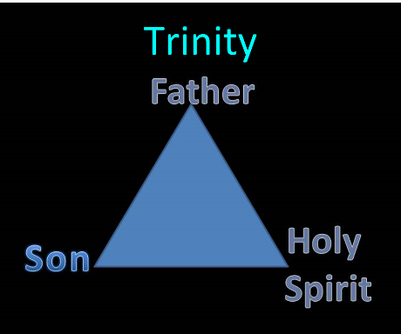

Slide 37
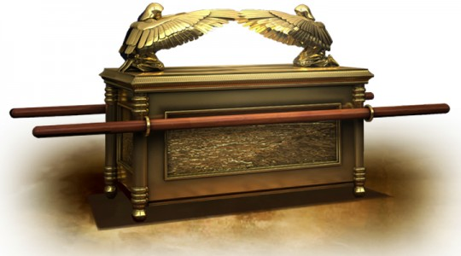

Slide 38
Preview (Rev. 4:1-11)
Summons to Heaven (4:1)
Sights in Heaven (4:2-8)
Song of Heaven (4:9-11)
Willmington. Outline Bible, 759

Slide 39
III. Song of Heaven (Rev. 4:9-11)
Singers (4:9-10)
4 Living Creatures (9)
24 Elders (10)
Song (4:11)
Willmington. Outline Bible, 759

Slide 40
III. Song of Heaven (Rev. 4:9-11)
Singers (4:9-10)
4 Living Creatures (9)
24 Elders (10)
Song (4:11)
Willmington. Outline Bible, 759

Slide 41
III. Song of Heaven (Rev. 4:9-11)
Singers (4:9-10)
4 Living Creatures (9)
24 Elders (10)
Song (4:11)
Willmington. Outline Bible, 759

Slide 42
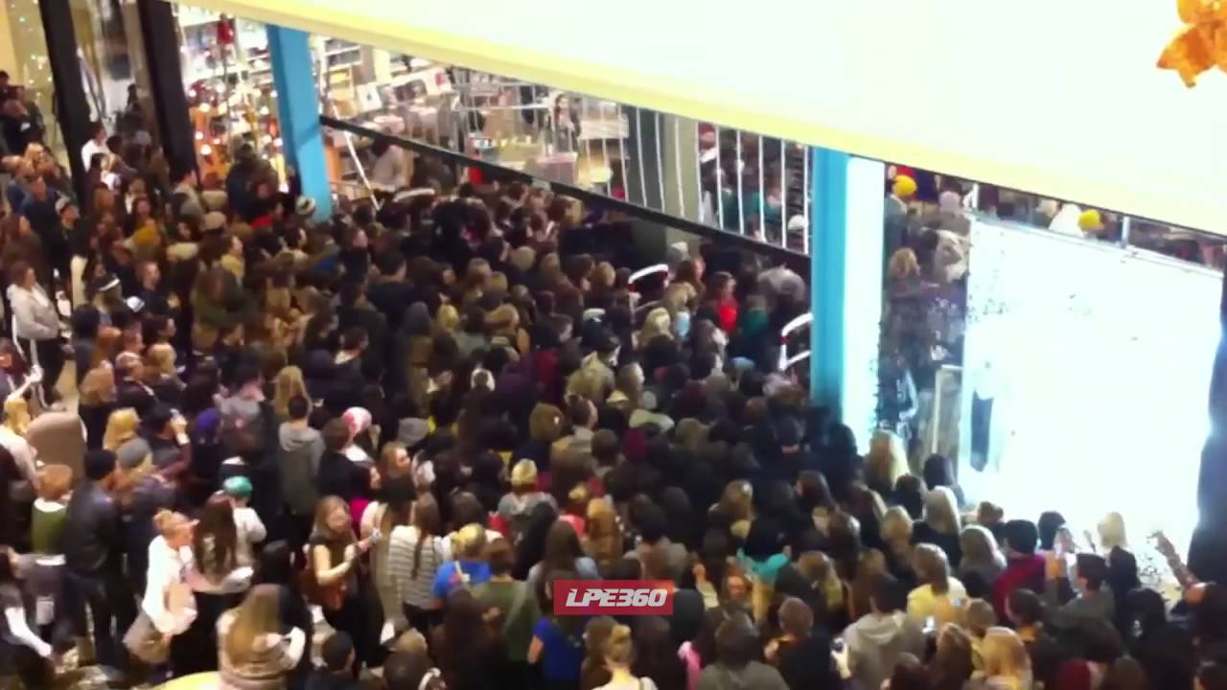

Slide 43
III. Song of Heaven (Rev. 4:9-11)
Singers (4:9-10)
4 Living Creatures (9)
24 Elders (10)
Song (4:11)
Willmington. Outline Bible, 759

Slide 44
Scripture’s Five Crowns (Rev 4:10: 3:11; 2 John 8)
SCRIPTURE | CROWN | PURPOSE
1 Cor. 9:24-27 | Incorruptible | Gaining mastery over the flesh
1 Thess. 2:19-20 | Rejoicing | Soul winning
Jas. 1:12; Rev. 2:10 | Life | Enduring trials
1 Pet. 5:2-4 | Glory | Shepherding God’s people
2 Tim. 4:8 | Righteousness | Longing for His appearing

Slide 45
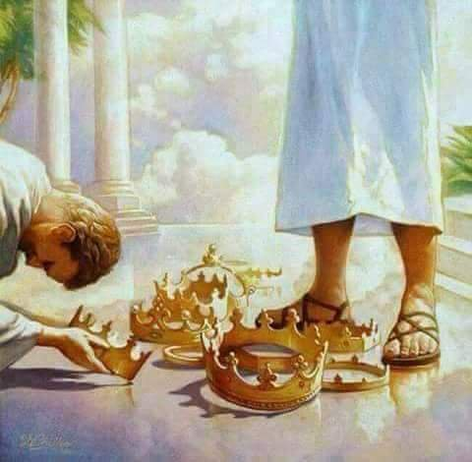

Slide 46
Revelation 3:11
“I am coming quickly; hold fast what you have, so that no one will take your crown.”

Slide 47
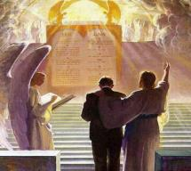
2 John 8
“Watch yourselves, that you do not lose what we have accomplished, but that you may receive a full reward.”

Slide 48
1 Corinthians 9:24-27
“²⁴ Do you not know that those who run in a race all run, but only one receives the prize? Run in such a way that you may win. ²⁵ Everyone who competes in the games exercises self-control in all things. They then do it to receive a perishable wreath, but we an imperishable. ²⁶ Therefore I run in such a way, as not without aim; I box in such a way, as not beating the air; ²⁷ but I discipline my body and make it my slave, so that, after I have preached to others, I myself will not be disqualified.”

Slide 49
1 Corinthians 3:10-15
“¹⁴ If any man’s work which he has built on it remains, he will receive a reward. ¹⁵ If any man’s work is burned up, he will suffer loss; but he himself will be saved, yet so as through fire.”

Slide 50
Grant R. Jeffrey
Apocalypse: The Coming Judgment of the Nations, p. 85, 87.
“Someday every Christian will stand before the Judgment Seat of Christ to receive rewards for faithful service. Some believers will receive no rewards at all because they lived their lives of service to self rather than service to the Lord...Christians are promised a number of golden crowns for us faithful service to the Lord. Jesus warned that we are to ‘hold fast’ lest we lose our crowns. This indicates that it is possible to lose eternal rewards and blessings that God prepared for those who love Him. While our salvation is assured today by our accepting Christ as our savior...our future reward will be determined at the Judgment Seat of Christ after the Rapture. We are encouraged to hold on to these rewards through continued faithful service.”

Slide 51
John 10:27-29
“²⁷ My sheep hear My voice, and I know them, and they follow Me; ²⁸ and I give eternal life to them, and they will never perish [ou mē; aiōnia]; and no one will snatch them out of My hand. ²⁹ My Father, who has given them to Me, is greater than all; and no one is able to snatch them out of the Father’s hand.”

Slide 52
Revelation 3:11
“I am coming quickly; hold fast what you have, so that no one will take your crown.”

Slide 53
III. Song of Heaven (Rev. 4:9-11)
Singers (4:9-10)
4 Living Creatures (9)
24 Elders (10)
Song (4:11)
Willmington. Outline Bible, 759

Slide 54
Revelation 11:15
¹⁵ “Then the seventh angel sounded; and there were loud voices in heaven, saying, ‘The kingdom of the world has become the kingdom of our Lord and of His Christ; and He will reign forever and ever.’”

Slide 56
Comparing Revelation 4 & 5
Chapter | Revelation 4 | Revelation 5
God-head Member | Father | Son
Role | Creator | Redeemer
Reason for Worship | Role in Creation (4:11) | Role in Redemption (5:9, 12)

Slide 57
Conclusion

Slide 58
Preview (Rev. 4:1-11)
Summons to Heaven (4:1)
Sights in Heaven (4:2-8)
Song of Heaven (4:9-11)
Willmington. Outline Bible, 759

Slide 59
“The Lord bless you and keep you; the Lord make his face shine on you and be gracious to you; the Lord turn his face toward you and give you peace.” (NIV)

