Slide 1
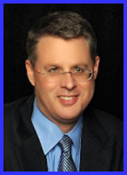
Ecclesiology Session 41
Dr. Andy Woods
Senior Pastor – Sugar Land Bible Church
President – Chafer Theological Seminary

Slide 2
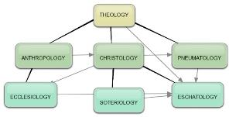
Areas of Systematic Theology
Prolegomena – Introduction
Theology – Study of God
Christology – Study of Christ
Pneumatology – Study of the Holy Spirit
Anthropology – Study of Man
Hamartiology – Study of sin
Soteriology – Study of salvation
Angelology – Study of angels
Ecclesiology – Study of the Church
Eschatology – Study of the end

Slide 3
Ecclesiology Overview
Definition
Universal vs. local
Word pictures
Origin
Israel – Church differences
Intercalation
Purposes
Activities
Government
Officers
Ordinances
Purity

Slide 4
Activities of the Local Church (Acts 2:41-47)
Doctrine (Acts 2:42)
Ordinances (Acts 2:41-42, 46)
Prayer (Acts 2:42)
Evangelism (Acts 2:47)
Worship (Acts 2:47)
Benevolence (Acts 2:44-45)
Fellowship (Acts 2:42, 46-47)

Slide 5
Ecclesiology Overview
Definition
Universal vs. local
Word pictures
Origin
Israel – Church differences
Intercalation
Purposes
Activities
Government
Officers
Ordinances
Purity

Slide 6
Local Church Government
Episcopalian/bishop rule – Acts 15:2, 6
Congregational rule – Acts 6:1-7
Presbyterian/elder rule – Acts 20:28; 1 Tim 5:17; 4:14

Slide 7
Local Church Government
Episcopalian/bishop rule – Acts 15:2, 6
Congregational rule – Acts 6:1-7
Presbyterian/elder rule – Acts 20:28; 1 Tim 5:17; 4:14

Slide 8
Ecclesiology Overview
Definition
Universal vs. local
Word pictures
Origin
Israel – Church differences
Intercalation
Purposes
Activities
Government
Officers
Ordinances
Purity

Slide 9
Local Church Officers
Elder
Qualifications (1 Tim 3:1-7; Titus 1:5-9)
Number (Jas 5:14)
Distinction among elders (1 Tim 5:17)
Duties
Removal (1 Tim 5:19)
Deacon
Definition (Acts 6:1-7)
Qualifications (1 Tim 3:8-13)

Slide 10
Local Church Officers
Elder
Qualifications (1 Tim 3:1-7; Titus 1:5-9)
Number (Jas 5:14)
Distinction among elders (1 Tim 5:17)
Duties
Removal (1 Tim 5:19)
Deacon
Definition (Acts 6:1-7)
Qualifications (1 Tim 3:8-13)

Slide 11
Local Church Officers
Elder
Qualifications (1 Tim 3:1-7; Titus 1:5-9)
Number (Jas 5:14)
Distinction among elders (1 Tim 5:17)
Duties
Removal (1 Tim 5:19)
Deacon
Definition (Acts 6:1-7)
Qualifications (1 Tim 3:8-13)

Slide 12
Elder Qualifications 1 Tim. 3:1-7; Titus 1:5-9
General qualifications
Moral qualifications
Mental qualifications
Personality qualifications
Domestic qualifications
Christian experience qualifications
Reputation qualifications
Knowledge qualifications

Slide 13
Local Church Officers
Elder
Qualifications (1 Tim 3:1-7; Titus 1:5-9)
Number (Jas 5:14)
Distinction among elders (1 Tim 5:17)
Duties
Removal (1 Tim 5:19)
Deacon
Definition (Acts 6:1-7)
Qualifications (1 Tim 3:8-13)

Slide 14
Local Church Officers
Elder
Qualifications (1 Tim 3:1-7; Titus 1:5-9)
Number (Jas 5:14)
Distinction among elders (1 Tim 5:17)
Duties
Removal (1 Tim 5:19)
Deacon
Definition (Acts 6:1-7)
Qualifications (1 Tim 3:8-13)

Slide 15
Local Church Officers
Elder
Qualifications (1 Tim 3:1-7; Titus 1:5-9)
Number (Jas 5:14)
Distinction among elders (1 Tim 5:17)
Duties
Removal (1 Tim 5:19)
Deacon
Definition (Acts 6:1-7)
Qualifications (1 Tim 3:8-13)

Slide 16
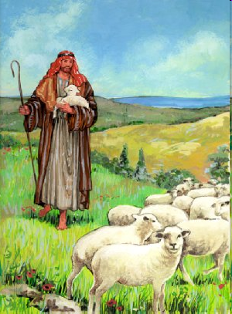
Shepherd/Pastor
Guide
Guard
Graze

Slide 17
Local Church Officers
Elder
Qualifications (1 Tim 3:1-7; Titus 1:5-9)
Number (Jas 5:14)
Distinction among elders (1 Tim 5:17)
Duties
Removal (1 Tim 5:19)
Deacon
Definition (Acts 6:1-7)
Qualifications (1 Tim 3:8-13)

Slide 18
Local Church Officers
Elder
Qualifications (1 Tim 3:1-7; Titus 1:5-9)
Number (Jas 5:14)
Distinction among elders (1 Tim 5:17)
Duties
Removal (1 Tim 5:19)
Deacon
Definition (Acts 6:1-7)
Qualifications (1 Tim 3:8-13)

Slide 19
Local Church Officers
Elder
Qualifications (1 Tim 3:1-7; Titus 1:5-9)
Number (Jas 5:14)
Distinction among elders (1 Tim 5:17)
Duties
Removal (1 Tim 5:19)
Deacon
Definition (Acts 6:1-7)
Qualifications (1 Tim 3:8-13)

Slide 20
Local Church Officers
Elder
Qualifications (1 Tim 3:1-7; Titus 1:5-9)
Number (Jas 5:14)
Distinction among elders (1 Tim 5:17)
Duties
Removal (1 Tim 5:19)
Deacon
Definition (Acts 6:1-7)
Qualifications (1 Tim 3:8-13)

Slide 21
Acts 6:3
“³ Therefore, brethren, select from among you seven men of good reputation, full of the Spirit and of wisdom, whom we may put in charge of this task.”

Slide 22
Deacon Qualifications Acts 6:3
Believer
Men
Good reputation
Honest
Spirit-filled
Wise
Examples
Stephen (Acts 7)
Philip (Acts 8)
Exodus 18:21 – Men, God-fearers, truthful, haters of dishonest gain

Slide 23
Deacon Qualifications Acts 6:3
Believer
Men
Good reputation
Honest
Spirit-filled
Wise
Examples
Stephen (Acts 7)
Philip (Acts 8)
Exodus 18:21 – Men, God-fearers, truthful, haters of dishonest gain

Slide 24
Deacon Qualifications Acts 6:3
Believer
Men
Good reputation
Honest
Spirit-filled
Wise
Examples
Stephen (Acts 7)
Philip (Acts 8)
Exodus 18:21 – Men, God-fearers, truthful, haters of dishonest gain

Slide 25
Deacon Qualifications Acts 6:3
Believer
Men
Good reputation
Honest
Spirit-filled
Wise
Examples
Stephen (Acts 7)
Philip (Acts 8)
Exodus 18:21 – Men, God-fearers, truthful, haters of dishonest gain

Slide 26
Deacon Qualifications Acts 6:3
Believer
Men
Good reputation
Honest
Spirit-filled
Wise
Examples
Stephen (Acts 7)
Philip (Acts 8)
Exodus 18:21 – Men, God-fearers, truthful, haters of dishonest gain

Slide 27
Deacon Qualifications Acts 6:3
Believer
Men
Good reputation
Honest
Spirit-filled
Wise
Examples
Stephen (Acts 7)
Philip (Acts 8)
Exodus 18:21 – Men, God-fearers, truthful, haters of dishonest gain

Slide 28
Deacon Qualifications Acts 6:3
Believer
Men
Good reputation
Honest
Spirit-filled
Wise
Examples
Stephen (Acts 7)
Philip (Acts 8)
Exodus 18:21 – Men, God-fearers, truthful, haters of dishonest gain

Slide 29
Deacon Qualifications Acts 6:3
Believer
Men
Good reputation
Honest
Spirit-filled
Wise
Examples
Stephen (Acts 7)
Philip (Acts 8)
Exodus 18:21 – Men, God-fearers, truthful, haters of dishonest gain

Slide 30
Deacon Qualifications Acts 6:3
Believer
Men
Good reputation
Honest
Spirit-filled
Wise
Examples
Stephen (Acts 7)
Philip (Acts 8)
Exodus 18:21 – Men, God-fearers, truthful, haters of dishonest gain

Slide 31
Deacon Qualifications Acts 6:3
Believer
Men
Good reputation
Honest
Spirit-filled
Wise
Examples
Stephen (Acts 7)
Philip (Acts 8)
Exodus 18:21 – Men, God-fearers, truthful, haters of dishonest gain

Slide 32
The Bible’s Many Raptures
Enoch (Gen 5)
Elijah (2 Kings 2)
Christ (Acts 1:11; Rev 12:5)
Philip (Acts 8:39)
Paul (2 Cor 12:2, 4)
John (Rev 4:1-2)
Two witnesses (Rev 11)

Slide 33
Deacon Qualifications Acts 6:3
Believer
Men
Good reputation
Honest
Spirit-filled
Wise
Examples
Stephen (Acts 7)
Philip (Acts 8)
Exodus 18:21 – Men, God-fearers, truthful, haters of dishonest gain

Slide 34
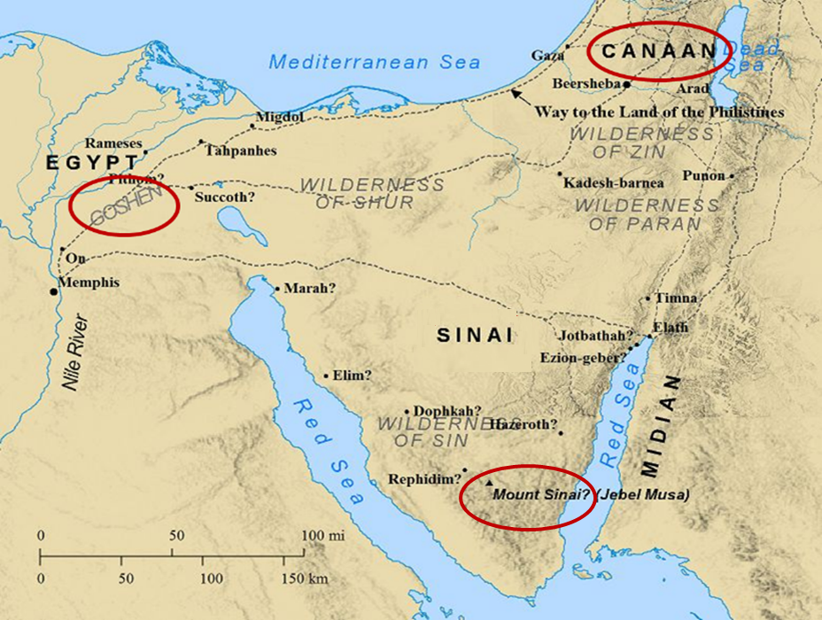

Slide 35
Exodus 18:21
“²¹ Furthermore, you shall select out of all the people able men who fear God, men of truth, those who hate dishonest gain; and you shall place these over them as leaders of thousands, of hundreds, of fifties and of tens.”

Slide 36
Deacon Qualifications 1 Tim. 3:8-13
Men of dignity
Not double-tongued
Not addicted to much wine
Not fond of sordid gain
Holding to the mystery of the faith with a clear conscience
First tested
Beyond reproach
Husband of one wife
Good managers of their children & household

Slide 37
Deacon Qualifications 1 Tim. 3:8-13
Men of dignity
Not double-tongued
Not addicted to much wine
Not fond of sordid gain
Holding to the mystery of the faith with a clear conscience
First tested
Beyond reproach
Husband of one wife
Good managers of their children & household

Slide 38
Deacon Qualifications 1 Tim. 3:8-13
Men of dignity
Not double-tongued
Not addicted to much wine
Not fond of sordid gain
Holding to the mystery of the faith with a clear conscience
First tested
Beyond reproach
Husband of one wife
Good managers of their children & household

Slide 39
Deacon Qualifications 1 Tim. 3:8-13
Men of dignity
Not double-tongued
Not addicted to much wine
Not fond of sordid gain
Holding to the mystery of the faith with a clear conscience
First tested
Beyond reproach
Husband of one wife
Good managers of their children & household

Slide 40
Deacon Qualifications 1 Tim. 3:8-13
Men of dignity
Not double-tongued
Not addicted to much wine
Not fond of sordid gain
Holding to the mystery of the faith with a clear conscience
First tested
Beyond reproach
Husband of one wife
Good managers of their children & household

Slide 41
Deacon Qualifications 1 Tim. 3:8-13
Men of dignity
Not double-tongued
Not addicted to much wine
Not fond of sordid gain
Holding to the mystery of the faith with a clear conscience
First tested
Beyond reproach
Husband of one wife
Good managers of their children & household

Slide 42
Deacon Qualifications 1 Tim. 3:8-13
Men of dignity
Not double-tongued
Not addicted to much wine
Not fond of sordid gain
Holding to the mystery of the faith with a clear conscience
First tested
Beyond reproach
Husband of one wife
Good managers of their children & household

Slide 43
Deacon Qualifications 1 Tim. 3:8-13
Men of dignity
Not double-tongued
Not addicted to much wine
Not fond of sordid gain
Holding to the mystery of the faith with a clear conscience
First tested
Beyond reproach
Husband of one wife
Good managers of their children & household

Slide 44
Deacon Qualifications 1 Tim. 3:8-13
Men of dignity
Not double-tongued
Not addicted to much wine
Not fond of sordid gain
Holding to the mystery of the faith with a clear conscience
First tested
Beyond reproach
Husband of one wife
Good managers of their children & household

Slide 45
Deacon Qualifications 1 Tim. 3:8-13
Men of dignity
Not double-tongued
Not addicted to much wine
Not fond of sordid gain
Holding to the mystery of the faith with a clear conscience
First tested
Beyond reproach
Husband of one wife
Good managers of their children & household

Slide 46
Gender Restrictions
Women are the backbone of the church
Trinitarian example
Gender restrictions
Elder: 1 Tim 3:1-2; Titus 1:6 (2x); 1 Tim 2:11-14
Deacon
Yes: Acts 6:3; 1 Tim. 3:8, 10, 12
No: Rom. 16:1; 1 Tim. 3:11

Slide 47
Gender Restrictions
Women are the backbone of the church
Trinitarian example
Gender restrictions
Elder: 1 Tim 3:1-2; Titus 1:6 (2x); 1 Tim 2:11-14
Deacon
Yes: Acts 6:3; 1 Tim. 3:8, 10, 12
No: Rom. 16:1; 1 Tim. 3:11

Slide 48
Gender Restrictions
Women are the backbone of the church
Trinitarian example
Gender restrictions
Elder: 1 Tim 3:1-2; Titus 1:6 (2x); 1 Tim 2:11-14
Deacon
Yes: Acts 6:3; 1 Tim. 3:8, 10, 12
No: Rom. 16:1; 1 Tim. 3:11

Slide 49
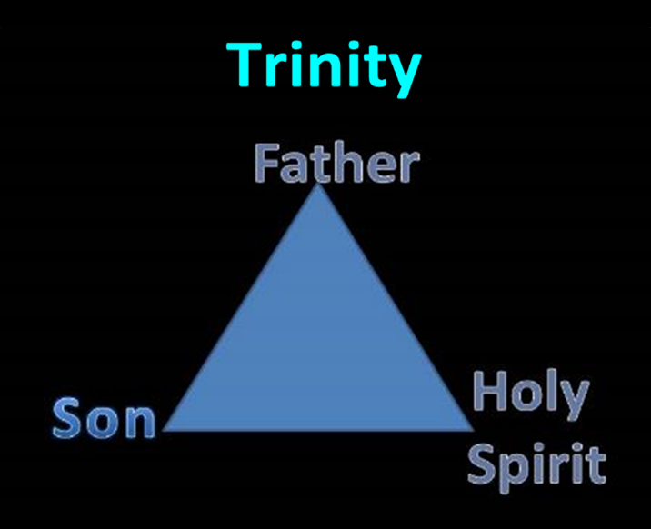

Slide 50
Gender Restrictions
Women are the backbone of the church
Trinitarian example
Gender restrictions
Elder: 1 Tim 3:1-2; Titus 1:6 (2x); 1 Tim 2:11-14
Deacon
Yes: Acts 6:3; 1 Tim. 3:8, 10, 12
No: Rom. 16:1; 1 Tim. 3:11

Slide 51
Gender Restrictions
Women are the backbone of the church
Trinitarian example
Gender restrictions
Elder: 1 Tim 3:1-2; Titus 1:6 (2x); 1 Tim 2:11-14
Deacon
Yes: Acts 6:3; 1 Tim. 3:8, 10, 12
No: Rom. 16:1; 1 Tim. 3:11

Slide 52
Gender Restrictions
Women are the backbone of the church
Trinitarian example
Gender restrictions
Elder: 1 Tim 3:1-2; Titus 1:6 (2x); 1 Tim 2:11-14
Deacon
Yes: Acts 6:3; 1 Tim. 3:8, 10, 12
No: Rom. 16:1; 1 Tim. 3:11

Slide 53
Gender Restrictions
Women are the backbone of the church
Trinitarian example
Gender restrictions
Elder: 1 Tim 3:1-2; Titus 1:6 (2x); 1 Tim 2:11-14
Deacon
Yes: Acts 6:3; 1 Tim. 3:8, 10, 12
No: Rom. 16:1; 1 Tim. 3:11

Slide 54
Acts 6:3
“³ Therefore, brethren, select from among you seven men of good reputation, full of the Spirit and of wisdom, whom we may put in charge of this task.”

Slide 55
Gender Restrictions
Women are the backbone of the church
Trinitarian example
Gender restrictions
Elder: 1 Tim 3:1-2; Titus 1:6 (2x); 1 Tim 2:11-14
Deacon
Yes: Acts 6:3; 1 Tim. 3:8, 10, 12
No: Rom. 16:1; 1 Tim. 3:11

Slide 56
Meaning of gynē in 1 Tim. 3:11
1 TIM. 3:11 | WIFE OF DEACON | DEACONESS
Example | “Wife”: Eph. 5:22 | “Woman”: Matt. 9:20
Advocate | Charles C. Ryrie | Thomas L. Constable
Problem | No corresponding requirement for elder’s wife (1 Tim. 3:1-7) | Disruption of the train of thought

Slide 57
Conclusion

Slide 58
Local Church Officers
Elder
Qualifications (1 Tim 3:1-7; Titus 1:5-9)
Number (Jas 5:14)
Distinction among elders (1 Tim 5:17)
Duties
Removal (1 Tim 5:19)
Deacon
Definition (Acts 6:1-7)
Qualifications (1 Tim 3:8-13)

Slide 59
Ecclesiology Overview
Definition
Universal vs. local
Word pictures
Origin
Israel – Church differences
Intercalation
Purposes
Activities
Government
Officers
Ordinances
Purity

