Slide 1
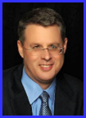
Dr. Andy Woods
Senior Pastor – Sugar Land Bible Church
President – Chafer Theological Seminary

Slide 2
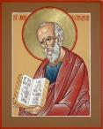
Answering Ten Questions
What is the title – Revelation of Jesus Christ
Who wrote it? – John
Where was it written from? – Patmos
To Whom was it written? – The Seven Churches
When was it written? – A.D. 95
How is it organized (outline)? – 3 part outline
How was it delivered – Seven steps
Why was it written? – Encouragement and holiness
What is it about? – Jesus’ final victory
What makes the book different? – OT relationship

Slide 3
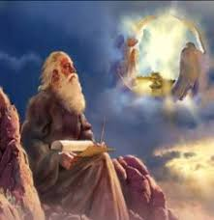
Prologue (Rev. 1:1-8)
Title (1a)
Chain of Communication (1b-2)
Blessing (3)
Author (4a)
Audience (4b)
Greeting (4c)
Source (4d-5a)
Subject (5b-8)

Slide 4
Revelation 1:19
“Therefore write the things which you have seen, and the things which are, and the things which will take place after these things [meta tauta].”

Slide 5
Revelation 1:19
Seen (Chapter 1)
Are (Chapters 2–3)
After these things (Chapters 4–22)

Slide 6
Revelation 1:19
Seen (Chapter 1)
Are (Chapters 2–3)
After these things (Chapters 4–22)

Slide 7
Revelation 1:19
Seen (Chapter 1)
Are (Chapters 2–3)
After these things (Chapters 4–22)

Slide 8
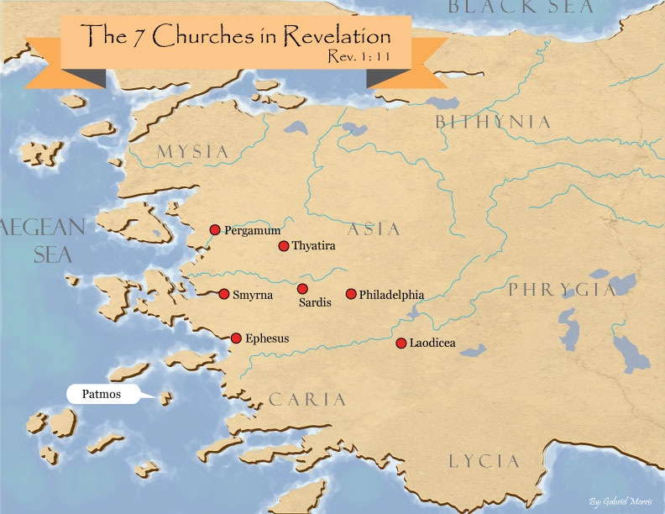

Slide 9
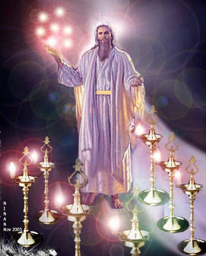
Pattern of the Letters in Revelation 2–3
Destination
Description of Christ (Rev. 1)
Commendation
Rebuke
Exhortation to change
Consequence
Exhortation to listen
Promise to overcomers (Rev. 21–22)

Slide 10
DESCRIPTION OF THE SEVEN CHURCHES Revelation 2‒3
CHURCH | SCRIPTURE | DESCRIPTION
Ephesus | 2:1-7 | Loveless
Smyrna | 2:8-11 | Persecuted
Pergamum | 2:12-17 | Compromised
Thyatira | 2:18-29 | Corrupt
Sardis | 3:1-6 | Dead
Philadelphia | 3:7-13 | Missionary
Laodicea | 3:14-22 | Man-centered

Slide 11
Revelation 1:19
Seen (Chapter 1)
Are (Chapters 2–3)
After these things (Chapters 4–22)

Slide 12
Revelation 1:19
“Therefore write the things which you have seen, and the things which are, and the things which will take place after these things [meta tauta].”

Slide 13
Revelation 4:1
“After these things [meta tauta] I looked, and behold, a door standing open in heaven, and the first voice which I had heard, like the sound of a trumpet speaking with me, said, ‘Come up here, and I will show you what must take place after these things [meta tauta].’”

Slide 14
“After These Things” (Rev. 4‒22)
Before the Tribulation (4‒5)
During the Tribulation (6‒19)
After the Tribulation (20‒22)
Kingdom (20:1-10)
Great White Throne Judgment (20:11-15)
Destruction of the Earth (21:1)
New Heaven and New Earth (21‒22)

Slide 16
“After These Things” (Rev. 4‒22)
Before the Tribulation (4‒5)
During the Tribulation (6‒19)
After the Tribulation (20‒22)
Kingdom (20:1-10)
Great White Throne Judgment (20:11-15)
Destruction of the Earth (21:1)
New Heaven and New Earth (21‒22)

Slide 17
7. Promise to the Overcomers
Rev 3:21
“He who overcomes, I will grant to him to sit down with Me on My throne, as I also overcame and sat down with My Father on His throne.”

Slide 18
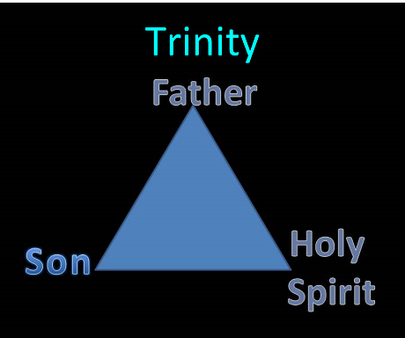

Slide 19
Comparing Revelation 4 & 5
Chapter | Revelation 4 | Revelation 5
God-head Member | Father | Son
Role | Creator | Redeemer
Reason for Worship | Role in Creation (4:11) | Role in Redemption (5:9, 12)

Slide 20
Preview (Rev. 4:1-11)
Summons to Heaven (4:1)
Sights in Heaven (4:2-8)
Song of Heaven (4:9-11)
Willmington. Outline Bible, 759

Slide 21
Preview (Rev. 4:1-11)
Summons to Heaven (4:1)
Sights in Heaven (4:2-8)
Song of Heaven (4:9-11)
Willmington. Outline Bible, 759

Slide 22
I. Summons to Heaven (Rev. 4:1)
Vision (4:1a)
Voice (4:1b)
Willmington. Outline Bible, 759

Slide 23
I. Summons to Heaven (Rev. 4:1)
Vision (4:1a)
Voice (4:1b)
Willmington. Outline Bible, 759

Slide 24
Revelation 4:1
“After these things I looked, and behold, a door standing open in heaven, and the first voice which I had heard, like the sound of a trumpet speaking with me, said, ‘Come up here, and I will show you what must take place after these things.’”

Slide 25
I. Summons to Heaven (Rev. 4:1)
Vision (4:1a)
Voice (4:1b)
Willmington. Outline Bible, 759

Slide 26
Revelation 4:1
“After these things I looked, and behold, a door standing open in heaven, and the first voice which I had heard, like the sound of a trumpet speaking with me, said, ‘Come up here, and I will show you what must take place after these things.’”

Slide 27
The Bible’s Many Raptures
Enoch (Gen 5)
Elijah (2 Kings 2)
Christ (Acts 1:11; Rev 12:5)
Philip (Acts 8:39)
Paul (2 Cor 12:2, 4)
John (Rev 4:1-2)
Two witnesses (Rev 11)

Slide 28
Preview (Rev. 4:1-11)
Summons to Heaven (4:1)
Sights in Heaven (4:2-8)
Song of Heaven (4:9-11)
Willmington. Outline Bible, 759

Slide 29
II. Sights in Heaven (Rev. 4:2-8)
Heavenly Throne (4:2-3, 5a, 6a)
On the Throne (2-3a)
Above the Throne (3b)
Out of the Throne (5a)
Before the Throne (6a)
Items Around the Throne (4:4, 5b, 6b-8)
24 Elders (4)
7 Lamps (5b)
4 Living Creatures (6b-8)
Willmington. Outline Bible, 759

Slide 30
II. Sights in Heaven (Rev. 4:2-8)
Heavenly Throne (4:2-3, 5a, 6a)
On the Throne (2-3a)
Above the Throne (3b)
Out of the Throne (5a)
Before the Throne (6a)
Items Around the Throne (4:4, 5b, 6b-8)
24 Elders (4)
7 Lamps (5b)
4 Living Creatures (6b-8)
Willmington. Outline Bible, 759

Slide 31
II. Sights in Heaven (Rev. 4:2-8)
Heavenly Throne (4:2-3, 5a, 6a)
On the Throne (2-3a)
Above the Throne (3b)
Out of the Throne (5a)
Before the Throne (6a)
Items Around the Throne (4:4, 5b, 6b-8)
24 Elders (4)
7 Lamps (5b)
4 Living Creatures (6b-8)
Willmington. Outline Bible, 759

Slide 32
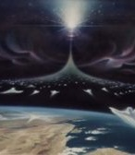
Instantaneous (1 Cor 15:52)
Twinkling of an eye
Flash or moment
Split second
Atomos (Greek) = atom (English)

Slide 33
INSPIRATION OF SCRIPTURE 2 Peter 1:20-21
Men Wrote as they were inspired by Holy Spirit
“phero” = to carry
Acts 27:15,17
Opposite of Knowledge of False Teachers
Which is their own imagination
Jer. 23:16

Slide 34
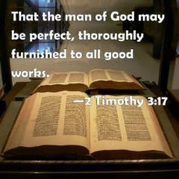
2 Timothy 3:16-17
“All Scripture is inspired by God [theopneustos] and profitable for teaching, for reproof, for correction, for training in righteousness; so that the man of God may be adequate, equipped for every good work.”

Slide 35
7. Promise to the Overcomers
Rev 3:21
“He who overcomes, I will grant to him to sit down with Me on My throne, as I also overcame and sat down with My Father on His throne.”

Slide 36
II. Sights in Heaven (Rev. 4:2-8)
Heavenly Throne (4:2-3, 5a, 6a)
On the Throne (2-3a)
Above the Throne (3b)
Out of the Throne (5a)
Before the Throne (6a)
Items Around the Throne (4:4, 5b, 6b-8)
24 Elders (4)
7 Lamps (5b)
4 Living Creatures (6b-8)
Willmington. Outline Bible, 759

Slide 37
II. Sights in Heaven (Rev. 4:2-8)
Heavenly Throne (4:2-3, 5a, 6a)
On the Throne (2-3a)
Above the Throne (3b)
Out of the Throne (5a)
Before the Throne (6a)
Items Around the Throne (4:4, 5b, 6b-8)
24 Elders (4)
7 Lamps (5b)
4 Living Creatures (6b-8)
Willmington. Outline Bible, 759

Slide 39
II. Sights in Heaven (Rev. 4:2-8)
Heavenly Throne (4:2-3, 5a, 6a)
On the Throne (2-3a)
Above the Throne (3b)
Out of the Throne (5a)
Before the Throne (6a)
Items Around the Throne (4:4, 5b, 6b-8)
24 Elders (4)
7 Lamps (5b)
4 Living Creatures (6b-8)
Willmington. Outline Bible, 759

Slide 40
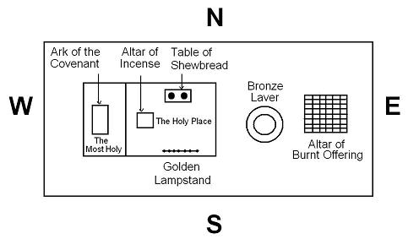

Slide 41
II. Sights in Heaven (Rev. 4:2-8)
Heavenly Throne (4:2-3, 5a, 6a)
On the Throne (2-3a)
Above the Throne (3b)
Out of the Throne (5a)
Before the Throne (6a)
Items Around the Throne (4:4, 5b, 6b-8)
24 Elders (4)
7 Lamps (5b)
4 Living Creatures (6b-8)
Willmington. Outline Bible, 759

Slide 42
II. Sights in Heaven (Rev. 4:2-8)
Heavenly Throne (4:2-3, 5a, 6a)
On the Throne (2-3a)
Above the Throne (3b)
Out of the Throne (5a)
Before the Throne (6a)
Items Around the Throne (4:4, 5b, 6b-8)
24 Elders (4)
7 Lamps (5b)
4 Living Creatures (6b-8)
Willmington. Outline Bible, 759

Slide 43
1. Twenty-Four Elders (Rev. 4:4)
Not
Israel
Redeemed of all ages
Angels

Slide 45
1. Twenty-Four Elders (Rev. 4:4)
Church
Crowned (2:10)
Clothed in White (3:5)
Redeemed (5:8-10)
Enthroned (3:21)
Elders (1 Tim. 3:1-7)
Kingdom of Priests (Rev. 1:6)
Twenty-four (Rev. 1:6)

Slide 46
7. Promise to the Overcomers
Rev 3:21
“He who overcomes, I will grant to him to sit down with Me on My throne, as I also overcame and sat down with My Father on His throne.”

Slide 47
Revelation 5:10
“You have made them to be a kingdom and priests to our God; and they will reign [basileuō] upon the earth [gē].”

Slide 48
Revelation 1:6
“and He has made us to be a kingdom, priests to His God and Father—to Him be the glory and the dominion forever and ever. Amen.”

Slide 49
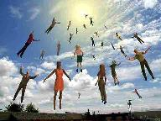
When Will the Rapture Take Place Relative to the Tribulation Period?
Pre-tribulation rapture theory
Mid-tribulation rapture theory
Post-tribulation rapture theory
Pre-wrath rapture theory
Partial rapture theory

Slide 51
II. Sights in Heaven (Rev. 4:2-8)
Heavenly Throne (4:2-3, 5a, 6a)
On the Throne (2-3a)
Above the Throne (3b)
Out of the Throne (5a)
Before the Throne (6a)
Items Around the Throne (4:4, 5b, 6b-8)
24 Elders (4)
7 Lamps (5b)
4 Living Creatures (6b-8)
Willmington. Outline Bible, 759

Slide 52
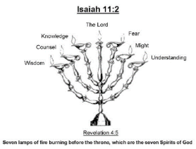
Isaiah 11:2
“The Spirit of the Lord will rest on Him, The spirit of wisdom and understanding, The spirit of counsel and strength, The spirit of knowledge and the fear of the Lord.”

Slide 53
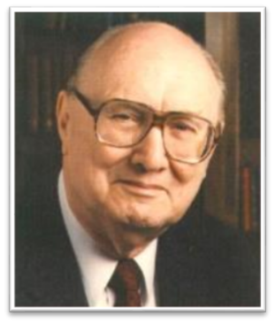
Two Rules of Interpretation
Search the immediate context
Walvoord: 26X
Search the remote context
Old Testament
Thomas: 278 / 404 verses

Slide 54
When Will the Rapture Take Place Relative to the Tribulation Period?
Pre-tribulation rapture theory
Mid-tribulation rapture theory
Post-tribulation rapture theory
Pre-wrath rapture theory
Partial rapture theory

Slide 56
STOPPED HERE

Slide 57
II. Sights in Heaven (Rev. 4:2-8)
Heavenly Throne (4:2-3, 5a, 6a)
On the Throne (2-3a)
Above the Throne (3b)
Out of the Throne (5a)
Before the Throne (6a)
Items Around the Throne (4:4, 5b, 6b-8)
24 Elders (4)
7 Lamps (5b)
4 Living Creatures (6b-8)
Willmington. Outline Bible, 759

Slide 58
3. Four Living Creatures (Rev. 4:6b-8)
Description (6b-8a)
Identification (6b)
Eyes (6c)
Faces (7)
Wings (8a)
Duty (8b)
Willmington. Outline Bible, 759

Slide 59
3. Four Living Creatures (Rev. 4:6b-8)
Description (6b-8a)
Identification (6b)
Eyes (6c)
Faces (7)
Wings (8a)
Duty (8b)
Willmington. Outline Bible, 759

Slide 60
3. Four Living Creatures (Rev. 4:6b-8)
Description (6b-8a)
Identification (6b)
Eyes (6c)
Faces (7)
Wings (8a)
Duty (8b)
Willmington. Outline Bible, 759

Slide 61
3. Four Living Creatures (Rev. 4:6b-8)
Description (6b-8a)
Identification (6b)
Eyes (6c)
Faces (7)
Wings (8a)
Duty (8b)
Willmington. Outline Bible, 759

Slide 62
3. Four Living Creatures (Rev. 4:6b-8)
Description (6b-8a)
Identification (6b)
Eyes (6c)
Faces (7)
Wings (8a)
Duty (8b)
Willmington. Outline Bible, 759

Slide 63
3. Four Living Creatures (Rev. 4:6b-8)
Description (6b-8a)
Identification (6b)
Eyes (6c)
Faces (7)
Wings (8a)
Duty (8b)
Willmington. Outline Bible, 759

Slide 64
3. Four Living Creatures (Rev. 4:6b-8)
Description (6b-8a)
Identification (6b)
Eyes (6c)
Faces (7)
Wings (8a)
Duty (8b)
Willmington. Outline Bible, 759

Slide 65
Preview (Rev. 4:1-11)
Summons to Heaven (4:1)
Sights in Heaven (4:2-8)
Song of Heaven (4:9-11)
Willmington. Outline Bible, 759

Slide 66
III. Song of Heaven (Rev. 4:9-11)
Singers (4:9-10)
4 Living Creatures (9)
24 Elders (10)
Song (4:11)
Willmington. Outline Bible, 759

Slide 67
III. Song of Heaven (Rev. 4:9-11)
Singers (4:9-10)
4 Living Creatures (9)
24 Elders (10)
Song (4:11)
Willmington. Outline Bible, 759

Slide 68
III. Song of Heaven (Rev. 4:9-11)
Singers (4:9-10)
4 Living Creatures (9)
24 Elders (10)
Song (4:11)
Willmington. Outline Bible, 759

Slide 69
III. Song of Heaven (Rev. 4:9-11)
Singers (4:9-10)
4 Living Creatures (9)
24 Elders (10)
Song (4:11)
Willmington. Outline Bible, 759

Slide 70
Scripture’s Five Crowns (Rev 4:10: 3:11; 2 John 8)
SCRIPTURE | CROWN | PURPOSE
1 Cor. 9:24-27 | Incorruptible | Gaining mastery over the flesh
1 Thess. 2:19-20 | Rejoicing | Soul winning
Jas. 1:12; Rev. 2:10 | Life | Enduring trials
1 Pet. 5:2-4 | Glory | Shepherding God’s people
2 Tim. 4:8 | Righteousness | Longing for His appearing

Slide 71
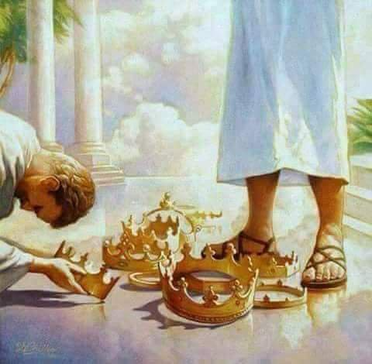

Slide 72
Revelation 3:11
“I am coming quickly; hold fast what you have, so that no one will take your crown.”

Slide 73
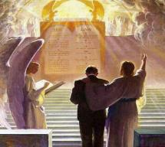
2 John 8
“Watch yourselves, that you do not lose what we have accomplished, but that you may receive a full reward.”

Slide 74
1 Corinthians 3:10-15
“¹⁴ If any man’s work which he has built on it remains, he will receive a reward. ¹⁵ If any man’s work is burned up, he will suffer loss; but he himself will be saved, yet so as through fire.”

Slide 75
1 Corinthians 9:24-27
“²⁴ Do you not know that those who run in a race all run, but only one receives the prize? Run in such a way that you may win. ²⁵ Everyone who competes in the games exercises self-control in all things. They then do it to receive a perishable wreath, but we an imperishable. ²⁶ Therefore I run in such a way, as not without aim; I box in such a way, as not beating the air; ²⁷ but I discipline my body and make it my slave, so that, after I have preached to others, I myself will not be disqualified.”

Slide 76
III. Song of Heaven (Rev. 4:9-11)
Singers (4:9-10)
4 Living Creatures (9)
24 Elders (10)
Song (4:11)
Willmington. Outline Bible, 759

Slide 77
Revelation 11:15
¹⁵ “Then the seventh angel sounded; and there were loud voices in heaven, saying, ‘The kingdom of the world has become the kingdom of our Lord and of His Christ; and He will reign forever and ever.’”

Slide 79
Conclusion

Slide 80
Preview (Rev. 4:1-11)
Summons to Heaven (4:1)
Sights in Heaven (4:2-8)
Song of Heaven (4:9-11)
Willmington. Outline Bible, 759

Slide 81
“The Lord bless you and keep you; the Lord make his face shine on you and be gracious to you; the Lord turn his face toward you and give you peace.” (NIV)

