Slide 1
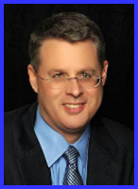
Ecclesiology Session 40
Dr. Andy Woods
Senior Pastor – Sugar Land Bible Church
President – Chafer Theological Seminary

Slide 2
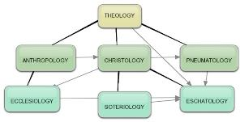
Areas of Systematic Theology
Prolegomena – Introduction
Theology – Study of God
Christology – Study of Christ
Pneumatology – Study of the Holy Spirit
Anthropology – Study of Man
Hamartiology – Study of sin
Soteriology – Study of salvation
Angelology – Study of angels
Ecclesiology – Study of the Church
Eschatology – Study of the end

Slide 3
Ecclesiology Overview
Definition
Universal vs. local
Word pictures
Origin
Israel – Church differences
Intercalation
Purposes
Activities
Government
Officers
Ordinances
Purity

Slide 4
Activities of the Local Church (Acts 2:41-47)
Doctrine (Acts 2:42)
Ordinances (Acts 2:41-42, 46)
Prayer (Acts 2:42)
Evangelism (Acts 2:47)
Worship (Acts 2:47)
Benevolence (Acts 2:44-45)
Fellowship (Acts 2:42, 46-47)

Slide 5
Ecclesiology Overview
Definition
Universal vs. local
Word pictures
Origin
Israel – Church differences
Intercalation
Purposes
Activities
Government
Officers
Ordinances
Purity

Slide 6
Local Church Government
Episcopalian/bishop rule – Acts 15:2, 6
Congregational rule – Acts 6:1-7
Presbyterian/elder rule – Acts 20:28; 1 Tim 5:17; 4:14

Slide 7
Local Church Government
Episcopalian/bishop rule – Acts 15:2, 6
Congregational rule – Acts 6:1-7
Presbyterian/elder rule – Acts 20:28; 1 Tim 5:17; 4:14

Slide 8
Local Church Government
Episcopalian/bishop rule – Acts 15:2, 6
Congregational rule – Acts 6:1-7
Presbyterian/elder rule – Acts 20:28; 1 Tim 5:17; 4:14

Slide 9
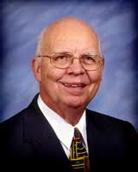
VII. Purposes of the Local Church
Glorify God (Eph 3:21)
Edify the saints (Eph 4:11-16)
Fulfill the Great Commission (Matt 28:18-20)

Slide 10
Ephesians 4:11-16
“¹¹ And He gave some as apostles, and some as prophets, and some as evangelists, and some as pastors and teachers, ¹² for the equipping of the saints for the work of service, to the building up of the body of Christ;”

Slide 11
Ephesians 4:11-16
“¹³ until we all attain to the unity of the faith, and of the knowledge of the Son of God, to a mature man, to the measure of the stature which belongs to the fullness of Christ. ¹⁴ As a result, we are no longer to be children, tossed here and there by waves and carried about by every wind of doctrine, by the trickery of men, by craftiness in deceitful scheming;”

Slide 12
Ephesians 4:11-16
“¹⁵ but speaking the truth in love, we are to grow up in all aspects into Him who is the head, even Christ, ¹⁶ from whom the whole body, being fitted and held together by what every joint supplies, according to the proper working of each individual part, causes the growth of the body for the building up of itself in love.”

Slide 13
Local Church Government
Episcopalian/bishop rule – Acts 15:2, 6
Congregational rule – Acts 6:1-7
Presbyterian/elder rule – Acts 20:28; 1 Tim 5:17; 4:14

Slide 14
Ecclesiology Overview
Definition
Universal vs. local
Word pictures
Origin
Israel – Church differences
Intercalation
Purposes
Activities
Government
Officers
Ordinances
Purity

Slide 15
Local Church Officers
Elder
Qualifications (1 Tim 3:1-7; Titus 1:5-9)
Number (Jas 5:14)
Distinction among elders (1 Tim 5:17)
Duties
Removal (1 Tim 5:19)
Deacon
Definition (Acts 6:1-7)
Qualifications (1 Tim 3:8-13)

Slide 16
Local Church Officers
Elder
Qualifications (1 Tim 3:1-7; Titus 1:5-9)
Number (Jas 5:14)
Distinction among elders (1 Tim 5:17)
Duties
Removal (1 Tim 5:19)
Deacon
Definition (Acts 6:1-7)
Qualifications (1 Tim 3:8-13)

Slide 17
Local Church Officers
Elder
Qualifications (1 Tim 3:1-7; Titus 1:5-9)
Number (Jas 5:14)
Distinction among elders (1 Tim 5:17)
Duties
Removal (1 Tim 5:19)
Deacon
Definition (Acts 6:1-7)
Qualifications (1 Tim 3:8-13)

Slide 18
Elder Qualifications 1 Tim. 3:1-7; Titus 1:5-9
General qualifications
Moral qualifications
Mental qualifications
Personality qualifications
Domestic qualifications
Christian experience qualifications
Reputation qualifications
Knowledge qualifications

Slide 19
Elder Qualifications 1 Tim. 3:1-7; Titus 1:5-9
General qualifications
Moral qualifications
Mental qualifications
Personality qualifications
Domestic qualifications
Christian experience qualifications
Reputation qualifications
Knowledge qualifications

Slide 20
Elder Qualifications 1 Tim. 3:1-7; Titus 1:5-9
General qualifications
Moral qualifications
Mental qualifications
Personality qualifications
Domestic qualifications
Christian experience qualifications
Reputation qualifications
Knowledge qualifications

Slide 21
Elder Qualifications 1 Tim. 3:1-7; Titus 1:5-9
General qualifications
Moral qualifications
Mental qualifications
Personality qualifications
Domestic qualifications
Christian experience qualifications
Reputation qualifications
Knowledge qualifications

Slide 22
Elder Qualifications 1 Tim. 3:1-7; Titus 1:5-9
General qualifications
Moral qualifications
Mental qualifications
Personality qualifications
Domestic qualifications
Christian experience qualifications
Reputation qualifications
Knowledge qualifications

Slide 23
Elder Qualifications 1 Tim. 3:1-7; Titus 1:5-9
General qualifications
Moral qualifications
Mental qualifications
Personality qualifications
Domestic qualifications
Christian experience qualifications
Reputation qualifications
Knowledge qualifications

Slide 24
Elder Qualifications 1 Tim. 3:1-7; Titus 1:5-9
General qualifications
Moral qualifications
Mental qualifications
Personality qualifications
Domestic qualifications
Christian experience qualifications
Reputation qualifications
Knowledge qualifications

Slide 25
Elder Qualifications 1 Tim. 3:1-7; Titus 1:5-9
General qualifications
Moral qualifications
Mental qualifications
Personality qualifications
Domestic qualifications
Christian experience qualifications
Reputation qualifications
Knowledge qualifications

Slide 26
Elder Qualifications 1 Tim. 3:1-7; Titus 1:5-9
General qualifications
Moral qualifications
Mental qualifications
Personality qualifications
Domestic qualifications
Christian experience qualifications
Reputation qualifications
Knowledge qualifications

Slide 27
Local Church Officers
Elder
Qualifications (1 Tim 3:1-7; Titus 1:5-9)
Number (Jas 5:14)
Distinction among elders (1 Tim 5:17)
Duties
Removal (1 Tim 5:19)
Deacon
Definition (Acts 6:1-7)
Qualifications (1 Tim 3:8-13)

Slide 28
Local Church Officers
Elder
Qualifications (1 Tim 3:1-7; Titus 1:5-9)
Number (Jas 5:14)
Distinction among elders (1 Tim 5:17)
Duties
Removal (1 Tim 5:19)
Deacon
Definition (Acts 6:1-7)
Qualifications (1 Tim 3:8-13)

Slide 29
Local Church Officers
Elder
Qualifications (1 Tim 3:1-7; Titus 1:5-9)
Number (Jas 5:14)
Distinction among elders (1 Tim 5:17)
Duties
Removal (1 Tim 5:19)
Deacon
Definition (Acts 6:1-7)
Qualifications (1 Tim 3:8-13)

Slide 30
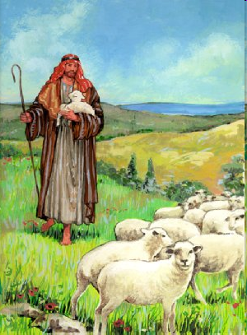
Shepherd/Pastor
Guide
Guard
Graze

Slide 31
Local Church Officers
Elder
Qualifications (1 Tim 3:1-7; Titus 1:5-9)
Number (Jas 5:14)
Distinction among elders (1 Tim 5:17)
Duties
Removal (1 Tim 5:19)
Deacon
Definition (Acts 6:1-7)
Qualifications (1 Tim 3:8-13)

Slide 32
Local Church Officers
Elder
Qualifications (1 Tim 3:1-7; Titus 1:5-9)
Number (Jas 5:14)
Distinction among elders (1 Tim 5:17)
Duties
Removal (1 Tim 5:19)
Deacon
Definition (Acts 6:1-7)
Qualifications (1 Tim 3:8-13)

Slide 33
Local Church Officers
Elder
Qualifications (1 Tim 3:1-7; Titus 1:5-9)
Number (Jas 5:14)
Distinction among elders (1 Tim 5:17)
Duties
Removal (1 Tim 5:19)
Deacon
Definition (Acts 6:1-7)
Qualifications (1 Tim 3:8-13)

Slide 34
Local Church Officers
Elder
Qualifications (1 Tim 3:1-7; Titus 1:5-9)
Number (Jas 5:14)
Distinction among elders (1 Tim 5:17)
Duties
Removal (1 Tim 5:19)
Deacon
Definition (Acts 6:1-7)
Qualifications (1 Tim 3:8-13)

Slide 35
Gender Restrictions
Women are the backbone of the church
Trinitarian example
Gender restrictions (1 Tim 3:1ff; Titus 1:5ff; 1 Tim 2:12)

Slide 36
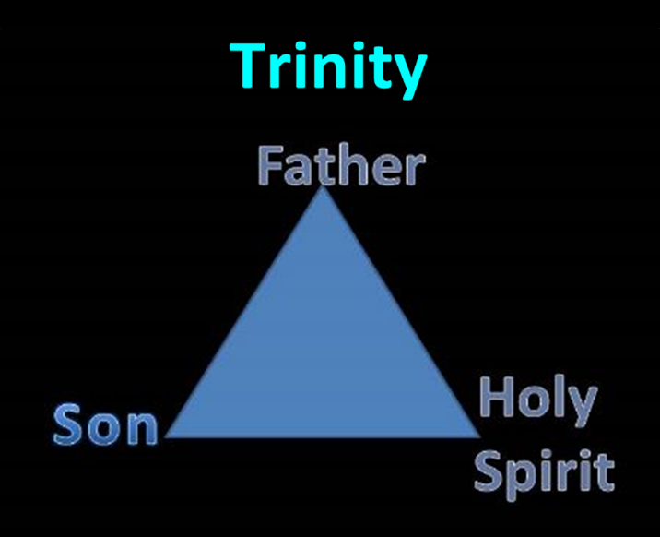

Slide 37
Conclusion

Slide 38
Ecclesiology Overview
Definition
Universal vs. local
Word pictures
Origin
Israel – Church differences
Intercalation
Purposes
Activities
Government
Officers
Ordinances
Purity

