Slide 1
Biblical Dispensationalism
Session 3
Introduction to Biblical Dispensationalism
Sugar Land Bible Church
11-14-2018
Jim McGowan, MTS, Th.D.

Slide 2
Session 3 Outline
Important Assumptions and Prerequisites
Definition of Biblical Dispensationalism
Origins of Biblical Dispensationalism
Evidence for Dispensationalism
What is a Dispensation?

Slide 3
Definition of Biblical Dispensationalism
A Common Misconception
Some Anti-Dispensationalists
Definition
Literal Interpretation
Biblical Distinctions
Dispensations

Slide 4
Definition of Biblical Dispensationalism
A Common Misconception
Some Anti-Dispensationalists
Definition
Literal Interpretation
Biblical Distinctions
Dispensations

Slide 5
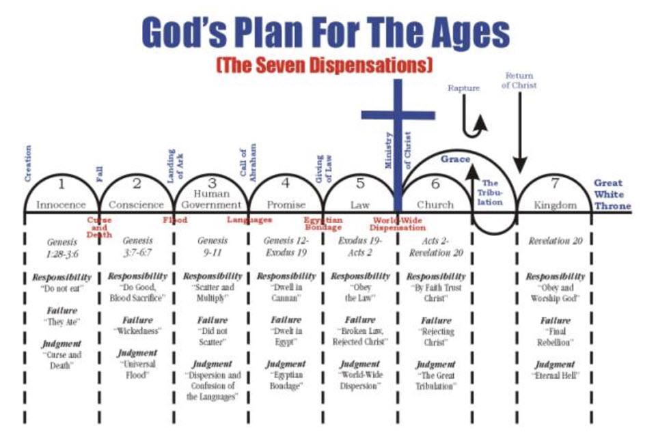
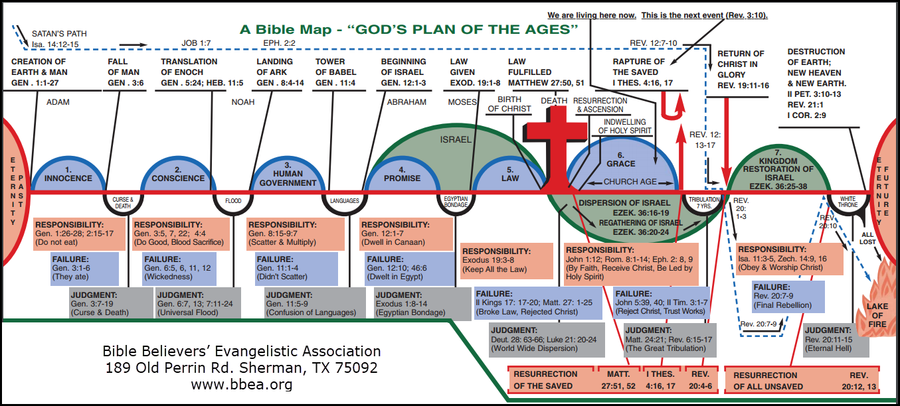
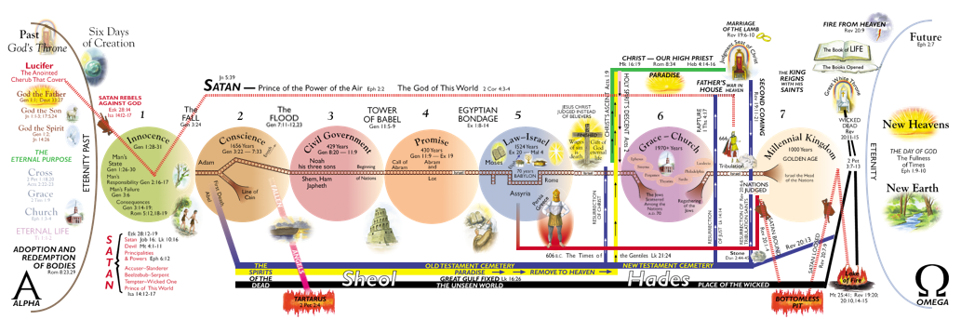
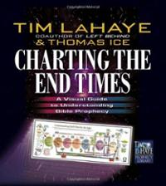
A Common Misconception
SOME PEOPLE THINK ALL WE DO IS PRODUCE CHARTS AND GRAPHS!

Slide 6
Definition of Biblical Dispensationalism
A Common Misconception
Some Anti-Dispensationalists
Definition
Literal Interpretation
Biblical Distinctions
Dispensations

Slide 7
Some Anti-Dispensationalists
John Gerstner – Wrongly Dividing the Word of Truth
Reginald Kimbro – The Gospel According to Dispensationalism
A.W. Pink – A Study of Dispensationalism
Joseph M. Canfield – The Incredible Scofield and His Book
George Ladd – Crucial Questions About the Kingdom of God
John Wick Bowman - “The Bible and Modern Religions

Slide 8
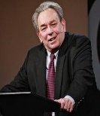
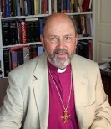
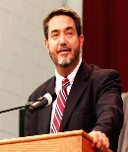
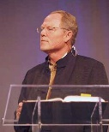
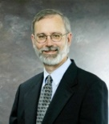
Some Anti-Dispensationalists (Preterists)
R.C. Sproul
N.T. Wright
Scott Hahn
J. Massyngbaerde Ford
David Chilton
Hank Hanegraaff
Kenneth Gentry

Slide 9
Definition of Biblical Dispensationalism
A Common Misconception
Some Anti-Dispensationalists
Definition
Literal Interpretation
Biblical Distinctions
Dispensations

Slide 10
Definition of Biblical Dispensationalism
A Common Misconception
Some Anti-Dispensationalists
Definition
Literal Interpretation
Biblical Distinctions
Dispensations

Slide 11
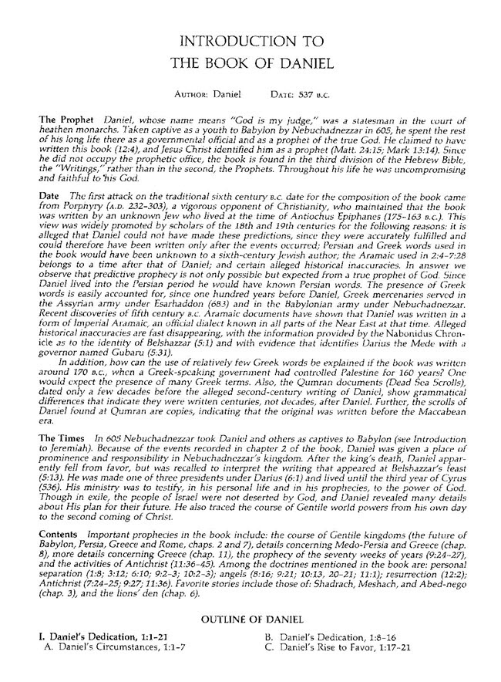
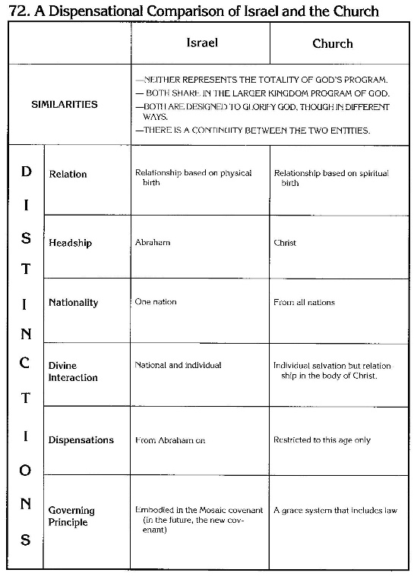
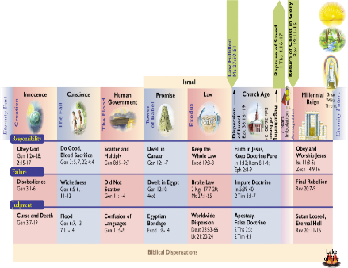
Definition of Biblical Dispensationalism
Biblical Dispensationalism is a theological system that emphasizes a CONSISTENT literal interpretation of the Bible, (including prophecy); recognizes a distinction between Israel and the church; and organizes the Bible into different dispensations, administrations, or economies.

Slide 12
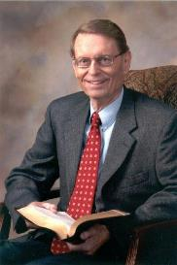
Definition of Biblical Dispensationalism
Sine Qua Non – ("Without which, not") - something absolutely indispensable or essential.
“The essence of dispensationalism, then, is the distinction between Israel and the Church. This grows out of the dispensationalist’s consistent employment of normal or plain or historical-grammatical interpretation, and it reflects an understanding of the basic purpose of God in all His dealings with mankind as that of glorifying Himself through salvation and other purposes as well.”
Ryrie, C. C. (1995). Dispensationalism (Rev. and expanded., p. 48). Chicago: Moody Publishers.

Slide 13
Definition of Biblical Dispensationalism
Consistent, Literal, Interpretation - The Golden Rule of Interpretation
When the plain sense of Scripture makes common sense, seek no other sense; therefore, take every word at its primary, ordinary, usual, literal meaning unless the facts of the immediate context, studied in the light of related passages and axiomatic and fundamental truths, indicate clearly otherwise.
Notes:
Axiomatic – obviously or accepted as true

Slide 14
Definition of Biblical Dispensationalism
A Common Misconception
Some Anti-Dispensationalists
Definition
Literal Interpretation
Biblical Distinctions
Dispensations

Slide 15
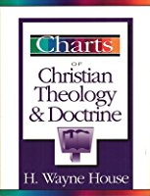
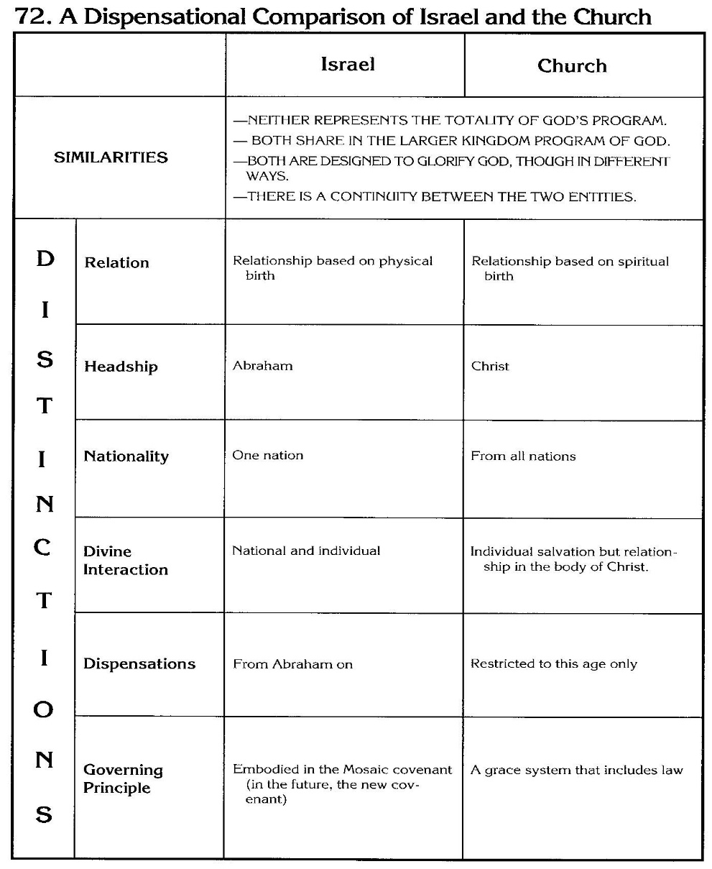
Definition of Biblical Dispensationalism
Distinction Between Israel and the Church

Slide 16
Definition of Biblical Dispensationalism
Do Distinctions Really Matter?

Slide 17
Definition of Biblical Dispensationalism
My Wife
My Daughters.
Notes:
B. Does This Really Matter?
Clarity of Identities & Relationships
My wife and my daughters. Wife born in Houston, TX – Two daughters born in Houston, TX
Three females… one’s a wife, and two are daughters.
All born in the same city and state
All are part of the same family
All at one point had the same last name.
There’s a lot alike here isn’t there? And I love all three of them.
But it’s very important that I make a distinction regardless of what I see in common! If I fail to make the appropriate distinctions in spite of what is in common between my wife and my daughters, a lot of people would get very upset…not the least of whom would be my daughters’ husbands and certainly my wife!!!
How about making proper distinctions with other women? Is that important? It is for me! My dear, sweet, kind, gentle, wife has clearly indicated the ramifications of not maintaining appropriate distinctions…I believe she has expressed it this way, “I’ll snatch another woman bald-headed”!!! She didn’t articulate what she would do to me and I didn’t ask!
It is very important then, in spite of what is in common, to see the distinctions. It matters greatly in regards to identities and relationships not only in our present earthly existence, but also in eternity. It matters that we understand identities and relationships.
NEXT SLIDE

Slide 18
Definition of Biblical Dispensationalism
A Common Misconception
Some Anti-Dispensationalists
Definition
Literal Interpretation
Biblical Distinctions
Dispensations

Slide 19
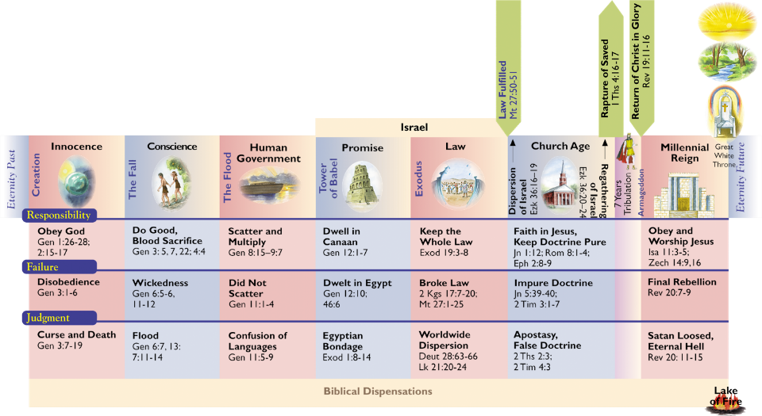
Definition of Biblical Dispensationalism
Dispensations or Administrations

Slide 20
Session 3 Outline
Important Assumptions and Prerequisites
Definition of Biblical Dispensationalism
Origins of Biblical Dispensationalism
Evidence for Dispensationalism
What is a Dispensation?

Slide 21
Origins of Biblical Dispensationalism
According to the writing of the church fathers, Dispensational concepts were held early and throughout the history of the church.
Justin Martyr (110–165) - recognizes several differing economies in the Old Testament.
Irenaeus (130–200) - refers in his writings to four principal covenants.
Clement of Alexandria (150–220) - identified four dispensations: Adamic, Noahic, Abrahamic, and Mosaic.
Augustine (A.D. 354–430) – referred to the “former dispensation” when sacrifices were offered and the “present age” when sacrifices are no longer required.

Slide 22
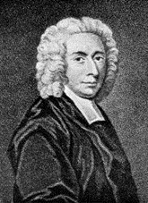
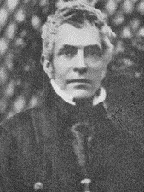
Origins of Biblical Dispensationalism
Pierre Poiret (1646–1719) – outlined a seven-fold dispensational scheme culminating in a literal, thousand year period.
John Edwards (1637–1716) - published two volumes entitled A Complete History or Survey of All the Dispensations.
Isaac Watts (1674–1748) – created a dispensational outline very similar to the one found in the original Scofield Reference Bible.
John Nelson Darby (1800–1882) – is credited with systematizing dispensationalism.
C. I. Scofield (1843–1921) – his scheme of dispensationalism was popularized in the Scofield Reference Bible.

Slide 23
Origins of Biblical Dispensationalism
Clarence Larkin (1850–1924) – Dispensational Truth, or God’s Plan and Purpose in the Ages.
James Martin Gray (1851–1935), past president of Moody Bible Institute.
Lewis Sperry Chafer (1871–1952), founder of the Dallas Theological Seminary.
Dr. David L. Cooper (1888-1965) – founder of the Biblical Research Society.

Slide 24
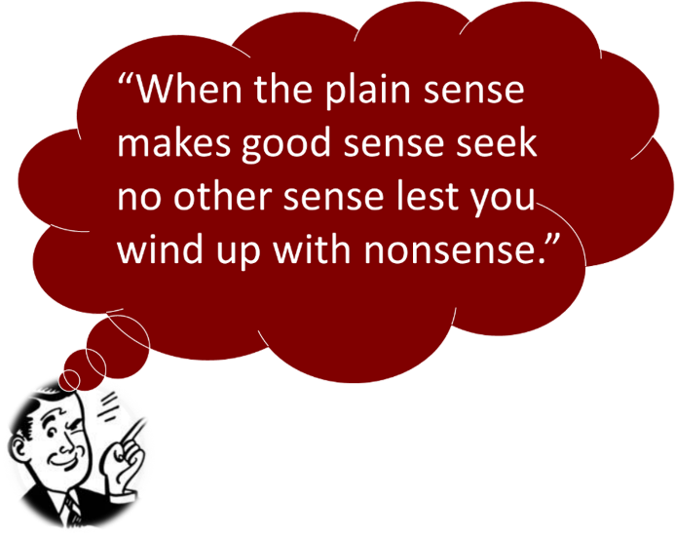
Origins of Biblical Dispensationalism
The Golden Rule of Interpretation
When the plain sense of Scripture makes common sense, seek no other sense; therefore, take every word at its primary, ordinary, usual, literal meaning unless the facts of the immediate context, studied in the light of related passages and axiomatic and fundamental truths, indicate clearly otherwise.

Slide 25
Origins of Biblical Dispensationalism
The Chaldeans (1000 B.C.) – a struggle between good and evil for the space of 6000 years; ‘and then Hades is to cease, and men are to be happy, neither wanting food nor making shade.’
Etruscan Religion* (800 B.C.)
The Persians (Zoroaster; 500 B.C.) – 12,000 years, the first 6,000 were employed in creation, 6000 for the duration of mankind.
The Egyptians – same as the Persians.
Israel (200 B.C.) – 6000 years + a Sabbath of 1000.

Slide 26
Origins of Biblical Dispensationalism
“The Etruscan cosmogony was of a very remarkable character. According to the account of it given by Suidas…, [God] appointed twelve millenniums for his acts of creation, and assigned them severally to the twelve signs of the zodiac. In the first chiliad he created heaven and earth; in the second, the firmament; in the third, the sea, and the waters upon the land; in the fourth, the great lights of heaven—sun, moon, and stars; in the fifth, everything in the air, earth, and water that creeps and flies and runs upon four feet; and in the sixth, man. Six thousand years had thus elapsed before the creation of man, and the human race should endure for six thousand years more. The similarity of this creation story to the Biblical account is unmistakable.” Ehlert, A. D. (1944). A Bibliography of Dispensationalism. Bibliotheca Sacra, 101, 99–100.

Slide 27
Session 3 Outline
Important Assumptions and Prerequisites
Definition of Biblical Dispensationalism
Origins of Biblical Dispensationalism
Evidence for Dispensationalism
What is a Dispensation?

Slide 28
Evidence for Dispensationalism
Law vs. Grace
The Coming Kingdom
Logic and Additional Dispensations

Slide 29
Evidence for Dispensationalism
Law vs. Grace
The Coming Kingdom
Logic and Additional Dispensations

Slide 30
Law vs. Grace
The change from Law to Grace is one of the fundamental teachings of the New Testament. Therefore, the Law of Moses is no longer binding as a “rule of life” for the Church. Consider the following passages:
Matthew 5:17 (Rom. 8:3-4); John 1:17; Rom. 6:14; Rom. 7:4; Rom. 10:4; 2 Cor. 3:7-11; Gal. 3:24-25; Eph. 2:14-15; Col. 2:13-14; Heb. 7:11-19, 22; Heb. 8:7, 13

Slide 31
Law vs. Grace
Throughout the Psalms, and all the Old Testament Saints’ experiences, we find that there is under the Law, an almost constant striving and groaning after a righteous state,—seen, but not experienced, because the Law consisted of outer enactments, to be fulfilled by man. The Law furnished no power. Now in Romans 8:4 we have three things: first, this righteous state or result; second, the fact that it was not fulfilled by us—we have no more power in ourselves than had the Old Testament saints: but it is fulfilled in us—it is the passive voice: be fulfilled. Third, it is fulfilled in us as we consent to reject the flesh and choose to walk according to the Spirit. In the Spirit lies all the power. With us, the responsibility of choice—a blessed, solemn one!
Newell, W. R. (n.d.). Romans Verse-by-Verse (p. 207). Grand Rapids, MI: Christian Classics Ethereal Library.

Slide 32
Law vs. Grace
This does not mean the Law of Moses has no value or that Christians should disparage the Old Testament.
God is immutable in His attributes therefore, everything that the O.T. teaches about God’s nature is still valid (Mal. 3:6; James 1:17).
The Law of Moses proves man’s guilt (Rom. 3:20; 1 Tim. 1:8 ff.).
The Law of Moses contains many unfulfilled prophecies and teaches about God’s dealings with gentile nations.

Slide 33
Law vs. Grace
O.T. stories along with the Law of Moses, may be used to prove or apply truths repeated in the Epistles (Rom. 15:4; 1 Cor. 10:6, 11; 2 Tim. 3:16).
Biblical Dispensationalism does not disregard the Old Testament but applies it properly. See 1 Tim. 1:8: “…the Law is good, if one uses it lawfully.”

Slide 34
Evidence for Dispensationalism
Law vs. Grace
The Coming Kingdom
Logic and Additional Dispensations

Slide 35
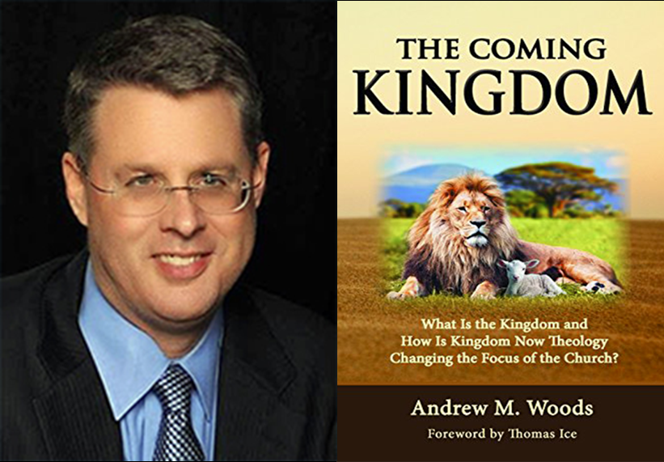
B. The Coming Kingdom

Slide 37
The Coming Kingdom
Scriptural evidence is more than conclusive that God has changed administrations from Law to the Church, and that He will one day change from a church administration to that of a political kingdom with Christ sitting on the Davidic throne in Jerusalem.
God’s promise that Abraham’s seed would eternally inherit and dwell in the Land of Promise, is repeated in each reassertion of it to successive generations. Consider the following passages:
Gen. 13:14-15; Gen. 17:7-8, 19; 1 Chron. 16:16-17; Psa. 105:8-10; Ezek. 16:60-62; Ezek. 37:25-26; Gal. 3:17; Heb. 6:13, 17-18

Slide 38
The Coming Kingdom
God promised David that his seed would rule over Israel forever. Yet, David’s children have not ruled over Israel since the exile. (King Herod was neither of David’s line nor even truly Jewish.) The original promise to David was stated to be eternally binding. Consider the following passages:
2 Samuel 7:12–16; Psa. 89:3-4, 28-29, 35-37

Slide 39
The Coming Kingdom
Just as with the Abrahamic Covenant, the Davidic Covenant is reaffirmed throughout Scripture as being irrevocable and eternal in nature.
The promise of an eternal throne for David’s son will be fulfilled in the ultimate Son of David, Jesus Christ. Consider the following passages:
2 Sam. 7:12-16; Psa. 89:3-4, 28-29, 33-37; Isa. 55:3; Jer. 30:8-9; Hos. 3:4-5; Amos 9:11

Slide 40
The Coming Kingdom
The Old Testament prophets also spoke of an eternal, unconditional, New Covenant that would be made with Israel which guarantees a future for Israel. Consider the following passages:
Jer. 31:31-37; 32:40; Ezek. 36:24-26; 37:12-14, 26
The Old Testament promises that Israel will be the center of a worldwide and enduring Kingdom. Consider the following passages:
Isa. 2:2-4; 60:3, 5, 10-11, 16-21; Isa. 61:6; Isa. 62:6-7; Jer. 3:17; Micah 4:1-3; Zech. 8:20-23; 14:9, 11, 14, 16-17

Slide 41
The Coming Kingdom
Many verses focus upon Messiah’s role in a coming Kingdom. Consider the following passages:
Psa. 2:6; Isa. 9:6-7; Jer. 23:5-6; Dan. 7:13-14; Zech. 14:9
Promises for an earthly Kingdom with Christ as King are also found in the New Testament. Just as the Law Dispensation ended, so the Church Dispensation will give way to the millennial Kingdom. Consider the following passages:
Matt. 19:28; Luke 1:32-33; Rom. 11:25-27; Rev. 20:4-6

Slide 42
Evidence for Dispensationalism
Law vs. Grace
The Coming Kingdom
Logic and Additional Dispensations

Slide 43
Logic and Additional Dispensations
As has been seen already, scripture asserts that there have been changes in administrations (dispensations) and without question, there are at least three clearly taught by the Bible including:
Law
Church
Kingdom
While it can be argued that Scriptural support for additional dispensations is not as clearly defined, logic suggests that we are not devoid of indications of additional dispensations in God’s program.

Slide 44
Logic and Additional Dispensations
For example it is not unreasonable to consider that God’s plan for mankind was significantly different:
Before the Fall (Gen. 1:28 -3:6)
After the Fall but before the Flood (Gen. 3:7 - 8:14)
After the Flood but before the promise to Abraham (Gen. 8:14 -11:32)
After Abraham’s call but before the giving of the Law of Moses at Mt. Sinai (Gen. 11:32 - Exodus 18)

Slide 45
Logic and Additional Dispensations
After the giving of the Law of Moses but before the institution of the Church (Exodus 19 - Acts 2)
After the institution of the Church but before the Rapture (Acts 2 to Rapture)
After the return of Christ to set up His millennial Kingdom (Matt. 8:11-12; 13:41-43, 49; 24:30-31; 25:13, 31-46; Luke 13:28-29)

Slide 46
Session 3 Outline
Important Assumptions and Prerequisites
Definition of Biblical Dispensationalism
Origins of Biblical Dispensationalism
Evidence for Dispensationalism
What is a Dispensation?

Slide 47
What is a Dispensation?
“As far as the use of the word in Scripture is concerned, a dispensation may be defined as a stewardship, administration, oversight, or management of others’ property.…this involves responsibility, accountability, and faithfulness on the part of the steward…A concise definition of a dispensation is this: A dispensation is a distinguishable economy in the outworking of God’s purpose….The differentiation of viewpoints in this definition is a helpful distinction. A dispensation is from God’s viewpoint an economy; from man’s, a responsibility; and in relation to progressive revelation, a stage in it.
Ryrie, C. C. (1995). Dispensationalism (Rev. and expanded., p. 33, 36). Chicago: Moody Publishers.
Notes:
Economy = an orderly management or arrangement of parts; organization or system

Slide 48
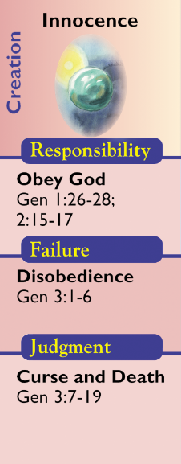
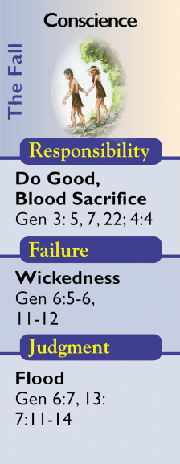
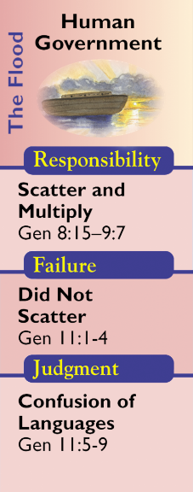
What is a Dispensation?

Slide 49
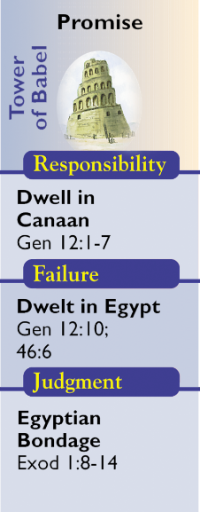
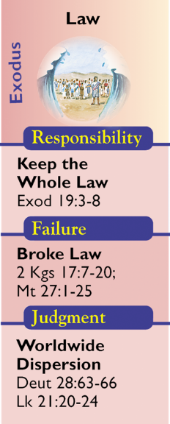
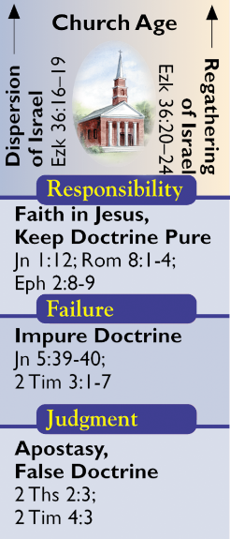
What is a Dispensation?
Notes:
Failure – “There is a famine in the land and rather than staying where God put him and trusting in the Lord Abraham finally decides that the best way to take care of everybody is to go down to Egypt and to live there. So he is going to take the human viewpoint solution. And what happens here is he leaves the land which was what God gave him, which means that he is no longer going to think in terms of his positional reality. Secondly, when he gets down into the land he lies about Sarah, she almost gets taken into be the wife of the Pharaoh, and he puts the seed at risk. Third, he brings divine discipline on the house of Pharaoh and so he is failing to be a blessing for all nations, and he is going to be a source of judgment for those around him.” – Robbie Dean
We see this pattern replicated later with Isaac and Rebecca!
Failure was seen on the part of the Israelites because of their consistent tendency to leave the Land. Fruchtenbaum, A. G. (1983). The Messianic Bible Study Collection (Vol. 41, p. 12). Tustin, CA: Ariel Ministries.
The fact that Jacob’s family could not leave Egypt once they settled there was due to a new Pharaoh’s new policies concerning the Israelites as residents of Egypt. Constable, T. (2003). Expository Notes on the Bible (Ge 45:16). Galaxie Software.

Slide 50
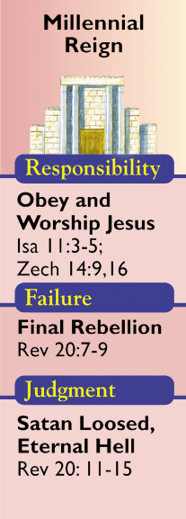
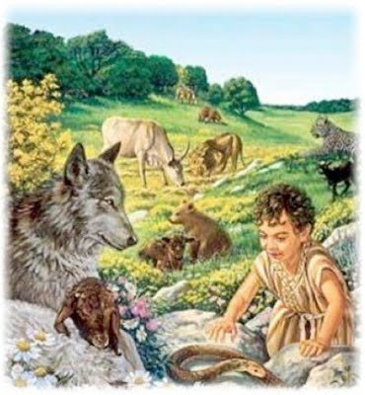
What is a Dispensation?

Slide 51
CONCLUSION

Slide 52
Session 3 Outline
Important Assumptions and Prerequisites
Definition of Biblical Dispensationalism
Origins of Biblical Dispensationalism
Evidence for Dispensationalism
What is a Dispensation?

Slide 53
Resources
Alva J. McClain, Law & Grace, Moody, 1967 978-088469-001-6
Charles C. Ryrie, Dispensationalism, Moody, 2007, 080242189X
Christopher Cone, gen. ed., Dispensationalism Tomorrow & Beyond, Tyndale Seminary Press, 2008 9780981479101
Christopher Cone, gen. ed., An Introduction To The New Covenant, Tyndale Seminary Press, 2013, 9781938484100
Walvoord, J. F., The Prophecy Knowledge Handbook. Wheaton, IL: Victor Books. 1990.
Lewis S. Chafer, Major Bible Themes, Zondervan, 1974, 0-310-22390-3
Mike Stallard, gen .ed., Dispensational Understanding of the New Covenant, Regular Baptist Books, 2012, 9781607764946
Paul Enns, The Moody Handbook of Theology, Moody 1989,
Renald E. Showers, There Really Is A Difference, Friend of Israel Gospel Ministry, 1990, 0915540509
Rene Pache, The Inspiration and Authority of Scripture, Sheffield Pub Co, 1992
Roy B. Zuck, Basic Bible Interpretation, SP Publications, 1991
Steven Waterhouse, Not By Bread Alone: An Outlined Guide to Bible Doctrine, Westcliff Press, ISBN-0977405125
Charting the End Times CD-Rom: A Visual Guide to Understanding Bible Prophecy, ISBN-10: 0736917624
Materials from:
Dr. Andy Woods, Sugar Land Bible Church, www.slbc.org
Dr. Vern Peterman, Holly Hills Bible Church, www.hollyhillsbiblechurch.org
George Zeller, Middletown Bible Church, www.middletownbiblechurch.org
Ed Allsteadt, Sugar Land Bible Church, www.slbc.org

