Slide 1
Law and Grace: An Overview Jim McGowan, Th.D. Sugar Land Bible Church 11-11-2018
…but grace and truth were realized through Jesus Christ - John 1:17
For the Law was given through Moses…
Special thanks to Dr. Vern Peterman for access to his insights and resources.

Slide 2
Session 15 Outline
Review
Purpose, Aim, and Objective
Session 14
Wipeout! (Joshua 24)
General Information
Comments and Commentary
Concluding Observations

Slide 3
OUR PURPOSE, AIM AND OBJECTIVE
Law and Grace
…is to Compare and Contrast Law and Grace so as to properly understand these two important themes and how they are related to the life of the New Testament Believer.

Slide 4
C. I. SCOFIELD, D. D.
The Grace of God, The Fundamentals Vol. 3, Chapter VII, p. 98
We have, most of us, been reared and now live under the influence of Galatianism. Protestant theology, alas, is for the most part, thoroughly Galatianized, in that neither law nor grace are given their distinct and separated places, as in the counsels of God, but are mingled together in one incoherent system.
The law is no longer, as in the Divine intent, a ministration of death (2 Cor. 3:7), of cursing (Gal. 3:10), of conviction (Rom. 3:19), because we are taught that we must try to keep it, and that by Divine help we may.
Nor, on the other hand, does grace bring us blessed deliverance from the dominion of sin, for we are kept under the law as a rule of life despite the plain declaration, “Sin shall not have dominion over you: for ye are not under the law, but under grace” (Rom. 6:14). (emphasis mine)

Slide 5
William R. Newell
Romans Verse-by-Verse (p. 274).
Grand Rapids, MI: Christian Classics Ethereal Library.
It is because Reformed theology has kept us Gentiles under the Law,—if not as a means of righteousness, then as “a rule of life,” that all the trouble has arisen. The Law is no more a rule of life than it is a means of righteousness. Walking in the Spirit has now taken the place of walking by ordinances. God has another principle under which He has put his saints: “Ye are not under law, but, under grace!” (italics mine)

Slide 6
Session 15 Outline
Review
Purpose, Aim, and Objective
Session 14
Wipeout! (Joshua 24)
General Information
Comments and Commentary
Concluding Observations

Slide 7
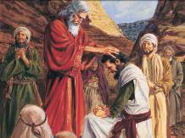
Joshua 1:16-18
¹⁶ They answered Joshua, saying, “All that you have commanded us we will do, and wherever you send us we will go. ¹⁷ “Just as we obeyed Moses in all things, so we will obey you; only may the Lord your God be with you as He was with Moses. ¹⁸ “Anyone who rebels against your command and does not obey your words in all that you command him, shall be put to death; only be strong and courageous.”

Slide 8
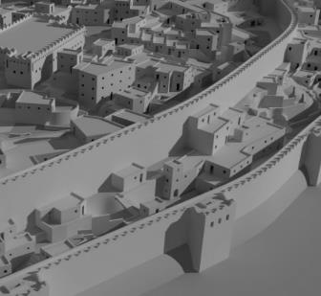
Israel was under both the Law of Moses and a Principle of Law
Review: Law and Grace: Lesson 14
As Israel entered the promised land they were to go into battle, living under the entire Law of Moses, and they were to follow directions on how to go about the battle, what to destroy and keep.
Failing to follow the specific orders from God for the battle meant both defeat and death penalty.

Slide 9
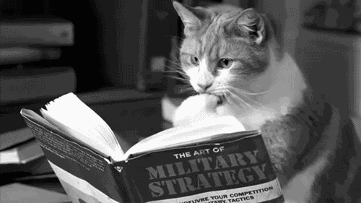
Did Joshua gain the upper hand through a study of Military Strategy?
Review: Law and Grace: Lesson 14

Slide 10
Did Joshua learn how to predict, or cause, an Earthquake?
Review: Law and Grace: Lesson 14

Slide 11
Did Joshua plan to take them out with superior physical strength and firepower?
Review: Law and Grace: Lesson 14

Slide 12
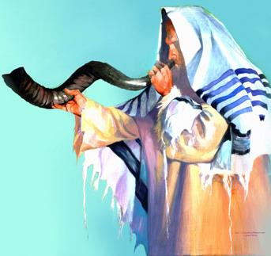
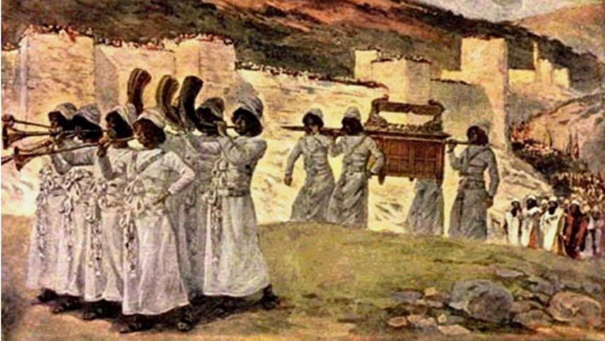
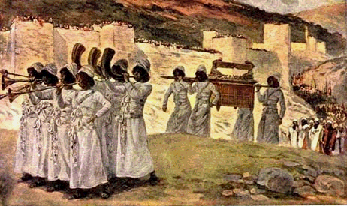
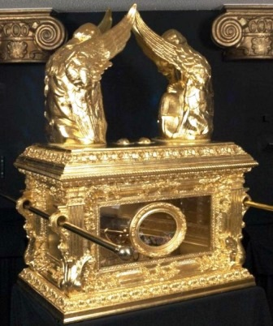
Review: Law and Grace: Lesson 14
God had Joshua tell the Israelites to do this
Joshua 6:6-21

Slide 13
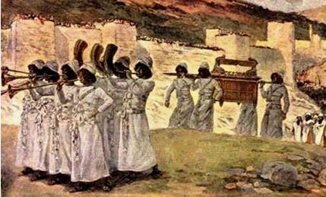
God’s plan for the conquest of the land was not uniform!
Review: Law and Grace: Lesson 14
According to the principle of law, the Children of Israel had to carefully follow God’s instructions every single time! Failing to do (even by only one person), meant defeat in that battle and the death penalty for the one who offended.

Slide 14
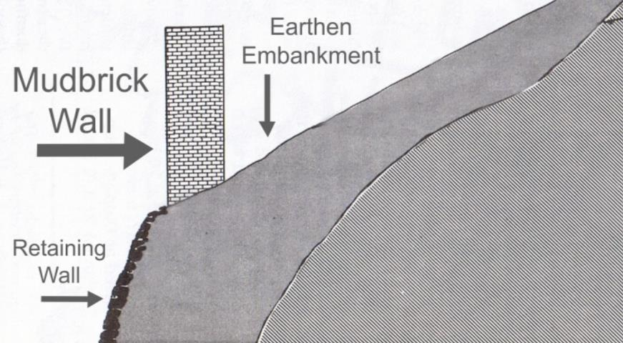
Review: Law and Grace: Lesson 14
God’s plan for the conquest of the land was not uniform!
The lower retaining wall & mudbrick wall at Jericho at the time of the conquest (1406 BC) – Sectional view

Slide 15
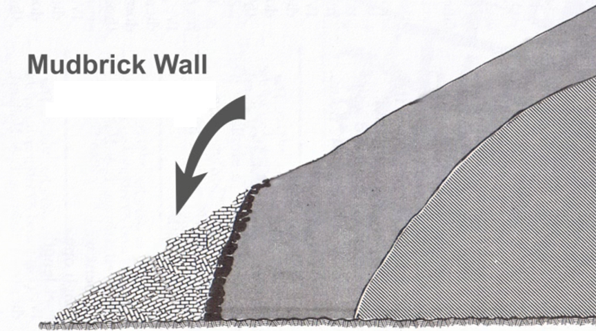
Review: Law and Grace: Lesson 14
God’s plan for the conquest of the land was not uniform!
This is what each of the major archaeological excavations have found at Jericho.

Slide 16
God’s plan for the conquest of the land was not uniform!
Review: Law and Grace: Lesson 14
The collapse of the walls of Jericho would have taken out many of the soldiers of Jericho with it.

Slide 17
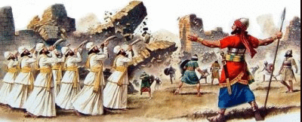
God’s plan for the conquest of the land was not uniform!
Review: Law and Grace: Lesson 14
So did God tell the Israelites to attack every Canaanite city that way? No – never again!

Slide 18
Review: Law and Grace: Lesson 14

Slide 19
Session 15 Outline
Review
Purpose, Aim, and Objective
Session 14
Wipeout! (Joshua 24)
General Information
Comments and Commentary
Concluding Observations

Slide 20
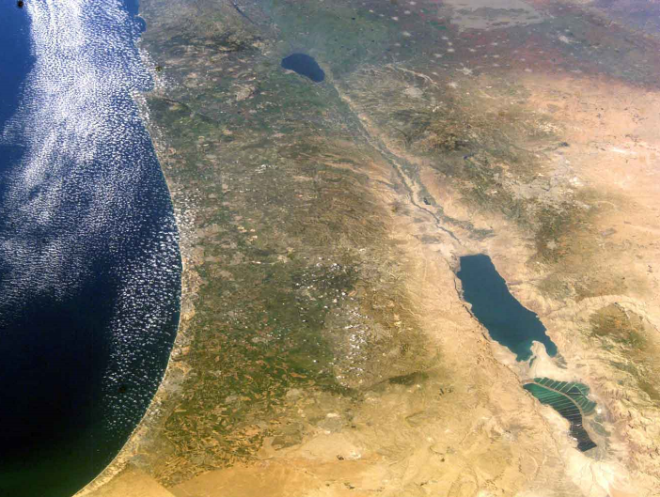
Law and Grace: Lesson 15 – WIPEOUT!
Jericho and Ai
Galilee
Canaan: the Promised Land
Jordan River
Jericho
Ai
Dead Sea

Slide 21
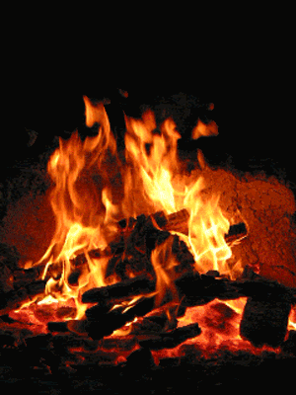
God had the Israelites burn the city of Jericho
Law and Grace: Lesson 15 – WIPEOUT!
So, is that what God had the Israelites do to all the cities they attacked?
Or did God never again have the Israelites burn any of the cities they encountered?
No, and no.

Slide 22
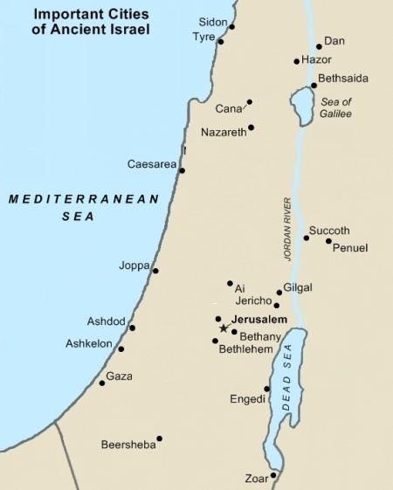
God had the Israelites burn Ai and Hazor too!
Law and Grace: Lesson 15 – WIPEOUT!
Of all the cities of Canaan, the Israelites were only directed to burn the cities of Jericho, Ai and Hazor.
Hazor
Ai
Jericho

Slide 23
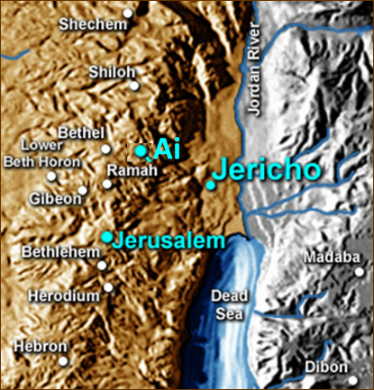
After Jericho Joshua 7
Law and Grace: Lesson 15 – WIPEOUT!
After Jericho, God had the Israelites go to Ai, which was higher in elevation and to the west.
But though the ‘battle’ for Jericho went very well, at first the battle for Ai did not go well.

Slide 24
Joshua 7:2-5
² Now Joshua sent men from Jericho to Ai, which is near Beth-aven, east of Bethel, and said to them, “Go up and spy out the land.” So the men went up and spied out Ai. ³ They returned to Joshua and said to him, “Do not let all the people go up; only about two or three thousand men need go up to Ai; do not make all the people toil up there, for they are few.” ⁴ So about three thousand men from the people went up there, but they fled from the men of Ai. ⁵ The men of Ai struck down about thirty-six of their men, and pursued them from the gate as far as Shebarim and struck them down on the descent, so the hearts of the people melted and became as water.

Slide 25
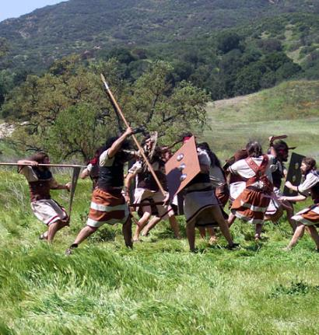
After Jericho Joshua 7
Law and Grace: Lesson 15 – WIPEOUT!
The soldiers of Ai soundly defeated the Israelites, so Joshua went to the Lord to seek the reason for the defeat.

Slide 26
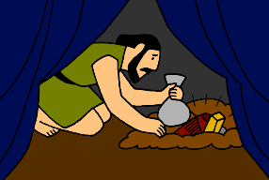
Joshua 7:1
¹ But the sons of Israel acted unfaithfully in regard to the things under the ban, for Achan, the son of Carmi, the son of Zabdi, the son of Zerah, from the tribe of Judah, took some of the things under the ban, therefore the anger of the Lord burned against the sons of Israel.

Slide 27
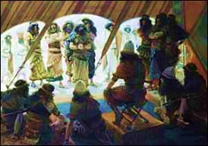
Joshua 7:19-22
¹⁹ Then Joshua said to Achan, “My son,…tell me now what you have done…²⁰ So Achan…said, “Truly, I have sinned against the Lord, the God of Israel,…when I saw among the spoil a beautiful mantle from Shinar and two hundred shekels of silver and a bar of gold fifty shekels in weight, then I coveted them and took them; and behold, they are concealed in the earth inside my tent…²² So Joshua sent messengers, and they ran to the tent; and behold, it was concealed in his tent...

Slide 28
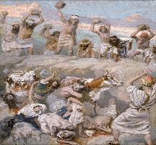
Joshua 7:24-26
²⁴ Then Joshua and all Israel with him, took Achan the son of Zerah, the silver, the mantle, the bar of gold, his sons, his daughters, his oxen, his donkeys, his sheep, his tent and all that belonged to him; and they brought them up to the valley of Achor. ²⁵ …And all Israel stoned them with stones; and they burned them with fire... ²⁶ They raised over him a great heap of stones that stands to this day, and the Lord turned from the fierceness of His anger...

Slide 29
Joshua 1:16-18
¹⁶ They answered Joshua, saying, “All that you have commanded us we will do, and wherever you send us we will go. ¹⁷ “Just as we obeyed Moses in all things, so we will obey you; only may the Lord your God be with you as He was with Moses. ¹⁸ “Anyone who rebels against your command and does not obey your words in all that you command him, shall be put to death; only be strong and courageous.”

Slide 30
Law and Grace: Lesson 15 – WIPEOUT!
Archeology Resources on the Conquest of Canaan
Youtube: Jericho and Archaeology, by Dr. Bryant Wood
Youtube: Finding the Lost City of Ai: Joshua 7-8 with Dr. Bryant Wood (Parts One – Eight)
Videos and articles: www.biblearchaeology.org

Slide 31
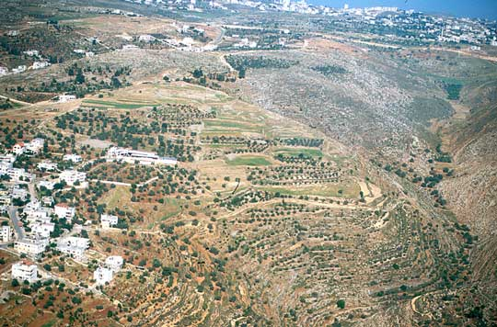
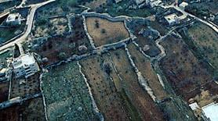
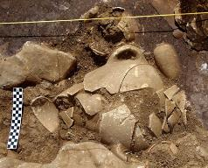
Law and Grace: Lesson 15 – WIPEOUT!
Khitbet El-Maqatir (Ai?) has been under excavation for the last decade
Bethel
Khirbet El-Maqatir (Ai?)

Slide 32
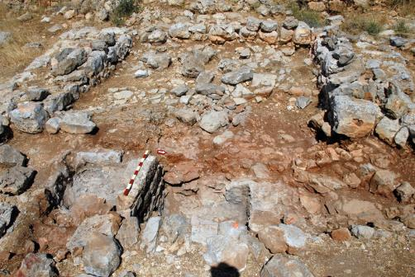
Law and Grace: Lesson 15 – WIPEOUT!
City Gate Structure – Khitbet El-Maqatir (Ai?)
‘In 1996 the west chamber of the gate of the fortress of Joshua’s time [KHITBET EL-MAQATIR (Ai?)] was excavated. Much evidence for fire in the form of burned stones and calcined bedrock was found. In 2009, the gate passageway was excavated to bedrock. The bedrock throughout the passageway is fractured and disintegrated, and the clay and bedrock are red in color. All of this appears to be the result of an intense fire most likely from the burning of Ai recorded in Joshua 8:28.’

Slide 33
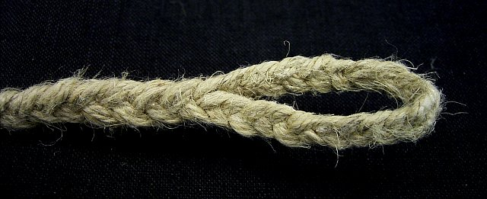
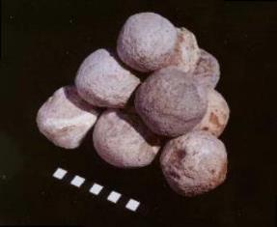
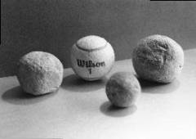
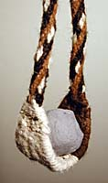
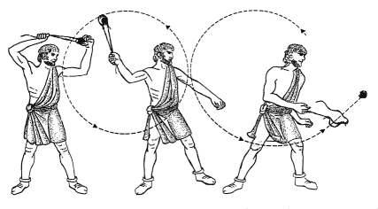
Law and Grace: Lesson 15 – WIPEOUT!
Artifacts found at Khitbet El-Maqatir (Ai?)
Sling
Stones

Slide 34
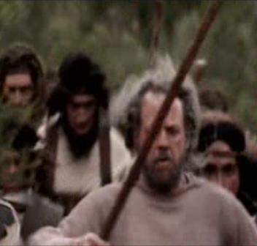
On to Ai Joshua 8
Law and Grace: Lesson 15 – WIPEOUT!
This 2nd time Joshua set up the Israelites to make it appear to the men of Ai that this time would be just like the last rout.
Some of the men of Israel drew the men of Ai out of the city.

Slide 35
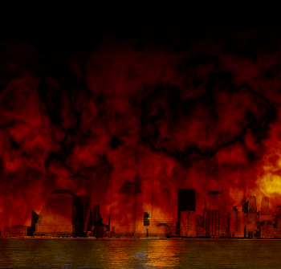
On to Ai Joshua 8
Law and Grace: Lesson 15 – WIPEOUT!
At that, the other soldiers of Israel rushed the city and took it, burning the city.
After defeating Ai, Joshua read the Law of Moses to all of the people of Israel.

Slide 36
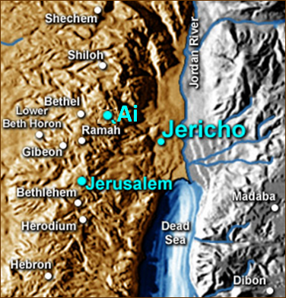
After defeating Ai Joshua 9-24
Law and Grace: Lesson 15 – WIPEOUT!
Joshua led multiple campaigns farther into the land of Canaan.
One campaign led the Israelites to the south, and driving off the Canaanites from the land.

Slide 37
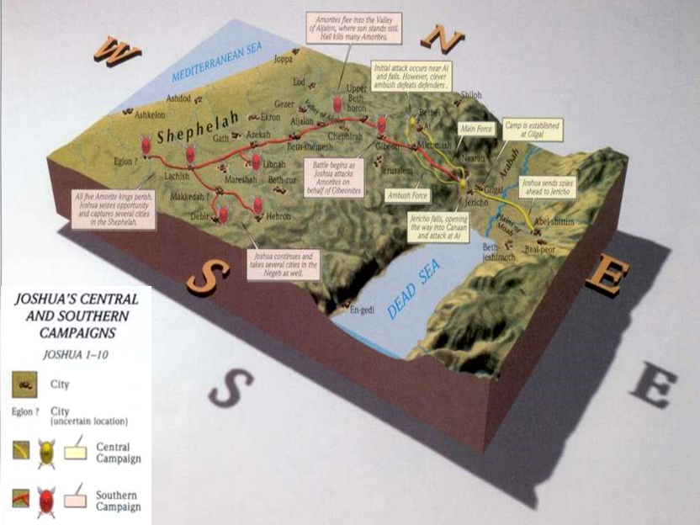
Law and Grace: Lesson 15 – WIPEOUT!

Slide 38
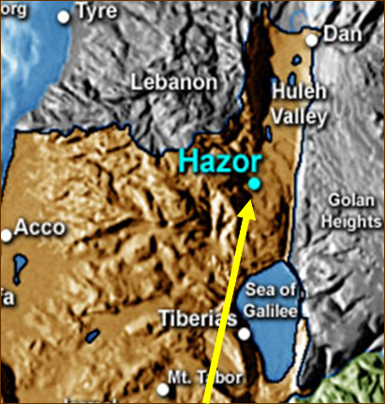
After defeating Ai Joshua 9-24
Law and Grace: Lesson 15 – WIPEOUT!
Another campaign went to the north, also driving off the Canaanites.
After Ai, only the city of Hazor was burned – most of the cities, orchards, and crops remained.

Slide 39
Law and Grace: Lesson 15 – WIPEOUT!

Slide 40
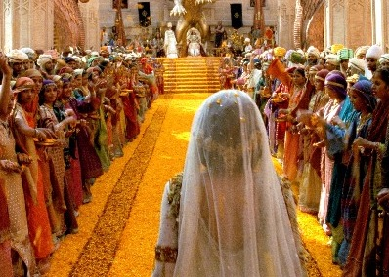
But the Israelites did not conquer all of the land Joshua 24
Law and Grace: Lesson 15 – WIPEOUT!
They failed to conquer all the land because they refused to follow the principle of law that God had given them regarding the inhabitants of the land and their abominable practices. This disobedience set the Israelites up for centuries of painful consequences.

Slide 41
Deuteronomy 25:17–19
¹⁷ “Remember what Amalek did to you along the way when you came out from Egypt, ¹⁸ how he met you along the way and attacked among you all the stragglers at your rear when you were faint and weary; and he did not fear God. ¹⁹ “Therefore it shall come about when the Lord your God has given you rest from all your surrounding enemies, in the land which the Lord your God gives you as an inheritance to possess, you shall blot out the memory of Amalek from under heaven; you must not forget.

Slide 42
1 Samuel 15:1–3
¹ Then Samuel said to Saul, “The Lord sent me to anoint you as king over His people, over Israel; now therefore, listen to the words of the Lord. ² “Thus says the Lord of hosts, ‘I will punish Amalek for what he did to Israel, how he set himself against him on the way while he was coming up from Egypt. ³ ‘Now go and strike Amalek and utterly destroy all that he has, and do not spare him; but put to death both man and woman, child and infant, ox and sheep, camel and donkey.’ ”

Slide 43
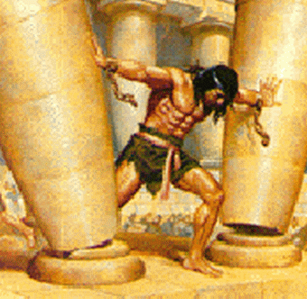
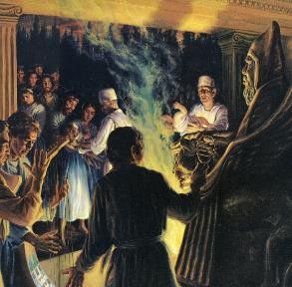
But the Israelites did not conquer all of the land Joshua 24
Law and Grace: Lesson 15 – WIPEOUT!
The Book of Judges in fact, is all about the ‘judges’ who God raised up to save the Israelites from the people groups who should have previously been driven off or killed.
Israel’s kings fought them, and the pagan morals, rituals and idol ‘deities’ polluted the Israelites.

Slide 44
Law and Grace: Lesson 15 – WIPEOUT!
Was God’s Command merely Genocide? Joshua

Slide 45
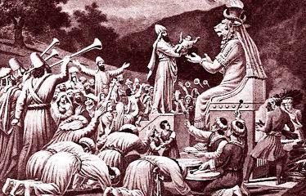
Numbers 33:51-52
⁵¹ “Speak to the sons of Israel and say to them, ‘When you cross over the Jordan into the land of Canaan, ⁵² then you shall drive out all the inhabitants of the land from before you, and destroy all their figured stones, and destroy all their molten images and demolish all their high places;

Slide 46
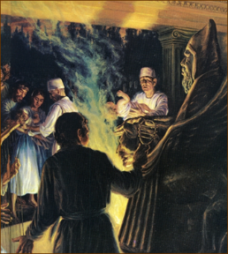
We ought to consider…
Law and Grace: Lesson 15 – WIPEOUT!
The Canaanites were spiritually and morally corrupt in the extreme.
These kinds of spiritually corrupt practices are targeted in the rest of Numbers 33:52.

Slide 47
Numbers 33:51-52
⁵¹ “Speak to the sons of Israel and say to them, ‘When you cross over the Jordan into the land of Canaan, ⁵² then you shall drive out all the inhabitants of the land from before you, and destroy all their figured stones, and destroy all their molten images and demolish all their high places;

Slide 48
Deuteronomy 12:29–31
²⁹ “When the Lord your God cuts off before you the nations which you are going in to dispossess, and you dispossess them and dwell in their land, ³⁰ beware that you are not ensnared to follow them, after they are destroyed before you, and that you do not inquire after their gods, saying, ‘How do these nations serve their gods, that I also may do likewise?’ ³¹ “You shall not behave thus toward the Lord your God, for every abominable act which the Lord hates they have done for their gods; for they even burn their sons and daughters in the fire to their gods.

Slide 49
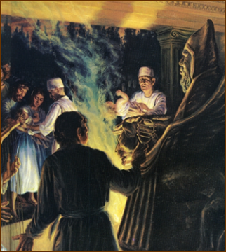
Law and Grace: Lesson 15 – WIPEOUT!
Canaanite "religious" rituals
Joshua
Child sacrifice – some of it in fire…infants would be sacrificed to the pagan god Molech – burned alive.
Incest
Bestiality (very common)
Homosexuality
Male and female cultic prostitution

Slide 50
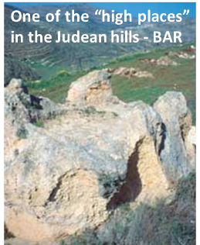
Law and Grace: Lesson 15 – WIPEOUT!
The Canaanites
Joshua
A large portion of the Mosaic Law forbids all of the many socially and morally destructive practices that were ingrained in the Canaanite culture (e.g., Deu. 9:5–6; 18:12; 23:17)

Slide 51
Deuteronomy 9:5–6
⁵ “It is not for your righteousness or for the uprightness of your heart that you are going to possess their land, but it is because of the wickedness of these nations that the Lord your God is driving them out before you, in order to confirm the oath which the Lord swore to your fathers, to Abraham, Isaac and Jacob. ⁶ “Know, then, it is not because of your righteousness that the Lord your God is giving you this good land to possess, for you are a stubborn people.

Slide 52
Deuteronomy 18:9–12
⁹ “When you enter the land which the Lord your God gives you, you shall not learn to imitate the detestable things of those nations. ¹⁰ “There shall not be found among you anyone who makes his son or his daughter pass through the fire, one who uses divination, one who practices witchcraft, or one who interprets omens, or a sorcerer, ¹¹ or one who casts a spell, or a medium, or a spiritist, or one who calls up the dead. ¹² “For whoever does these things is detestable to the Lord; and because of these detestable things the Lord your God will drive them out before you.

Slide 53
Deuteronomy 23:17–18
¹⁷ “None of the daughters of Israel shall be a cult prostitute, nor shall any of the sons of Israel be a cult prostitute. ¹⁸ “You shall not bring the hire of a harlot or the wages of a dog into the house of the Lord your God for any votive offering, for both of these are an abomination to the Lord your God.

Slide 54
Law and Grace: Lesson 15 – WIPEOUT!
The Canaanites
Joshua
The historical books of the Old Testament record the assaults against and seductions of Canaanite religion, to the extent that the Israelites had failed to drive out all of the Canaanites (Gideon-Judges 6:25-32; Solomon-1 Kings 3:2).

Slide 55
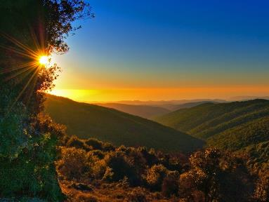
Joshua 24:31
³¹ Israel served the Lord all the days of Joshua and all the days of the elders who survived Joshua, and had known all the deeds of the Lord which He had done for Israel.

Slide 56
1 Kings 11:1–7
¹ Now King Solomon loved many foreign women along with the daughter of Pharaoh: Moabite, Ammonite, Edomite, Sidonian, and Hittite women, ² from the nations concerning which the Lord had said …, “You shall not associate with them, nor shall they associate with you, for they will surely turn your heart away after their gods.”…³ …and his wives turned his heart away. ⁴ …his wives turned his heart away after other gods;…⁵ For Solomon went after Ashtoreth …and after Milcom the detestable idol of the Ammonites….⁷ Solomon built a high place for Chemosh the detestable idol of Moab, …and for Molech the detestable idol of the sons of Ammon.

Slide 57
Session 15 Outline
Review
Purpose, Aim, and Objective
Session 14
Wipeout! (Joshua 24)
General Information
Comments and Commentary
Concluding Observations

Slide 58
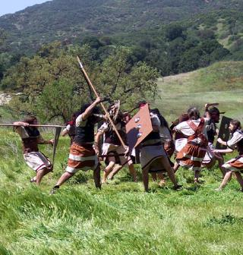
Law and Grace: Lesson 15 – WIPEOUT!
Grace holds forth several contrasts
We who are in the Body of Christ are not called to live under the Law of Moses, nor to take a land by killing some and driving out the other inhabitants.

Slide 59
Law and Grace: Lesson 15 – WIPEOUT!
Grace holds forth several contrasts
Grace
Life
Forgiveness Love
Blessing
The death Christ died for us was not a result of invading armies but rather from Him voluntarily taking our sins upon Himself.
Grace gives us the motive, means and the opportunity to offer life instead of death, forgiveness instead of penalty, and unconditional love and blessing.

Slide 60
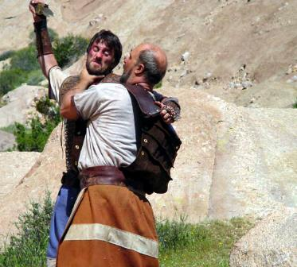
Law and Grace: Lesson 15 – WIPEOUT!
This is a life and death issue!
And instead of someone else dying because they deserve it, so that we can have the land...

Slide 61
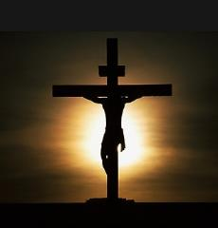
Law and Grace: Lesson 15 – WIPEOUT!
This is a life and death issue!
Christ, who didn’t deserve it, died for us, so that we can have a home with Him that displaces nobody on earth.
The source of our life here on earth was begun by our having been identified with Christ’s death on earth, so that we are blessed in the heavenlies, there with Him.

Slide 62
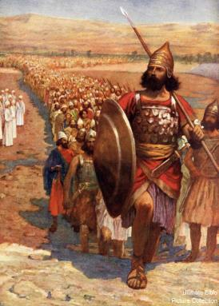
Law and Grace: Lesson 15 – WIPEOUT!
Don’t just do something – stand there!
The principle of law that applied to the people of Israel required them to aggressively do many things in order to take and capture the land of Canaan.

Slide 63
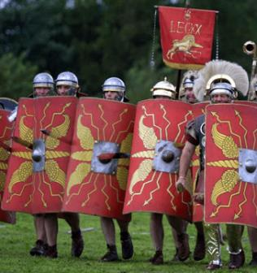
Law and Grace: Lesson 15 – WIPEOUT!
Don’t just do something – stand there!
But for us in the body of Christ, the ‘right thing to do’ is to take our stand in all of the spiritual accomplishments of Christ, our primary armor being who we are in Jesus Christ.

Slide 64
Ephesians 6:11, 13-14
¹¹ Put on the full armor of God, so that you will be able to stand firm against the schemes of the devil. ¹² For our struggle is not against flesh and blood, but against the rulers, against the powers, against the world forces of this darkness, against the spiritual forces of wickedness in the heavenly places. ¹³ Therefore, take up the full armor of God, so that you will be able to resist in the evil day, and having done everything, to stand firm. ¹⁴ Stand firm therefore, having girded your loins with truth, and having put on the breastplate of righteousness,

Slide 65
Law and Grace: An Overview Jim McGowan, Th.D. Sugar Land Bible Church 11-11-2018
…but grace and truth were realized through Jesus Christ - John 1:17
For the Law was given through Moses…
Special thanks to Dr. Vern Peterman for access to his insights and resources.

