Slide 1
The book of Jude
Lessons in Present Day Apostasy
Part 2

Slide 3
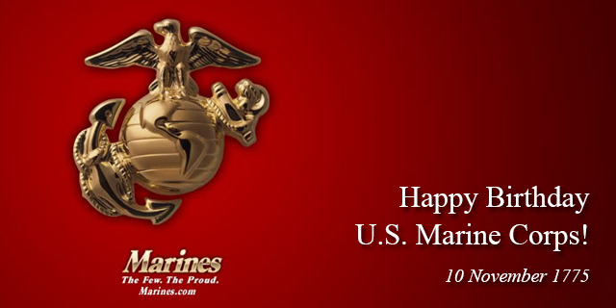

Slide 4
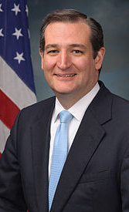
Congratulations!

Slide 5
The Book of Jude
Who wrote the book? Jude, brother of James, half –brother of Jesus Christ.
Who was the book written to? Believers, Jews scattered in Asia Minor
When was the book written? Between 68-80 AD
Where was the book written from? Possibly in the Land of Canaan
What’s the Genre of the book? Epistolary
What’s the purpose of the book? To exhort believers to earnestly contend for the faith in the face of apostasy.
What’s in the book? A present threat of and defense against false teachers.
Is there an application? 1) grow spiritually (v.20); 2) be assured of your salvation (v.21; 24-25); and 3) also to help those who doubt (v.23-24).

Slide 6
Jude 8-9
8 Yet in the same way these men, also by dreaming, defile the flesh, and reject authority, and revile angelic majesties.
9 But Michael the archangel, when he disputed with the devil and argued about the body of Moses, did not dare pronounce against him a railing judgment, but said, “The Lord rebuke you!”

Slide 7
Jude 8-9
8 Yet in the same way these men, also by dreaming, defile the flesh, and reject authority, and revile angelic majesties.
9 But Michael the archangel, when he disputed with the devil and argued about the body of Moses, did not dare pronounce against him a railing judgment, but said, “The Lord rebuke you!”

Slide 8
…Revile angelic majesties
Reference | Jewish Belief
Jub. 1:27-29; Josephus Ant.; Acts 7:38, 53; Heb 2:2 | Law of Moses mediated by angels
Herm. Sim. 8:3:3 | Angels watched over the Law’s observance
Jude 6 | Angels guardian of the created order
1 Cor 11:10?? | Angels guardian over the Christian assembly??
Bauckham, Richard, J. World Biblical Commentary: Jude, 2 Peter. Vol. 50. 61 vols. Waco, Texas: Word Books, Publisher, 1983, 58-59.

Slide 10
Jude 8-9
8 Yet in the same way these men, also by dreaming, defile the flesh, and reject authority, and revile angelic majesties.
9 But Michael the archangel, when he disputed with the devil and argued about the body of Moses, did not dare pronounce against him a railing judgment, but said, “The Lord rebuke you!”

Slide 11
Jude 9-10
9 But Michael the archangel, when he disputed with the devil and argued about the body of Moses, did not dare pronounce against him a railing judgment, but said, “The Lord rebuke you!”
10 But these men revile the things which they do not understand; and the things which they know by instinct, alike unreasoning animals, by these things they are destroyed.

Slide 12
"The ideas of binding, rebuking, performing exorcisms, or taking dominion over Satan and demonic strongholds are offensive ideas. When believers go on the offensive against Satan, they are stepping out of their legitimate bounds by becoming involved in situations that the Lord has never intended for them. This offensive type of response was described by Peter as characteristic of false teachers (2 Peter 2:10–11). Often, this response opens the door to demonic oppression in the believer’s life” (2000, 154).

Slide 13
2 Cor 12:7-10
7 Because of the surpassing greatness of the revelations, for this reason, to keep me from exalting myself, there was given me a thorn in the flesh, a messenger of Satan to torment me—to keep me from exalting myself!
8 Concerning this I implored the Lord three times that it might leave me.
9 And He has said to me, “My grace is sufficient for you, for power is perfected in weakness.” Most gladly, therefore, I will rather boast about my weaknesses, so that the power of Christ may dwell in me.
10 Therefore I am well content with weaknesses, with insults, with distresses, with persecutions, with difficulties, for Christ’s sake; for when I am weak, then I am strong.

Slide 14
Acts 19:11-16
11 God was performing extraordinary miracles by the hands of Paul, 12 so that handkerchiefs or aprons were even carried from his body to the sick, and the diseases left them and the evil spirits went out. 13 But also some of the Jewish exorcists who went from place to place, attempted to name over those who had the evil spirits the name of the Lord Jesus, saying, “I adjure you to by Jesus whom Paul preaches.” 14 Seven sons of one Sceva, a Jewish chief priest, were doing this. 15 And the evil spirit answered and said to them, “I recognize Jesus, and I know about Paul, but who are you?” 16 And the man, in whom was the evil spirit, leaped on them and subdued all of them and overpowered them, so that they fled out of that house naked and wounded.

Slide 15
Acts 19:17
This became known to all, both Jews and Greeks, who lived in Ephesus; and fear fell upon them all and the name of the Lord Jesus was being magnified.

Slide 16
1 Cor 4:6
“Now these things, brethren, I have figuratively applied to myself and Apollos for your sakes, so that in us you may learn not to exceed what is written, so that no one of you will become arrogant in behalf of one against the other.

Slide 17
James 4:7
Submit therefore to God. Resist the devil and he will flee from you.

Slide 18
Eph 6:10-11
10 Finally, be strong in the Lord and in the strength of His might.
11 Put on the full armor of God, so that you will be able to stand firm against the schemes of the devil.

Slide 19
1 Peter 5:8-9
“Be of sober spirit, be on the alert. Your adversary, the devil, prowls around like a roaring lion, seeking someone to devour. But resist him, firm in your faith, knowing that the same experiences of suffering are being accomplished by your brethren who are in the world.”

Slide 20
Romans 7:18-19
For I know that nothing good dwells in me, that is, in my flesh; for the willing is present in me, but the doing of the good is not. For the good that I want, I do not do, but I practice the very evil that I do not want.

Slide 21
1 Peter 1:2-10
Now for this very reason also, applying all diligence, in your faith supply moral excellence, and in your moral excellence, knowledge, 6 and in your knowledge, self-control, and in your self-control, perseverance, and in your perseverance, godliness, 7 and in your godliness, brotherly kindness, and in your brotherly kindness, love.

Slide 22
1 Peter 1:2-10
8 For if these qualities are yours and are increasing, they render you neither useless nor unfruitful in the true knowledge of our Lord Jesus Christ. 9 For he who lacks these qualities is blind or short-sighted, having forgotten his purification from his former sins. 10 Therefore, brethren, be all the more diligent to make certain about His calling and choosing you; for as long as you practice these things, you will never stumble…”

Slide 23
Jude 9-10
9 But Michael the archangel, when he disputed with the devil and argued about the body of Moses, did not dare pronounce against him a railing judgment, but said, “The Lord rebuke you!”
10 But these men revile the things which they do not understand; and the things which they know by instinct, alike unreasoning animals, by these things they are destroyed.

