Slide 1
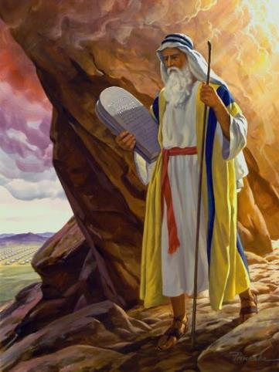
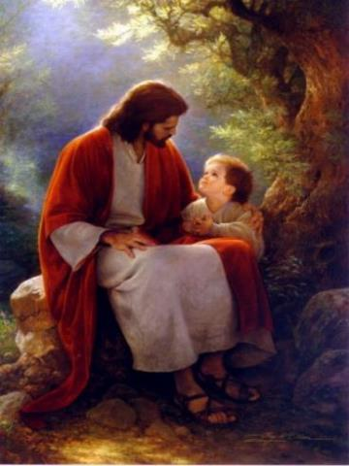
Law & Grace: An Overview Jim McGowan, Th.D. Sugar Land Bible Church 10-28-2018
…but grace & truth were realized through Jesus Christ - John 1:17
For the Law was given through Moses…
Special thanks to Dr. Vern Peterman for access to his insights and resources.

Slide 2
Session 13 Outline
Review
Purpose, Aim, and Objective
Session 12
The Big ‘IF’ (Deuteronomy 28)
General Information
Comments & Commentary
Concluding Observations

Slide 3
Session 13 Outline
Review
Purpose, Aim, and Objective
Session 12
The Big ‘IF’ (Deuteronomy 28)
General Information
Comments & Commentary
Concluding Observations

Slide 4
OUR PURPOSE, AIM AND OBJECTIVE
Law & Grace
…is to Compare and Contrast Law and Grace so as to properly understand these two important themes and how they are related to the life of the New Testament Believer.

Slide 5
C. I. SCOFIELD, D. D.
The Grace of God, The Fundamentals Vol. 3, Chapter VII, p. 98
We have, most of us, been reared and now live under the influence of Galatianism. Protestant theology, alas, is for the most part, thoroughly Galatianized, in that neither law nor grace are given their distinct and separated places, as in the counsels of God, but are mingled together in one incoherent system.
The law is no longer, as in the Divine intent, a ministration of death (2 Cor. 3:7), of cursing (Gal. 3:10), of conviction (Rom. 3:19), because we are taught that we must try to keep it, and that by Divine help we may.
Nor, on the other hand, does grace bring us blessed deliverance from the dominion of sin, for we are kept under the law as a rule of life despite the plain declaration, “Sin shall not have dominion over you: for ye are not under the law, but under grace” (Rom. 6:14). (emphasis mine)

Slide 6
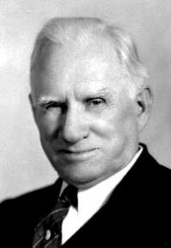
William R. Newell
Romans Verse-by-Verse (p. 274).
Grand Rapids, MI: Christian Classics Ethereal Library.
It is because Reformed theology has kept us Gentiles under the Law,—if not as a means of righteousness, then as “a rule of life,” that all the trouble has arisen. The Law is no more a rule of life than it is a means of righteousness. Walking in the Spirit has now taken the place of walking by ordinances. God has another principle under which He has put his saints: “Ye are not under law, but, under grace!” (italics mine)

Slide 7
Session 13 Outline
Review
Purpose, Aim, and Objective
Session 12
The Big ‘IF’ (Deuteronomy 28)
General Information
Comments & Commentary
Concluding Observations

Slide 8
Key insights from The New Testament Galatians 5:2-4; James 2:14
Law & Grace: Session 12 Review
The New Testament not only supports what we have seen already in the Law of Moses, but it also provides astounding perspectives on the nature of the Law of Moses.

Slide 9
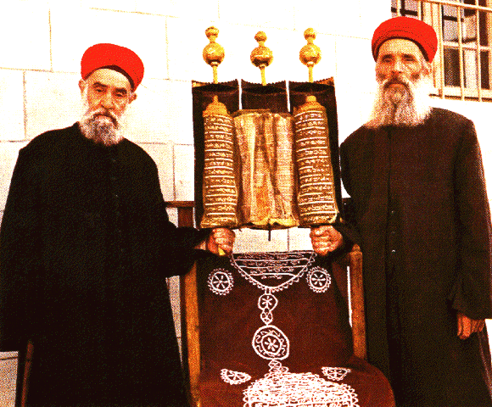
Key insights from The New Testament Galatians 5:2-4; James 2:14
Law & Grace: Session 12 Review
In addition to the direct and repeated exhortation of the Old Testament to follow all the laws, the New Testament makes the Law of Moses a completely inseparable, indivisible, whole.

Slide 10
Galatians 5:2-4 is not a ‘loss of salvation’ passage
Law & Grace: Session 12 Review
Galatians 5:2-4 only addresses the daily condition of one who is already saved.
Paul calls his readers, “brethren” nine times in the letter to the Galatians, both before and after this passage.
See Gal. 1:11; 2:4; 3:15; 4:12, 28, 31; 5:11, 13; 6:1, 18
You’ve fallen!
Let’s get you back into grace!

Slide 11
Law & Grace: Session 12 Review
The Law of Moses offers no ‘partial credit’
Galatians 5:2-4; James 2:14
The apostle Paul makes it clear for us that a person cannot sign up to follow just one of or some select part of the Law of Moses. If we choose any part to follow, we are obligated to all.
This is principle #1

Slide 12
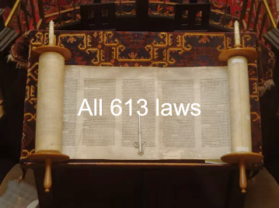
Law & Grace: Session 12 Review
All perfection all the time
James 2:10-11
James spells out principle # 2 in verse 10 - that those who wish to follow the Law of Moses must follow every single part of it - perfectly.
The Law of Moses requires absolute perfection on every point of the Law all the time to the end of one’s time.

Slide 13
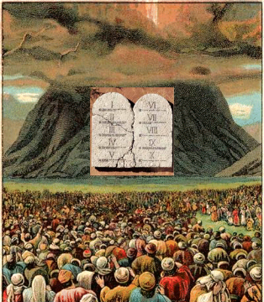
The Law doesn’t have a problem – we do!
Law & Grace: Session 12 Review
The Law of Moses, which is good and righteous and holy, requires total compliance…but mankind is not up to the task of living it out.
Trying to live out the Law of Moses is a commitment to guaranteed failure.

Slide 14
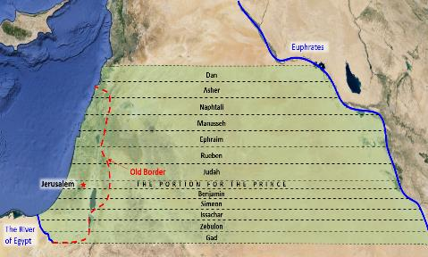
Law & Grace: Session 12 Review
The law written on their hearts!
Jeremiah 31:33–34
God has solved the question of man’s inability to live out the good, and righteous, and holy law, by addressing it uniquely with reference to national Israel during the millennium, by enabling and empowering national Israel to know and live out Kingdom law.

Slide 15
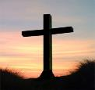
Law & Grace: Session 12 Review
But for us in the body of Christ…
God has solved the question of man’s inability to live out the good, and righteous, and holy law, by addressing it uniquely with reference to the Church.
Christ’s sacrifice of Himself on the Cross satisfied all the divine requirements of the Law of Moses and Christ’s imputed righteousness fulfilled all the divine requirements of the Law of Moses, and it did so without placing us under the Law of Moses!
We also died to the law through our identification with Christ in His death!

Slide 16
Law & Grace: Session 12 Review
But for us in the body of Christ…
It is by Christ’s life and His righteousness that we are to live out the life that God desires…not by seeking in our own sufficiency, to live out any part of the Law of Moses. It’s all by grace.

Slide 17
Law & Grace: Session 12 Review

Slide 18
Session 13 Outline
Review
Purpose, Aim, and Objective
Session 12
The Big ‘IF’ (Deuteronomy 28)
General Information
Comments & Commentary
Concluding Observations

Slide 19
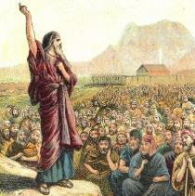
Deuteronomy 11:26-28
²⁶ “See, I am setting before you today a blessing and a curse: ²⁷ the blessing, if you listen to the commandments of the Lord your God, which I am commanding you today; ²⁸ and the curse, if you do not listen to the commandments of the Lord your God, but turn aside from the way which I am commanding you today, by following other gods which you have not known.

Slide 20
Deuteronomy 28:1-6
¹ "Now it shall be, if you diligently obey the Lord your God, being careful to do all His commandments which I command you today, the Lord your God will set you high above all the nations of the earth. ² All these blessings will come upon you and overtake you if you obey the Lord your God: ³ Blessed shall you be in the city, and blessed shall you be in the country. ⁴ Blessed shall be the offspring of your body and the produce of your ground and the offspring of your beasts, the increase of your herd and the young of your flock. ⁵ Blessed shall be your basket and your kneading bowl. ⁶ Blessed shall you be when you come in, and blessed shall you be when you go out. - Blessings through verse 14

Slide 21
Deuteronomy 28:15-19
¹⁵ "But it shall come about, if you do not obey the Lord your God, to observe to do all His commandments and His statutes with which I charge you today, that all these curses will come upon you and overtake you: ¹⁶ Cursed shall you be in the city, and cursed shall you be in the country. ¹⁷ Cursed shall be your basket and your kneading bowl. ¹⁸ Cursed shall be the offspring of your body and the produce of your ground, the increase of your herd and the young of your flock. ¹⁹ Cursed shall you be when you come in, and cursed shall you be when you go out…" - Curses through verse 68

Slide 22
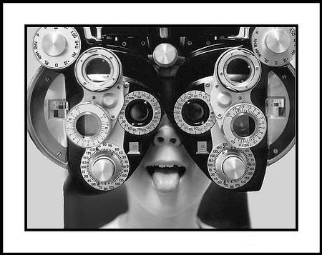
Law & Grace: Session 13: The Law and Laws – The Big IF
The Law of Moses: Which is Better?

Slide 23
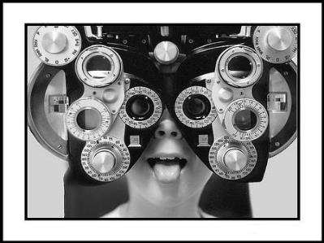
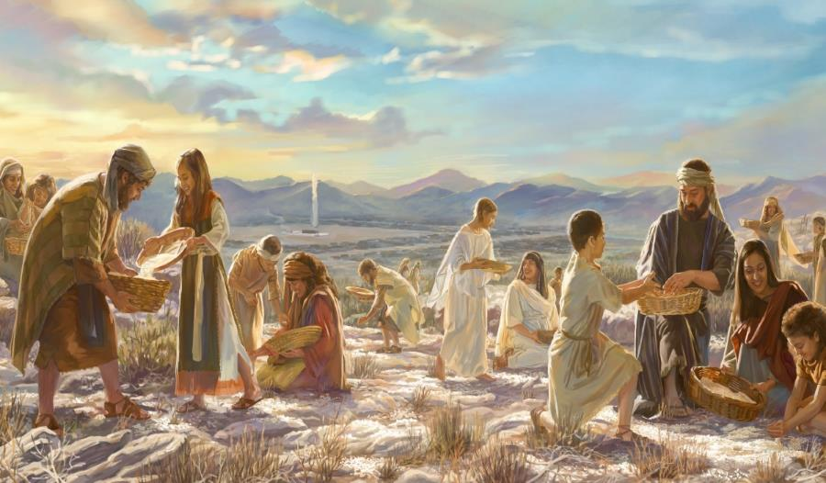
Law & Grace: Session 13: The Law and Laws – The Big IF
The Law of Moses: Blessing?

Slide 24
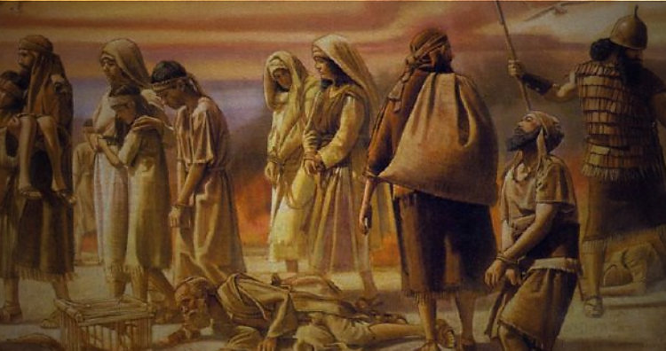
Law & Grace: Session 13: The Law and Laws – The Big IF
The Law of Moses: Cursing?

Slide 25
The Law of Moses: Blessing & Cursing Deuteronomy 28
Law & Grace: Session 13 The Law and Laws – The Big IF
The Law of Moses was about staying alive and doing well if you obeyed it all or dying if you broke some of the laws, and punishment for breaking others.

Slide 26
The Law of Moses: Blessing & Cursing Deuteronomy 28
Law & Grace: Session 13 The Law and Laws – The Big IF
The Law provided the rules of survival.

Slide 27
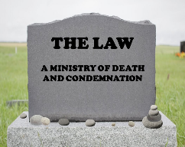
2 Corinthians 3:7-9
⁷ But if the ministry of death, in letters engraved on stones, came with glory, so that the sons of Israel could not look intently at the face of Moses because of the glory of his face, fading as it was, ⁸ how will the ministry of the Spirit fail to be even more with glory? ⁹ For if the ministry of condemnation has glory, much more does the ministry of righteousness abound in glory.

Slide 28
Law & Grace: Session 13 The Law and Laws – The Big IF
Law & Grace: Contrast and Comparison
Steward | MOSES | CHRIST
Governing Principle | Law | Grace
Who’s Works are you depending on? | Self | Christ
People Group | ISRAEL | CHURCH
Baptism | Into Moses | Into Christ
MINISTRY CHARACTERISTIC | DEATH / CONDEMNATION | SPIRIT / RIGHTEOUSNESS
Nature of Blessings | Conditional (If) / Earthly | Unconditional / Heavenly
Earthly Difficulties | Curses for disobedience | Growth or discipline

Slide 29
The Law of Moses: Blessing & Cursing Deuteronomy 28
Law & Grace: Session 13 The Law and Laws – The Big IF
The Law of Moses was all about blessing for obedience and cursing for disobedience, but it is an impossible standard.

Slide 30
The Law of Moses: Blessing & Cursing Deuteronomy 28
Law & Grace: Session 13 The Law and Laws – The Big IF
Deuteronomy 28 does not mention the name of Israel even once, but immediately after:

Slide 31
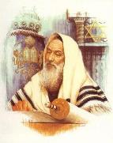
The Law of Moses: Blessing & Cursing Deuteronomy 28
Law & Grace: Session 13 The Law and Laws – The Big IF
In Hebrew (Jewish) Bibles this verse is the last verse in chapter 28.

Slide 32
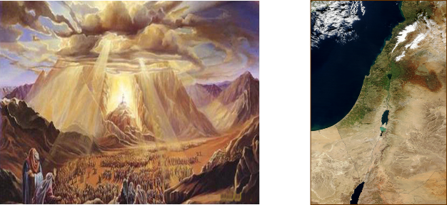
Deuteronomy 29:1 (HB 28:69)
These are the words of the covenant which the Lord commanded Moses to make with the sons of Israel in the land of Moab, besides the covenant which He had made with them at Horeb.

Slide 33
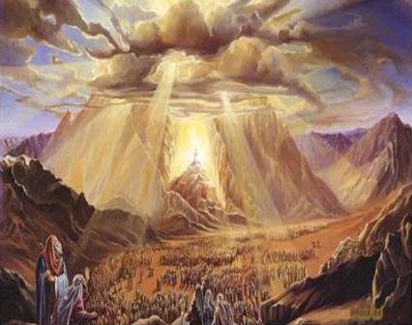
The Law of Moses: Blessing & Cursing Deuteronomy 28
Law & Grace: Session 13 The Law and Laws – The Big IF
The 1st covenant ‘at Horeb’ (Deu. 5:2) was the Law covenant and the foundation for the entire Law of Moses starting in Exo. 20:1 and ending in Deu. 28:68 (v.69 Heb).

Slide 34
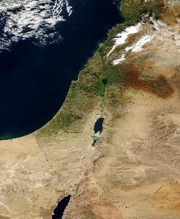
The Law of Moses: Blessing & Cursing Deuteronomy 28
Law & Grace: Session 13 The Law and Laws – The Big IF
The 2nd covenant ‘in Moab’, introduced here as they are about to enter the land, establishes the Law as the one basis for the blessing and cursing of the Children of Israel in the land of Israel. These are the rules for how to continue to live in, and enjoy, the land!

Slide 35
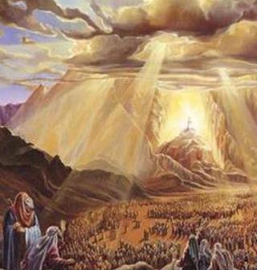
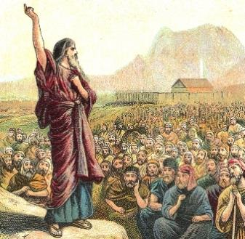
Law & Grace: Session 13 The Law and Laws – The Big IF
Covenant at Horeb, Covenant at Moab
Deuteronomy 28
Both the Law covenant and the provision for the enjoyment of the land aspects of the Abrahamic covenant enumerated here, were conditional and solely with Israel!
1

Slide 36
Law & Grace: Session 13 The Law and Laws – The Big IF

Slide 37
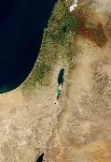
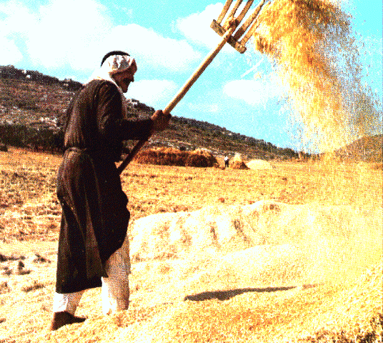
Deuteronomy 28:8-11
⁸ “The Lord will command the blessing upon you in your barns and in all that you put your hand to, and He will bless you in the land which the Lord your God gives you… ¹¹ “The Lord will make you abound in prosperity, in the offspring of your body and in the offspring of your beast and in the produce of your ground, in the land which the Lord swore to your fathers to give you.

Slide 38
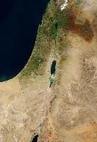
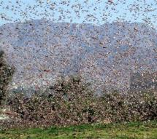
Deuteronomy 28:21, 63
²¹ “The Lord will make the pestilence cling to you until He has consumed you from the land where you are entering to possess it…⁶³ “It shall come about that as the LORD delighted over you to prosper you, and multiply you, so the LORD will delight over you to make you perish and destroy you; and you will be torn from the land where you are entering to possess it.

Slide 39
Law & Grace: Session 13 The Law and Laws – The Big IF
Chapter 28 isn’t the only place
There are other passages that give blessings and curses:
blessings… Deuteronomy 7:12-16; 14:28-15:6, 18; 16:15; 23:19-20; 24:19; 26:15, et al, are all.
curses… Deuteronomy 29:21 (there are more)

Slide 40
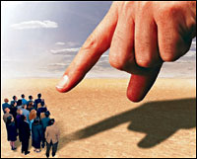
Deuteronomy 29:21
“Then the Lord will single him out for adversity from all the tribes of Israel, according to all the curses of the covenant which are written in this book of the law.

Slide 41
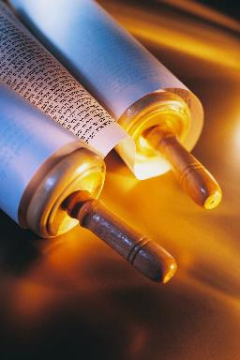
Law & Grace: Session 13 The Law and Laws – The Big IF
Where are the blessings and curses? Deuteronomy 28
The entire Law of Moses and this specific chapter say that the blessings and curses are “in the land” or are “from the land”.

Slide 42
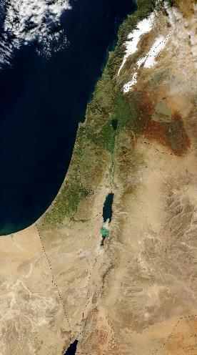
Law & Grace: Session 13 The Law and Laws – The Big IF
Where are the blessings & curses? Deuteronomy 28
In other words, the people of Israel are told that, depending on what they do, they will have earthly blessings, or curses.
The Law of Moses is spiritual since it is from God and based on His holiness, but the blessings and curses are earthly.

Slide 43
Session 13 Outline
Review
Purpose, Aim, and Objective
Session 12
The Big ‘IF’ (Deuteronomy 28)
General Information
Comments & Commentary
Concluding Observations

Slide 44
Law & Grace: Session 13 The Law and Laws – The Big IF
The Big ‘IF’
Deuteronomy 28
IF

Slide 45
Law & Grace: Session 13 The Law and Laws – The Big IF
The Big ‘IF’
Deuteronomy 28
The rather small word ‘if’ occurs 5 times in the ‘blessings verses’ of Deuteronomy 28.
Deuteronomy 28:1
"Now it shall be, if you diligently obey the Lord your God, being careful to do all His commandments which I command you today…

Slide 46
Law & Grace: Session 13 The Law and Laws – The Big IF
The Big ‘IF’
Deuteronomy 28
That small word ‘if’ also occurs 2 times in the ‘curses verses’ of Deuteronomy 28.
Deuteronomy 28:15
"But it shall come about, if you do not obey the Lord your God, to observe to do all His commandments and His statutes with which I charge you today, that all these curses will come upon you…

Slide 47
Law & Grace: Session 13 The Law and Laws – The Big IF
The Big ‘IF’
Deuteronomy 28
So, the word ‘if’ becomes really big in determining the kind of outcome one will have on earth – even to the point of whether one will live or die!
IF

Slide 48
Did God expect that the Israelites would keep the Law of Moses?
Law & Grace: Session 13 The Law and Laws – The Big IF
Important Question

Slide 49
Deuteronomy 31:16-17b
¹⁶ The Lord said to Moses, “Behold, you are about to lie down with your fathers; and this people will arise and play the harlot with the strange gods of the land, into the midst of which they are going, and will forsake Me and break My covenant which I have made with them. ¹⁷ “Then My anger will be kindled against them in that day, and I will forsake them and hide My face from them, and they will be consumed, and many evils and troubles will come upon them…

Slide 50
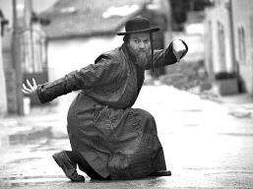
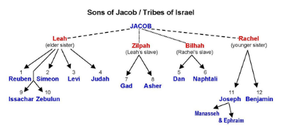
What if someone wants to be under the Law? Deuteronomy 28
Law & Grace: Session 13 The Law and Laws – The Big IF
You can tell the person that they have missed the ideal ‘window of opportunity’ to be under the Law by about 3400 years.
They might also be of the wrong family tree – one ought to be from one of the 12 tribes of Israel, which is hard to fix after the fact.

Slide 51
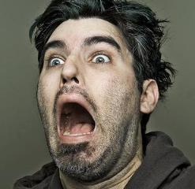
What if someone wants to be under the Law? Deuteronomy 28
Law & Grace: Session 13 The Law and Laws – The Big IF
Say that God won’t be happy with them for trying to live under the Law of Moses!
Then take them to Galatians 3:10-14

Slide 52
Galatians 3:10-14
¹⁰ For as many as are of the works of the Law are under a curse...¹¹ Now that no one is justified by the Law before God is evident…¹² However, the Law is not of faith…¹³ Christ redeemed us from the curse of the Law, having become a curse for us…
Why would Christ do that?

Slide 53
Galatians 3:10-14
¹⁴ in order that in Christ Jesus the blessing of Abraham might come to the Gentiles, so that we would receive the promise of the Spirit through faith.
That’s Why He did that!

Slide 54
Romans 7:4-6
⁴ Therefore, my brethren, you also were made to die to the Law through the body of Christ, so that you might be joined to another, to Him who was raised from the dead, in order that we might bear fruit for God. ⁵ For while we were in the flesh, the sinful passions, which were aroused by the Law, were at work in the members of our body to bear fruit for death. ⁶ But now we have been released from the Law, having died to that by which we were bound, so that we serve in newness of the Spirit and not in oldness of the letter.

Slide 55
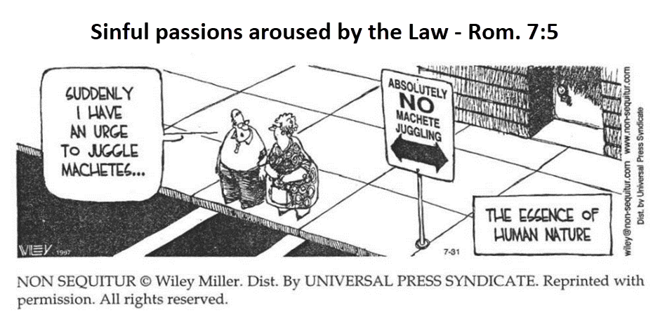
Law & Grace: Session 13 The Law and Laws – The Big IF
The Law makes the sin issue worse!

Slide 56
Romans 7:4-6
⁴ Therefore, my brethren, you also were made to die to the Law through the body of Christ, so that you might be joined to another, to Him who was raised from the dead, in order that we might bear fruit for God. ⁵ For while we were in the flesh, the sinful passions, which were aroused by the Law, were at work in the members of our body to bear fruit for death. ⁶ But now we have been released from the Law, having died to that by which we were bound, so that we serve in newness of the Spirit and not in oldness of the letter.

Slide 57
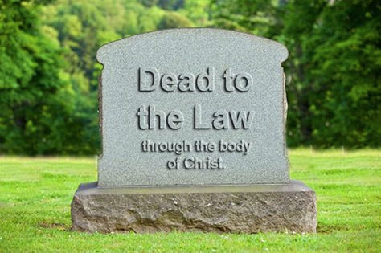
Galatians 2:19-20
¹⁹ “For through the Law I died to the Law, so that I might live to God. ²⁰ I have been crucified with Christ; and it is no longer I who live, but Christ lives in me; and the life which I now live in the flesh I live by faith in the Son of God, who loved me and gave Himself up for me.”

Slide 58
What if someone wants to be under the Law? Deuteronomy 28
Law & Grace: Session 13 The Law and Laws – The Big IF
There are those who will say that if we are not under Law, then we are lawless. But it was God’s intent that we die in relationship to the Law so that we might be alive to God. God intends for us to be alive to Him!

Slide 59
Ephesians 1:3
Blessed be the God and Father of our Lord Jesus Christ, who has blessed us with every spiritual blessing in the heavenly places in Christ…

Slide 60
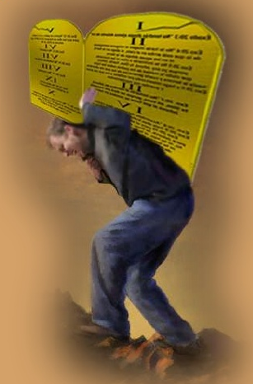
What if someone wants to be under the Law? Deuteronomy 28
Law & Grace: Session 13 The Law and Laws – The Big IF
For anyone who has been saved by grace through faith, to rely on all or any part of the Law of Moses for justification and/or blessing, is to be ignorant of, or to deny, the shared, personal, history that believer has in Christ!

Slide 61
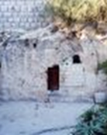
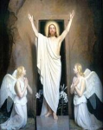
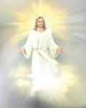
Law & Grace: Session 13 The Law and Laws – The Big IF
Our Shared, Personal, History in Jesus Christ
Died with Christ……………………………………………
Buried with Christ………………………………………..
Arose with Christ………………………………………….
Ascended with Christ……………………………………
Notes:
Our Personal History in the Last Adam (Jesus Christ)
In Christ Buried
In Christ Risen
Our New Position of Life
Our New Nature of Righteousness
In Christ Ascended & Seated
A New Walk of Fruitfulness

Slide 62
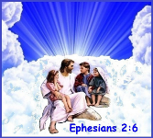
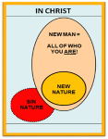
Law & Grace: Session 13 The Law and Laws – The Big IF
Our Shared, Personal, History in Jesus Christ
Seated with Christ………………………….………..
Positioned in Christ……………………………………
New Nature of Righteousness in Christ……
A New Walk of Fruitfulness in Christ………..
Notes:
Our Personal History in the Last Adam (Jesus Christ)
In Christ Buried
In Christ Risen
Our New Position of Life
Our New Nature of Righteousness
In Christ Ascended & Seated
A New Walk of Fruitfulness

Slide 63
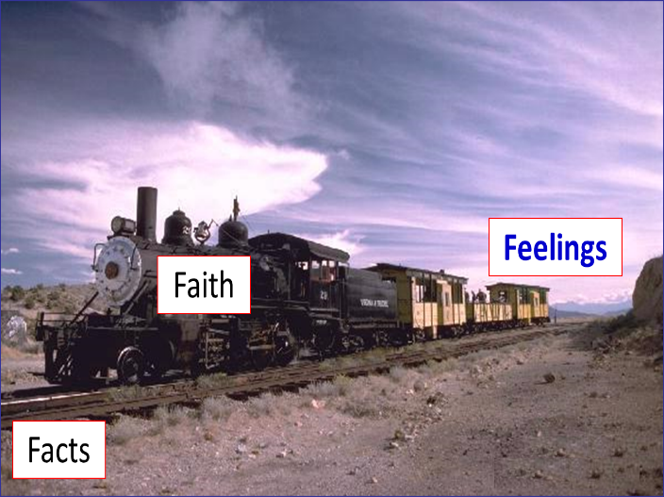
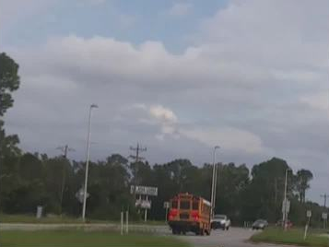
“Faith in the facts, is like the train on the tracks.”
Law & Grace: Session 13 The Law and Laws – The Big IF

Slide 64
Session 13 Outline
Review
Purpose, Aim, and Objective
Session 12
The Big ‘IF’ (Deuteronomy 28)
General Information
Comments & Commentary
Concluding Observations

Slide 65
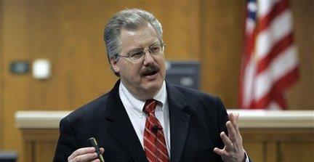
Law & Grace: Session 13 The Law and Laws – The Big IF
Motive, Means & Opportunity

Slide 66
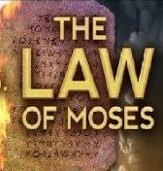
Law & Grace: Session 13 The Law and Laws – The Big IF
Motive, Means & Opportunity
PRINCIPLE | MOTIVE | MEANS | OPPORTUNITY
 | Blessings on this earth if you do it, but curses if not
 | Blessed in the heavenlies in Christ – now, permanently

Slide 67
Law & Grace: Session 13 The Law and Laws – The Big IF
Motive, Means & Opportunity
PRINCIPLE | MOTIVE | MEANS | OPPORTUNITY
 | Blessings on this earth if you do it, but curses if not | You do it, with no help from God – not of faith
 | Blessed in the heavenlies in Christ – now, permanently | Holy Spirit enabled empowered and energized

Slide 68
Law & Grace: Session 13 The Law and Laws – The Big IF
Motive, Means & Opportunity
PRINCIPLE | MOTIVE | MEANS | OPPORTUNITY
 | Blessings on this earth if you do it, but curses if not | You do it, with no help from God – not of faith | Stir up the sin nature as its instrument, curse and death
 | Blessed in the heavenlies in Christ – now, permanently | Holy Spirit enabled empowered and energized | To be God’s instrument, blessed, live by Christ’s life

Slide 69
Galatians 2:20
“I have been crucified with Christ; and it is no longer I who live, but Christ lives in me; and the life which I now live in the flesh I live by faith in the Son of God, who loved me and gave Himself up for me.

Slide 70
Law & Grace: Session 13 The Law and Laws – The Big IF
Which is Better?

Slide 71
Law & Grace: Session 13 The Law and Laws – The Big IF
The Law of Moses?

Slide 72
Law & Grace: Session 13 The Law and Laws – The Big IF
Grace of God?

Slide 73
Law & Grace: An Overview Jim McGowan, Th.D. Sugar Land Bible Church 10-28-2018
…but grace & truth were realized through Jesus Christ - John 1:17
For the Law was given through Moses…
Special thanks to Dr. Vern Peterman for access to his insights and resources.

