Slide 1


Slide 2

The Coming Kingdom
Chapter 17
Dr. Andy Woods
Senior Pastor – Sugar Land Bible Church
President – Chafer Theological Seminary

Slide 3

Kingdom Study Outline
What does the Bible Say About the Kingdom?
The Main Problem with Kingdom Now NT interpretations
Why do some believe that we are in the kingdom now?
Why does it matter?

Slide 4
Kingdom Study Outline
What does the Bible Say About the Kingdom?
The Main Problem with Kingdom Now NT interpretations
Why do some believe that we are in the kingdom now?
Why does it matter?

Slide 5
1. Kingdom Throughout the Bible
Eden Abrahamic Covenant Mosaic Covenant Divided Kingdom Times of the Gentiles | Old Testament Prophets Post exile Offer of the King / Kingdom Rejection of the Offer Interim Age

Slide 6
1. Kingdom Throughout the Bible
Kingdom Mysteries Church Israel’s Discipline & Restoration Re-offer of the King/Kingdom | Transfer of Kingdom Authority Kingdom Establishment Eternal State Testimony of Early Church History

Slide 7
Kingdom Study Outline
What does the Bible Say About the Kingdom?
The Main Problem with Kingdom Now NT interpretations
Why do some believe that we are in the kingdom now?
Why does it matter?

Slide 8

2. The Main Problem with Kingdom Now NT interpretations
The kingdom is always earthly (Gen. 15:18-21) over a repentant Israel (Ezek. 36‒37)
The kingdom will only manifest after a time of tribulation (Jer. 30:7; Dan. 9:24-27)

Slide 9

Kingdom Study Outline
What does the Bible Say About the Kingdom?
The Main Problem with Kingdom Now NT interpretations
Why do some believe that we are in the kingdom now?
Why does it matter?

Slide 10
Response to Kingdom Now Problem Passages
Passages from Christ’s ministry
Passages from Acts
Passages from Paul
Passages from the General letters
Passages from Revelation
Miscellaneous Arguments

Slide 11
Response to Kingdom Now Problem Passages
Passages from Christ’s ministry
Passages from Acts
Passages from Paul
Passages from the General letters
Passages from Revelation
Miscellaneous Arguments

Slide 12

1. Passages from Christ’s ministry
The kingdom is at hand (Matt. 3:2)
Theirs is the kingdom (Matt. 5:3, 10)
Thy kingdom come (Matt. 6:9-13)
Seek first the kingdom (Matt. 6:33)
The kingdom suffers violence (Matt. 11:12)
Satan falls like lightning (Luke 10:18)
The kingdom has come upon you (Matt. 12:28)

Slide 13
1. Passages from Christ’s ministry
The kingdom is in your midst (Luke 17:21)
Born again to enter the kingdom (John 3:3-5)
No death until kingdom comes (Matt. 16:28)
Kingdom given to another people (Matt. 21:43)
Kingdom is not of this world (John 18:36)
All authority given to me (Matt 28:18-20)

Slide 14
Response to Kingdom Now Problem Passages
Passages from Christ’s ministry
Passages from Acts
Passages from Paul
Passages from the General letters
Passages from Revelation
Miscellaneous Arguments

Slide 15

2. Is Jesus Now Reigning from David’s Throne?
(Acts 2)
David’s Throne is Earthly
A Davidic heavenly Throne changes its original meaning
No NT verse places Jesus currently of David’s Throne
The Davidic Throne comes into existence only after the Times of the Gentiles have run their course
A present Davidic Throne misunderstands the mystery nature of the Church
A present Davidic Throne misunderstands the parenthetical nature of the Church

Slide 16
2. Is Jesus Now Reigning from David’s Throne?
(Acts 2)
David’s Throne is Earthly
A Davidic heavenly Throne changes its original meaning
No NT verse places Jesus currently of David’s Throne
The Davidic Throne comes into existence only after the Times of the Gentiles have run their course
A present Davidic Throne misunderstands the mystery nature of the Church
A present Davidic Throne misunderstands the parenthetical nature of the Church

Slide 17


2 Samuel 3:10
“to transfer the kingdom from the house of Saul and to establish the throne of David over Israel and over Judah, from Dan even to Beersheba.”

Slide 18
1 Kings 2:11-12
“The days that David reigned over Israel were forty years: seven years he reigned in Hebron and thirty-three years he reigned in Jerusalem. And Solomon sat on the throne of David his father, and his kingdom was firmly established.”

Slide 19
Jeremiah 13:13
“then say to them, ‘Thus says the Lord, ‘Behold I am about to fill all the inhabitants of this land—the kings that sit for David on his throne, the priests, the prophets and all the inhabitants of Jerusalem—with drunkenness!’”

Slide 20

Jeremiah 22:2, 4
“and say, ‘Hear the word of the Lord, O king of Judah, who sits on David’s throne, you and your servants and your people who enter these gates…For if you men will indeed perform this thing, then kings will enter the gates of this house, sitting in David’s place on his throne, riding in chariots and on horses, even the king himself and his servants and his people.”

Slide 21
2 Samuel 7:12-16
“When your days are complete and you lie down with your fathers, I will raise up your descendant after you, who will come forth from you, and I will establish his kingdom. ¹³ He shall build a house for My name, and I will establish the throne of his kingdom forever. ¹⁴ I will be a father to him and he will be a son to Me; when he commits iniquity, I will correct him with the rod of men and the strokes of the sons of men, ¹⁵ but My lovingkindness shall not depart from him, as I took it away from Saul, whom I removed from before you. ¹⁶ Your house and your kingdom shall endure before Me forever; your throne shall be established forever.” ¹⁷ In accordance with all these words and all this vision, so Nathan spoke to David.”

Slide 22
2 Samuel 7:12-16
“When your days are complete and you lie down with your fathers, I will raise up your descendant after you, who will come forth from you, and I will establish his kingdom. ¹³ He shall build a house for My name, and I will establish the throne of his kingdom forever. ¹⁴ I will be a father to him and he will be a son to Me; when he commits iniquity, I will correct him with the rod of men and the strokes of the sons of men, ¹⁵ but My lovingkindness shall not depart from him, as I took it away from Saul, whom I removed from before you. ¹⁶ Your house and your kingdom shall endure before Me forever; your throne shall be established forever.” ¹⁷ In accordance with all these words and all this vision, so Nathan spoke to David.”

Slide 23

John F. Walvoord
Israel in Prophecy (Grand Rapids: Zondervan, 1962), 84-85, 87.
“The covenant with David is not only given twice in its major content— namely, II Samuel 7 and I Chronicles 17—but it is also confirmed in Psalm 89. In this and other Old Testament references there is no allusion anywhere to the idea that these promises are to be understood in a spiritualized sense as referring to the church or to a reign of God in heaven. Rather, it is linked to the earth and to the seed of Israel, and to the land...There is no indication that this kingdom extended to a spiritual entity such as the church nor that the throne in view is the throne of God in heaven rather than the throne of David on earth...Such a situation does not prevail in this present age and is not related here or elsewhere to the reign of Christ from the throne of His Father in heaven.”

Slide 24


Slide 25


Slide 26

Joshua 24:22-3

Slide 27
Genesis 15:18-21
¹⁸ On that day the Lord made a covenant with Abram, saying, “To your descendants I have given this land, From the river of Egypt as far as the great river, the river Euphrates: ¹⁹ the Kenite and the Kenizzite and the Kadmonite ²⁰ and the Hittite and the Perizzite and the Rephaim ²¹ and the Amorite and the Canaanite and the Girgashite and the Jebusite.”

Slide 28
Luke 1:32-33
“He will be great and will be called the Son of the Most High; and the Lord God will give Him the throne of His father David; and He will reign over the house of Jacob forever, and His kingdom will have no end.”

Slide 29

Alva J. McClain
Alva J. McClain, The Greatness of the Kingdom: An Inductive Study of the Kingdom of God as Set Forth in the Scriptures (Grand Rapids: Zondervan, 1959), 282.
“The ‘throne of David’ here is not God’s throne in heaven, nor is the ‘house of Jacob’ a reference to the Christian church. As Godet rightly observed: ‘These expressions in the mouth of the angel keep their natural and literal sense. It is, indeed, the theocratic royalty and the Israelitish people, neither more nor less, that are in question here; Mary could have understood these expressions in no other way.’”

Slide 30
Matthew 19:28
“And Jesus said to them, ‘Truly I say to you, that you who have followed Me, in the regeneration when the Son of Man will sit on His glorious throne, you also shall sit upon twelve thrones, judging the twelve tribes of Israel.’”

Slide 31
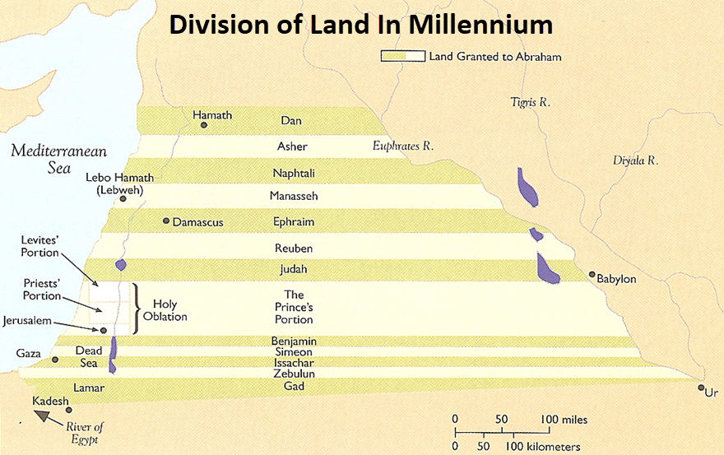

Slide 32
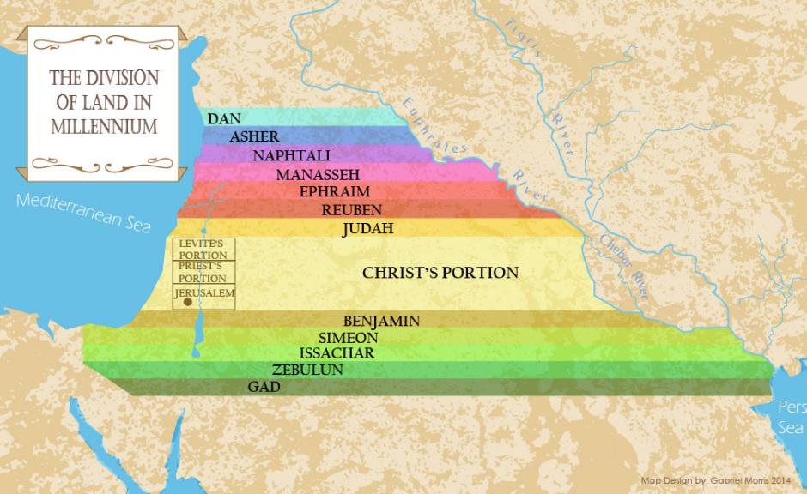

Slide 33
Matthew 20:20-21
“Then the mother of the sons of Zebedee came to Jesus with her sons, bowing down and making a request of Him. And He said to her, ‘What do you wish?’ She said to Him, ‘Command that in Your kingdom these two sons of mine may sit one on Your right and one on Your left.’”

Slide 34
Matthew 25:31
“But when the Son of Man comes in His glory, and all the angels with Him, then He will sit on His glorious throne.”

Slide 35

Matthew 25:31-34
“³¹ But when the Son of Man comes in His glory, and all the angels with Him, then He will sit on His glorious throne. ³² All the nations will be gathered before Him; and He will separate them from one another, as the shepherd separates the sheep from the goats; ³³ and He will put the sheep on His right, and the goats on the left. ³⁴“Then the King will say to those on His right, ‘Come, you who are blessed of My Father, inherit the kingdom prepared for you from the foundation of the world.”

Slide 36
2. Is Jesus Now Reigning from David’s Throne?
(Acts 2)
David’s Throne is Earthly
A Davidic heavenly Throne changes its original meaning
No NT verse places Jesus currently of David’s Throne
The Davidic Throne comes into existence only after the Times of the Gentiles have run their course
A present Davidic Throne misunderstands the mystery nature of the Church
A present Davidic Throne misunderstands the parenthetical nature of the Church

Slide 37


Jesus Now Reigning on David’s Throne?
“So, they have not only changed the people to include the Church, but they have also changed the place where the covenant is to be fulfilled. Now it’s not only on earth, but it’s also in heaven. . . . The people have changed and the place has changed.”
Robert Lightner, “Progressive Dispensationalism,” Conservative Theological Journal 4, no. 11 (March 2000): 53–54.

Slide 38
Matthew 23:37-39
³⁷ “Jerusalem, Jerusalem, who kills the prophets and stones those who are sent to her! How often I wanted to gather your children together, the way a hen gathers her chicks under her wings, and you were unwilling. ³⁸ Behold, your house is being left to you desolate! ³⁹ For I say to you, from now on you will not see Me until you say, ‘Blessed is He who comes in the name of the Lord!’”

Slide 39

Matthew 24:15
“Therefore when you see the abomination of desolation which was spoken of through Daniel the prophet, standing in the holy place (let the reader understand).”

Slide 40
Matthew 25:31
“³¹ But when the Son of Man comes in His glory, and all the angels with Him, then He will sit on His glorious throne. ³² All the nations will be gathered before Him; and He will separate them from one another, as the shepherd separates the sheep from the goats; ³³ and He will put the sheep on His right, and the goats on the left. ³⁴ Then the King will say to those on His right, ‘Come, you who are blessed of My Father, inherit the kingdom prepared for you from the foundation of the world.’”

Slide 41
Romans 10:21
“But as for Israel He says, ‘All the day long I have stretched out My hands to a disobedient and obstinate people.’”

Slide 42
Romans 11:25
“For I do not want you, brethren, to be uninformed of this mystery—so that you will not be wise in your own estimation—that a partial hardening has happened to Israel until the fullness of the Gentiles has come in.”

Slide 43
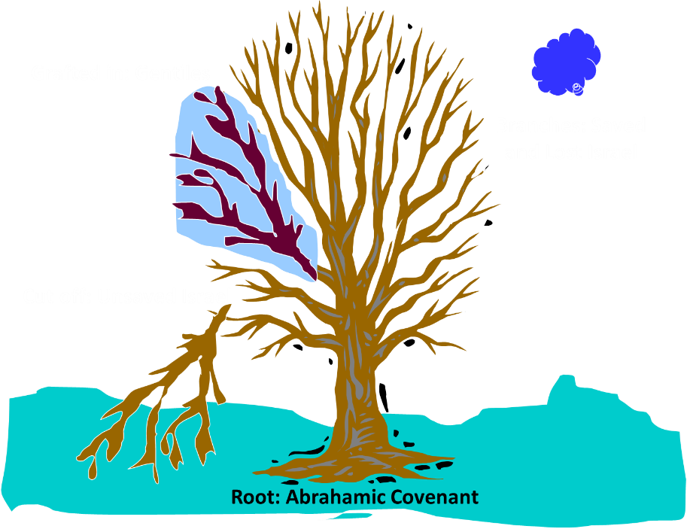
Notes:
43

Slide 44
Changes: | Biblical Davidic Throne | Davidic Throne Now?
Place: | Earth | Heaven
People: | Israel | Gentile Church
Israel: | Converted | Unconverted

Slide 45
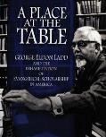

George Eldon Ladd
A Theology of the New Testament (Grand Rapids: Eerdmans, 1974), 336–37.
“[T]he new redemptive events in the course of Heilsgeschichte have compelled Peter to reinterpret the Old Testament. Because of the resurrection and ascension of Jesus, Peter transfers the messianic Davidic throne from Jerusalem to God’s right hand in heaven. Jesus has now been enthroned as the Davidic Messiah on the throne of David, and is awaiting the final consummation of his messianic reign. . . . This involves a rather radical reinterpretation of Old Testament prophecies, but no more so than the entire reinterpretation of God’s redemptive plan by the early church. In fact, it is an essential part of this reinterpretation demanded by the events of redemptive history. . . . Jesus is enthroned as the Messiah. . . . He must reign until all his enemies are made a stool for his feet.”

Slide 46

George Murray
George Murray, Millennial Studies (Grand Rapids: Baker, 1948), 44.
“The Davidic Covenant, of which much has been said, was to the effect that his seed would sit upon his throne and had its natural fulfillment in the reign of King Solomon. Its eternal aspects include the Lord Jesus Christ of the seed of David; and in the book of Acts, Peter insists that Christ’s resurrection and ascension fulfilled God’s promise to David that his seed would sit upon his throne (Acts 2:30). Why insist, then, on a literal fulfillment of a promise which the Scriptures certify to have had a spiritual fulfillment?”

Slide 47

J. Dwight Pentecost
Things to Come, Page 103
“The amillennialist is bound to argue for a conditional covenant and a spiritualized fulfillment, so that the throne on which Christ is now seated at the right hand of the father becomes the ‘throne’ of the covenant, the household of faith becomes the ‘house’ of the covenant, and the church becomes the ‘kingdom’ of the covenant. . . . This makes the church the ‘seed’ and the ‘kingdom’ promised in the covenant. The kingdom becomes heavenly, not earthly. . . . Only by extensive allegorization can such a view be held.”

Slide 48

Lewis Sperry Chafer
vol. 5, Systematic Theology (Grand Rapids, MI: Kregel Publications, 1993), 315.
“Similarly, the earthly kingdom that according to the Scriptures had its origin in the covenant made to David, which is mundane and literal in its original form and equally as mundane and literal in uncounted references to it in all subsequent Scriptures which trace it on to its consummation, is by theological legerdemain (trickery, deception) metamorphosed into a spiritual monstrosity in which an absent King seated on His Father’s throne in heaven is accepted in lieu of the theocratic monarch of David’s line seated on David’s throne in Jerusalem.”

Slide 49

Darrell Bock
Darrell Bock, “Evidence from Acts,” in The Coming Millennial Kingdom, ed. Donald Campbell and Jeffrey Townsend (Chicago: Moody, 1992), 194.
“The Davidic throne and the heavenly throne of Jesus at the right hand of the Father are one and the same.”

Slide 50
Darrell Bock
Darrell Bock, “The Reign of the Lord Christ,” in Dispensationalism, Israel and the Church, ed. Craig Blaising and Darrell Bock (Grand Rapids: Zondervan, 1992), 49, 51.
This novel interpretive approach allows mere “crucial linking allusions,” or “pictorial descriptions” Jesus as the heir to David’s Throne to expand the original terrestrial promise of the Davidic Throne so that it now encompasses a current spiritual form of the Davidic Kingdom with Jesus presently ruling from a celestial Davidic Throne.

Slide 51
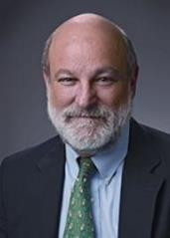
“Complementary Hermeneutics” in Progressive Dispensationalism
“…the New Testament does introduce change and advance; it does not merely repeat Old Testament revelation. In making complementary additions, however, it does not jettison Old Testament promises. The enhancement is not at the expense of the original promise.”
Craig Blaising and Darrell Bock, “Dispensationalism, Israel and the Church: Assessment and Dialogue,” in Dispensationalism, Israel and the Church, ed. Craig Blaising and Darrell Bock (Grand Rapids: Zondervan, 1992), 392–93.
Notes:
WRONG!!!

Slide 52
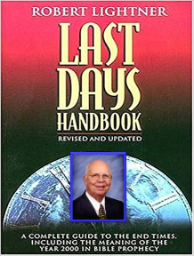
Jesus Now Reigning on David’s Throne?
“‘Complementary hermeneutics’ must not be confused with the historic orthodox doctrine of progressive revelation. The latter truth means that God revealed His truth gradually, sometimes over a long period of time. What was revealed later never changed the original revelation, however. The meaning and the recipients of the original promise always remain the same.”
Robert Lightner, Last Days Handbook (Nashville: Thomas Nelson, 1997), 210.

Slide 53
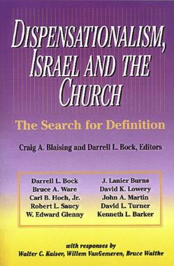
Blaising
Dispensationalism, Israel, and the Church, p. 29
“But when that which is in fact new is presented and accepted as if it had always been the case, the result is not only historical confusion but a conceptual naïveté that resists both the idea and the fact of further development within the tradition.”

Slide 54

Charles Ryrie
Charles C. Ryrie, Dispensationalism, rev. ed. (Chicago: Moody, 1995), 146.
“Although these early conferences were called to oppose postmillennialism and to promote premillennialism, today progressive dispensationalists focus on them as examples of ecumenicity in order to justify their interest in finding a rapprochement between dispensationalism and covenant theology. The early conferences in America sought no such rapprochement between themselves and postmillennialists or annihilationists or perfectionists.”

Slide 55
Jesus Now Reigning on David’s Throne?
“What if you apply the complementary hermeneutic to all of Scripture? . . . What if the complementary hermeneutic, used by progressives in Acts 2 to substantiate the fact that the kingdom has been inaugurated, in part, would be applied universally to all prophetic matters of Scripture ever given? One could not know for sure precisely who was involved in the prophecy or where it would be fulfilled until either the prophecy was fulfilled or the canon of Scripture was closed. . . . If the same hermeneutic was applied to other areas of prophecy, like it is applied to the Davidic covenant, you could never be sure of anything in the Scripture until it was either fulfilled or the canon was closed. Then, of course, you know there is not going to be any further revelation, ‘change.’”
Robert Lightner, “Progressive Dispensationalism,” Conservative Theological Journal 4, no. 11 (March 2000): 53–59, 62.

Slide 56

Jesus Now Reigning on David’s Throne?
“Until that time, all prophecy is open to complementation. For example, when God, through the prophets, predicted the Assyrian captivity of Israel and the Babylonian captivity of Judah, they couldn’t really be sure that it was an exclusive captivity of Assyria. Who knows, but what, the Babylonians would have been included, or vise versa. . . . Because it involves people and if the people involved in the Davidic Covenant can change and include other people, then why can’t the people change in these other prophecies? If the place can change in the Davidic Covenant as in Acts 2, then why can’t the place change in other prophecies of Scripture? Other people or other places can be brought in totally changing the original promise in later revelation. . . . Take another illustration. All prophecy or prediction in the Bible, which involves a specific place and people, might be changed in later revelation.”
Robert Lightner, “Progressive Dispensationalism,” Conservative Theological Journal 4, no. 11 (March 2000): 53–59, 62.

Slide 57
Jesus Now Reigning on David’s Throne?
“How about Daniel 2, Daniel 7, Daniel 9?, and the Gentile world powers, are we to understand those nations, when given, exclusively as those nations? Maybe not; maybe later revelation would change them...Just like some today have an open view of God, the complementary hermeneutic, whether they admit it or know it, is an open view of Scripture as well, to this extent, until the prophecy is realized, it is fulfilled, or the canon has closed. It is not open any longer, please understand me, but I mean that until the canon was closed or the prophecy was fulfilled, it had to be open, if you apply the same hermeneutic to other passages of Scripture. The promise of the land, the promise to Israel, might involve another people later on. I consider this to be a serious danger. . . . If you apply their complementary hermeneutic across the board to other Scripture, it is devastating.”
Robert Lightner, “Progressive Dispensationalism,” Conservative Theological Journal 4, no. 11 (March 2000): 53–59, 62.

Slide 58
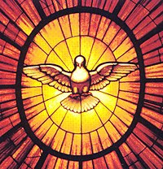
How Could the Early Church Test All Things if God Changed His Original Promises?
Deut. 13:1-5
Isa. 8:20
Acts 17:11
Gal. 1:8-9
1 Thess. 5:20-21
1 Cor. 14:29
1 John 4:1
Rev. 2:2

Slide 59
CONCLUSION

Slide 60
Response to Kingdom Now Problem Passages
Passages from Christ’s ministry
Passages from Acts
Passages from Paul
Passages from the General letters
Passages from Revelation
Miscellaneous Arguments

Slide 61
2. Is Jesus Now Reigning from David’s Throne?
(Acts 2)
David’s Throne is Earthly
A Davidic heavenly Throne changes its original meaning
No NT verse places Jesus currently of David’s Throne
The Davidic Throne comes into existence only after the Times of the Gentiles have run their course
A present Davidic Throne misunderstands the mystery nature of the Church
A present Davidic Throne misunderstands the parenthetical nature of the Church

