Slide 1
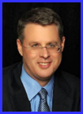
Dr. Andy Woods
Senior Pastor – Sugar Land Bible Church
President – Chafer Theological Seminary

Slide 2
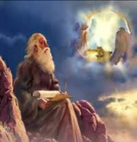
Revelation 1:19
Seen (Chapter 1)
Are (Chapters 2–3)
After these things (Chapters 4–22)

Slide 3
DESCRIPTION OF THE SEVEN CHURCHES Revelation 2‒3
CHURCH | SCRIPTURE | DESCRIPTION
Ephesus | 2:1-7 | Loveless
Smyrna | 2:8-11 | Persecuted
Pergamum | 2:12-17 | Compromised
Thyatira | 2:18-29 | Corrupt
Sardis | 3:1-6 | Dead
Philadelphia | 3:7-13 | Missionary
Laodicea | 3:14-22 | Man-centered

Slide 4
DESCRIPTION OF THE SEVEN CHURCHES Revelation 2‒3
CHURCH | SCRIPTURE | DESCRIPTION
Ephesus | 2:1-7 | Loveless
Smyrna | 2:8-11 | Persecuted
Pergamum | 2:12-17 | Compromised
Thyatira | 2:18-29 | Corrupt
Sardis | 3:1-6 | Dead
Philadelphia | 3:7-13 | Missionary
Laodicea | 3:14-22 | Man-centered

Slide 5
DESCRIPTION OF THE SEVEN CHURCHES Revelation 2‒3
CHURCH | SCRIPTURE | DESCRIPTION
Ephesus | 2:1-7 | Loveless
Smyrna | 2:8-11 | Persecuted
Pergamum | 2:12-17 | Compromised
Thyatira | 2:18-29 | Corrupt
Sardis | 3:1-6 | Dead
Philadelphia | 3:7-13 | Missionary
Laodicea | 3:14-22 | Man-centered

Slide 6
DESCRIPTION OF THE SEVEN CHURCHES Revelation 2‒3
CHURCH | SCRIPTURE | DESCRIPTION
Ephesus | 2:1-7 | Loveless
Smyrna | 2:8-11 | Persecuted
Pergamum | 2:12-17 | Compromised
Thyatira | 2:18-29 | Corrupt
Sardis | 3:1-6 | Dead
Philadelphia | 3:7-13 | Missionary
Laodicea | 3:14-22 | Man-centered

Slide 7
DESCRIPTION OF THE SEVEN CHURCHES Revelation 2‒3
CHURCH | SCRIPTURE | DESCRIPTION
Ephesus | 2:1-7 | Loveless
Smyrna | 2:8-11 | Persecuted
Pergamum | 2:12-17 | Compromised
Thyatira | 2:18-29 | Corrupt
Sardis | 3:1-6 | Dead
Philadelphia | 3:7-13 | Missionary
Laodicea | 3:14-22 | Man-centered

Slide 8
DESCRIPTION OF THE SEVEN CHURCHES Revelation 2‒3
CHURCH | SCRIPTURE | DESCRIPTION
Ephesus | 2:1-7 | Loveless
Smyrna | 2:8-11 | Persecuted
Pergamum | 2:12-17 | Compromised
Thyatira | 2:18-29 | Corrupt
Sardis | 3:1-6 | Dead
Philadelphia | 3:7-13 | Missionary
Laodicea | 3:14-22 | Man-centered

Slide 9
DESCRIPTION OF THE SEVEN CHURCHES Revelation 2‒3
CHURCH | SCRIPTURE | DESCRIPTION
Ephesus | 2:1-7 | Loveless
Smyrna | 2:8-11 | Persecuted
Pergamum | 2:12-17 | Compromised
Thyatira | 2:18-29 | Corrupt
Sardis | 3:1-6 | Dead
Philadelphia | 3:7-13 | Missionary
Laodicea | 3:14-22 | Man-centered

Slide 10
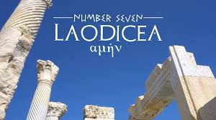
Laodicea Revelation 3:14-22
Destination (14a)
Description of Christ (14b)
Commendation
Rebuke (15-17)
Exhortation (18-20)
Consequence (19a)
Promise to overcomers (21)
Exhortation to listen (22)

Slide 11
Laodicea Revelation 3:14-22
Destination (14a)
Description of Christ (14b)
Commendation
Rebuke (15-17)
Exhortation (18-20)
Consequence (19a)
Promise to overcomers (21)
Exhortation to listen (22)

Slide 12
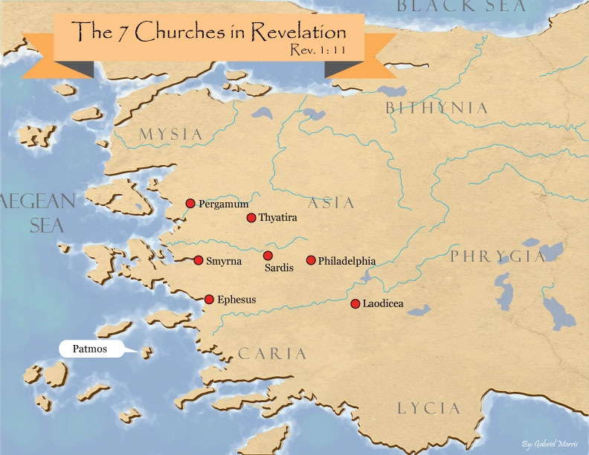

Slide 13
Laodicea Revelation 3:14-22
Destination (14a)
Description of Christ (14b)
Commendation
Rebuke (15-17)
Exhortation (18-20)
Consequence (19a)
Promise to overcomers (21)
Exhortation to listen (22)

Slide 14
2. Description of Christ to Philadelphia (Rev. 3:14b)
Amen
Faithful
True witness
The originator or source of creation

Slide 15
Laodicea Revelation 3:14-22
Destination (14a)
Description of Christ (14b)
Commendation
Rebuke (15-17)
Exhortation (18-20)
Consequence (19a)
Promise to overcomers (21)
Exhortation to listen (22)

Slide 16
William Newell The Book of the Revelation (Chicago: Moody, 1935), 75.
“The name comes from laos, people, and dikao, to rule: the rule of the people: ‘democracy,’ in other words.”

Slide 17
Laodicea Revelation 3:14-22
Destination (14a)
Description of Christ (14b)
Commendation
Rebuke (15-17)
Exhortation (18-20)
Consequence (19a)
Promise to overcomers (21)
Exhortation to listen (22)

Slide 18
4. Rebuke to Laodicea (Rev. 3:15-17)
Luke warm ‒ 15-16a
Christ’s reaction ‒ 16b
The curse of prosperity ‒ 17a
Spiritual blindness ‒ 17b

Slide 19
Laodicea Revelation 3:14-22
Destination (14a)
Description of Christ (14b)
Commendation
Rebuke (15-17)
Exhortation (18-20)
Consequence (19a)
Promise to overcomers (21)
Exhortation to listen (22)

Slide 20
5. Exhortation to Change (Rev. 3:18-20)
Buy from Christ ‒ 18a
Gold ‒ 18b
White garments ‒ 18c
Eye salve ‒ 18d
Be zealous ‒ 19b
Repent ‒ 19c
Restore fellowship ‒ 20

Slide 21
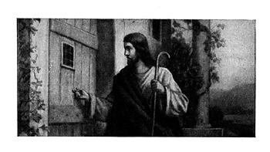
Imminency?
Ethnocentricity
Does not exactly fit church history
Allegorical

Slide 22
1 John 1:9
“If we confess our sins, He is faithful and righteous to forgive us our sins and to cleanse us from all unrighteousness.”

Slide 23
Laodicea Revelation 3:14-22
Destination (14a)
Description of Christ (14b)
Commendation
Rebuke (15-17)
Exhortation (18-20)
Consequence (19a)
Promise to overcomers (21)
Exhortation to listen (22)

Slide 24
6. Consequences
Rev 3:19
“Those whom I love, I reprove and discipline; therefore be zealous and repent.”

Slide 25
6. Consequences
Rev 3:19
“Those whom I love, I reprove and discipline; therefore be zealous and repent.”

Slide 26
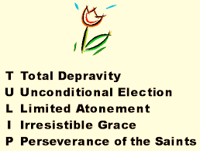

Slide 27
1 Corinthians 3:1-3 (NKJV)
¹ And I, brethren, could not speak to you as to spiritual people but as to carnal, as to babes in Christ. ² I fed you with milk and not with solid food; for until now you were not able to receive it, and even now you are still not able; ³ for you are still carnal. For where there are envy, strife, and divisions among you, are you not carnal and behaving like mere men?

Slide 28
Notes:
Ray Steadman – “1st Californians”
Unbelievers vs Categories of Believers
Unbelievers – ψυχικός psuchikós; Natural, pertaining to the natural as distinguished from the spiritual
Spiritual Believers – πνευματικός pneumatikós; of persons who are spiritual, enlightened by the Holy Spirit
Infant Believers – σάρκινος sárkinos; with propensities of the flesh unto sin; νήπιος nḗpios; an infant, child, baby without any definite limitation of age. (This relates to immaturity and lack of instruction)
Carnal Believers – σαρκικός sarkikós; tendency to satisfy the flesh, implying sinfulness, sinful propensity, carnal (This relates to disobedience and open rebellion)

Slide 29
Revelation 2:22-23
“Behold, I will throw her on a bed of sickness, and those who commit adultery with her into great tribulation, unless they repent of her deeds. And I will kill her children with pestilence, and all the churches will know that I am He who searches the minds and hearts; and I will give to each one of you according to your deeds.”

Slide 30
1 John 5:16
“If anyone sees his brother committing a sin not leading to death, he shall ask and God will for him give life to those who commit sin not leading to death. There is a sin leading to death; I do not say that he should make request for this.”

Slide 31
Laodicea Revelation 3:14-22
Destination (14a)
Description of Christ (14b)
Commendation
Rebuke (15-17)
Exhortation (18-20)
Consequence (19a)
Promise to overcomers (21)
Exhortation to listen (22)

Slide 32
7. Promise to the Overcomers
Rev 3:21
“He who overcomes, I will grant to him to sit down with Me on My throne, as I also overcame and sat down with My Father on His throne.”

Slide 33
7. Promise to the Overcomers
Rev 3:21
“He who overcomes, I will grant to him to sit down with Me on My throne, as I also overcame and sat down with My Father on His throne.”

Slide 34
1 John 5:4-5
^{“4} For whatever is born of God overcomes the world; and this is the victory that has overcome the world—our faith. ⁵ Who is the one who overcomes the world, but he who believes that Jesus is the Son of God?”

Slide 36
7. Promise to the Overcomers
Rev 3:21
“He who overcomes, I will grant to him to sit down with Me on My throne, as I also overcame and sat down with My Father on His throne.”

Slide 37
7. Promise to the Overcomers
Rev 3:21
“He who overcomes, I will grant to him to sit down with Me on My throne, as I also overcame and sat down with My Father on His throne.”

Slide 38
7. Promise to the Overcomers
Rev 3:21
“He who overcomes, I will grant [future tense of didōmi] to him to sit down with Me on My throne, as I also overcame and sat down [aorist tense of kathizō] with My Father on His throne.”

Slide 39
Revelation 12:5
“And she gave birth to a son, a male child, who is to rule all the nations with a rod of iron; and her child was caught up to God and to His throne.”

Slide 40
John 17:5
“Now, Father, glorify Me together with Yourself, with the glory which I had with You before the world was.”

Slide 41
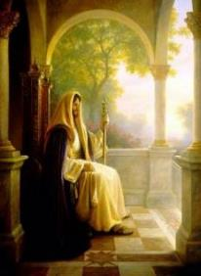
Christ’s Three Offices
Prophet – 1st Coming (Matt. 4:17)
Priest – Present Session (Heb. 4:15)
King – 2nd Coming (Isa. 9:6-7; Matt. 25:31)

Slide 42
Christ’s Three Offices
Prophet – 1st Coming (Matt. 4:17)
Priest – Present Session (Heb. 4:15)
King – 2nd Coming (Isa. 9:6-7; Matt. 25:31)

Slide 44
Revelation 22:1
“Then he showed me a river of the water of life, clear as crystal, coming from the throne of God and of the Lamb.”

Slide 45
Christ’s Three Offices
Prophet – 1st Coming (Matt. 4:17)
Priest – Present Session (Heb. 4:15)
King – 2nd Coming (Isa. 9:6-7; Matt. 25:31)

Slide 46
Revelation 3:21 in Progressive Dispensationalism
“One may object that the throne at the right hand of God is not the Davidic throne, which is earthly. The objection might be raised by appealing to a text like Revelation 3:21, where Jesus distinguishes between ‘my throne,’ in which the overcomer will sit, and the Father’s throne, on which Jesus currently sits. The argument is made that the throne on which Jesus sits in Acts is the Father’s throne, not David’s…this throne of the lamb, set next to the Father, is alluded to again in Revelation 22:1. This is the same throne that Jesus occupies in the consummation! He exercises Davidic rule now even as he will exercises it then.”
Darrell Bock, “The Reign of the Lord Christ,” in Dispensationalism, Israel and the Church, ed. Craig Blaising and Darrell Bock (Grand Rapids: Zondervan, 1992), 50, 62.
Notes:
WRONG!!!

Slide 47
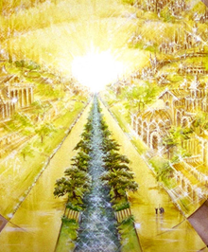
Eternal State is Future
No Satan (Rev 20:10)
No sea (Rev 21:1)
No death, crying, or pain (Rev 21:4)
No Sun (Rev 22:5)
No Moon (Rev 21:23)
No night (Rev 21:25)
No evil (Rev 21:27)
No curse (Rev 22:23)

Slide 48
John 1:11
“He came to His own, and those who were His own did not receive Him.”

Slide 49
Daniel 9:26
“So you are to know and discern that from the issuing of a decree to restore and rebuild Jerusalem until Messiah the Prince there will be seven weeks and sixty-two weeks; it will be built again, with plaza and moat, even in times of distress. ²⁶ Then after the sixty-two weeks the Messiah will be cut off and have nothing, and the people of the prince who is to come will destroy the city and the sanctuary. And its end will come with a flood; even to the end there will be war; desolations are determined.’”

Slide 50
Revelation 3:7
“And to the angel of the church in Philadelphia write: He who is holy, who is true, who has the key of David, who opens and no one will shut, and who shuts and no one opens, says this:…”

Slide 51
Revelation 5:5
and one of the elders said to me, “Stop weeping; behold, the Lion that is from the tribe of Judah, the Root of David, has overcome so as to open the book and its seven seals.”

Slide 52
Revelation 22:16
“I, Jesus, have sent My angel to testify to you these things for the churches. I am the root and the descendant of David, the bright morning star.”

Slide 53
Christ’s Three Offices
Prophet – 1st Coming (Matt. 4:17)
Priest – Present Session (Heb. 4:15)
King – 2nd Coming (Isa. 9:6-7; Matt. 25:31)

Slide 54
Hebrews 7:3
“Without father, without mother, without genealogy, having neither beginning of days nor end of life, but made like the Son of God, he remains a priest perpetually.”

Slide 55
Hebrews 6:20
“where Jesus has entered as a forerunner for us, having become a high priest forever according to the order of Melchizedek.”

Slide 56
Lewis Sperry Chafer
vol. 5, Systematic Theology (Grand Rapids, MI: Kregel Publications, 1993), 315.
“Similarly, the earthly kingdom that according to the Scriptures had its origin in the covenant made to David, which is mundane and literal in its original form and equally as mundane and literal in uncounted references to it in all subsequent Scriptures which trace it on to its consummation, is by theological legerdemain (trickery, deception) metamorphosed into a spiritual monstrosity in which an absent King seated on His Father’s throne in heaven is accepted in lieu of the theocratic monarch of David’s line seated on David’s throne in Jerusalem.”

Slide 57
Christ’s High Priestly Activities in His Present Session
Sustains creation (Col. 16-17)
Head over the Church (Eph. 1:22-23)
Groom of the Church (Eph. 5:22-33)
Building the Church (Matt. 16:18; Acts 2:41; 4:4)
Bestowal of Spiritual Gifts (Eph. 4:7-12)
Intercedes for the Saints (Rom. 8:24; Heb. 7:25)
Advocate for the Saints (Heb. 9:24; 1 John 2:1; Rev. 12:10)
Forgives the Saints (1 John 1:9)

Slide 58
Christ’s High Priestly Activities in His Present Session
Sustains creation (Col. 16-17)
Head over the Church (Eph. 1:22-23)
Groom of the Church (Eph. 5:22-33)
Building the Church (Matt. 16:18; Acts 2:41; 4:4)
Bestowal of Spiritual Gifts (Eph. 4:7-12)
Intercedes for the Saints (Rom. 8:24; Heb. 7:25)
Advocate for the Saints (Heb. 9:24; 1 John 2:1; Rev. 12:10)
Forgives the Saints (1 John 1:9)

Slide 59
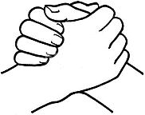
John 10:27-29
“²⁷ My sheep hear My voice, and I know them, and they follow Me; ²⁸ and I give eternal life to them, and they will never perish [ou mē; aiōnia]; and no one will snatch them out of My hand. ²⁹ My Father, who has given them to Me, is greater than all; and no one is able to snatch them out of the Father’s hand.”

Slide 60
1 John 1:9
“If we confess our sins, He is faithful and righteous to forgive us our sins and to cleanse us from all unrighteousness.”

Slide 61
Lewis Sperry Chafer
vol. 5, Systematic Theology (Grand Rapids, MI: Kregel Publications, 1993), 277.
“The effect of the Christian’s sin upon himself is that he loses his fellowship with God, his joy, his peace, and his power. On the other hand, these experiences are restored in infinite grace on the sole ground that he confesses his sin (1 John 1:9).”

Slide 62
Christ’s High Priestly Activities in His Present Session
Sustains creation (Col. 16-17)
Head over the Church (Eph. 1:22-23)
Groom of the Church (Eph. 5:22-33)
Building the Church (Matt. 16:18; Acts 2:41; 4:4)
Bestowal of Spiritual Gifts (Eph. 4:7-12)
Intercedes for the Saints (Rom. 8:24; Heb. 7:25)
Advocate for the Saints (Heb. 9:24; 1 John 2:1; Rev. 12:10)
Forgives the Saints (1 John 1:9)

Slide 63
Lewis Sperry Chafer
vol. 5, Systematic Theology (Grand Rapids, MI: Kregel Publications, 1993), 273-74.
“The present ministry of Christ in heaven, known as His session, is far-reaching both in consequence and import. It, too, has not been treated even with a passing consideration by Covenant theologians, doubtless due to their inability—because of being confronted with their one covenant theory—to introduce features and ministries which indicate a new divine purpose in the Church and by so much tend to disrupt the unity of a supposed immutable purpose and covenant of God’s. Since, as will be seen, certain vital ministries of Christ in heaven provide completely for the believer’s security, the present session of Christ has been eschewed by Arminians in a manner equally unpardonable.”

Slide 64
Lewis Sperry Chafer
vol. 5, Systematic Theology (Grand Rapids, MI: Kregel Publications, 1993), 273-74.
“This neglect accounts very well for the emphasis of their pulpit ministrations. The Christian public, because deprived of the knowledge of Christ’s present ministry, are unaware of its vast realities, though they are able from childhood itself to relate the mere historical facts and activities of Christ during His three and one-half years of service on earth. That Christ is doing anything now is not recognized by Christians generally and for this part-truth kind of preaching is wholly responsible. It yet remains true, whether neglected by one or the other kind of theologian, that Christ is now engaged in ministry which determines the service and destiny of all those who have put their trust in Him.”

Slide 65
7. Promise to the Overcomers
Rev 3:21
“He who overcomes, I will grant to him to sit down with Me on My throne, as I also overcame and sat down with My Father on His throne.”

Slide 66
Revelation 2:26-27
“He who overcomes, and he who keeps My deeds until the end, to him I will give authority over the nations; and he shall rule them with a rod of iron, as the vessels of the potter are broken to pieces, as I also have received authority from My Father.”

Slide 67
Revelation 5:10
“You have made them to be a kingdom and priests to our God; and they will reign [basileuō] upon the earth [gē].”

Slide 68
Revelation 11:15
¹⁵ “Then the seventh angel sounded; and there were loud voices in heaven, saying, ‘The kingdom of the world has become the kingdom of our Lord and of His Christ; and He will reign forever and ever.’”

Slide 69
1 Corinthians 6:2-3
“Or do you not know that the saints will judge the world? If the world is judged by you, are you not competent to constitute the smallest law courts? Do you not know that we will judge angels? How much more matters of this life?”

Slide 70
Laodicea Revelation 3:14-22
Destination (14a)
Description of Christ (14b)
Commendation
Rebuke (15-17)
Exhortation (18-20)
Consequence (19a)
Promise to overcomers (21)
Exhortation to listen (22)

Slide 71
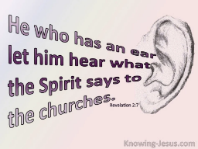
8. Exhortation to Listen
Rev 3:22
“He who has an ear, let him hear what the Spirit says to the churches.”

Slide 72
8. Exhortation to Listen
Rev 3:22
“He who has an ear, let him hear what the Spirit says to the churches.”

Slide 73
Deuteronomy 6:4-7
⁴ “Hear, O Israel! The Lord is our God, the Lord is one!...⁶ These words, which I am commanding you today, shall be on your heart. ⁷ You shall teach them diligently to your sons and shall talk of them when you sit in your house and when you walk by the way and when you lie down and when you rise up.”

Slide 74
8. Exhortation to Listen
Rev 3:22
“He who has an ear, let him hear what the Spirit says to the churches.”

Slide 75
Revelation 1:19
“Therefore write the things which you have seen, and the things which are, and the things which will take place after these things [meta tauta].”

Slide 76
Revelation 1:19
Seen (Chapter 1)
Are (Chapters 2–3)
After these things (Chapters 4–22)

Slide 77
Revelation 1:19
Seen (Chapter 1)
Are (Chapters 2–3)
After these things (Chapters 4–22)

Slide 78
Revelation 4:1
“After these things [meta tauta] I looked, and behold, a door standing open in heaven, and the first voice which I had heard, like the sound of a trumpet speaking with me, said, ‘Come up here, and I will show you what must take place after these things [meta tauta].’”

Slide 79
7. Promise to the Overcomers
Rev 3:21
“He who overcomes, I will grant to him to sit down with Me on My throne, as I also overcame and sat down with My Father on His throne.”

Slide 80
Revelation 12:5
“And she gave birth to a son, a male child, who is to rule all the nations with a rod of iron; and her child was caught up to God and to His throne.”

Slide 81
Conclusion

Slide 82
Laodicea Revelation 3:14-22
Destination (14a)
Description of Christ (14b)
Commendation
Rebuke (15-17)
Exhortation (18-20)
Consequence (19a)
Promise to overcomers (21)
Exhortation to listen (22)

Slide 83
“The Lord bless you and keep you; the Lord make his face shine on you and be gracious to you; the Lord turn his face toward you and give you peace.” (NIV)

