Slide 1
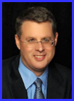
Dr. Andy Woods
Senior Pastor – Sugar Land Bible Church
President – Chafer Theological Seminary

Slide 2
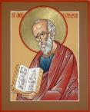
Answering Ten Questions
What is the title – Revelation of Jesus Christ
Who wrote it? – John
Where was it written from? – Patmos
To Whom was it written? – The Seven Churches
When was it written? – A.D. 95
How is it organized (outline)? – 3 part outline
How was it delivered – Seven steps
Why was it written? – Encouragement and holiness
What is it about? – Jesus’ final victory
What makes the book different? – OT relationship

Slide 3
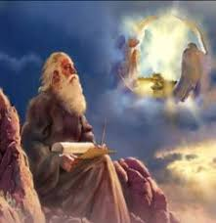
Prologue (Rev. 1:1-8)
Title (1a)
Chain of Communication (1b-2)
Blessing (3)
Author (4a)
Audience (4b)
Greeting (4c)
Source (4d-5a)
Subject (5b-8)

Slide 4
Revelation 1:19
“Therefore write the things which you have seen, and the things which are, and the things which will take place after these things [meta tauta].”

Slide 5
Revelation 1:19
Seen (Chapter 1)
Are (Chapters 2–3)
After these things (Chapters 4–22)

Slide 6
Revelation 1:19
Seen (Chapter 1)
Are (Chapters 2–3)
After these things (Chapters 4–22)

Slide 7
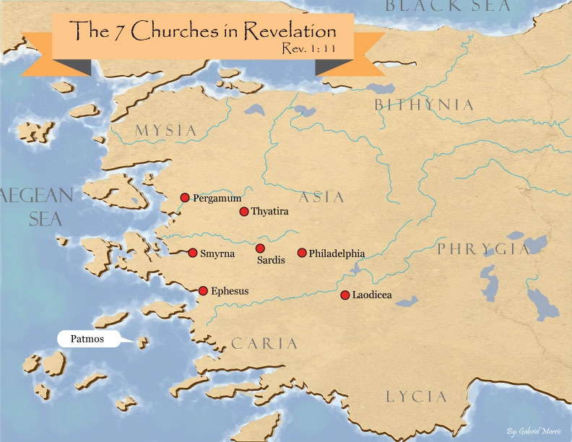

Slide 8
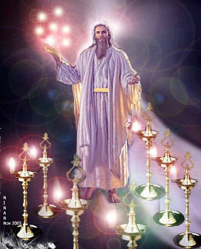
Pattern of the Letters in Revelation 2–3
Destination
Description of Christ (Rev. 1)
Commendation
Rebuke
Exhortation to change
Consequence
Exhortation to listen
Promise to overcomers (Rev. 21–22)

Slide 9
DESCRIPTION OF THE SEVEN CHURCHES Revelation 2‒3
CHURCH | SCRIPTURE | DESCRIPTION
Ephesus | 2:1-7 | Loveless
Smyrna | 2:8-11 | Persecuted
Pergamum | 2:12-17 | Compromised
Thyatira | 2:18-29 | Corrupt
Sardis | 3:1-6 | Dead
Philadelphia | 3:7-13 | Missionary
Laodicea | 3:14-22 | Man-centered

Slide 10
DESCRIPTION OF THE SEVEN CHURCHES Revelation 2‒3
CHURCH | SCRIPTURE | DESCRIPTION
Ephesus | 2:1-7 | Loveless
Smyrna | 2:8-11 | Persecuted
Pergamum | 2:12-17 | Compromised
Thyatira | 2:18-29 | Corrupt
Sardis | 3:1-6 | Dead
Philadelphia | 3:7-13 | Missionary
Laodicea | 3:14-22 | Man-centered

Slide 11
DESCRIPTION OF THE SEVEN CHURCHES Revelation 2‒3
CHURCH | SCRIPTURE | DESCRIPTION
Ephesus | 2:1-7 | Loveless
Smyrna | 2:8-11 | Persecuted
Pergamum | 2:12-17 | Compromised
Thyatira | 2:18-29 | Corrupt
Sardis | 3:1-6 | Dead
Philadelphia | 3:7-13 | Missionary
Laodicea | 3:14-22 | Man-centered

Slide 12
DESCRIPTION OF THE SEVEN CHURCHES Revelation 2‒3
CHURCH | SCRIPTURE | DESCRIPTION
Ephesus | 2:1-7 | Loveless
Smyrna | 2:8-11 | Persecuted
Pergamum | 2:12-17 | Compromised
Thyatira | 2:18-29 | Corrupt
Sardis | 3:1-6 | Dead
Philadelphia | 3:7-13 | Missionary
Laodicea | 3:14-22 | Man-centered

Slide 13
DESCRIPTION OF THE SEVEN CHURCHES Revelation 2‒3
CHURCH | SCRIPTURE | DESCRIPTION
Ephesus | 2:1-7 | Loveless
Smyrna | 2:8-11 | Persecuted
Pergamum | 2:12-17 | Compromised
Thyatira | 2:18-29 | Corrupt
Sardis | 3:1-6 | Dead
Philadelphia | 3:7-13 | Missionary
Laodicea | 3:14-22 | Man-centered

Slide 14
DESCRIPTION OF THE SEVEN CHURCHES Revelation 2‒3
CHURCH | SCRIPTURE | DESCRIPTION
Ephesus | 2:1-7 | Loveless
Smyrna | 2:8-11 | Persecuted
Pergamum | 2:12-17 | Compromised
Thyatira | 2:18-29 | Corrupt
Sardis | 3:1-6 | Dead
Philadelphia | 3:7-13 | Missionary
Laodicea | 3:14-22 | Man-centered

Slide 15
DESCRIPTION OF THE SEVEN CHURCHES Revelation 2‒3
CHURCH | SCRIPTURE | DESCRIPTION
Ephesus | 2:1-7 | Loveless
Smyrna | 2:8-11 | Persecuted
Pergamum | 2:12-17 | Compromised
Thyatira | 2:18-29 | Corrupt
Sardis | 3:1-6 | Dead
Philadelphia | 3:7-13 | Missionary
Laodicea | 3:14-22 | Man-centered

Slide 16
DESCRIPTION OF THE SEVEN CHURCHES Revelation 2‒3
CHURCH | SCRIPTURE | DESCRIPTION
Ephesus | 2:1-7 | Loveless
Smyrna | 2:8-11 | Persecuted
Pergamum | 2:12-17 | Compromised
Thyatira | 2:18-29 | Corrupt
Sardis | 3:1-6 | Dead
Philadelphia | 3:7-13 | Missionary
Laodicea | 3:14-22 | Man-centered

Slide 17
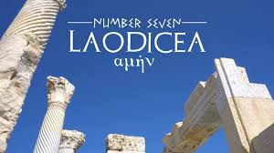
Laodicea Revelation 3:14-22
Destination (14a)
Description of Christ (14b)
Commendation
Rebuke (15-17)
Exhortation (18-20)
Consequence (19a)
Promise to overcomers (21)
Exhortation to listen (22)

Slide 18
Laodicea Revelation 3:14-22
Destination (14a)
Description of Christ (14b)
Commendation
Rebuke (15-17)
Exhortation (18-20)
Consequence (19a)
Promise to overcomers (21)
Exhortation to listen (22)

Slide 20
William Newell William Newell, The Book of the Revelation (Chicago: Moody, 1935), 75.
“The name comes from laos, people, and dikao, to rule: the rule of the people: ‘democracy,’ in other words.”

Slide 21
Laodicea Revelation 3:14-22
Destination (14a)
Description of Christ (14b)
Commendation
Rebuke (15-17)
Exhortation (18-20)
Consequence (19a)
Promise to overcomers (21)
Exhortation to listen (22)

Slide 22
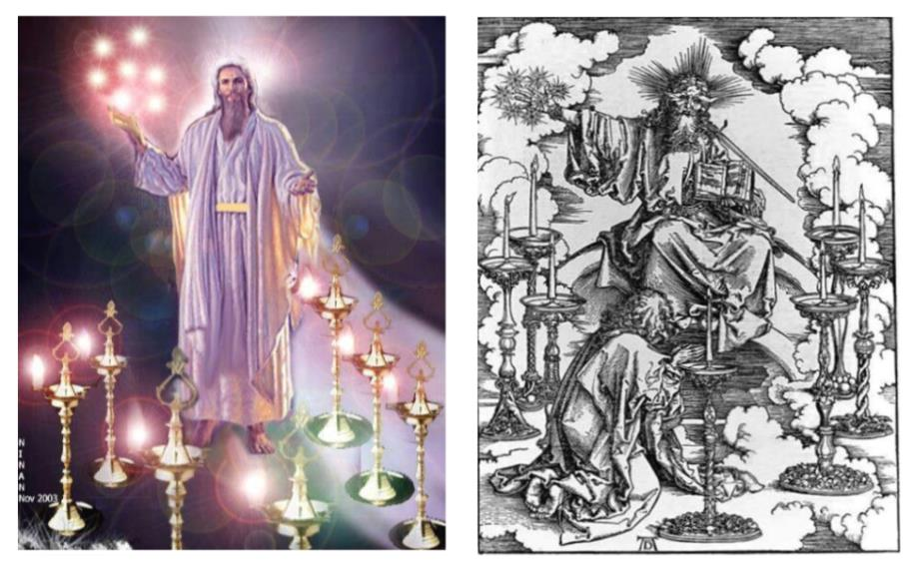

Slide 23
2. Description of Christ to Philadelphia (Rev. 3:14b)
Amen
Faithful
True witness
The originator or source of creation

Slide 24
2. Description of Christ to Philadelphia (Rev. 3:14b)
Amen
Faithful
True witness
The originator or source of creation

Slide 25
2. Description of Christ to Philadelphia (Rev. 3:14b)
Amen
Faithful
True witness
The originator or source of creation

Slide 26
1 John 1:9
“If we confess our sins, He is faithful and righteous to forgive us our sins and to cleanse us from all unrighteousness.”

Slide 27
2. Description of Christ to Philadelphia (Rev. 3:14b)
Amen
Faithful
True witness
The originator or source of creation

Slide 28
2. Description of Christ to Philadelphia (Rev. 3:14b)
Amen
Faithful
True witness
The originator or source of creation

Slide 29
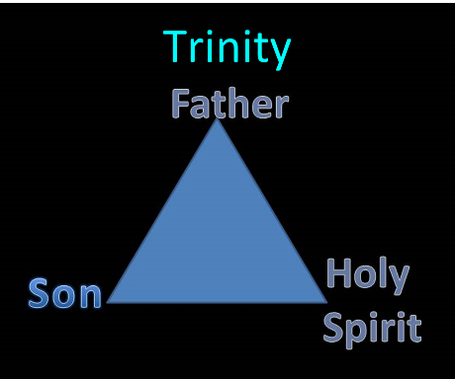

Slide 30
Laodicea Revelation 3:14-22
Destination (14a)
Description of Christ (14b)
Commendation
Rebuke (15-17)
Exhortation (18-20)
Consequence (19a)
Promise to overcomers (21)
Exhortation to listen (22)

Slide 31
Laodicea Revelation 3:14-22
Destination (14a)
Description of Christ (14b)
Commendation
Rebuke (15-17)
Exhortation (18-20)
Consequence (19a)
Promise to overcomers (21)
Exhortation to listen (22)

Slide 32
4. Rebuke to Laodicea (Rev. 3:15-17)
Luke warm ‒ 15-16a
Christ’s reaction ‒ 16b
The curse of prosperity ‒ 17a
Spiritual blindness ‒ 17b

Slide 33
4. Rebuke to Laodicea (Rev. 3:15-17)
Luke warm ‒ 15-16a
Christ’s reaction ‒ 16b
The curse of prosperity ‒ 17a
Spiritual blindness ‒ 17b

Slide 34
4. Rebuke to Laodicea (Rev. 3:15-17)
Luke warm ‒ 15-16a
Christ’s reaction ‒ 16b
The curse of prosperity ‒ 17a
Spiritual blindness ‒ 17b

Slide 35
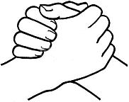
John 10:27-29
“²⁷ My sheep hear My voice, and I know them, and they follow Me; ²⁸ and I give eternal life to them, and they will never perish [ou mē; aiōnia]; and no one will snatch them out of My hand. ²⁹ My Father, who has given them to Me, is greater than all; and no one is able to snatch them out of the Father’s hand.”

Slide 36
4. Rebuke to Laodicea (Rev. 3:15-17)
Luke warm ‒ 15-16a
Christ’s reaction ‒ 16b
The curse of prosperity ‒ 17a
Spiritual blindness ‒ 17b

Slide 37
4. Rebuke to Laodicea (Rev. 3:15-17)
Luke warm ‒ 15-16a
Christ’s reaction ‒ 16b
The curse of prosperity ‒ 17a
Spiritual blindness ‒ 17b

Slide 38
Revelation 2:9
“I know your tribulation and your poverty (but you are rich), and the blasphemy by those who say they are Jews and are not, but are a synagogue of Satan.”

Slide 39
Laodicea Revelation 3:14-22
Destination (14a)
Description of Christ (14b)
Commendation
Rebuke (15-17)
Exhortation (18-20)
Consequence (19a)
Promise to overcomers (21)
Exhortation to listen (22)

Slide 40
5. Exhortation to Change (Rev. 3:18-20)
Buy from Christ ‒ 18a
Gold ‒ 18b
White garments ‒ 18c
Eye salve ‒ 18d
Be zealous ‒ 19b
Repent ‒ 19c
Restore fellowship ‒ 20

Slide 41
5. Exhortation to Change (Rev. 3:18-20)
Buy from Christ ‒ 18a
Gold ‒ 18b
White garments ‒ 18c
Eye salve ‒ 18d
Be zealous ‒ 19b
Repent ‒ 19c
Restore fellowship ‒ 20

Slide 42
5. Exhortation to Change (Rev. 3:18-20)
Buy from Christ ‒ 18a
Gold ‒ 18b
White garments ‒ 18c
Eye salve ‒ 18d
Be zealous ‒ 19b
Repent ‒ 19c
Restore fellowship ‒ 20

Slide 43
5. Exhortation to Change (Rev. 3:18-20)
Buy from Christ ‒ 18a
Gold ‒ 18b
White garments ‒ 18c
Eye salve ‒ 18d
Be zealous ‒ 19b
Repent ‒ 19c
Restore fellowship ‒ 20

Slide 44
1 John 1:9
“If we confess our sins, He is faithful and righteous to forgive us our sins and to cleanse us from all unrighteousness.”

Slide 45
5. Exhortation to Change (Rev. 3:18-20)
Buy from Christ ‒ 18a
Gold ‒ 18b
White garments ‒ 18c
Eye salve ‒ 18d
Be zealous ‒ 19b
Repent ‒ 19c
Restore fellowship ‒ 20

Slide 46
5. Exhortation to Change (Rev. 3:18-20)
Buy from Christ ‒ 18a
Gold ‒ 18b
White garments ‒ 18c
Eye salve ‒ 18d
Be zealous ‒ 19b
Repent ‒ 19c
Restore fellowship ‒ 20

Slide 47
5. Exhortation to Change (Rev. 3:18-20)
Buy from Christ ‒ 18a
Gold ‒ 18b
White garments ‒ 18c
Eye salve ‒ 18d
Be zealous ‒ 19b
Repent ‒ 19c
Restore fellowship ‒ 20

Slide 48
Lewis Sperry Chafer vol. 7, Systematic Theology (Grand Rapids, MI: Kregel Publications, 1993), 265-66.
[A] serious Arminian error respecting this doctrine occurs when repentance is added to faith or believing as a condition of salvation. It is true that repentance can very well be required as a condition of salvation, but then only because the change of mind which...has been involved when turning from every other confidence to the one needful trust in Christ. Such turning about, of course, cannot be achieved without a change of mind.

Slide 49
Lewis Sperry Chafer vol. 7, Systematic Theology (Grand Rapids, MI: Kregel Publications, 1993), 265-66.
This vital newness of mind is a part of believing, after all, and therefore it may be and is used as a synonym for believing at times (cf. Acts 17:30; 20:21; 26:20; Rom. 2:4; 2Tim. 2:25; 2 Pet. 3:9). Repentance nevertheless cannot be added to believing as a condition of salvation, because upwards of 150 passages of Scripture condition salvation upon believing only (cf. John 3:16; Acts 16:31).

Slide 50
Three Tenses of Salvation
Phase | Justification | Sanctification | Glorification
Tense | Past | Present | Future
Saved from sin’s: | Penalty | Power | Presence
Scripture | Eph 2:8-9; Titus 3:5 | Philip 2:12 | Rom 5:10

Slide 51
5. Exhortation to Change (Rev. 3:18-20)
Buy from Christ ‒ 18a
Gold ‒ 18b
White garments ‒ 18c
Eye salve ‒ 18d
Be zealous ‒ 19b
Repent ‒ 19c
Restore fellowship ‒ 20

Slide 52
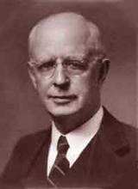
Lewis Sperry Chafer, vol. 7, Systematic Theology (Grand Rapids, MI: Kregel Publications, 1993), 265-66.
Belief – God’s One Condition for Justification
“…because upwards of 150 passages of Scripture condition salvation upon believing only (cf. John 3:16; Acts 16:31).”

Slide 53
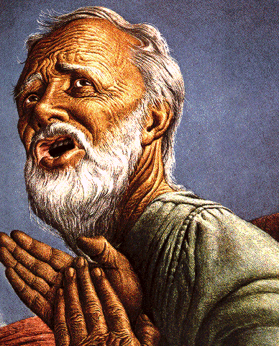
Belief – God’s One Condition for Justification
Gen 15:6
Then he believed in the LORD; and He reckoned it to him as righteousness.
John 3:16
For God so loved the world, that He gave His only begotten Son, that whoever believes in Him shall not perish, but have eternal life.
Acts 16:30-31
"Sirs, what must I do to be saved?" They said, "Believe in the Lord Jesus, and you will be saved..."

Slide 54
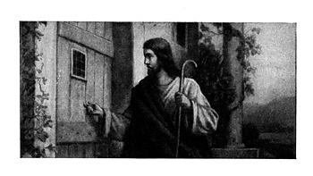
Imminency?
Ethnocentricity
Does not exactly fit church history
Allegorical

Slide 55
1 John 1:9
“If we confess our sins, He is faithful and righteous to forgive us our sins and to cleanse us from all unrighteousness.”

Slide 56
John 15:4-5
“Abide in Me, and I in you. As the branch cannot bear fruit of itself unless it abides in the vine, so neither can you unless you abide in Me. ⁵ I am the vine, you are the branches; he who abides in Me and I in him, he bears much fruit, for apart from Me you can do nothing..”

Slide 57
Laodicea Revelation 3:14-22
Destination (14a)
Description of Christ (14b)
Commendation
Rebuke (15-17)
Exhortation (18-20)
Consequence (19a)
Promise to overcomers (21)
Exhortation to listen (22)

Slide 59
Revelation 2:22-23
“Behold, I will throw her on a bed of sickness, and those who commit adultery with her into great tribulation, unless they repent of her deeds. And I will kill her children with pestilence, and all the churches will know that I am He who searches the minds and hearts; and I will give to each one of you according to your deeds.”

Slide 60
1 John 5:16
“If anyone sees his brother committing a sin not leading to death, he shall ask and God will for him give life to those who commit sin not leading to death. There is a sin leading to death; I do not say that he should make request for this.”

Slide 61
Laodicea Revelation 3:14-22
Destination (14a)
Description of Christ (14b)
Commendation
Rebuke (15-17)
Exhortation (18-20)
Consequence (19a)
Promise to overcomers (21)
Exhortation to listen (22)

Slide 62
7. Promise to the Overcomers
Rev 3:21
“He who overcomes, I will grant to him to sit down with Me on My throne, as I also overcame and sat down with My Father on His throne.”

Slide 63
7. Promise to the Overcomers
Rev 3:21
“He who overcomes, I will grant to him to sit down with Me on My throne, as I also overcame and sat down with My Father on His throne.”

Slide 64
1 John 5:4-5
^{“4} For whatever is born of God overcomes the world; and this is the victory that has overcome the world—our faith. ⁵ Who is the one who overcomes the world, but he who believes that Jesus is the Son of God?”

Slide 66
7. Promise to the Overcomers
Rev 3:21
“He who overcomes, I will grant to him to sit down with Me on My throne, as I also overcame and sat down with My Father on His throne.”

Slide 67
7. Promise to the Overcomers
Rev 3:21
“He who overcomes, I will grant to him to sit down with Me on My throne, as I also overcame and sat down with My Father on His throne.”

Slide 68
Revelation 5:10
“You have made them to be a kingdom and priests to our God; and they will reign [basileuō] upon the earth [gē].”

Slide 69
Laodicea Revelation 3:14-22
Destination (14a)
Description of Christ (14b)
Commendation
Rebuke (15-17)
Exhortation (18-20)
Consequence (19a)
Promise to overcomers (21)
Exhortation to listen (22)

Slide 70
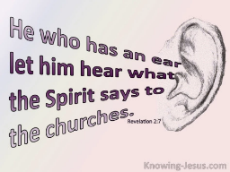
8. Exhortation to Listen
Rev 3:22
“He who has an ear, let him hear what the Spirit says to the churches.”

Slide 71
8. Exhortation to Listen
Rev 3:22
“He who has an ear, let him hear what the Spirit says to the churches.”

Slide 72
Deuteronomy 6:4-7
⁴ “Hear, O Israel! The Lord is our God, the Lord is one!...⁶ These words, which I am commanding you today, shall be on your heart. ⁷ You shall teach them diligently to your sons and shall talk of them when you sit in your house and when you walk by the way and when you lie down and when you rise up.”

Slide 73
8. Exhortation to Listen
Rev 3:22
“He who has an ear, let him hear what the Spirit says to the churches.”

Slide 74
Conclusion

Slide 75
Laodicea Revelation 3:14-22
Destination (14a)
Description of Christ (14b)
Commendation
Rebuke (15-17)
Exhortation (18-20)
Consequence (19a)
Promise to overcomers (21)
Exhortation to listen (22)

Slide 76
“The Lord bless you and keep you; the Lord make his face shine on you and be gracious to you; the Lord turn his face toward you and give you peace.” (NIV)

