Slide 1

Ecclesiology
Session 38
Dr. Andy Woods
Senior Pastor – Sugar Land Bible Church
President – Chafer Theological Seminary

Slide 2


Areas of Systematic Theology
Prolegomena – Introduction
Theology – Study of God
Christology – Study of Christ
Pneumatology – Study of the Holy Spirit
Anthropology – Study of Man
Hamartiology – Study of sin
Soteriology – Study of salvation
Angelology – Study of angels
Ecclesiology – Study of the Church
Eschatology – Study of the end

Slide 3

Ecclesiology Overview
Definition
Universal vs. local
Word pictures
Origin
Israel – Church differences
Intercalation
Purposes
Activities
Government
Officers
Ordinances
Purity

Slide 4

VII. Purposes of the Local Church
Glorify God (Eph 3:21)
Edify the saints (Eph 4:11-16)
Fulfill the Great Commission (Matt 28:18-20)

Slide 5

Ephesians 4:11-16
“¹¹ And He gave some as apostles, and some as prophets, and some as evangelists, and some as pastors and teachers, ¹² for the equipping of the saints for the work of service, to the building up of the body of Christ;”

Slide 6
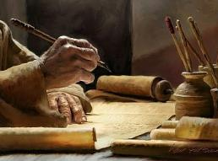
2 Timothy 3:16-17
“¹⁶ All Scripture is inspired by God and profitable for teaching, for reproof, for correction, for training in righteousness; ¹⁷ so that the man of God may be adequate, equipped for every good work.”

Slide 7

Spiritual Gifts

Slide 8
Areas of Systematic Theology
Prolegomena – Introduction
Theology – Study of God
Christology – Study of Christ
Pneumatology – Study of the Holy Spirit
Anthropology – Study of Man
Hamartiology – Study of sin
Soteriology – Study of salvation
Angelology – Study of angels
Ecclesiology – Study of the Church
Eschatology – Study of the end

Slide 9
12/12/4/4
Romans 12
1 Corinthians 12
1 Peter 4
Ephesians 4

Slide 10
Four Questions
What are some general observations about spiritual gifts?
Are all the spiritual gifts for today?
What are the spiritual gifts?
How do we discover our own unique area of gifting?

Slide 11
Four Questions
What are some general observations about spiritual gifts?
Are all the spiritual gifts for today?
What are the spiritual gifts?
How do we discover our own unique area of gifting?

Slide 12
Four Questions
What are some general observations about spiritual gifts?
Are all the spiritual gifts for today?
What are the spiritual gifts?
How do we discover our own unique area of gifting?

Slide 13
The 7 Disputed Gifts
Apostle
Prophet
Worker of Miracles
Tongues
Interpretation of tongues
Healing
Knowledge

Slide 14
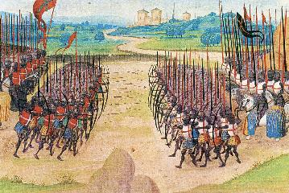
Two Camps
Charismatics – All the spiritual gifts are in operation today
Cessationists (selective)– Most of the spiritual gifts are in operation today

Slide 15
SLBC Position Statement No. 7
“TEMPORARY SPIRITUAL GIFTS – This church teaches that the miraculous sign gifts, including the gift of tongues, (always the ability to speak in a previously unlearned, known language) along with the gift of healings were temporal gifts, given by the Holy Spirit solely to authenticate both the apostles and their message before the close of the canon of Scripture (1 Cor. 13:8-10). We do not believe that these are active as gifts today. However, we affirm that God is sovereign and may heal and/or give someone the ability to speak in a tongue (foreign language) today. We believe that the majority of what is termed ‘miraculous’ within the contemporary charismatic movement is something other than the Biblical gifts of tongues or healing.”

Slide 16
Four Questions
What are some general observations about spiritual gifts?
Are all the spiritual gifts for today?
What are the spiritual gifts?
How do we discover our own unique area of gifting?

Slide 17
12/12/4/4
Romans 12
1 Corinthians 12
1 Peter 4
Ephesians 4

Slide 18
Spiritual Gifts: #1
Prophecy: the ability to proclaim God’s truth without compromise

Slide 19
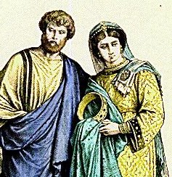
Spiritual Gifts: #2
Teaching: the ability to explain clearly what God has already revealed (1 Cor 12:28)

Slide 20
Spiritual Gifts: #3
Pastor-teacher: the ability to equip and mature the body of Christ (Eph 4:11-16)

Slide 21
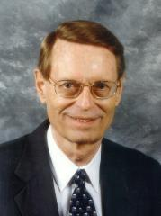
Pastor-Teacher (Eph 4:11)
“pastors and teachers. The two ministries are linked together here, though separated elsewhere (Rom 12:7; 1 Pet 5:2).”
Ryrie Study Bible, p. 1881

Slide 22
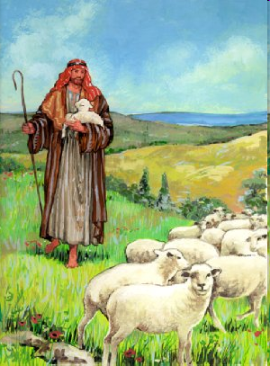
Shepherd/Pastor
Guide
Guard
Graze

Slide 23
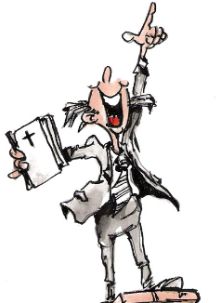
Spiritual Gifts: #4
Evangelism: the ability to share the good news of Jesus Christ with unbelievers

Slide 24
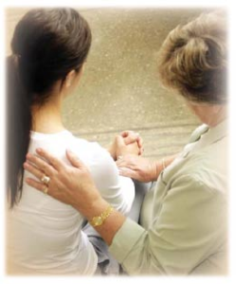
Spiritual Gifts: #5
Exhortation: the ability to encourage others in the body of Christ

Slide 25
Spiritual Gifts: #6
Discernment: the ability to detect moral or doctrinal error (Rev 2:2)

Slide 26
Spiritual Gifts: #7
Administration: the ability to effectively run or manage a church program

Slide 27
Spiritual Gifts: #8
Leadership: the ability to cast an organizational vision and motivate others toward the fulfillment of that vision

Slide 28
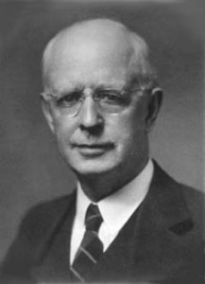
Spiritual Gifts: #9
Knowledge: the ability to understand complex biblical truths (1 Cor 8:1)

Slide 29
Spiritual Gifts: #10
Wisdom: the ability to find knowledge from the Scriptures and apply it to daily life (1 Cor 2:6-7)

Slide 30
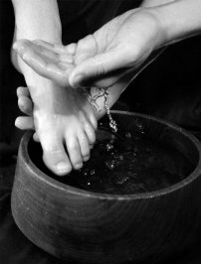
Spiritual Gifts: #11
Service: the ability to minister to others

Slide 31
Spiritual Gifts: #12
Giving: the ability to give material goods and financial resources with joy so that the needs of the Lord’s work are met

Slide 32

Spiritual Gifts: #13
Hospitality: the ability to make guests feel comfortable and at home (Rom 12:13)

Slide 33
Spiritual Gifts: #14
Mercy: the ability to devote energy toward helping those in pitiable conditions

Slide 34
Spiritual Gifts: #15
Helps: the ability to free up others from certain responsibilities so that they can exercise their gifts more effectively (Acts 6:1-4)

Slide 35
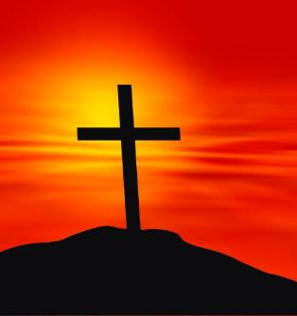
Spiritual Gifts: #16
Faith: the ability to trust God in the midst of life’s difficulties

Slide 36
Four Questions
What are some general observations about spiritual gifts?
Are all the spiritual gifts for today?
What are the spiritual gifts?
How do we discover our own unique area of gifting?

Slide 37
4. How do we discover our own unique area of gifting?
Know what the Spiritual gifts are and their purposes
Obey the revealed will of God to all believers
What do you naturally gravitate towards?
What ministries do you enjoy (Ps. 37:4)?
Does anyone get especially blessed when you serve in particular way?
What are you most critical of?
Step out in faith (Rom. 12:6)
Do not despise the day of small beginnings (Zech. 4:10)

Slide 38
4. How do we discover our own unique area of gifting?
Know what the Spiritual gifts are and their purposes
Obey the revealed will of God to all believers
What do you naturally gravitate towards?
What ministries do you enjoy (Ps. 37:4)?
Does anyone get especially blessed when you serve in particular way?
What are you most critical of?
Step out in faith (Rom. 12:6)
Do not despise the day of small beginnings (Zech. 4:10)

Slide 39
How Do We Discover Our Gifts?
Know what the gifts are and their purpose

Slide 40
4. How do we discover our own unique area of gifting?
Know what the Spiritual gifts are and their purposes
Obey the revealed will of God to all believers
What do you naturally gravitate towards?
What ministries do you enjoy (Ps. 37:4)?
Does anyone get especially blessed when you serve in particular way?
What are you most critical of?
Step out in faith (Rom. 12:6)
Do not despise the day of small beginnings (Zech. 4:10)

Slide 41
How Do We Discover Our Gifts?
Obey the known or revealed will of God to all believers (Luke 16:10; Rom 12:1)

Slide 42
4. How do we discover our own unique area of gifting?
Know what the Spiritual gifts are and their purposes
Obey the revealed will of God to all believers
What do you naturally gravitate towards?
What ministries do you enjoy (Ps. 37:4)?
Does anyone get especially blessed when you serve in particular way?
What are you most critical of?
Step out in faith (Rom. 12:6)
Do not despise the day of small beginnings (Zech. 4:10)

Slide 43
How Do We Discover Our Gifts?
What do you naturally gravitate toward?

Slide 44
4. How do we discover our own unique area of gifting?
Know what the Spiritual gifts are and their purposes
Obey the revealed will of God to all believers
What do you naturally gravitate towards?
What ministries do you enjoy (Ps. 37:4)?
Does anyone get especially blessed when you serve in particular way?
What are you most critical of?
Step out in faith (Rom. 12:6)
Do not despise the day of small beginnings (Zech. 4:10)

Slide 45
How Do We Discover Our Gifts?
What ministry or ministries do you enjoy doing?

Slide 46
4. How do we discover our own unique area of gifting?
Know what the Spiritual gifts are and their purposes
Obey the revealed will of God to all believers
What do you naturally gravitate towards?
What ministries do you enjoy (Ps. 37:4)?
Does anyone get especially blessed when you serve in particular way?
What are you most critical of?
Step out in faith (Rom. 12:6)
Do not despise the day of small beginnings (Zech. 4:10)

Slide 47
How Do We Discover Our Gifts?
Does anyone get especially blessed when you serve God in a particular way?

Slide 48
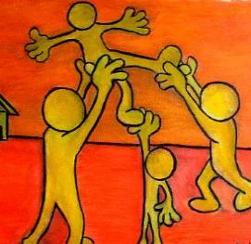
Spiritual Gifts: Observation #6
Spiritual gifts are given in order to edify the church (1 Cor 12:7; 14:12, 26; Eph 4:11-12; 1 Pet 4:10)

Slide 49
4. How do we discover our own unique area of gifting?
Know what the Spiritual gifts are and their purposes
Obey the revealed will of God to all believers
What do you naturally gravitate towards?
What ministries do you enjoy (Ps. 37:4)?
Does anyone get especially blessed when you serve in particular way?
What are you most critical of?
Step out in faith (Rom. 12:6)
Do not despise the day of small beginnings (Zech. 4:10)

Slide 50

How Do We Discover Our Gifts?
What are you most critical of?

Slide 51
4. How do we discover our own unique area of gifting?
Know what the Spiritual gifts are and their purposes
Obey the revealed will of God to all believers
What do you naturally gravitate towards?
What ministries do you enjoy (Ps. 37:4)?
Does anyone get especially blessed when you serve in particular way?
What are you most critical of?
Step out in faith (Rom. 12:6)
Do not despise the day of small beginnings (Zech. 4:10)

Slide 52
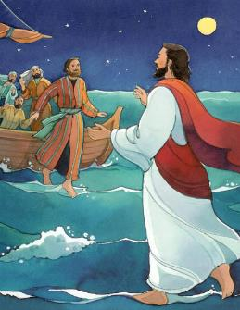
How Do We Discover Our Gifts?
Step out in faith (Rom 12:6)

Slide 53
4. How do we discover our own unique area of gifting?
Know what the Spiritual gifts are and their purposes
Obey the revealed will of God to all believers
What do you naturally gravitate towards?
What ministries do you enjoy (Ps. 37:4)?
Does anyone get especially blessed when you serve in particular way?
What are you most critical of?
Step out in faith (Rom. 12:6)
Do not despise the day of small beginnings (Zech. 4:10)

Slide 54
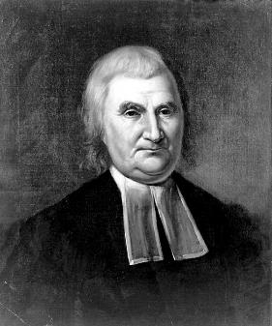
How Do We Discover Our Gifts?
Do not despise the day of small beginnings (Zech 4:10)

Slide 55
4. How do we discover our own unique area of gifting?
Know what the Spiritual gifts are and their purposes
Obey the revealed will of God to all believers
What do you naturally gravitate towards?
What ministries do you enjoy (Ps. 37:4)?
Does anyone get especially blessed when you serve in particular way?
What are you most critical of?
Step out in faith (Rom. 12:6)
Do not despise the day of small beginnings (Zech. 4:10)

Slide 56
Four Questions
What are some general observations about spiritual gifts?
Are all the spiritual gifts for today?
What are the spiritual gifts?
How do we discover our own unique area of gifting?

Slide 57
Conclusion

Slide 58
Ecclesiology Overview
Definition
Universal vs. local
Word pictures
Origin
Israel – Church differences
Intercalation
Purposes
Activities
Government
Officers
Ordinances
Purity

