Slide 1
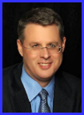
Dr. Andy Woods
Senior Pastor – Sugar Land Bible Church
President – Chafer Theological Seminary

Slide 2
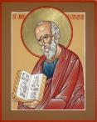
Answering Ten Questions
What is the title – Revelation of Jesus Christ
Who wrote it? – John
Where was it written from? – Patmos
To Whom was it written? – The Seven Churches
When was it written? – A.D. 95
How is it organized (outline)? – 3 part outline
How was it delivered – Seven steps
Why was it written? – Encouragement and holiness
What is it about? – Jesus’ final victory
What makes the book different? – OT relationship

Slide 3
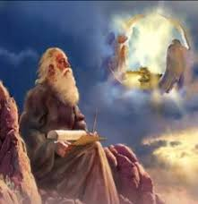
Prologue (Rev. 1:1-8)
Title (1a)
Chain of Communication (1b-2)
Blessing (3)
Author (4a)
Audience (4b)
Greeting (4c)
Source (4d-5a)
Subject (5b-8)

Slide 4
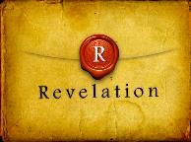
Revelation 1:19
“Therefore write the things which you have seen, and the things which are, and the things which will take place after these things [meta tauta].”

Slide 5
Revelation 1:19
Seen (Chapter 1)
Are (Chapters 2–3)
After these things (Chapters 4–22)

Slide 6
Revelation 1:19
Seen (Chapter 1)
Are (Chapters 2–3)
After these things (Chapters 4–22)

Slide 7
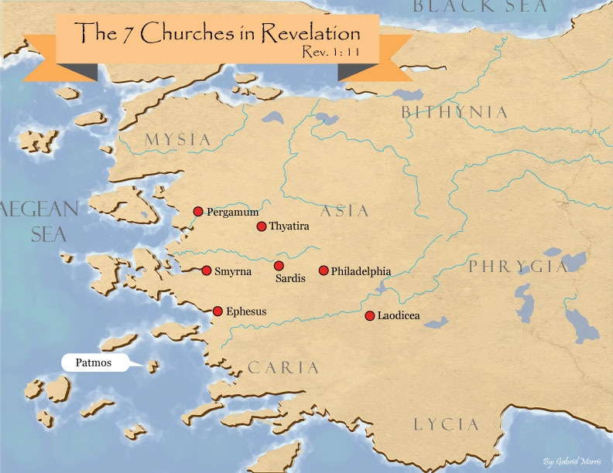

Slide 8
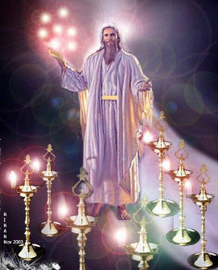
Pattern of the Letters in Revelation 2–3
Destination
Description of Christ (Rev. 1)
Commendation
Rebuke
Exhortation to change
Consequence
Exhortation to listen
Promise to overcomers (Rev. 21–22)

Slide 9
DESCRIPTION OF THE SEVEN CHURCHES Revelation 2‒3
CHURCH | SCRIPTURE | DESCRIPTION
Ephesus | 2:1-7 | Loveless
Smyrna | 2:8-11 | Persecuted
Pergamum | 2:12-17 | Compromised
Thyatira | 2:18-29 | Corrupt
Sardis | 3:1-6 | Dead
Philadelphia | 3:7-13 | Missionary
Laodicea | 3:14-22 | Man-centered

Slide 10
DESCRIPTION OF THE SEVEN CHURCHES Revelation 2‒3
CHURCH | SCRIPTURE | DESCRIPTION
Ephesus | 2:1-7 | Loveless
Smyrna | 2:8-11 | Persecuted
Pergamum | 2:12-17 | Compromised
Thyatira | 2:18-29 | Corrupt
Sardis | 3:1-6 | Dead
Philadelphia | 3:7-13 | Missionary
Laodicea | 3:14-22 | Man-centered

Slide 11
DESCRIPTION OF THE SEVEN CHURCHES Revelation 2‒3
CHURCH | SCRIPTURE | DESCRIPTION
Ephesus | 2:1-7 | Loveless
Smyrna | 2:8-11 | Persecuted
Pergamum | 2:12-17 | Compromised
Thyatira | 2:18-29 | Corrupt
Sardis | 3:1-6 | Dead
Philadelphia | 3:7-13 | Missionary
Laodicea | 3:14-22 | Man-centered

Slide 12
DESCRIPTION OF THE SEVEN CHURCHES Revelation 2‒3
CHURCH | SCRIPTURE | DESCRIPTION
Ephesus | 2:1-7 | Loveless
Smyrna | 2:8-11 | Persecuted
Pergamum | 2:12-17 | Compromised
Thyatira | 2:18-29 | Corrupt
Sardis | 3:1-6 | Dead
Philadelphia | 3:7-13 | Missionary
Laodicea | 3:14-22 | Man-centered

Slide 13
DESCRIPTION OF THE SEVEN CHURCHES Revelation 2‒3
CHURCH | SCRIPTURE | DESCRIPTION
Ephesus | 2:1-7 | Loveless
Smyrna | 2:8-11 | Persecuted
Pergamum | 2:12-17 | Compromised
Thyatira | 2:18-29 | Corrupt
Sardis | 3:1-6 | Dead
Philadelphia | 3:7-13 | Missionary
Laodicea | 3:14-22 | Man-centered

Slide 14
DESCRIPTION OF THE SEVEN CHURCHES Revelation 2‒3
CHURCH | SCRIPTURE | DESCRIPTION
Ephesus | 2:1-7 | Loveless
Smyrna | 2:8-11 | Persecuted
Pergamum | 2:12-17 | Compromised
Thyatira | 2:18-29 | Corrupt
Sardis | 3:1-6 | Dead
Philadelphia | 3:7-13 | Missionary
Laodicea | 3:14-22 | Man-centered

Slide 15
DESCRIPTION OF THE SEVEN CHURCHES Revelation 2‒3
CHURCH | SCRIPTURE | DESCRIPTION
Ephesus | 2:1-7 | Loveless
Smyrna | 2:8-11 | Persecuted
Pergamum | 2:12-17 | Compromised
Thyatira | 2:18-29 | Corrupt
Sardis | 3:1-6 | Dead
Philadelphia | 3:7-13 | Missionary
Laodicea | 3:14-22 | Man-centered

Slide 16
Philadelphia Revelation 3:7-13
Destination (7a)
Description of Christ (7b)
Commendation (8-9)
Rebuke
Consequence
Exhortation (10-11)
Promise to overcomers (12)
Exhortation to listen (13)

Slide 17
Philadelphia Revelation 3:7-13
Destination (7a)
Description of Christ (7b)
Commendation (8-9)
Rebuke
Consequence
Exhortation (10-11)
Promise to overcomers (12)
Exhortation to listen (13)

Slide 19
Philadelphia Revelation 3:7-13
Destination (7a)
Description of Christ (7b)
Commendation (8-9)
Rebuke
Consequence
Exhortation (10-11)
Promise to overcomers (12)
Exhortation to listen (13)

Slide 20
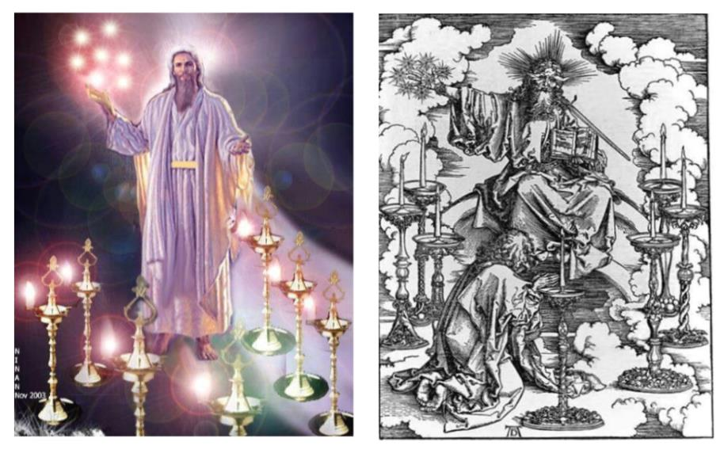

Slide 21
2. Description of Christ to Philadelphia (Rev. 3:7b)
Holy
True
Holds the Key of David
Authoritatively opens and closes doors

Slide 22
Philadelphia Revelation 3:7-13
Destination (7a)
Description of Christ (7b)
Commendation (8-9)
Rebuke
Consequence
Exhortation (10-11)
Promise to overcomers (12)
Exhortation to listen (13)

Slide 23
Revelation 3:8
“I know your deeds. Behold, I have put before you an open door which no one can shut, because you have a little power, and have kept My word, and have not denied My name.”

Slide 24
Revelation 3:8
“I know your deeds. Behold, I have put before you an open door which no one can shut, because you have a little power, and have kept My word, and have not denied My name.”

Slide 25
Revelation 3:9
“Behold, I will cause those of the synagogue of Satan, who say that they are Jews and are not, but lie—I will make them come and bow down at your feet, and make them know that I have loved you.”

Slide 26
Philadelphia Revelation 3:7-13
Destination (7a)
Description of Christ (7b)
Commendation (8-9)
Rebuke
Consequence
Exhortation (10-11)
Promise to overcomers (12)
Exhortation to listen (13)

Slide 27
Philadelphia Revelation 3:7-13
Destination (7a)
Description of Christ (7b)
Commendation (8-9)
Rebuke
Consequence
Exhortation (10-11)
Promise to overcomers (12)
Exhortation to listen (13)

Slide 28
Philadelphia Revelation 3:7-13
Destination (7a)
Description of Christ (7b)
Commendation (8-9)
Rebuke
Consequence
Exhortation (10-11)
Promise to overcomers (12)
Exhortation to listen (13)

Slide 29
Revelation 3:10
“Because you have kept the word of My perseverance, I also will keep you from the hour of testing, that hour which is about to come upon the whole world, to test those who dwell on the earth.”

Slide 30
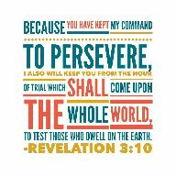
Does Revelation 3:10 Teach the Pre-Tribulation Rapture?
Are there easier ways to convey “protection through”?
Will God protect believers during the Tribulation?
What is the meaning of “keep you from”?
What is the meaning of “the hour”?
What is the meaning of the “whole world”?
What is the meaning of “testing/to test”?

Slide 31
Does Revelation 3:10 Teach the Pre-Tribulation Rapture?
Who are the “earth-dwellers”?
What is the meaning of “about to come”?
How will Christ keep His promise?
Is this promise for Philadelphia only?
How does the Pre-Trib. View of Rev. 3:10 harmonize with the rest of the Book of Revelation?

Slide 32
Revelation 3:11
“I am coming quickly; hold fast what you have, so that no one will take your crown.”

Slide 33
Revelation 3:11
“I am coming quickly [tacos]; hold fast what you have, so that no one will take your crown.”

Slide 34
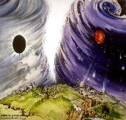
Chronological vs. Adverbial Use of Tacos
“I hope to come to you soon” (1 Tim 3:14) vs. “Leave Jerusalem quickly” (Acts 22:18)
LXX
Isaiah 13:22: “Her fateful time also will soon come”
Isaiah 51:5: “My righteous is near, My salvation has gone forth, And my arms will judge the peoples; The coastlands will wait upon me, And on My arms they will trust.”
Thomas Ice, End Times Controversy, pp.102-108

Slide 35
Revelation 3:11
“I am coming quickly; hold fast what you have, so that no one will take your crown.”

Slide 36
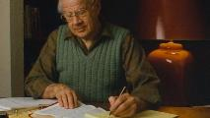
J. Dwight Pentecost
Prophecy for Today, Page 20
“A short time ago, I took occasion to go through the New Testament to mark each reference to the coming of the Lord Jesus Christ and to observe the use made of that teaching about His coming. I was struck anew with the fact that almost without exception, when the coming of Christ is mentioned in the New Testament, it is followed by an exhortation to godliness and holy living.”

Slide 37
2 Peter 3:10-11
¹⁰ But the day of the Lord will come like a thief, in which the heavens will pass away with a roar and the elements will be destroyed with intense heat, and the earth and its works will be burned up. ¹¹ Since all these things are to be destroyed in this way, what sort of people ought you to be in holy conduct and godliness.

Slide 38
Remembrance in 2 Peter
Has forgotten that he has been cleansed (1:9)
I will always remind you of these things (1:12)
It is right to refresh your memory (1:13)
You will always be able to remember these things (1:15)
I have written both of them as reminders (3:1)
Do not forget (3:8)
Bear in mind (3:15)

Slide 39
Revelation 2:24-25
“But I say to you, the rest who are in Thyatira, who do not hold this teaching, who have not known the deep things of Satan, as they call them—I place no other burden on you. Nevertheless what you have, hold fast until I come.”

Slide 40
Jeremiah 6:16
“Thus says the Lord, ‘Stand by the ways and see and ask for the ancient paths, Where the good way is, and walk in it; And you will find rest for your souls. But they said, ‘We will not walk in it.’”

Slide 41
Revelation 3:11
“I am coming quickly; hold fast what you have, so that no one will take your crown.”

Slide 42
Scripture’s Five Crowns (Rev 4:10: 3:11; 2 John 8)
SCRIPTURE | CROWN | PURPOSE
1 Cor. 9:24-27 | Incorruptible | Gaining mastery over the flesh
1 Thess. 2:19-20 | Rejoicing | Soul winning
Jas. 1:12; Rev. 2:10 | Life | Enduring trials
1 Pet. 5:2-4 | Glory | Shepherding God’s people
2 Tim. 4:8 | Righteousness | Longing for His appearing

Slide 43
2 Timothy 4:8
“In the future there is laid up for me the crown of righteousness, which the Lord, the righteous Judge, will award to me on that day; and not only to me, but also to all who have loved His appearing.”

Slide 44
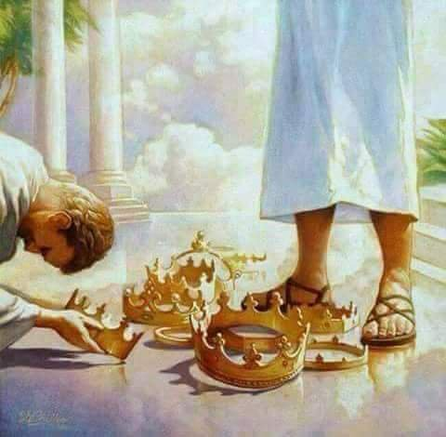

Slide 45
1 Corinthians 3:10-15
“¹⁰ According to the grace of God which was given to me, like a wise master builder I laid a foundation, and another is building on it. But each man must be careful how he builds on it. ¹¹ For no man can lay a foundation other than the one which is laid, which is Jesus Christ. ¹² Now if any man builds on the foundation with gold, silver, precious stones, wood, hay, straw…”

Slide 46
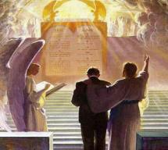
1 Corinthians 3:10-15
“¹⁴ If any man’s work which he has built on it remains, he will receive a reward. ¹⁵ If any man’s work is burned up, he will suffer loss; but he himself will be saved, yet so as through fire.”

Slide 47
1 Corinthians 9:24-27
“²⁴ Do you not know that those who run in a race all run, but only one receives the prize? Run in such a way that you may win. ²⁵ Everyone who competes in the games exercises self-control in all things. They then do it to receive a perishable wreath, but we an imperishable. ²⁶ Therefore I run in such a way, as not without aim; I box in such a way, as not beating the air; ²⁷ but I discipline my body and make it my slave, so that, after I have preached to others, I myself will not be disqualified.”

Slide 48
2 John 8
“Watch yourselves, that you do not lose what we have accomplished, but that you may receive a full reward.”

Slide 49
1 Corinthians 4:5
“ Therefore do not go on passing judgment before the time, but wait until the Lord comes who will both bring to light the things hidden in the darkness and disclose the motives of men’s hearts; and then each man’s praise will come to him from God.”

Slide 50
Grant R. Jeffrey
Apocalypse: The Coming Judgment of the Nations, p. 85, 87.
“Someday every Christian will stand before the Judgment Seat of Christ to receive rewards for faithful service. Some believers will receive no rewards at all because they lived their lives of service to self rather than service to the Lord...Christians are promised a number of golden crowns for us faithful service to the Lord. Jesus warned that we are to ‘hold fast’ lest we lose our crowns. This indicates that it is possible to lose eternal rewards and blessings that God prepared for those who love Him. While our salvation is assured today by our accepting Christ as our savior...our future reward will be determined at the Judgment Seat of Christ after the Rapture. We are encouraged to hold on to these rewards through continued faithful service.”

Slide 51
John 10:27-29
“My sheep hear My voice, and I know them, and they follow Me; ²⁸ and I give eternal life to them, and they will never perish [ou mē; aiōnia]; and no one will snatch them out of My hand. 29 My Father, who has given them to Me, is greater than all; and no one is able to snatch them out of the Father’s hand.”

Slide 52
Philadelphia Revelation 3:7-13
Destination (7a)
Description of Christ (7b)
Commendation (8-9)
Rebuke
Consequence
Exhortation (10-11)
Promise to overcomers (12)
Exhortation to listen (13)

Slide 53
7. Promise to the Overcomers
Rev 3:12
“He who overcomes, I will make him a pillar in the temple of My God, and he will not go out from it anymore; and I will write on him the name of My God, and the name of the city of My God, the new Jerusalem, which comes down out of heaven from My God, and My new name.”

Slide 54
7. Promise to the Overcomers
Rev 3:12
“He who overcomes, I will make him a pillar in the temple of My God, and he will not go out from it anymore; and I will write on him the name of My God, and the name of the city of My God, the new Jerusalem, which comes down out of heaven from My God, and My new name.”

Slide 55
1 John 5:4-5
^{“4} For whatever is born of God overcomes the world; and this is the victory that has overcome the world—our faith. ⁵ Who is the one who overcomes the world, but he who believes that Jesus is the Son of God?”

Slide 57
7. Christ’s Promises to Overcomers in Philadelphia (Rev. 3:12)
Pillar in God’s Temple ‒ 12a
Three names ‒ 12b
My God
New Jerusalem
Son’s new name

Slide 58
7. Christ’s Promises to Overcomers in Philadelphia (Rev. 3:12)
Pillar in God’s Temple ‒ 12a
Three names ‒ 12b
My God
New Jerusalem
Son’s new name

Slide 59
7. Promise to the Overcomers
Rev 3:12
“He who overcomes, I will make him a pillar in the temple of My God, and he will not go out from it anymore; and I will write on him the name of My God, and the name of the city of My God, the new Jerusalem, which comes down out of heaven from My God, and My new name.”

Slide 60
7. Christ’s Promises to Overcomers in Philadelphia (Rev. 3:12)
Pillar in God’s Temple ‒ 12a
Three names ‒ 12b
My God
New Jerusalem
Son’s new name

Slide 61
7. Christ’s Promises to Overcomers in Philadelphia (Rev. 3:12)
Pillar in God’s Temple ‒ 12a
Three names ‒ 12b
My God
New Jerusalem
Son’s new name

Slide 62
7. Promise to the Overcomers
Rev 3:12
“He who overcomes, I will make him a pillar in the temple of My God, and he will not go out from it anymore; and I will write on him the name of My God, and the name of the city of My God, the new Jerusalem, which comes down out of heaven from My God, and My new name.”

Slide 63
7. Christ’s Promises to Overcomers in Philadelphia (Rev. 3:12)
Pillar in God’s Temple ‒ 12a
Three names ‒ 12b
My God
New Jerusalem
Son’s new name

Slide 64
7. Promise to the Overcomers
Rev 3:12
“He who overcomes, I will make him a pillar in the temple of My God, and he will not go out from it anymore; and I will write on him the name of My God, and the name of the city of My God, the new Jerusalem, which comes down out of heaven from My God, and My new name.”

Slide 65
Jerusalem Descending
Notes:
The descending city is described as being like a stone called Jasper, only unlike the earthly stone, this one is clear as crystal. The ultimate state of heaven sounds more like a diamond, doesn’t it?

Slide 66
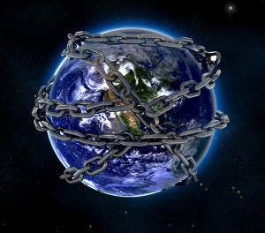

Slide 67
Romans 8:19-22
¹⁹ For the anxious longing of the creation waits eagerly for the revealing of the sons of God. ²⁰ For the creation was subjected to futility, not willingly, but because of Him who subjected it, in hope ²¹ that the creation itself also will be set free from its slavery to corruption into the freedom of the glory of the children of God. ²² For we know that the whole creation groans and suffers the pains of childbirth together until now.

Slide 68
7. Christ’s Promises to Overcomers in Philadelphia (Rev. 3:12)
Pillar in God’s Temple ‒ 12a
Three names ‒ 12b
My God
New Jerusalem
Son’s new name

Slide 69
7. Promise to the Overcomers
Rev 3:12
“He who overcomes, I will make him a pillar in the temple of My God, and he will not go out from it anymore; and I will write on him the name of My God, and the name of the city of My God, the new Jerusalem, which comes down out of heaven from My God, and My new name.”

Slide 70
1 Peter 1:2
“according to the foreknowledge of God the Father, by the sanctifying work of the Spirit, to obey Jesus Christ and be sprinkled with His blood: May grace and peace be yours in the fullest measure.”

Slide 71
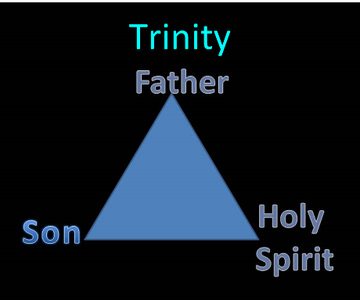

Slide 72
Philadelphia Revelation 3:7-13
Destination (7a)
Description of Christ (7b)
Commendation (8-9)
Rebuke
Consequence
Exhortation (10-11)
Promise to overcomers (12)
Exhortation to listen (13)

Slide 73
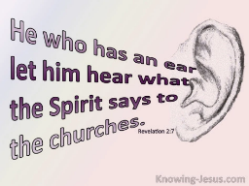
8. Exhortation to Listen
Rev 3:13
“He who has an ear, let him hear what the Spirit says to the churches.”

Slide 74
8. Exhortation to Listen
Rev 3:13
“He who has an ear, let him hear what the Spirit says to the churches.”

Slide 75
Deuteronomy 6:4-7
⁴ “Hear, O Israel! The Lord is our God, the Lord is one!...⁶ These words, which I am commanding you today, shall be on your heart. ⁷ You shall teach them diligently to your sons and shall talk of them when you sit in your house and when you walk by the way and when you lie down and when you rise up.”

Slide 76
8. Exhortation to Listen
Rev 3:13
“He who has an ear, let him hear what the Spirit says to the churches.”

Slide 77
Conclusion

Slide 78
Philadelphia Revelation 3:7-13
Destination (7a)
Description of Christ (7b)
Commendation (8-9)
Rebuke
Consequence
Exhortation (10-11)
Promise to overcomers (12)
Exhortation to listen (13)

Slide 79
“The Lord bless you and keep you; the Lord make his face shine on you and be gracious to you; the Lord turn his face toward you and give you peace.” (NIV)

