Slide 1
Biblical Dispensationalism
Session 1
Introduction to Biblical Dispensationalism
Sugar Land Bible Church
10-03-2018
Jim McGowan, MTS, Th.D.

Slide 2
Session 1 Outline
Important Assumptions and Prerequisites
The Inspiration & Authority of Scripture
Revelation
Inspiration
Inerrancy
Canon
Hermeneutics

Slide 3
Session 1 Outline
Important Assumptions and Prerequisites
The Inspiration & Authority of Scripture
Revelation
Inspiration
Inerrancy
Canon
Hermeneutics

Slide 4
The Inspiration & Authority of Scripture
Revelation - Revelation is of necessity an act of God by which God makes Himself known to His creatures.
Theophanies (appearances of God)
Dreams and visions
Direct contacts
Miracles and signs
Prophets
The revelation of God in Jesus Christ
The Scriptures
Notes:
Revelation – The act by which God makes Himself known to His creatures
God is, by definition, inaccessible to the creature. Isa 55:9, 1 Tim 6:15-16, Isa 45:15
By the fall, man broke the contact with God. Eph 2:1,5; 1 Cor 2:14; 2 Cor 4:4
The revelation of God in nature. Rom 1:19-21; Ps 19:1; Ps 8:3-4
The voice of God in conscience. Rom 2:14-16; 1 Tim 1:19

Slide 5
Revelation
Theophanies (appearances of God)
to Abraham – Gen 17:1; Gen 18:1
to Isaac – Gen 26:2
to Jacob – Gen 32:30
to Moses – Ex 3:2; Ex 33:11
to Gideon – Jdg 6:12

Slide 6
Revelation
Dreams and visions
to Jacob – Gen 28:12
to Solomon – 1 Kings 3:5
to Daniel – Dan 2:19; 7:1; 10:7
to Joseph – Matt 1:20; 2:13
Cornelius – Acts 10:1-8
Peter – Acts 10:10, 17, 19; 11:5ff
Paul – Acts 9 (26:19); 16:10; 18:9; 2 Cor. 12
John – Rev. 1:10; 9:17

Slide 7
Revelation
Direct contact
With Moses – Ex 33:11
With the 70 elders of Israel – Ex 24:9-11
With Balaam – Num 22:9; 23:4

Slide 8
Revelation
Miracles and signs
Judgement of the flood – Gen 6-9
Destruction of Sodom – Gen 19
Burning bush, plagues of Egypt, deliverance of Israel – Ex 3-15
Miracles of the desert and entering promised land – Numbers and Joshua

Slide 9
Revelation
Prophets
Spoke for God – Ex 4:11-12
Do not speak according to their own will – 2 Pet 1:21

Slide 10
Revelation
The revelation of God in Jesus Christ
Jn 1:18
Matt 11:27
Jn 14:9

Slide 11
Revelation
The Scriptures
The written text calls to mind the original message – Ex 17:14; Mal 3:16
A book groups together all the messages received – 1 Cor 10:11
The written message works independently of orator and writer – Jer 36:2-32

Slide 12
Revelation
The Scriptures
Written message becomes universal, indestructible and almost omnipresent - Revelation to the prophet, orally to a few, but written word could be put in all population
Written revelation makes its readers forever afterward responsible – Luke 16:29

Slide 13
Important Assumptions and Prerequisites
The Inspiration & Authority of Scripture
Revelation
Inspiration
Inerrancy
Canon
Hermeneutics

Slide 14
The Inspiration & Authority of Scripture
Inspiration – The determining influence exercised by the Holy Spirit on the writers of the Old and New Testaments in order that they might accurately proclaim and set down in an exact and authentic way the message as received from God. This influence guided them even to the extent of their use of words, that they might be kept from all error and omission.

Slide 15
2 Timothy 3:16–17
¹⁶ All Scripture is inspired by God and profitable for teaching, for reproof, for correction, for training in righteousness; ¹⁷ so that the man of God may be adequate, equipped for every good work.

Slide 16
The Inspiration & Authority of Scripture
Inspiration (cont’d)
“All Scripture is inspired by God” – in the Greek theopneustos, literally: breathed out from God – produced by the life-giving breath of God, proceeding from Him, spoken by Him.
Creation by the breath of His mouth (Ps 33:6)
It is “every Scripture” or “all the Scripture” which is inspired.
It is the Scripture, the text itself, which, according to Paul, is inspired.
Notes:
“All Scripture is inspired by God” – in the Greek theopneustos, literally: breathed out from God – produced by the life-giving breath of God, proceeding from Him, spoken by Him.
Creation by the breath of His mouth (Ps 33:6)
It is “every Scripture” or “all the Scripture” which is inspired.
It is the Scripture, the text itself, which, according to Paul, is inspired.
Every scripture is “profitable.” Rev 22:18-19
Every scripture is “for reproof”. John 16:8 – Same word as “convict”
Every scripture is “for correction”. Ps 119:9-11
Every scripture is “training in righteousness”. Ps 119:98-99, 130; 2 Tim 3:15
Every scripture is “so that the man of God may be adequate, equipped for every good work.” James 1:4

Slide 17
The Inspiration & Authority of Scripture
Inspiration (cont’d)
Every scripture is “profitable.” Rev 22:18-19
Every scripture is “for reproof”. John 16:8 – Same word as “convict”
Every scripture is “for correction”. Ps 119:9-11
Every scripture is for “training in righteousness”. Ps 119:98-99, 130; 2 Tim 3:15
Every scripture is “so that the man of God may be adequate, equipped for every good work.” Eph 2:10; 2 Peter 1:3
Notes:
“All Scripture is inspired by God” – in the Greek theopneustos, literally: breathed out from God – produced by the life-giving breath of God, proceeding from Him, spoken by Him.
Creation by the breath of His mouth (Ps 33:6)
It is “every Scripture” or “all the Scripture” which is inspired.
It is the Scripture, the text itself, which, according to Paul, is inspired.
Every scripture is “profitable.” Rev 22:18-19
Every scripture is “for reproof”. John 16:8 – Same word as “convict”
Every scripture is “for correction”. Ps 119:9-11
Every scripture is “training in righteousness”. Ps 119:98-99, 130; 2 Tim 3:15
Every scripture is “so that the man of God may be adequate, equipped for every good work.” James 1:4

Slide 18
The Inspiration & Authority of Scripture
Inspiration (cont’d)
Four ways to regard the Bible:
It is only a remarkable human book without divine inspiration.
It is partially inspired by God.
It is only divine, devoid of any human adjunction (subordinate association).
It is at the same time divine and human, God having fully inspired the sacred authors who spoke in His name.
Notes:
If true, how were the biblical writers able to make so many detailed predictions, confirmed by history, if they had no revelation from above? If the Scriptures were only the product of the human brain, inherently fallible as it is, the Bible would have failed completely in its purpose, which is to give us a sure knowledge of truth.
Those who make such a distinction seem to admit that God spoke to the prophets, but they consider themselves entirely free to reject or to make changes in the written message.
The view that the Scriptures are twofold, both the divine inspiration of every word and the human character, does not seem acceptable to modern unbelievers, even “religious” ones.
We believe that in the composition of the original manuscripts, the Holy Spirit guided the authors even in their choice of expressions and this throughout all the pages of the Scriptures still without eroding the personalities of the different men.

Slide 19
The Inspiration & Authority of Scripture
Inspiration (cont’d)
Four ways to regard the Bible:
It is only a remarkable human book without divine inspiration – If true, and if they had no revelation from above, how were the biblical writers able to make so many detailed predictions, confirmed by history? If the Scriptures were only the product of the human brain, inherently fallible as it is, the Bible would have failed completely in its purpose, which is to give us a sure knowledge of truth.
Notes:
If true, how were the biblical writers able to make so many detailed predictions, confirmed by history, if they had no revelation from above? If the Scriptures were only the product of the human brain, inherently fallible as it is, the Bible would have failed completely in its purpose, which is to give us a sure knowledge of truth.
Those who make such a distinction seem to admit that God spoke to the prophets, but they consider themselves entirely free to reject or to make changes in the written message.
The view that the Scriptures are twofold, both the divine inspiration of every word and the human character, does not seem acceptable to modern unbelievers, even “religious” ones.
We believe that in the composition of the original manuscripts, the Holy Spirit guided the authors even in their choice of expressions and this throughout all the pages of the Scriptures still without eroding the personalities of the different men.

Slide 20
The Inspiration & Authority of Scripture
Inspiration (cont’d)
Four ways to regard the Bible:
It is partially inspired by God – Those who make such a distinction seem to admit that God spoke to the prophets, but they consider themselves entirely free to reject or to make changes in the written message.
Notes:
If true, how were the biblical writers able to make so many detailed predictions, confirmed by history, if they had no revelation from above? If the Scriptures were only the product of the human brain, inherently fallible as it is, the Bible would have failed completely in its purpose, which is to give us a sure knowledge of truth.
Those who make such a distinction seem to admit that God spoke to the prophets, but they consider themselves entirely free to reject or to make changes in the written message.
The view that the Scriptures are twofold, both the divine inspiration of every word and the human character, does not seem acceptable to modern unbelievers, even “religious” ones.
We believe that in the composition of the original manuscripts, the Holy Spirit guided the authors even in their choice of expressions and this throughout all the pages of the Scriptures still without eroding the personalities of the different men.

Slide 21
The Inspiration & Authority of Scripture
Inspiration (cont’d)
Four ways to regard the Bible:
It is only divine, devoid of any human contribution (mechanical dictation theory) – God “dictated” His Word to the writers of Scripture, who were fully under God’s control, in a state of relative passivity. Human personality and error could not interfere because the human writers did not personally contribute anything to the content of Scripture.
Notes:
If true, how were the biblical writers able to make so many detailed predictions, confirmed by history, if they had no revelation from above? If the Scriptures were only the product of the human brain, inherently fallible as it is, the Bible would have failed completely in its purpose, which is to give us a sure knowledge of truth.
Those who make such a distinction seem to admit that God spoke to the prophets, but they consider themselves entirely free to reject or to make changes in the written message.
The view that the Scriptures are twofold, both the divine inspiration of every word and the human character, does not seem acceptable to modern unbelievers, even “religious” ones.
We believe that in the composition of the original manuscripts, the Holy Spirit guided the authors even in their choice of expressions and this throughout all the pages of the Scriptures still without eroding the personalities of the different men.

Slide 22
The Inspiration & Authority of Scripture
Inspiration (cont’d)
Four ways to regard the Bible:
It is at the same time divine and human, God having fully inspired the sacred authors who spoke in His name – We believe that in the composition of the original manuscripts, the Holy Spirit guided the authors even in their choice of expressions and this throughout all the pages of the Scriptures still without eroding the personalities of the different men.
Notes:
If true, how were the biblical writers able to make so many detailed predictions, confirmed by history, if they had no revelation from above? If the Scriptures were only the product of the human brain, inherently fallible as it is, the Bible would have failed completely in its purpose, which is to give us a sure knowledge of truth.
Those who make such a distinction seem to admit that God spoke to the prophets, but they consider themselves entirely free to reject or to make changes in the written message.
The view that the Scriptures are twofold, both the divine inspiration of every word and the human character, does not seem acceptable to modern unbelievers, even “religious” ones.
We believe that in the composition of the original manuscripts, the Holy Spirit guided the authors even in their choice of expressions and this throughout all the pages of the Scriptures still without eroding the personalities of the different men.

Slide 23
The Inspiration & Authority of Scripture
Inspiration (cont’d)
We hold to verbal inspiration (the very words, not just thoughts and ideas) and plenary inspiration (equally in every part of the Scriptures).

Slide 24
Matthew 5:17–18 (KJV)
¹⁷ Think not that I am come to destroy the law, or the prophets: I am not come to destroy, but to fulfil. ¹⁸ For verily I say unto you, Till heaven and earth pass, one jot or one tittle shall in no wise pass from the law, till all be fulfilled.

Slide 25
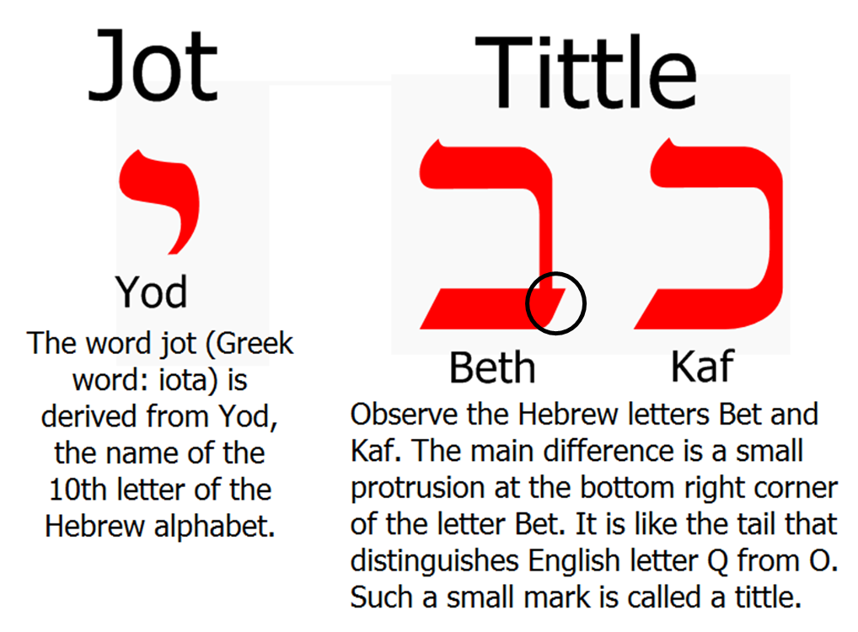
The Inspiration & Authority of Scripture
Inspiration (cont’d)

Slide 26
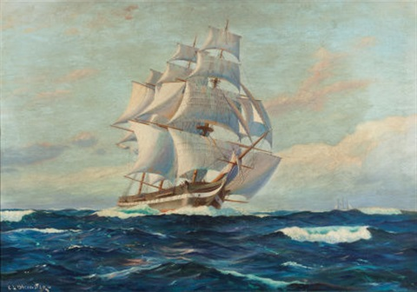
2 Peter 1:20–21
²⁰ But know this first of all, that no prophecy of Scripture is a matter of one’s own interpretation, ²¹ for no prophecy was ever made by an act of human will, but men moved by the Holy Spirit spoke from God.
men… ‘ones being borne along’ by the Holy Spirit… φερόμενοι - Present Passive Participle - Nomative Masculine Plural of φέρω phérō
Notes:
Men…ones being borne along by the Holy Spirit… φερόμενοι PPP NMP φέρω phérō;

Slide 27
Important Assumptions and Prerequisites
The Inspiration & Authority of Scripture
Revelation
Inspiration
Inerrancy
Canon
Hermeneutics

Slide 28
The Inspiration & Authority of Scripture
Inerrancy – 3,808 times, the Old Testament authors claim to be transmitting the very words of God. Our Lord confirmed the Old Testament when He declared “One jot or one tittle shall in no wise pass away from the law, till all things be accomplished” (Matt 5:18). He says to the Jews, “The Scripture cannot be broken” (John 10:35) At the end of His earthly ministry He said “Sanctify them in truth; thy word is truth” (John 17:17)

Slide 29
The Inspiration & Authority of Scripture
Inerrancy – The Extent
Inerrancy does not mean uniformity in all the details given in analogous accounts written by different authors – The books of Samuel, Kings, and Chronicles all belong in large part to the same historical period but their point of view and their expression vary sometimes. The four Gospel recount the life of Christ yet with different details.
Notes:
The books of Samuel, Kings, and Chronicles all belong in large part to the same historical period but their point of view and their expression vary sometimes. The four Gospel recount the life of Christ yet with different details.

Slide 30
The Inspiration & Authority of Scripture
Inerrancy – The Extent
Biblical inerrancy does not exclude the use of pictures and symbols – The plain meaning of many passages is clear from an historical, practical, legal and moral point of view. But there are also many pages where the language is obviously symbolical.
Notes:
The books of Samuel, Kings, and Chronicles all belong in large part to the same historical period but their point of view and their expression vary sometimes. The four Gospel recount the life of Christ yet with different details.
The plain meaning of many passages is clear from an historical, practical, legal and moral point of view. But there are also many pages where the language is obviously symbolical.

Slide 31
The Inspiration & Authority of Scripture
Inerrancy – The Extent
Biblical inerrancy does not imply the use of an exact technical vocabulary, conformed to present scientific terminology – The Biblical authors employed the language of their times, not claiming to foresee modern science. But when they did set down facts in the realm of science, they expressed themselves without error in regard to fundamental principles.
Notes:
The books of Samuel, Kings, and Chronicles all belong in large part to the same historical period but their point of view and their expression vary sometimes. The four Gospel recount the life of Christ yet with different details.
The plain meaning of many passages is clear from an historical, practical, legal and moral point of view. But there are also many pages where the language is obviously symbolical.
The Biblical authors employed the language of their times, not claiming to foresee modern science. But when they did set down facts in the realm of science, they expressed themselves without error in regard to fundamental principles.

Slide 32
The Inspiration & Authority of Scripture
Inerrancy – The Extent
Apropos of (with reference to; concerning) inerrancy, the biblical message has to be put back into its own historical setting – Certain declarations of Scripture were true when they were made, although the circumstances are different now. (cf. Joshua 4:9 “are there unto this day”).
Notes:
The books of Samuel, Kings, and Chronicles all belong in large part to the same historical period but their point of view and their expression vary sometimes. The four Gospel recount the life of Christ yet with different details.
The plain meaning of many passages is clear from an historical, practical, legal and moral point of view. But there are also many pages where the language is obviously symbolical.
The Biblical authors employed the language of their times, not claiming to foresee modern science. But when they did set down facts in the realm of science, they expressed themselves without error in regard to fundamental principles.
Certain declarations of Scripture were true when they were made, although the circumstances are different now. Joshua 4:9 “are there unto this day”

Slide 33
The Inspiration & Authority of Scripture
Inerrancy – The Extent
Inerrancy has to do with the whole of the biblical message – Everything in Scripture is true, not just the “faith and practice”. The historical facts are so intimately tied in with spiritual realities that we would find it very hard to separate the two.
Notes:
The books of Samuel, Kings, and Chronicles all belong in large part to the same historical period but their point of view and their expression vary sometimes. The four Gospel recount the life of Christ yet with different details.
The plain meaning of many passages is clear from an historical, practical, legal and moral point of view. But there are also many pages where the language is obviously symbolical.
The Biblical authors employed the language of their times, not claiming to foresee modern science. But when they did set down facts in the realm of science, they expressed themselves without error in regard to fundamental principles.
Certain declarations of Scripture were true when they were made, although the circumstances are different now. Joshua 4:9 “are there unto this day”
Everything in Scripture is true, not just the “faith and practice”. The historical facts are so intimately tied in with spiritual realities that we would find it very hard to separate the two.

Slide 34
The Inspiration & Authority of Scripture
Inerrancy – The Extent
Inerrancy does not imply omniscience on the part of the biblical authors – The Scriptures were written by men who were kept from error, but who were not endowed with the perceptive faculties which belong to God alone.
Notes:
The books of Samuel, Kings, and Chronicles all belong in large part to the same historical period but their point of view and their expression vary sometimes. The four Gospel recount the life of Christ yet with different details.
The plain meaning of many passages is clear from an historical, practical, legal and moral point of view. But there are also many pages where the language is obviously symbolical.
The Biblical authors employed the language of their times, not claiming to foresee modern science. But when they did set down facts in the realm of science, they expressed themselves without error in regard to fundamental principles.
Certain declarations of Scripture were true when they were made, although the circumstances are different now. Joshua 4:9 “are there unto this day”
Everything in Scripture is true, not just the “faith and practice”. The historical facts are so intimately tied in with spiritual realities that we would find it very hard to separate the two.
The Scriptures were written by men who were kept from error, but who were not endowed with the perceptive faculties which belong to God alone.

Slide 35
Important Assumptions and Prerequisites
The Inspiration & Authority of Scripture
Revelation
Inspiration
Inerrancy
Canon
Hermeneutics
Notes:
God is, by definition, inaccessible to the creature. Isa 55:9, 1 Tim 6:15-16, Isa 45:15
By the fall, man broke the contact with God. Eph 2:1,5; 1 Cor 2:14; 2 Cor 4:4
The revelation of God in nature. Rom 1:19-21; Ps 19:1; Ps 8:3-4
The voice of God in conscience. Rom 2:14-16; 1 Tim 1:19
Revelation – The act by which God makes Himself known to His creatures

Slide 36
The Inspiration & Authority of Scripture
Canon – means a rule which serves as a measure; and then, by extension, that which is measured. A book is canonical if the Jewish synagogue or the Christian church recognized it as the bearer of the revelation communicated by the Spirit of God.
Notes:
Are men capable of discerning inspiration to the point of knowing with certainty whether or not a specific book belongs in the canon? In themselves, of course, they are not. The principle is the same essentially as for the revelation itself.
How did God assemble the Canon?
God grants inspiration to the sacred writers; illumination to the open-hearted individual reader, that he may understand the inspired text; and discernment to the body of believers, for the recognition of the books of divine origin and for the inclusion of these books in the canon.

Slide 37
The Inspiration & Authority of Scripture
Canon – Are men capable of discerning inspiration to the point of knowing with certainty whether or not a specific book belongs in the canon? In themselves, of course, they are not. The principle is the same essentially as for the revelation itself.
So how did God assemble the Canon?
God grants inspiration to the sacred writers; illumination to the open-hearted individual reader, that he may understand the inspired text; and discernment to the body of believers, for the recognition of the books of divine origin and for the inclusion of these books in the canon.
Notes:
Are men capable of discerning inspiration to the point of knowing with certainty whether or not a specific book belongs in the canon? In themselves, of course, they are not. The principle is the same essentially as for the revelation itself.
How did God assemble the Cannon?
God grants inspiration to the sacred writers; illumination to the open-hearted individual reader, that he may understand the inspired text; and discernment to the body of believers, for the recognition of the books of divine origin and for the inclusion of these books in the canon.

Slide 38
1 Corinthians 2:9–10, 14
⁹ but just as it is written, “Things which eye has not seen and ear has not heard, And which have not entered the heart of man, All that God has prepared for those who love Him.” ¹⁰ For to us God revealed them through the Spirit; for the Spirit searches all things, even the depths of God…¹⁴ But a natural man does not accept the things of the Spirit of God, for they are foolishness to him; and he cannot understand them, because they are spiritually appraised.

Slide 39
Important Assumptions and Prerequisites
The Inspiration & Authority of Scripture
Revelation
Inspiration
Inerrancy
Canon
Hermeneutics

Slide 40
The Inspiration & Authority of Scripture
“Proper” Hermeneutics – a consistently literal, or normal, interpretive grid which attaches to every word the same meaning that it would have in normal usage, whether in speaking, writing, or thinking. Often referred to as the “Literal, Historical, Grammatical,” method of interpretation.

Slide 41
The Inspiration & Authority of Scripture
10 essentials of “Proper” Hermeneutics
Scripture interprets Scripture.
The meaning of words is to be established by their usage.
Context must be taken into account.
A grammatico-historical interpretation must be used.
The interpreter must begin assuming literal or normal interpretation in a passage unless otherwise indicated by common linguistic sense.
Figurative language such as poetry, figures of speech, metaphors, similes and illustrations attempt to convey very actual, even literal concepts.
Couch, M. (2000). An Introduction to Classical Evangelical Hermeneutics, A Guide to the History and Practice of Biblical Interpretation. Grand Rapids, MI: Kregel Publications.

Slide 42
The Inspiration & Authority of Scripture
10 essentials of “Proper” Hermeneutics
The “human drama” must be allowed to come forth.
As part of the context, factors such as culture, historical background, social setting, and geography all play a part in interpretation.
The Bible must be studied dispensationally in order to see how God dealt with people and nations differently at different time periods.
Progressive revelation is also important in dispensational hermeneutics.
Couch, M. (2000). An Introduction to Classical Evangelical Hermeneutics, A Guide to the History and Practice of Biblical Interpretation. Grand Rapids, MI: Kregel Publications.

Slide 43
The Inspiration & Authority of Scripture
10 essentials of “Proper” Hermeneutics
Scripture interprets Scripture – The Bible is a closed volume of literature, having a cohesive historical context that is obviously differentiated from all other writings.
Couch, M. (2000). An Introduction to Classical Evangelical Hermeneutics, A Guide to the History and Practice of Biblical Interpretation. Grand Rapids, MI: Kregel Publications.
Notes:
The Bible is a closed volume of literature, having a cohesive historical context that is obviously differentiated from all other writings.
The Holy Spirit chose human language to convey the Word of God. Thus, an ordinary use of language conveys to us what God wants us to know.
Words and thoughts must be understood within the setting, the time frame, the mood of the moment, the culture, etc.
A mastery of the historical setting and of the grammar used is imperative to comprehending the sense of a given sentence or paragraph.
Behind the poetry are literal concepts that in turn give meaning to the poetic language, i.e., “the hills skipped like lambs”
The Biblical interpreter must use common sense in interpreting figurative language.

Slide 44
The Inspiration & Authority of Scripture
10 essentials of “Proper” Hermeneutics
The meaning of words is to be established by their usage – The Holy Spirit chose human language to convey the Word of God. Thus, an ordinary use of language conveys to us what God wants us to know.
Couch, M. (2000). An Introduction to Classical Evangelical Hermeneutics, A Guide to the History and Practice of Biblical Interpretation. Grand Rapids, MI: Kregel Publications.
Notes:
The Bible is a closed volume of literature, having a cohesive historical context that is obviously differentiated from all other writings.
The Holy Spirit chose human language to convey the Word of God. Thus, an ordinary use of language conveys to us what God wants us to know.
Words and thoughts must be understood within the setting, the time frame, the mood of the moment, the culture, etc.
A mastery of the historical setting and of the grammar used is imperative to comprehending the sense of a given sentence or paragraph.
Behind the poetry are literal concepts that in turn give meaning to the poetic language, i.e., “the hills skipped like lambs”
The Biblical interpreter must use common sense in interpreting figurative language.

Slide 45
The Inspiration & Authority of Scripture
10 essentials of “Proper” Hermeneutics
Context must be taken into account – Words and thoughts must be understood within the setting, the time frame, the mood of the moment, the culture, etc.
Couch, M. (2000). An Introduction to Classical Evangelical Hermeneutics, A Guide to the History and Practice of Biblical Interpretation. Grand Rapids, MI: Kregel Publications.
Notes:
The Bible is a closed volume of literature, having a cohesive historical context that is obviously differentiated from all other writings.
The Holy Spirit chose human language to convey the Word of God. Thus, an ordinary use of language conveys to us what God wants us to know.
Words and thoughts must be understood within the setting, the time frame, the mood of the moment, the culture, etc.
A mastery of the historical setting and of the grammar used is imperative to comprehending the sense of a given sentence or paragraph.
Behind the poetry are literal concepts that in turn give meaning to the poetic language, i.e., “the hills skipped like lambs”
The Biblical interpreter must use common sense in interpreting figurative language.

Slide 46
The Inspiration & Authority of Scripture
10 essentials of “Proper” Hermeneutics
Couch, M. (2000). An Introduction to Classical Evangelical Hermeneutics, A Guide to the History and Practice of Biblical Interpretation. Grand Rapids, MI: Kregel Publications.
Notes:
The Bible is a closed volume of literature, having a cohesive historical context that is obviously differentiated from all other writings.
The Holy Spirit chose human language to convey the Word of God. Thus, an ordinary use of language conveys to us what God wants us to know.
Words and thoughts must be understood within the setting, the time frame, the mood of the moment, the culture, etc.
A mastery of the historical setting and of the grammar used is imperative to comprehending the sense of a given sentence or paragraph.
Behind the poetry are literal concepts that in turn give meaning to the poetic language, i.e., “the hills skipped like lambs”
The Biblical interpreter must use common sense in interpreting figurative language.

Slide 47
The Inspiration & Authority of Scripture
10 essentials of “Proper” Hermeneutics
A grammatico-historical interpretation must be used – A mastery of the historical setting and of the grammar used is imperative to comprehending the sense of a given sentence or paragraph.
Couch, M. (2000). An Introduction to Classical Evangelical Hermeneutics, A Guide to the History and Practice of Biblical Interpretation. Grand Rapids, MI: Kregel Publications.
Notes:
The Bible is a closed volume of literature, having a cohesive historical context that is obviously differentiated from all other writings.
The Holy Spirit chose human language to convey the Word of God. Thus, an ordinary use of language conveys to us what God wants us to know.
Words and thoughts must be understood within the setting, the time frame, the mood of the moment, the culture, etc.
A mastery of the historical setting and of the grammar used is imperative to comprehending the sense of a given sentence or paragraph.
Behind the poetry are literal concepts that in turn give meaning to the poetic language, i.e., “the hills skipped like lambs”
The Biblical interpreter must use common sense in interpreting figurative language.

Slide 48
The Inspiration & Authority of Scripture
10 essentials of “Proper” Hermeneutics
The interpreter must begin assuming literal or normal interpretation in a passage unless otherwise indicated by common linguistic sense – Behind the poetry are literal concepts that in turn give meaning to the poetic language, i.e., “the hills skipped like lambs”
Couch, M. (2000). An Introduction to Classical Evangelical Hermeneutics, A Guide to the History and Practice of Biblical Interpretation. Grand Rapids, MI: Kregel Publications.
Notes:
The Bible is a closed volume of literature, having a cohesive historical context that is obviously differentiated from all other writings.
The Holy Spirit chose human language to convey the Word of God. Thus, an ordinary use of language conveys to us what God wants us to know.
Words and thoughts must be understood within the setting, the time frame, the mood of the moment, the culture, etc.
A mastery of the historical setting and of the grammar used is imperative to comprehending the sense of a given sentence or paragraph.
Behind the poetry are literal concepts that in turn give meaning to the poetic language, i.e., “the hills skipped like lambs”
The Biblical interpreter must use common sense in interpreting figurative language.

Slide 49
The Inspiration & Authority of Scripture
10 essentials of “Proper” Hermeneutics
Figurative language such as poetry, figures of speech, metaphors, similes and illustrations attempt to convey very actual, even literal concepts – The Biblical interpreter must use common sense in interpreting figurative language.
Couch, M. (2000). An Introduction to Classical Evangelical Hermeneutics, A Guide to the History and Practice of Biblical Interpretation. Grand Rapids, MI: Kregel Publications.
Notes:
The Bible is a closed volume of literature, having a cohesive historical context that is obviously differentiated from all other writings.
The Holy Spirit chose human language to convey the Word of God. Thus, an ordinary use of language conveys to us what God wants us to know.
Words and thoughts must be understood within the setting, the time frame, the mood of the moment, the culture, etc.
A mastery of the historical setting and of the grammar used is imperative to comprehending the sense of a given sentence or paragraph.
Behind the poetry are literal concepts that in turn give meaning to the poetic language, i.e., “the hills skipped like lambs”
The Biblical interpreter must use common sense in interpreting figurative language.

Slide 50
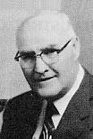
The Inspiration & Authority of Scripture
10 essentials of “Proper” Hermeneutics
When the plain sense of Scripture makes common sense, seek no other sense; therefore, take every word at its primary, ordinary, usual, and literal meaning unless the facts of the immediate context, studied in the light of related passages and axiomatic and fundamental truths, clearly indicate otherwise. – David L. Cooper

Slide 51
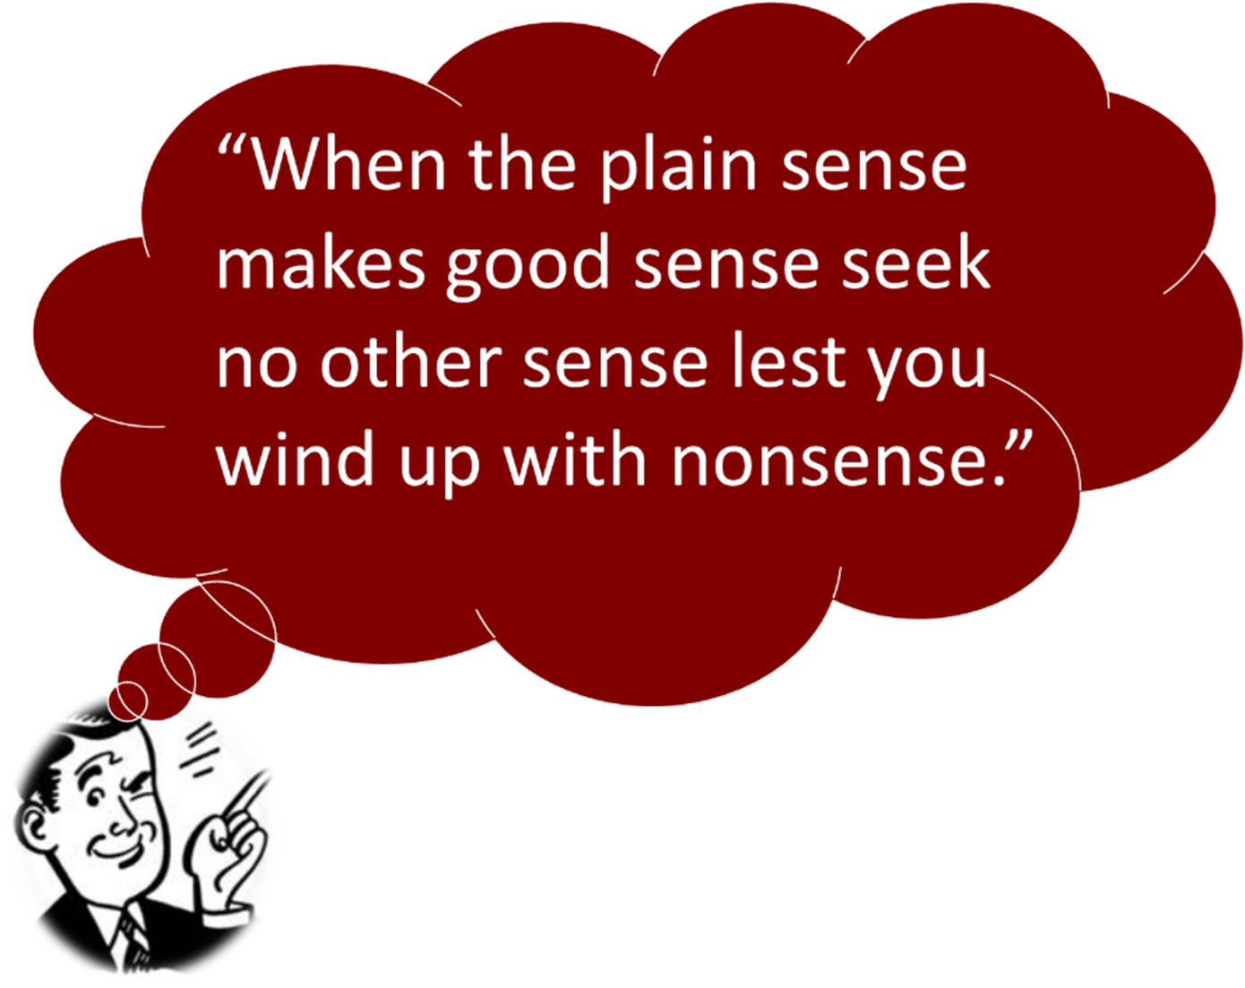
The Inspiration & Authority of Scripture
10 essentials of “Proper” Hermeneutics

Slide 52
The Inspiration & Authority of Scripture
10 essentials of “Proper” Hermeneutics
The “human drama” must be allowed to come forth – The interpreter should avoid “wooden-headed literalism” that follows so stiff and rigid an interpretation that all normal human expression is destroyed.
Couch, M. (2000). An Introduction to Classical Evangelical Hermeneutics, A Guide to the History and Practice of Biblical Interpretation. Grand Rapids, MI: Kregel Publications.
Notes:
7. The interpreter should avoid “wooden-headed literalism” that follows so stiff and rigid and interpretation that all normal human expression is destroyed.
8. The interpreter must familiarize himself with the customs and cultural norms related to the passage under consideration.
9. The student of Scripture must observe carefully the context of a specific period in Bible history to ascertain how God worked in different ways.
10. Not everything is revealed at the beginning of the Bible. Not only does each successive book presuppose the books that went before, but many passages in the earlier books clearly point to Scripture that was yet to come. God progressively, generation to generation, revealed new truth. Some things, such as the church, were mysteries and not previously revealed in the Old Testament.

Slide 53
The Inspiration & Authority of Scripture
10 essentials of “Proper” Hermeneutics
As part of the context, factors such as culture, historical background, social setting, and geography all play a part in interpretation – The interpreter must familiarize himself with the customs, historical data, unique cultural norms (i.e., Jewish vs. Gentile), and significant geological references (i.e., locations and topography) related to the passage under consideration (i.e., Matt. 20:29–34; Mark 10:46–52).
Couch, M. (2000). An Introduction to Classical Evangelical Hermeneutics, A Guide to the History and Practice of Biblical Interpretation. Grand Rapids, MI: Kregel Publications.
Notes:
7. The interpreter should avoid “wooden-headed literalism” that follows so stiff and rigid and interpretation that all normal human expression is destroyed.
8. The interpreter must familiarize himself with the customs and cultural norms related to the passage under consideration.
9. The student of Scripture must observe carefully the context of a specific period in Bible history to ascertain how God worked in different ways.
10. Not everything is revealed at the beginning of the Bible. Not only does each successive book presuppose the books that went before, but many passages in the earlier books clearly point to Scripture that was yet to come. God progressively, generation to generation, revealed new truth. Some things, such as the church, were mysteries and not previously revealed in the Old Testament.

Slide 54
The Inspiration & Authority of Scripture
10 essentials of “Proper” Hermeneutics
The Bible must be studied dispensationally in order to see how God dealt with people and nations differently at different time periods – The student of Scripture must observe carefully the context of a specific period in Bible history to ascertain how God worked in different ways.
Couch, M. (2000). An Introduction to Classical Evangelical Hermeneutics, A Guide to the History and Practice of Biblical Interpretation. Grand Rapids, MI: Kregel Publications.
Notes:
7. The interpreter should avoid “wooden-headed literalism” that follows so stiff and rigid and interpretation that all normal human expression is destroyed.
8. The interpreter must familiarize himself with the customs and cultural norms related to the passage under consideration.
9. The student of Scripture must observe carefully the context of a specific period in Bible history to ascertain how God worked in different ways.
10. Not everything is revealed at the beginning of the Bible. Not only does each successive book presuppose the books that went before, but many passages in the earlier books clearly point to Scripture that was yet to come. God progressively, generation to generation, revealed new truth. Some things, such as the church, were mysteries and not previously revealed in the Old Testament.

Slide 55
The Inspiration & Authority of Scripture
10 essentials of “Proper” Hermeneutics
Progressive revelation is also important in dispensational hermeneutics – Not everything is revealed at the beginning of the Bible. Not only does each successive book presuppose the books that went before, but many passages in the earlier books clearly point to Scripture that was yet to come. God progressively, generation to generation, revealed new truth. Some things, such as the church, were mysteries and not previously revealed in the Old Testament.
Couch, M. (2000). An Introduction to Classical Evangelical Hermeneutics, A Guide to the History and Practice of Biblical Interpretation. Grand Rapids, MI: Kregel Publications.
Notes:
7. The interpreter should avoid “wooden-headed literalism” that follows so stiff and rigid and interpretation that all normal human expression is destroyed.
8.
9. The student of Scripture must observe carefully the context of a specific period in Bible history to ascertain how God worked in different ways.
10. Not everything is revealed at the beginning of the Bible. Not only does each successive book presuppose the books that went before, but many passages in the earlier books clearly point to Scripture that was yet to come. God progressively, generation to generation, revealed new truth. Some things, such as the church, were mysteries and not previously revealed in the Old Testament.

Slide 56
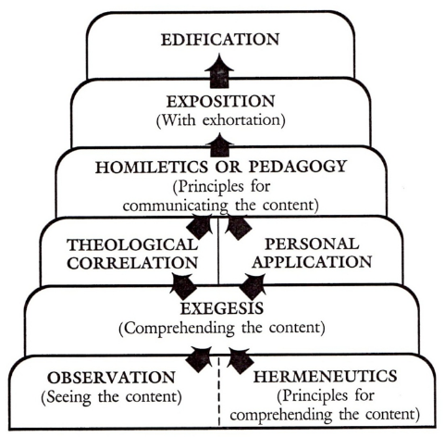
The Inspiration & Authority of Scripture
“Proper” Hermeneutics
Zuck, R. B. (1991). Basic Bible Interpretation: A Practical Guide to Discovering Biblical Truth. (C. Bubeck Sr., Ed.). Colorado Springs, CO: David C. Cook.
Notes:
Observation asks the question “what does it say”.
Hermeneutics is the science (principles) and art (task) by which the meaning of the biblical text is determined.
Exegesis is the determination of the meaning of the biblical text in its historical and literary contexts.
Homiletics is the science (principles) and art (task) by which the meaning and relevance of the biblical text are communicated in a preaching situation.
Pedagogy is the science (principles) and art (task) by which the meaning and relevance of the biblical text are communicated in a teaching situation.
Exposition is the communication of the meaning of the text along with its relevance to present-day hearers.
Concerning Edification:
“All the historical, doctrinal, and practical truth of the Bible is for one purpose: to promote the spiritual prosperity of man. The Bible is not an end; it is a means.” Bernard Ramm

Slide 57
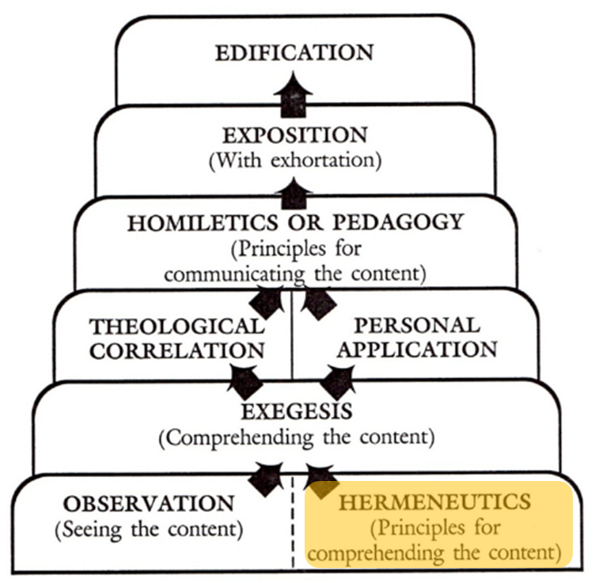
The Inspiration & Authority of Scripture
“Proper” Hermeneutics
Hermeneutics is the science (principles) and art (task) by which the meaning of the biblical text is determined.
Zuck, R. B. (1991). Basic Bible Interpretation: A Practical Guide to Discovering Biblical Truth. (C. Bubeck Sr., Ed.). Colorado Springs, CO: David C. Cook.
Notes:
Hermeneutics is the science (principles) and art (task) by which the meaning of the biblical text is determined.

Slide 58
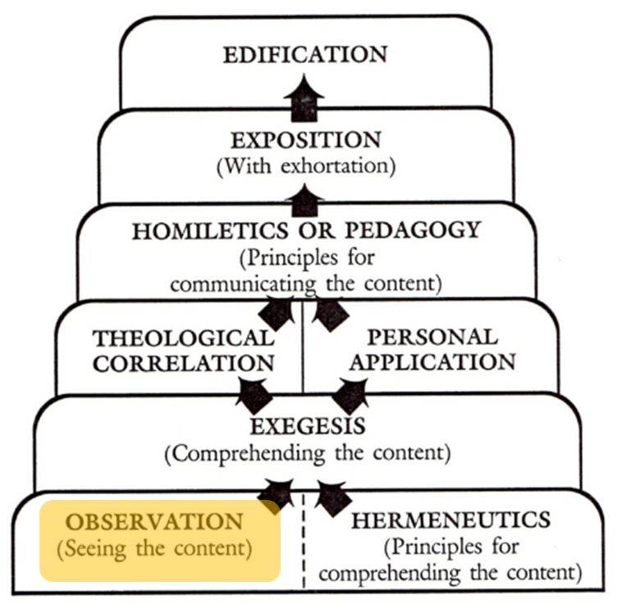
The Inspiration & Authority of Scripture
“Proper” Hermeneutics
Observation asks the question “what does it say”.
Zuck, R. B. (1991). Basic Bible Interpretation: A Practical Guide to Discovering Biblical Truth. (C. Bubeck Sr., Ed.). Colorado Springs, CO: David C. Cook.
Notes:
Observation asks the question “what does it say”.

Slide 59
“Proper” Hermeneutics – Observation
OBSERVATION
WHO | are the participants, the author, and the intended first readers? If there is a command, who must obey it?
WHAT | happened or will happen? If there is a command, what should be done? What does the text say about God, Jesus, people, Satan, angels, demons, etc.? What ideas are discussed, and what is said about them?
WHEN | did (will) it happen? (Time lines may be found in the back of some Bibles.) If there is a command, when must it be done? If the text is a prophecy, has it been fulfilled?
WHERE | did (will) it happen? (The maps in your Bible may be helpful.) If there is a command, where must it be performed?
WHY | was (is) this done? Why did (will) this happen? Why should it be done?

Slide 60
“Proper” Hermeneutics – Observation

Slide 61
“Proper” Hermeneutics – Observation

Slide 62
“Proper” Hermeneutics – Observation

Slide 63
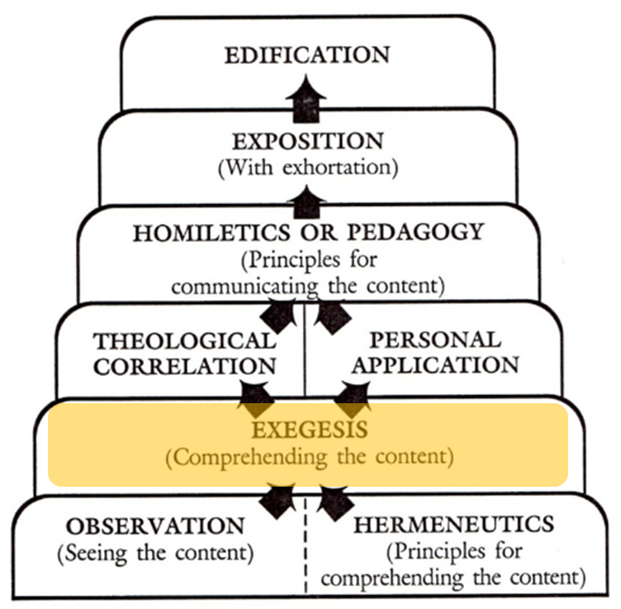
The Inspiration & Authority of Scripture
“Proper” Hermeneutics
Exegesis is the determination of the meaning of the biblical text in its historical and literary contexts.
Zuck, R. B. (1991). Basic Bible Interpretation: A Practical Guide to Discovering Biblical Truth. (C. Bubeck Sr., Ed.). Colorado Springs, CO: David C. Cook.
Notes:
Exegesis is the determination of the meaning of the biblical text in its historical and literary contexts.

Slide 64
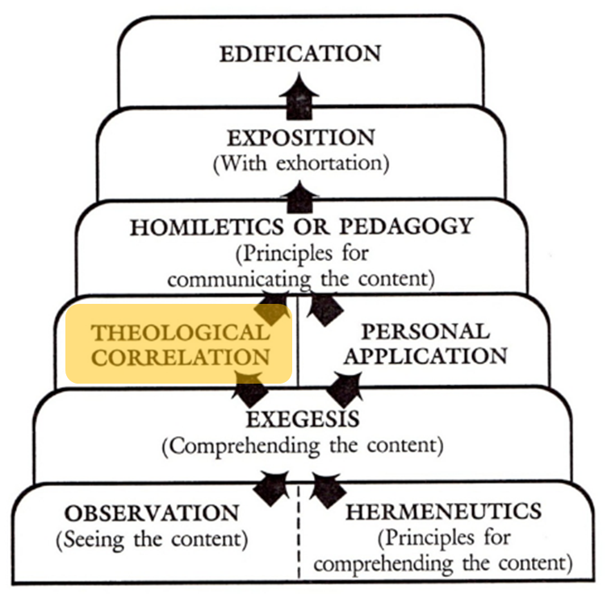
The Inspiration & Authority of Scripture
“Proper” Hermeneutics
Theological Correlation refers to how the passage fits within the overall theological structure of the Bible.
Zuck, R. B. (1991). Basic Bible Interpretation: A Practical Guide to Discovering Biblical Truth. (C. Bubeck Sr., Ed.). Colorado Springs, CO: David C. Cook.
Notes:
Theological Correlation refers t how the passage fits within the overall theological structure of the Bible.

Slide 65
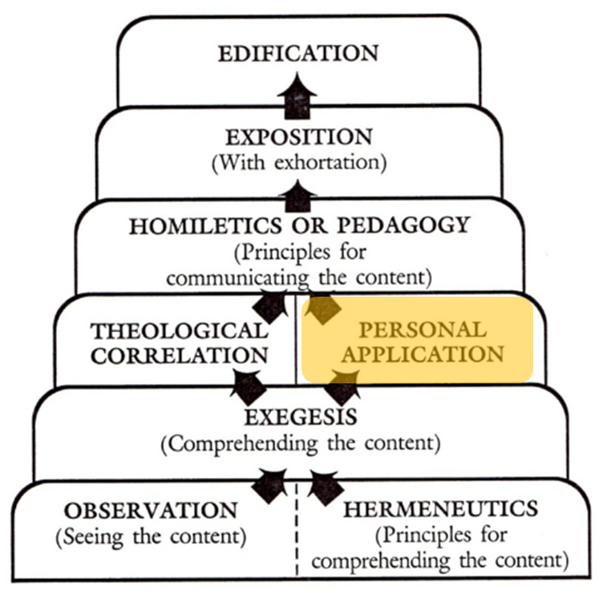
The Inspiration & Authority of Scripture
“Proper” Hermeneutics
Personal Application refers to how I am to assimilate and incorporate the passage into my daily Christian experience.
Zuck, R. B. (1991). Basic Bible Interpretation: A Practical Guide to Discovering Biblical Truth. (C. Bubeck Sr., Ed.). Colorado Springs, CO: David C. Cook.
Notes:
Personal Application refers to how I am to assimilate and incorporate the passage into my daily Christian experience.

Slide 66
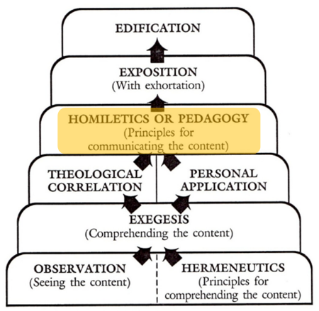
The Inspiration & Authority of Scripture
“Proper” Hermeneutics
Homiletics is the science (principles) and art (task) by which the meaning and relevance of the biblical text are communicated in a preaching situation. Pedagogy is the science (principles) and art (task) by which the meaning and relevance of the biblical text are communicated in a teaching situation.
Zuck, R. B. (1991). Basic Bible Interpretation: A Practical Guide to Discovering Biblical Truth. (C. Bubeck Sr., Ed.). Colorado Springs, CO: David C. Cook.
Notes:
Homiletics is the science (principles) and art (task) by which the meaning and relevance of the biblical text are communicated in a preaching situation.

Slide 67
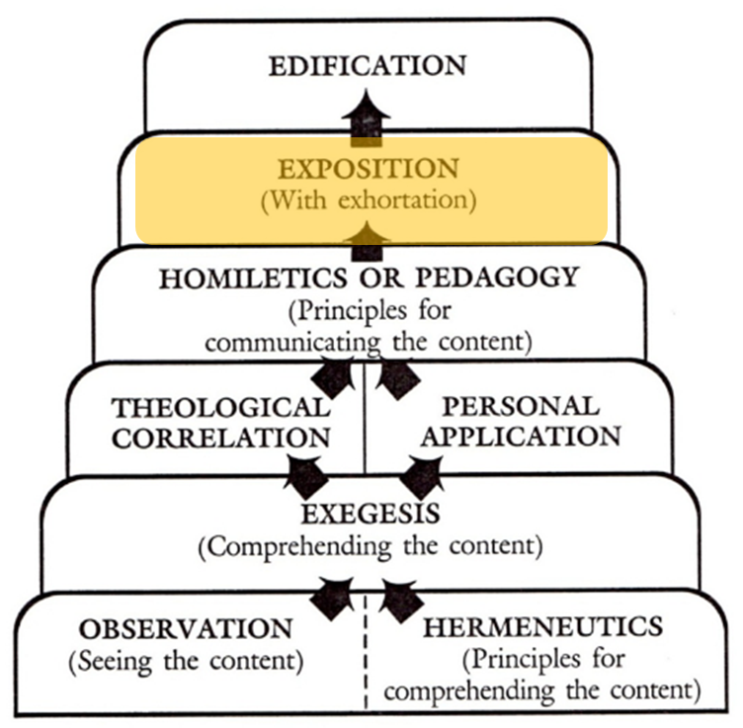
The Inspiration & Authority of Scripture
“Proper” Hermeneutics
Exposition is the communication of the meaning of the text along with its relevance to present-day hearers.
Zuck, R. B. (1991). Basic Bible Interpretation: A Practical Guide to Discovering Biblical Truth. (C. Bubeck Sr., Ed.). Colorado Springs, CO: David C. Cook.
Notes:
Exposition is the communication of the meaning of the text along with its relevance to present-day hearers.

Slide 68
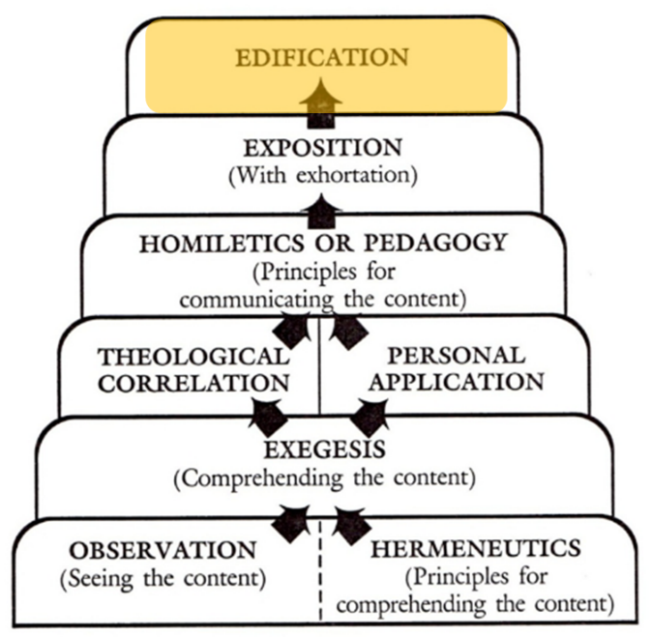
The Inspiration & Authority of Scripture
“Proper” Hermeneutics
Concerning Edification: “All the historical, doctrinal, and practical truth of the Bible is for one purpose: to promote the spiritual prosperity of man. The Bible is not an end; it is a means.” Bernard Ramm
Zuck, R. B. (1991). Basic Bible Interpretation: A Practical Guide to Discovering Biblical Truth. (C. Bubeck Sr., Ed.). Colorado Springs, CO: David C. Cook.
Notes:
Concerning Edification: “All the historical, doctrinal, and practical truth of the Bible is for one purpose: to promote the spiritual prosperity of man. The Bible is not an end; it is a means.” Bernard Ramm

Slide 69
Resources
Alva J. McClain, Law & Grace, Moody, 1967 978-088469-001-6
Charles C. Ryrie, Dispensationalism, Moody, 2007, 080242189X
Christopher Cone, gen. ed., Dispensationalism Tomorrow & Beyond, Tyndale Seminary Press, 2008 9780981479101
Christopher Cone, gen. ed., An Introduction To The New Covenant, Tyndale Seminary Press, 2013, 9781938484100
Walvoord, J. F., The Prophecy Knowledge Handbook. Wheaton, IL: Victor Books. 1990.
Lewis S. Chafer, Major Bible Themes, Zondervan, 1974, 0-310-22390-3
Mike Stallard, gen .ed., Dispensational Understanding of the New Covenant, Regular Baptist Books, 2012, 9781607764946
Paul Enns, The Moody Handbook of Theology, Moody 1989,
Renald E. Showers, There Really Is A Difference, Friend of Israel Gospel Ministry, 1990, 0915540509
Rene Pache, The Inspiration and Authority of Scripture, Sheffield Pub Co, 1992
Roy B. Zuck, Basic Bible Interpretation, SP Publications, 1991
Steven Waterhouse, Not By Bread Alone: An Outlined Guide to Bible Doctrine, Westcliff Press, ISBN-0977405125
Charting the End Times CD-Rom: A Visual Guide to Understanding Bible Prophecy, ISBN-10: 0736917624
Materials from:
Dr. Andy Woods, Sugar Land Bible Church, www.slbc.org
Dr. Vern Peterman, Holly Hills Bible Church, www.hollyhillsbiblechurch.org
George Zeller, Middletown Bible Church, www.middletownbiblechurch.org
Ed Allsteadt, Sugar Land Bible Church, www.slbc.org

Slide 70
END OF SESSION 1

