Slide 1


Slide 2

The Coming Kingdom
Chapter 16
Dr. Andy Woods
Senior Pastor – Sugar Land Bible Church
President – Chafer Theological Seminary

Slide 3

Kingdom Study Outline
What does the Bible Say About the Kingdom?
The Main Problem with Kingdom Now NT interpretations
Why do some believe that we are in the kingdom now?
Why does it matter?

Slide 4
Kingdom Study Outline
What does the Bible Say About the Kingdom?
The Main Problem with Kingdom Now NT interpretations
Why do some believe that we are in the kingdom now?
Why does it matter?

Slide 5
1. Kingdom Throughout the Bible
Eden Abrahamic Covenant Mosaic Covenant Divided Kingdom Times of the Gentiles | Old Testament Prophets Post exile Offer of the King / Kingdom Rejection of the Offer Interim Age

Slide 6
1. Kingdom Throughout the Bible
Kingdom Mysteries Church Israel’s Discipline & Restoration Re-offer of the King/Kingdom | Transfer of Kingdom Authority Kingdom Establishment Eternal State Testimony of Early Church History

Slide 7
Kingdom Study Outline
What does the Bible Say About the Kingdom?
The Main Problem with Kingdom Now NT interpretations
Why do some believe that we are in the kingdom now?
Why does it matter?

Slide 8

2. The Main Problem with Kingdom Now NT interpretations
The kingdom is always earthly (Gen. 15:18-21) over a repentant Israel (Ezek. 36‒37)
The kingdom will only manifest after a time of tribulation (Jer. 30:7; Dan. 9:24-27)

Slide 9

Kingdom Study Outline
What does the Bible Say About the Kingdom?
The Main Problem with Kingdom Now NT interpretations
Why do some believe that we are in the kingdom now?
Why does it matter?

Slide 10
Response to Kingdom Now Problem Passages
Passages from Christ’s ministry
Passages from Acts
Passages from Paul
Passages from the General letters
Passages from Revelation
Miscellaneous Arguments

Slide 11
Response to Kingdom Now Problem Passages
Passages from Christ’s ministry
Passages from Acts
Passages from Paul
Passages from the General letters
Passages from Revelation
Miscellaneous Arguments

Slide 12

1. Passages from Christ’s ministry
The kingdom is at hand (Matt. 3:2)
Theirs is the kingdom (Matt. 5:3, 10)
Thy kingdom come (Matt. 6:9-13)
Seek first the kingdom (Matt. 6:33)
The kingdom suffers violence (Matt. 11:12)
Satan falls like lightning (Luke 10:18)
The kingdom has come upon you (Matt. 12:28)

Slide 13
1. Passages from Christ’s ministry
The kingdom is in your midst (Luke 17:21)
Born again to enter the kingdom (John 3:3-5)
No death until kingdom comes (Matt. 16:28)
Kingdom given to another people (Matt. 21:43)
Kingdom is not of this world (John 18:36)
All authority given to me (Matt 28:18-20)

Slide 14

Luke 17:20-21
²⁰ “Now having been questioned by the Pharisees as to when the kingdom of God was coming, He answered them and said, ‘The kingdom of God is not coming with signs to be observed; ²¹ nor will they say, ‘Look, here it is!’ or, ‘There it is!’ For behold, the kingdom of God is in your midst.’”

Slide 15

h. The Kingdom is Within Your Midst
(Luke 17:20-21)
Does not say “the kingdom is within you”
Sufficiency of the offer of the kingdom framework
Possibility of a futuristic rather than present reality

Slide 16

1. Passages from Christ’s ministry
The kingdom is in your midst (Luke 17:21)
Born again to enter the kingdom (John 3:3-5)
No death until kingdom comes (Matt. 16:28)
Kingdom given to another people (Matt. 21:43)
Kingdom is not of this world (John 18:36)
All authority given to me (Matt 28:18-20)

Slide 17
John 3:3-5
“³ Jesus answered and said to him, ‘Truly, truly, I say to you, unless one is born again he cannot see the kingdom of God.’⁴ Nicodemus said to Him, ‘How can a man be born when he is old? He cannot enter a second time into his mother’s womb and be born, can he?’ ⁵ Jesus answered, ‘Truly, truly, I say to you, unless one is born of water and the Spirit he cannot enter into the kingdom of God.’”

Slide 18
John 3:3-5
“³ Jesus answered and said to him, ‘Truly, truly, I say to you, unless one is born again he cannot see the kingdom of God.’⁴ Nicodemus said to Him, ‘How can a man be born when he is old? He cannot enter a second time into his mother’s womb and be born, can he?’ ⁵ Jesus answered, ‘Truly, truly, I say to you, unless one is born of water and the Spirit he cannot enter into the kingdom of God.’”

Slide 19
Clayton Sullivan
Clayton Sullivan, Rethinking Realized Eschatology (Macon, GA: Mercer, 1988), 127..
“Because in these verses the Kingdom is not dealt with extensively, it is impossible to use such references to reach a meaningful understanding of the basileia.”

Slide 20

John 3:14-15
“¹⁴ As Moses lifted up the serpent in the wilderness, even so must the Son of Man be lifted up; ¹⁵ so that whoever believes will in Him have eternal life.’”

Slide 21


Slide 22
John 3:9-10
“⁹ Nicodemus said to Him, ‘How can these things be?’ ¹⁰ Jesus answered and said to him, ‘Are you the teacher of Israel and do not understand these things?’”

Slide 23

Mark 7:13
“thus invalidating the word of God by your tradition which you have handed down; and you do many things such as that.”

Slide 24
Ezekiel 36:24-28
“For I will take you from the nations, gather you from all the lands and bring you into your own land. ²⁵ Then I will sprinkle clean water on you, and you will be clean; I will cleanse you from all your filthiness and from all your idols. ²⁶ Moreover, I will give you a new heart and put a new spirit within you; and I will remove the heart of stone from your flesh and give you a heart of flesh. ²⁷ I will put My Spirit within you and cause you to walk in My statutes, and you will be careful to observe My ordinances. ²⁸ You will live in the land that I gave to your forefathers; so you will be My people, and I will be your God.”

Slide 25
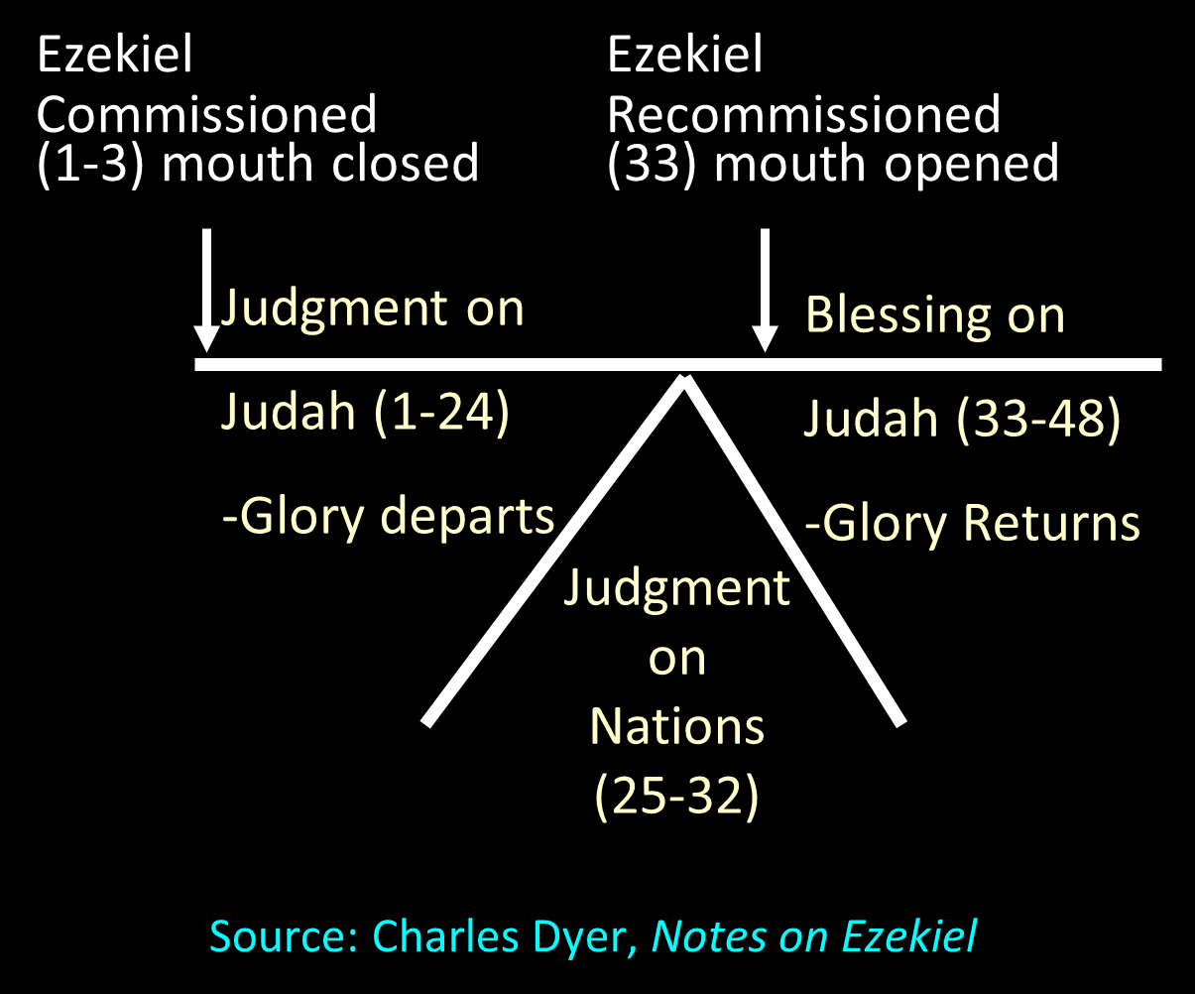

Slide 26
Ezekiel 37:7-11
So I prophesied as I was commanded; and as I prophesied, there was a noise, and behold, a rattling; and the bones came together, bone to its bone. ⁸ And I looked, and behold, sinews were on them, and flesh grew and skin covered them; but there was no breath in them. ⁹ Then He said to me, “Prophesy to the breath, prophesy, son of man, and say to the breath, ‘Thus says the Lord God, “Come from the four, . . .

Slide 27
Ezekiel 37:7-11
. . .O breath, and breathe on these slain, that they come to life.”’” ¹⁰ So I prophesied as He commanded me, and the breath came into them, and they came to life and stood on their feet, an exceedingly great army. ¹¹ Then He said to me, “Son of man, these bones are the whole house of Israel; behold, they say, ‘Our bones are dried up and our hope has perished. We are completely cut off’.”

Slide 28


Slide 29


Slide 30


Slide 31
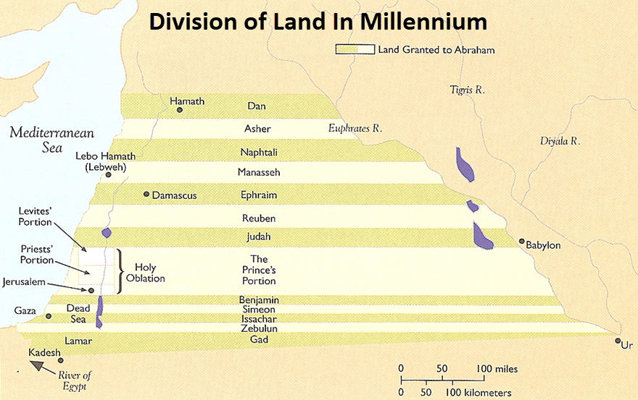

Slide 32
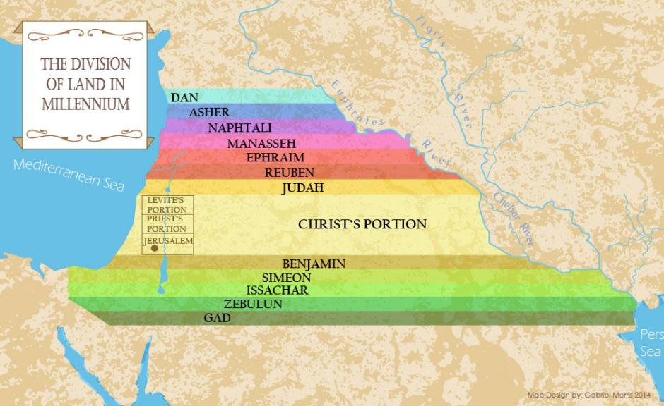

Slide 33
John 3:3-5
“³ Jesus answered and said to him, ‘Truly, truly, I say to you, unless one is born again he cannot see the kingdom of God.’⁴ Nicodemus said to Him, ‘How can a man be born when he is old? He cannot enter a second time into his mother’s womb and be born, can he?’ ⁵ Jesus answered, ‘Truly, truly, I say to you, unless one is born of water and the Spirit he cannot enter into the kingdom of God.’”

Slide 34
1. Passages from Christ’s ministry
The kingdom is in your midst (Luke 17:21)
Born again to enter the kingdom (John 3:3-5)
No death until kingdom comes (Matt. 16:28)
Kingdom given to another people (Matt. 21:43)
Kingdom is not of this world (John 18:36)
All authority given to me (Matt 28:18-20)

Slide 35
Matthew 16:27-28
“²⁷ For the Son of Man is going to come in the glory of His Father with His angels, and will then repay every man according to his deeds.²⁸ Truly I say to you, there are some of those who are standing here who will not taste death until they see the Son of Man coming in His kingdom.”

Slide 36
E.R. Craven
“Excursus on the Basileia,” in Revelation of John, J. P. Lange (New York: Scribner, 1874), 96.
“The declaration of Jesus, “There be some standing here,” etc., Matt. 16:28; Mark 9:1; Luke 9:27. This, according to the opinion of Chrysostom and others (see Lange Comm. on Matt. 16:28), may find its fulfillment in the immediately following Transfiguration. In this event the Basileia was not merely symbolized, but in all its glory was for a moment set up on earth (comp. 2 Peter 1:16–18).”

Slide 37
2 Peter 1:16-18
“¹⁶ For we did not follow cleverly devised tales when we made known to you the power and coming of our Lord Jesus Christ, but we were eyewitnesses of His majesty. ¹⁷ For when He received honor and glory from God the Father, such an utterance as this was made to Him by the Majestic Glory, ‘This is My beloved Son with whom I am well-pleased’— ¹⁸ and we ourselves heard this utterance made from heaven when we were with Him on the holy mountain.”

Slide 38

Alva J. McClain
Alva J. McClain, The Greatness of the Kingdom: An Inductive Study of the Kingdom of God as Set Forth in the Scriptures (Grand Rapids: Zondervan, 1959), 337.
“the conjunction with which chapter 17 begins clearly establishes the unbroken continuity of thought between 16:28 and 17:1, as also in the accounts of Mark and Luke where no chapter division occurs.”

Slide 39
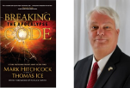
Thomas Ice
Thomas Ice, “Preterist ‘Time Texts,’” in The End Times Controversy: The Second Coming under Attack, ed. Tim LaHaye and Thomas Ice (Eugene, OR: Harvest House, 2003), 88.
“All three accounts of the prophesied event speak of seeing and the kingdom. Matthew says they will see ‘the Son of Man coming in His kingdom,’ emphasizing the person of the Son of Man coming. Mark says, ‘they see the kingdom of God’ and he adds that it will come ‘with power.’ Luke simply says that ‘they see the kingdom of God.’ The transfiguration fits all aspects of the various emphases found in each of the three precise predictions. Matthew’s stress upon the actual, physical presence of the Son of Man is clearly met in the transfiguration because Jesus was personally and visibly present. . . .”

Slide 40
Thomas Ice
Thomas Ice, “Preterist ‘Time Texts,’” in The End Times Controversy: The Second Coming under Attack, ed. Tim LaHaye and Thomas Ice (Eugene, OR: Harvest House, 2003), 88.
“Mark’s emphasis upon a display of the kingdom with ‘power’ was certainly fulfilled by the transfiguration. No one could doubt that the transfiguration certainly fit the definition of a ‘power encounter’ for the disciples. That Jesus appears dressed in the Shekinah glory of God upon the Mount (Mark 9:3) is further evidence to the disciples that He was God and acted with His power. Luke’s simple statement about some who will ‘see the kingdom of God’ is vindicated also by his account (17:28–36). Twice Luke records our Lord describing the transfiguration with the term ‘glory’ (17:31, 32).”

Slide 41
CONCLUSION

Slide 42
1. Passages from Christ’s ministry
The kingdom is in your midst (Luke 17:21)
Born again to enter the kingdom (John 3:3-5)
No death until kingdom comes (Matt. 16:28)
Kingdom given to another people (Matt. 21:43)
Kingdom is not of this world (John 18:36)
All authority given to me (Matt 28:18-20)

