Slide 1
The book of jude
Lessons in Apostasy, Part 2

Slide 2
The Book of Jude
Who wrote the book? Jude, brother of James, half –brother of Jesus Christ.
Who was the book written to? Believers, Jews scattered in Asia Minor
When was the book written? Between 68-80 AD
Where was the book written from? Possibly in the Land of Canaan
What’s the Genre of the book? Epistolary
What’s the purpose of the book? To exhort believers to earnestly contend for the faith in the face of apostasy.
What’s in the book? A present threat of and defense against false teachers.
Is there an application? 1) grow spiritually (v.20); 2) be assured of your salvation (v.21; 24-25); and 3) also to help those who doubt (v.23-24).

Slide 3
Outline of Jude
Salutation – vv. 1-2
Purpose Statement – vv. 3-4
Beware of Apostates– vv. 5-16
Previous Failures – vv. 5-7
Examples of Certain Israelites – v. 5
Examples of Certain Angels – v. 6
Examples of Certain Pagans – v. 7
Present Failures – vv. 8-16
Exhortation to the Faithful – vv.17-23
Benediction – vv. 24-25
Outline adapted from Thomas Constable, Dr. Constable’s Expository Notes, Jude, (http://www.planobiblechapel.org/tcon/notes/html/nt/jude/jude.htm)

Slide 4
The Ten Plagues
SCRIPTURE | PLAGUE | ISRAEL EXEMPT? | ATTACK ON EGYPT’S GODS
1) Ex 7:14-24 | Nile River to Blood | No | Hapi-spirit of Nile Khnum-guardian of the Nile
2) Ex 7:25-8:15 | Frogs | No | Heqt-form of a frog Hapi-spirit of Nile
3) Ex 8:16-19 | Swarms of Lice/Gnats | No | Uncertain-perhaps to attack Egypt’s priests
4) Ex 8:20-32 | Flies | Yes | Uatchit-Fly god
5) Ex 9:1-7 | Disease on Cattle | Yes | Apis bull revered; Sacred bulls and Cows: Ptah, Mnvis, Hathor
6) Ex 9:8-12 | Boils/Sores on Man & Animal | Yes | Sekhmet-healing goddess Serapis-healing god
7) Ex 9:13-35 | Destruction of Cattle and Crops by Hail | Yes | Seth-protector of crops Nut-sky goddess
8)Ex 10:1-20 | Destruction of Crops by Locusts | Yes | Isis-goddess of life Seth-protector of crops
9) Ex 10:21-29 | Darkness | Yes | Re-sun god. Atum-god of setting sun
10) Ex 11:1-12:36 | Death of Firstborn | Yes, if blood properly applied | Osiris-life giver Pharaoh-considered a god
Chart adapted from Ryrie Study Bible, The Ten Plagues, 101.

Slide 5
Exodus 4:29-31
29Then Moses and Aaron went and assembled all the elders of the sons of Israel; 30and Aaron spoke all the words which the Lord had spoken to Moses. He then performed the signs in the sight of the people. 31 So the people believed; and when they heard that the Lord was concerned about the sons of Israel and that He had seen their affliction, then they bowed low and worshiped.

Slide 6
Psalm 106:6-12
“We have sinned like our fathers, We have committed iniquity, we have behaved wickedly. 7Our fathers in Egypt did not understand Your wonders; They did not remember Your abundant kindnesses, But rebelled by the sea, at the Red Sea. 8Nevertheless He saved them for the sake of His name, That He might make His power known. 9Thus He rebuked the Red Sea and it dried up…

Slide 7
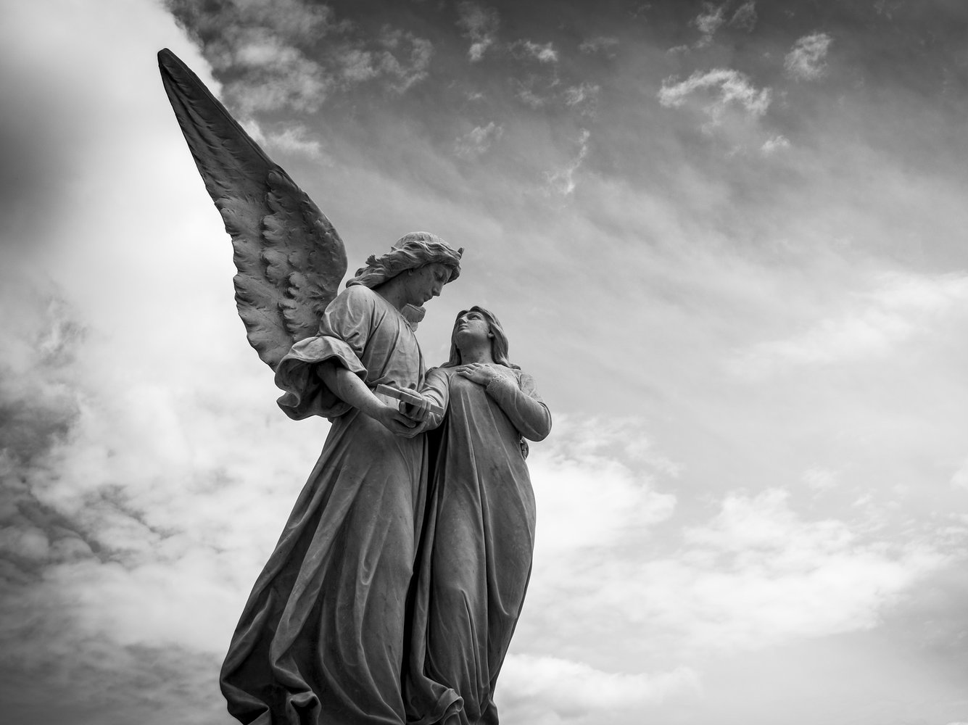

Slide 8
For if God did not spare angels when they sinned, but cast them into hell and committed them to pits of darkness, reserved for judgment... -2 Peter 2:4
And angels who did not keep their own domain, but abandoned their proper abode, He has kept in eternal bonds under darkness for the judgment of the great day. – Jude 6

Slide 9
Outline of Jude
Salutation – vv. 1-2
Purpose Statement – vv. 3-4
Beware of Apostates– vv. 5-16
Previous Failures – vv. 5-7
Examples of Certain Israelites – v. 5
Examples of Certain Angels – v. 6
Examples of Certain Pagans – v. 7
Present Failures – vv. 8-16
Exhortation to the Faithful – vv.17-23
Benediction – vv. 24-25
Outline adapted from Thomas Constable, Dr. Constable’s Expository Notes, Jude, (http://www.planobiblechapel.org/tcon/notes/html/nt/jude/jude.htm)

Slide 10
Jude 5-7
5Now I desire to remind you, though you know all things once for all, that the Lord, after saving a people out of the land of Egypt, subsequently destroyed those who did not believe.
6And angels who did not keep their own domain, but abandoned their proper abode, He has kept in eternal bonds under darkness for the judgment of the great day,
7just as Sodom and Gomorrah and the cities around them, since they in the same way as these indulged in gross immorality and went after strange flesh, are exhibited as an example in undergoing the punishment of eternal fire.

Slide 11
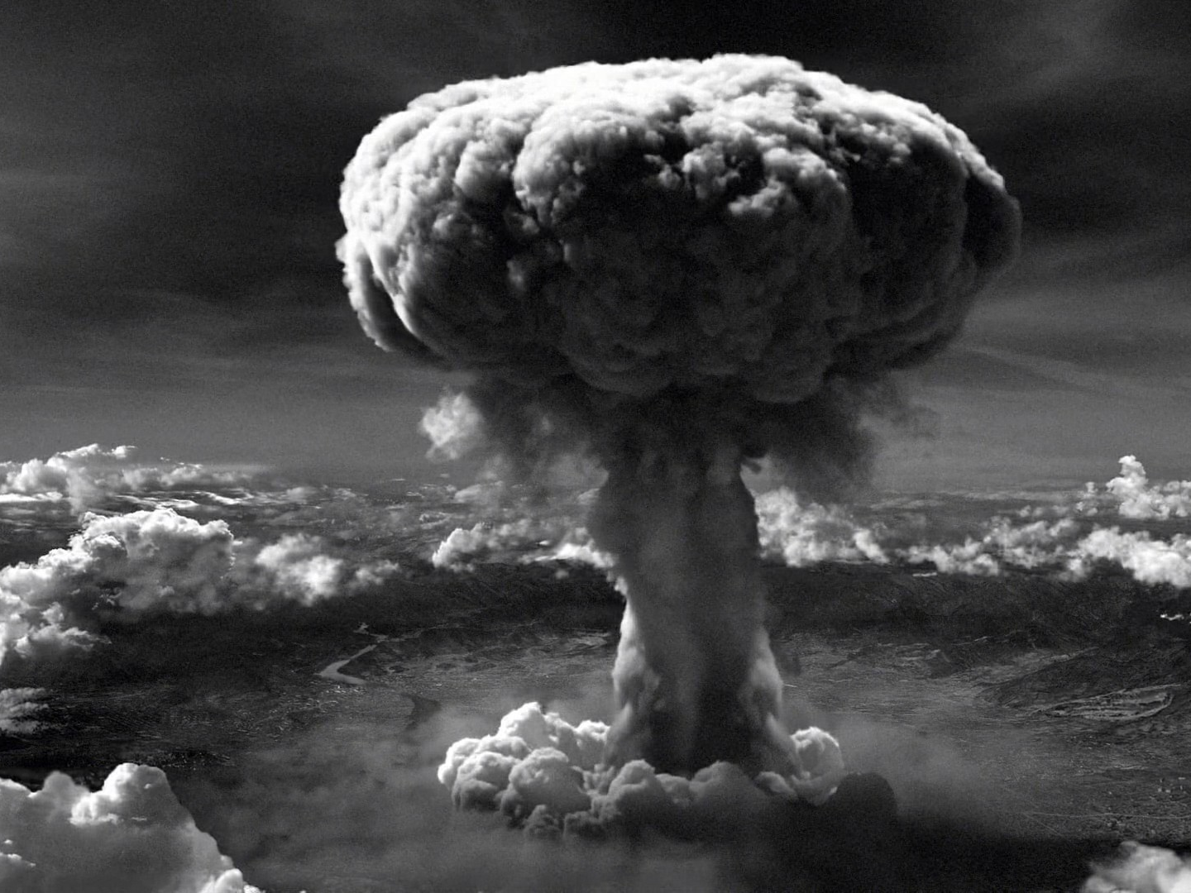

Slide 14
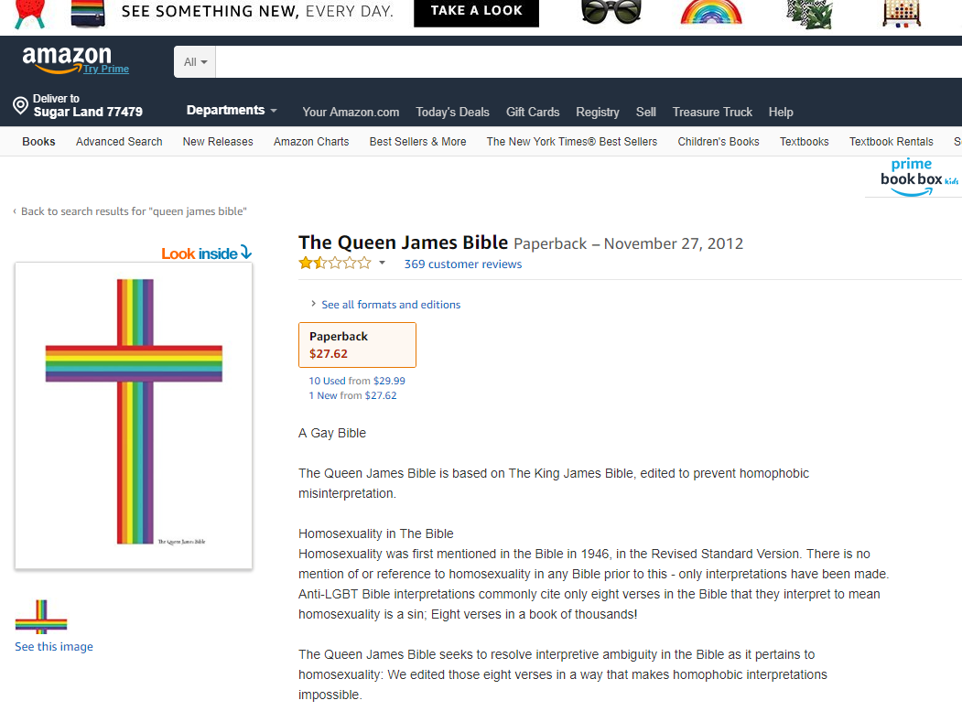

Slide 15
Jude 7
just as Sodom and Gomorrah and the cities around them, since they in the same way as these indulged in gross immorality and went after strange flesh, are exhibited as an example in undergoing the punishment of eternal fire.

Slide 16
Jude 7
just as Sodom and Gomorrah and the cities around them, since they in the same way as these indulged in gross immorality and went after strange flesh, are exhibited as an example in undergoing the punishment of eternal fire.

Slide 17
Jude 7
just as Sodom and Gomorrah and the cities around them, since they in the same way as these indulged in gross immorality and went after strange flesh, are exhibited as an example in undergoing the punishment of eternal fire.

Slide 18
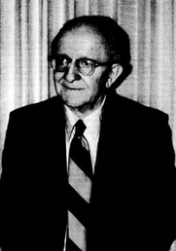
D. Edmond Hiebert
“’And gone after strange flesh’ elaborates on what the sin involved. The compound expression “gone after” (apelthousai opisō) indicates a departure from the established order in nature to follow a practice contrary to nature. Deserting the established male-female relationship, they deliberately pursued a relationship with ‘strange flesh’ (sarkos heteras, literally, ‘other flesh’); that is, they followed a course of action in conjugal matters other than that prescribed by God.”
D. Edmond Hiebert, Second Peter and Jude: An Expositional Commentary (Greenville, SC: Bob Jones University Press, 1989), 238.

Slide 19
Jude 7
just as Sodom and Gomorrah and the cities around them, since they in the same way as these indulged in gross immorality and went after strange flesh, are exhibited as an example in undergoing the punishment of eternal fire.

Slide 20
Jude 7
just as Sodom and Gomorrah and the cities around them, since they in the same way as these indulged in gross immorality and went after strange flesh, are exhibited as an example in undergoing the punishment of eternal fire.

Slide 21
Jude 5-7
5Now I desire to remind you, though you know all things once for all, that the Lord, after saving a people out of the land of Egypt, subsequently destroyed those who did not believe.
6And angels who did not keep their own domain, but abandoned their proper abode, He has kept in eternal bonds under darkness for the judgment of the great day,
7just as Sodom and Gomorrah and the cities around them, since they in the same way as these indulged in gross immorality and went after strange flesh, are exhibited as an example in undergoing the punishment of eternal fire.

Slide 22
Romans 1:18-32
18 For the wrath of God is revealed from heaven against all ungodliness and unrighteousness of men who suppress the truth in unrighteousness,
19 because that which is known about God is evident within them; for God made it evident to them.
20 For since the creation of the world His invisible attributes, His eternal power and divine nature, have been clearly seen, being understood through what has been made, so that they are without excuse.
21 For even though they knew God, they did not honor Him as God or give thanks, but they became futile in their speculations, and their foolish heart was darkened.

Slide 23
Romans 1:18-32
22 Professing to be wise, they became fools,
23 and exchanged the glory of the incorruptible God for an image in the form of corruptible man and of birds and four-footed animals and crawling creatures.
24 Therefore God gave them over in the lusts of their hearts to impurity, so that their bodies would be dishonored among them.
25 For they exchanged the truth of God for a lie, and worshiped and served the creature rather than the Creator, who is blessed forever. Amen.

Slide 24
Romans 1:18-32
26 For this reason God gave them over to degrading passions; for their women exchanged the natural function for that which is unnatural,
27 and in the same way also the men abandoned the natural function of the woman and burned in their desire toward one another, men with men committing indecent acts and receiving in their own persons the due penalty of their error.
28 And just as they did not see fit to acknowledge God any longer, God gave them over to a depraved mind, to do those things which are not proper,

Slide 25
Romans 1:18-32
29 being filled with all unrighteousness, wickedness, greed, evil; full of envy, murder, strife, deceit, malice; they are gossips,
30 slanderers, haters of God, insolent, arrogant, boastful, inventors of evil, disobedient to parents,
31 without understanding, untrustworthy, unloving, unmerciful;
32 and although they know the ordinance of God, that those who practice such things are worthy of death, they not only do the same, but also give hearty approval to those who practice them.

Slide 26
Outline of Jude
Salutation – vv. 1-2
Purpose Statement – vv. 3-4
Beware of Apostates– vv. 5-16
Previous Failures – vv. 5-7
Examples of Certain Israelites – v. 5
Examples of Certain Angels – v. 6
Examples of Certain Pagans – v. 7
Present Failures – vv. 8-16
Exhortation to the Faithful – vv.17-23
Benediction – vv. 24-25
Outline adapted from Thomas Constable, Dr. Constable’s Expository Notes, Jude, (http://www.planobiblechapel.org/tcon/notes/html/nt/jude/jude.htm)

Slide 27
The book of jude
Lessons in Apostasy, Part 2

