Slide 1
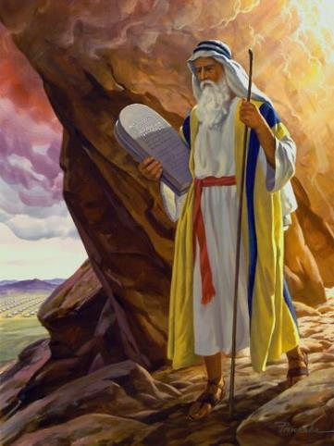
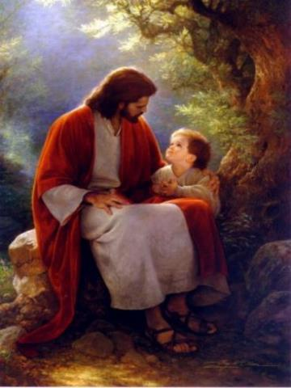
Law & Grace: An Overview Jim McGowan, Th.D. Sugar Land Bible Church 09-23-2018
…but grace & truth were realized through Jesus Christ - John 1:17
For the Law was given through Moses…
Special thanks to Dr. Vern Peterman for access to his insights and resources.

Slide 2
Session 11 Outline
Review
Purpose, Aim, and Objective
Session 10
The Law and Laws – The Whole Enchilada Part I (Exo. 20; Num. 15, Deut. 4-5; 8; 11; 14-15; Psa. 147)
General Information
Comments & Commentary
Concluding Observations

Slide 3
Session 11 Outline
Review
Purpose, Aim, and Objective
Session 10
The Law and Laws – The Whole Enchilada Part I (Exo. 20; Num. 15, Deut. 4-5; 8; 11; 14-15; Psa. 147)
General Information
Comments & Commentary
Concluding Observations

Slide 4
OUR PURPOSE, AIM AND OBJECTIVE
Law & Grace
…is to Compare and Contrast Law and Grace so as to properly understand these two important themes and how they are related to the life of the New Testament Believer.

Slide 5
C. I. SCOFIELD, D. D.
The Grace of God, The Fundamentals Vol. 3, Chapter VII, p. 98
We have, most of us, been reared and now live under the influence of Galatianism. Protestant theology, alas, is for the most part, thoroughly Galatianized, in that neither law nor grace are given their distinct and separated places, as in the counsels of God, but are mingled together in one incoherent system.
The law is no longer, as in the Divine intent, a ministration of death (2 Cor. 3:7), of cursing (Gal. 3:10), of conviction (Rom. 3:19), because we are taught that we must try to keep it, and that by Divine help we may.
Nor, on the other hand, does grace bring us blessed deliverance from the dominion of sin, for we are kept under the law as a rule of life despite the plain declaration, “Sin shall not have dominion over you: for ye are not under the law, but under grace” (Rom. 6:14). (emphasis mine)

Slide 6
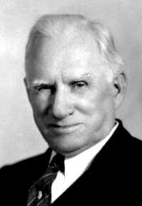
William R. Newell
Romans Verse-by-Verse (p. 274).
Grand Rapids, MI: Christian Classics Ethereal Library.
It is because Reformed theology has kept us Gentiles under the Law,—if not as a means of righteousness, then as “a rule of life,” that all the trouble has arisen. The Law is no more a rule of life than it is a means of righteousness. Walking in the Spirit has now taken the place of walking by ordinances. God has another principle under which He has put his saints: “Ye are not under law, but, under grace!” (italics mine)

Slide 7
Session 11 Outline
Review
Purpose, Aim, and Objective
Session 10
The Law and Laws – The Whole Enchilada Part I (Exo. 20; Num. 15, Deut. 4-5; 8; 11; 14-15; Psa. 147)
General Information
Comments & Commentary
Concluding Observations

Slide 8
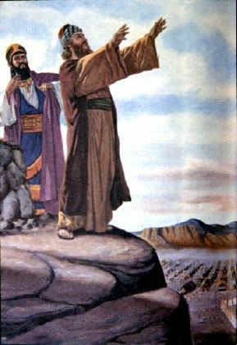
Law & Grace: Lesson 10 Review
Passages addressing Balaam in the Old Testament
Numbers 22-24 – Balak king of Moab hires Balaam to curse Israel
Numbers 31:8, 16 – Balaam’s treachery revealed, and his death recorded
Deuteronomy 23:4-5 – Brief summary of Numbers 22-24.
Joshua 13:22; 24:9, 10 – Brief summary of Numbers 22-24

Slide 9
Law & Grace: Lesson 10 Review
Passages addressing Balaam in the Old Testament
Micah 6:5 – A call to remember Numbers 22-24
Nehemiah 13:2 – Brief summary of Numbers 22-24

Slide 10
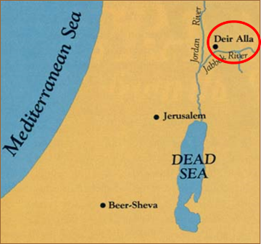
Law & Grace: Lesson 10 Review
Balaam Scriptural Timeline
1500 1000 500 <BC 0 AD>
Micah 6:5
Deir Alla Inscription
Numbers 22-24
Numbers 31:8, 16 Deuteronomy 23:4, 5 Joshua 13:22
Joshua 24:9, 10

Slide 11
Law & Grace: Lesson 10 Review
Balaam Scriptural Timeline
1500 1000 500 <BC 0 AD>
Micah 6:5
Deir Alla Inscription
Numbers 22-24
Numbers 31:8, 16 Deuteronomy 23:4, 5 Joshua 13:22
Joshua 24:9, 10
Nehemiah 13:2

Slide 12
Law & Grace: Lesson 10 Review
Books addressing Balaam in the New Testament
2 Peter 2:15
Jude 11
Revelation 2:14

Slide 13
Law & Grace: Lesson 10 Review
Balaam Scriptural Timeline
1500 1000 500 <BC 0 AD>
Micah 6:5
Deir Alla Inscription
Numbers 22-24
Numbers 31:8, 16 Deuteronomy 23:4, 5 Joshua 13:22
Joshua 24:9, 10
Nehemiah 13:2
2 Peter 2:15
Jude 11
Revelation 2:14

Slide 14
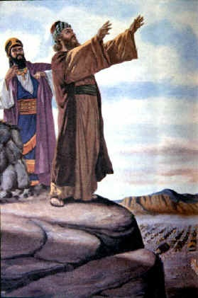
Applicable Principles under both Law and Grace
Law & Grace: Lesson 10 Review
Though Law and Grace stand in contrast, the spiritual principles compare very well.
So the lessons involving Balaam, who came to the people of Israel, who were baptized into Moses and under a covenant of Law, apply to us, too!

Slide 15
The Way of Balaam 2 Peter 2:15
Law & Grace: Lesson 10 Review
Balaam’s way was to hire himself out for ‘religious’ or ‘spiritual’ work, in this case to curse the Israelites, so as to override God’s own blessings of the people of Israel.

Slide 16
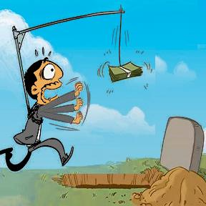
So what was Balaam’s problem? 2 Peter 2:15
Law & Grace: Lesson 10 Review
Balaam founded his faith in his own feelings: he was drawn by a love of money above all else. (cf. 1 Tim. 3:3; 6:10)
It was a heart attachment to money that really motivated him.

Slide 17
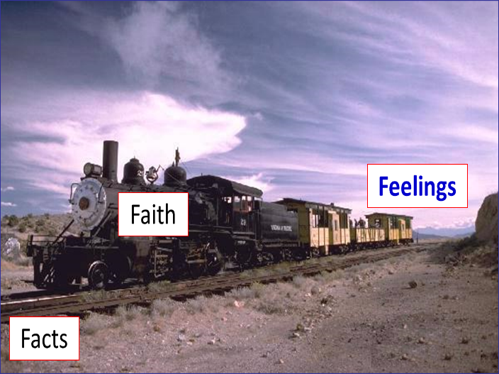
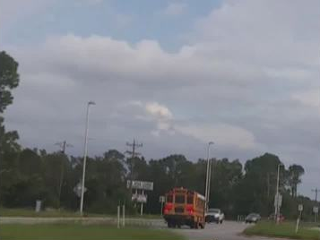
“Faith in the facts, is like the train on the tracks.”
Law & Grace: Lesson 10 Review

Slide 18
Law & Grace: Lesson 10 Review
The Error of Balaam
Jude 11
Balaam not only had a way that was wrong, but he also had a twisted view of the relationship between people and God: he thought that God could be manipulated to fulfill human purposes.

Slide 19
Law & Grace: Lesson 10 Review
The Teaching of Balaam
Revelation 2:14
We have discussed the ‘Way of Balaam’ and the ‘Error of Balaam’, but the scriptures also mention the ‘Teaching of Balaam’ in Rev 2:14.

Slide 20
Law & Grace: Lesson 10 Review
The Teaching of Balaam
Revelation 2:14
As far as blessings or curses, Balaam was constrained by God to say only what God told him to say. But Balaam also instructed Balak how to bring the Israelites down, by getting them to compromise with idolatry and immorality!
This was the teaching of Balaam!

Slide 21
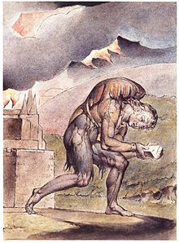
Law & Grace: Comparison & Contrast 1 MOTIVATED BY FEAR
Law & Grace: Lesson 10 Review
Those living under the Principle of Law (as the Jews were under Moses) are blessed if they obey and are cursed if they don’t obey. (Deut. 28).

Slide 22
Law & Grace: Comparison & Contrast 1 MOTIVATED BY GRACE
Law & Grace: Lesson 10 Review
Believers living under the Principle of Grace are all blessed and motivated by Grace to be obedient …not out of a fear of being cursed! (Ephesians 1:1-3; 2:1-10).
Under the law you better not steal you had better not lie or you will not be blessed! But when it comes to motivation, earthly-based curses can’t touch heaven’s grace blessings.

Slide 23
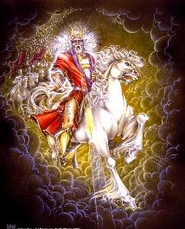
Law & Grace: Comparison & Contrast 3
Law & Grace: Lesson 10 Review
The people of Israel were to live out the Mosaic Law, though they were given no enablement to do so.
However, the Holy Spirit will enable them to know and live out the kingdom law in the Millennial Kingdom.

Slide 24
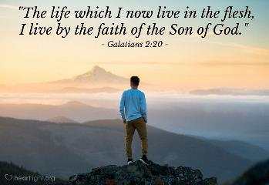
Law & Grace: Comparison & Contrast 3
Law & Grace: Lesson 10 Review
However, we in the body of Christ, are empowered to live by the life of Christ, apart from the Law, walking and living by faith in Christ and who we are in Him and who He is in us…by the Holy Spirit who indwells us (Gal. 2:19–20).

Slide 25
Law & Grace: Lesson 10 Review

Slide 26
Session 11 Outline
Review
Purpose, Aim, and Objective
Session 10
The Law and Laws – The Whole Enchilada Part I (Exo. 20; Num. 15, Deut. 4-5; 8; 11; 14-15; Psa. 147)
General Information
Comments & Commentary
Concluding Observations

Slide 27
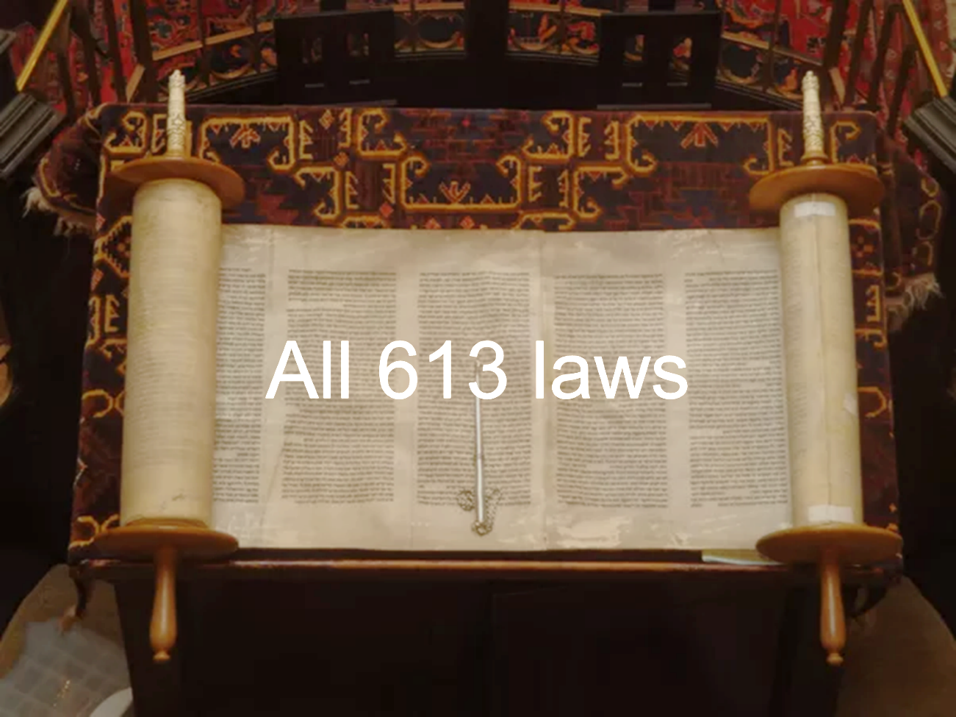
Law & Grace: Lesson 11 The Law and Laws – The Whole Enchilada Part I

Slide 28
*Deuteronomy 8:1
All the commandments that I am commanding you today you shall be careful to do…
*deuteros (second) + nomos (law)

Slide 29
Session 11 Outline
Review
Purpose, Aim, and Objective
Session 10
The Law and Laws – The Whole Enchilada Part I (Exo. 20; Num. 15, Deut. 4-5; 8; 11; 14-15; Psa. 147)
General Information
Comments & Commentary
Concluding Observations

Slide 30
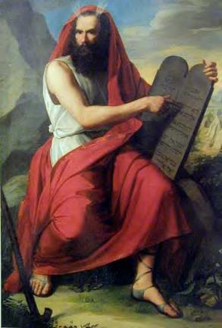
Subtracting from, and adding to, the Law of Moses
Law & Grace: Lesson 11 The Law and Laws – The Whole Enchilada Part I
Many groups within Christendom* hold to some smaller set of the Law of Moses.
* ‘Christendom’ here includes those groups who do not teach a saving Gospel but still ‘claim’ to be ‘Christian’ (Mormon, Jehovah’s Witness, etc.).

Slide 31
Subtracting from, and adding to, the Law of Moses
Law & Grace: Lesson 11 The Law and Laws – The Whole Enchilada Part I
These groups pick and choose from among the 613 laws of the Law of Moses to assemble the set they claim is ‘right’.

Slide 32
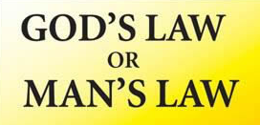
Subtracting from, and adding to, the Law of Moses
Law & Grace: Lesson 11 The Law and Laws – The Whole Enchilada Part I
Each group claims that we ought to follow their set of Laws in order to be right before God, ‘get saved’, to stay saved, be blessed or some similar terminology.

Slide 33
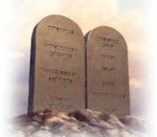
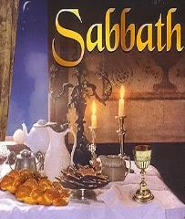
The 10 Commandments (+/-) Exodus 20:1-17
Law & Grace: Lesson 11 The Law and Laws – The Whole Enchilada Part I
It is fairly common among these groups, to say that Christians are still under the 10 commandments, however:
Few will hold to the Sabbath from sundown Friday to sundown Saturday. Exceptions include the Seventh-day Adventists and the Seventh-day Baptists (?).

Slide 34
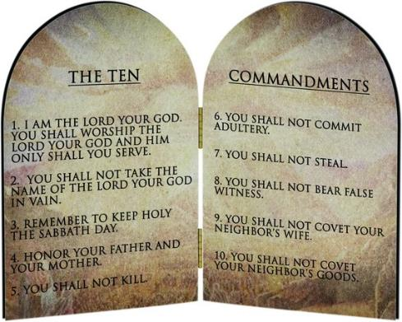
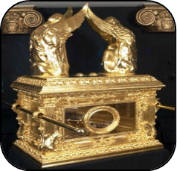
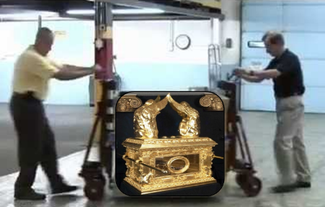
Law & Grace: Lesson 11 The Law and Laws – The Whole Enchilada Part I
The 10 Commandments (+/-) Exodus 20:1-17
The 10 commandments were put on tablets of stone so that Moses could put the tablets in the Ark of the Covenant.

Slide 35
The 10 Commandments (+/-) Exodus 20:1-17
Law & Grace: Lesson 11 The Law and Laws – The Whole Enchilada Part I
Just about nobody wants to carry out the death penalty as required by the law for breaking any of the ten commandments.
According to modern Orthodox Judaism, you had better not flip a light switch on a Friday evening!

Slide 36
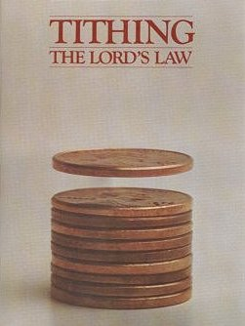
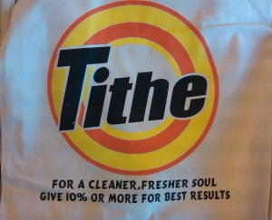
Law & Grace: Lesson 11 The Law and Laws – The Whole Enchilada Part I
The 10 Commandments (+/-) Exodus 20:1-17
Many want to add to the requirement to give a tithe (a tenth).

Slide 37
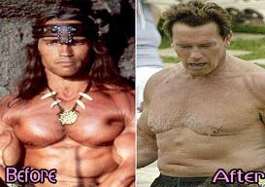
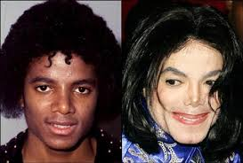
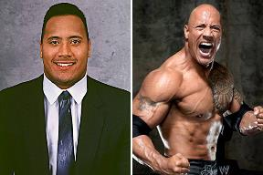
Law & Grace: Lesson 11 The Law and Laws – The Whole Enchilada Part I
Before & After Deuteronomy 14 & 15

Slide 38
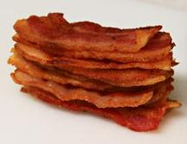
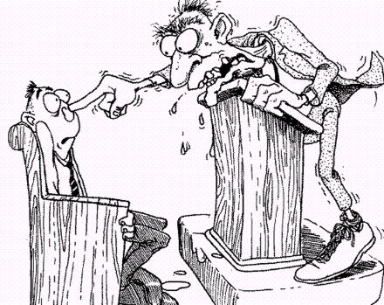
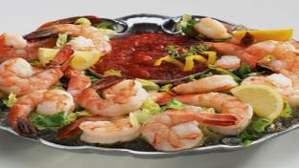
Law & Grace: Lesson 11 The Law and Laws – The Whole Enchilada Part I
Before & After Deuteronomy 14 & 15
Right BEFORE the tithe commandments are the food laws, such as not eating crab and lobster, or anything that comes from a pig or a camel.

Slide 39
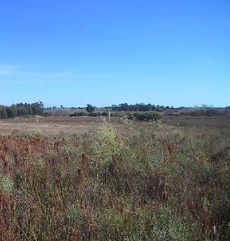
Law & Grace: Lesson 11 The Law and Laws – The Whole Enchilada Part I
Before & After Deuteronomy 14 & 15
Right AFTER the tithe commandments are all the laws about letting your land be uncultivated every seventh year – let it rest.
Nothing in the context that justifies applying tithing to Christians, but not the food or land laws.

Slide 40
‘HOG WILD AND OUT OF CONTROL’
Law & Grace: Lesson 11 The Law and Laws – The Whole Enchilada Part I
Legalists tell us that we need some laws so that believers don’t go ‘hog-wild’.
But the belief and teaching that we need some laws to keep us from going hog-wild fails to recognize that believers are indwelt by Christ and the Holy Spirit.

Slide 41
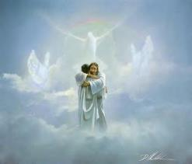
‘HOG WILD AND OUT OF CONTROL’
Law & Grace: Lesson 11 The Law and Laws – The Whole Enchilada Part I
Are Christ and the Holy Spirit prone to going ‘hog wild’?
Are Christ and the Holy Spirit so limited in power and divine resources that they need extra rules to keep believers from going ‘hog wild’?
Do Christ and the Holy Spirit need a few extra carefully chosen constraints to keep believers godly?

Slide 42
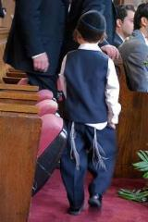
Numbers 15:37-41
³⁷ The Lord also spoke to Moses, saying, ³⁸ “Speak to the sons of Israel, and tell them that they shall make for themselves tassels (צִיצִת tzitzit) on the corners of their garments throughout their generations, and that they shall put on the tassel (צִיצִת tzitzit) of each corner a cord of blue…

Slide 43
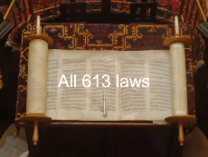
Numbers 15:37-41
… ³⁹ “It shall be a tassel for you to look at and remember all the commandments of the Lord, so as to do them and not follow after your own heart and your own eyes, after which you played the harlot, ⁴⁰ so that you may remember to do all My commandments and be holy to your God. ⁴¹ “I am the Lord your God who brought you out from the land of Egypt to be your God; I am the Lord your God.”

Slide 44
Deuteronomy 4:5-6
⁵ “See, I have taught you statutes and judgments just as the Lord my God commanded me, that you should do thus in the land where you are entering to possess it. ⁶ “So keep and do them, for that is your wisdom and your understanding in the sight of the peoples who will hear all these statutes and say, ‘Surely this great nation is a wise and understanding people.’

Slide 45
Deuteronomy 4:7-8
⁷ “For what great nation is there that has a god so near to it as is the Lord our God whenever we call on Him? ⁸ “Or what great nation is there that has statutes and judgments as righteous as this whole law which I am setting before you today?

Slide 46
Deuteronomy 5:31
³¹ ‘But as for you, stand here by Me, that I may speak to you all the commandments and the statutes and the judgments which you shall teach them, that they may observe them in the land which I give them to possess.

Slide 47
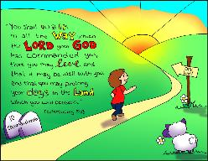
Deuteronomy 5:32-33a
³² “So you shall observe to do just as the Lord your God has commanded you; you shall not turn aside to the right or to the left. ³³ “You shall walk in all the way which the Lord your God has commanded you, that you may live and that it may be well with you, and that you may prolong your days in the land which you will possess.

Slide 48
Law & Grace: Lesson 11 The Law and Laws – The Whole Enchilada Part I
Points of Contrast and Comparison
Steward | MOSES | CHRIST
Governing Principle | Law | Grace
Who’s Works are you depending on? | Self | Christ
People Group | ISRAEL | CHURCH
Baptism | Into Moses | Into Christ
Ministry Characteristic | Death / Condemnation 2 Cor. 3:7, 9 | Spirit / Righteousness
Nature of Blessings | Conditional (If) / Earthly | Unconditional / Heavenly
Earthly Difficulties | Curses for disobedience | Growth or discipline
Notes:
Points of Comparison & Contrast
Steward MOSES CHRIST
Scripture portrays both Moses and Christ as Stewards. Each was entrusted by God with the establishment of something.
Principle Israel under Law The Church under Grace
The principle of Law reigns over Israel while the principle of Grace reigns over the Church.
Who’s Works are you depending on? Self Christ
Under the Law – Do’s and Don’ts to be blessed or cursed. Under Grace we rely on Christ’s works! It is His works that save and make me who I am “In Christ”.
People Group ISRAEL CHURCH
Baptism Into Moses Into Christ
The people groups mentioned above are spoken of as having been baptized into (identified with and joined to) either Moses (LAW) or Christ (GRACE). We as believers have been baptized into Christ which has great significance for us.
Ministry Characteristic Death Condemnation Spirit Righteousness
2 Cor. 3
Nature of Blessings Conditional (If) / Earthly Unconditional / Heavenly
Deut. 28:1-14 (Blessings) 15-68 (Curses) Eph. 1:3; 4 (practical implications)
Earthly Difficulties Curses for disobedience Growth or discipline
NEXT SLIDE

Slide 49
LAW = Death and Condemnation
Law & Grace: Lesson 11 The Law and Laws – The Whole Enchilada Part I

Slide 50
Deuteronomy 5:33b
…³² “So you shall observe to do just as the Lord your God has commanded you; you shall not turn aside to the right or to the left. ³³ “You shall walk in all the way which the Lord your God has commanded you, that you may live and that it may be well with you, and that you may prolong your days in the land which you will possess.

Slide 51
Deuteronomy 8:1
“All the commandments that I am commanding you today you shall be careful to do, that you may live and multiply, and go in and possess the land which the Lord swore to give to your forefathers.

Slide 52
Deuteronomy 11:8-9
⁸ “You shall therefore keep every commandment which I am commanding you today, so that you may be strong and go in and possess the land into which you are about to cross to possess it; ⁹ so that you may prolong your days on the land which the Lord swore to your fathers to give to them and to their descendants, a land flowing with milk and honey.

Slide 53
Deuteronomy 11:31-32
³¹ “For you are about to cross the Jordan to go in to possess the land which the Lord your God is giving you, and you shall possess it and live in it, ³² and you shall be careful to do all the statutes and the judgments which I am setting before you today.

Slide 54
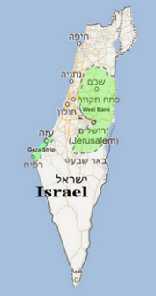
Psalm 147:19-20
¹⁹ He declares His words to Jacob, His statutes and His ordinances to Israel. ²⁰ He has not dealt thus with any nation; And as for His ordinances, they have not known them. Praise the Lord!

Slide 55
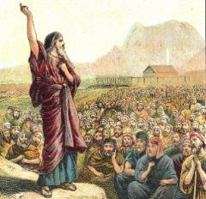
Law & Grace: Lesson 11 The Law and Laws – The Whole Enchilada Part I
The Law of Moses was given to Israel!
Psalm 147:19-20
Over and over again we see that the Law of Moses was given to the people of Israel, and not to any other nation or nations.

Slide 56
Law & Grace: Lesson 11 The Law and Laws – The Whole Enchilada Part I

Slide 57
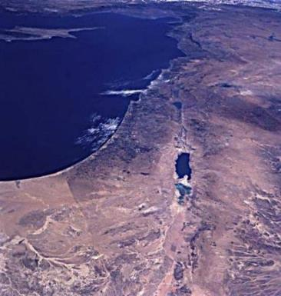
Law & Grace: Lesson 11 The Law and Laws – The Whole Enchilada Part I
The Law of Moses was given to Israel!
Psalm 147:19-20
Over and over again we see that the Law of Moses was to be lived out in the land that was promised to Israel.
The original intent in the giving of the Law of Moses to the Children of Israel, was that it would and could only be kept by Jews living in the land of Israel.

Slide 58
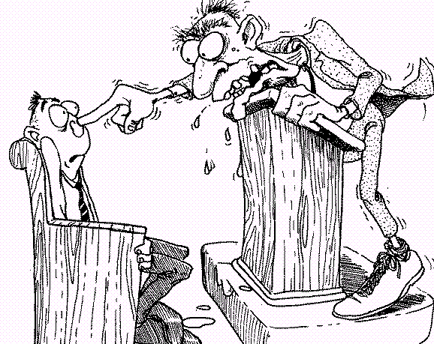
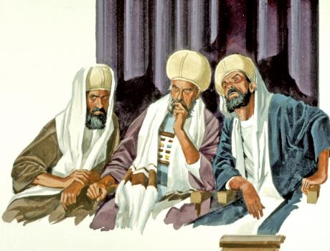
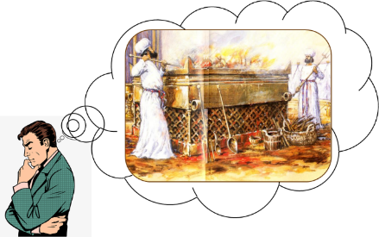
Law & Grace: Lesson 11 The Law and Laws – The Whole Enchilada Part I
The Law of Moses was given to Israel!
Psalm 147:19-20
How many pastors and bible teachers who beat their listeners over the head with tithing actually live in Israel, are from the tribe of Levi, and make animal sacrifices in the Temple every day?

Slide 59
Law & Grace: Lesson 11 The Law and Laws – The Whole Enchilada Part I
Picking and Choosing - no biblical basis!
With the clear emphasis on keeping all of the statutes, ordinances, and judgments - every single law - it is hard to fathom how anyone can justify ‘choosing’.
Numbers 15:39, 40 (“all, “all”)
Deuteronomy 4:6, 7, 8 (“all”, “the whole law”)
Deuteronomy 5:31, 33 (“all, “all”)
Deuteronomy 8:1 (“all”)
Deuteronomy 11:8, 32 (“Every”, “all”)

Slide 60
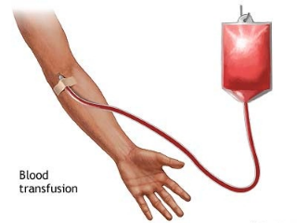
Law & Grace: Lesson 11 The Law and Laws – The Whole Enchilada Part I
Picking and Choosing - no biblical basis!
There are those who have the impudence to add to the laws God so clearly gave! No blood transfusions! No eating meat! But there is no basis for picking and choosing ‘laws’.
One group comes up with one law another group comes up with another law - It’s all arbitrary!

Slide 61
Law & Grace: Lesson 11 The Law and Laws – The Whole Enchilada Part I
Picking and Choosing - no biblical basis!
It takes incredible brazenness to think that you can add anything to, or subtract anything from, the 613 Laws given specifically to the Children of Israel.
If it’s about making decisions to be healthy go for it. Just don’t make it about holiness.
Legalism

Slide 62
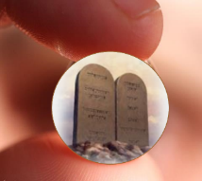
Law & Grace: Lesson 11 The Law and Laws – The Whole Enchilada Part I
The Big Tragedy ‘Mini-Law’ leads to ‘Mini-Grace’
Some people want a more manageable set of laws. 613 is just too many, so they decide which ones they will follow.
The problem is that a trimmed down Law robs it of it’s awesome, ominous, overwhelming nature and removes the purpose of the Law which is to reveal our desperate need for God’s Grace.

Slide 63
Law & Grace: Lesson 11 The Law and Laws – The Whole Enchilada Part I
The Big Tragedy ‘Mini-Law’ leads to ‘Mini-Grace’
A paired down, Mini-Law leads to a paired down Mini-Grace and ultimately a paired down Mini-God, who is not the God of the Bible.

Slide 64
Session 11 Outline
Review
Purpose, Aim, and Objective
Session 10
The Law and Laws – The Whole Enchilada Part I (Exo. 20; Num. 15, Deut. 4-5; 8; 11; 14-15; Psa. 147)
General Information
Comments & Commentary
Concluding Observations

Slide 65
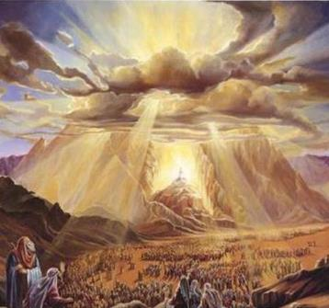
Law & Grace: Lesson 11 The Law and Laws – The Whole Enchilada Part I
What God intended
God intended for the Law of Moses to reflect His most awesome and infinite moral character.
One who thinks he has the authority to choose from among the Laws of Moses is spiritually ‘dense’.

Slide 66
Law & Grace: Lesson 11 The Law and Laws – The Whole Enchilada Part I
What God intended
God intended that the Law of Moses should be so awesome and overwhelming that we are in ultimate desperation for God’s even more amazing and very awesome grace!

Slide 67
Law & Grace: Lesson 11 The Law and Laws – The Whole Enchilada Part I
What God intended

Slide 68
Ephesians 2:4-7
⁴ But God, being rich in mercy, because of His great love with which He loved us, ⁵ even when we were dead in our transgressions, made us alive together with Christ (by grace you have been saved), ⁶ and raised us up with Him, and seated us with Him in the heavenly places in Christ Jesus, ⁷ so that in the ages to come He might show the surpassing riches of His grace in kindness toward us in Christ Jesus.

Slide 69
Law & Grace: An Overview Jim McGowan, Th.D. Sugar Land Bible Church 09-23-2018
…but grace & truth were realized through Jesus Christ - John 1:17
For the Law was given through Moses…
Special thanks to Dr. Vern Peterman for access to his insights and resources.

