Slide 1
Righteous by Faith
Romans 1:16-17
September 23, 2018
Alex Garcia

Slide 2
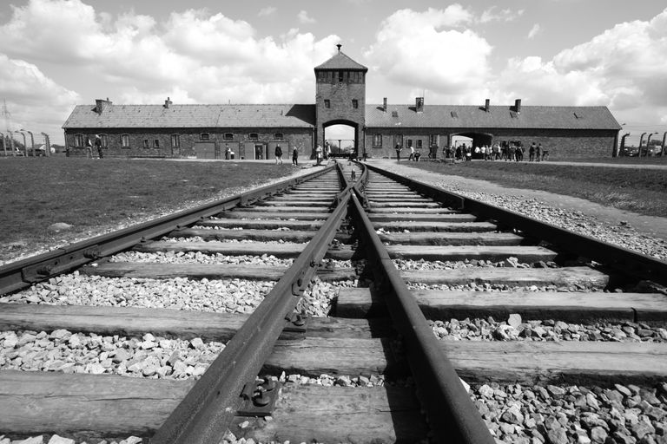
Auschwitz

Slide 3
RIGHTEOUS BY FAITH (Rom 1:16-17)
Don’t be ashamed of the gospel
Gospel is the power of God
Negative consequences of sin removed and positive benefits given
Righteousness of God revealed, by faith
Salvation protected by God’s power

Slide 4
RIGHTEOUS BY FAITH (Rom 1:16-17)
Don’t be ashamed of the gospel
Gospel is the power of God
Negative consequences of sin removed and positive benefits given
Righteousness of God revealed, by faith
Salvation protected by God’s power

Slide 5
Romans 1:16
“For I am not ashamed of the gospel . . . .”

Slide 6
Romans 1:16
“For I am not ashamed of the gospel, for it is the power of God for salvation . . . .”

Slide 7
RIGHTEOUS BY FAITH (Rom 1:16-17)
Don’t be ashamed of the gospel
Gospel is the power of God
Negative consequences of sin removed and positive benefits given
Righteousness of God revealed, by faith
Salvation protected by God’s power

Slide 8
1 Corinthians 1:18
“For the word of the cross is foolishness to those who are perishing, but to us who are being saved it is the power of God.”

Slide 9
Romans 1:16
“For I am not ashamed of the gospel, for it is the power of God for salvation . . . .”

Slide 10
Romans 5:9-10
“⁹Much more then, having now been justified by His blood, we shall be saved from the wrath of God through Him. ¹⁰For if while we were enemies we were reconciled to God through the death of His Son, much more, having been reconciled, we shall be saved by His life.”

Slide 11
RIGHTEOUS BY FAITH (Rom 1:16-17)
Don’t be ashamed of the gospel
Gospel is the power of God
Negative consequences of sin removed and positive benefits given
Righteousness of God revealed, by faith
Salvation protected by God’s power

Slide 12
Negative Consequences of sin removed:
1. Wrath of God (Rom 5:9)
2. Condemnation (judgment) of God (Rom 8:1)
3. Spiritual death (Eph 2:5)
4. Physical death (1 Cor 15:52)

Slide 13
Positive Benefits given:
1. Eternal life (John 11:25-26)
2. Righteousness (Rom 1:17)
3. Glory (Rom 8:30)
4. Adoption into His heavenly family (Eph 1:5)

Slide 14
Romans 1:16
“For I am not ashamed of the gospel, for it is the power of God for salvation to everyone who believes, to the Jew first and also to the Greek.”

Slide 15
Romans 5:6
“For while we were still helpless, at the right time Christ died for the ungodly.”

Slide 16
Dwight Pentecost
“We are the heirs of generations of the teaching of evolution, which sees man in an ever-ascending spiral, rising higher and higher from the depth from which he has sprung, until finally he will reach the stars. So widely accepted is that concept that we have come somehow to feel that there is so much good in the worst of us that man is not so bad off after all.”
Dwight Pentecost: Things Which Become Sound Doctrine, pg. 10.

Slide 17
Romans 1:17
“For in it the righteousness of God is revealed from faith to faith; as it is written, “BUT THE RIGHTEOUS man SHALL LIVE BY FAITH.”

Slide 18
RIGHTEOUS BY FAITH (Rom 1:16-17)
Don’t be ashamed of the gospel
Gospel is the power of God
Negative consequences of sin removed and positive benefits given
Righteousness of God revealed, by faith
Salvation protected by God’s power

Slide 19
Romans 1:17
“For in it the righteousness of God is revealed from faith to faith; as it is written, “BUT THE RIGHTEOUS man SHALL LIVE BY FAITH.”

Slide 20
Salvation delivers from sin:
1. Immediate deliverance from judgment (Eph 2:8; Rom 8:1)
2. Ongoing deliverance from power of sin to enslave (Rom 6:12-14)
3. Future deliverance from presence of sin in heaven (Rom 5:10; Rev 21:4)

Slide 21
Martin Luther
“My situation was that, although an impeccable monk, I stood before God as a sinner troubled in conscience, and I had no confidence that my merit would assuage him. Therefore I did not love a just and angry God, but rather hated and murmured against him.…Then I grasped that the justice of God is that righteousness by which through grace and sheer mercy God justifies us through faith.…whereas before the ‘justice of God’ had filled me with hate, now it became to me inexpressibly sweet in greater love.”
Martin Luther quoted in Roland H. Bainton’s Here I Stand, pg 51.

Slide 22
Council of Trent
Canon IX. “If any one shall say, that by faith alone the impious [i.e., the sinner] is justified; so as to mean that nothing else is required to co-operate in order unto the obtaining the grace of justification, . . . ; let him be anathema [i.e., accursed].”
T.A. Buckley: The Canons and Decrees of the Council of Trent, pg. 46.

Slide 23
Council of Trent
Canon XXXIV. “If any one shall say, that the justice received is not preserved, and also increased in the sight of God through good works; but that the said works are merely the fruits and signs of justification received, but not a cause of the increase thereof; let him be anathema.”
T.A. Buckley: The Canons and Decrees of the Council of Trent, pg. 46.

Slide 24
Council of Trent
Chapter IX. “. . . no one can know with a certainty of faith, which cannot be subject to mistake, that he has obtained the grace of God.”
T.A. Buckley: The Canons and Decrees of the Council of Trent, pg. 36.

Slide 25
RIGHTEOUS BY FAITH (Rom 1:16-17)
Don’t be ashamed of the gospel
Gospel is the power of God
Negative consequences of sin removed and positive benefits given
Righteousness of God revealed, by faith
Salvation protected by God’s power

Slide 26
1 Peter 1:3-5
“Blessed be the God and Father of our Lord Jesus Christ, who according to His great mercy has caused us to be born again to a living hope . . . protected by the power of God through faith for a salvation ready to be revealed in the last time.”

