Slide 1


Slide 2

The Coming Kingdom
Chapter 16
Dr. Andy Woods
Senior Pastor – Sugar Land Bible Church
President – Chafer Theological Seminary

Slide 3

Kingdom Study Outline
What does the Bible Say About the Kingdom?
The Main Problem with Kingdom Now NT interpretations
Why do some believe that we are in the kingdom now?
Why does it matter?

Slide 4
Kingdom Study Outline
What does the Bible Say About the Kingdom?
The Main Problem with Kingdom Now NT interpretations
Why do some believe that we are in the kingdom now?
Why does it matter?

Slide 5
1. Kingdom Throughout the Bible
Eden Abrahamic Covenant Mosaic Covenant Divided Kingdom Times of the Gentiles | Old Testament Prophets Post exile Offer of the King / Kingdom Rejection of the Offer Interim Age

Slide 6
1. Kingdom Throughout the Bible
Kingdom Mysteries Church Israel’s Discipline & Restoration Re-offer of the King/Kingdom | Transfer of Kingdom Authority Kingdom Establishment Eternal State Testimony of Early Church History

Slide 7
Kingdom Study Outline
What does the Bible Say About the Kingdom?
The Main Problem with Kingdom Now NT interpretations
Why do some believe that we are in the kingdom now?
Why does it matter?

Slide 8

2. The Main Problem with Kingdom Now NT interpretations
The kingdom is always earthly (Gen. 15:18-21) over a repentant Israel (Ezek. 36‒37)
The kingdom will only manifest after a time of tribulation (Jer. 30:7; Dan. 9:24-27)

Slide 9

Kingdom Study Outline
What does the Bible Say About the Kingdom?
The Main Problem with Kingdom Now NT interpretations
Why do some believe that we are in the kingdom now?
Why does it matter?

Slide 10
Response to Kingdom Now Problem Passages
Passages from Christ’s ministry
Passages from Acts
Passages from Paul
Passages from the General letters
Passages from Revelation
Miscellaneous Arguments

Slide 11
Response to Kingdom Now Problem Passages
Passages from Christ’s ministry
Passages from Acts
Passages from Paul
Passages from the General letters
Passages from Revelation
Miscellaneous Arguments

Slide 12

1. Passages from Christ’s ministry
The kingdom is at hand (Matt. 3:2)
Theirs is the kingdom (Matt. 5:3, 10)
Thy kingdom come (Matt. 6:9-13)
Seek first the kingdom (Matt. 6:33)
The kingdom suffers violence (Matt. 11:12)
Satan falls like lightning (Luke 10:18)
The kingdom has come upon you (Matt. 12:28)

Slide 13
1. Passages from Christ’s ministry
The kingdom is in your midst (Luke 17:21)
Born again to enter the kingdom (John 3:3-5)
No death until kingdom comes (Matt. 16:28)
Kingdom given to another people (Matt. 21:43)
Kingdom is not of this world (John 18:36)
All authority given to me (Matt 28:18-20)

Slide 14

Luke 17:20-21
“Now having been questioned by the Pharisees as to when the kingdom of God was coming, He answered them and said, ‘The kingdom of God is not coming with signs to be observed; nor will they say, ‘Look, here it is!’ or, ‘There it is!’ For behold, the kingdom of God is in your midst.’”

Slide 15

E.R. Craven
“Excursus on the Basileia,” in Revelation of John, J. P. Lange (New York: Scribner, 1874), 96.
“This passage, probably, by the advocates of the prevalent theory of the Basileia, is regarded as their most important proof-text, both as to its nature and present establishment.”

Slide 16
h. The Kingdom is Within Your Midst
(Luke 17:20-21)
Does not say “the kingdom is within you”
Sufficiency of the offer of the kingdom framework
Possibility of a futuristic rather than present reality

Slide 17
h. The Kingdom is Within Your Midst
(Luke 17:20-21)
Does not say “the kingdom is within you”
Sufficiency of the offer of the kingdom framework
Possibility of a futuristic rather than present reality

Slide 18
Luke 17:20-21 (NCV)
“Some of the Pharisees asked Jesus, “When will the kingdom of God come?” Jesus answered, ’God’s kingdom is coming, but not in a way that you will be able to see with your eyes. People will not say, ‘Look, here it is!’ or, ‘There it is!’ because God’s kingdom is within you.’”

Slide 19

1. The Kingdom is Within You?
Addressing the Pharisees (Luke 17:20; John 8:44)
People enter the kingdom (Matt. 5:20; 23:13; 25:31-46; John 3:5)
Perfect rule of Christ? (Rev. 12:5; 1 Thess. 5:19; Rom. 6:12; Eph. 4:30)
Kingdom always retains its terrestrial meaning
Subsequent and latter ministry of Christ (Matt. 19:28; 20:20-21; 26:29; Luke 23:42; Mark 15:43; Acts 1:6)
NASB provides a better translation

Slide 20
h. The Kingdom is Within Your Midst
(Luke 17:20-21)
Does not say “the kingdom is within you”
Sufficiency of the offer of the kingdom framework
Possibility of a futuristic rather than present reality

Slide 21
2. Sufficiency of the Offer of the Kingdom Framework
King & Kingdom went together (Isa. 9:6-7; Dan. 7:13-14; Luke 1:26-27, 32)
Review of the Offer of the Kingdom framework
Kingdom offer rejected by Israel (Luke 19:14, 42, 44, 11)
Offer will be received by future Israel (Luke 21:31)

Slide 22

h. The Kingdom is Within Your Midst
(Luke 17:20-21)
Does not say “the kingdom is within you”
Sufficiency of the offer of the kingdom framework
Possibility of a futuristic rather than present reality

Slide 23
3. Futuristic Rather than Present Reality
Rejection of the offer (Luke 17:22, 25)
Future kingdom to come instantaneously (Dan. 2:35, 44; Luke 17:23-33)
Present tense? (Luke 17:20-21)
  Pharisees asked the question in the present tense (Luke 17:20)
  Biblical languages sometimes use the present tense to depict future certainty (Ps. 90:4; 2 Pet. 3:8; Josh. 6:2; Rom. 8:29-30; Jude 14; Matt. 13:31, 47; 26:2; 1 Cor. 15:42-44)

Slide 24
3. Futuristic Rather than Present Reality
Rejection of the offer (Luke 17:22, 25)
Future kingdom to come instantaneously (Dan. 2:35, 44; Luke 17:23-33)
Present tense? (Luke 17:20-21)
  Pharisees asked the question in the present tense (Luke 17:20)
  Biblical languages sometimes use the present tense to depict future certainty (Ps. 90:4; 2 Pet. 3:8; Josh. 6:2; Rom. 8:29-30; Jude 14; Matt. 13:31, 47; 26:2; 1 Cor. 15:42-44)

Slide 25
3. Futuristic Rather than Present Reality
Rejection of the offer (Luke 17:22, 25)
Future kingdom to come instantaneously (Dan. 2:35, 44; Luke 17:23-33)
Present tense? (Luke 17:20-21)
  Pharisees asked the question in the present tense (Luke 17:20)
  Biblical languages sometimes use the present tense to depict future certainty (Ps. 90:4; 2 Pet. 3:8; Josh. 6:2; Rom. 8:29-30; Jude 14; Matt. 13:31, 47; 26:2; 1 Cor. 15:42-44)

Slide 26


Statue
&
Stone

Slide 27
Luke 17:20-21
“Now having been questioned by the Pharisees as to when the kingdom of God was coming, He answered them and said, ‘The kingdom of God is not coming with signs to be observed; nor will they say, ‘Look, here it is!’ or, ‘There it is!’ For behold, the kingdom of God is in your midst.’”

Slide 28
Luke 17:20-21
“Now having been questioned by the Pharisees as to when the kingdom of God was coming, He answered them and said, ‘The kingdom of God is not coming with signs to be observed; nor will they say [lego], ‘Look, here it is!’ or, ‘There it is!’ For behold, the kingdom of God is in your midst.’”

Slide 29

E.R. Craven
“Excursus on the Basileia,” in Revelation of John, J. P. Lange (New York: Scribner, 1874), 97.
“Does it not become manifest that this passage, so far from teaching the doctrine of a present establishment of the Basileia, must be numbered amongst those that connect the establishment with the Second Advent?”

Slide 30
3. Futuristic Rather than Present Reality
Rejection of the offer (Luke 17:22, 25)
Future kingdom to come instantaneously (Dan. 2:35, 44; Luke 17:23-33)
Present tense? (Luke 17:20-21)
  Pharisees asked the question in the present tense (Luke 17:20)
  Biblical languages sometimes use the present tense to depict future certainty (Ps. 90:4; 2 Pet. 3:8; Josh. 6:2; Rom. 8:29-30; Jude 14; Matt. 13:31, 47; 26:2; 1 Cor. 15:42-44)

Slide 31
Luke 17:20-21
“Now having been questioned by the Pharisees as to when the kingdom of God was coming, He answered them and said, ‘The kingdom of God is not coming with signs to be observed; nor will they say, ‘Look, here it is!’ or, ‘There it is!’ For behold, the kingdom of God is [eimi] in your midst.’”

Slide 32
3. Futuristic Rather than Present Reality
Rejection of the offer (Luke 17:22, 25)
Future kingdom to come instantaneously (Dan. 2:35, 44; Luke 17:23-33)
Present tense? (Luke 17:20-21)
  Pharisees asked the question in the present tense (Luke 17:20)
  Biblical languages sometimes use the present tense to depict future certainty (Ps. 90:4; 2 Pet. 3:8; Josh. 6:2; Rom. 8:29-30; Jude 14; Matt. 13:31, 47; 26:2; 1 Cor. 15:42-44)

Slide 33
Luke 17:20-21
“Now having been questioned by the Pharisees as to when the kingdom of God was coming [erchomai], He answered them and said, ‘The kingdom of God is not coming with signs to be observed; nor will they say, ‘Look, here it is!’ or, ‘There it is!’ For behold, the kingdom of God is [eimi] in your midst.’”

Slide 34

E.R. Craven
“Excursus on the Basileia,” in Revelation of John, J. P. Lange (New York: Scribner, 1874), 96.
“In the E. V. there is a difference in tense between the question of the Pharisees and the answer of Jesus—they asking, when the Basileia should come, and He answering, it cometh not with observation, it is within you—which necessarily implies a declaration of then existing establishment. This difference is altogether unauthorized—both the question and the answer are in the present; the question of the Pharisees should be translated “when cometh (erchetai) the kingdom of God?” The question was asked in the vivid, . . .

Slide 35
E.R. Craven
“Excursus on the Basileia,” in Revelation of John, J. P. Lange (New York: Scribner, 1874), 96.
. . .dramatic present; it manifestly had reference to the future; it would be in defiance of every conceivable law of language to suppose that our Lord, in following the lead of His questioners, intended to indicate a different tense. The question and the answer are but illustrations of that law proper to all languages, but pre-eminently to the Greek.”

Slide 36
3. Futuristic Rather than Present Reality
Rejection of the offer (Luke 17:22, 25)
Future kingdom to come instantaneously (Dan. 2:35, 44; Luke 17:23-33)
Present tense? (Luke 17:20-21)
  Pharisees asked the question in the present tense (Luke 17:20)
  Biblical languages sometimes use the present tense to depict future certainty (Ps. 90:4; 2 Pet. 3:8; Josh. 6:2; Rom. 8:29-30; Jude 14; Matt. 13:31, 47; 26:2; 1 Cor. 15:42-44)

Slide 37

2 Peter 3:8
“But do not let this one fact escape your notice, beloved, that with the Lord one day is like a thousand years, and a thousand years like one day.”

Slide 38
Joshua 6:2
“The Lord said to Joshua, “See, I have given Jericho into your hand, with its king and the valiant warriors.”

Slide 39
Romans 8:29–30
²⁹ For those whom He foreknew, He also predestined to become conformed to the image of His Son, so that He would be the firstborn among many brethren; ³⁰ and these whom He predestined, He also called; and these whom He called, He also justified; and these whom He justified, He also glorified.

Slide 40
Jude 14
“It was also about these men that Enoch, in the seventh generation from Adam, prophesied, saying, ‘Behold, the Lord came with many thousands of His holy ones.’”

Slide 41

Futuristic Present
Daniel B. Wallace, Greek Grammar Beyond the Basics: An Exegetical Syntax of the New Testament with Scripture, Subject, and Greek Word Indexes (Grand Rapids: Zondervan, 1996), 535-35.
“The present tense may be used to describe a future event, though. . . . it typically adds connotations of immediacy and certainty....The present tense may describe an event that is wholly subsequent to the time of speaking, although as if it were present.”

Slide 42
1 John 2:17
“The world is passing away (paragō), and also its lusts; but the one who does the will of God lives forever.”

Slide 43
E.R. Craven
“Excursus on the Basileia,” in Revelation of John, J. P. Lange (New York: Scribner, 1874), 96-97.
“[P]re-eminently to the Greek, by which a certain future may be represented by a verb in the present; illustrations may be found, Matt. 26:2 (after two days is the feast of the Passover, and the Son of Man is betrayed, etc.); 1 Cor. 15:42–44 (it is sown in corruption, it is [in the future resurrection] raised in incorruption)....To the conclusion that the language of our Lord must be understood as having reference to the future, it may also be remarked, we are shut up by the following considerations: The supposition disconnects His words from the immediately-following address to the disciples, whilst the contrary supposition brings them into manifest and beautiful connection therewith, and with His other utterances In this connection may be considered that class of passages which…

Slide 44
E.R. Craven
“Excursus on the Basileia,” in Revelation of John, J. P. Lange (New York: Scribner, 1874), 96-97.
…are regarded as teaching the doctrine of a present Basileia from their use of present verb when mentioning it. (Reference is not now had to those in which there is taught in the context that apparently requires the hypothesis of a present kingdom—each of these receives an independent consideration). These passages are: all those parables which thus refer to the Basileia, Matt. 13:31, 38, 44, 45, 47, etc.; also Matt. 11:11; Rom. 14:17. These, it is admitted, are all consistent with the hypothesis of a present kingdom; but, under the rule set forth under the preceding head, they are all grammatically consistent with that of a certain future establishment.”

Slide 45
1 Corinthians 15:42-44
“⁴² So also is the resurrection of the dead. It is sown a perishable body, it is raised an imperishable body; ⁴³ it is sown in dishonor, it is raised in glory; it is sown in weakness, it is raised in power; ⁴⁴ it is sown a natural body, it is raised a spiritual body. If there is [eimi] a natural body, there is [eimi] also a spiritual body.’”

Slide 46
h. The Kingdom is Within Your Midst
(Luke 17:20-21)
Does not say “the kingdom is within you”
Sufficiency of the offer of the kingdom framework
Possibility of a futuristic rather than present reality

Slide 47

1. Passages from Christ’s ministry
The kingdom is in your midst (Luke 17:21)
Born again to enter the kingdom (John 3:3-5)
No death until kingdom comes (Matt. 16:28)
Kingdom given to another people (Matt. 21:43)
Kingdom is not of this world (John 18:36)
All authority given to me (Matt 28:18-20)

Slide 48
John 3:3-5
“³ Jesus answered and said to him, ‘Truly, truly, I say to you, unless one is born again he cannot see the kingdom of God.’⁴ Nicodemus said to Him, ‘How can a man be born when he is old? He cannot enter a second time into his mother’s womb and be born, can he?’ ⁵ Jesus answered, ‘Truly, truly, I say to you, unless one is born of water and the Spirit he cannot enter into the kingdom of God.’”

Slide 49
John 3:3-5
“³ Jesus answered and said to him, ‘Truly, truly, I say to you, unless one is born again he cannot see the kingdom of God.’⁴ Nicodemus said to Him, ‘How can a man be born when he is old? He cannot enter a second time into his mother’s womb and be born, can he?’ ⁵ Jesus answered, ‘Truly, truly, I say to you, unless one is born of water and the Spirit he cannot enter into the kingdom of God.’”

Slide 50
Clayton Sullivan
Clayton Sullivan, Rethinking Realized Eschatology (Macon, GA: Mercer, 1988), 127..
“Because in these verses the Kingdom is not dealt with extensively, it is impossible to use such references to reach a meaningful understanding of the basileia.”

Slide 51
John 3:14-15
“¹⁴ As Moses lifted up the serpent in the wilderness, even so must the Son of Man be lifted up;¹⁵ so that whoever believes will in Him have eternal life.’”

Slide 52


Slide 53
John 3:9-10
“⁹ Nicodemus said to Him, ‘How can these things be?’ ¹⁰ Jesus answered and said to him, ‘Are you the teacher of Israel and do not understand these things?’”

Slide 54


Mark 7:13 (NASB)
“thus invalidating the word of God by your tradition which you have handed down; and you do many things such as that.”

Slide 55
Ezekiel 36:24-28
“For I will take you from the nations, gather you from all the lands and bring you into your own land. ²⁵ Then I will sprinkle clean water on you, and you will be clean; I will cleanse you from all your filthiness and from all your idols. ²⁶ Moreover, I will give you a new heart and put a new spirit within you; and I will remove the heart of stone from your flesh and give you a heart of flesh. ²⁷ I will put My Spirit within you and cause you to walk in My statutes, and you will be careful to observe My ordinances. ²⁸ You will live in the land that I gave to your forefathers; so you will be My people, and I will be your God.”

Slide 56
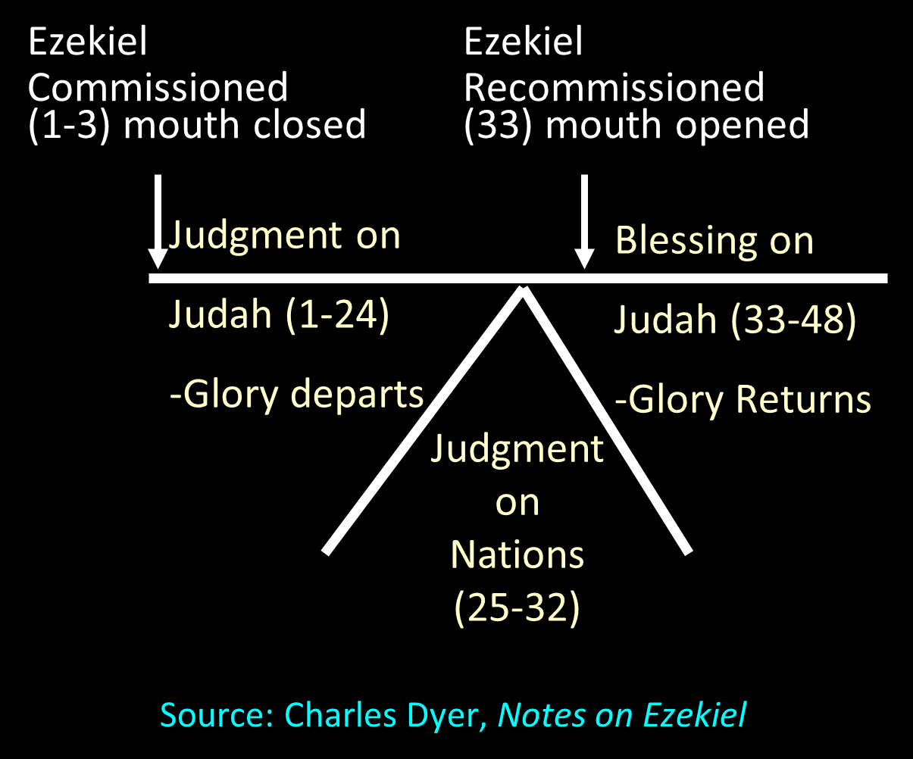

Slide 57
Ezekiel 37:7-11
So I prophesied as I was commanded; and as I prophesied, there was a noise, and behold, a rattling; and the bones came together, bone to its bone. ⁸ And I looked, and behold, sinews were on them, and flesh grew and skin covered them; but there was no breath in them. ⁹ Then He said to me, “Prophesy to the breath, prophesy, son of man, and say to the breath, ‘Thus says the Lord God, “Come from the four winds, O breath, and breathe on these slain, that they come to life.”’” ¹⁰ So I prophesied as He commanded me, and the breath came into them, and they came to life and stood on their feet, an exceedingly great army. ¹¹ Then He said to me, “Son of man, these bones are the whole house of Israel; behold, they say, ‘Our bones are dried up and our hope has perished. We are completely cut off’.”

Slide 58


Slide 59


Slide 60


Slide 61
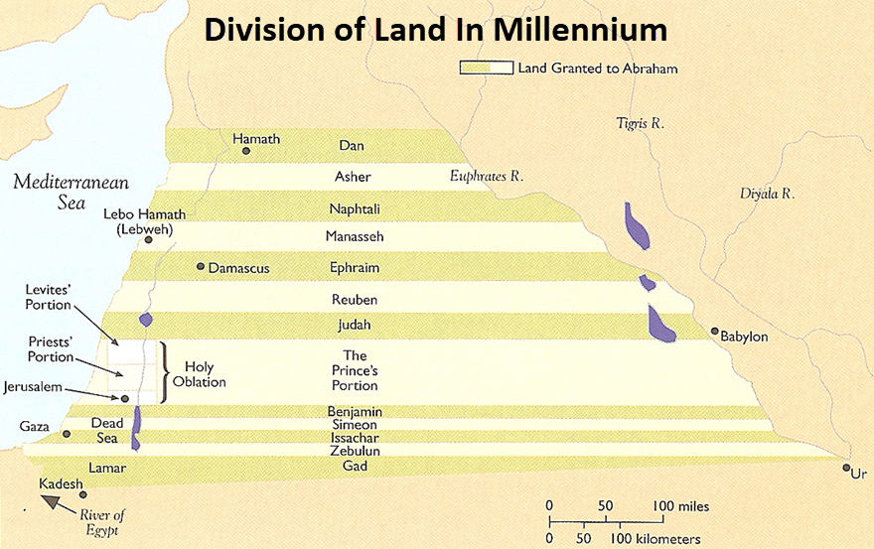

Slide 62
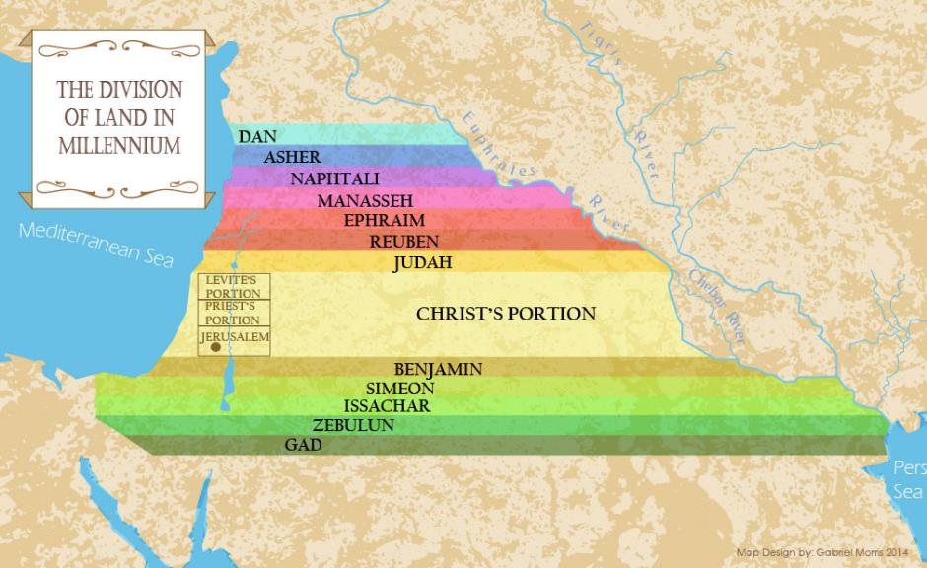

Slide 63
John 3:3-5
“³ Jesus answered and said to him, ‘Truly, truly, I say to you, unless one is born again he cannot see the kingdom of God.’⁴ Nicodemus said to Him, ‘How can a man be born when he is old? He cannot enter a second time into his mother’s womb and be born, can he?’ ⁵ Jesus answered, ‘Truly, truly, I say to you, unless one is born of water and the Spirit he cannot enter into the kingdom of God.’”

Slide 64
CONCLUSION

Slide 65
1. Passages from Christ’s ministry
The kingdom is in your midst (Luke 17:21)
Born again to enter the kingdom (John 3:3-5)
No death until kingdom comes (Matt. 16:28)
Kingdom given to another people (Matt. 21:43)
Kingdom is not of this world (John 18:36)
All authority given to me (Matt 28:18-20)

