Slide 1
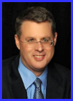
Dr. Andy Woods
Senior Pastor – Sugar Land Bible Church
President – Chafer Theological Seminary

Slide 2
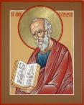
Answering Ten Questions
What is the title – Revelation of Jesus Christ
Who wrote it? – John
Where was it written from? – Patmos
To Whom was it written? – The Seven Churches
When was it written? – A.D. 95
How is it organized (outline)? – 3 part outline
How was it delivered – Seven steps
Why was it written? – Encouragement and holiness
What is it about? – Jesus’ final victory
What makes the book different? – OT relationship

Slide 3
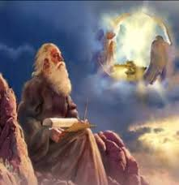
Prologue (Rev. 1:1-8)
Title (1a)
Chain of Communication (1b-2)
Blessing (3)
Author (4a)
Audience (4b)
Greeting (4c)
Source (4d-5a)
Subject (5b-8)

Slide 4
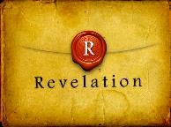
Revelation 1:19
“Therefore write the things which you have seen, and the things which are, and the things which will take place after these things [meta tauta].”

Slide 5
Revelation 1:19
Seen (Chapter 1)
Are (Chapters 2–3)
After these things (Chapters 4–22)

Slide 6
Revelation 1:19
Seen (Chapter 1)
Are (Chapters 2–3)
After these things (Chapters 4–22)

Slide 7
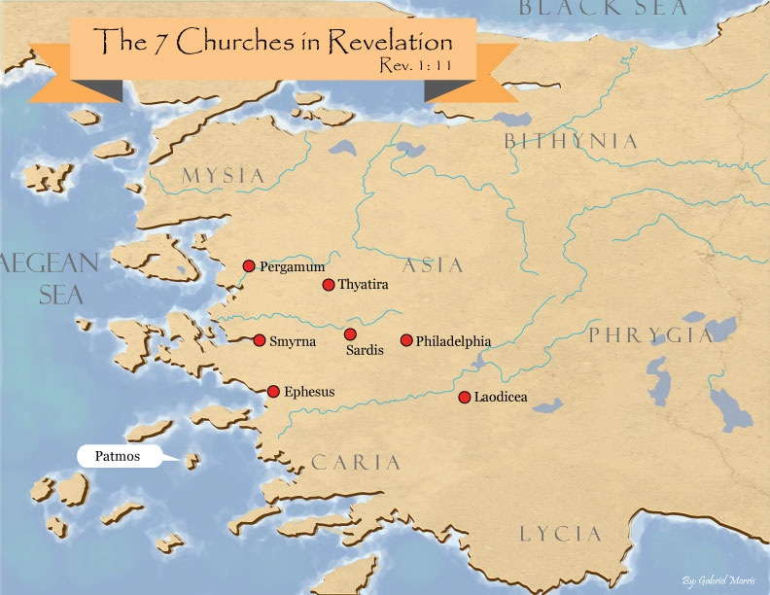

Slide 8
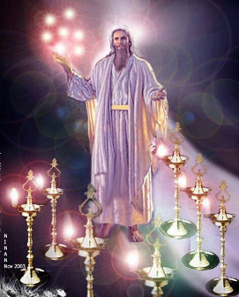
Pattern of the Letters in Revelation 2–3
Destination
Description of Christ (Rev. 1)
Commendation
Rebuke
Exhortation to change
Consequence
Exhortation to listen
Promise to overcomers (Rev. 21–22)

Slide 9
DESCRIPTION OF THE SEVEN CHURCHES Revelation 2‒3
CHURCH | SCRIPTURE | DESCRIPTION
Ephesus | 2:1-7 | Loveless
Smyrna | 2:8-11 | Persecuted
Pergamum | 2:12-17 | Compromised
Thyatira | 2:18-29 | Corrupt
Sardis | 3:1-6 | Dead
Philadelphia | 3:7-13 | Missionary
Laodicea | 3:14-22 | Man-centered

Slide 10
DESCRIPTION OF THE SEVEN CHURCHES Revelation 2‒3
CHURCH | SCRIPTURE | DESCRIPTION
Ephesus | 2:1-7 | Loveless
Smyrna | 2:8-11 | Persecuted
Pergamum | 2:12-17 | Compromised
Thyatira | 2:18-29 | Corrupt
Sardis | 3:1-6 | Dead
Philadelphia | 3:7-13 | Missionary
Laodicea | 3:14-22 | Man-centered

Slide 11
DESCRIPTION OF THE SEVEN CHURCHES Revelation 2‒3
CHURCH | SCRIPTURE | DESCRIPTION
Ephesus | 2:1-7 | Loveless
Smyrna | 2:8-11 | Persecuted
Pergamum | 2:12-17 | Compromised
Thyatira | 2:18-29 | Corrupt
Sardis | 3:1-6 | Dead
Philadelphia | 3:7-13 | Missionary
Laodicea | 3:14-22 | Man-centered

Slide 12
DESCRIPTION OF THE SEVEN CHURCHES Revelation 2‒3
CHURCH | SCRIPTURE | DESCRIPTION
Ephesus | 2:1-7 | Loveless
Smyrna | 2:8-11 | Persecuted
Pergamum | 2:12-17 | Compromised
Thyatira | 2:18-29 | Corrupt
Sardis | 3:1-6 | Dead
Philadelphia | 3:7-13 | Missionary
Laodicea | 3:14-22 | Man-centered

Slide 13
DESCRIPTION OF THE SEVEN CHURCHES Revelation 2‒3
CHURCH | SCRIPTURE | DESCRIPTION
Ephesus | 2:1-7 | Loveless
Smyrna | 2:8-11 | Persecuted
Pergamum | 2:12-17 | Compromised
Thyatira | 2:18-29 | Corrupt
Sardis | 3:1-6 | Dead
Philadelphia | 3:7-13 | Missionary
Laodicea | 3:14-22 | Man-centered

Slide 14
DESCRIPTION OF THE SEVEN CHURCHES Revelation 2‒3
CHURCH | SCRIPTURE | DESCRIPTION
Ephesus | 2:1-7 | Loveless
Smyrna | 2:8-11 | Persecuted
Pergamum | 2:12-17 | Compromised
Thyatira | 2:18-29 | Corrupt
Sardis | 3:1-6 | Dead
Philadelphia | 3:7-13 | Missionary
Laodicea | 3:14-22 | Man-centered

Slide 15
DESCRIPTION OF THE SEVEN CHURCHES Revelation 2‒3
CHURCH | SCRIPTURE | DESCRIPTION
Ephesus | 2:1-7 | Loveless
Smyrna | 2:8-11 | Persecuted
Pergamum | 2:12-17 | Compromised
Thyatira | 2:18-29 | Corrupt
Sardis | 3:1-6 | Dead
Philadelphia | 3:7-13 | Missionary
Laodicea | 3:14-22 | Man-centered

Slide 16
Philadelphia Revelation 3:7-13
Destination (7a)
Description of Christ (7b)
Commendation (8-9)
Rebuke
Consequence
Exhortation (10-11)
Promise to overcomers (12)
Exhortation to listen (13)

Slide 17
Philadelphia Revelation 3:7-13
Destination (7a)
Description of Christ (7b)
Commendation (8-9)
Rebuke
Consequence
Exhortation (10-11)
Promise to overcomers (12)
Exhortation to listen (13)

Slide 19
Philadelphia Revelation 3:7-13
Destination (7a)
Description of Christ (7b)
Commendation (8-9)
Rebuke
Consequence
Exhortation (10-11)
Promise to overcomers (12)
Exhortation to listen (13)

Slide 20
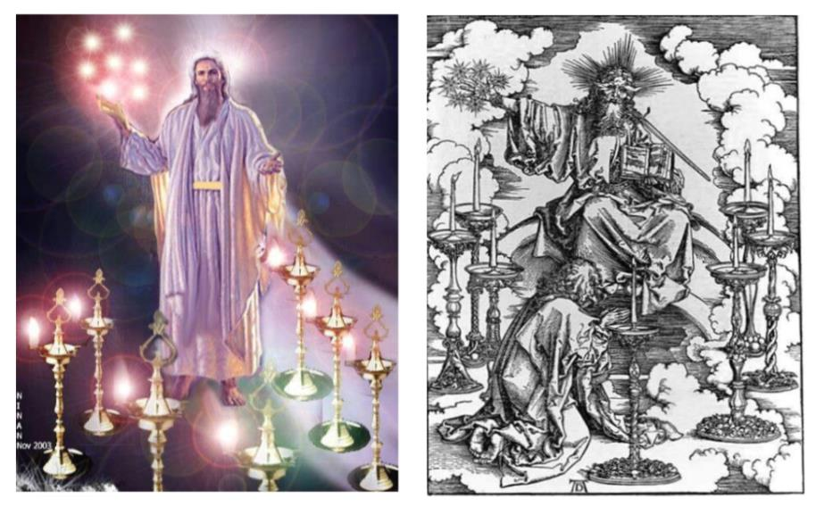

Slide 21
2. Description of Christ to Philadelphia (Rev. 3:7b)
Holy
True
Holds the Key of David
Authoritatively opens and closes doors

Slide 22
Philadelphia Revelation 3:7-13
Destination (7a)
Description of Christ (7b)
Commendation (8-9)
Rebuke
Consequence
Exhortation (10-11)
Promise to overcomers (12)
Exhortation to listen (13)

Slide 23
Revelation 3:8
“I know your deeds. Behold, I have put before you an open door which no one can shut, because you have a little power, and have kept My word, and have not denied My name.”

Slide 24
Revelation 3:8
“I know your deeds. Behold, I have put before you an open door which no one can shut, because you have a little power, and have kept My word, and have not denied My name.”

Slide 25
Revelation 3:9
“Behold, I will cause those of the synagogue of Satan, who say that they are Jews and are not, but lie—I will make them come and bow down at your feet, and make them know that I have loved you.”

Slide 26
Philadelphia Revelation 3:7-13
Destination (7a)
Description of Christ (7b)
Commendation (8-9)
Rebuke
Consequence
Exhortation (10-11)
Promise to overcomers (12)
Exhortation to listen (13)

Slide 27
Philadelphia Revelation 3:7-13
Destination (7a)
Description of Christ (7b)
Commendation (8-9)
Rebuke
Consequence
Exhortation (10-11)
Promise to overcomers (12)
Exhortation to listen (13)

Slide 28
Philadelphia Revelation 3:7-13
Destination (7a)
Description of Christ (7b)
Commendation (8-9)
Rebuke
Consequence
Exhortation (10-11)
Promise to overcomers (12)
Exhortation to listen (13)

Slide 29
Revelation 3:10
“Because you have kept the word of My perseverance, I also will keep you from the hour of testing, that hour which is about to come upon the whole world, to test those who dwell on the earth.”

Slide 30
Revelation 3:10
“Because you have kept the word of My perseverance, I also will keep you from the hour of testing, that hour which is about to come upon the whole world, to test those who dwell on the earth.”

Slide 31
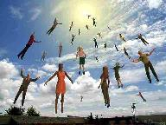
When Will the Rapture Take Place Relative to the Tribulation Period?
Pre-tribulation rapture theory
Mid-tribulation rapture theory
Post-tribulation rapture theory
Pre-wrath rapture theory
Partial rapture theory

Slide 32
Problems with Partial Rapturism?
Every divine blessing is given on the basis of His grace and not human effort (Eph. 2:8-9; Rom. 12:6)
Symbolic parallels mandate that carnal as well as sanctified Christians will be taken up in the rapture (Gen. 19:22)
The promise of the rapture is mentioned in Paul's letter to the carnal Corinthian church (1 Cor. 15:51)
A partial rapture would sever Christ's body (1 Cor 12:12-14)
The partial rapture view subjects believers to God's wrath (Thess 1:10)

Slide 33
Problems with Partial Rapturism?
Partial rapturism makes the Bema Seat Judgment unnecessary (1 Cor. 3:10-15)
Partial rapturists never objectively quantify the exact degree of faithfulness or spiritual maturity that is necessary to participate in the rapture
Partial rapturists appear individually biased
Partial rapturists dispensationally misapply Bible passages (Matt. 25:1-13)
Partial rapturists misapply passages promising a reward to faithful believers (Rev. 3:11)

Slide 34
Revelation 3:9-10
“⁹ Behold, I will cause those of the synagogue of Satan, who say that they are Jews and are not, but lie—I will make them come and bow down at your feet, and make them know that I have loved you. ¹⁰ Because you have kept the word of My perseverance, I also will keep you from the hour of testing, that hour which is about to come upon the whole world, to test those who dwell on the earth.”

Slide 35
Revelation 3:9-10
“⁹ Behold, I will cause those of the synagogue of Satan, who say that they are Jews and are not, but lie—I will make them come and bow down at your feet, and make them know that I have loved you ¹⁰ because you have kept the word of My perseverance. I also will keep you from the hour of testing, that hour which is about to come upon the whole world, to test those who dwell on the earth.”

Slide 36
Problems with Beginning the Sentence in Rev. 3:10 with “Because”
Not part of the original manuscripts: chapter & verse divisions & punctuation marks (periods, commas, or exclamation points).
These things were all added by later copyists.
Most English translations separate the two verses with a period.
Thus, it becomes cause for participating the Rapture and not a cause for their enemies to worship before their feet.
However, the period should be placed in the middle of verse 10.
Thus, it becomes not a cause for participating the Rapture and a cause for their enemies to worship before their feet.
John Niemela, The Interpretation of Revelation 3:10: You Have Kept My Word, CTS Journal; As summarized by Dennis Rokser, A Golden Nugget in Revelation 3:10, Grace for the Race, no. 29.

Slide 37
Problems with Beginning the Sentence in Rev. 3:10 with “Because” (cont’d)
Rev. 3:10b becomes an additional unconditional promise of Rapture participation beyond the promises of Rev. 2:9b.
It is rare to begin a sentence with “because” (hoti) in a causative sense.
Instead, hoti (“because”), when casual in function, usually follows a statement or promise in providing a reason for what preceded it in the sentence.
Thus, Greek sentences rarely begin a sentence with the phrase “Because you have” when explaining the cause or reason for something, as Greek and English texts of Revelation 3:10 unfortunately do today. Instead, the “because” phraseology consistently follows later in the sentence.
John Niemela, The Interpretation of Revelation 3:10: You Have Kept My Word, CTS Journal; As summarized by Dennis Rokser, A Golden Nugget in Revelation 3:10, Grace for the Race, no. 29.

Slide 38
Revelation 3:9-10
MacDonald’s Idiomatic Translation (MIT)
“⁹ I would put at your disposal those from the synagogue of Satan who call themselves Jews but are not; they are lying. See: I will make them come and bow down before your feet, and they will know that I loved you ¹⁰ because you kept my enduring word. I also will keep you from the time of trial that is about to come...”

Slide 39
Revelation 3:10
“Because you have kept the word of My perseverance, I also will keep you from the hour of testing, that hour which is about to come upon the whole world, to test those who dwell on the earth.”

Slide 40
When Will the Rapture Take Place Relative to the Tribulation Period?
Pre-tribulation rapture theory
Mid-tribulation rapture theory
Post-tribulation rapture theory
Pre-wrath rapture theory

Slide 42
Does Revelation 3:10 Teach the Pre-Tribulation Rapture?
Are there easier ways to convey “protection through”?
Will God protect believers during the Tribulation?
What is the meaning of “keep you from”?
What is the meaning of “the hour”?
What is the meaning of the “whole world”?
What is the meaning of “testing/to test”?

Slide 43
Does Revelation 3:10 Teach the Pre-Tribulation Rapture?
Who are the “earth-dwellers”?
What is the meaning of “about to come”?
How will Christ keep His promise?
Is this promise for Philadelphia only?
How does the Pre-Trib. View of Rev. 3:10 harmonize with the rest of the Book of Revelation?

Slide 44
Does Revelation 3:10 Teach the Pre-Tribulation Rapture?
Are there easier ways to convey “protection through”?
Will God protect believers during the Tribulation?
What is the meaning of “keep you from”?
What is the meaning of “the hour”?
What is the meaning of the “whole world”?
What is the meaning of “testing/to test”?

Slide 45
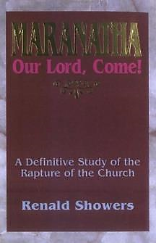
Renald Showers
Renald Showers, Maranatha Our Lord, Come! (Bellmawr, NJ: Friends of Israel, 1995), 212.
“The idea of the saints being shielded from the testing while living within and through this time period also would have been expressed more clearly through the use of another preposition, either en (meaning "in") or dia (meaning "through") [thus, "I will keep you in or through the time period of testing] rather than ek.”

Slide 46
Does Revelation 3:10 Teach the Pre-Tribulation Rapture?
Are there easier ways to convey “protection through”?
Will God protect believers during the Tribulation?
What is the meaning of “keep you from”?
What is the meaning of “the hour”?
What is the meaning of the “whole world”?
What is the meaning of “testing/to test”?

Slide 47
2. Protection Through the Tribulation? (Revelation 3:10)
Like the protection in Goshen (Exod. 8:22, 24; 9;4, 6; 11:4-7; Rev. 9;4; 16:2)
Effective ? Rev. 6:9-11; 7:13-14; 13:10, 15:20:4
Comfort? John 14:1; 1 Thess. 4:18; Titus 2:13

Slide 48
Does Revelation 3:10 Teach the Pre-Tribulation Rapture?
Are there easier ways to convey “protection through”?
Will God protect believers during the Tribulation?
What is the meaning of “keep you from”?
What is the meaning of “the hour”?
What is the meaning of the “whole world”?
What is the meaning of “testing/to test”?

Slide 49
Revelation 3:10
“Because you have kept the word of My perseverance, I also will keep you from [ek] the hour of testing, that hour which is about to come upon the whole world, to test those who dwell on the earth.”

Slide 50
Charles Ryrie
Charles C. Ryrie, What You Should Know About the Rapture, Current Christian Issues (Chicago: Moody, 1981), 114-15.
“Posttribulationists say that ‘from’ (ek) refers to protection of the church within the Tribulation. Pretribulationalists understand it to mean preservation by being absent from the time of tribulation. One is internal protection (while living through the Tribulation); the other is external protection (being in heaven during that time). Which meaning does ‘from’ (ek) support? The answer is either, if the preposition is considered alone. But for the record, let it be said that ek does denote a position outside something without. The pretribulationist understanding of ek is supported by a number of verses that have nothing to do with the rapture and therefore do not beg the question.”

Slide 51
Matthew 7:5
“You hypocrite, first take the log out of [ek] your own eye, and then you will see clearly to take the speck out of [ek] your brother’s eye.”

Slide 52
Revelation 3:10
“Because you have kept the word of My perseverance, I also will keep [tēreō] you from [ek] the hour of testing, that hour which is about to come upon the whole world, to test those who dwell on the earth.”

Slide 53
Acts 15:29
“that you abstain from things sacrificed to idols and from blood and from things strangled and from fornication; if you keep [diatēreō] yourselves free from [ek] such things, you will do well. Farewell.”

Slide 54
John 12:27
“Now My soul has become troubled; and what shall I say, ‘Father, save [sōzō] Me from [ek] this hour’? But for this purpose I came to this hour.”

Slide 55
Colossians 1:13
“For He rescued [rhyomai] us from [ek] the domain of darkness, and transferred us to the kingdom of His beloved Son.”

Slide 56
1 John 5:18
“We know that no one who is born of God sins; but He who was born of God keeps him, and the evil one does not touch him.”

Slide 57
John 17:15
“I do not ask You to take them out of the world, but to keep [tēreō] them from [ek] the evil one.”

Slide 58
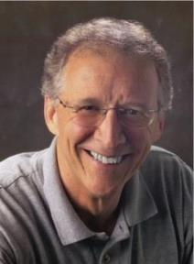
John Piper
Lauren Leigh Noske, "Nine Reasons Why john Piper Disagrees with Nicolas' Cage's 'Left Behind' Movie's View of Rapture," The Gospel Herald, August 6, 2014; www.gospelheradld.com. See also John Piper, "Definition and Observations Concerning the Second Coming of Christ," Desiring God Ministry, August 30, 1987; www.desringgod.org.
“John Piper believes that the main Scripture which some believe supports the pre-tribulational rapture viewpoint (Revelation 3:10) does not necessarily mean that believers will be taken away from the earth, however; rather, it could mean that God will keep or protect His people from evil during the tribulation (see also John 17:15).”

Slide 59
Colossians 1:13
“For He rescued us from the domain of darkness, and transferred us to the kingdom of His beloved Son.”

Slide 60
1 John 5:18
“We know that no one who is born of God sins; but He who was born of God keeps him, and the evil one does not touch him.”

Slide 61
Does Revelation 3:10 Teach the Pre-Tribulation Rapture?
Are there easier ways to convey “protection through”?
Will God protect believers during the Tribulation?
What is the meaning of “keep you from”?
What is the meaning of “the hour”?
What is the meaning of the “whole world”?
What is the meaning of “testing/to test”?

Slide 62
Revelation 3:10
“Because you have kept the word of My perseverance, I also will keep you from the hour [hōra] of testing, that hour which is about to come upon the whole world, to test those who dwell on the earth.”

Slide 63
John 12:27
“Now My soul has become troubled; and what shall I say, ‘Father, save Me from this hour [hōra]’? But for this purpose I came to this hour [hōra]’.”

Slide 65
Charles Ryrie
Charles C. Ryrie, What You Should Know About the Rapture, Current Christian Issues (Chicago: Moody, 1981), 116-17.
“However, the promise of Revelation 3:10 not only guarantees being kept from the trials of the Tribulation period but being kept from the time period of the Tribulation. The promise is not, I will keep you from the trials. It is I will keep you from the hour of the trials...But how clear and plain is the promise. "I...will keep you from the hour of testing." Not just from any persecution, but from the coming time that will affect the whole earth. (The only way to escape worldwide trouble is not to be on the earth.) And not just from the events, but from the time. And the only way to escape the time when the events take place is not to be in a place where time ticks on. The only place that meets those qualifications is heaven.”

Slide 66
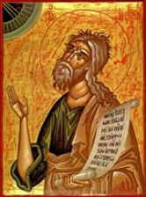
Jeremiah 30:7 (LXX)
“Alas! for that day is great, There is none like it; And it is the time of Jacob’s distress (Gen. 32:8; 35:10), But he will be saved [sōzō] from [apo] it.”

Slide 67
Zechariah 13:8-9
⁸“It will come about in all the land,” Declares the Lord, “That two parts in it will be cut off and perish; But the third will be left in it. ⁹“And I will bring the third part through the fire, Refine them as silver is refined, And test them as gold is tested. They will call on My name, And I will answer them; I will say, ‘They are My people,’ And they will say, ‘The Lord is my God.’ ”

Slide 68
Does Revelation 3:10 Teach the Pre-Tribulation Rapture?
Are there easier ways to convey “protection through”?
Will God protect believers during the Tribulation?
What is the meaning of “keep you from”?
What is the meaning of “the hour”?
What is the meaning of the “whole world”?
What is the meaning of “testing/to test”?

Slide 69
Revelation 3:10
“Because you have kept the word of My perseverance, I also will keep you from the hour of testing, that hour which is about to come upon the whole [holos] world [oikouménē], to test those who dwell on the earth.”

Slide 70
5. The Whole World? (Revelation 3:10)
Oikouménē – known world? (Luke 2:1; Acts 11:28)
Oikouménē – entire world (Luke 4:5; Acts 17:31; Rev. 12:9)
Context favors the global definition
Adjective “whole” (holos)
Rev. 6‒18

Slide 72
Does Revelation 3:10 Teach the Pre-Tribulation Rapture?
Are there easier ways to convey “protection through”?
Will God protect believers during the Tribulation?
What is the meaning of “keep you from”?
What is the meaning of “the hour”?
What is the meaning of the “whole world”?
What is the meaning of “testing/to test”?

Slide 73
Revelation 3:10
“Because you have kept the word of My perseverance, I also will keep you from the hour of testing [peirasmós], that hour which is about to come upon the whole world, to test [peirázō] those who dwell on the earth.”

Slide 74
6. Test (Revelation 3:10)
Peirasmós / peirázō
To demonstrate the quality of something rather than to purify its contents
A Test for the purpose of exposing someone’s true character typically with the negative intent to demonstrate a failure
Examples (Jas. 1:13-14; Rev. 2:2)

Slide 75
Revelation 2:2
“I know your deeds and your toil and perseverance, and that you cannot tolerate evil men, and you put to the test [peirázō] those who call themselves apostles, and they are not, and you found them to be false.”

Slide 76
James 1:13-14
“¹³ Let no one say when he is tempted [peirázō], ‘I am being tempted [peirázō] by God’; for God cannot be tempted by evil, and He Himself does not tempt [peirázō] anyone. ¹⁴ But each one is tempted [peirázō] when he is carried away and enticed by his own lust.”

Slide 77
Renald Showers
Renald Showers, Maranatha Our Lord, Come! (Bellmawr, NJ: Friends of Israel, 1995), 215.
“Christ was declaring that the purpose of the future period of testing will be for God to test 'them that dwell on the earth' to demonstrate or expose the kind of people they are.”

Slide 78
Does Revelation 3:10 Teach the Pre-Tribulation Rapture?
Who are the “earth-dwellers”?
What is the meaning of “about to come”?
How will Christ keep His promise?
Is this promise for Philadelphia only?
How does the Pre-Trib. View of Rev. 3:10 harmonize with the rest of the Book of Revelation?

Slide 79
Revelation 3:10
“Because you have kept the word of My perseverance, I also will keep you from the hour of testing, that hour which is about to come upon the whole world, to test those who dwell on the earth [katoikeō epi gē].”

Slide 80
Revelation 13:8
“All who dwell on the earth [katoikeō epi gē] will worship him, everyone whose name has not been written from the foundation of the world in the book of life of the Lamb who has been slain.”

Slide 81
Revelation 17:8
“⁸ The beast that you saw was, and is not, and is about to come up out of the abyss and go to destruction. And those who dwell on the earth [katoikeō epi gē], whose name has not been written in the book of life from the foundation of the world, will wonder when they see the beast, that he was and is not and will come..”

Slide 82
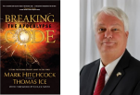
Thomas Ice Thomas Ice, “Kept From the Hour,” online: www.pre-trib.org, accessed 4 September 2014, 2.
“This phrase ‘earth dwellers’ is used eleven times in nine verses in Revelation (3:10; 6:10; 8:13; 11:10 2xs; 13:8, 12, 14 2xs; 14:6; 17:8). As you examine each individual use, except 3:10, you will see that all refer to a special class of stubborn sinners who are set in their rebellion against the God of heaven. You will also find that the phrase is only used to refer to those during the tribulation period. Therefore, since the future hour spoken of in 3:10 is set in contrast with the present set of believers in the church age, and the future ‘earth dwellers’ will be active during the time period in which believers are said to be kept from, it is clear that John speaks of the time or hour of the tribulation. This is why 3:10 is a clear promise that Christ will keep believers from the time of the seven year tribulation.”

Slide 83
Pretribulationism is not Escapism
Trials (John 16:33)
Man’s wrath (2 Tim. 3:12)
Satan’s wrath (Eph. 6:11-12)
World’s wrath (John 15:18-19)

Slide 84
Revelation 3:10
“Because you have kept the word of My perseverance, I also will keep you from the hour of testing, that hour which is about to come upon the whole world, to test those who dwell on the earth.”

Slide 85
Renald Showers
Renald Showers, Maranatha Our Lord, Come! (Bellmawr, NJ: Friends of Israel, 1995), 212.
“Christ based His promise on the fact that the church saints had already passed their test. In light of that, it appears that because they had already passed their test, Christ promised that He would not put them into the period that...will have the purpose of testing a very different group of people.”

Slide 86
Does Revelation 3:10 Teach the Pre-Tribulation Rapture?
Who are the “earth-dwellers”?
What is the meaning of “about to come”?
How will Christ keep His promise?
Is this promise for Philadelphia only?
How does the Pre-Trib. View of Rev. 3:10 harmonize with the rest of the Book of Revelation?

Slide 87
Revelation 3:10
“Because you have kept the word of My perseverance, I also will keep you from the hour of testing, that hour which is about to come [mellō] upon the whole world, to test those who dwell on the earth.”

Slide 88
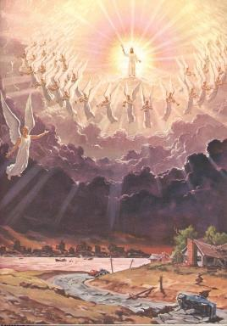
Imminency
Méllō: “and one who will share in the glory to be revealed” (1 Pet 5:1)

Slide 89
Does Revelation 3:10 Teach the Pre-Tribulation Rapture?
Who are the “earth-dwellers”?
What is the meaning of “about to come”?
How will Christ keep His promise?
Is this promise for Philadelphia only?
How does the Pre-Trib. View of Rev. 3:10 harmonize with the rest of the Book of Revelation?

Slide 90
Revelation 3:11
“I am coming quickly; hold fast what you have, so that no one will take your crown.”

Slide 91
Revelation 3:11
“I am coming quickly; hold fast what you have, so that no one will take your crown.”

Slide 92
Revelation 3:11
“I am coming quickly; hold fast what you have, so that no one will take your crown.”

Slide 93
1 Corinthians 4:5
“ Therefore do not go on passing judgment before the time, but wait until the Lord comes who will both bring to light the things hidden in the darkness and disclose the motives of men’s hearts; and then each man’s praise will come to him from God.”

Slide 94
2 Timothy 4:8
“In the future there is laid up for me the crown of righteousness, which the Lord, the righteous Judge, will award to me on that day; and not only to me, but also to all who have loved His appearing.”

Slide 95
Does Revelation 3:10 Teach the Pre-Tribulation Rapture?
Who are the “earth-dwellers”?
What is the meaning of “about to come”?
How will Christ keep His promise?
Is this promise for Philadelphia only?
How does the Pre-Trib. View of Rev. 3:10 harmonize with the rest of the Book of Revelation?

Slide 96
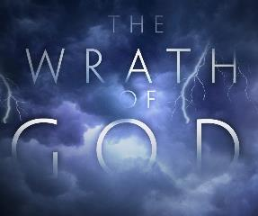
Promised Exemption from Divine Wrath
The promise (1 Thess. 1:10; 5:9; Rom 5:9; 8:1; Rev 3:10)
Tribulation = divine wrath (Rev 6:16-17; 11:18; 15:1, 7; 16:19)

Slide 97
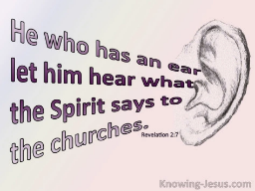
8. Exhortation to Listen
Rev 3:13
“He who has an ear, let him hear what the Spirit says to the churches.”

Slide 98
Does Revelation 3:10 Teach the Pre-Tribulation Rapture?
Who are the “earth-dwellers”?
What is the meaning of “about to come”?
How will Christ keep His promise?
Is this promise for Philadelphia only?
How does the Pre-Trib. View of Rev. 3:10 harmonize with the rest of the Book of Revelation?

Slide 99
Revelation 1:19
“Therefore write the things which you have seen, and the things which are, and the things which will take place after these things [meta tauta].”

Slide 100
Revelation 1:19
Seen (Chapter 1)
Are (Chapters 2–3)
After these things (Chapters 4–22)

Slide 101
The Missing Church
Rev 4-19
Rev 13:9
Revelation’s Jewish nature

Slide 102
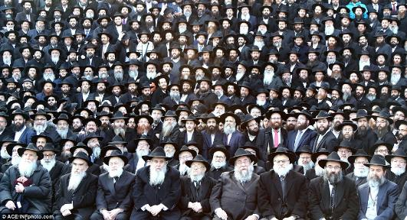
God’s Work Through Israel
Revelation 7 – 144,000 Jews
Revelation 11 – Two Jewish witnesses
Revelation 12 – Israel flees

Slide 103
Does Revelation 3:10 Teach the Pre-Tribulation Rapture?
Are there easier ways to convey “protection through”?
Will God protect believers during the Tribulation?
What is the meaning of “keep you from”?
What is the meaning of “the hour”?
What is the meaning of the “whole world”?
What is the meaning of “testing/to test”?

Slide 104
Does Revelation 3:10 Teach the Pre-Tribulation Rapture?
Who are the “earth-dwellers”?
What is the meaning of “about to come”?
How will Christ keep His promise?
Is this promise for Philadelphia only?
How does the Pre-Trib. View of Rev. 3:10 harmonize with the rest of the Book of Revelation?

Slide 105
Revelation 3:11
“I am coming quickly; hold fast what you have, so that no one will take your crown.”

Slide 106
Revelation 3:11
“I am coming quickly [tacos]; hold fast what you have, so that no one will take your crown.”

Slide 107
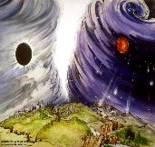
Chronological vs. Adverbial Use of Tacos
“I hope to come to you soon” (1 Tim 3:14) vs. “Leave Jerusalem quickly” (Acts 22:18)
LXX
Isaiah 13:22: “Her fateful time also will soon come”
Isaiah 51:5: “My righteous is near, My salvation has gone forth, And my arms will judge the peoples; The coastlands will wait upon me, And on My arms they will trust.”
Thomas Ice, End Times Controversy, pp.102-108

Slide 108
Revelation 3:11
“I am coming quickly; hold fast what you have, so that no one will take your crown.”

Slide 109
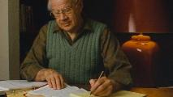
J. Dwight Pentecost
Prophecy for Today, Page 20
“A short time ago, I took occasion to go through the New Testament to mark each reference to the coming of the Lord Jesus Christ and to observe the use made of that teaching about His coming. I was struck anew with the fact that almost without exception, when the coming of Christ is mentioned in the New Testament, it is followed by an exhortation to godliness and holy living.”

Slide 110
Remembrance in 2 Peter
Has forgotten that he has been cleansed (1:9)
I will always remind you of these things (1:12)
It is right to refresh your memory (1:13)
You will always be able to remember these things (1:15)
I have written both of them as reminders (3:1)
Do not forget (3:8)
Bear in mind (3:15)

Slide 111
Jeremiah 6:16
“Thus says the Lord, ‘Stand by the ways and see and ask for the ancient paths, Where the good way is, and walk in it; And you will find rest for your souls. But they said, ‘We will not walk in it.’”

Slide 112
Revelation 3:11
“I am coming quickly; hold fast what you have, so that no one will take your crown.”

Slide 113
Scripture’s Five Crowns (Rev 4:10: 3:11; 2 John 8)
SCRIPTURE | CROWN | PURPOSE
1 Cor. 9:24-27 | Incorruptible | Gaining mastery over the flesh
1 Thess. 2:19-20 | Rejoicing | Soul winning
Jas. 1:12; Rev. 2:10 | Life | Enduring trials
1 Pet. 5:2-4 | Glory | Shepherding God’s people
2 Tim. 4:8 | Righteousness | Longing for His appearing

Slide 114
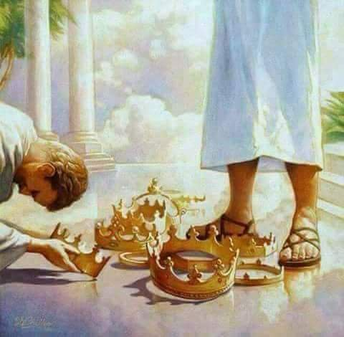

Slide 115
1 Corinthians 3:10-15
“¹⁰ According to the grace of God which was given to me, like a wise master builder I laid a foundation, and another is building on it. But each man must be careful how he builds on it. ¹¹ For no man can lay a foundation other than the one which is laid, which is Jesus Christ. ¹² Now if any man builds on the foundation with gold, silver, precious stones, wood, hay, straw…”

Slide 116
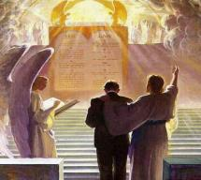
1 Corinthians 3:10-15
“¹⁴ If any man’s work which he has built on it remains, he will receive a reward. ¹⁵ If any man’s work is burned up, he will suffer loss; but he himself will be saved, yet so as through fire.”

Slide 117
1 Corinthians 9:24-27
“²⁴ Do you not know that those who run in a race all run, but only one receives the prize? Run in such a way that you may win. ²⁵ Everyone who competes in the games exercises self-control in all things. They then do it to receive a perishable wreath, but we an imperishable. ²⁶ Therefore I run in such a way, as not without aim; I box in such a way, as not beating the air; ²⁷ but I discipline my body and make it my slave, so that, after I have preached to others, I myself will not be disqualified.”

Slide 118
2 John 8
“Watch yourselves, that you do not lose what we have accomplished, but that you may receive a full reward.”

Slide 119
Grant R. Jeffrey
Apocalypse: The Coming Judgment of the Nations, p. 85, 87.
“Someday every Christian will stand before the Judgment Seat of Christ to receive rewards for faithful service. Some believers will receive no rewards at all because they lived their lives of service to self rather than service to the Lord...Christians are promised a number of golden crowns for us faithful service to the Lord. Jesus warned that we are to “hold fast“ lest we lose our crowns. This indicates that it is possible to lose eternal rewards and blessings that God prepared for those who love Him. While our salvation is assured today by our accepting Christ as our savior...our future reward will be determined at the Judgment Seat of Christ after the Rapture. We are encouraged to hold on to these rewards through continued faithful service.”

Slide 120
Philadelphia Revelation 3:7-13
Destination (7a)
Description of Christ (7b)
Commendation (8-9)
Rebuke
Consequence
Exhortation (10-11)
Promise to overcomers (12)
Exhortation to listen (13)

Slide 121
7. Promise to the Overcomers
Rev 3:12
“He who overcomes, I will make him a pillar in the temple of My God, and he will not go out from it anymore; and I will write on him the name of My God, and the name of the city of My God, the new Jerusalem, which comes down out of heaven from My God, and My new name.”

Slide 122
7. Promise to the Overcomers
Rev 3:12
“He who overcomes, I will make him a pillar in the temple of My God, and he will not go out from it anymore; and I will write on him the name of My God, and the name of the city of My God, the new Jerusalem, which comes down out of heaven from My God, and My new name.”

Slide 123
1 John 5:4-5
^{“4} For whatever is born of God overcomes the world; and this is the victory that has overcome the world—our faith. ⁵ Who is the one who overcomes the world, but he who believes that Jesus is the Son of God?”

Slide 125
7. Christ’s Promises to Overcomers in Philadelphia (Rev. 3:12)
Pillar in God’s Temple ‒ 12a
Three names ‒ 12b
My God
New Jerusalem
Son’s new name

Slide 126
7. Christ’s Promises to Overcomers in Philadelphia (Rev. 3:12)
Pillar in God’s Temple ‒ 12a
Three names ‒ 12b
My God
New Jerusalem
Son’s new name

Slide 127
7. Christ’s Promises to Overcomers in Philadelphia (Rev. 3:12)
Pillar in God’s Temple ‒ 12a
Three names ‒ 12b
My God
New Jerusalem
Son’s new name

Slide 128
7. Christ’s Promises to Overcomers in Philadelphia (Rev. 3:12)
Pillar in God’s Temple ‒ 12a
Three names ‒ 12b
My God
New Jerusalem
Son’s new name

Slide 129
7. Christ’s Promises to Overcomers in Philadelphia (Rev. 3:12)
Pillar in God’s Temple ‒ 12a
Three names ‒ 12b
My God
New Jerusalem
Son’s new name

Slide 130
Jerusalem Descending
Notes:
The descending city is described as being like a stone called Jasper, only unlike the earthly stone, this one is clear as crystal. The ultimate state of heaven sounds more like a diamond, doesn’t it?

Slide 131
7. Christ’s Promises to Overcomers in Philadelphia (Rev. 3:12)
Pillar in God’s Temple ‒ 12a
Three names ‒ 12b
My God
New Jerusalem
Son’s new name

Slide 132
1 Peter 1:2
“according to the foreknowledge of God the Father, by the sanctifying work of the Spirit, to obey Jesus Christ and be sprinkled with His blood: May grace and peace be yours in the fullest measure.”

Slide 133
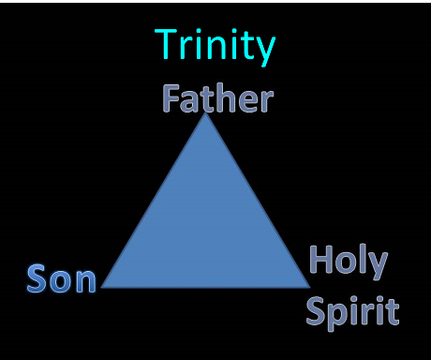

Slide 134
Philadelphia Revelation 3:7-13
Destination (7a)
Description of Christ (7b)
Commendation (8-9)
Rebuke
Consequence
Exhortation (10-11)
Promise to overcomers (12)
Exhortation to listen (13)

Slide 135
8. Exhortation to Listen
Rev 3:13
“He who has an ear, let him hear what the Spirit says to the churches.”

Slide 136
8. Exhortation to Listen
Rev 3:13
“He who has an ear, let him hear what the Spirit says to the churches.”

Slide 137
Deuteronomy 6:4-7
⁴ “Hear, O Israel! The Lord is our God, the Lord is one!...⁶ These words, which I am commanding you today, shall be on your heart. ⁷ You shall teach them diligently to your sons and shall talk of them when you sit in your house and when you walk by the way and when you lie down and when you rise up.”

Slide 138
8. Exhortation to Listen
Rev 3:13
“He who has an ear, let him hear what the Spirit says to the churches.”

Slide 139
Conclusion

Slide 140
Philadelphia Revelation 3:7-13
Destination (7a)
Description of Christ (7b)
Commendation (8-9)
Rebuke
Consequence
Exhortation (10-11)
Promise to overcomers (12)
Exhortation to listen (13)

Slide 141
“The Lord bless you and keep you; the Lord make his face shine on you and be gracious to you; the Lord turn his face toward you and give you peace.” (NIV)

