Slide 1
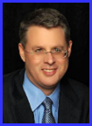
Dr. Andy Woods
Senior Pastor – Sugar Land Bible Church
President – Chafer Theological Seminary

Slide 2
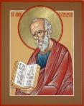
Answering Ten Questions
What is the title – Revelation of Jesus Christ
Who wrote it? – John
Where was it written from? – Patmos
To Whom was it written? – The Seven Churches
When was it written? – A.D. 95
How is it organized (outline)? – 3 part outline
How was it delivered – Seven steps
Why was it written? – Encouragement and holiness
What is it about? – Jesus’ final victory
What makes the book different? – OT relationship

Slide 3
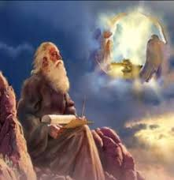
Prologue (Rev. 1:1-8)
Title (1a)
Chain of Communication (1b-2)
Blessing (3)
Author (4a)
Audience (4b)
Greeting (4c)
Source (4d-5a)
Subject (5b-8)

Slide 4
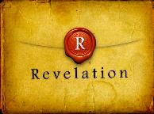
Revelation 1:19
“Therefore write the things which you have seen, and the things which are, and the things which will take place after these things [meta tauta].”

Slide 5
Revelation 1:19
Seen (Chapter 1)
Are (Chapters 2–3)
After these things (Chapters 4–22)

Slide 6
Revelation 1:19
Seen (Chapter 1)
Are (Chapters 2–3)
After these things (Chapters 4–22)

Slide 7
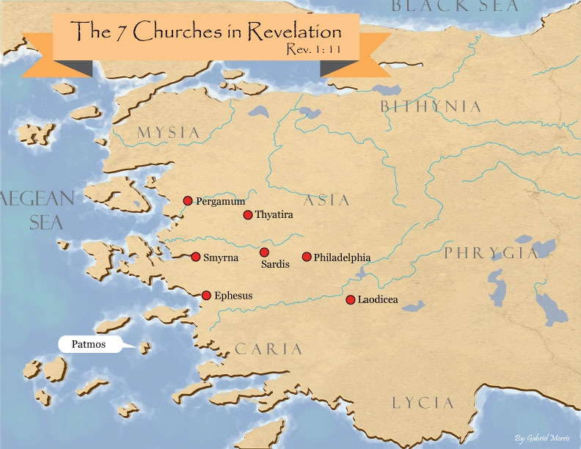

Slide 8
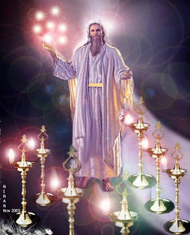
Pattern of the Letters in Revelation 2–3
Destination
Description of Christ (Rev. 1)
Commendation
Rebuke
Exhortation to change
Consequence
Exhortation to listen
Promise to overcomers (Rev. 21–22)

Slide 9
DESCRIPTION OF THE SEVEN CHURCHES Revelation 2‒3
CHURCH | SCRIPTURE | DESCRIPTION
Ephesus | 2:1-7 | Loveless
Smyrna | 2:8-11 | Persecuted
Pergamum | 2:12-17 | Compromised
Thyatira | 2:18-29 | Corrupt
Sardis | 3:1-6 | Dead
Philadelphia | 3:7-13 | Missionary
Laodicea | 3:14-22 | Man-centered

Slide 10
DESCRIPTION OF THE SEVEN CHURCHES Revelation 2‒3
CHURCH | SCRIPTURE | DESCRIPTION
Ephesus | 2:1-7 | Loveless
Smyrna | 2:8-11 | Persecuted
Pergamum | 2:12-17 | Compromised
Thyatira | 2:18-29 | Corrupt
Sardis | 3:1-6 | Dead
Philadelphia | 3:7-13 | Missionary
Laodicea | 3:14-22 | Man-centered

Slide 11
DESCRIPTION OF THE SEVEN CHURCHES Revelation 2‒3
CHURCH | SCRIPTURE | DESCRIPTION
Ephesus | 2:1-7 | Loveless
Smyrna | 2:8-11 | Persecuted
Pergamum | 2:12-17 | Compromised
Thyatira | 2:18-29 | Corrupt
Sardis | 3:1-6 | Dead
Philadelphia | 3:7-13 | Missionary
Laodicea | 3:14-22 | Man-centered

Slide 12
DESCRIPTION OF THE SEVEN CHURCHES Revelation 2‒3
CHURCH | SCRIPTURE | DESCRIPTION
Ephesus | 2:1-7 | Loveless
Smyrna | 2:8-11 | Persecuted
Pergamum | 2:12-17 | Compromised
Thyatira | 2:18-29 | Corrupt
Sardis | 3:1-6 | Dead
Philadelphia | 3:7-13 | Missionary
Laodicea | 3:14-22 | Man-centered

Slide 13
DESCRIPTION OF THE SEVEN CHURCHES Revelation 2‒3
CHURCH | SCRIPTURE | DESCRIPTION
Ephesus | 2:1-7 | Loveless
Smyrna | 2:8-11 | Persecuted
Pergamum | 2:12-17 | Compromised
Thyatira | 2:18-29 | Corrupt
Sardis | 3:1-6 | Dead
Philadelphia | 3:7-13 | Missionary
Laodicea | 3:14-22 | Man-centered

Slide 14
DESCRIPTION OF THE SEVEN CHURCHES Revelation 2‒3
CHURCH | SCRIPTURE | DESCRIPTION
Ephesus | 2:1-7 | Loveless
Smyrna | 2:8-11 | Persecuted
Pergamum | 2:12-17 | Compromised
Thyatira | 2:18-29 | Corrupt
Sardis | 3:1-6 | Dead
Philadelphia | 3:7-13 | Missionary
Laodicea | 3:14-22 | Man-centered

Slide 15
DESCRIPTION OF THE SEVEN CHURCHES Revelation 2‒3
CHURCH | SCRIPTURE | DESCRIPTION
Ephesus | 2:1-7 | Loveless
Smyrna | 2:8-11 | Persecuted
Pergamum | 2:12-17 | Compromised
Thyatira | 2:18-29 | Corrupt
Sardis | 3:1-6 | Dead
Philadelphia | 3:7-13 | Missionary
Laodicea | 3:14-22 | Man-centered

Slide 16
Philadelphia Revelation 3:7-13
Destination (7a)
Description of Christ (7b)
Commendation (8-9)
Rebuke
Consequence
Exhortation (10-11)
Promise to overcomers (12)
Exhortation to listen (13)

Slide 17
Philadelphia Revelation 3:7-13
Destination (7a)
Description of Christ (7b)
Commendation (8-9)
Rebuke
Consequence
Exhortation (10-11)
Promise to overcomers (12)
Exhortation to listen (13)

Slide 19
Philadelphia Revelation 3:7-13
Destination (7a)
Description of Christ (7b)
Commendation (8-9)
Rebuke
Consequence
Exhortation (10-11)
Promise to overcomers (12)
Exhortation to listen (13)

Slide 20
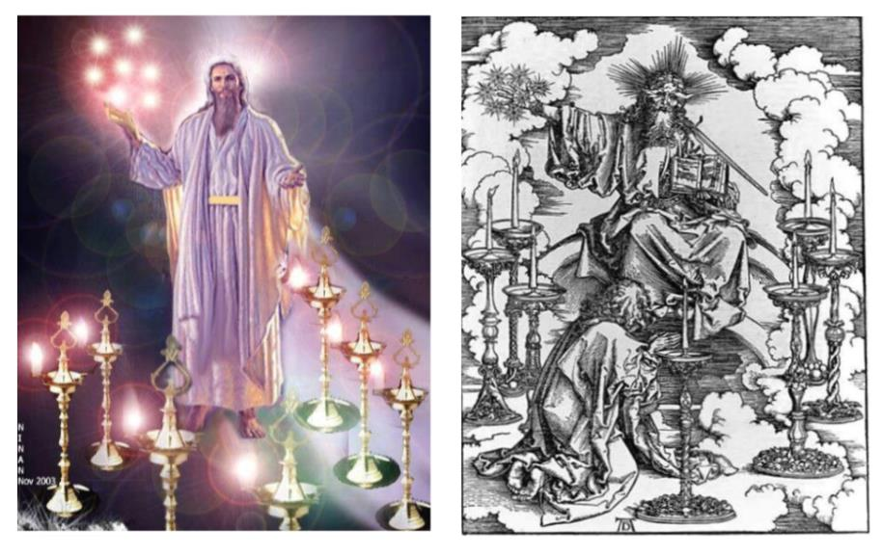

Slide 21
2. Description of Christ to Philadelphia (Rev. 3:7b)
Holy
True
Holds the Key of David
Authoritatively opens and closes doors

Slide 22
2. Description of Christ to Philadelphia (Rev. 3:7b)
Holy
True
Holds the Key of David
Authoritatively opens and closes doors

Slide 23
2. Description of Christ to Philadelphia (Rev. 3:7b)
Holy
True
Holds the Key of David
Authoritatively opens and closes doors

Slide 24
2. Description of Christ to Philadelphia (Rev. 3:7b)
Holy
True
Holds the Key of David
Authoritatively opens and closes doors

Slide 26
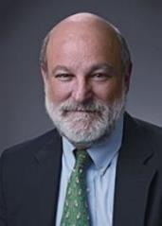
Kingdom Now Theology?
Darrell L. Bock, “The Reign of the Lord Christ,” in Dispensationalism, Israel and the Church, ed. Craig A. Blaising and Darrell L. Bock (Grand Rapids: Zondervan, 1992), 51, 62..
“The rule is extended from the Father to the disciple through the Son, the one who in Revelation 3:7 says he has ‘the key of David.’. . . Here Jesus refers to himself as ‘the one who has the key of David,’ a phrase that contains a present participle . . . ‘the one who has.’ This is currently held Davidic authority.”
Notes:
WRONG!!!

Slide 27
Jesus Holds the Key of David? (Rev. 3:7)
Authority to enter a reality is not the same thing as the presence of that reality (Isa. 22:22; Matt. 16:19; Philip 3:20)
Jesus is in heaven (Rev. 4:1; 5:6) while God’s Kingdom is on the Earth (Zech. 14:9)
Christ’s unsubdued enemies (Ps. 110:1-2, 5-6, Rev. 3:9)

Slide 28
Jesus Holds the Key of David? (Rev. 3:7)
Authority to enter a reality is not the same thing as the presence of that reality (Isa. 22:22; Matt. 16:19; Philip 3:20)
Jesus is in heaven (Rev. 4:1; 5:6) while God’s Kingdom is on the Earth (Zech. 14:9)
Christ’s unsubdued enemies (Ps. 110:1-2, 5-6, Rev. 3:9)

Slide 29
Rev. 3:7 Robert L. Thomas, Revelation 1–7: An Exegetical Commentary, ed. Kenneth Barker (Chicago: Moody, 1992), 275.
"As the root and offspring of David (cf. Rev. 5:5; 22:16), Christ in the fullest sense controls the entrance to David’s house, which ultimately refers to the Messianic kingdom. . . . He is the genuine Messiah, and in the coming reign of glory His power to open the door to His own and close it to the self-styled ‘children of the kingdom’ is established.”

Slide 30
Jesus Holds the Key of David? (Rev. 3:7)
Authority to enter a reality is not the same thing as the presence of that reality (Isa. 22:22; Matt. 16:19; Philip 3:20)
Jesus is in heaven (Rev. 4:1; 5:6) while God’s Kingdom is on the Earth (Zech. 14:9)
Christ’s unsubdued enemies (Ps. 110:1-2, 5-6, Rev. 3:9)

Slide 31
Jesus Holds the Key of David? (Rev. 3:7)
Authority to enter a reality is not the same thing as the presence of that reality (Isa. 22:22; Matt. 16:19; Philip 3:20)
Jesus is in heaven (Rev. 4:1; 5:6) while God’s Kingdom is on the Earth (Zech. 14:9)
Christ’s unsubdued enemies (Ps. 110:1-2, 5-6, Rev. 3:9)

Slide 32
2. Description of Christ to Philadelphia (Rev. 3:7b)
Holy
True
Holds the Key of David
Authoritatively opens and closes doors

Slide 33
Philadelphia Revelation 3:7-13
Destination (7a)
Description of Christ (7b)
Commendation (8-9)
Rebuke
Consequence
Exhortation (10-11)
Promise to overcomers (12)
Exhortation to listen (13)

Slide 34
Revelation 3:8
“I know your deeds. Behold, I have put before you an open door which no one can shut, because you have a little power, and have kept My word, and have not denied My name.”

Slide 35
Revelation 3:8
“I know your deeds. Behold, I have put before you an open door which no one can shut, because you have a little power, and have kept My word, and have not denied My name.”

Slide 36
Revelation 3:8
“I know your deeds [ergon]. Behold, I have put before you an open door which no one can shut, because you have a little power, and have kept My word, and have not denied My name.”

Slide 37
Revelation 3:8
“I know your deeds. Behold, I have put before you an open door which no one can shut, because you have a little power, and have kept My word, and have not denied My name.”

Slide 38
Revelation 3:8
“I know your deeds. Behold, I have put before you an open door which no one can shut, because [hoti] you have a little power, and have kept My word, and have not denied My name.”

Slide 39
Revelation 3:8
“I know your deeds. Behold, I have put before you an open door which no one can shut, because you have a little power, and have kept My word, and have not denied My name.”

Slide 40
Grant R. Jeffrey
Apocalypse: The Coming Judgment of the Nations, p. 84-85.
“In a practical way, Christ encouraged them to ‘strengthen the things that remain.’ If there is to be a revival in a spiritually dying church, we must start with the small remnant and build upon their faithful prayers and devotion to Jesus Christ. Just as in Gideon's army, God delights to accomplish His great victories with a small remnant. Then it will be obvious to all that it is God who has won the victory, not man. The message to the church at Sardis reminds us that no matter how dead a church or denomination may be, God still has ‘a few names...who have not defiled their garments; and they shall walk with me in white, for they are worthy.’ The prayer of every believer should be that they shall join that faithful remnant and walk with Him.”

Slide 41
Revelation 3:8
“I know your deeds. Behold, I have put before you an open door which no one can shut, because you have a little [mikros] power [dynamis], and have kept My word, and have not denied My name.”

Slide 42
Revelation 3:8
“I know your deeds. Behold, I have put before you an open door which no one can shut, because you have a little power, and have kept My word, and have not denied My name.”

Slide 43
Revelation 3:8
“I know your deeds. Behold, I have put before you an open door which no one can shut, because you have a little power, and have kept My word, and have not denied My name.”

Slide 44
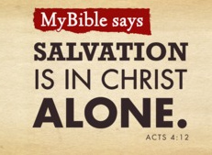
Acts 4:12
“And there is salvation in no one else; for there is no other name under heaven that has been given among men by which we must [dei] be saved.”

Slide 45
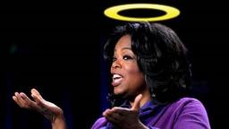
“…one of the mistakes that human beings make is believing that there is only one way…We don’t accept that there are diverse ways of being in the world; that there are millions of ways to be a human being. And many ways…many paths to what you call God. That her path might be something else and when she gets there she might call it the light. But her loving, and her kindness, and her generosity brings her to the…same point that it brings you…
www.youtube.com/watch?v=Lb2RUpMDk34

Slide 46
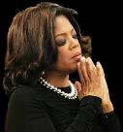
…It doesn’t matter whether she called it ‘God’ along the way or not…There couldn’t possibly be just one way!…There couldn’t possibly be only one way with millions of people in the world!...You think…if you are somewhere on the planet and you never hear the name of Jesus but yet you live with a loving heart. You lived as Jesus would have had you to live. You lived for the same purpose as Jesus came to the planet to teach us all, but you are in some remote part of the earth and you never heard the name of Jesus. You cannot get to Heaven…?”
www.youtube.com/watch?v=Lb2RUpMDk34

Slide 47
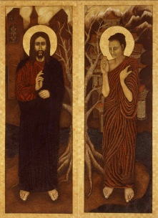
Emergent Missions & Alternative Religions
“I don’t believe making disciples must equal adherents to the Christian religion. It may be advisable in many (not all!) circumstances to help people become followers of Jesus and remain within their Buddhist, Hindu, or Jewish contexts” (Italics added).
Brian McLaren, A Generous Orthodoxy, 260.

Slide 48
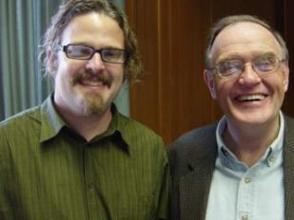
Emergent Missions & Alternative Religions Gibbs and Bolger, Emerging Churches, 131
“Evangelism or missions for me is no longer persuading people to believe what I believe, no matter how edgy or creative I get. Its more about shared experiences and encounters. Its about walking the journey of life and faith together, each distinct to his or her own tradition and culture but with the possibility of encountering God and truth from one another” (Italics added).

Slide 49
Revelation 3:9
“Behold, I will cause those of the synagogue of Satan, who say that they are Jews and are not, but lie—I will make them come and bow down at your feet, and make them know that I have loved you.”

Slide 50
Revelation 3:9
“Behold, I will cause those of the synagogue of Satan, who say that they are Jews and are not, but lie—I will make them come and bow down at your feet, and make them know that I have loved you.”

Slide 51
Revelation 3:9
“Behold, I will cause those of the synagogue of Satan, who say that they are Jews and are not, but lie—I will make them come and bow down at your feet, and make them know that I have loved you.”

Slide 52
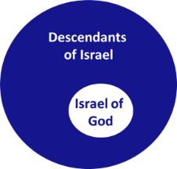
Revelation 2:9
“I know your tribulation and your poverty (but you are rich), and the blasphemy by those who say they are Jews and are not, but are a synagogue of Satan.”

Slide 53
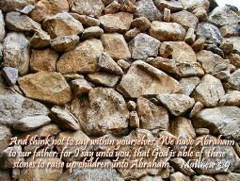
Matthew 3:9
“and do not suppose that you can say to yourselves, ‘We have Abraham for our father’; for I say to you that from these stones God is able to raise up children to Abraham.”

Slide 54
Romans 2:28-29
“²⁸ For he is not a Jew who is one outwardly, nor is circumcision that which is outward in the flesh. ²⁹ But he is a Jew who is one inwardly; and circumcision is that which is of the heart, by the Spirit, not by the letter; and his praise is not from men, but from God.”

Slide 55
Romans 9:6
“But it is not as though the word of God has failed. For they are not all Israel who are descended from Israel.”

Slide 56
Zechariah 13:8-9
⁸“It will come about in all the land,” Declares the Lord, “That two parts in it will be cut off and perish; But the third will be left in it. ⁹“And I will bring the third part through the fire, Refine them as silver is refined, And test them as gold is tested. They will call on My name, And I will answer them; I will say, ‘They are My people,’ And they will say, ‘The Lord is my God.’ ”

Slide 57
Revelation 3:9
“Behold, I will cause those of the synagogue of Satan, who say that they are Jews and are not, but lie—I will make them come and bow down at your feet, and make them know that I have loved you.”

Slide 58
Revelation 3:9
“Behold, I will cause those of the synagogue of Satan, who say that they are Jews and are not, but lie—I will make them come and bow down [proskyneō] at your feet, and make them know that I have loved you.”

Slide 59
Revelation 3:9
“Behold, I will cause those of the synagogue of Satan, who say that they are Jews and are not, but lie—I will make them come and bow down at your feet, and make them know that I have loved you.”

Slide 60
Philadelphia Revelation 3:7-13
Destination (7a)
Description of Christ (7b)
Commendation (8-9)
Rebuke
Consequence
Exhortation (10-11)
Promise to overcomers (12)
Exhortation to listen (13)

Slide 61
Philadelphia Revelation 3:7-13
Destination (7a)
Description of Christ (7b)
Commendation (8-9)
Rebuke
Consequence
Exhortation (10-11)
Promise to overcomers (12)
Exhortation to listen (13)

Slide 62
Revelation 3:9
“Behold, I will cause those of the synagogue of Satan, who say that they are Jews and are not, but lie—I will make them come and bow down at your feet, and make them know that I have loved you.”

Slide 63
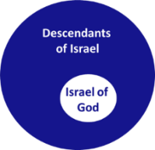
Revelation 2:9
“I know your tribulation and your poverty (but you are rich), and the blasphemy by those who say they are Jews and are not, but are a synagogue of Satan.”

Slide 64
Conclusion

Slide 65
Philadelphia Revelation 3:7-13
Destination (7a)
Description of Christ (7b)
Commendation (8-9)
Rebuke
Consequence
Exhortation (10-11)
Promise to overcomers (12)
Exhortation to listen (13)

Slide 66
“The Lord bless you and keep you; the Lord make his face shine on you and be gracious to you; the Lord turn his face toward you and give you peace.” (NIV)

