Slide 1
Dr. Andy Woods
Senior Pastor – Sugar Land Bible Church
President – Chafer Theological Seminary

Slide 2
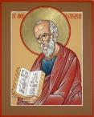
Answering Ten Questions
What is the title – Revelation of Jesus Christ
Who wrote it? – John
Where was it written from? – Patmos
To Whom was it written? – The Seven Churches
When was it written? – A.D. 95
How is it organized (outline)? – 3 part outline
How was it delivered – Seven steps
Why was it written? – Encouragement and holiness
What is it about? – Jesus’ final victory
What makes the book different? – OT relationship

Slide 3
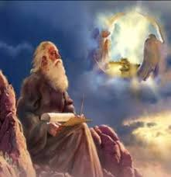
Prologue (Rev. 1:1-8)
Title (1a)
Chain of Communication (1b-2)
Blessing (3)
Author (4a)
Audience (4b)
Greeting (4c)
Source (4d-5a)
Subject (5b-8)

Slide 4
Revelation 1:19
“Therefore write the things which you have seen, and the things which are, and the things which will take place after these things [meta tauta].”

Slide 5
Revelation 1:19
Seen (Chapter 1)
Are (Chapters 2–3)
After these things (Chapters 4–22)

Slide 6
Revelation 1:19
Seen (Chapter 1)
Are (Chapters 2–3)
After these things (Chapters 4–22)

Slide 7
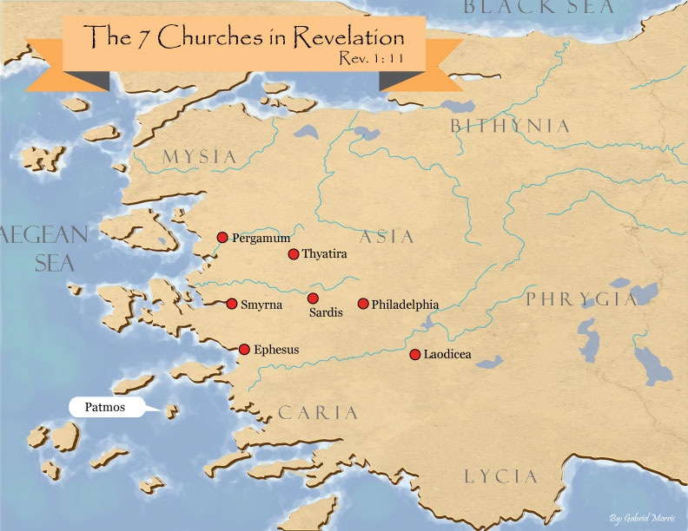

Slide 8
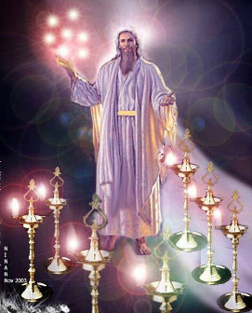
Pattern of the Letters in Revelation 2–3
Destination
Description of Christ (Rev. 1)
Commendation
Rebuke
Exhortation to change
Consequence
Exhortation to listen
Promise to overcomers (Rev. 21–22)

Slide 9
DESCRIPTION OF THE SEVEN CHURCHES Revelation 2‒3
CHURCH | SCRIPTURE | DESCRIPTION
Ephesus | 2:1-7 | Loveless
Smyrna | 2:8-11 | Persecuted
Pergamum | 2:12-17 | Compromised
Thyatira | 2:18-29 | Corrupt
Sardis | 3:1-6 | Dead
Philadelphia | 3:7-13 | Missionary
Laodicea | 3:14-22 | Man-centered

Slide 10
DESCRIPTION OF THE SEVEN CHURCHES Revelation 2‒3
CHURCH | SCRIPTURE | DESCRIPTION
Ephesus | 2:1-7 | Loveless
Smyrna | 2:8-11 | Persecuted
Pergamum | 2:12-17 | Compromised
Thyatira | 2:18-29 | Corrupt
Sardis | 3:1-6 | Dead
Philadelphia | 3:7-13 | Missionary
Laodicea | 3:14-22 | Man-centered

Slide 11
DESCRIPTION OF THE SEVEN CHURCHES Revelation 2‒3
CHURCH | SCRIPTURE | DESCRIPTION
Ephesus | 2:1-7 | Loveless
Smyrna | 2:8-11 | Persecuted
Pergamum | 2:12-17 | Compromised
Thyatira | 2:18-29 | Corrupt
Sardis | 3:1-6 | Dead
Philadelphia | 3:7-13 | Missionary
Laodicea | 3:14-22 | Man-centered

Slide 12
DESCRIPTION OF THE SEVEN CHURCHES Revelation 2‒3
CHURCH | SCRIPTURE | DESCRIPTION
Ephesus | 2:1-7 | Loveless
Smyrna | 2:8-11 | Persecuted
Pergamum | 2:12-17 | Compromised
Thyatira | 2:18-29 | Corrupt
Sardis | 3:1-6 | Dead
Philadelphia | 3:7-13 | Missionary
Laodicea | 3:14-22 | Man-centered

Slide 13
DESCRIPTION OF THE SEVEN CHURCHES Revelation 2‒3
CHURCH | SCRIPTURE | DESCRIPTION
Ephesus | 2:1-7 | Loveless
Smyrna | 2:8-11 | Persecuted
Pergamum | 2:12-17 | Compromised
Thyatira | 2:18-29 | Corrupt
Sardis | 3:1-6 | Dead
Philadelphia | 3:7-13 | Missionary
Laodicea | 3:14-22 | Man-centered

Slide 14
DESCRIPTION OF THE SEVEN CHURCHES Revelation 2‒3
CHURCH | SCRIPTURE | DESCRIPTION
Ephesus | 2:1-7 | Loveless
Smyrna | 2:8-11 | Persecuted
Pergamum | 2:12-17 | Compromised
Thyatira | 2:18-29 | Corrupt
Sardis | 3:1-6 | Dead
Philadelphia | 3:7-13 | Missionary
Laodicea | 3:14-22 | Man-centered

Slide 15
Sardis Revelation 3:1-6
Destination (1a)
Description of Christ (1b)
Commendation (1c)
Rebuke (1d)
Exhortation (2a-3c)
Consequence (3d-4)
Promise to overcomers (5)
Exhortation to listen (6)

Slide 16
Sardis Revelation 3:1-6
Destination (1a)
Description of Christ (1b)
Commendation (1c)
Rebuke (1d)
Exhortation (2a-3c)
Consequence (3d-4)
Promise to overcomers (5)
Exhortation to listen (6)

Slide 18
Sardis Revelation 3:1-6
Destination (1a)
Description of Christ (1b)
Commendation (1c)
Rebuke (1d)
Exhortation (2a-3c)
Consequence (3d-4)
Promise to overcomers (5)
Exhortation to listen (6)

Slide 19
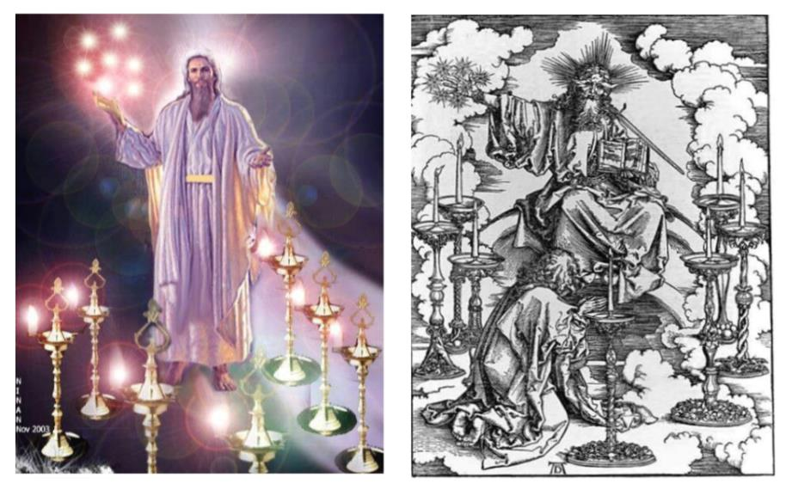

Slide 20
2. Description of Christ to Sardis (Rev. 3:1b)
Has the seven Spirits of God
Has the seven stars

Slide 21
Sardis Revelation 3:1-6
Destination (1a)
Description of Christ (1b)
Commendation (1c)
Rebuke (1d)
Exhortation (2a-3c)
Consequence (3d-4)
Promise to overcomers (5)
Exhortation to listen (6)

Slide 22
Sardis Revelation 3:1-6
Destination (1a)
Description of Christ (1b)
Commendation (1c)
Rebuke (1d)
Exhortation (2a-3c)
Consequence (3d-4)
Promise to overcomers (5)
Exhortation to listen (6)

Slide 23
Sardis Revelation 3:1-6
Destination (1a)
Description of Christ (1b)
Commendation (1c)
Rebuke (1d)
Exhortation (2a-3c)
Consequence (3d-4)
Promise to overcomers (5)
Exhortation to listen (6)

Slide 24
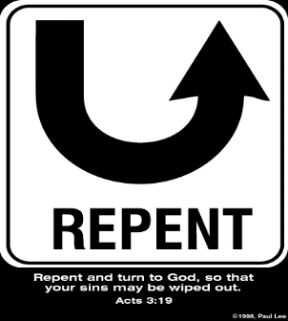
5. So What? - Points of Application!
Rev 3:2-3c
“² Wake up, and strengthen the things that remain, which were about to die; for I have not found your deeds completed in the sight of My God. ³ So remember what you have received and heard; and keep it, and repent.”

Slide 25
Sardis Revelation 3:1-6
Destination (1a)
Description of Christ (1b)
Commendation (1c)
Rebuke (1d)
Exhortation (2a-3c)
Consequence (3d-4)
Promise to overcomers (5)
Exhortation to listen (6)

Slide 26
Sardis Revelation 3:1-6
Destination (1a)
Description of Christ (1b)
Commendation (1c)
Rebuke (1d)
Exhortation (2a-3c)
Consequence (3d-4)
Promise to overcomers (5)
Exhortation to listen (6)

Slide 27
7. Promise to the Overcomers
Rev 3:5
“He who overcomes will thus be clothed in white garments; and I will not erase his name from the book of life, and I will confess his name before My Father and before His angels.”

Slide 28
7. Promise to the Overcomers
Rev 3:5
“He who overcomes will thus be clothed in white garments; and I will not erase his name from the book of life, and I will confess his name before My Father and before His angels.”

Slide 29
1 John 5:4-5
^{“4} For whatever is born of God overcomes the world; and this is the victory that has overcome the world—our faith. ⁵ Who is the one who overcomes the world, but he who believes that Jesus is the Son of God?”

Slide 31
7. Christ’s Promises to Overcomers in Sarids (Rev. 3:5)
Clothed in white ‒ 5a
Name not erased from the Book of Life ‒ 5b
Confession name before Father & Angels – 5c

Slide 32
7. Christ’s Promises to Overcomers in Sardis (Rev. 3:5)
Clothed in white ‒ 5a
Name not erased from the Book of Life ‒ 5b
Confession name before Father & Angels – 5c

Slide 33
7. Promise to the Overcomers
Rev 3:5
“He who overcomes will thus be clothed in white garments; and I will not erase his name from the book of life, and I will confess his name before My Father and before His angels.”

Slide 34
Philippians 3:9
“and may be found in Him, not having a righteousness of my own derived from the Law, but that which is through faith in Christ, the righteousness which comes from God on the basis of faith.”

Slide 35
7. Christ’s Promises to Overcomers in Sardis (Rev. 3:5)
Clothed in white ‒ 5a
Name not erased from the Book of Life ‒ 5b
Confession name before Father & Angels – 5c

Slide 36
7. Promise to the Overcomers
Rev 3:5
“He who overcomes will thus be clothed in white garments; and I will not erase his name from the book of life, and I will confess his name before My Father and before His angels.”

Slide 37
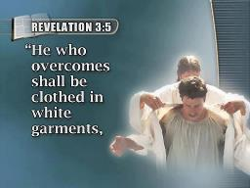
Revelation 3:5
“He who overcomes [nikaō] will thus be clothed in white garments; and I will not erase his name from the book of life, and I will confess his name before My Father and before His angels.”

Slide 38
Romans 12:21
“Do not be overcome [nikaō] by evil, but overcome evil with good.”

Slide 39
Revelation 3:5
“He who overcomes [nikaō] will thus be clothed in white garments; and I will not erase his name from the book of life, and I will confess his name before My Father and before His angels.”

Slide 40
Revelation 5:5
“and one of the elders said to me, ‘Stop weeping; behold, the Lion that is from the tribe of Judah, the Root of David, has overcome [nikaō] so as to open the book and its seven seals.’”

Slide 41
John 16:33
“These things I have spoken to you, so that in Me you may have peace. In the world you have tribulation, but take courage; I have overcome [nikaō; perfect tense] the world.”

Slide 42
1 John 4:4
“You are from God, little children, and have overcome [nikaō; perfect tense] them; because greater is He who is in you than he who is in the world.”

Slide 43
1 John 5:4-5
“For whatever is born of God overcomes [nikaō] the world; and this is the victory that has overcome [nikaō] the world—our faith.⁵ Who is the one who overcomes [nikaō] the world, but he who believes that Jesus is the Son of God?”

Slide 44
Romans 8:37
“But in all these things we overwhelmingly conquer [hypernikaō, present tense] through Him who loved us.”

Slide 45
Revelation 21:6-8
“⁶ Then He said to me, ‘It is done. I am the Alpha and the Omega, the beginning and the end. I will give to the one who thirsts from the spring of the water of life without cost. ⁷ He who overcomes [nikaō] will inherit these things, and I will be his God and he will be My son. ⁸ But for the cowardly and unbelieving and abominable and murderers and immoral persons and sorcerers and idolaters and all liars, their part will be in the lake that burns with fire and brimstone, which is the second death.’”

Slide 46
Revelation 3:5
“He who overcomes [all believers; nikaō] will thus be clothed in white garments; and I will not erase his name from the book of life, and I will confess his name before My Father and before His angels.”

Slide 47
“Overcomer” in Revelation 3:5?
INCORRECT VIEW | CORRECT VIEW
Imperative verb | Articular participle
Command | Modifies pronoun “he”
Prescriptive | Descriptive
The believer must overcome | The believer is an overcoming one
What the believer ought to do | Who the believer already is
Conditions | Statements of fact
Possible benefit | Inevitable benefit
Motivation in the present through potential loss | Motivation in the present through what’s inevitably theirs
Keep performing to maintain your position | Let your practice catch up to your position
Position kept through human works | Position maintained through divine grace

Slide 48
Revelation 3:5
“He who overcomes [all believers; nikaō] will thus be clothed in white garments; and I will not [ou mē; not ever, no not ever] erase his name from the book of life, and I will confess his name before My Father and before His angels.”
Notes:
Emphatic negation is indicated by οὐ μή plus the aorist subjunctive or, less frequently, οὐ μή plus the future indicative (e.g., Matt 26:35; Mark 13:31; John 4:14; 6:35). This is the strongest way to negate something in Greek. …a soteriological theme is frequently found in such statements, especially in John: what is negatived is the possibility of the loss of salvation. Wallace, D. B. (1996). Greek Grammar beyond the Basics: An Exegetical Syntax of the New Testament (p. 468). Grand Rapids, MI: Zondervan.

Slide 49
John 10:27-29
²⁷“My sheep hear My voice, and I know them, and they follow Me; ²⁸ and I give eternal life to them, and they will never perish [ou mē; aiōnia]; and no one will snatch them out of My hand. ²⁹ My Father, who has given them to Me, is greater than all; and no one is able to snatch them out of the Father’s hand.”
Notes:
Emphatic negation is indicated by οὐ μή plus the aorist subjunctive or, less frequently, οὐ μή plus the future indicative (e.g., Matt 26:35; Mark 13:31; John 4:14; 6:35). This is the strongest way to negate something in Greek. …a soteriological theme is frequently found in such statements, especially in John: what is negatived is the possibility of the loss of salvation. Wallace, D. B. (1996). Greek Grammar beyond the Basics: An Exegetical Syntax of the New Testament (p. 468). Grand Rapids, MI: Zondervan.

Slide 50
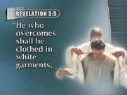
Philippians 4:2-3
“² I urge Euodia and I urge Syntyche to live in harmony in the Lord.³ Indeed, true companion, I ask you also to help these women who have shared my struggle in the cause of the gospel, together with Clement also and the rest of my fellow workers, whose names are in the book of life.”

Slide 51
Luke 10:17, 20
“¹⁷ The seventy returned with joy, saying, ‘Lord, even the demons are subject to us in Your name’.…²⁰ ‘Nevertheless do not rejoice in this, that the spirits are subject to you, but rejoice that your names are recorded in heaven.’”

Slide 52
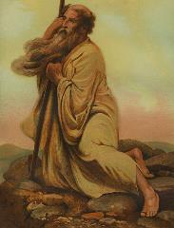
Exodus 32:32
“But now, if You will, forgive their sin—and if not, please blot me out from Your book which You have written!”

Slide 53
Psalm 69:28
“May they be blotted out of the book of life And may they not be recorded with the righteous.”

Slide 54
Two Books
TITLE? | Book of Life | Lamb’s Book of life
KIND OF LIFE RECORDED? | Physical life | Spiritual life
WHEN RECORDED? | Conception | Regeneration
WHICH TESTAMENT? | Old Testament | New Testament
SCRIPTURE? | Exod. 32:32; Ps. 69:28 | Luke 10:20; Rev. 3:5; 20:12, 15

Slide 55
7. Christ’s Promises to Overcomers in Sardis (Rev. 3:5)
Clothed in white ‒ 5a
Name not erased from the Book of Life ‒ 5b
Confession name before Father & Angels – 5c

Slide 56
7. Promise to the Overcomers
Rev 3:5
“He who overcomes will thus be clothed in white garments; and I will not erase his name from the book of life, and I will confess his name before My Father and before His angels.”

Slide 57
Sardis Revelation 3:1-6
Destination (1a)
Description of Christ (1b)
Commendation (1c)
Rebuke (1d)
Exhortation (2a-3c)
Consequence (3d-4)
Promise to overcomers (5)
Exhortation to listen (6)

Slide 58
8. Exhortation to Listen
Rev 3:6
“He who has an ear, let him hear what the Spirit says to the churches.”

Slide 59
8. Exhortation to Listen
Rev 3:6
“He who has an ear, let him hear what the Spirit says to the churches.”

Slide 60
Deuteronomy 6:4-7
⁴ “Hear, O Israel! The Lord is our God, the Lord is one!...⁶ These words, which I am commanding you today, shall be on your heart. ⁷ You shall teach them diligently to your sons and shall talk of them when you sit in your house and when you walk by the way and when you lie down and when you rise up.”

Slide 61
8. Exhortation to Listen
Rev 3:6
“He who has an ear, let him hear what the Spirit says to the churches.”

Slide 62
Conclusion

Slide 63
Sardis Revelation 3:1-6
Destination (1a)
Description of Christ (1b)
Commendation (1c)
Rebuke (1d)
Exhortation (2a-3c)
Consequence (3d-4)
Promise to overcomers (5)
Exhortation to listen (6)

Slide 64
“The Lord bless you and keep you; the Lord make his face shine on you and be gracious to you; the Lord turn his face toward you and give you peace.” (NIV)

