Slide 1
The book of Jude
Lessons in Apostasy

Slide 2
Outline of Jude
Salutation – vv. 1-2
Purpose Statement – vv. 3-4
Beware of Apostates– vv. 5-16
Previous Failures – vv. 5-7
Examples of Certain Israelites – v. 5
Examples of Certain Angels – v. 6
Examples of Certain Pagans – v. 7
Present Failures – vv. 8-16
Exhortation to the Faithful – vv.17-23
Benediction – vv. 24-25
Outline adapted from Thomas Constable, Dr. Constable’s Expository Notes, Jude, (http://www.planobiblechapel.org/tcon/notes/html/nt/jude/jude.htm)

Slide 3
Outline of Jude
Salutation – vv. 1-2
Purpose Statement – vv. 3-4
Beware of Apostates– vv. 5-16
Previous Failures – vv. 5-7
Examples of Certain Israelites – v. 5
Examples of Certain Angels – v. 6
Examples of Certain Pagans – v. 7
Present Failures – vv. 8-16
Exhortation to the Faithful – vv.17-23
Benediction – vv. 24-25
Outline adapted from Thomas Constable, Dr. Constable’s Expository Notes, Jude, (http://www.planobiblechapel.org/tcon/notes/html/nt/jude/jude.htm)

Slide 4
Outline of Jude
Salutation – vv. 1-2
Purpose Statement – vv. 3-4
Beware of Apostates– vv. 5-16
Previous Failures – vv. 5-7
Examples of Certain Israelites – v. 5
Examples of Certain Angels – v. 6
Examples of Certain Pagans – v. 7
Present Failures – vv. 8-16
Exhortation to the Faithful – vv.17-23
Benediction – vv. 24-25
Outline adapted from Thomas Constable, Dr. Constable’s Expository Notes, Jude, (http://www.planobiblechapel.org/tcon/notes/html/nt/jude/jude.htm)

Slide 5
Outline of Jude
Salutation – vv. 1-2
Purpose Statement – vv. 3-4
Beware of Apostates– vv. 5-16
Previous Failures – vv. 5-7
Examples of Certain Israelites – v. 5
Examples of Certain Angels – v. 6
Examples of Certain Pagans – v. 7
Present Failures – vv. 8-16
Exhortation to the Faithful – vv.17-23
Benediction – vv. 24-25
Outline adapted from Thomas Constable, Dr. Constable’s Expository Notes, Jude, (http://www.planobiblechapel.org/tcon/notes/html/nt/jude/jude.htm)

Slide 6
Outline of Jude
Salutation – vv. 1-2
Purpose Statement – vv. 3-4
Beware of Apostates– vv. 5-16
Previous Failures – vv. 5-7
Examples of Certain Israelites – v. 5
Examples of Certain Angels – v. 6
Examples of Certain Pagans – v. 7
Present Failures – vv. 8-16
Exhortation to the Faithful – vv.17-23
Benediction – vv. 24-25
Outline adapted from Thomas Constable, Dr. Constable’s Expository Notes, Jude, (http://www.planobiblechapel.org/tcon/notes/html/nt/jude/jude.htm)

Slide 7
Jude’s Triads
JUDE | TRIAD
v. 1 | Jude | Servant | Brother
v. 1 | Called | Loved | Kept
v. 2 | Mercy | Peace | Love
v. 4 | Godless | Change the Grace | Deny
v. 5-7 | Israelites | Angels | Sodom & Gomorrah
v. 6 | Did not keep | He has kept | Bound
v. 8 | Pollute | Reject | Slander
v. 11 | Cain | Balaam | Korah

Slide 8
Jude’s Triads
JUDE | TRIAD
v. 12 | Without fruit | Uprooted | Twice dead
v. 15 | Ungodly | Ungodly acts | Ungodly way
v. 16 | Grumblers | Faultfinders | Following evil desires
v. 19 | Divide you | Follow…instincts | Don’t have Spirit
v. 20-21 | Holy Spirit | God (the Father) | Lord Jesus Christ
v. 22-23 | Be merciful | Snatch others | Show mercy
v. 25 | God | Savior | Lord
v. 25 | Before all ages | Now | Forevermore

Slide 9
Outline of Jude
Salutation – vv. 1-2
Purpose Statement – vv. 3-4
Beware of Apostates– vv. 5-16
Previous Failures – vv. 5-7
Examples of Certain Israelites – v. 5
Examples of Certain Angels – v. 6
Examples of Certain Pagans – v. 7
Present Failures – vv. 8-16
Exhortation to the Faithful – vv.17-23
Benediction – vv. 24-25
Outline adapted from Thomas Constable, Dr. Constable’s Expository Notes, Jude, (http://www.planobiblechapel.org/tcon/notes/html/nt/jude/jude.htm)

Slide 10
Exodus 12:40
40Now the time that the sons of Israel lived in Egypt was four hundred and thirty years.
41And at the end of four hundred and thirty years, to the very day, all the hosts of the Lord went out from the land of Egypt.

Slide 11
The Ten Plagues
SCRIPTURE | PLAGUE | ISRAEL EXEMPT? | ATTACK ON EGYPT’S GODS
1) Ex 7:14-24 | Nile River to Blood | No | Hapi-spirit of Nile Khnum-guardian of the Nile
2) Ex 7:25-8:15 | Frogs | No | Heqt-form of a frog Hapi-spirit of Nile
3) Ex 8:16-19 | Swarms of Lice/Gnats | No | Uncertain-perhaps to attack Egypt’s priests
4) Ex 8:20-32 | Flies | Yes | Uatchit-Fly god
5) Ex 9:1-7 | Disease on Cattle | Yes | Apis bull revered; Sacred bulls and Cows: Ptah, Mnvis, Hathor
6) Ex 9:8-12 | Boils/Sores on Man & Animal | Yes | Sekhmet-healing goddess Serapis-healing god
7) Ex 9:13-35 | Destruction of Cattle and Crops by Hail | Yes | Seth-protector of crops Nut-sky goddess
8)Ex 10:1-20 | Destruction of Crops by Locusts | Yes | Isis-goddess of life Seth-protector of crops
9) Ex 10:21-29 | Darkness | Yes | Re-sun god. Atum-god of setting sun
10) Ex 11:1-12:36 | Death of Firstborn | Yes, if blood properly applied | Osiris-life giver Pharaoh-considered a god
Chart adapted from Ryrie Study Bible, The Ten Plagues, 101.

Slide 12
Exodus 4:29-31
29Then Moses and Aaron went and assembled all the elders of the sons of Israel; 30and Aaron spoke all the words which the Lord had spoken to Moses. He then performed the signs in the sight of the people. 31 So the people believed; and when they heard that the Lord was concerned about the sons of Israel and that He had seen their affliction, then they bowed low and worshiped.

Slide 13
Exodus 14:31
When Israel saw the great power which the Lord had used against the Egyptians, the people feared the Lord, and they believed in the Lord and in His servant Moses.

Slide 14
Psalm 106:6-12
“We have sinned like our fathers, We have committed iniquity, we have behaved wickedly. 7Our fathers in Egypt did not understand Your wonders; They did not remember Your abundant kindnesses, But rebelled by the sea, at the Red Sea. 8Nevertheless He saved them for the sake of His name, That He might make His power known. 9Thus He rebuked the Red Sea and it dried up…

Slide 15
Psalm 106:6-12
And He led them through the deeps, as through the wilderness. 10So He saved them from the hand of the one who hated them, And redeemed them from the hand of the enemy. 11The waters covered their adversaries; Not one of them was left. 12Then they believed His words; They sang His praise.

Slide 16
Psalm 106:13-18
13They quickly forgot His works; They did not wait for His counsel, 14But craved intensely in the wilderness, And tempted God in the desert. 15So He gave them their request, But sent a wasting disease among them. 16When they became envious of Moses in the camp, And of Aaron, the holy one of the Lord, 17The earth opened and swallowed up Dathan, And engulfed the company of Abiram. 18And a fire blazed up in their company; The flame consumed the wicked.

Slide 17
Hebrews 3:17-12
Therefore, just as the Holy Spirit says, “Today if you hear His voice, 8Do not harden your hearts as when they provoked Me, As in the day of trial in the wilderness, 9Where your fathers tried Me by testing Me, And saw My works for forty years. 10“Therefore I was angry with this generation, And said, ‘They always go astray in their heart, And they did not know My ways’; 11As I swore in My wrath, ‘They shall not enter My rest.’ ”12Take care, brethren, that there not be in any one of you an evil, unbelieving heart that falls away from the living God.

Slide 18
Numbers
27 How long shall I bear with this evil congregation who are grumbling against Me? I have heard the complaints of the sons of Israel, which they are making against Me.
28“Say to them, ‘As I live,’ says the Lord, ‘just as you have spoken in My hearing, so I will surely do to you;
29your corpses will fall in this wilderness, even all your numbered men, according to your complete number from twenty years old and upward, who have grumbled against Me.

Slide 19
Numbers 14:27-33
30‘Surely you shall not come into the land in which I swore to settle you, except Caleb the son of Jephunneh and Joshua the son of Nun.
31‘Your children, however, whom you said would become a prey—I will bring them in, and they will know the land which you have rejected.
32‘But as for you, your corpses will fall in this wilderness.
33‘Your sons shall be shepherds for forty years in the wilderness, and they will suffer for your unfaithfulness, until your corpses lie in the wilderness.

Slide 20
Hebrews 3:17-21
7Therefore, just as the Holy Spirit says, “Today if you hear His voice, 8Do not harden your hearts as when they provoked Me, As in the day of trial in the wilderness, 9Where your fathers tried Me by testing Me, And saw My works for forty years. 10“Therefore I was angry with this generation, And said, ‘They always go astray in their heart, And they did not know My ways’; 11As I swore in My wrath, ‘They shall not enter My rest.’ ”12Take care, brethren, that there not be in any one of you an evil, unbelieving heart that falls away from the living God.

Slide 21
Outline of Jude
Salutation – vv. 1-2
Purpose Statement – vv. 3-4
Beware of Apostates– vv. 5-16
Previous Failures – vv. 5-7
Examples of Certain Israelites – v. 5
Examples of Certain Angels – v. 6
Examples of Certain Pagans – v. 7
Present Failures – vv. 8-16
Exhortation to the Faithful – vv.17-23
Benediction – vv. 24-25
Outline adapted from Thomas Constable, Dr. Constable’s Expository Notes, Jude, (http://www.planobiblechapel.org/tcon/notes/html/nt/jude/jude.htm)

Slide 22
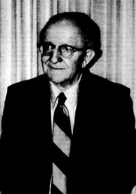
D. Edmond Hiebert
“Angels” (anggelous), used without an article, is qualitative, and indicates no beings lesser than angels; their position of privilege did not exempt them from punishment when they violated God’s established order for them.
D. Edmond Hiebert, Second Peter and Jude: An Expositional Commentary (Greenville, SC: Bob Jones University Press, 1989), 232.

Slide 23
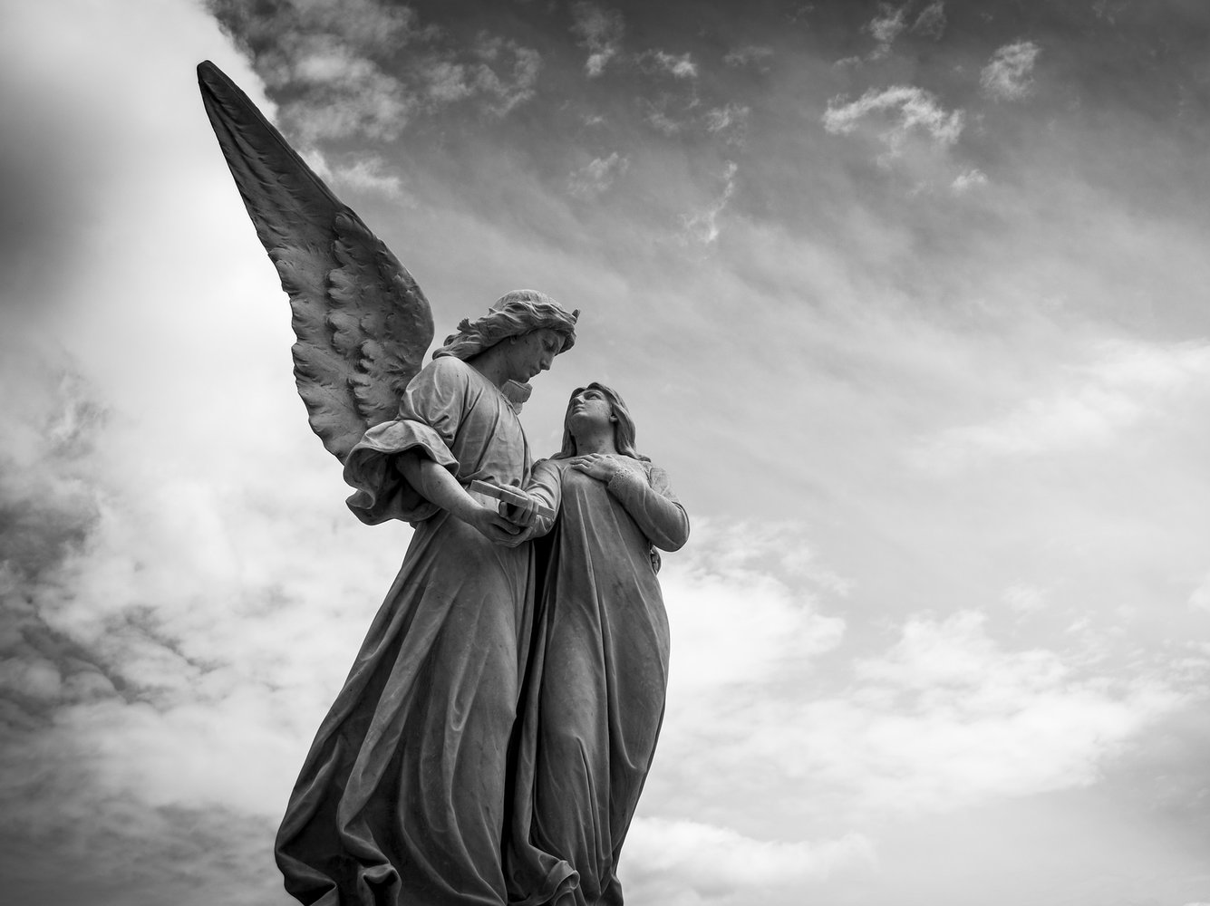

Slide 24
Jude | Similarities | 2 Peter
4 | Ungodly men, denying the Lord | 2:1
6 | Angels incarcerated until Judgment Day | 2:4
7 | Sodom & Gomorrah judged by eternal fire | 2:6
8 | they are defiled, reject authority, and slander dignitaries | 2:10
9 | Michael did not slanderously accuse them | 2:11
10 | they are brute beasts that speak evil | 2:12
11 | they followed Balaam’s path | 2:15
12 | They are clouds without water, carried about by the winds | 2:13
12-13 | They are wandering stars reserved for eternal darkness | 2:17
16 | they grumble, complain, lust, and flatter people | 2:18
17 | this was predicted by the apostles of the Lord | 3:2
18 | in the last days scoffers are predicted to arrive | 3:3
Chart adapted from article by Andy Woods, Jude Argument, 2007, 3-4.

Slide 25
Jude | Similarities | 2 Peter
4 | Ungodly men, denying the Lord | 2:1
6 | Angels incarcerated until Judgment Day | 2:4
7 | Sodom & Gomorrah judged by eternal fire | 2:6
8 | they are defiled, reject authority, and slander dignitaries | 2:10
9 | Michael did not slanderously accuse them | 2:11
10 | they are brute beasts that speak evil | 2:12
11 | they followed Balaam’s path | 2:15
12 | They are clouds without water, carried about by the winds | 2:13
12-13 | They are wandering stars reserved for eternal darkness | 2:17
16 | they grumble, complain, lust, and flatter people | 2:18
17 | this was predicted by the apostles of the Lord | 3:2
18 | in the last days scoffers are predicted to arrive | 3:3
Chart adapted from article by Andy Woods, Jude Argument, 2007, 3-4.

Slide 26
For if God did not spare angels when they sinned, but cast them into hell and committed them to pits of darkness, reserved for judgment... -2 Peter 2:4
And angels who did not keep their own domain, but abandoned their proper abode, He has kept in eternal bonds under darkness for the judgment of the great day. – Jude 6

Slide 28
Matthew 22:29-30
29 But Jesus answered and said to them, “You are mistaken, not understanding the Scriptures nor the power of God.
30 For in the resurrection they neither marry nor are given in marriage, but are like angels in heaven.

Slide 30
Jude 6
And angels who did not keep their own domain, but abandoned their proper abode, He has kept in eternal bonds under darkness for the judgment of the great day.

Slide 31
Jude 6
And angels who did not keep their own domain, but abandoned (Gk-apolipontas) their proper abode, He has kept in eternal bonds under darkness for the judgment of the great day.

Slide 32
Ephesians 2:10
For we are His workmanship, created in Christ Jesus for good works, which God prepared beforehand so that we would walk in them.

Slide 33
Source: https://www.thecut.com/2018/04/theybies-gender-creative-parenting.html

Slide 34
Jude 6
And angels who did not keep their own domain, but abandoned their proper abode, He has kept in eternal bonds under darkness for the judgment of the great day.

Slide 35
Outline of Jude
Salutation – vv. 1-2
Purpose Statement – vv. 3-4
Beware of Apostates– vv. 5-16
Previous Failures – vv. 5-7
Examples of Certain Israelites – v. 5
Examples of Certain Angels – v. 6
Examples of Certain Pagans – v. 7
Present Failures – vv. 8-16
Exhortation to the Faithful – vv.17-23
Benediction – vv. 24-25
Outline adapted from Thomas Constable, Dr. Constable’s Expository Notes, Jude, (http://www.planobiblechapel.org/tcon/notes/html/nt/jude/jude.htm)

Slide 36
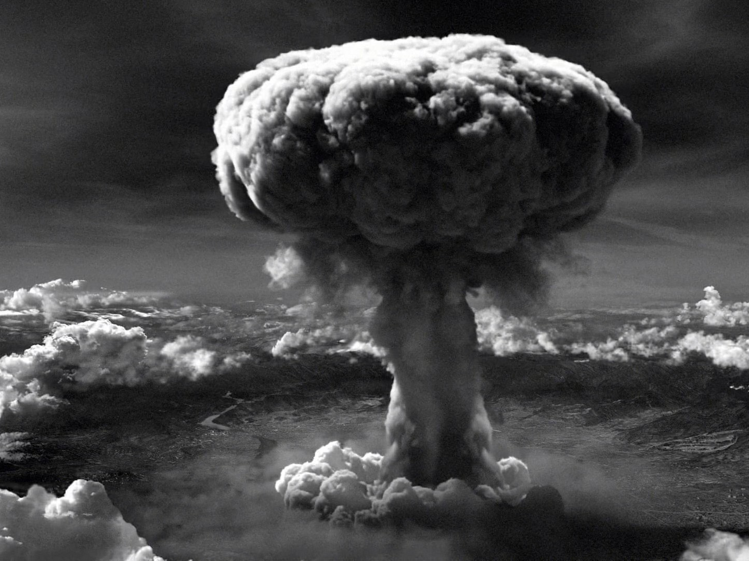

Slide 37
Jude 7
just as Sodom and Gomorrah and the cities around them, since they in the same way as these indulged in gross immorality and went after strange flesh, are exhibited as an example in undergoing the punishment of eternal fire.

Slide 38
Jude 7
just as Sodom and Gomorrah and the cities around them, since they in the same way as these indulged in gross immorality and went after strange flesh, are exhibited as an example in undergoing the punishment of eternal fire.

Slide 39
Jude 7
just as Sodom and Gomorrah and the cities around them, since they(cities) in the same way as these(angels) indulged in gross immorality and went after strange flesh, are exhibited as an example in undergoing the punishment of eternal fire.

Slide 40
Jude 5-7
5Now I desire to remind you, though you know all things once for all, that the Lord, after saving a people out of the land of Egypt, subsequently destroyed those who did not believe.
6And angels who did not keep their own domain, but abandoned their proper abode, He has kept in eternal bonds under darkness for the judgment of the great day,
7just as Sodom and Gomorrah and the cities around them, since they in the same way as these indulged in gross immorality and went after strange flesh, are exhibited as an example in undergoing the punishment of eternal fire.

Slide 41
Outline of Jude
Salutation – vv. 1-2
Purpose Statement – vv. 3-4
Beware of Apostates– vv. 5-16
Previous Failures – vv. 5-7
Examples of Certain Israelites – v. 5
Examples of Certain Angels – v. 6
Examples of Certain Pagans – v. 7
Present Failures – vv. 8-16
Exhortation to the Faithful – vv.17-23
Benediction – vv. 24-25
Outline adapted from Thomas Constable, Dr. Constable’s Expository Notes, Jude, (http://www.planobiblechapel.org/tcon/notes/html/nt/jude/jude.htm)

Slide 42
The book of Jude
Lessons in Apostasy

