Slide 1
Dr. Andy Woods
Senior Pastor – Sugar Land Bible Church
President – Chafer Theological Seminary

Slide 2
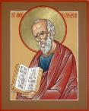
Answering Ten Questions
What is the title – Revelation of Jesus Christ
Who wrote it? – John
Where was it written from? – Patmos
To Whom was it written? – The Seven Churches
When was it written? – A.D. 95
How is it organized (outline)? – 3 part outline
How was it delivered – Seven steps
Why was it written? – Encouragement and holiness
What is it about? – Jesus’ final victory
What makes the book different? – OT relationship

Slide 3
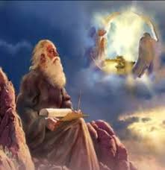
Prologue (Rev. 1:1-8)
Title (1a)
Chain of Communication (1b-2)
Blessing (3)
Author (4a)
Audience (4b)
Greeting (4c)
Source (4d-5a)
Subject (5b-8)

Slide 4
Revelation 1:19
“Therefore write the things which you have seen, and the things which are, and the things which will take place after these things [meta tauta].”

Slide 5
Revelation 1:19
Seen (Chapter 1)
Are (Chapters 2–3)
After these things (Chapters 4–22)

Slide 6
Revelation 1:19
Seen (Chapter 1)
Are (Chapters 2–3)
After these things (Chapters 4–22)

Slide 7
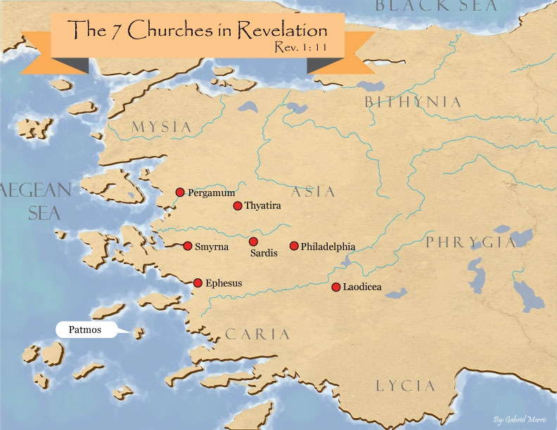

Slide 8
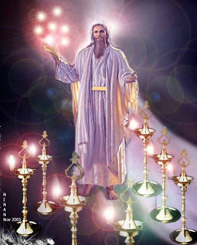
Pattern of the Letters in Revelation 2–3
Destination
Description of Christ (Rev. 1)
Commendation
Rebuke
Exhortation to change
Consequence
Exhortation to listen
Promise to overcomers (Rev. 21–22)

Slide 9
DESCRIPTION OF THE SEVEN CHURCHES Revelation 2‒3
CHURCH | SCRIPTURE | DESCRIPTION
Ephesus | 2:1-7 | Loveless
Smyrna | 2:8-11 | Persecuted
Pergamum | 2:12-17 | Compromised
Thyatira | 2:18-29 | Corrupt
Sardis | 3:1-6 | Dead
Philadelphia | 3:7-13 | Missionary
Laodicea | 3:14-22 | Man-centered

Slide 10
DESCRIPTION OF THE SEVEN CHURCHES Revelation 2‒3
CHURCH | SCRIPTURE | DESCRIPTION
Ephesus | 2:1-7 | Loveless
Smyrna | 2:8-11 | Persecuted
Pergamum | 2:12-17 | Compromised
Thyatira | 2:18-29 | Corrupt
Sardis | 3:1-6 | Dead
Philadelphia | 3:7-13 | Missionary
Laodicea | 3:14-22 | Man-centered

Slide 11
DESCRIPTION OF THE SEVEN CHURCHES Revelation 2‒3
CHURCH | SCRIPTURE | DESCRIPTION
Ephesus | 2:1-7 | Loveless
Smyrna | 2:8-11 | Persecuted
Pergamum | 2:12-17 | Compromised
Thyatira | 2:18-29 | Corrupt
Sardis | 3:1-6 | Dead
Philadelphia | 3:7-13 | Missionary
Laodicea | 3:14-22 | Man-centered

Slide 12
DESCRIPTION OF THE SEVEN CHURCHES Revelation 2‒3
CHURCH | SCRIPTURE | DESCRIPTION
Ephesus | 2:1-7 | Loveless
Smyrna | 2:8-11 | Persecuted
Pergamum | 2:12-17 | Compromised
Thyatira | 2:18-29 | Corrupt
Sardis | 3:1-6 | Dead
Philadelphia | 3:7-13 | Missionary
Laodicea | 3:14-22 | Man-centered

Slide 13
DESCRIPTION OF THE SEVEN CHURCHES Revelation 2‒3
CHURCH | SCRIPTURE | DESCRIPTION
Ephesus | 2:1-7 | Loveless
Smyrna | 2:8-11 | Persecuted
Pergamum | 2:12-17 | Compromised
Thyatira | 2:18-29 | Corrupt
Sardis | 3:1-6 | Dead
Philadelphia | 3:7-13 | Missionary
Laodicea | 3:14-22 | Man-centered

Slide 14
DESCRIPTION OF THE SEVEN CHURCHES Revelation 2‒3
CHURCH | SCRIPTURE | DESCRIPTION
Ephesus | 2:1-7 | Loveless
Smyrna | 2:8-11 | Persecuted
Pergamum | 2:12-17 | Compromised
Thyatira | 2:18-29 | Corrupt
Sardis | 3:1-6 | Dead
Philadelphia | 3:7-13 | Missionary
Laodicea | 3:14-22 | Man-centered

Slide 15
Sardis Revelation 3:1-6
Destination (1a)
Description of Christ (1b)
Commendation (1c)
Rebuke (1d)
Exhortation (2a-3c)
Consequence (3d-4)
Promise to overcomers (5)
Exhortation to listen (6)

Slide 16
Sardis Revelation 3:1-6
Destination (1a)
Description of Christ (1b)
Commendation (1c)
Rebuke (1d)
Exhortation (2a-3c)
Consequence (3d-4)
Promise to overcomers (5)
Exhortation to listen (6)

Slide 18
Sardis Revelation 3:1-6
Destination (1a)
Description of Christ (1b)
Commendation (1c)
Rebuke (1d)
Exhortation (2a-3c)
Consequence (3d-4)
Promise to overcomers (5)
Exhortation to listen (6)

Slide 19
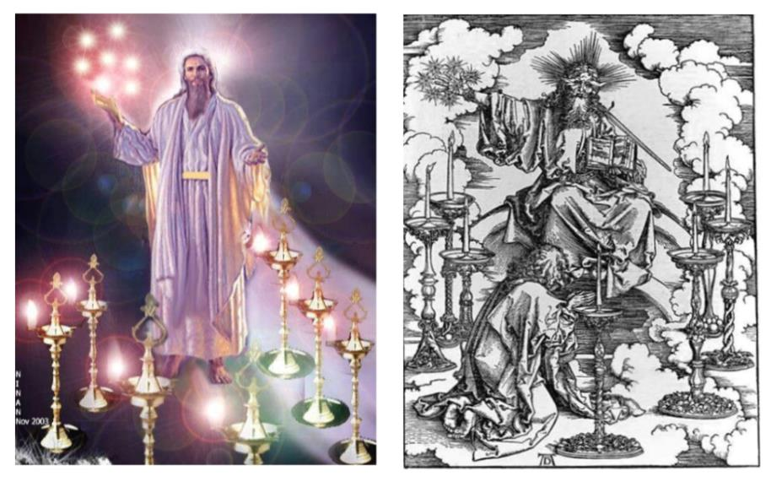

Slide 20
2. Description of Christ to Thyatira (Rev. 3:1b)
Has the seven Spirits of God
Has the seven stars

Slide 21
2. Description of Christ to Thyatira (Rev. 3:1b)
Has the seven Spirits of God
Has the seven stars

Slide 22
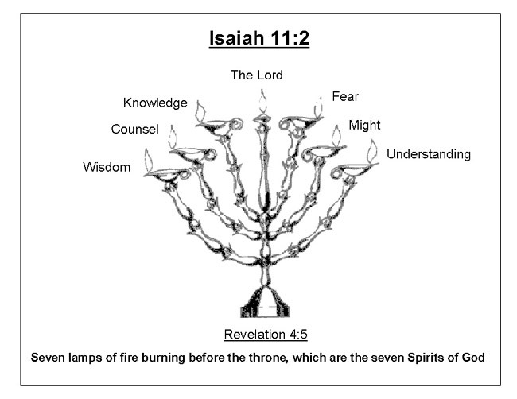
Isaiah 11:2
“The Spirit of the Lord will rest on Him, The spirit of wisdom and understanding, The spirit of counsel and strength, The spirit of knowledge and the fear of the Lord.”

Slide 23
2. Description of Christ to Thyatira (Rev. 3:1b)
Has the seven Spirits of God
Has the seven stars

Slide 24
Sardis Revelation 3:1-6
Destination (1a)
Description of Christ (1b)
Commendation (1c)
Rebuke (1d)
Exhortation (2a-3c)
Consequence (3d-4)
Promise to overcomers (5)
Exhortation to listen (6)

Slide 25
Sardis Revelation 3:1-6
Destination (1a)
Description of Christ (1b)
Commendation (1c)
Rebuke (1d)
Exhortation (2a-3c)
Consequence (3d-4)
Promise to overcomers (5)
Exhortation to listen (6)

Slide 26
Sardis Revelation 3:1-6
Destination (1a)
Description of Christ (1b)
Commendation (1c)
Rebuke (1d)
Exhortation (2a-3c)
Consequence (3d-4)
Promise to overcomers (5)
Exhortation to listen (6)

Slide 27
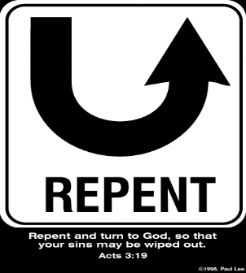
5. So What? - Points of Application!
Rev 3:2a-3c
“² Wake up, and strengthen the things that remain, which were about to die; for I have not found your deeds completed in the sight of My God. ³ So remember what you have received and heard; and keep it, and repent.”

Slide 28
5. So What? - Points of Application!
Rev 3:2a-3c
“² Wake up, and strengthen the things that remain, which were about to die; for I have not found your deeds completed in the sight of My God. ³ So remember what you have received and heard; and keep it, and repent.”

Slide 29
5. So What? - Points of Application!
Rev 3:2a-3c
“² Wake up, and strengthen the things that remain, which were about to die; for I have not found your deeds completed in the sight of My God. ³ So remember what you have received and heard; and keep it, and repent.”

Slide 30
Grant R. Jeffrey
Apocalypse: The Coming Judgment of the Nations, p. 84-85.
“In a practical way, Christ encouraged them to ‘strengthen the things that remain.’ If there is to be a revival in a spiritually dying church, we must start with the small remnant and build upon their faithful prayers and devotion to Jesus Christ. Just as in Gideon's army, God delights to accomplish His great victories with a small remnant. Then it will be obvious to all that it is God who has won the victory, not man. The message to the church at Sardis reminds us that no matter how dead a church or denomination may be, God still has ‘a few names...who have not defiled their garments; and they shall walk with me in white, for they are worthy.’ The prayer of every believer should be that they shall join that faithful remnant and walk with Him.”

Slide 31
5. So What? - Points of Application!
Rev 3:2a-3c
“² Wake up, and strengthen the things that remain, which were about to die; for I have not found your deeds completed in the sight of My God. ³ So remember what you have received and heard; and keep it, and repent.”

Slide 32
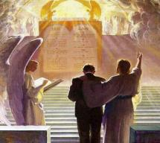
1 Corinthians 3:14-15
“¹⁴ If any man’s work which he has built on it remains, he will receive a reward. ¹⁵ If any man’s work is burned up, he will suffer loss; but he himself will be saved, yet so as through fire.”

Slide 33
5. So What? - Points of Application!
Rev 3:2a-3c
“² Wake up, and strengthen the things that remain, which were about to die; for I have not found your deeds completed in the sight of My God. ³ So remember what you have received and heard; and keep it, and repent.”

Slide 34
5. So What? - Points of Application!
Rev 2:5
“Therefore remember from where you have fallen, and repent and do the deeds you did at first; or else I am coming to you and will remove your lampstand out of its place—unless you repent.”

Slide 35
5. So What? - Points of Application!
Rev 3:2a-3c
“² Wake up, and strengthen the things that remain, which were about to die; for I have not found your deeds completed in the sight of My God. ³ So remember what you have received and heard; and keep it, and repent.”

Slide 36
5. So What? - Points of Application!
Rev 3:2a-3c
“² Wake up, and strengthen the things that remain, which were about to die; for I have not found your deeds completed in the sight of My God. ³ So remember what you have received and heard; and keep it, and repent.”

Slide 37
Lewis Sperry Chafer vol. 7, Systematic Theology (Grand Rapids, MI: Kregel Publications, 1993), 265-66.
[A] serious Arminian error respecting this doctrine occurs when repentance is added to faith or believing as a condition of salvation. It is true that repentance can very well be required as a condition of salvation, but then only because the change of mind which...has been involved when turning from every other confidence to the one needful trust in Christ. Such turning about, of course, cannot be achieved without a change of mind.

Slide 38
Lewis Sperry Chafer vol. 7, Systematic Theology (Grand Rapids, MI: Kregel Publications, 1993), 265-66.
This vital newness of mind is a part of believing, after all, and therefore it may be and is used as a synonym for believing at times (cf. Acts 17:30; 20:21; 26:20; Rom. 2:4; 2Tim. 2:25; 2 Pet. 3:9). Repentance nevertheless cannot be added to believing as a condition of salvation, because upwards of 150 passages of Scripture condition salvation upon believing only (cf. John 3:16; Acts 16:31).

Slide 39
Three Tenses of Salvation
Phase | Justification | Sanctification | Glorification
Tense | Past | Present | Future
Saved from sin’s: | Penalty | Power | Presence
Scripture | Eph 2:8-9; Titus 3:5 | Philip 2:12 | Rom 5:10

Slide 40
Sardis Revelation 3:1-6
Destination (1a)
Description of Christ (1b)
Commendation (1c)
Rebuke (1d)
Exhortation (2a-3c)
Consequence (3d-4)
Promise to overcomers (5)
Exhortation to listen (6)

Slide 41
John 10:27-29
“My sheep hear My voice, and I know them, and they follow Me; ²⁸ and I give eternal life to them, and they will never perish [ou mē; aiōnia]; and no one will snatch them out of My hand. 29 My Father, who has given them to Me, is greater than all; and no one is able to snatch them out of the Father’s hand.”

Slide 42
Matthew 7:13-14
“¹³ Enter through the narrow gate; for the gate is wide and the way is broad that leads to destruction, and there are many who enter through it. ¹⁴ For the gate is small and the way is narrow that leads to life, and there are few who find it.”

Slide 43
Sardis Revelation 3:1-6
Destination (1a)
Description of Christ (1b)
Commendation (1c)
Rebuke (1d)
Exhortation (2a-3c)
Consequence (3d-4)
Promise to overcomers (5)
Exhortation to listen (6)

Slide 44
1 John 5:4-5
^{“4} For whatever is born of God overcomes the world; and this is the victory that has overcome the world—our faith. ⁵ Who is the one who overcomes the world, but he who believes that Jesus is the Son of God?”

Slide 46
7. Christ’s Promises to Overcomers in Thyatira (Rev. 3:5)
Clothed in white ‒ 5a
Name not erased from the Book of Life ‒ 5b
Confession name before Father & Angels – 5c

Slide 47
7. Christ’s Promises to Overcomers in Thyatira (Rev. 3:5)
Clothed in white ‒ 5a
Name not erased from the Book of Life ‒ 5b
Confession name before Father & Angels – 5c

Slide 48
7. Christ’s Promises to Overcomers in Thyatira (Rev. 3:5)
Clothed in white ‒ 5a
Name not erased from the Book of Life ‒ 5b
Confession name before Father & Angels – 5c

Slide 49
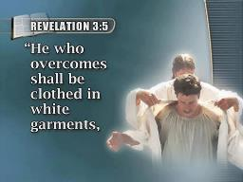
Revelation 3:5
“He who overcomes [nikaō] will thus be clothed in white garments; and I will not erase his name from the book of life, and I will confess his name before My Father and before His angels.”

Slide 50
Romans 8:37
“But in all these things we overwhelmingly conquer [hypernikaō] through Him who loved us.”

Slide 51
John 16:33
“These things I have spoken to you, so that in Me you may have peace. In the world you have tribulation, but take courage; I have overcome [nikaō] the world.”

Slide 52
1 John 4:4
“You are from God, little children, and have overcome them; because greater is He who is in you than he who is in the world.”

Slide 53
1 John 5:4-5
“For whatever is born of God overcomes [nikaō] the world; and this is the victory that has overcome [nikaō] the world—our faith.⁵ Who is the one who overcomes [nikaō] the world, but he who believes that Jesus is the Son of God?”

Slide 54
Revelation 3:5
“He who overcomes [all believers; nikaō] will thus be clothed in white garments; and I will not [ou mē] erase his name from the book of life, and I will confess his name before My Father and before His angels.”

Slide 55
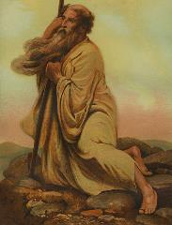
Exodus 32:32
“But now, if You will, forgive their sin—and if not, please blot me out from Your book which You have written!”

Slide 56
Psalm 69:28
“May they be blotted out of the book of life And may they not be recorded with the righteous.”

Slide 57
7. Christ’s Promises to Overcomers in Thyatira (Rev. 3:5)
Clothed in white ‒ 5a
Name not erased from the Book of Life ‒ 5b
Confession name before Father & Angels – 5c

Slide 58
Sardis Revelation 3:1-6
Destination (1a)
Description of Christ (1b)
Commendation (1c)
Rebuke (1d)
Exhortation (2a-3c)
Consequence (3d-4)
Promise to overcomers (5)
Exhortation to listen (6)

Slide 59
Deuteronomy 6:4-7
⁴ “Hear, O Israel! The Lord is our God, the Lord is one!...⁶ These words, which I am commanding you today, shall be on your heart. ⁷ You shall teach them diligently to your sons and shall talk of them when you sit in your house and when you walk by the way and when you lie down and when you rise up.”

Slide 60
Conclusion

Slide 61
Sardis Revelation 3:1-6
Destination (1a)
Description of Christ (1b)
Commendation (1c)
Rebuke (1d)
Exhortation (2a-3c)
Consequence (3d-4)
Promise to overcomers (5)
Exhortation to listen (6)

Slide 62
“The Lord bless you and keep you; the Lord make his face shine on you and be gracious to you; the Lord turn his face toward you and give you peace.” (NIV)

