Slide 1
Dr. Andy Woods
Senior Pastor – Sugar Land Bible Church
President – Chafer Theological Seminary

Slide 2
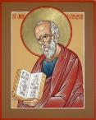
Answering Ten Questions
What is the title – Revelation of Jesus Christ
Who wrote it? – John
Where was it written from? – Patmos
To Whom was it written? – The Seven Churches
When was it written? – A.D. 95
How is it organized (outline)? – 3 part outline
How was it delivered – Seven steps
Why was it written? – Encouragement and holiness
What is it about? – Jesus’ final victory
What makes the book different? – OT relationship

Slide 3
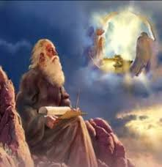
Prologue (Rev. 1:1-8)
Title (1a)
Chain of Communication (1b-2)
Blessing (3)
Author (4a)
Audience (4b)
Greeting (4c)
Source (4d-5a)
Subject (5b-8)

Slide 4
Revelation 1:19
“Therefore write the things which you have seen, and the things which are, and the things which will take place after these things [meta tauta].”

Slide 5
Revelation 1:19
Seen (Chapter 1)
Are (Chapters 2–3)
After these things (Chapters 4–22)

Slide 6
Revelation 1:19
Seen (Chapter 1)
Are (Chapters 2–3)
After these things (Chapters 4–22)

Slide 7
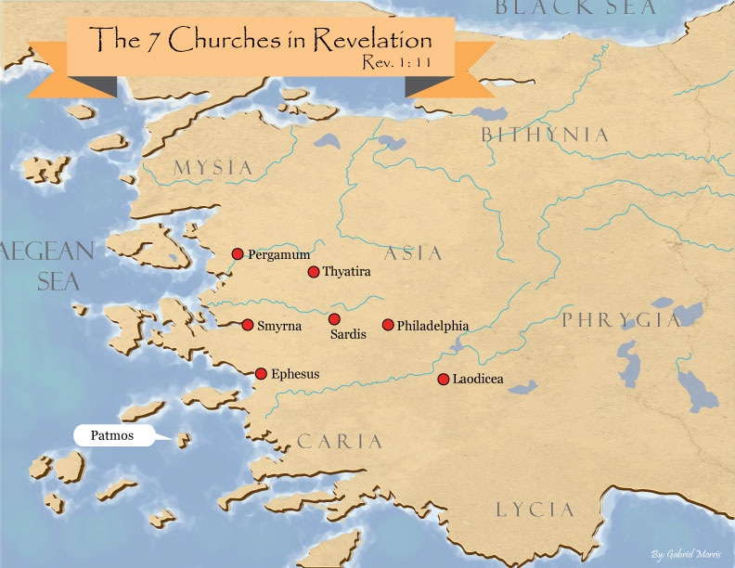

Slide 8
DESCRIPTION OF THE SEVEN CHURCHES Revelation 2‒3
CHURCH | SCRIPTURE | DESCRIPTION
Ephesus | 2:1-7 | Loveless
Smyrna | 2:8-11 | Persecuted
Pergamum | 2:12-17 | Compromised
Thyatira | 2:18-29 | Corrupt
Sardis | 3:1-6 | Dead
Philadelphia | 3:7-13 | Missionary
Laodicea | 3:14-22 | Man-centered

Slide 9
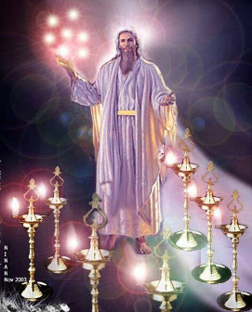
Pattern of the Letters in Revelation 2–3
Destination
Description of Christ (Rev. 1)
Commendation
Rebuke
Exhortation to change
Consequence
Exhortation to listen
Promise to overcomers (Rev. 21–22)

Slide 10
DESCRIPTION OF THE SEVEN CHURCHES Revelation 2‒3
CHURCH | SCRIPTURE | DESCRIPTION
Ephesus | 2:1-7 | Loveless
Smyrna | 2:8-11 | Persecuted
Pergamum | 2:12-17 | Compromised
Thyatira | 2:18-29 | Corrupt
Sardis | 3:1-6 | Dead
Philadelphia | 3:7-13 | Missionary
Laodicea | 3:14-22 | Man-centered

Slide 11
DESCRIPTION OF THE SEVEN CHURCHES Revelation 2‒3
CHURCH | SCRIPTURE | DESCRIPTION
Ephesus | 2:1-7 | Loveless
Smyrna | 2:8-11 | Persecuted
Pergamum | 2:12-17 | Compromised
Thyatira | 2:18-29 | Corrupt
Sardis | 3:1-6 | Dead
Philadelphia | 3:7-13 | Missionary
Laodicea | 3:14-22 | Man-centered

Slide 12
DESCRIPTION OF THE SEVEN CHURCHES Revelation 2‒3
CHURCH | SCRIPTURE | DESCRIPTION
Ephesus | 2:1-7 | Loveless
Smyrna | 2:8-11 | Persecuted
Pergamum | 2:12-17 | Compromised
Thyatira | 2:18-29 | Corrupt
Sardis | 3:1-6 | Dead
Philadelphia | 3:7-13 | Missionary
Laodicea | 3:14-22 | Man-centered

Slide 13
DESCRIPTION OF THE SEVEN CHURCHES Revelation 2‒3
CHURCH | SCRIPTURE | DESCRIPTION
Ephesus | 2:1-7 | Loveless
Smyrna | 2:8-11 | Persecuted
Pergamum | 2:12-17 | Compromised
Thyatira | 2:18-29 | Corrupt
Sardis | 3:1-6 | Dead
Philadelphia | 3:7-13 | Missionary
Laodicea | 3:14-22 | Man-centered

Slide 14
Thyatira Revelation 2:18-29
Destination (18a)
Description of Christ (18b)
Commendation (19)
Rebuke (20)
Exhortation (21)
Consequence (22-25)
Promise to overcomers (26-28)
Exhortation to listen (29)

Slide 15
Thyatira Revelation 2:18-29
Destination (18a)
Description of Christ (18b)
Commendation (19)
Rebuke (20)
Exhortation (21)
Consequence (22-25)
Promise to overcomers (26-28)
Exhortation to listen (29)

Slide 17
Thyatira Revelation 2:18-29
Destination (18a)
Description of Christ (18b)
Commendation (19)
Rebuke (20)
Exhortation (21)
Consequence (22-25)
Promise to overcomers (26-28)
Exhortation to listen (29)

Slide 18
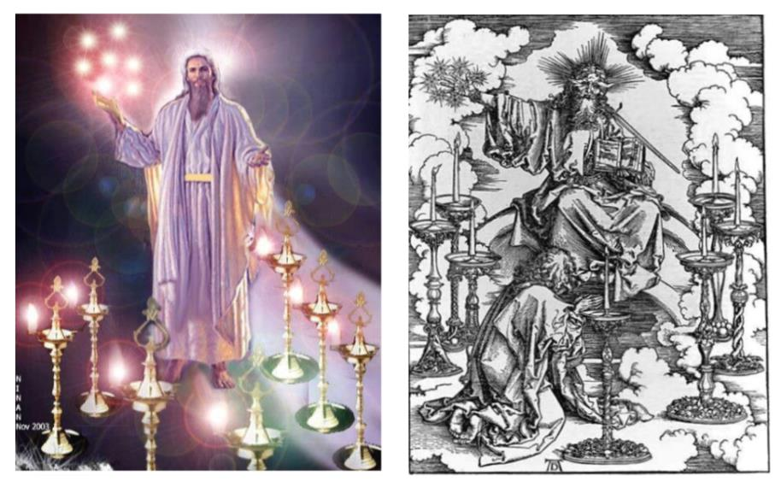

Slide 19
2. Description of Christ to Thyatira (Rev. 2:18b)
Son of God
Eyes like a flame of fire
Feet like burnished bronze

Slide 20
Thyatira Revelation 2:18-29
Destination (18a)
Description of Christ (18b)
Commendation (19)
Rebuke (20)
Exhortation (21)
Consequence (22-25)
Promise to overcomers (26-28)
Exhortation to listen (29)

Slide 21
3. What Christ Commends in Thyatira (Rev. 2:19)
Deeds (ergon) ‒ 19a
Love – 19b
Faith – 19c
Service – 19d
Perseverance (hypomonē) – 19e
Your latter deeds are greater – 19f

Slide 22
Thyatira Revelation 2:18-29
Destination (18a)
Description of Christ (18b)
Commendation (19)
Rebuke (20)
Exhortation (21)
Consequence (22-25)
Promise to overcomers (26-28)
Exhortation to listen (29)

Slide 23
Thyatira Revelation 2:18-29
Destination (18a)
Description of Christ (18b)
Commendation (19)
Rebuke (20)
Exhortation (21)
Consequence (22-25)
Promise to overcomers (26-28)
Exhortation to listen (29)

Slide 24
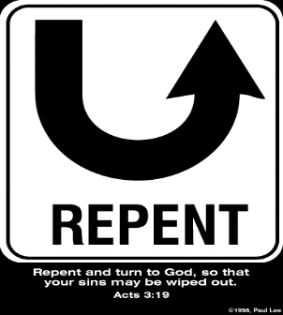
5. So What? - Points of Application!
Rev 2:21
“I gave her time to repent, and she does not want to repent of her immorality.”

Slide 25
Thyatira Revelation 2:18-29
Destination (18a)
Description of Christ (18b)
Commendation (19)
Rebuke (20)
Exhortation (21)
Consequence (22-25)
Promise to overcomers (26-28)
Exhortation to listen (29)

Slide 26
John 10:27-29
“My sheep hear My voice, and I know them, and they follow Me; ²⁸ and I give eternal life to them, and they will never perish [ou mē; aiōnia]; and no one will snatch them out of My hand. 29 My Father, who has given them to Me, is greater than all; and no one is able to snatch them out of the Father’s hand.”

Slide 27
2 Corinthians 5:10
“For we must all appear before the judgment seat of Christ, so that each one may be recompensed for his deeds in the body, according to what he has done, whether good or bad.”

Slide 29
Remembrance in 2 Peter
Has forgotten that he has been cleansed (1:9)
I will always remind you of these things (1:12)
It is right to refresh your memory (1:13)
You will always be able to remember these things (1:15)
I have written both of them as reminders (3:1)
Do not forget (3:8)
Bear in mind (3:15)

Slide 30
Thyatira Revelation 2:18-29
Destination (18a)
Description of Christ (18b)
Commendation (19)
Rebuke (20)
Exhortation (21)
Consequence (22-25)
Promise to overcomers (26-28)
Exhortation to listen (29)

Slide 31
1 John 5:4-5
⁴ For whatever is born of God overcomes the world; and this is the victory that has overcome the world—our faith. ⁵ Who is the one who overcomes the world, but he who believes that Jesus is the Son of God?”

Slide 33
8. Christ’s Promises to Overcomers in Thyatira (Rev. 2:26-28)
Authority over the nations ‒ 26-27
The morning star – 28

Slide 34
8. Christ’s Promises to Overcomers in Thyatira (Rev. 2:26-28)
Authority over the nations ‒ 26-27
The morning star – 28

Slide 35
8. Christ’s Promises to Overcomers in Thyatira (Rev. 2:26-28)
Authority over the nations ‒ 26-27
The morning star – 28

Slide 36
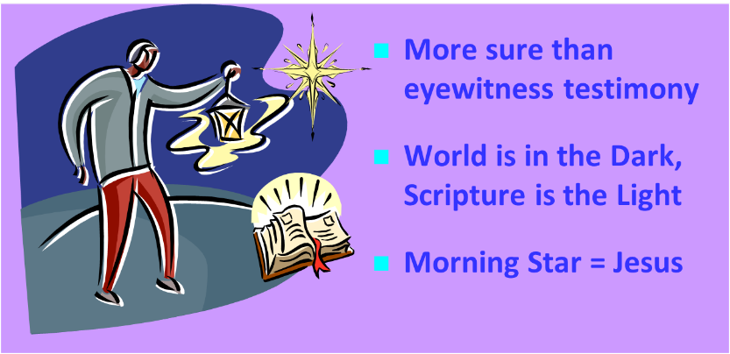
Jesus = The Morning Star (2 Peter 1:19; Rev. 2:28; 22:16)

Slide 37
Grant R. Jeffrey
Apocalypse: The Coming Judgment of the Nations, p. 83.
“Christ’s final promise to the Overcomer is that ‘I will give him the morning star.’ Just as the morning star refers to Christ Himself, it also describes a star that appears just before dawn, while night still lingers. Like the morning star, Jesus will come for His bride, the church, without warning before commencing the great and terrible Day of the Lord.”

Slide 38
Thyatira Revelation 2:18-29
Destination (18a)
Description of Christ (18b)
Commendation (19)
Rebuke (20)
Exhortation (21)
Consequence (22-25)
Promise to overcomers (26-28)
Exhortation to listen (29)

Slide 39
Deuteronomy 6:4-7
⁴ “Hear, O Israel! The Lord is our God, the Lord is one!...⁶ These words, which I am commanding you today, shall be on your heart. ⁷ You shall teach them diligently to your sons and shall talk of them when you sit in your house and when you walk by the way and when you lie down and when you rise up.”

Slide 41
Conclusion

Slide 42
Thyatira Revelation 2:18-29
Destination (18a)
Description of Christ (18b)
Commendation (19)
Rebuke (20)
Exhortation (21)
Consequence (22-25)
Promise to overcomers (26-28)
Exhortation to listen (29)

Slide 43
“The Lord bless you and keep you; the Lord make his face shine on you and be gracious to you; the Lord turn his face toward you and give you peace.” (NIV)

