Slide 1

Ecclesiology
Session 33
Dr. Andy Woods
Senior Pastor – Sugar Land Bible Church
President – Chafer Theological Seminary

Slide 2


Areas of Systematic Theology
Prolegomena – Introduction
Theology – Study of God
Christology – Study of Christ
Pneumatology – Study of the Holy Spirit
Anthropology – Study of Man
Hamartiology – Study of sin
Soteriology – Study of salvation
Angelology – Study of angels
Ecclesiology – Study of the Church
Eschatology – Study of the end

Slide 3

Ecclesiology Overview
Definition
Universal vs. local
Word pictures
Origin
Israel – Church differences
Intercalation
Purposes
Activities
Government
Officers
Ordinances
Purity

Slide 4

VII. Purposes of the Local Church
Glorify God (Eph 3:21)
Edify the saints (Eph 4:11-16)
Fulfill the Great Commission (Matt 28:18-20)

Slide 5

Spiritual Gifts

Slide 6
Four Questions
What are some general observations about spiritual gifts?
Are all the spiritual gifts for today?
What are the spiritual gifts?
How do we discover our own unique area of gifting?

Slide 7
Four Questions
What are some general observations about spiritual gifts?
Are all the spiritual gifts for today?
What are the spiritual gifts?
How do we discover our own unique area of gifting?

Slide 8
Four Questions
What are some general observations about spiritual gifts?
Are all the spiritual gifts for today?
What are the spiritual gifts?
How do we discover our own unique area of gifting?

Slide 9

The Case for Selective Cessationism
Preliminary thoughts
Four categories of gifts
  Foundational (Eph 2:20)
  Confirmatory (Heb 2:3-4)
  Revelatory (Jude 3)
  Edificatory gifts continue (Eph. 4:11-16)
Church history and selective cessationism
Proper operation of the Sign & Revelatory gifts
True source of the charismatic movement
Explanation of the Charismatic movement's popularity

Slide 10
The Case for Selective Cessationism
Preliminary thoughts
Four categories of gifts
  Foundational (Eph 2:20)
  Confirmatory (Heb 2:3-4)
  Revelatory (Jude 3)
  Edificatory gifts continue (Eph. 4:11-16)
Church history and selective cessationism
Proper operation of the Sign & Revelatory gifts
True source of the charismatic movement
Explanation of the Charismatic movement's popularity

Slide 11
The 7 Disputed Gifts
Apostle
Prophet
Worker of Miracles
Tongues
Interpretation of tongues
Healing
Knowledge

Slide 12
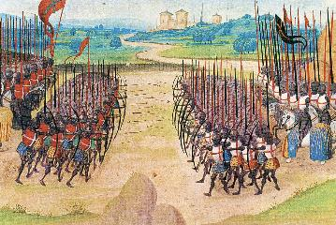
Two Camps
Charismatics – All the spiritual gifts are in operation today
Cessationists (selective)– Most of the spiritual gifts are in operation today

Slide 13
SLBC Position Statement No. 7
“TEMPORARY SPIRITUAL GIFTS – This church teaches that the miraculous sign gifts, including the gift of tongues, (always the ability to speak in a previously unlearned, known language) along with the gift of healings were temporal gifts, given by the Holy Spirit solely to authenticate both the apostles and their message before the close of the canon of Scripture (1 Cor. 13:8-10). We do not believe that these are active as gifts today. However, we affirm that God is sovereign and may heal and/or give someone the ability to speak in a tongue (foreign language) today. We believe that the majority of what is termed ‘miraculous’ within the contemporary charismatic movement is something other than the Biblical gifts of tongues or healing.”

Slide 14
The Case for Selective Cessationism
Preliminary thoughts
Four categories of gifts
  Foundational (Eph 2:20)
  Confirmatory (Heb 2:3-4)
  Revelatory (Jude 3)
  Edificatory gifts continue (Eph. 4:11-16)
Church history and selective cessationism
Proper operation of the Sign & Revelatory gifts
True source of the charismatic movement
Explanation of the Charismatic movement's popularity

Slide 15
The Case for Selective Cessationism
Preliminary thoughts
Four categories of gifts
  Foundational (Eph 2:20)
  Confirmatory (Heb 2:3-4)
  Revelatory (Jude 3)
  Edificatory gifts continue (Eph. 4:11-16)
Church history and selective cessationism
Proper operation of the Sign & Revelatory gifts
True source of the charismatic movement
Explanation of the Charismatic movement's popularity

Slide 16
The Case for Selective Cessationism
Preliminary thoughts
Four categories of gifts
  Foundational (Eph 2:20)
  Confirmatory (Heb 2:3-4)
  Revelatory (Jude 3)
  Edificatory gifts continue (Eph. 4:11-16)
Church history and selective cessationism
Proper operation of the Sign & Revelatory gifts
True source of the charismatic movement
Explanation of the Charismatic movement's popularity

Slide 17
SLBC Position Statement No. 7
“TEMPORARY SPIRITUAL GIFTS – This church teaches that the miraculous sign gifts, including the gift of tongues, (always the ability to speak in a previously unlearned, known language) along with the gift of healings were temporal gifts, given by the Holy Spirit solely to authenticate both the apostles and their message before the close of the canon of Scripture (1 Cor. 13:8-10). We do not believe that these are active as gifts today. However, we affirm that God is sovereign and may heal and/or give someone the ability to speak in a tongue (foreign language) today. We believe that the majority of what is termed ‘miraculous’ within the contemporary charismatic movement is something other than the Biblical gifts of tongues or healing.”

Slide 18
IV. Proper Operation of the Sign & Revelatory Gifts
Prophecy
Tongues

Slide 19
IV. Proper Operation of the Sign & Revelatory Gifts
Prophecy
Tongues

Slide 20

A. Proper Rules for Prophecy
100% accuracy (Deut. 18:20-22; Acts 11:28; 21:10-11)
2 to 3 prophets at a time (1 Cor. 14:29a)
Prophets are in full control of their faculties (1 Cor. 14:32)
Listeners are to judge carefully
  1 Cor. 14:29b
  Deut. 13:1-5; Isa. 8:19-20; Acts 17:11; Gal. 1:8-9; 1 Thess. 5:20-21; 1 John 4:1; Rev. 2:2

Slide 21
IV. Proper Operation of the Sign & Revelatory Gifts
Prophecy
Tongues

Slide 22

B. 10 Proper Rules for Tongues
No gibberish or incoherent speech (1 Cor. 12:10)
Tongues are low priority in Church (1 Cor. 12:28-30)
Teaching edification = priority over tongues (1 Cor. 14:19)
No untranslated tongues in Church (1 Cor. 14:23, 28)
Only 2 to 3 tongue speakers at a time (1 Cor. 14:27)
Speakers are in control of their faculties (1 Cor. 14:32)
Services = orderly absent confusion (1 Cor. 14:33, 40)
Not all Christians speak in tongues (1 Cor. 12:30)
Christians need not seek tongues (1 Cor. 12:31)
Tongues are not a prayer language (1 Cor. 14:26-27)

Slide 23
B. 10 Proper Rules for Tongues
No gibberish or incoherent speech (1 Cor. 12:10)
Tongues are low priority in Church (1 Cor. 12:28-30)
Teaching edification = priority over tongues (1 Cor. 14:19)
No untranslated tongues in Church (1 Cor. 14:23, 28)
Only 2 to 3 tongue speakers at a time (1 Cor. 14:27)
Speakers are in control of their faculties (1 Cor. 14:32)
Services = orderly absent confusion (1 Cor. 14:33, 40)
Not all Christians speak in tongues (1 Cor. 12:30)
Christians need not seek tongues (1 Cor. 12:31)
Tongues are not a prayer language (1 Cor. 14:26-27)

Slide 24
B. 10 Proper Rules for Tongues
No gibberish or incoherent speech (1 Cor. 12:10)
Tongues are low priority in Church (1 Cor. 12:28-30)
Teaching edification = priority over tongues (1 Cor. 14:19)
No untranslated tongues in Church (1 Cor. 14:23, 28)
Only 2 to 3 tongue speakers at a time (1 Cor. 14:27)
Speakers are in control of their faculties (1 Cor. 14:32)
Services = orderly absent confusion (1 Cor. 14:33, 40)
Not all Christians speak in tongues (1 Cor. 12:30)
Christians need not seek tongues (1 Cor. 12:31)
Tongues are not a prayer language (1 Cor. 14:26-27)

Slide 25
B. 10 Proper Rules for Tongues
No gibberish or incoherent speech (1 Cor. 12:10)
Tongues are low priority in Church (1 Cor. 12:28-30)
Teaching edification = priority over tongues (1 Cor. 14:19)
No untranslated tongues in Church (1 Cor. 14:23, 28)
Only 2 to 3 tongue speakers at a time (1 Cor. 14:27)
Speakers are in control of their faculties (1 Cor. 14:32)
Services = orderly absent confusion (1 Cor. 14:33, 40)
Not all Christians speak in tongues (1 Cor. 12:30)
Christians need not seek tongues (1 Cor. 12:31)
Tongues are not a prayer language (1 Cor. 14:26-27)

Slide 26
B. 10 Proper Rules for Tongues
No gibberish or incoherent speech (1 Cor. 12:10)
Tongues are low priority in Church (1 Cor. 12:28-30)
Teaching edification = priority over tongues (1 Cor. 14:19)
No untranslated tongues in Church (1 Cor. 14:23, 28)
Only 2 to 3 tongue speakers at a time (1 Cor. 14:27)
Speakers are in control of their faculties (1 Cor. 14:32)
Services = orderly absent confusion (1 Cor. 14:33, 40)
Not all Christians speak in tongues (1 Cor. 12:30)
Christians need not seek tongues (1 Cor. 12:31)
Tongues are not a prayer language (1 Cor. 14:26-27)

Slide 27
B. 10 Proper Rules for Tongues
No gibberish or incoherent speech (1 Cor. 12:10)
Tongues are low priority in Church (1 Cor. 12:28-30)
Teaching edification = priority over tongues (1 Cor. 14:19)
No untranslated tongues in Church (1 Cor. 14:23, 28)
Only 2 to 3 tongue speakers at a time (1 Cor. 14:27)
Speakers are in control of their faculties (1 Cor. 14:32)
Services = orderly absent confusion (1 Cor. 14:33, 40)
Not all Christians speak in tongues (1 Cor. 12:30)
Christians need not seek tongues (1 Cor. 12:31)
Tongues are not a prayer language (1 Cor. 14:26-27)

Slide 28

1 Corinthians 14:26-27
“²⁶ What is the outcome then, brethren? When you assemble, each one has a psalm, has a teaching, has a revelation, has a tongue, has an interpretation. Let all things be done for edification. ²⁷ If anyone speaks in a tongue, it should be by two or at the most three, and each in turn, and one must interpret.”

Slide 29
B. 10 Proper Rules for Tongues
No gibberish or incoherent speech (1 Cor. 12:10)
Tongues are low priority in Church (1 Cor. 12:28-30)
Teaching edification = priority over tongues (1 Cor. 14:19)
No untranslated tongues in Church (1 Cor. 14:23, 28)
Only 2 to 3 tongue speakers at a time (1 Cor. 14:27)
Speakers are in control of their faculties (1 Cor. 14:32)
Services = orderly absent confusion (1 Cor. 14:33, 40)
Not all Christians speak in tongues (1 Cor. 12:30)
Christians need not seek tongues (1 Cor. 12:31)
Tongues are not a prayer language (1 Cor. 14:26-27)

Slide 30
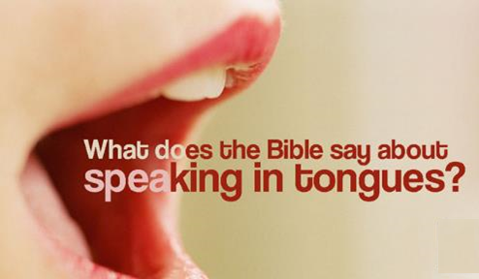
1 Corinthians 14:32
“and the spirits of prophets are subject to prophets.”

Slide 31
1 Corinthians 14:26-27
“²⁶ What is the outcome then, brethren? When you assemble, each one has a psalm, has a teaching, has a revelation, has a tongue, has an interpretation. Let all things be done for edification. ²⁷ If anyone speaks in a tongue, it should be by two or at the most three, and each in turn, and one must interpret.”

Slide 32
B. 10 Proper Rules for Tongues
No gibberish or incoherent speech (1 Cor. 12:10)
Tongues are low priority in Church (1 Cor. 12:28-30)
Teaching edification = priority over tongues (1 Cor. 14:19)
No untranslated tongues in Church (1 Cor. 14:23, 28)
Only 2 to 3 tongue speakers at a time (1 Cor. 14:27)
Speakers are in control of their faculties (1 Cor. 14:32)
Services = orderly absent confusion (1 Cor. 14:33, 40)
Not all Christians speak in tongues (1 Cor. 12:30)
Christians need not seek tongues (1 Cor. 12:31)
Tongues are not a prayer language (1 Cor. 14:26-27)

Slide 33
1 Corinthians 14:33, 40
³³ “for God is not a God of confusion but of peace, as in all the churches of the saints…⁴⁰ But all things must be done properly and in an orderly manner.”

Slide 34
B. 10 Proper Rules for Tongues
No gibberish or incoherent speech (1 Cor. 12:10)
Tongues are low priority in Church (1 Cor. 12:28-30)
Teaching edification = priority over tongues (1 Cor. 14:19)
No untranslated tongues in Church (1 Cor. 14:23, 28)
Only 2 to 3 tongue speakers at a time (1 Cor. 14:27)
Speakers are in control of their faculties (1 Cor. 14:32)
Services = orderly absent confusion (1 Cor. 14:33, 40)
Not all Christians speak in tongues (1 Cor. 12:30)
Christians need not seek tongues (1 Cor. 12:31)
Tongues are not a prayer language (1 Cor. 14:26-27)

Slide 35
1 Corinthians 12:28-30
“²⁸ And God has appointed in the church, first apostles, second prophets, third teachers, then miracles, then gifts of healings, helps, administrations, various kinds of tongues. ²⁹ All are not apostles, are they? All are not prophets, are they? All are not teachers, are they? All are not workers of miracles, are they? ³⁰ All do not have gifts of healings, do they? All do not speak with tongues, do they? All do not interpret, do they?”

Slide 36
B. 10 Proper Rules for Tongues
No gibberish or incoherent speech (1 Cor. 12:10)
Tongues are low priority in Church (1 Cor. 12:28-30)
Teaching edification = priority over tongues (1 Cor. 14:19)
No untranslated tongues in Church (1 Cor. 14:23, 28)
Only 2 to 3 tongue speakers at a time (1 Cor. 14:27)
Speakers are in control of their faculties (1 Cor. 14:32)
Services = orderly absent confusion (1 Cor. 14:33, 40)
Not all Christians speak in tongues (1 Cor. 12:30)
Christians need not seek tongues (1 Cor. 12:31)
Tongues are not a prayer language (1 Cor. 14:26-27)

Slide 37

Spiritual Gifts: Observation #2
God sovereignly bestows all the Spiritual gifts (1 Cor 12:11; Heb 2:4)

Slide 38

1 Corinthians 12:31
“³⁰ All do not have gifts of healings, do they? All do not speak with tongues, do they? All do not interpret, do they? ³¹ But earnestly desire (zēloō) the greater gifts. And I show you a still more excellent way.”

Slide 39
B. 10 Proper Rules for Tongues
No gibberish or incoherent speech (1 Cor. 12:10)
Tongues are low priority in Church (1 Cor. 12:28-30)
Teaching edification = priority over tongues (1 Cor. 14:19)
No untranslated tongues in Church (1 Cor. 14:23, 28)
Only 2 to 3 tongue speakers at a time (1 Cor. 14:27)
Speakers are in control of their faculties (1 Cor. 14:32)
Services = orderly absent confusion (1 Cor. 14:33, 40)
Not all Christians speak in tongues (1 Cor. 12:30)
Christians need not seek tongues (1 Cor. 12:31)
Tongues are not a prayer language (1 Cor. 14:26-27)

Slide 40

Spiritual Gifts: Observation #6
Spiritual gifts are given in order to edify the church (1 Cor 12:7; 14:12, 26; Eph 4:11-12; 1 Pet 4:10)

Slide 41
1 Corinthians 14:26-27
“²⁶ What is the outcome then, brethren? When you assemble, each one has a psalm, has a teaching, has a revelation, has a tongue, has an interpretation. Let all things be done for edification. ²⁷ If anyone speaks in a tongue, it should be by two or at the most three, and each in turn, and one must interpret.”

Slide 42
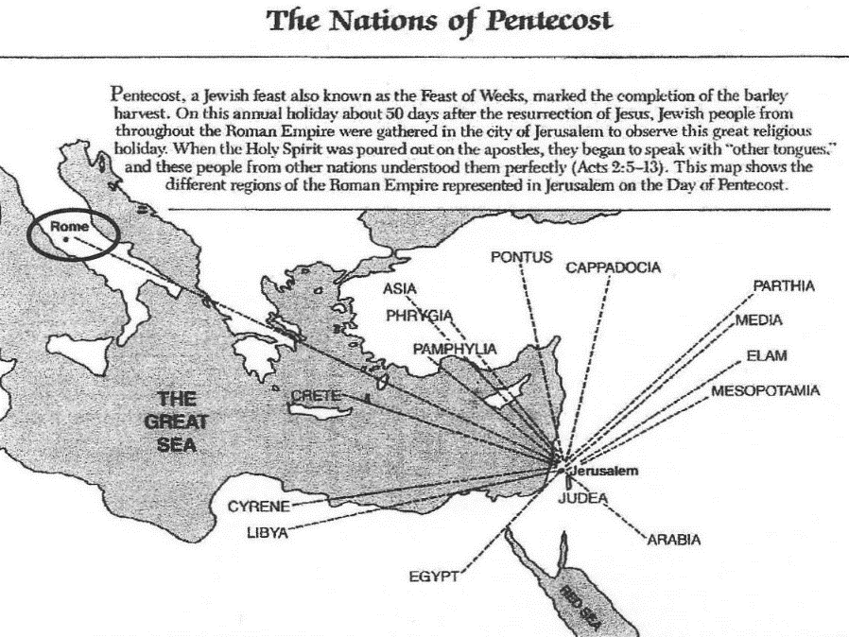

Slide 43
1 Corinthians 14:21-22
“²¹ In the Law it is written, ‘By men of strange tongues and by the lips of strangers I will speak to this people, and even so they will not listen to Me,’ says the Lord. ²² So then tongues are for a sign, not to those who believe but to unbelievers; but prophecy is for a sign, not to unbelievers but to those who believe.”

Slide 44

1 Corinthians 13:1
“¹ If I speak with the tongues of men and of angels, but do not have love, I have become a noisy gong or a clanging cymbal.”

Slide 45
Luke 1:26-38
Now in the sixth month the angel Gabriel was sent from God to a city in Galilee called Nazareth, to a virgin engaged to a man whose name was Joseph, of the descendants of David; and the virgin’s name was Mary. And coming in, he said to her, “Greetings, favored one! The Lord is with you.”…The angel said to her, “Do not be afraid, Mary; for you have found favor with God.”

Slide 46
Luke 1:26-38
“And behold, you will conceive in your womb and bear a son, and you shall name Him Jesus. He will be great and will be called the Son of the Most High; and the Lord God will give Him the throne of His father David; and He will reign over the house of Jacob forever, and His kingdom will have no end.” Mary said to the angel, “How can this be, since I am a virgin?”

Slide 47
Luke 1:26-38
The angel answered and said to her, “The Holy Spirit will come upon you, and the power of the Most High will overshadow you; and for that reason the holy Child shall be called the Son of God. And behold, even your relative Elizabeth has also conceived a son in her old age; and she who was called barren is now in her sixth month. For nothing will be impossible with God.” And Mary said, “Behold, the bonds slave of the Lord; may it be done to me according to your word.” And the angel departed from her.

Slide 48
1 Corinthians 14:1–2
¹ Pursue love, yet desire earnestly spiritual gifts, but especially that you may prophesy. ² For one who speaks in a tongue does not speak to men but to God; for no one understands, but in his spirit he speaks mysteries.

Slide 49

1 Corinthians 14:4
One who speaks in a tongue edifies (oikodomeō) himself; but one who prophesies edifies the church.

Slide 50

1 Corinthians 8:10
“For if someone sees you, who have knowledge, dining in an idol’s temple, will not his conscience, if he is weak, be strengthened (oikodomeō) to eat things sacrificed to idols?”

Slide 51

1 Corinthians 14:28
“but if there is no interpreter, he must keep silent in the church; and let him speak to himself and to God.”

Slide 52
Romans 8:26-27
“²⁶ In the same way the Spirit also helps our weakness; for we do not know how to pray as we should, but the Spirit Himself intercedes for us with groanings too deep for words; ²⁷ and He who searches the hearts knows what the mind of the Spirit is, because He intercedes for the saints according to the will of God.”

Slide 53
Conclusion

Slide 54
B. 10 Proper Rules for Tongues
No gibberish or incoherent speech (1 Cor. 12:10)
Tongues are low priority in Church (1 Cor. 12:28-30)
Teaching edification = priority over tongues (1 Cor. 14:19)
No untranslated tongues in Church (1 Cor. 14:23, 28)
Only 2 to 3 tongue speakers at a time (1 Cor. 14:27)
Speakers are in control of their faculties (1 Cor. 14:32)
Services = orderly absent confusion (1 Cor. 14:33, 40)
Not all Christians speak in tongues (1 Cor. 12:30)
Christians need not seek tongues (1 Cor. 12:31)
Tongues are not a prayer language (1 Cor. 14:26-27)

Slide 55
The Case for Selective Cessationism
Preliminary thoughts
Four categories of gifts
  Foundational (Eph 2:20)
  Confirmatory (Heb 2:3-4)
  Revelatory (Jude 3)
  Edificatory gifts continue (Eph. 4:11-16)
Church history and selective cessationism
Proper operation of the Sign & Revelatory gifts
True source of the charismatic movement
Explanation of the Charismatic movement's popularity

