Slide 1
Dr. Andy Woods
Senior Pastor – Sugar Land Bible Church
President – Chafer Theological Seminary

Slide 2
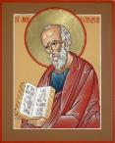
Answering Ten Questions
What is the title – Revelation of Jesus Christ
Who wrote it? – John
Where was it written from? – Patmos
To Whom was it written? – The Seven Churches
When was it written? – A.D. 95
How is it organized (outline)? – 3 part outline
How was it delivered – Seven steps
Why was it written? – Encouragement and holiness
What is it about? – Jesus’ final victory
What makes the book different? – OT relationship

Slide 3
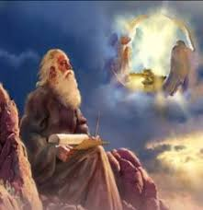
Prologue (Rev. 1:1-8)
Title (1a)
Chain of Communication (1b-2)
Blessing (3)
Author (4a)
Audience (4b)
Greeting (4c)
Source (4d-5a)
Subject (5b-8)

Slide 4
Revelation 1:19
“Therefore write the things which you have seen, and the things which are, and the things which will take place after these things [meta tauta].”

Slide 5
Revelation 1:19
Seen (Chapter 1)
Are (Chapters 2–3)
After these things (Chapters 4–22)

Slide 6
Revelation 1:19
Seen (Chapter 1)
Are (Chapters 2–3)
After these things (Chapters 4–22)

Slide 7
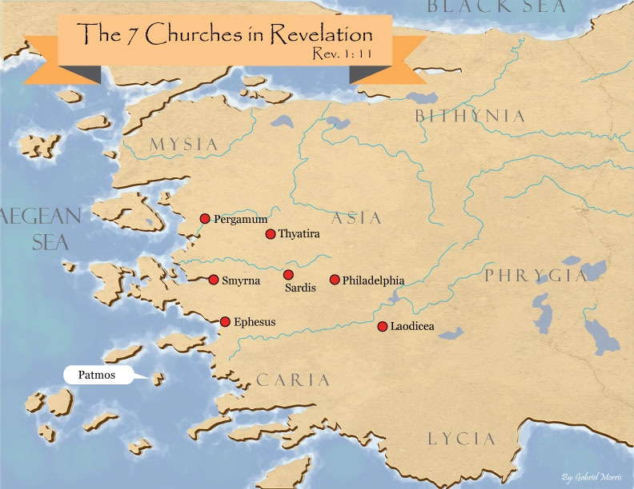

Slide 8
DESCRIPTION OF THE SEVEN CHURCHES Revelation 2‒3
CHURCH | SCRIPTURE | DESCRIPTION
Ephesus | 2:1-7 | Loveless
Smyrna | 2:8-11 | Persecuted
Pergamum | 2:12-17 | Compromised
Thyatira | 2:18-29 | Corrupt
Sardis | 3:1-6 | Dead
Philadelphia | 3:7-13 | Missionary
Laodicea | 3:14-22 | Man-centered

Slide 9
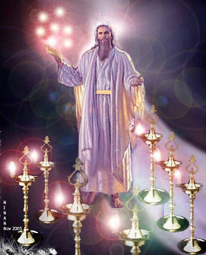
Pattern of the Letters in Revelation 2–3
Destination
Description of Christ (Rev. 1)
Commendation
Rebuke
Exhortation to change
Consequence
Exhortation to listen
Promise to overcomers (Rev. 21–22)

Slide 10
DESCRIPTION OF THE SEVEN CHURCHES Revelation 2‒3
CHURCH | SCRIPTURE | DESCRIPTION
Ephesus | 2:1-7 | Loveless
Smyrna | 2:8-11 | Persecuted
Pergamum | 2:12-17 | Compromised
Thyatira | 2:18-29 | Corrupt
Sardis | 3:1-6 | Dead
Philadelphia | 3:7-13 | Missionary
Laodicea | 3:14-22 | Man-centered

Slide 11
DESCRIPTION OF THE SEVEN CHURCHES Revelation 2‒3
CHURCH | SCRIPTURE | DESCRIPTION
Ephesus | 2:1-7 | Loveless
Smyrna | 2:8-11 | Persecuted
Pergamum | 2:12-17 | Compromised
Thyatira | 2:18-29 | Corrupt
Sardis | 3:1-6 | Dead
Philadelphia | 3:7-13 | Missionary
Laodicea | 3:14-22 | Man-centered

Slide 12
DESCRIPTION OF THE SEVEN CHURCHES Revelation 2‒3
CHURCH | SCRIPTURE | DESCRIPTION
Ephesus | 2:1-7 | Loveless
Smyrna | 2:8-11 | Persecuted
Pergamum | 2:12-17 | Compromised
Thyatira | 2:18-29 | Corrupt
Sardis | 3:1-6 | Dead
Philadelphia | 3:7-13 | Missionary
Laodicea | 3:14-22 | Man-centered

Slide 13
DESCRIPTION OF THE SEVEN CHURCHES Revelation 2‒3
CHURCH | SCRIPTURE | DESCRIPTION
Ephesus | 2:1-7 | Loveless
Smyrna | 2:8-11 | Persecuted
Pergamum | 2:12-17 | Compromised
Thyatira | 2:18-29 | Corrupt
Sardis | 3:1-6 | Dead
Philadelphia | 3:7-13 | Missionary
Laodicea | 3:14-22 | Man-centered

Slide 14
Thyatira Revelation 2:18-29
Destination (18a)
Description of Christ (18b)
Commendation (19)
Rebuke (20)
Exhortation (21)
Consequence (22-25)
Promise to overcomers (26-28)
Exhortation to listen (29)

Slide 15
Thyatira Revelation 2:18-29
Destination (18a)
Description of Christ (18b)
Commendation (19)
Rebuke (20)
Exhortation (21)
Consequence (22-25)
Promise to overcomers (26-28)
Exhortation to listen (29)

Slide 17
Thyatira Revelation 2:18-29
Destination (18a)
Description of Christ (18b)
Commendation (19)
Rebuke (20)
Exhortation (21)
Consequence (22-25)
Promise to overcomers (26-28)
Exhortation to listen (29)

Slide 18
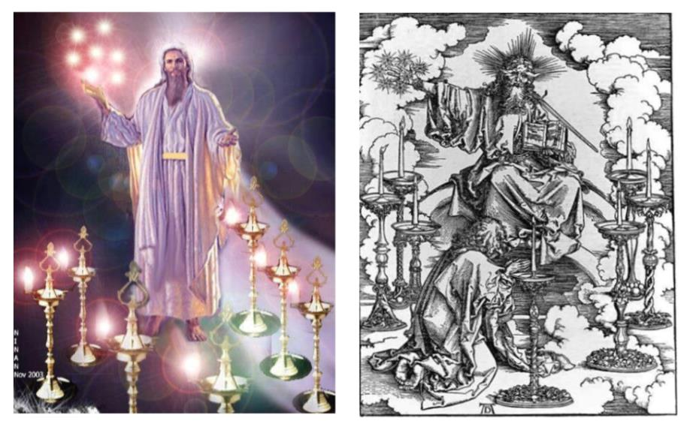

Slide 19
2. Description of Christ to Thyatira (Rev. 2:18b)
Son of God
Eyes like a flame of fire
Feet like burnished bronze

Slide 20
2. Description of Christ to Thyatira (Rev. 2:18b)
Son of God
Eyes like a flame of fire
Feet like burnished bronze

Slide 21
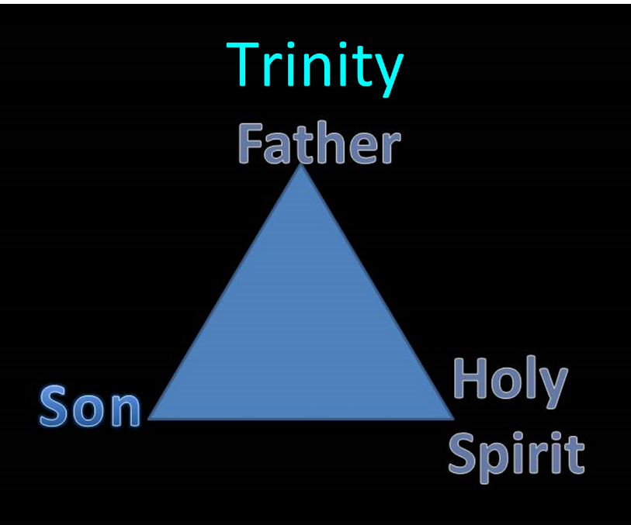

Slide 22
2. Description of Christ to Thyatira (Rev. 2:18b)
Son of God
Eyes like a flame of fire
Feet like burnished bronze

Slide 23
1 Corinthians 4:5
“ Therefore do not go on passing judgment before the time, but wait until the Lord comes who will both bring to light the things hidden in the darkness and disclose the motives of men’s hearts; and then each man’s praise will come to him from God.”

Slide 24
2. Description of Christ to Thyatira (Rev. 2:18b)
Son of God
Eyes like a flame of fire
Feet like burnished bronze

Slide 25
Thyatira Revelation 2:18-29
Destination (18a)
Description of Christ (18b)
Commendation (19)
Rebuke (20)
Exhortation (21)
Consequence (22-25)
Promise to overcomers (26-28)
Exhortation to listen (29)

Slide 26
3. What Christ Commends in Thyatira (Rev. 2:19)
Deeds (ergon) ‒ 19a
Love – 19b
Faith – 19c
Service – 19d
Perseverance (hypomonē) – 19e
Your latter deeds are greater – 19f

Slide 27
3. What Christ Commends in Thyatira (Rev. 2:19)
Deeds (ergon) ‒ 19a
Love – 19b
Faith – 19c
Service – 19d
Perseverance (hypomonē) – 19e
Your latter deeds are greater – 19f

Slide 28
3. What Christ Commends in Thyatira (Rev. 2:19)
Deeds (ergon) ‒ 19a
Love – 19b
Faith – 19c
Service – 19d
Perseverance (hypomonē) – 19e
Your latter deeds are greater – 19f

Slide 29
3. What Christ Commends in Thyatira (Rev. 2:19)
Deeds (ergon) ‒ 19a
Love – 19b
Faith – 19c
Service – 19d
Perseverance (hypomonē) – 19e
Your latter deeds are greater – 19f

Slide 30
3. What Christ Commends in Thyatira (Rev. 2:19)
Deeds (ergon) ‒ 19a
Love – 19b
Faith – 19c
Service – 19d
Perseverance (hypomonē) – 19e
Your latter deeds are greater – 19f

Slide 31
3. What Christ Commends in Thyatira (Rev. 2:19)
Deeds (ergon) ‒ 19a
Love – 19b
Faith – 19c
Service – 19d
Perseverance (hypomonē) – 19e
Your latter deeds are greater – 19f

Slide 32
3. What Christ Commends in Thyatira (Rev. 2:19)
Deeds (ergon) ‒ 19a
Love – 19b
Faith – 19c
Service – 19d
Perseverance (hypomonē) – 19e
Your latter deeds are greater – 19f

Slide 33
1 Corinthians 3:15
“If any man’s work is burned up, he will suffer loss; but he himself will be saved, yet so as through fire.”

Slide 34
Thyatira Revelation 2:18-29
Destination (18a)
Description of Christ (18b)
Commendation (19)
Rebuke (20)
Exhortation (21)
Consequence (22-25)
Promise to overcomers (26-28)
Exhortation to listen (29)

Slide 35
Thyatira Revelation 2:18-29
Destination (18a)
Description of Christ (18b)
Commendation (19)
Rebuke (20)
Exhortation (21)
Consequence (22-25)
Promise to overcomers (26-28)
Exhortation to listen (29)

Slide 36
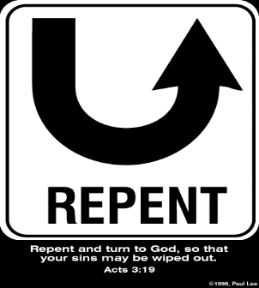
5. So What? - Points of Application!
Rev 2:21
“I gave her time to repent, and she does not want to repent of her immorality.”

Slide 37
5. So What? - Points of Application!
Rev 2:21
“I gave her time to repent, and she does not want to repent of her immorality.”

Slide 38
Lewis Sperry Chafer vol. 7, Systematic Theology (Grand Rapids, MI: Kregel Publications, 1993), 265-66.
[A] serious Arminian error respecting this doctrine occurs when repentance is added to faith or believing as a condition of salvation. It is true that repentance can very well be required as a condition of salvation, but then only because the change of mind which...has been involved when turning from every other confidence to the one needful trust in Christ. Such turning about, of course, cannot be achieved without a change of mind.

Slide 39
Lewis Sperry Chafer vol. 7, Systematic Theology (Grand Rapids, MI: Kregel Publications, 1993), 265-66.
This vital newness of mind is a part of believing, after all, and therefore it may be and is used as a synonym for believing at times (cf. Acts 17:30; 20:21; 26:20; Rom. 2:4; 2Tim. 2:25; 2 Pet. 3:9). Repentance nevertheless cannot be added to believing as a condition of salvation, because upwards of 150 passages of Scripture condition salvation upon believing only (cf. John 3:16; Acts 16:31).

Slide 40
Three Tenses of Salvation
Phase | Justification | Sanctification | Glorification
Tense | Past | Present | Future
Saved from sin’s: | Penalty | Power | Presence
Scripture | Eph 2:8-9; Titus 3:5 | Philip 2:12 | Rom 5:10

Slide 41
5. So What? - Points of Application!
Rev 2:21
“I gave her time to repent, and she does not want to repent of her immorality.”

Slide 42
5. So What? - Points of Application!
Rev 2:21
“I gave her time to repent, and she does not want to repent of her immorality.”

Slide 43
Genesis 1:26-28
²⁶ Then God said, “Let Us make man in Our image, according to Our likeness; and let them rule over the fish of the sea and over the birds of the sky and over the cattle and over all the earth, and over every creeping thing that creeps on the earth.” ²⁷ God created man in His own image, in the image of God He created him; male and female He created them. ²⁸ God blessed them; and God said to them, “Be fruitful and multiply, and fill the earth, and subdue it; and rule over the fish of the sea and over the birds of the sky and over every living thing that moves on the earth.”

Slide 44
Thyatira Revelation 2:18-29
Destination (18a)
Description of Christ (18b)
Commendation (19)
Rebuke (20)
Exhortation (21)
Consequence (22-25)
Promise to overcomers (26-28)
Exhortation to listen (29)

Slide 45
John 10:27-29
“My sheep hear My voice, and I know them, and they follow Me; ²⁸ and I give eternal life to them, and they will never perish [ou mē; aiōnia]; and no one will snatch them out of My hand. 29 My Father, who has given them to Me, is greater than all; and no one is able to snatch them out of the Father’s hand.”

Slide 46
Remembrance in 2 Peter
Has forgotten that he has been cleansed (1:9)
I will always remind you of these things (1:12)
It is right to refresh your memory (1:13)
You will always be able to remember these things (1:15)
I have written both of them as reminders (3:1)
Do not forget (3:8)
Bear in mind (3:15)

Slide 47
Thyatira Revelation 2:18-29
Destination (18a)
Description of Christ (18b)
Commendation (19)
Rebuke (20)
Exhortation (21)
Consequence (22-25)
Promise to overcomers (26-28)
Exhortation to listen (29)

Slide 48
1 John 5:4-5
⁴ For whatever is born of God overcomes the world; and this is the victory that has overcome the world—our faith. ⁵ Who is the one who overcomes the world, but he who believes that Jesus is the Son of God?”

Slide 50
8. Christ’s Promises to Overcomers in Thyatira (Rev. 2:26-28)
Authority over the nations ‒ 26-27
The morning star – 28

Slide 51
8. Christ’s Promises to Overcomers in Thyatira (Rev. 2:26-28)
Authority over the nations ‒ 26-27
The morning star – 28

Slide 52
8. Christ’s Promises to Overcomers in Thyatira (Rev. 2:26-28)
Authority over the nations ‒ 26-27
The morning star – 28

Slide 53
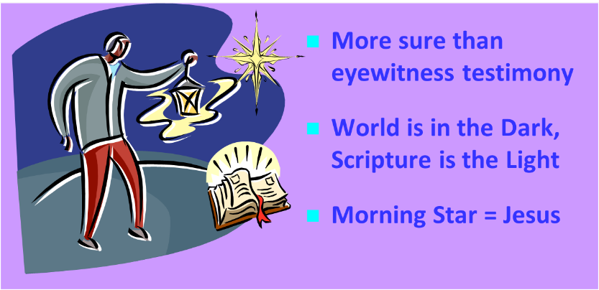
Jesus = The Morning Star (Rev. 2:28; 22:16)

Slide 54
Grant R. Jeffrey
Apocalypse: The Coming Judgment of the Nations, p. 83.
“Christ’s final promise to the Overcomer is that ‘I will give him the morning star.’ Just as the morning star refers to Christ Himself, it also describes a star that appears just before dawn, while night still lingers. Like the morning star, Jesus will come for His bride, the church, without warning before commencing the great and terrible Day of the Lord.”

Slide 55
Thyatira Revelation 2:18-29
Destination (18a)
Description of Christ (18b)
Commendation (19)
Rebuke (20)
Exhortation (21)
Consequence (22-25)
Promise to overcomers (26-28)
Exhortation to listen (29)

Slide 56
Deuteronomy 6:4-7
⁴ “Hear, O Israel! The Lord is our God, the Lord is one!...⁶ These words, which I am commanding you today, shall be on your heart. ⁷ You shall teach them diligently to your sons and shall talk of them when you sit in your house and when you walk by the way and when you lie down and when you rise up.”

Slide 57
Conclusion

Slide 58
Thyatira Revelation 2:18-29
Destination (18a)
Description of Christ (18b)
Commendation (19)
Rebuke (20)
Exhortation (21)
Consequence (22-25)
Promise to overcomers (26-28)
Exhortation to listen (29)

Slide 59
“The Lord bless you and keep you; the Lord make his face shine on you and be gracious to you; the Lord turn his face toward you and give you peace.” (NIV)

