Slide 1
Dr. Andy Woods
Senior Pastor – Sugar Land Bible Church
President – Chafer Theological Seminary

Slide 2
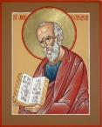
Answering Ten Questions
What is the title – Revelation of Jesus Christ
Who wrote it? – John
Where was it written from? – Patmos
To Whom was it written? – The Seven Churches
When was it written? – A.D. 95
How is it organized (outline)? – 3 part outline
How was it delivered – Seven steps
Why was it written? – Encouragement and holiness
What is it about? – Jesus’ final victory
What makes the book different? – OT relationship

Slide 3
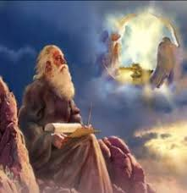
Prologue (Rev. 1:1-8)
Title (1a)
Chain of Communication (1b-2)
Blessing (3)
Author (4a)
Audience (4b)
Greeting (4c)
Source (4d-5a)
Subject (5b-8)

Slide 4
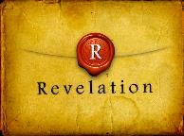
Revelation 1:19
“Therefore write the things which you have seen, and the things which are, and the things which will take place after these things [meta tauta].”

Slide 5
Revelation 1:19
Seen (Chapter 1)
Are (Chapters 2–3)
After these things (Chapters 4–22)

Slide 6
Revelation 1:19
Seen (Chapter 1)
Are (Chapters 2–3)
After these things (Chapters 4–22)

Slide 7
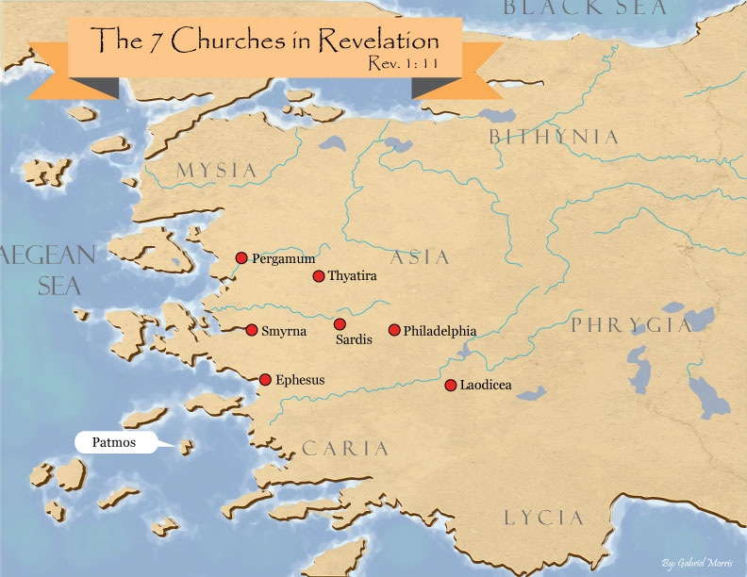

Slide 8
DESCRIPTION OF THE SEVEN CHURCHES Revelation 2‒3
CHURCH | SCRIPTURE | DESCRIPTION
Ephesus | 2:1-7 | Loveless
Smyrna | 2:8-11 | Persecuted
Pergamum | 2:12-17 | Compromised I
Thyatira | 2:18-29 | Compromised II
Sardis | 3:1-6 | Dead
Philadelphia | 3:7-13 | Missionary
Laodicea | 3:14-22 | Man-centered

Slide 9
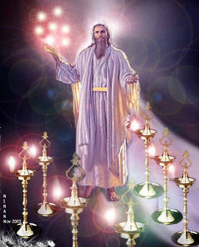
Pattern of the Letters in Revelation 2–3
Destination
Description of Christ (Rev. 1)
Commendation
Rebuke
Exhortation to change
Consequence
Exhortation to listen
Promise to overcomers (Rev. 21–22)

Slide 10
DESCRIPTION OF THE SEVEN CHURCHES Revelation 2‒3
CHURCH | SCRIPTURE | DESCRIPTION
Ephesus | 2:1-7 | Loveless
Smyrna | 2:8-11 | Persecuted
Pergamum | 2:12-17 | Compromised I
Thyatira | 2:18-29 | Compromised II
Sardis | 3:1-6 | Dead
Philadelphia | 3:7-13 | Missionary
Laodicea | 3:14-22 | Man-centered

Slide 11
DESCRIPTION OF THE SEVEN CHURCHES Revelation 2‒3
CHURCH | SCRIPTURE | DESCRIPTION
Ephesus | 2:1-7 | Loveless
Smyrna | 2:8-11 | Persecuted
Pergamum | 2:12-17 | Compromised I
Thyatira | 2:18-29 | Compromised II
Sardis | 3:1-6 | Dead
Philadelphia | 3:7-13 | Missionary
Laodicea | 3:14-22 | Man-centered

Slide 12
DESCRIPTION OF THE SEVEN CHURCHES Revelation 2‒3
CHURCH | SCRIPTURE | DESCRIPTION
Ephesus | 2:1-7 | Loveless
Smyrna | 2:8-11 | Persecuted
Pergamum | 2:12-17 | Compromised I
Thyatira | 2:18-29 | Compromised II
Sardis | 3:1-6 | Dead
Philadelphia | 3:7-13 | Missionary
Laodicea | 3:14-22 | Man-centered

Slide 13
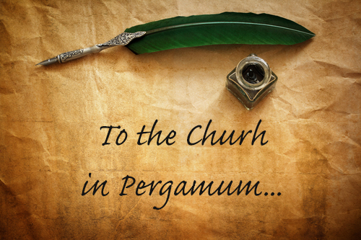
Pergamum Revelation 2:12-17
Destination (12a)
Description of Christ (12b)
Commendation (13)
Rebuke (14-15)
Exhortation (16a)
Consequence (16b)
Exhortation to listen (17a)
Promise to overcomers (17b)

Slide 14
Pergamum Revelation 2:12-17
Destination (12a)
Description of Christ (12b)
Commendation (13)
Rebuke (14-15)
Exhortation (16a)
Consequence (16b)
Exhortation to listen (17a)
Promise to overcomers (17b)

Slide 16
Pergamum Revelation 2:12-17
Destination (12a)
Description of Christ (12b)
Commendation (13)
Rebuke (14-15)
Exhortation (16a)
Consequence (16b)
Exhortation to listen (17a)
Promise to overcomers (17b)

Slide 17
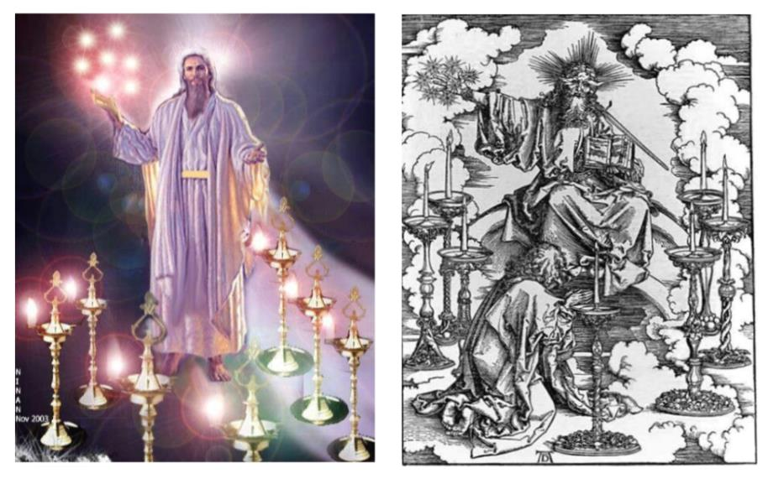

Slide 18
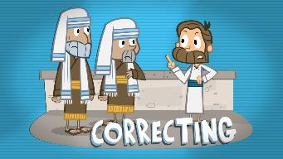
2 Timothy 3:16
“¹⁶ All Scripture is inspired by God and profitable for teaching, for reproof, for correction, for training in righteousness.”

Slide 19
Pergamum Revelation 2:12-17
Destination (12a)
Description of Christ (12b)
Commendation (13)
Rebuke (14-15)
Exhortation (16a)
Consequence (16b)
Exhortation to listen (17a)
Promise to overcomers (17b)

Slide 20
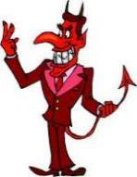
Names & Titles Demonstrating Satan’s Post-Fall, Earthly Authority (Job 1:7; 2:2; Luke 4:5-8; Rom. 8:19-22)
Prince of this world (John 12:31; 14:30; 16:11)
God of this world (2 Cor. 4:4)
Prince and power of the air (Eph. 2:2)
Who the believer wrestles with (Eph. 6:12)
Roaring lion (1 Pet. 5:8)
Whole world lies in his power (1 John 5:19)

Slide 21
Revelation 11:15
¹⁵ “Then the seventh angel sounded; and there were loud voices in heaven, saying, ‘The kingdom of the world has become the kingdom of our Lord and of His Christ; and He will reign forever and ever.’”

Slide 22
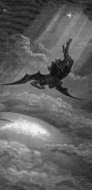
Satan’s Progressive Defeat
Initial eviction from heaven (Isa 14:12-15; Ezek 28:12-17)
Eden (Gen 3:15)
Pre-diluvian world (1 Pet 3:19-20)
Cross (John 12:31; 16:11; Col 2:15; Heb 2:14; 1 John 3:8)
Mid point of the Tribulation (Rev 12:9)
Beginning of millennium (Rev 20:2-3)
End of millennium (Rev 20:10)

Slide 23
3. What Christ Commends in Pergamum (Rev. 2:13)
Held fast to His name ‒ 13a
Did not deny His faith – 13b
Positive example of Antipas – 13c

Slide 24
3. What Christ Commends in Pergamum (Rev. 2:13)
Held fast to His name ‒ 13a
Did not deny His faith – 13b
Positive example of Antipas – 13c

Slide 25
3. What Christ Commends in Pergamum (Rev. 2:13)
Held fast to His name ‒ 13a
Did not deny His faith – 13b
Positive example of Antipas – 13c

Slide 26
3. What Christ Commends in Pergamum (Rev. 2:13)
Held fast to His name ‒ 13a
Did not deny His faith – 13b
Positive example of Antipas – 13c

Slide 27
Pergamum Revelation 2:12-17
Destination (12a)
Description of Christ (12b)
Commendation (13)
Rebuke (14-15)
Exhortation (16a)
Consequence (16b)
Exhortation to listen (17a)
Promise to overcomers (17b)

Slide 28
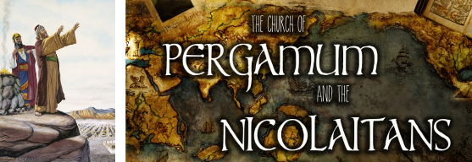
4. What Christ Corrected in Pergamum (Rev. 2:14-15)
Teachings of Balaam ‒ 14
Teachings of the Nicolaitans – 15

Slide 29
4. What Christ Corrected in Pergamum (Rev. 2:14-15)
Teachings of Balaam ‒ 14
Teachings of the Nicolaitans – 15

Slide 30
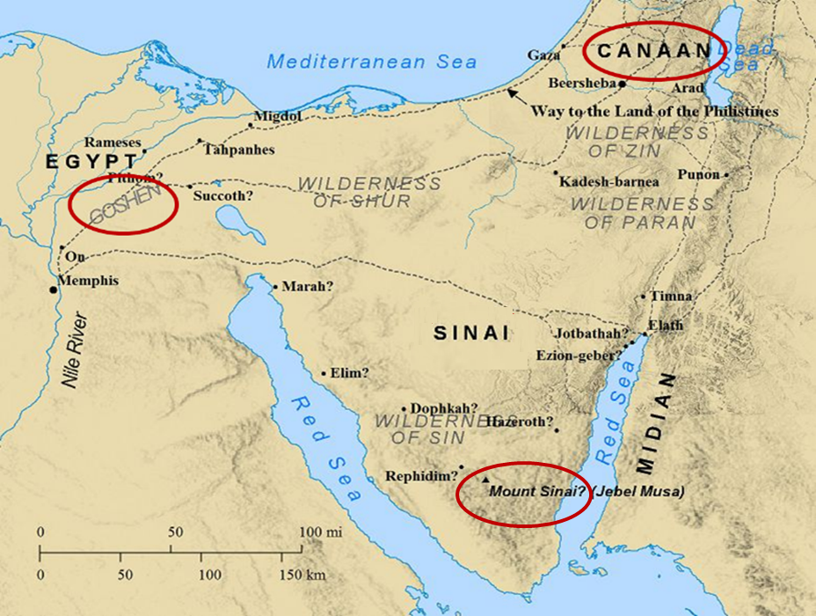

Slide 31
Balaam's 7 Oracles Blessing Israel (23-24)
First oracle (23:1-12), Balaam explained that God’s blessings upon Israel were irrevocable.
Second oracle (23:13-26), Balaam explained that the source of Israel’s blessing was her unique relationship to Yahweh
Third oracle (23:27–24:14), Balaam extolled Israel’s beauty.
Fourth oracle (24:15-19), Balaam explained that a future messianic deliverer (Gen 49:10) would spring forth and exercise dominion from Israel.

Slide 32
Balaam's 7 Oracles Blessing Israel (23-24)
Fifth oracle (Num 24:20) predicts Amalek’s destruction. Amalek was the first foe that Israel had to fight against after leaving Egypt (Exod 17).
Sixth oracle (24:21-22) predicts the destruction of the Midianite group known as the Kenites as well as Assyria.
The nations of the seventh oracle are difficult to identify (24:23-24).

Slide 33
Balaam's 7 Oracles Blessing Israel (23-24)
First oracle (23:1-12), Balaam explained that God’s blessings upon Israel were irrevocable.
Second oracle (23:13-26), Balaam explained that the source of Israel’s blessing was her unique relationship to Yahweh
Third oracle (23:27–24:14), Balaam extolled Israel’s beauty.
Fourth oracle (24:15-19), Balaam explained that a future messianic deliverer (Gen 49:10) would spring forth and exercise dominion from Israel.

Slide 34
Numbers 24:17
“I see him, but not now; I behold him, but not near; A star shall come forth from Jacob, A scepter shall rise from Israel, And shall crush through the forehead of Moab, And tear down all the sons of Sheth.”

Slide 35
4. What Christ Corrected in Pergamum (Rev. 2:14-15)
Teachings of Balaam ‒ 14
Teachings of the Nicolaitans – 15

Slide 37
Grant R. Jeffrey
Apocalypse: The Coming Judgment of the Nations, p. 72-73.
“There is a lot of disagreement about who these Nicolaitans were...Christ created a universal ‘holy priesthood’ (1 Peter 2:5) where every believer is a priest. The Nicolaitans attempted to re-create the hierarchy of the Old Testament priesthood. They sought to establish a priestly authority over laymen. The Greek word is derived from Nike meaning ‘victory’ and Laos meaning ‘people.’ It suggests a group of people who seek to elevate themselves into a special class of priesthood over other Christians. Jesus told us in 1 Timothy 2:5: ‘For there is one God and one mediator between God and man, the man Christ Jesus.’ Such men sought the sole right to interpret the Scriptures for other Christians. Centuries later, after Emperor Constantine‘s conversion, this Nicolaitan heresy produced the Babylonian hierarchy of priests, leading to the spiritual “dark ages“ of the medieval period.”

Slide 38
Pergamum Revelation 2:12-17
Destination (12a)
Description of Christ (12b)
Commendation (13)
Rebuke (14-15)
Exhortation (16a)
Consequence (16b)
Exhortation to listen (17a)
Promise to overcomers (17b)

Slide 39
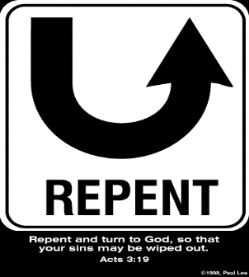
5. So What? - Points of Application!
Rev 2:16
“Therefore repent; or else I am coming to you quickly, and I will make war against them with the sword of My mouth.”

Slide 40
5. So What? - Points of Application!
Rev 2:16
“Therefore repent; or else I am coming to you quickly, and I will make war against them with the sword of My mouth.”

Slide 41
Lewis Sperry Chafer vol. 7, Systematic Theology (Grand Rapids, MI: Kregel Publications, 1993), 265-66.
[A] serious Arminian error respecting this doctrine occurs when repentance is added to faith or believing as a condition of salvation. It is true that repentance can very well be required as a condition of salvation, but then only because the change of mind which...has been involved when turning from every other confidence to the one needful trust in Christ. Such turning about, of course, cannot be achieved without a change of mind.

Slide 42
Lewis Sperry Chafer vol. 7, Systematic Theology (Grand Rapids, MI: Kregel Publications, 1993), 265-66.
This vital newness of mind is a part of believing, after all, and therefore it may be and is used as a synonym for believing at times (cf. Acts 17:30; 20:21; 26:20; Rom. 2:4; 2Tim. 2:25; 2 Pet. 3:9). Repentance nevertheless cannot be added to believing as a condition of salvation, because upwards of 150 passages of Scripture condition salvation upon believing only (cf. John 3:16; Acts 16:31).

Slide 43
Three Tenses of Salvation
Phase | Justification | Sanctification | Glorification
Tense | Past | Present | Future
Saved from sin’s: | Penalty | Power | Presence
Scripture | Eph 2:8-9; Titus 3:5 | Philip 2:12 | Rom 5:10

Slide 44
Pergamum Revelation 2:12-17
Destination (12a)
Description of Christ (12b)
Commendation (13)
Rebuke (14-15)
Exhortation (16a)
Consequence (16b)
Exhortation to listen (17a)
Promise to overcomers (17b)

Slide 45
6. So What? - Points of Application!
Rev 2:16
“Therefore repent; or else I am coming to you quickly, and I will make war against them with the sword of My mouth.”

Slide 46
John 10:27-29
“My sheep hear My voice, and I know them, and they follow Me; ²⁸ and I give eternal life to them, and they will never perish [ou mē; aiōnia]; and no one will snatch them out of My hand. 29 My Father, who has given them to Me, is greater than all; and no one is able to snatch them out of the Father’s hand.”

Slide 47
6. So What? - Points of Application!
Rev 2:16
“Therefore repent; or else I am coming to you quickly, and I will make war against them with the sword of My mouth.”

Slide 48
6. So What? - Points of Application!
Rev 2:16
“Therefore repent; or else I am coming to you quickly, and I will make war against them with the sword of My mouth.”

Slide 49
6. So What? - Points of Application!
Rev 2:16
“Therefore repent; or else I am coming to you quickly, and I will make war against them with the sword of My mouth.”

Slide 50
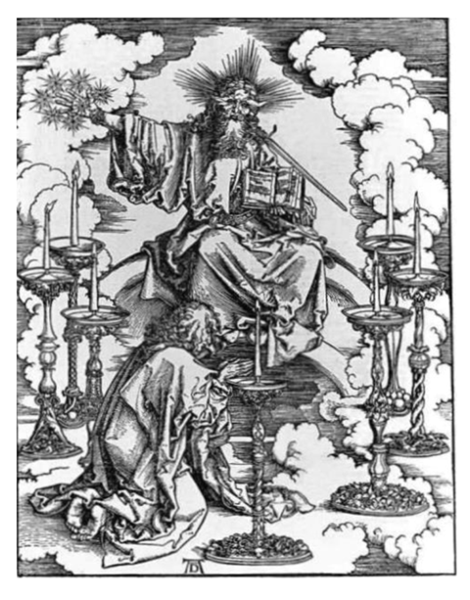

Slide 51
Pergamum Revelation 2:12-17
Destination (12a)
Description of Christ (12b)
Commendation (13)
Rebuke (14-15)
Exhortation (16a)
Consequence (16b)
Exhortation to listen (17a)
Promise to overcomers (17b)

Slide 52
Deuteronomy 6:4-7
⁴ “Hear, O Israel! The Lord is our God, the Lord is one!...⁶ These words, which I am commanding you today, shall be on your heart. ⁷ You shall teach them diligently to your sons and shall talk of them when you sit in your house and when you walk by the way and when you lie down and when you rise up.”

Slide 53
Pergamum Revelation 2:12-17
Destination (12a)
Description of Christ (12b)
Commendation (13)
Rebuke (14-15)
Exhortation (16a)
Consequence (16b)
Exhortation to listen (17a)
Promise to overcomers (17b)

Slide 54
1 John 5:4-5
⁴ For whatever is born of God overcomes the world; and this is the victory that has overcome the world—our faith. ⁵ Who is the one who overcomes the world, but he who believes that Jesus is the Son of God?”

Slide 56
8. Christ’s Promises to Overcomers in Pergamum (Rev. 2:17)
Hidden Manna ‒ 17a
White Stone – 17b
New Name – 17c

Slide 57
8. Christ’s Promises to Overcomers in Pergamum (Rev. 2:17)
Hidden Manna ‒ 17a
White Stone – 17b
New Name – 17c

Slide 59
8. Christ’s Promises to Overcomers in Pergamum (Rev. 2:17)
Hidden Manna ‒ 17a
White Stone – 17b
New Name – 17c

Slide 60
8. Christ’s Promises to Overcomers in Pergamum (Rev. 2:17)
Hidden Manna ‒ 17a
White Stone – 17b
New Name – 17c

Slide 61
Conclusion

Slide 62
Pergamum Revelation 2:12-17
Destination (12a)
Description of Christ (12b)
Commendation (13)
Rebuke (14-15)
Exhortation (16a)
Consequence (16b)
Exhortation to listen (17a)
Promise to overcomers (17b)

Slide 63
“The Lord bless you and keep you; the Lord make his face shine on you and be gracious to you; the Lord turn his face toward you and give you peace.” (NIV)

