Slide 1


Dr. Andy Woods
Senior Pastor – Sugar Land Bible Church
President – Chafer Theological Seminary

Slide 2
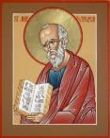
Answering Ten Questions
What is the title – Revelation of Jesus Christ
Who wrote it? – John
Where was it written from? – Patmos
To Whom was it written? – The Seven Churches
When was it written? – A.D. 95
How is it organized (outline)? – 3 part outline
How was it delivered – Seven steps
Why was it written? – Encouragement and holiness
What is it about? – Jesus’ final victory
What makes the book different? – OT relationship

Slide 3

Prologue (Rev. 1:1-8)
Title (1a)
Chain of Communication (1b-2)
Blessing (3)
Author (4a)
Audience (4b)
Greeting (4c)
Source (4d-5a)
Subject (5b-8)

Slide 4


Revelation 1:19
“Therefore write the things which you have seen, and the things which are, and the things which will take place after these things [meta tauta].”

Slide 5

Revelation 1:19
Seen (Chapter 1)
Are (Chapters 2–3)
After these things (Chapters 4–22)

Slide 6
Revelation 1:19
Seen (Chapter 1)
Are (Chapters 2–3)
After these things (Chapters 4–22)

Slide 7



Slide 8
DESCRIPTION OF THE SEVEN CHURCHES Revelation 2‒3
CHURCH | SCRIPTURE | DESCRIPTION
Ephesus | 2:1-7 | Loveless
Smyrna | 2:8-11 | Persecuted
Pergamum | 2:12-17 | Compromised I
Thyatira | 2:18-29 | Compromised II
Sardis | 3:1-6 | Dead
Philadelphia | 3:7-13 | Missionary
Laodicea | 3:14-22 | Man-centered

Slide 9
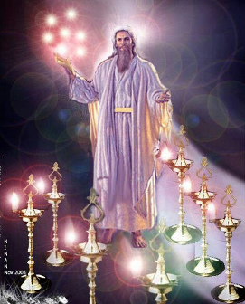
Pattern of the Letters in Revelation 2–3
Destination
Description of Christ (Rev. 1)
Commendation
Rebuke
Exhortation to change
Consequence
Exhortation to listen
Promise to overcomers (Rev. 21–22)

Slide 10
DESCRIPTION OF THE SEVEN CHURCHES Revelation 2‒3
CHURCH | SCRIPTURE | DESCRIPTION
Ephesus | 2:1-7 | Loveless
Smyrna | 2:8-11 | Persecuted
Pergamum | 2:12-17 | Compromised I
Thyatira | 2:18-29 | Compromised II
Sardis | 3:1-6 | Dead
Philadelphia | 3:7-13 | Missionary
Laodicea | 3:14-22 | Man-centered

Slide 11
DESCRIPTION OF THE SEVEN CHURCHES Revelation 2‒3
CHURCH | SCRIPTURE | DESCRIPTION
Ephesus | 2:1-7 | Loveless
Smyrna | 2:8-11 | Persecuted
Pergamum | 2:12-17 | Compromised I
Thyatira | 2:18-29 | Compromised II
Sardis | 3:1-6 | Dead
Philadelphia | 3:7-13 | Missionary
Laodicea | 3:14-22 | Man-centered

Slide 12
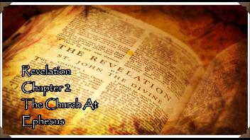
Smyrna
Revelation 2:8-11
Destination (8a)
Description of Christ (8b)
Commendation (9)
Rebuke
Exhortation (10a-c)
Consequence (10d)
Exhortation to listen (11a)
Promise to overcomers (11b)

Slide 13
Smyrna
Revelation 2:8-11
Destination (8a)
Description of Christ (8b)
Commendation (9)
Rebuke
Exhortation (10a-c)
Consequence (10d)
Exhortation to listen (11a)
Promise to overcomers (11b)

Slide 15
Smyrna
Revelation 2:8-11
Destination (8a)
Description of Christ (8b)
Commendation (9)
Rebuke
Exhortation (10a-c)
Consequence (10d)
Exhortation to listen (11a)
Promise to overcomers (11b)

Slide 16


Slide 17
2. Description of Christ
(Rev. 2:8b)
I am the first (prōtos) and the last (eschatos) (1:17)
I was dead and have come back to life (zaō) (1:18)

Slide 18
2. Description of Christ
(Rev. 2:8b)
I am the first (prōtos) and the last (eschatos) (1:17)
I was dead and have come back to life (zaō) (1:18)

Slide 19
2. Description of Christ
(Rev. 2:8b)
I am the first (prōtos) and the last (eschatos) (1:17)
I was dead and have come back to life (zaō) (1:18)

Slide 20
Why God Became Man
To restore God’s original purpose for man (5-8)
To taste death for every man (9)
To bring many to glory (10-13)
To break Satan’s rule over humanity (14)
To remove the fear of death (15)
To become our merciful high priest (16-17a)
To make a complete purification for sin (17b)
To sympathize with those tested (18)
Adapted from J. Dwight Pentecost, Faith that Endures (Grand Rapids, MI: Kregel, 2000), 60-71.

Slide 21
Why God Became Man
To restore God’s original purpose for man (5-8)
To taste death for every man (9)
To bring many to glory (10-13)
To break Satan’s rule over humanity (14)
To remove the fear of death (15)
To become our merciful high priest (16-17a)
To make a complete purification for sin (17b)
To sympathize with those tested (18)
Adapted from J. Dwight Pentecost, Faith that Endures (Grand Rapids, MI: Kregel, 2000), 60-71.

Slide 22
Romans 8:38-39
“For I am convinced that neither death, nor life, nor angels, nor principalities, nor things present, nor things to come, nor powers, ³⁹ nor height, nor depth, nor any other created thing, will be able to separate us from the love of God, which is in Christ Jesus our Lord.”

Slide 23
Smyrna
Revelation 2:8-11
Destination (8a)
Description of Christ (8b)
Commendation (9)
Rebuke
Exhortation (10a-c)
Consequence (10d)
Exhortation to listen (11a)
Promise to overcomers (11b)

Slide 24
3. What Christ Commends in Smyrna
(Rev. 2:9)
Tribulation (thlipsis) ‒ 9a
Poverty (ptōcheia) – 9b
Persecution – 9c

Slide 25
3. What Christ Commends in Smyrna
(Rev. 2:9)
Tribulation (thlipsis) ‒ 9a
Poverty (ptōcheia) – 9b
Persecution – 9c

Slide 26
Pretribulationism is not Escapism
Trials (John 16:33)
Man’s wrath (2 Tim. 3:12)
Satan’s wrath (Eph. 6:11-12)
World’s wrath (John 15:18-19)

Slide 27
3. What Christ Commends in Smyrna
(Rev. 2:9)
Tribulation (thlipsis) ‒ 9a
Poverty (ptōcheia) – 9b
Persecution – 9c

Slide 28

Revelation 2:9
“I know your tribulation and your poverty (but you are rich), and the blasphemy by those who say they are Jews and are not, but are a synagogue of Satan.”

Slide 29
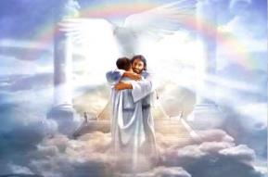
Ephesians 1:3
“Blessed be the God and Father of our Lord Jesus Christ, who has blessed us with every spiritual blessing in the heavenly places in Christ.”

Slide 30
3. What Christ Commends in Smyrna
(Rev. 2:9)
Tribulation (thlipsis) ‒ 9a
Poverty (ptōcheia) – 9b
Persecution – 9c

Slide 31
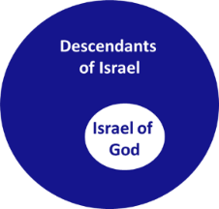
Revelation 2:9
“I know your tribulation and your poverty (but you are rich), and the blasphemy by those who say they are Jews and are not, but are a synagogue of Satan.”

Slide 32
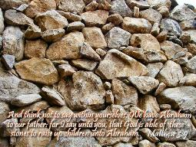
Matthew 3:9
“and do not suppose that you can say to yourselves, ‘We have Abraham for our father’; for I say to you that from these stones God is able to raise up children to Abraham.”

Slide 33
Romans 2:28-29
“²⁸ For he is not a Jew who is one outwardly, nor is circumcision that which is outward in the flesh. ²⁹ But he is a Jew who is one inwardly; and circumcision is that which is of the heart, by the Spirit, not by the letter; and his praise is not from men, but from God.”

Slide 34

Romans 9:6
“But it is not as though the word of God has failed. For they are not all Israel who are descended from Israel.”

Slide 35
Zechariah 13:8-9
⁸“It will come about in all the land,” Declares the Lord, “That two parts in it will be cut off and perish; But the third will be left in it. ⁹“And I will bring the third part through the fire, Refine them as silver is refined, And test them as gold is tested. They will call on My name, And I will answer them; I will say, ‘They are My people,’ And they will say, ‘The Lord is my God.’ ”

Slide 36
Smyrna
Revelation 2:8-11
Destination (8a)
Description of Christ (8b)
Commendation (9)
Rebuke
Exhortation (10a-c)
Consequence (10d)
Exhortation to listen (11a)
Promise to overcomers (11b)

Slide 37
Smyrna
Revelation 2:8-11
Destination (8a)
Description of Christ (8b)
Commendation (9)
Rebuke
Exhortation (10a-c)
Consequence (10d)
Exhortation to listen (11a)
Promise to overcomers (11b)

Slide 38


4. So What? - Points of Application!
Rev 2:10
“Do not fear what you are about to suffer. Behold, the devil is about to cast some of you into prison, so that you will be tested, and you will have tribulation for ten days. Be faithful until death, and I will give you the crown of life.”

Slide 39
4. So What? - Points of Application!
Rev 2:10
“Do not fear what you are about to suffer. Behold, the devil is about to cast some of you into prison, so that you will be tested, and you will have tribulation for ten days. Be faithful until death, and I will give you the crown of life.”

Slide 40

Robert Thomas
Revelation 8 to 22: An Exegetical Commentary
(Chicago: Moody Press, 1992), 408.
Robert Thomas observes that, "no number in Revelation is verifiably a symbolic number.”

Slide 41


Slide 42
4. So What? - Points of Application!
Rev 2:10
“Do not fear what you are about to suffer. Behold, the devil is about to cast some of you into prison, so that you will be tested, and you will have tribulation for ten days. Be faithful until death, and I will give you the crown of life.”

Slide 43
4. So What? - Points of Application!
Rev 2:10
“Do not fear what you are about to suffer. Behold, the devil is about to cast some of you into prison, so that you will be tested, and you will have tribulation for ten days. Be faithful until death, and I will give you the crown of life.”

Slide 44
Smyrna
Revelation 2:8-11
Destination (8a)
Description of Christ (8b)
Commendation (9)
Rebuke
Exhortation (10a-c)
Consequence (10d)
Exhortation to listen (11a)
Promise to overcomers (11b)

Slide 45
5. Consequence
Rev 2:10
“Do not fear what you are about to suffer. Behold, the devil is about to cast some of you into prison, so that you will be tested, and you will have tribulation for ten days. Be faithful until death, and I will give you the crown of life.”

Slide 46
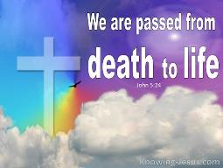
John 5:24
“Truly, truly, I say to you, he who hears My word, and believes Him who sent Me, has eternal life, and does not come into judgment, but has passed out of death into life.”

Slide 47

Lewis Sperry Chafer
vol. 7, Systematic Theology (Grand Rapids, MI: Kregel Publications, 1993), 265-66.
This vital newness of mind is a part of believing, after all, and therefore it may be and is used as a synonym for believing at times (cf. Acts 17:30; 20:21; 26:20; Rom. 2:4; 2Tim. 2:25; 2 Pet. 3:9). Repentance nevertheless cannot be added to believing as a condition of salvation, because upwards of 150 passages of Scripture condition salvation upon believing only (cf. John 3:16; Acts 16:31).

Slide 48
Scripture’s Five Crowns (Rev 4:10: 3:11; 2 John 8)
Scripture | Crown | Purpose
1 Cor. 9:24-27 | Incorruptible | Gaining mastery over the flesh
1 Thess. 2:19-20 | Rejoicing | Soul winning
Jas. 1:12; Rev. 2:10 | Life | Enduring trials
1 Pet. 5:2-4 | Glory | Shepherding God’s people
2 Tim. 4:8 | Righteousness | Longing for His appearing

Slide 49
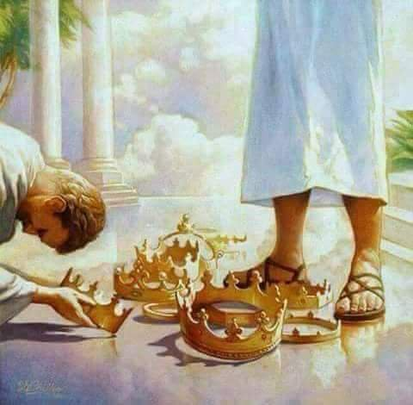

Slide 50
Smyrna
Revelation 2:8-11
Destination (8a)
Description of Christ (8b)
Commendation (9)
Rebuke
Exhortation (10a-c)
Consequence (10d)
Exhortation to listen (11a)
Promise to overcomers (11b)

Slide 51

Deuteronomy 6:4-7
⁴ “Hear, O Israel! The Lord is our God, the Lord is one!...⁶ These words, which I am commanding you today, shall be on your heart. ⁷ You shall teach them diligently to your sons and shall talk of them when you sit in your house and when you walk by the way and when you lie down and when you rise up.”

Slide 52
Smyrna
Revelation 2:8-11
Destination (8a)
Description of Christ (8b)
Commendation (9)
Rebuke
Exhortation (10a-c)
Consequence (10d)
Exhortation to listen (11a)
Promise to overcomers (11b)

Slide 53

1 John 5:4-5
⁴ For whatever is born of God overcomes the world; and this is the victory that has overcome the world—our faith. ⁵ Who is the one who overcomes the world, but he who believes that Jesus is the Son of God?”

Slide 54
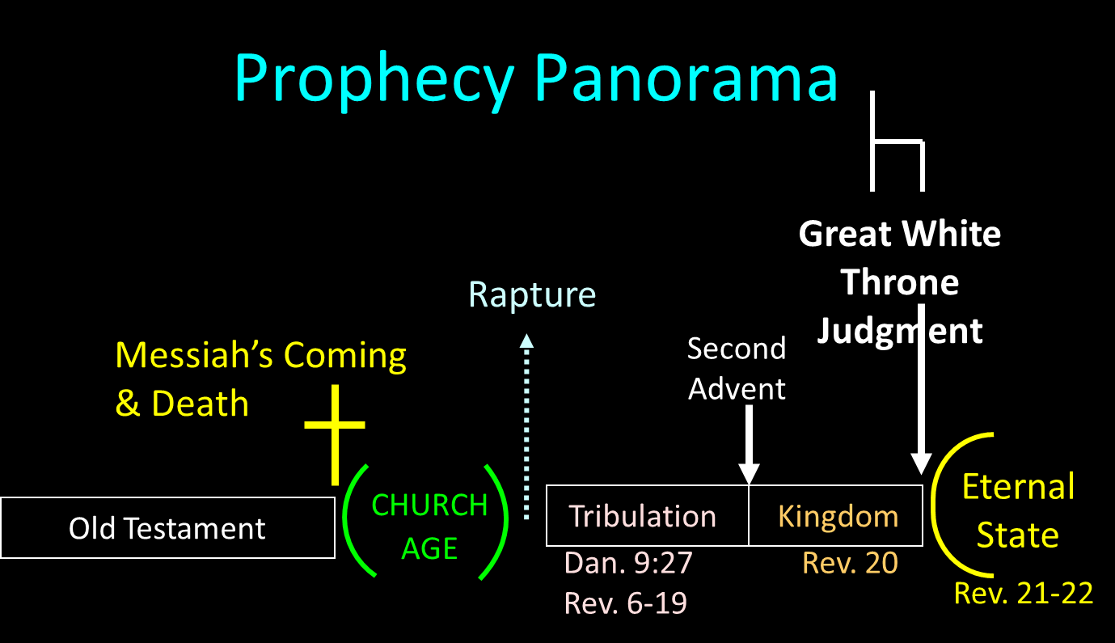

Slide 55
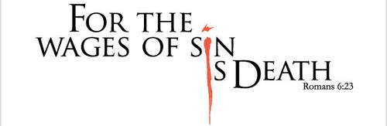
Penalty of Sin
Death – Gen. 2:17; Ezek. 18:20; Rom. 6:23; Jas. 1:14-15
Death = separation
Three types of death
  Spiritual (Isa. 59:1-2; Eph. 2:1)
  Physical (Gen. 3:19)
  Eternal or Second (Rev. 2:11; 20:6. 14; 21:8)

Slide 56
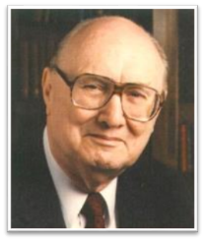
Two Rules of Interpretation
Search the immediate context
  Walvoord: 26X
Search the remote context
  Old Testament
  Thomas: 278 / 404 verses

Slide 57
Conclusion

Slide 58
Smyrna
Revelation 2:8-11
Destination (8a)
Description of Christ (8b)
Commendation (9)
Rebuke
Exhortation (10a-c)
Consequence (10d)
Exhortation to listen (11a)
Promise to overcomers (11b)

Slide 59

“The Lord bless you and keep you; the Lord make his face shine on you and be gracious to you; the Lord turn his face toward you and give you peace.” (NIV)

