Slide 1
Dr. Andy Woods
Senior Pastor – Sugar Land Bible Church
President – Chafer Theological Seminary

Slide 2
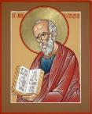
Answering Ten Questions
What is the title – Revelation of Jesus Christ
Who wrote it? – John
Where was it written from? – Patmos
To Whom was it written? – The Seven Churches
When was it written? – A.D. 95
How is it organized (outline)? – 3 part outline
How was it delivered – Seven steps
Why was it written? – Encouragement and holiness
What is it about? – Jesus’ final victory
What makes the book different? – OT relationship

Slide 3
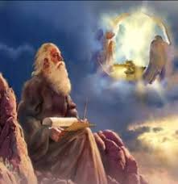
Prologue (Rev. 1:1-8)
Title (1a)
Chain of Communication (1b-2)
Blessing (3)
Author (4a)
Audience (4b)
Greeting (4c)
Source (4d-5a)
Subject (5b-8)

Slide 4
Revelation 1:19
“Therefore write the things which you have seen, and the things which are, and the things which will take place after these things [meta tauta].”

Slide 5
Revelation 1:19
Seen (Chapter 1)
Are (Chapters 2–3)
After these things (Chapters 4–22)

Slide 6
Revelation 1:19
Seen (Chapter 1)
Are (Chapters 2–3)
After these things (Chapters 4–22)

Slide 7
The Things Which You Have Seen (Rev. 1:9-20)
Circumstances of the vision (1:9-11)
Content of the vision (1:12-16)
Communication from Christ to John (1:17-20)

Slide 8
Revelation 1:19
“Therefore write the things which you have seen, and the things which are, and the things which will take place after these things [meta tauta].”

Slide 9
Revelation 1:19
Seen (Chapter 1)
Are (Chapters 2–3)
After these things (Chapters 4–22)

Slide 10
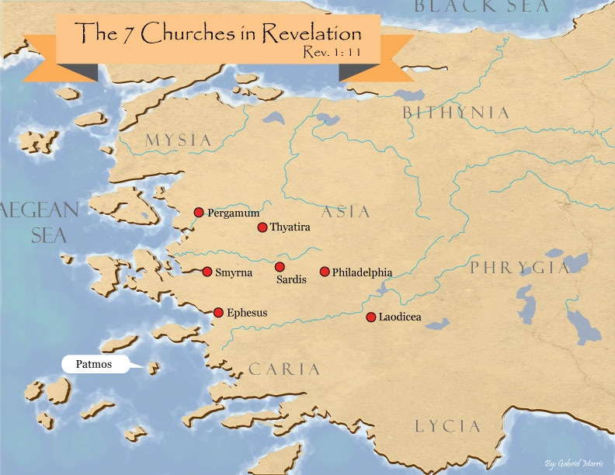

Slide 11
DESCRIPTION OF THE SEVEN CHURCHES Revelation 2‒3
CHURCH | SCRIPTURE | DESCRIPTION
Ephesus | 2:1-7 | Loveless
Smyrna | 2:8-11 | Persecuted
Pergamum | 2:12-17 | Compromised I
Thyatira | 2:18-29 | Compromised II
Sardis | 3:1-6 | Dead
Philadelphia | 3:7-13 | Missionary
Laodicea | 3:14-22 | Man-centered

Slide 12
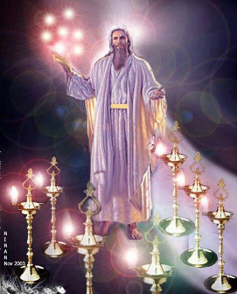
Pattern of the Letters in Revelation 2–3
Destination
Description of Christ (Rev. 1)
Commendation
Rebuke
Exhortation to change
Consequence
Exhortation to listen
Promise to overcomers (Rev. 21–22)

Slide 13
DESCRIPTION OF THE SEVEN CHURCHES Revelation 2‒3
CHURCH | SCRIPTURE | DESCRIPTION
Ephesus | 2:1-7 | Loveless
Smyrna | 2:8-11 | Persecuted
Pergamum | 2:12-17 | Compromised I
Thyatira | 2:18-29 | Compromised II
Sardis | 3:1-6 | Dead
Philadelphia | 3:7-13 | Missionary
Laodicea | 3:14-22 | Man-centered

Slide 14
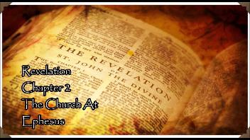
Ephesus Revelation 2:1-7
Destination (1a)
Description of Christ (1b)
Commendation (2-3, 6)
Rebuke (4)
Exhortation to change (5a)
Consequence (5b)
Exhortation to listen (7a)
Promise to overcomers (7b)

Slide 15
Ephesus Revelation 2:1-7
Destination (1a)
Description of Christ (1b)
Commendation (2-3, 6)
Rebuke (4)
Exhortation to change (5a)
Consequence (5b)
Exhortation to listen (7a)
Promise to overcomers (7b)

Slide 17
Ephesus Revelation 2:1-7
Destination (1a)
Description of Christ (1b)
Commendation (2-3, 6)
Rebuke (4)
Exhortation to change (5a)
Consequence (5b)
Exhortation to listen (7a)
Promise to overcomers (7b)

Slide 19
Ephesus Revelation 2:1-7
Destination (1a)
Description of Christ (1b)
Commendation (2-3, 6)
Rebuke (4)
Exhortation to change (5a)
Consequence (5b)
Exhortation to listen (7a)
Promise to overcomers (7b)

Slide 20
What Christ Commends in Ephesus (Rev. 2:2-3, 6)
Deeds (ergon) ‒ 2a
Discernment ‒ 2b
Perseverance (hypomonē) – 3
Holy hatred – 2:6

Slide 21
What Christ Commends in Ephesus (Rev. 2:2-3, 6)
Deeds (ergon) ‒ 2a
Discernment ‒ 2b
Perseverance (hypomonē) – 3
Holy hatred – 2:6

Slide 22
Grant R. Jeffrey
Apocalypse: The Coming Judgment of the Nations, p. 72-73.
“There is a lot of disagreement about who these Nicolaitans were...Christ created a universal ‘holy priesthood’ (1 Peter 2:5) where every believer is a priest. The Nicolaitans attempted to re-create the hierarchy of the Old Testament priesthood. They sought to establish a priestly authority over laymen. The Greek word is derived from Nike meaning ‘victory’ and Laos meaning ‘people.’ It suggests a group of people who seek to elevate themselves into a special class of priesthood over other Christians. Jesus told us in 1 Timothy 2:5: ‘For there is one God and one mediator between God and man, the man Christ Jesus.’ Such men sought the sole right to interpret the Scriptures for other Christians. Centuries later, after Emperor Constantine‘s conversion, this Nicolaitan heresy produced the Babylonian hierarchy of priests, leading to the spiritual “dark ages“ of the medieval period.”

Slide 23
Revelation 1:6; 5:10
“and He has made us to be a kingdom, priests to His God and Father—to Him be the glory and the dominion forever and ever. Amen…You have made them to be a kingdom and priests to our God; and they will reign [basileuō] upon the earth [gē].”

Slide 24
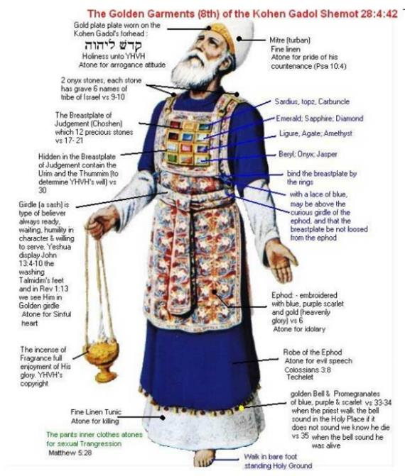

Slide 25
Ephesus Revelation 2:1-7
Destination (1a)
Description of Christ (1b)
Commendation (2-3, 6)
Rebuke (4)
Exhortation to change (5a)
Consequence (5b)
Exhortation to listen (7a)
Promise to overcomers (7b)

Slide 26
Ephesus Revelation 2:1-7
Destination (1a)
Description of Christ (1b)
Commendation (2-3, 6)
Rebuke (4)
Exhortation to change (5a)
Consequence (5b)
Exhortation to listen (7a)
Promise to overcomers (7b)

Slide 27
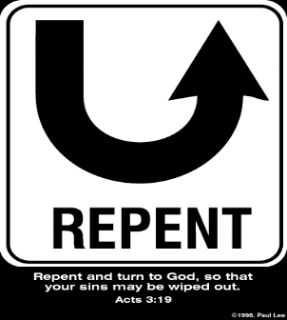
So What? - Points of Application!
Rev 2:5
“Therefore remember from where you have fallen, and repent and do the deeds you did at first; or else I am coming to you and will remove your lampstand out of its place—unless you repent.”

Slide 28
So What? - Points of Application!
Rev 2:5
“Therefore remember from where you have fallen, and repent and do the deeds you did at first; or else I am coming to you and will remove your lampstand out of its place—unless you repent.”

Slide 29
So What? - Points of Application!
Rev 2:5
“Therefore remember from where you have fallen, and repent and do the deeds you did at first; or else I am coming to you and will remove your lampstand out of its place—unless you repent.”

Slide 30
Lewis Sperry Chafer vol. 7, Systematic Theology (Grand Rapids, MI: Kregel Publications, 1993), 265-66.
[A] serious Arminian error respecting this doctrine occurs when repentance is added to faith or believing as a condition of salvation. It is true that repentance can very well be required as a condition of salvation, but then only because the change of mind which...has been involved when turning from every other confidence to the one needful trust in Christ. Such turning about, of course, cannot be achieved without a change of mind.

Slide 31
Lewis Sperry Chafer vol. 7, Systematic Theology (Grand Rapids, MI: Kregel Publications, 1993), 265-66.
This vital newness of mind is a part of believing, after all, and therefore it may be and is used as a synonym for believing at times (cf. Acts 17:30; 20:21; 26:20; Rom. 2:4; 2Tim. 2:25; 2 Pet. 3:9). Repentance nevertheless cannot be added to believing as a condition of salvation, because upwards of 150 passages of Scripture condition salvation upon believing only (cf. John 3:16; Acts 16:31).

Slide 32
Three Tenses of Salvation
Phase | Justification | Sanctification | Glorification
Tense | Past | Present | Future
Saved from sin’s: | Penalty | Power | Presence
Scripture | Eph 2:8-9; Titus 3:5 | Philip 2:12 | Rom 5:10

Slide 33
So What? - Points of Application!
Rev 2:5
“Therefore remember from where you have fallen, and repent and do the deeds you did at first; or else I am coming to you and will remove your lampstand out of its place—unless you repent.”

Slide 34
Ephesus Revelation 2:1-7
Destination (1a)
Description of Christ (1b)
Commendation (2-3, 6)
Rebuke (4)
Exhortation to change (5a)
Consequence (5b)
Exhortation to listen (7a)
Promise to overcomers (7b)

Slide 35
So What? - Points of Application!
Rev 2:5
“Therefore remember from where you have fallen, and repent and do the deeds you did at first; or else I am coming to you and will remove your lampstand out of its place—unless you repent.”

Slide 36
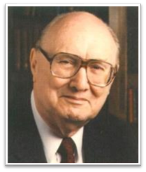
Two Rules of Interpretation
Search the immediate context
Walvoord: 26X
Search the remote context
Old Testament
Thomas: 278 / 404 verses

Slide 38
Ephesus Revelation 2:1-7
Destination (1a)
Description of Christ (1b)
Commendation (2-3, 6)
Rebuke (4)
Exhortation to change (5a)
Consequence (5b)
Exhortation to listen (7a)
Promise to overcomers (7b)

Slide 39
Deuteronomy 6:4-7
⁴ “Hear, O Israel! The Lord is our God, the Lord is one!...⁶ These words, which I am commanding you today, shall be on your heart. ⁷ You shall teach them diligently to your sons and shall talk of them when you sit in your house and when you walk by the way and when you lie down and when you rise up.”

Slide 40
Ephesus Revelation 2:1-7
Destination (1a)
Description of Christ (1b)
Commendation (2-3, 6)
Rebuke (4)
Exhortation to change (5a)
Consequence (5b)
Exhortation to listen (7a)
Promise to overcomers (7b)

Slide 41
1 John 5:4-5
⁴ For whatever is born of God overcomes the world; and this is the victory that has overcome the world—our faith. ⁵ Who is the one who overcomes the world, but he who believes that Jesus is the Son of God?”

Slide 43
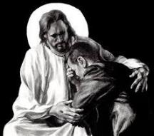
Revelation 21:4
“and He will wipe away every tear from their eyes; and there will no longer be any death; there will no longer be any mourning, or crying, or pain; the first things have passed away.”

Slide 44
Revelation 21:4
“and He will wipe away every tear from their eyes; and there will no longer be any death; there will no longer be any mourning, or crying, or pain; the first things have passed away.”

Slide 45
Conclusion

Slide 46
“The Lord bless you and keep you; the Lord make his face shine on you and be gracious to you; the Lord turn his face toward you and give you peace.” (NIV)

