Slide 1
Dr. Andy Woods
Senior Pastor – Sugar Land Bible Church
President – Chafer Theological Seminary

Slide 2
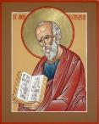
Answering Ten Questions
What is the title – Revelation of Jesus Christ
Who wrote it? – John
Where was it written from? – Patmos
To Whom was it written? – The Seven Churches
When was it written? – A.D. 95
How is it organized (outline)? – 3 part outline
How was it delivered – Seven steps
Why was it written? – Encouragement and holiness
What is it about? – Jesus’ final victory
What makes the book different? – OT relationship

Slide 3
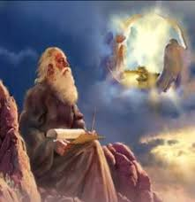
Prologue (Rev. 1:1-8)
Title (1a)
Chain of Communication (1b-2)
Blessing (3)
Author (4a)
Audience (4b)
Greeting (4c)
Source (4d-5a)
Subject (5b-8)

Slide 4
Revelation 1:19
“Therefore write the things which you have seen, and the things which are, and the things which will take place after these things [meta tauta].”

Slide 5
Revelation 1:19
Seen (Chapter 1)
Are (Chapters 2–3)
After these things (Chapters 4–22)

Slide 6
Revelation 1:19
Seen (Chapter 1)
Are (Chapters 2–3)
After these things (Chapters 4–22)

Slide 7
The Things Which You Have Seen (Rev. 1:9-20)
Circumstances of the vision (1:9-11)
Content of the vision (1:12-16)
Communication from Christ to John (1:17-20)

Slide 8
Revelation 1:19
“Therefore write the things which you have seen, and the things which are, and the things which will take place after these things [meta tauta].”

Slide 9
Revelation 1:19
Seen (Chapter 1)
Are (Chapters 2–3)
After these things (Chapters 4–22)

Slide 10
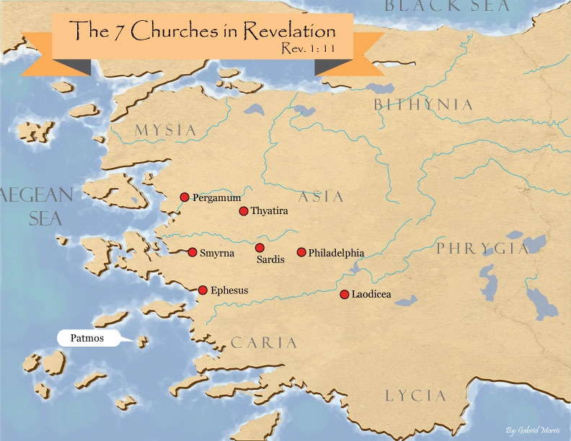

Slide 11
DESCRIPTION OF THE SEVEN CHURCHES Revelation 2‒3
CHURCH | SCRIPTURE | DESCRIPTION
Ephesus | 2:1-7 | Loveless
Smyrna | 2:8-11 | Persecuted
Pergamum | 2:12-17 | Compromised I
Thyatira | 2:18-29 | Compromised II
Sardis | 3:1-6 | Dead
Philadelphia | 3:7-13 | Missionary
Laodicea | 3:14-22 | Man-centered

Slide 12
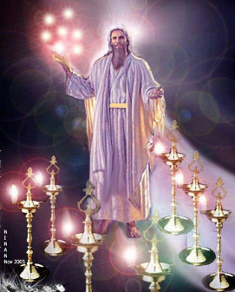
Pattern of the Letters in Revelation 2–3
Destination
Description of Christ (Rev. 1)
Commendation
Rebuke
Exhortation to change
Consequence
Exhortation to listen
Promise to overcomers (Rev. 21–22)

Slide 14
HISTORICO-PROPHETIC VIEW Each Letter Represents An Age Of The Church
CHURCH | SCRIPTURE | ERA | YEARS AD
Ephesus | 2:1-7 | Apostolic | 33–64
Smyrna | 2:8-11 | Persecuted | 64–313
Pergamum | 2:12-17 | Church/state union | 313–606
Thyatira | 2:18-29 | Middle Ages | 606–1520
Sardis | 3:1-6 | Reformation | 1520–1750
Philadelphia | 3:7-13 | Missionary | 1750–1900
Laodicea | 3:14-22 | Modern | 1900–present

Slide 15
Historico-Prophetic View Problems
Imminency?
Ethnocentricity
Does not fit church history
Allegorical

Slide 16
DESCRIPTION OF THE SEVEN CHURCHES Revelation 2‒3
CHURCH | SCRIPTURE | DESCRIPTION
Ephesus | 2:1-7 | Loveless
Smyrna | 2:8-11 | Persecuted
Pergamum | 2:12-17 | Compromised I
Thyatira | 2:18-29 | Compromised II
Sardis | 3:1-6 | Dead
Philadelphia | 3:7-13 | Missionary
Laodicea | 3:14-22 | Man-centered

Slide 17
Ephesus Revelation 2:1-7
Destination (1a)
Description of Christ (1b)
Commendation (2-3, 6)
Rebuke (4)
Exhortation to change (5a)
Consequence (5b)
Exhortation to listen (7a)
Promise to overcomers (7b)

Slide 18
Ephesus Revelation 2:1-7
Destination (1a)
Description of Christ (1b)
Commendation (2-3, 6)
Rebuke (4)
Exhortation to change (5a)
Consequence (5b)
Exhortation to listen (7a)
Promise to overcomers (7b)

Slide 19
Method of Communication
From the Father
to Christ the Son
to an angel
to John
to a book
to a reader or preacher
to a listener or the seven churches

Slide 21
Ephesus Revelation 2:1-7
Destination (1a)
Description of Christ (1b)
Commendation (2-3, 6)
Rebuke (4)
Exhortation to change (5a)
Consequence (5b)
Exhortation to listen (7a)
Promise to overcomers (7b)

Slide 22
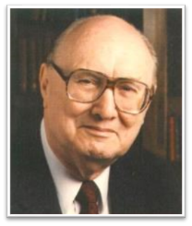
Two Rules of Interpretation
Search the immediate context
Walvoord: 26X
Search the remote context
Old Testament
Thomas: 278 / 404 verses

Slide 24
Ephesus Revelation 2:1-7
Destination (1a)
Description of Christ (1b)
Commendation (2-3, 6)
Rebuke (4)
Exhortation to change (5a)
Consequence (5b)
Exhortation to listen (7a)
Promise to overcomers (7b)

Slide 25
What Christ Commends in Ephesus (Rev. 2:2-3, 6)
Deeds (ergon)‒2a
Discernment‒2b
Perseverance (hypomonē)-3
Holy hatred-2:6

Slide 26
What Christ Commends in Ephesus (Rev. 2:2-3, 6)
Deeds (ergon)‒2a
Discernment‒2b
Perseverance (hypomonē)-3
Holy hatred-2:6

Slide 27
What Christ Commends in Ephesus (Rev. 2:2-3, 6)
Deeds (ergon)‒2a
Discernment‒2b
Perseverance (hypomonē)-3
Holy hatred-2:6

Slide 28
What Christ Commends in Ephesus (Rev. 2:2-3, 6)
Deeds (ergon)‒2a
Discernment‒2b
Perseverance (hypomonē)-3
Holy hatred-2:6

Slide 29
What Christ Commends in Ephesus (Rev. 2:2-3, 6)
Deeds (ergon)‒2a
Discernment‒2b
Perseverance (hypomonē)-3
Holy hatred-2:6

Slide 30
Grant R. Jeffrey
Apocalypse: The Coming Judgment of the Nations, p. 72-73.
“There is a lot of disagreement about who these Nicolaitans were...Christ created a universal ‘holy priesthood’ (1 Peter 2:5) where every believer is a priest. The Nicolaitans attempted to re-create the hierarchy of the Old Testament priesthood. They sought to establish a priestly authority over laymen. The Greek word is derived from Nike meaning ‘victory’ and Laos meaning ‘people.’ It suggests a group of people who seek to elevate themselves into a special class of priesthood over other Christians. Jesus told us in 1 Timothy 2:5: ‘For there is one God and one mediator between God and man, the man Christ Jesus.’ Such men sought the sole right to interpret the Scriptures for other Christians. Centuries later, after Emperor Constantine‘s conversion, this Nicolaitan heresy produced the Babylonian hierarchy of priests, leading to the spiritual “dark ages“ of the medieval period.”

Slide 31
Ephesus Revelation 2:1-7
Destination (1a)
Description of Christ (1b)
Commendation (2-3, 6)
Rebuke (4)
Exhortation to change (5a)
Consequence (5b)
Exhortation to listen (7a)
Promise to overcomers (7b)

Slide 32
Ephesus Revelation 2:1-7
Destination (1a)
Description of Christ (1b)
Commendation (2-3, 6)
Rebuke (4)
Exhortation to change (5a)
Consequence (5b)
Exhortation to listen (7a)
Promise to overcomers (7b)

Slide 33
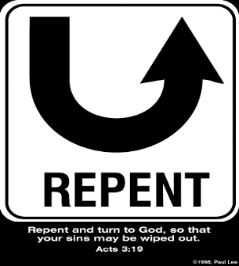
So What? - Points of Application!
Rev 2:5
“Therefore remember from where you have fallen, and repent and do the deeds you did at first; or else I am coming to you and will remove your lampstand out of its place—unless you repent.”

Slide 34
So What? - Points of Application!
Rev 2:5
“Therefore remember from where you have fallen, and repent and do the deeds you did at first; or else I am coming to you and will remove your lampstand out of its place—unless you repent.”

Slide 35
So What? - Points of Application!
Rev 2:5
“Therefore remember from where you have fallen, and repent and do the deeds you did at first; or else I am coming to you and will remove your lampstand out of its place—unless you repent.”

Slide 36
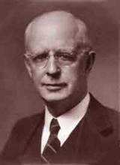
Lewis Sperry Chafer, vol. 7, Systematic Theology (Grand Rapids, MI: Kregel Publications, 1993), 265-66.
[A] serious Arminian error respecting this doctrine occurs when repentance is added to faith or believing as a condition of salvation. It is true that repentance can very well be required as a condition of salvation, but then only because the change of mind which...has been involved when turning from every other confidence to the one needful trust in Christ. Such turning about, of course, cannot be achieved without a change of mind.

Slide 37
Lewis Sperry Chafer, vol. 7, Systematic Theology (Grand Rapids, MI: Kregel Publications, 1993), 265-66.
This vital newness of mind is a part of believing, after all, and therefore it may be and is used as a synonym for believing at times (cf. Acts 17:30; 20:21; 26:20; Rom. 2:4; 2Tim. 2:25; 2 Pet. 3:9). Repentance nevertheless cannot be added to believing as a condition of salvation, because upwards of 150 passages of Scripture condition salvation upon believing only (cf. John 3:16; Acts 16:31).

Slide 38
So What? - Points of Application!
Rev 2:5
“Therefore remember from where you have fallen, and repent and do the deeds you did at first; or else I am coming to you and will remove your lampstand out of its place—unless you repent.”

Slide 39
Ephesus Revelation 2:1-7
Destination (1a)
Description of Christ (1b)
Commendation (2-3, 6)
Rebuke (4)
Exhortation to change (5a)
Consequence (5b)
Exhortation to listen (7a)
Promise to overcomers (7b)

Slide 40
Ephesus Revelation 2:1-7
Destination (1a)
Description of Christ (1b)
Commendation (2-3, 6)
Rebuke (4)
Exhortation to change (5a)
Consequence (5b)
Exhortation to listen (7a)
Promise to overcomers (7b)

Slide 41
Deuteronomy 6:4-7
⁴ “Hear, O Israel! The Lord is our God, the Lord is one!...⁶ These words, which I am commanding you today, shall be on your heart. ⁷ You shall teach them diligently to your sons and shall talk of them when you sit in your house and when you walk by the way and when you lie down and when you rise up.”

Slide 42
Ephesus Revelation 2:1-7
Destination (1a)
Description of Christ (1b)
Commendation (2-3, 6)
Rebuke (4)
Exhortation to change (5a)
Consequence (5b)
Exhortation to listen (7a)
Promise to overcomers (7b)

Slide 44
Conclusion

Slide 45
“The Lord bless you and keep you; the Lord make his face shine on you and be gracious to you; the Lord turn his face toward you and give you peace.” (NIV)

