Slide 1


Dr. Andy Woods
Senior Pastor – Sugar Land Bible Church
President – Chafer Theological Seminary

Slide 2
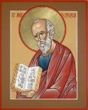
Answering Ten Questions
What is the title – Revelation of Jesus Christ
Who wrote it? – John
Where was it written from? – Patmos
To Whom was it written? – The Seven Churches
When was it written? – A.D. 95
How is it organized (outline)? – 3 part outline
How was it delivered – Seven steps
Why was it written? – Encouragement and holiness
What is it about? – Jesus’ final victory
What makes the book different? – OT relationship

Slide 3

Prologue (Rev. 1:1-8)
Title (1a)
Chain of Communication (1b-2)
Blessing (3)
Author (4a)
Audience (4b)
Greeting (4c)
Source (4d-5a)
Subject (5b-8)

Slide 4


Revelation 1:19
“Therefore write the things which you have seen, and the things which are, and the things which will take place after these things [meta tauta].”

Slide 5

Revelation 1:19
Seen (Chapter 1)
Are (Chapters 2–3)
After these things (Chapters 4–22)

Slide 6
Revelation 1:19
Seen (Chapter 1)
Are (Chapters 2–3)
After these things (Chapters 4–22)

Slide 7
The Things Which You Have Seen
(Rev. 1:9-20)
Circumstances of the vision (1:9-11)
Content of the vision (1:12-16)
Communication from Christ to John (1:17-20)

Slide 8
The Things Which You Have Seen
(Rev. 1:9-20)
Circumstances of the vision (1:9-11)
Content of the vision (1:12-16)
Communication from Christ to John (1:17-20)

Slide 9
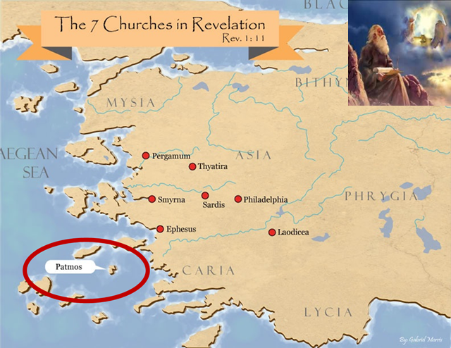
How John Got Exiled on Patmos
(Rev. 1:9)
Word (logos)
Testimony (martyria)

Slide 10
The Things Which You Have Seen
(Rev. 1:9-20)
Circumstances of the vision (1:9-11)
Content of the vision (1:12-16)
Communication from Christ to John (1:17-20)

Slide 11
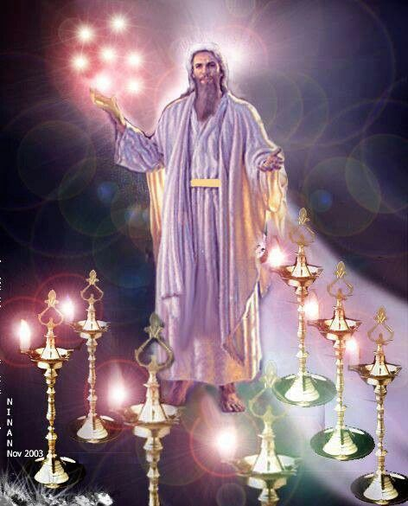

Slide 12
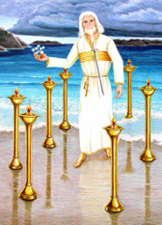
B. His Clothing
(Rev. 1:13b-c)
His robe (13b)
His sash (13c)

Slide 13
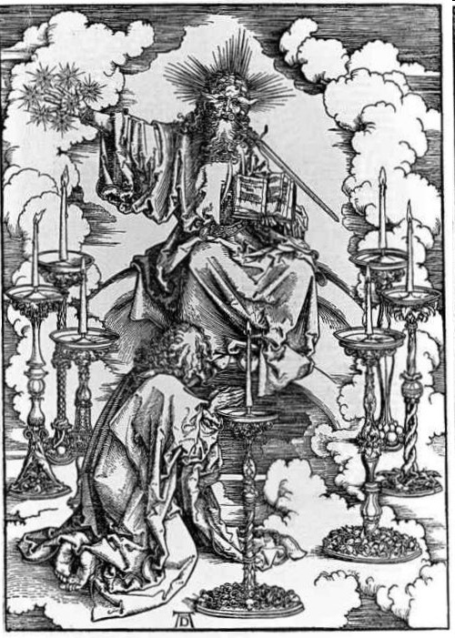
C. His Body
(Rev. 1:14-16)
His hair (14a)
His eyes (14b)
His feet (15a)
His voice (15b)
His right hand (16a)
His mouth (16b)
His face (16c)

Slide 14
The Things Which You Have Seen
(Rev. 1:9-20)
Circumstances of the vision (1:9-11)
Content of the vision (1:12-16)
Communication from Christ to John (1:17-20)

Slide 15
III. Communication from Christ to John
(Rev. 1:17-20)
John’s reaction to Jesus (1:17a)
Jesus’s comfort of John (1:17b-18)
Jesus’s command to John (1:19-20)

Slide 16
III. Communication from Christ to John
(Rev. 1:17-20)
John’s reaction to Jesus (1:17a)
Jesus’s comfort of John (1:17b-18)
Jesus’s command to John (1:19-20)

Slide 17
III. Communication from Christ to John
(Rev. 1:17-20)
John’s reaction to Jesus (1:17a)
Jesus’s comfort of John (1:17b-18)
Jesus’s command to John (1:19-20)

Slide 18
B. Jesus’s Comfort to John
(Rev. 1:17b-18)
Right hand (17b)
Do not be afraid (1:17c)
I am the first (prōtos) and the last (eschatos) (1:17d)
I have conquered the grave (1:18a)
I have the keys of death and hades (1:18b)

Slide 19
B. Jesus’s Comfort to John
(Rev. 1:17b-18)
Right hand (17b)
Do not be afraid (1:17c)
I am the first (prōtos) and the last (eschatos) (1:17d)
I have conquered the grave (1:18a)
I have the keys of death and hades (1:18b)

Slide 20
B. Jesus’s Comfort to John
(Rev. 1:17b-18)
Right hand (17b)
Do not be afraid (1:17c)
I am the first (prōtos) and the last (eschatos) (1:17d)
I have conquered the grave (1:18a)
I have the keys of death and hades (1:18b)

Slide 21
B. Jesus’s Comfort to John
(Rev. 1:17b-18)
Right hand (17b)
Do not be afraid (1:17c)
I am the first (prōtos) & the last (eschatos) (1:17d)
I have conquered the grave (1:18a)
I have the keys of death and hades (1:18b)

Slide 22
B. Jesus’s Comfort to John
(Rev. 1:17b-18)
Right hand (17b)
Do not be afraid (1:17c)
I am the first (prōtos) and the last (eschatos) (1:17d)
I have conquered the grave (1:18a)
I have the keys of death and hades (1:18b)

Slide 23
B. Jesus’s Comfort to John
(Rev. 1:17b-18)
Right hand (17b)
Do not be afraid (1:17c)
I am the first (prōtos) and the last (eschatos) (1:17d)
I have conquered the grave (1:18a)
I have the keys of death and hades (1:18b)

Slide 24
Preview
To restore God’s original purpose for man (5-8)
To taste death for every man (9)
To bring many to glory (10-13)
To break Satan’s rule over humanity (14)
To remove the fear of death (15)
To become our merciful high priest (16-17a)
To make a complete purification for sin (17b)
To sympathize with those tested (18)
Adapted from J. Dwight Pentecost, Faith that Endures (Grand Rapids, MI: Kregel, 2000), 60-71.

Slide 25
Preview
To restore God’s original purpose for man (5-8)
To taste death for every man (9)
To bring many to glory (10-13)
To break Satan’s rule over humanity (14)
To remove the fear of death (15)
To become our merciful high priest (16-17a)
To make a complete purification for sin (17b)
To sympathize with those tested (18)
Adapted from J. Dwight Pentecost, Faith that Endures (Grand Rapids, MI: Kregel, 2000), 60-71.

Slide 26
III. Communication from Christ to John
(Rev. 1:17-20)
John’s reaction to Jesus (1:17a)
Jesus’s comfort of John (1:17b-18)
Jesus’s command to John (1:19-20)

Slide 27
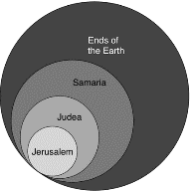
Acts 1:8
“but you will receive power when the Holy Spirit has come upon you; and you shall be My witnesses both in Jerusalem, and in all Judea and Samaria, and even to the remotest part of the earth.”

Slide 28
Revelation 1:19
“Therefore write the things which you have seen, and the things which are, and the things which will take place after these things [meta tauta].”

Slide 29
Revelation 1:19
Seen (Chapter 1)
Are (Chapters 2–3)
After these things (Chapters 4–22)

Slide 30
Revelation 4:1
“After these things [meta tauta] I looked, and behold, a door standing open in heaven, and the first voice which I had heard, like the sound of a trumpet speaking with me, said, ‘Come up here, and I will show you what must take place after these things [meta tauta].’”

Slide 31
“Mystery” Defined
“In the N.T, it [mystērion] denotes, not the mysterious (as with the Eng. word), but that which, being outside the range of unassisted natural apprehension, can be made known only by Divine revelation, and is made known in a manner and at a time appointed by God, and to those who are illumined by His Spirit.”
W. E. Vine, Merrill F. Unger, and William White, Vine's Complete Expository Dictionary of the Old and New Testament Words (Nashville: Nelson, 1996), 424.

Slide 32

Ephesians 3:3-6
“that by revelation there was made known to me the mystery, as I wrote before in brief. ⁴ By referring to this, when you read you can understand my insight into the mystery of Christ, ⁵ which in other generations was not made known to the sons of men, as it has now been revealed to His holy apostles and prophets in the Spirit; ⁶ to be specific, that the Gentiles are fellow heirs and fellow members of the body, and fellow partakers of the promise in Christ Jesus through the gospel”.

Slide 33

Ephesians 3:9
“and to bring to light what is the administration of the mystery which for ages has been hidden in God who created all things.”

Slide 35
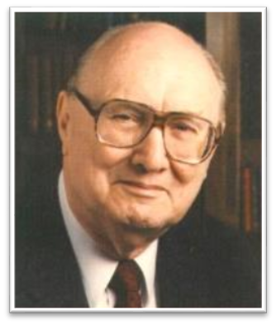
Two Rules of Interpretation
Search the immediate context
  Walvoord: 26X
Search the remote context
  Old Testament
  Thomas: 278 / 404 verses

Slide 36
Method of Communication
From the Father
to Christ the Son
to an angel
to John
to a book
to a reader or preacher
to a listener or the seven churches

Slide 37
Conclusion

Slide 38
The Things Which You Have Seen
(Rev. 1:9-20)
Circumstances of the vision (1:9-11)
Content of the vision (1:12-16)
Communication from Christ to John (1:17-20)

Slide 39

“The Lord bless you and keep you; the Lord make his face shine on you and be gracious to you; the Lord turn his face toward you and give you peace.” (NIV)

