Slide 1

Ecclesiology
Session 26
Dr. Andy Woods
Senior Pastor – Sugar Land Bible Church
President – Chafer Theological Seminary

Slide 2


Areas of Systematic Theology
Prolegomena – Introduction
Theology – Study of God
Christology – Study of Christ
Pneumatology – Study of the Holy Spirit
Anthropology – Study of Man
Hamartiology – Study of sin
Soteriology – Study of salvation
Angelology – Study of angels
Ecclesiology – Study of the Church
Eschatology – Study of the end

Slide 3
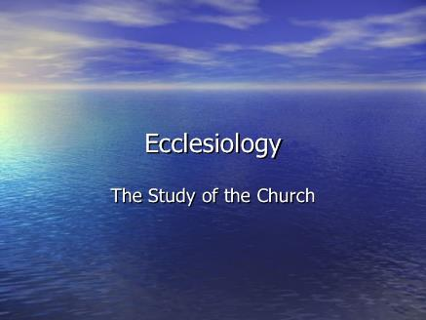
Ecclesiology Overview
Definition
Universal vs. local
Word pictures
Origin
Israel – Church differences
Intercalation
Purposes
Activities
Government
Officers
Ordinances
Purity

Slide 4

VII. Purposes of the Local Church
Glorify God (Eph 3:21)
Edify the saints (Eph 4:11-16)
Fulfill the Great Commission (Matt 28:18-20)

Slide 5
VII. Purposes of the Local Church
Glorify God (Eph 3:21)
Edify the saints (Eph 4:11-16)
Fulfill the Great Commission (Matt 28:18-20)

Slide 6

Ephesians 4:11-16
“¹¹ And He gave some as apostles, and some as prophets, and some as evangelists, and some as pastors and teachers, ¹² for the equipping of the saints for the work of service, to the building up of the body of Christ;”

Slide 7

Spiritual Gifts

Slide 8
Areas of Systematic Theology
Prolegomena – Introduction
Theology – Study of God
Christology – Study of Christ
Pneumatology – Study of the Holy Spirit
Anthropology – Study of Man
Hamartiology – Study of sin
Soteriology – Study of salvation
Angelology – Study of angels
Ecclesiology – Study of the Church
Eschatology – Study of the end

Slide 9
Four Questions
What are some general observations about spiritual gifts?
Are all the spiritual gifts for today?
What are the spiritual gifts?
How do we discover our own unique area of gifting?

Slide 10
Four Questions
What are some general observations about spiritual gifts?
Are all the spiritual gifts for today?
What are the spiritual gifts?
How do we discover our own unique area of gifting?

Slide 11
Four Questions
What are some general observations about spiritual gifts?
Are all the spiritual gifts for today?
What are the spiritual gifts?
How do we discover our own unique area of gifting?

Slide 12

The Case for Selective Cessationism
Preliminary thoughts
Four categories of gifts
  Foundational (Eph 2:20)
  Confirmatory (Heb 2:3-4)
  Revelatory (Jude 3)
  Edificatory gifts continue (Eph. 4:11-16)
Church history and selective cessationism
Proper operation of the Sign & Revelatory gifts
True source of the charismatic movement
Explanation of the Charismatic movement's popularity

Slide 13
The Case for Selective Cessationism
Preliminary thoughts
Four categories of gifts
  Foundational (Eph 2:20)
  Confirmatory (Heb 2:3-4)
  Revelatory (Jude 3)
  Edificatory gifts continue (Eph. 4:11-16)
Church history and selective cessationism
Proper operation of the Sign & Revelatory gifts
True source of the charismatic movement
Explanation of the Charismatic movement's popularity

Slide 14
12/12/4/4
Romans 12
1 Corinthians 12
1 Peter 4
Ephesians 4

Slide 15
The 7 Disputed Gifts
Apostle
Prophet
Worker of Miracles
Tongues
Interpretation of tongues
Healing
Knowledge

Slide 16
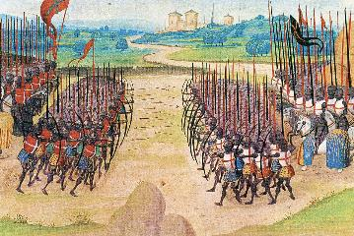
Two Camps
Charismatics – All the spiritual gifts are in operation today
Cessationists (selective)– Most of the spiritual gifts are in operation today

Slide 17
Preamble to Position Statements of SLBC Constitution
“Although agreement with the POSITION STATEMENTS is not required for membership, they are taught in this church. The POSITION STATEMENTS are not meant to prohibit honest and healthy discussions concerning what the Bible teaches about these issues; however, we believe that such discussions must be conducted under the guiding principle that believers are to strive to maintain unity.”

Slide 18
SLBC Position Statement No. 7
“TEMPORARY SPIRITUAL GIFTS – This church teaches that the miraculous sign gifts, including the gift of tongues, (always the ability to speak in a previously unlearned, known language) along with the gift of healings were temporal gifts, given by the Holy Spirit solely to authenticate both the apostles and their message before the close of the canon of Scripture (1 Cor. 13:8-10). We do not believe that these are active as gifts today. However, we affirm that God is sovereign and may heal and/or give someone the ability to speak in a tongue (foreign language) today. We believe that the majority of what is termed ‘miraculous’ within the contemporary charismatic movement is something other than the Biblical gifts of tongues or healing.”

Slide 19
The Case for Selective Cessationism
Preliminary thoughts
Four categories of gifts
  Foundational (Eph 2:20)
  Confirmatory (Heb 2:3-4)
  Revelatory (Jude 3)
  Edificatory gifts continue (Eph. 4:11-16)
Church history and selective cessationism
Proper operation of the Sign & Revelatory gifts
True source of the charismatic movement
Explanation of the Charismatic movement's popularity

Slide 20
The Case for Selective Cessationism
Preliminary thoughts
Four categories of gifts
  Foundational (Eph 2:20)
  Confirmatory (Heb 2:3-4)
  Revelatory (Jude 3)
  Edificatory gifts continue (Eph. 4:11-16)
Church history and selective cessationism
Proper operation of the Sign & Revelatory gifts
True source of the charismatic movement
Explanation of the Charismatic movement's popularity

Slide 21
The 7 Disputed Gifts
Apostle
Prophet
Worker of Miracles
Tongues
Interpretation of tongues
Healing
Knowledge

Slide 22
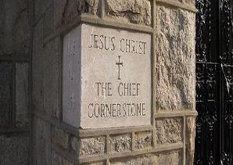
Ephesians 2:20
“having been built on the foundation of the apostles and prophets, Christ Jesus Himself being the corner stone,”

Slide 23
The Case for Selective Cessationism
Preliminary thoughts
Four categories of gifts
  Foundational (Eph 2:20)
  Confirmatory (Heb 2:3-4)
  Revelatory (Jude 3)
  Edificatory gifts continue (Eph. 4:11-16)
Church history and selective cessationism
Proper operation of the Sign & Revelatory gifts
True source of the charismatic movement
Explanation of the Charismatic movement's popularity

Slide 24
The 7 Disputed Gifts
Apostle
Prophet
Worker of Miracles
Tongues
Interpretation of tongues
Healing
Knowledge

Slide 25
Miracle Clusters In Scripture
NUM. | ERA | AUTHENTICATION
1. | Moses | Law
2. | Joshua | Conquest
3. | Elijah-Elisha | Prophet
4. | Christ | Kingdom offer
5. | Apostles | Church
6. | Tribulation & Millennium | Kingdom establishment

Slide 26
Apostolic Gift of Healing | Healing Today
No prayer | Prayer
Indirect | Direct
Apostles | Physicians
Instantaneous | Gradual
Common | Less common
Automatic | Non-automatic

Slide 27
Automatic Healing Today?
Scripture – Gal. 4:13; 2 Cor. 12:7-9; 1 Tim. 5:23; 2 Tim. 4:20
False guilt
False view of God
Sickness is sometimes caused by sin – John 5:14; 1 Cor. 11:30
Sickness is not always caused by sin – Job 1:1-2, 5; 2:7-8; Ps. 34:19
Theology of suffering
Healing is only guaranteed (Isa. 53:4; 1 Pet. 2:24-25) in the Eternal State – Rom. 8:22-23; Isa. 65:20; Rev. 21:4

Slide 28
The Case for Selective Cessationism
Preliminary thoughts
Four categories of gifts
  Foundational (Eph 2:20)
  Confirmatory (Heb 2:3-4)
  Revelatory (Jude 3)
  Edificatory gifts continue (Eph. 4:11-16)
Church history and selective cessationism
Proper operation of the Sign & Revelatory gifts
True source of the charismatic movement
Explanation of the Charismatic movement's popularity

Slide 29
The 7 Disputed Gifts
Apostle
Prophet
Worker of Miracles
Tongues
Interpretation of tongues
Healing
Knowledge

Slide 30
The Revelatory Gifts
Prophet (Deut. 18:18; 2 Pet. 1:20-21; Eph. 3:5; 1 Cor. 14:29-30; Acts 11:28; 21:10-11)
Knowledge (1 Cor. 13:2, 8-9; 14:6)
Tongues & Interpretation of tongues (1 Cor. 14:21-22 vs. 26-27)

Slide 31
The Revelatory Gifts
Prophet (Deut. 18:18; 2 Pet. 1:20-21; Eph. 3:5; 1 Cor. 14:29-30; Acts 11:28; 21:10-11)
Knowledge (1 Cor. 13:2, 8-9; 14:6)
Tongues & Interpretation of tongues (1 Cor. 14:21-22 vs. 26-27)

Slide 32
INSPIRATION OF SCRIPTURE
2 Peter 1:20-21
Men Wrote as they were inspired by Holy Spirit
  “phero” = to carry
    Acts 27:15,17
Opposite of Knowledge of False Teachers
  Which is their own imagination
    Jer. 23:16

Slide 33
The Revelatory Gifts
Prophet (Deut. 18:18; 2 Pet. 1:20-21; Eph. 3:5; 1 Cor. 14:29-30; Acts 11:28; 21:10-11)
Knowledge (1 Cor. 13:2, 8-9; 14:6)
Tongues & Interpretation of tongues (1 Cor. 14:21-22 vs. 26-27)

Slide 34
1 Corinthians 13:8-10
“⁸ Love never fails; but if there are gifts of prophecy, they will be done away; if there are tongues, they will cease; if there is knowledge, it will be done away. ⁹ For we know in part and we prophesy in part; ¹⁰ but when the perfect comes, the partial will be done away.”

Slide 35
The Revelatory Gifts
Prophet (Deut. 18:18; 2 Pet. 1:20-21; Eph. 3:5; 1 Cor. 14:29-30; Acts 11:28; 21:10-11)
Knowledge (1 Cor. 13:2, 8-9; 14:6)
Tongues & Interpretation of tongues (1 Cor. 14:21-22 vs. 26-27)

Slide 36
1 Corinthians 14:21-22
“²¹ In the Law it is written, ‘By men of strange tongues and by the lips of strangers I will speak to this people, and even so they will not listen to Me,’ says the Lord. ²² So then tongues are for a sign, not to those who believe but to unbelievers; but prophecy is for a sign, not to unbelievers but to those who believe.”

Slide 37
1 Corinthians 14:26-27
“²⁶ What is the outcome then, brethren? When you assemble, each one has a psalm, has a teaching, has a revelation, has a tongue, has an interpretation. Let all things be done for edification. ²⁷ If anyone speaks in a tongue, it should be by two or at the most three, and each in turn, and one must interpret.”

Slide 38
SLBC Position Statement No. 7
“TEMPORARY SPIRITUAL GIFTS – This church teaches that the miraculous sign gifts, including the gift of tongues, (always the ability to speak in a previously unlearned, known language) along with the gift of healings were temporal gifts, given by the Holy Spirit solely to authenticate both the apostles and their message before the close of the canon of Scripture (1 Cor. 13:8-10). We do not believe that these are active as gifts today. However, we affirm that God is sovereign and may heal and/or give someone the ability to speak in a tongue (foreign language) today. We believe that the majority of what is termed ‘miraculous’ within the contemporary charismatic movement is something other than the Biblical gifts of tongues or healing.”

Slide 39
Spiritual Gifts
(1 Corinthians 12–14)
Unity (1:11; 3:22; 6; 8–10; 11:18-19; 12:25; 15:12)
Corinthians 12–14
  Many gifts for use in one Body – 1 Cor. 12
  The needed emphasis of Love – 1 Cor. 13
  Priority and Order – 1 Cor. 14

Slide 40
Spiritual Gifts
(1 Corinthians 12–14)
Unity (1:11; 3:22; 6; 8–10; 11:18-19; 12:25; 15:12)
Corinthians 12–14
  Many gifts for use in one Body – 1 Cor. 12
  The needed emphasis of Love – 1 Cor. 13
  Priority and Order – 1 Cor. 14

Slide 41

  Love Emphasis (1 Cor. 13)
Necessity of love (13:1-3)
Nature of love (13:4-7)
Endurance of love (13:8-13)

Slide 42
  Love Emphasis (1 Cor. 13)
Necessity of love (13:1-3)
Nature of love (13:4-7)
Endurance of love (13:8-13)

Slide 43
1 Corinthians 13:8-10
“⁸ Love never fails; but if there are gifts of prophecy, they will be done away; if there are tongues, they will cease; if there is knowledge, it will be done away. ⁹ For we know in part and we prophesy in part; ¹⁰ but when the perfect comes, the partial will be done away.”

Slide 44
1 Corinthians 13:11-13
“¹¹ When I was a child, I used to speak like a child, think like a child, reason like a child; when I became a man, I did away with childish things. ¹² For now we see in a mirror dimly, but then face to face; now I know in part, but then I will know fully just as I also have been fully known. ¹³ But now faith, hope, love, abide these three; but the greatest of these is love.”

Slide 45
Endurance of Love Emphasis
(1 Cor. 13:8-13)
Unlike Love, the revelatory gifts will cease (8-10)
Two illustrations (11-12)
  Immaturity to maturity (11)
  Limited to full sight (12)
Unlike love, Faith (2 Cor. 5:7) and Hope (Rom. 8:24) will cease (13)

Slide 46
1 Corinthians 13:8-10
“⁸ Love never fails; but if there are gifts of prophecy, they will be done away; if there are tongues, they will cease; if there is knowledge, it will be done away. ⁹ For we know in part and we prophesy in part; ¹⁰ but when the perfect [teleios] comes, the partial will be done away.”

Slide 47
“The Perfect” [teleios] in 1 Cor. 13:10
Three Interpretations
Eschaton or End
Maturity of the Church
Completion of the NT canon

Slide 48
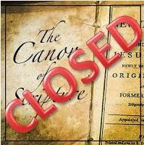
“The Perfect” [teleios] in 1 Cor. 13:10
Three Interpretations
Eschaton or End
Maturity of the Church
Completion of the NT canon

Slide 49
SLBC Position Statement No. 7
“TEMPORARY SPIRITUAL GIFTS – This church teaches that the miraculous sign gifts, including the gift of tongues, (always the ability to speak in a previously unlearned, known language) along with the gift of healings were temporal gifts, given by the Holy Spirit solely to authenticate both the apostles and their message before the close of the canon of Scripture (1 Cor. 13:8-10). We do not believe that these are active as gifts today. However, we affirm that God is sovereign and may heal and/or give someone the ability to speak in a tongue (foreign language) today. We believe that the majority of what is termed ‘miraculous’ within the contemporary charismatic movement is something other than the Biblical gifts of tongues or healing.”

Slide 50

D. Martyn Lloyd-Jones
D. Martyn Lloyd Jones, Prove All Things, ed. Christopher Catherwood (Eastbourne, England: Kingsway, 1985), 32–33.
“It means that you and I, who have the Scriptures open before us, know much more than the apostle Paul of Gods truth...It means that we are altogether superior...even to the apostles themselves, including the apostle Paul! It means that we are now in a position which . . . ‘we know, even as we are known’ by God . . . indeed, there is only one word to describe such a view, it is nonsense.”

Slide 51
“The Perfect” [teleios] in 1 Cor. 13:10
Three Interpretations
Eschaton or End
Maturity of the Church
Completion of the NT canon

Slide 52
“The Perfect” [teleios] in 1 Cor. 13:10 = The Eschaton or End
Something ideal, perfect, unblemished
Death, rapture, 2nd advent, eternal state (vs. 12; Rev. 22:4)
“Now” (vs. 12) = revelatory gifts continuing until the end
“Then” (vs. 12) = revelatory gifts ceasing after the end
Most popular view

Slide 53
Problems with the Eschaton View
Teleios never means perfection but maturity
Teleios never used of Eschatological events
Perfection (quality) does not provide a suitable antithesis to “in part” [ek meros] of verses 10, 12 (quantitative)
Eschatological events happen immediately making the analogy of vs. 11 difficult
Teleios is neuter while the personal coming of Christ would require a masculine adjective
Allows an open canon (Jude 3; Rev. 22:18-19)

Slide 54
Jude 3
“³ Beloved, while I was making every effort to write you about our common salvation, I felt the necessity to write to you appealing that you contend earnestly for the faith which was once for all handed down to the saints.”

Slide 55
Revelation 22:18-19
“¹⁸ I testify to everyone who hears the words of the prophecy of this book: if anyone adds to them, God will add to him the plagues which are written in this book; ¹⁹ and if anyone takes away from the words of the book of this prophecy, God will take away his part from the tree of life and from the holy city, which are written in this book.”

Slide 56
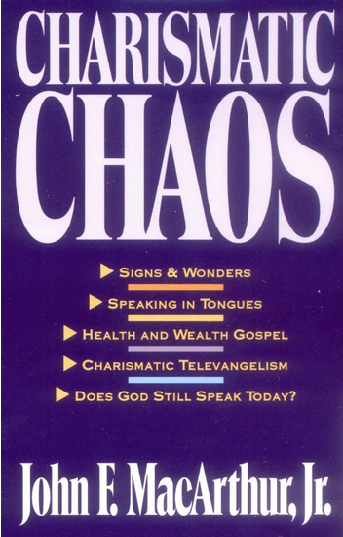
John MacArthur
Charismatic Chaos, p. 66-84
Montanism
Roman Catholicism
Neo-orthodoxy
Mormonism

Slide 57
“The Perfect” [teleios] in 1 Cor. 13:10
Three Interpretations
Eschaton or End
Maturity of the Church
Completion of the NT canon

Slide 58
“The Perfect” [teleios] in 1 Cor. 13:10 = Church’s Maturity
Canon, unity, independence, death of the apostles, AD 70
“Now” (vs. 12) = revelatory gifts continuing until end of first century
“Then” (vs. 12) = revelatory gifts cease in the second century
Closer to the truth than the Eschaton view

Slide 59
Strengths of the Maturity View
Consistent with “infants” and “adulthood” (vs. 11)
Fits context of 1 Corinthians (3:1-3)
Teleios = maturity in 1 Corinthians 2:6 and 14:20
Teleios = maturity in the NT (Philip. 3:15; Eph. 4:13; Col. 1:28; 4:12)

Slide 60
4 Kinds of People from 1 Corinthians 3:1-3
Spiritual Believers
Infant
Believers
Unbelievers
Carnal
Believers
Notes:
Ray Steadman – “1st Californians”
Unbelievers vs Categories of Believers
Unbelievers – ψυχικός psuchikós; Natural, pertaining to the natural as distinguished from the spiritual
Spiritual Believers – πνευματικός pneumatikós; of persons who are spiritual, enlightened by the Holy Spirit
Infant Believers – σάρκινος sárkinos; with propensities of the flesh unto sin; νήπιος nḗpios; an infant, child, baby without any definite limitation of age. (This relates to immaturity and lack of instruction)
Carnal Believers – σαρκικός sarkikós; tendency to satisfy the flesh, implying sinfulness, sinful propensity, carnal (This relates to disobedience and open rebellion)

Slide 61
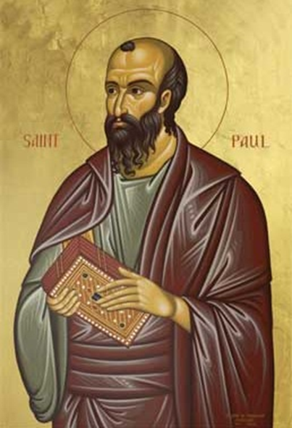
1 Corinthians 3:1-3 (NKJV)
¹ And I, brethren, could not speak to you as to spiritual people but as to carnal, as to babes in Christ. ² I fed you with milk and not with solid food; for until now you were not able to receive it, and even now you are still not able; ³ for you are still carnal. For where there are envy, strife, and divisions among you, are you not carnal and behaving like mere men?

Slide 62
Strengths of the Maturity View
Consistent with “infants” and “adulthood” (vs. 11)
Fits context of 1 Corinthians (3:1-3)
Teleios = maturity in 1 Corinthians 2:6 and 14:20
Teleios = maturity in the NT (Philip. 3:15; Eph. 4:13; Col. 1:28; 4:12)

Slide 63
Problems with the Maturity View
Maturity (quality) does not provide a suitable antithesis to “in part” [ek meros] of verses 10, 12 (quantitative)
Criteria for depicting the church’s maturity is arbitrary
  Canon, unity, independence, death of the apostles?
  AD 70 vs. AD 135?
  Church remains immature (1 Cor. 3:3; Eph. 4:11-12)

Slide 64

1 Corinthians 3:1-3 (NKJV)
“¹And I, brethren, could not speak to you as to spiritual people but as to carnal, as to babes in Christ. ² I fed you with milk and not with solid food; for until now you were not able to receive it, and even now you are still not able; ³ for you are still carnal. For where there are envy, strife, and divisions among you, are you not carnal and behaving like mere men?”

Slide 65
Ephesians 4:13-14
“¹³ until we all attain to the unity of the faith, and of the knowledge of the Son of God, to a mature man, to the measure of the stature which belongs to the fullness of Christ. ¹⁴ As a result, we are no longer to be children, tossed here and there by waves and carried about by every wind of doctrine, by the trickery of men, by craftiness in deceitful scheming;”

Slide 66
Three Interpretations of “The Perfect” [teleios] in 1 Cor. 13:10
Eschaton or End
Maturity of the Church
Completion of the NT canon

Slide 67
3. “The Perfect” [teleios] in 1 Cor. 13:10 = The Completed Canon
“Now” (vs. 12) = revelatory gifts continuing throughout the apostolic and pre-NT canon era
“Then” (vs. 12) = revelatory gifts cease in the post-apostolic and post-NT canon era
1st-century revelatory gifts were “in part” [ek meros] (vs. 10, 12)
Superseded by a sufficient (2 Tim. 3:17; 2 Pet. 1:3-4) and completed (Jude 3; Rev. 22:18-19) NT canon

Slide 68
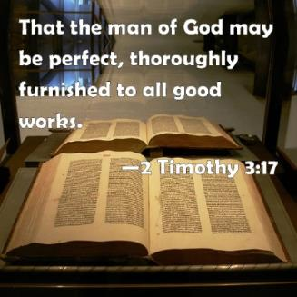
2 Timothy 3:16-17
“All Scripture is inspired by God and profitable for teaching, for reproof, for correction, for training in righteousness; so that the man of God may be adequate, equipped for every good work.”

Slide 69
2 Peter 1:3-4
“Seeing that His divine power has granted to us everything pertaining to life and godliness, through the true knowledge of Him who called us by His own glory and excellence. For by these He has granted to us His precious and magnificent promises, so that by them you may become partakers of the divine nature, having escaped the corruption that is in the world by lust.”

Slide 70
Jude 3
“³ Beloved, while I was making every effort to write you about our common salvation, I felt the necessity to write to you appealing that you contend earnestly for the faith which was once for all handed down to the saints.”

Slide 71
Revelation 22:18-19
“¹⁸ I testify to everyone who hears the words of the prophecy of this book: if anyone adds to them, God will add to him the plagues which are written in this book; ¹⁹ and if anyone takes away from the words of the book of this prophecy, God will take away his part from the tree of life and from the holy city, which are written in this book.”

Slide 72
1 Corinthians 13:8-11
“⁸ Love never fails; but if there are gifts of prophecy, they will be done away; if there are tongues, they will cease; if there is knowledge, it will be done away. ⁹ For we know in part and we prophesy in part; ¹⁰ but when the perfect comes, the partial will be done away. “¹¹ When I was a child, I used to speak like a child, think like a child, reason like a child; when I became a man, I did away with childish things.”

Slide 73
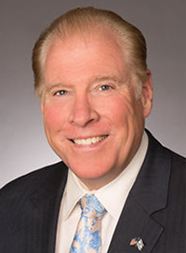
Robert Dean
Robert Dean, “Three Arguments for the Cessation of Tongues” (paper, Conservative Theological Society, Fort Worth, TX, 2002), 9.
“[T]he child represents the incomplete knowledge available to the infant, pre-canon church. Just as a child has inadequate knowledge to live as a mature adult, so the pre-canon church lacked a sufficient canon and doctrine to lead the spiritual life of the new Church Age. An adult reaches maturity when he is complete with the knowledge and skills necessary for life. So, too the post canon church has the completed canon of Scripture which is sufficient for every need, every problem, every difficulty in life. Through the learning of the doctrines of the Word under the filling of the Holy Spirit the believer is able to pursue spiritual maturity.”

Slide 74
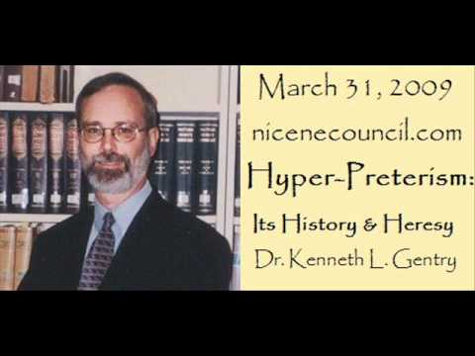
Kenneth Gentry
Robert Dean, “Three Arguments for the Cessation of Tongues” (paper, Conservative Theological Society, Fort Worth, TX, 2002), 9.
“When Paul was in his childhood, he thought as a child was expected to think. But when he became a mature man, he naturally put away childish thought modes. Similarly, when the church was in her infancy, she operated by means of bit by bit piecemeal revelation. But when she grew older, she operated by means of finalized Scripture. Thus, tongues were related to the Church in her infancy stage (cp. 1 Cor. 14:19, 20).”

Slide 75
SLBC Position Statement No. 7
“TEMPORARY SPIRITUAL GIFTS – This church teaches that the miraculous sign gifts, including the gift of tongues, (always the ability to speak in a previously unlearned, known language) along with the gift of healings were temporal gifts, given by the Holy Spirit solely to authenticate both the apostles and their message before the close of the canon of Scripture (1 Cor. 13:8-10). We do not believe that these are active as gifts today. However, we affirm that God is sovereign and may heal and/or give someone the ability to speak in a tongue (foreign language) today. We believe that the majority of what is termed ‘miraculous’ within the contemporary charismatic movement is something other than the Biblical gifts of tongues or healing.”

Slide 76


Slide 77
Strengths of the Completed NT Canon View
Completed NT canon (quantitative) provides a suitable antithesis to “in part” [ek meros] of verses 10, 12 (quantitative)
Teleios is used in James (AD 44‒47) for Scripture (1:25)
The canon view handles well the mirror [esoptron] analogy of verse 12 (Jas. 1:23) since Scripture furnishes us with realistic self assessment (Gal. 3:24; Rom. 5:20; 7:7; Jas. 1:23-25)
The canon view handles well the immediate “now” [arti] of verse 12 and the distant “non” [nyni] of verse 13

Slide 78
A Completed NT Canon is a Suitable Antithesis to Revelation “In Part”
“Is it possible to determine the nature of the partial gifts of prophecy, tongues, and knowledge? Yes. The answer is that they are revelational in quality. Since this is so, then ‘the perfect’ must also be revelational.”
Myron J. Houghton, “A Reexamination of 1 Corinthians 13:8–13,” BibSac 153 (July-September 1996): 350.

Slide 79
A Completed NT Canon is a Suitable Antithesis to Revelation “In Part”
“‘That which is complete’ should logically be of the same kind as ‘that which is partial’ and is therefore most naturally understood as a reference to the completion of revelation for the Church Age.”
Charles R. Smith, Tongues in Biblical Perspective (Winona Lake, IN: BMH, 1972), 75.

Slide 80
Strengths of the Completed NT Canon View
Completed NT canon (quantitative) provides a suitable antithesis to “in part” [ek meros] of verses 10, 12 (quantitative)
Teleios is used in James (AD 44‒47) for Scripture (1:25)
The canon view handles well the mirror [esoptron] analogy of verse 12 (Jas. 1:23) since Scripture furnishes us with realistic self assessment (Gal. 3:24; Rom. 5:20; 7:7; Jas. 1:23-25)
The canon view handles well the immediate “now” [arti] of verse 12 and the distant “non” [nyni] of verse 13

Slide 81
James 1:25
“²⁵ But one who looks intently at the perfect [teleios] law, the law of liberty, and abides by it, not having become a forgetful hearer but an effectual doer, this man will be blessed in what he does.”

Slide 82
Strengths of the Completed NT Canon View
Completed NT canon (quantitative) provides a suitable antithesis to “in part” [ek meros] of verses 10, 12 (quantitative)
Teleios is used in James (AD 44‒47) for Scripture (1:25)
The canon view handles well the mirror [esoptron] analogy of verse 12 (Jas. 1:23) since Scripture furnishes us with realistic self assessment (Gal. 3:24; Rom. 5:20; 7:7; Jas. 1:23-25)
The canon view handles well the immediate “now” [arti] of verse 12 and the distant “non” [nyni] of verse 13

Slide 83
James 1:22-23
“²² But prove yourselves doers of the word, and not merely hearers who delude themselves. ²³ For if anyone is a hearer of the word and not a doer, he is like a man who looks at his natural face in a mirror [esoptron].”

Slide 84
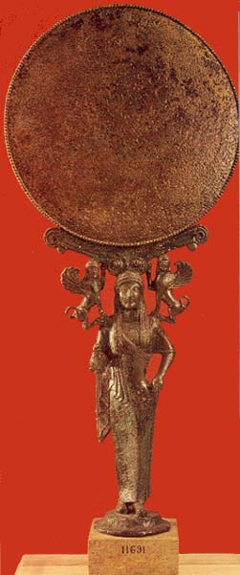
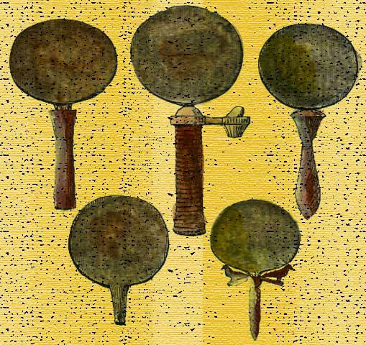
Mirrors at Corinth
“Corinth was famous as the producer of some of the finest bronze mirrors in antiquity.”…“But even the best mirrors reflected images imperfectly.”
Craig S. Keener, The IVP Bible Background Commentary: New Testament (Grove, IL: Inter Varsity Press, 1993), 480; Gordon D. Fee, The First Epistle to the Corinthians, NICNT, ed. F. F. Bruce (Grand Rapids: Eerdmans, 1987), 647-48.

Slide 85
Robert Dean
Robert Dean, “Three Arguments for the Cessation of Tongues” (paper, Conservative Theological Society, Fort Worth, TX, 2002), 11.
“Paul envisioned a time, yet future when believers would have the entire realm of mystery doctrine to objectively know themselves as never before and be spiritually self sustaining. Only God has a complete knowledge of the believer and only with a complete canon can the believer have sufficient, objective knowledge of himself. Through learning and applying doctrine from the completed and sufficient Scripture a mirror is constructed in his soul. This mirror of truth enables the believer to accurately and objectively evaluate his own life and circumstances from the divine viewpoint. Prior to the completed canon the believer could only have an incomplete understanding of who he is and what he possesses as a member of the royal family of God, and all the vast assets that God has provided for him. It is the completed Word of God that provides this sufficient, perspicuous understanding of ourselves as we truly are. Prior to the revelation of the mystery doctrine the believer looked into the mirror of God’s Word dimly and saw a riddle, due to incomplete revelation.”

Slide 86
“Because believers today possess complete revelation, they are able to understand what God’s Word teaches about themselves, their potential, their limitations, and the means that God has made available for them to obtain victory over sin in a clear and detailed manner that was not possible before the completion of the canon. The Scriptures equip a believer for every good work by being profitable for teaching, reproving, correcting, and training (2 Tim 3:16–17).”
Myron J. Houghton, “A Reexamination of 1 Corinthians 13:8–13,” BibSac 153 (July-September 1996): 353.

Slide 87
Strengths of the Completed NT Canon View
Completed NT canon (quantitative) provides a suitable antithesis to “in part” [ek meros] of verses 10, 12 (quantitative)
Teleios is used in James (AD 44‒47) for Scripture (1:25)
The canon view handles well the mirror [esoptron] analogy of verse 12 (Jas. 1:23) since Scripture furnishes us with realistic self assessment (Gal. 3:24; Rom. 5:20; 7:7; Jas. 1:23-25)
The canon view handles well the immediate “now” [arti] of verse 12 and the distant “non” [nyni] of verse 13

Slide 88
1 Corinthians 13:11-13
“¹¹ When I was a child, I used to speak like a child, think like a child, reason like a child; when I became a man, I did away with childish things. ¹² For now [arti] we see in a mirror dimly, but then face to face; now [arti] I know in part, but then I will know fully just as I also have been fully known. ¹³ But now [nyni] faith, hope, love, abide these three; but the greatest of these is love.”

Slide 89
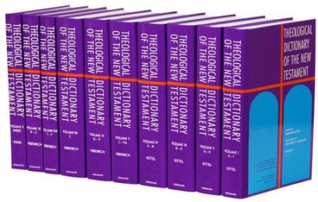
Theological Dictionary of the New Testament (TDNT)
G. Stählin, “Nyn (arti),” in Theological Dictionary of the New Testament, ed. G. Kittel, trans. G.W. Bromiley (Grand Rapids: Eerdmans, 1967), 4:1107 n. 8, and p.111
“How closely ἄρτι and νῦν approximate may be seen from a whole series of expressions which have their roots in either the one or the other. …On the other hand, in the koine ἄρτι may, with νῦν, denote the present strictly as a pt. of time…or as a period of time, e.g., 1 C. 13:12…The most important and frequent use of νῦν in this way is for the period between the comings…it embraces in its fulness the whole of the period.”

Slide 90
Problems with the Canon View Answered
“Face to face” (vs. 12a) refers not to fellowship with God (Judges 6:22) but rather revelation from God (Num. 12:6-8) allowing honest self assessment (Jas. 1:23)
“Knowing as known” (vs. 12b) refers not to omniscience but rather to the Spirit’s illumination (John 16:12-15; 1 Cor. 2:9-15)
Completed NT canon is in the immediate context since Paul understood the notion of an OT canon & was also aware of a limited body of NT inspired writings (1 Tim. 1:12, 14; 6:20; 2 Tim. 4:13; 2 Pet. 3:15)
Whole chapter not for us? All Scripture is for us (Rom. 15:4; 2 Tim. 3:16) but not directly about us

Slide 91
1 Corinthians 13:11-12
“¹¹ When I was a child, I used to speak like a child, think like a child, reason like a child; when I became a man, I did away with childish things. ¹² For now we see in a mirror [esoptron] dimly, but then face to face [prosōpon pros prosōpon] ; now I know in part, but then I will know fully just as I also have been fully known.”

Slide 92
Problems with the Canon View Answered
“Face to face” (vs. 12a) refers not to fellowship with God (Judges 6:22) but rather revelation from God (Num. 12:6-8) allowing honest self assessment (Jas. 1:23)
“Knowing as known” (vs. 12b) refers not to omniscience but rather to the Spirit’s illumination (John 16:12-15; 1 Cor. 2:9-15)
Completed NT canon is in the immediate context since Paul understood the notion of an OT canon & was also aware of a limited body of NT inspired writings (1 Tim. 1:12, 14; 6:20; 2 Tim. 4:13; 2 Pet. 3:15)
Whole chapter not for us? All Scripture is for us (Rom. 15:4; 2 Tim. 3:16) but not directly about us

Slide 93
D. Martyn Lloyd-Jones
D. Martyn Lloyd Jones, Prove All Things, ed. Christopher Catherwood (Eastbourne, England: Kingsway, 1985), 32–33.
“It means that you and I, who have the Scriptures open before us, know much more than the apostle Paul of Gods truth...It means that we are altogether superior...even to the apostles themselves, including the apostle Paul! It means that we are now in a position which . . . ‘we know, even as we are known’ by God . . . indeed, there is only one word to describe such a view, it is nonsense.”

Slide 94
Problems with the Canon View Answered
“Face to face” (vs. 12a) refers not to fellowship with God (Judges 6:22) but rather revelation from God (Num. 12:6-8) allowing honest self assessment (Jas. 1:23)
“Knowing as known” (vs. 12b) refers not to omniscience but rather to the Spirit’s illumination (John 16:12-15; 1 Cor. 2:9-15)
Completed NT canon is in the immediate context since Paul understood the notion of an OT canon & was also aware of a limited body of NT inspired writings (1 Tim. 1:12, 14; 6:20; 2 Tim. 4:13; 2 Pet. 3:15)
Whole chapter not for us? All Scripture is for us (Rom. 15:4; 2 Tim. 3:16) but not directly about us

Slide 95
2 Timothy 3:16-17
“All Scripture is inspired by God and profitable for teaching, for reproof, for correction, for training in righteousness; so that the man of God may be adequate, equipped for every good work.”

Slide 96
Problems with Cessationism Answered
Prophets are predicted in the future (Joel 2:28-32; Rev. 11:3-13)? Israel-Church distinction
Leaves the church without the ability to understand and proclaim Scripture? These revelatory gifts transitioned into edificatory gifts
Cessationists are anti- super-naturalists? Today God miraculously intervenes directly
You are putting God in a box? God’s work is limited based upon the parameters that God Himself has already set (Isa. 64:6: Heb. 6:18)

Slide 97
APOSTOLIC GIFT OF HEALING | HEALING TODAY
No prayer | Prayer
Indirect | Direct
Apostles | Physicians
Instantaneous | Gradual
Common | Less common
Automatic | Non-automatic

Slide 98
Problems with Cessationism Answered
Prophets are predicted in the future (Joel 2:28-32; Rev. 11:3-13)? Israel-Church distinction
Leaves the church without the ability to understand and proclaim Scripture? These revelatory gifts transitioned into edificatory gifts
Cessationists are anti- super-naturalists? Today God miraculously intervenes directly
You are putting God in a box? God’s work is limited based upon the parameters that God Himself has already set (Isa. 64:6: Heb. 6:18)

Slide 99
The Case for Selective Cessationism
Preliminary thoughts
Four categories of gifts
  Foundational (Eph 2:20)
  Confirmatory (Heb 2:3-4)
  Revelatory (Jude 3)
  Edificatory gifts continue (Eph. 4:11-16)
Church history and selective cessationism
Proper operation of the Sign & Revelatory gifts
True source of the charismatic movement
Explanation of the Charismatic movement's popularity

Slide 100
The Case for Selective Cessationism
Preliminary thoughts
Four categories of gifts
  Foundational (Eph 2:20)
  Confirmatory (Heb 2:3-4)
  Revelatory (Jude 3)
  Edificatory gifts continue (Eph. 4:11-16)
Church history and selective cessationism
Proper operation of the Sign & Revelatory gifts
True source of the charismatic movement
Explanation of the Charismatic movement's popularity

Slide 101
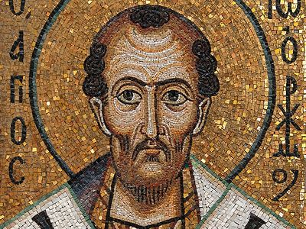
Chrysostom (A.D. 345‒407)
Chrysostom, Homily 29 on First Corinthians.
“This whole place is very obscure: but the obscurity is produced by our ignorance of the facts referred to and by their cessation, being such as then used to occur but now no longer take place. And why do they not happen now? Why look now, the cause too of the obscurity has produced us again another question: namely, why did they then happen, and now do so no more?”

Slide 102
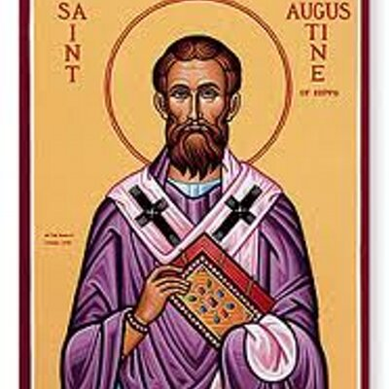
Augustine (A.D. 354‒430)
Augustine, Homily 6:10 on the First Epistle of John.
“In the earliest times, the Holy Ghost fell upon them that believed: and they spoke with tongues, which they had not learned, as the Spirit gave them utterance. Acts 2:4 These were signs adapted to the time. For there behooved to be that betokening of the Holy Spirit in all tongues, to show that the Gospel of God was to run through all tongues over the whole earth. That thing was done for a betokening, and it passed away. . . . If then the witness of the presence of the Holy Ghost be not now given through these miracles, by what is it given, by what does one get to know that he has received the Holy Ghost?”

Slide 103

Schaff
History of the Christian Church, vol. 1 , p. 236-37.
“We do not know how long the glossolalia, as thus described by Paul, continued. It passed away gradually with the other extraordinary or strictly supernatural gifts of the apostolic age. It is not mentioned in the Pastoral, nor in the Catholic Epistles. We have but a few allusions to it at the close of the second century. Irenæus (Adv. Haer. 1. v. c. 6 § 1,) speaks of ‘many brethren’ whom he heard in the church having the gift of prophecy and of speaking in ‘diverse tongues’ (παντοδαπαῖς γλώσσαις), bringing the hidden things of men (τὰ κρύφια τῶν ἀνθρώπων) to light and expounding the mysteries of God (τὰ μυστήρια τοῦ θεοῦ). It is not clear whether by the term ‘diverse,’ which does not elsewhere occur, he means a speaking in foreign languages, or in diversities of tongues altogether peculiar, like those meant by Paul.”

Slide 104
Schaff
History of the Christian Church, vol. 1 , p. 236-37.
“The latter is more probable. Irenæus himself had to learn the language of Gaul. Tertullian (Adv. Marc. V. 8; comp. De Anima, c. 9) obscurely speaks of the spiritual gifts, including the gift of tongues, as being still manifest among the Montanists to whom he belonged. At the time of Chrysostom it had entirely disappeared; at least he accounts for the obscurity of the gift from our ignorance of the fact. From that time on the glossolalia was usually misunderstood as a miraculous and permanent gift of foreign languages for missionary purposes. But the whole history of missions furnishes no clear example of such a gift for such a purpose.”

Slide 105
Conclusion

Slide 106
Ecclesiology Overview
Definition
Universal vs. local
Word pictures
Origin
Israel – Church differences
Intercalation
Purposes
Activities
Government
Officers
Ordinances
Purity

