Slide 1
Law & Grace: An Overview Jim McGowan, Th.D. Sugar Land Bible Church 06-24-2018
…but grace & truth were realized through Jesus Christ - John 1:17
For the Law was given through Moses…
Special thanks to Dr. Vern Peterman for access to his insights and resources.

Slide 2
Session 9 Outline
Review
Purpose, Aim, and Objective
Session 8
Gods Talking to You but that’s Not Good - Part I (Numbers 22)
General Information
Comments & Commentary
Concluding Observations

Slide 3
Session 9 Outline
Review
Purpose, Aim, and Objective
Session 8
Gods Talking to You but that’s Not Good - Part I (Numbers 22)
General Information
Comments & Commentary
Concluding Observations

Slide 4
OUR PURPOSE, AIM AND OBJECTIVE
Law & Grace
…is to Compare and Contrast Law and Grace so as to properly understand these two important themes and how they are related to the life of the New Testament Believer.

Slide 5
C. I. SCOFIELD, D. D.
The Grace of God, The Fundamentals Vol. 3, Chapter VII, p. 98
We have, most of us, been reared and now live under the influence of Galatianism. Protestant theology, alas, is for the most part, thoroughly Galatianized, in that neither law nor grace are given their distinct and separated places, as in the counsels of God, but are mingled together in one incoherent system.
The law is no longer, as in the Divine intent, a ministration of death (2 Cor. 3:7), of cursing (Gal. 3:10), of conviction (Rom. 3:19), because we are taught that we must try to keep it, and that by Divine help we may.
Nor, on the other hand, does grace bring us blessed deliverance from the dominion of sin, for we are kept under the law as a rule of life despite the plain declaration, “Sin shall not have dominion over you: for ye are not under the law, but under grace” (Rom. 6:14). (emphasis mine)

Slide 6
William R. Newell
Romans Verse-by-Verse (p. 274).
Grand Rapids, MI: Christian Classics Ethereal Library.
It is because Reformed theology has kept us Gentiles under the Law,—if not as a means of righteousness, then as “a rule of life,” that all the trouble has arisen. The Law is no more a rule of life than it is a means of righteousness. Walking in the Spirit has now taken the place of walking by ordinances. God has another principle under which He has put his saints: “Ye are not under law, but, under grace!” (italics mine)

Slide 7
Session 9 Outline
Review
Purpose, Aim, and Objective
Session 8
Gods Talking to You but that’s Not Good - Part I (Numbers 22)
General Information
Comments & Commentary
Concluding Observations

Slide 8
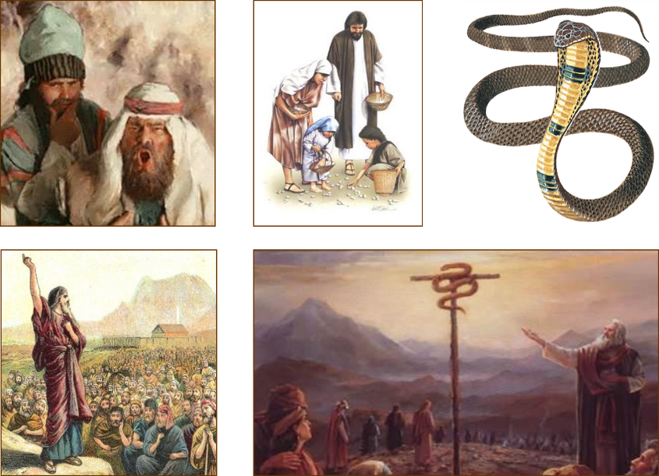
Law & Grace: Lesson 8 Review

Slide 9
Numbers 21:4-9
Law & Grace: Lesson 8 Review
This is the last time that the Children of Israel griped and complained against God and Moses.
The people come to Moses and pick up where they left off in the preceding chapter once again complaining about being hungry and thirsty and directing their ire against both God and Moses.
By this time most of the Children of Israel had grown up eating mostly manna, but now, they refer to it as “this miserable food”.

Slide 10
Numbers 21:4-9
Law & Grace: Lesson 8 Review
“I am the bread of life” is one of 7 ‘I AM’ declarations that Jesus makes in the John 6:35-57.
Jesus made a significant contrast and comparison between ‘the manna’ and Himself, the ‘Bread of Life’.
Those who ate the manna ultimately, all died but those eating the ‘Bread of Life’ have eternal life!
‘Eating the ‘Bread of Life’ is another way to express believing in Christ.

Slide 11
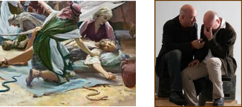
Numbers 21:4-9
Law & Grace: Lesson 8 Review
The Lord chose to send fiery serpents to discipline the Children of Israel, because they murmured against God and Moses.
Although we are under Grace, the Lord loves us and disciplines us in the Church also.
Discipline under Grace is primarily directed at getting believers to walk in fellowship with Him and back on the path of fellowship other believers.
Trials under Grace are used by God in the lives of those who are walking in fellowship with Him, to induce growth and maturity.

Slide 12
Numbers 21:4-9
Law & Grace: Lesson 8 Review
The Lord chose not to directly answer the Children of Israel’s request to remove the serpents, for at least a couple of reasons:
By having Moses place the serpent on a standard, the Children of Israel were confronted with their one and only requirement for deliverance and healing: faith in God’s provision.
By having Moses place the serpent on a standard, God could use this even as an illustration that would point to Christ, God’s one and only provision for spiritual deliverance and healing.

Slide 13
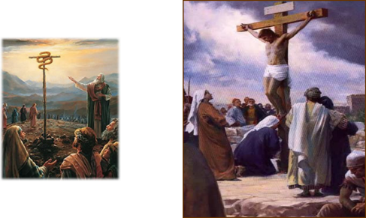
Numbers 21:4-9
Law & Grace: Lesson 8 Review
As the serpent was lifted up, so was Christ lifted up.
The Children of Israel who were bitten were saved physically by looking in faith at God’s provision.
Unbelievers are saved spiritually by looking in faith to God’s provision in Christ.

Slide 14
Numbers 21:4-9
Law & Grace: Lesson 8 Review
It’s always about looking…
The one who has looked to Christ for salvation is transformed into Christ’s image.
Then those who had been looking in faith will one day see Him face to face (1 John 3:2)

Slide 15
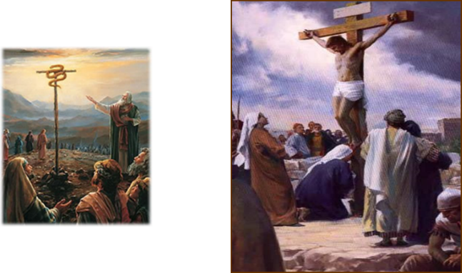
Numbers 21:4-9
Law & Grace: Lesson 8 Review
The bronze serpent didn’t love the Children of Israel.
God and Christ both loved and gave (John3:16; Gal. 2:20; Eph. 5:2, 25)

Slide 17
Session 9 Outline
Review
Purpose, Aim, and Objective
Session 8
Gods Talking to You but that’s Not Good - Part I (Numbers 22)
General Information
Comments & Commentary
Concluding Observations

Slide 18
Numbers 22:1-6
¹ Then the sons of Israel journeyed, and camped in the plains of Moab beyond the Jordan opposite Jericho. ² Now Balak the son of Zippor saw all that Israel had done to the Amorites. ³ So Moab was in great fear because of the people, for they were numerous; and Moab was in dread of the sons of Israel. ⁴ Moab said to the elders of Midian, “Now this horde will lick up all that is around us, as the ox licks up the grass of the field.” And Balak the son of Zippor was king of Moab at that time. ⁵ So he sent messengers to Balaam the son of Beor, at Pethor, which is near the River, in the land of the sons of his people, to call him, saying, “Behold, a people came out of …

Slide 19
Numbers 22:1-6
… behold, they cover the surface of the land, and they are living opposite me. ⁶ “Now, therefore, please come, curse this people for me since they are too mighty for me; perhaps I may be able to defeat them and drive them out of the land. For I know that he whom you bless is blessed, and he whom you curse is cursed.”

Slide 20
Session 9 Outline
Review
Purpose, Aim, and Objective
Session 8
Gods Talking to You but that’s Not Good - Part I (Numbers 22)
General Information
Comments & Commentary
Concluding Observations

Slide 21
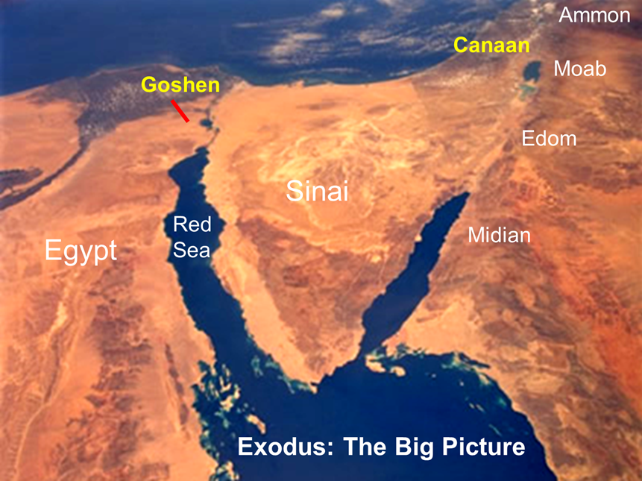
Law & Grace: Lesson 9 Gods Talking to You but that’s Not Good - Part I

Slide 22
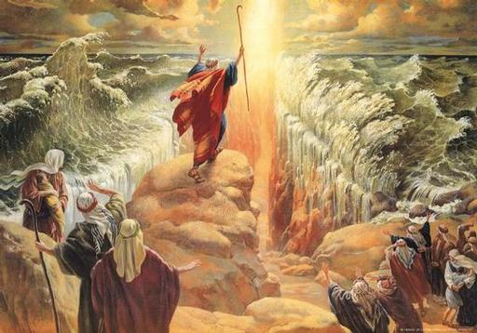
Law & Grace: Lesson 9 Gods Talking to You but that’s Not Good - Part I

Slide 23
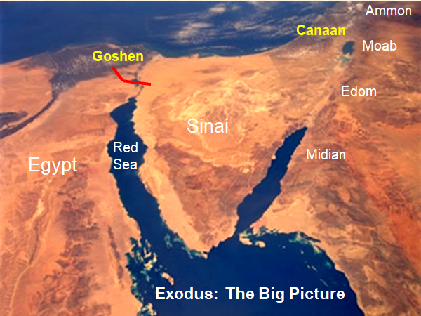
Law & Grace: Lesson 9 Gods Talking to You but that’s Not Good - Part I

Slide 24
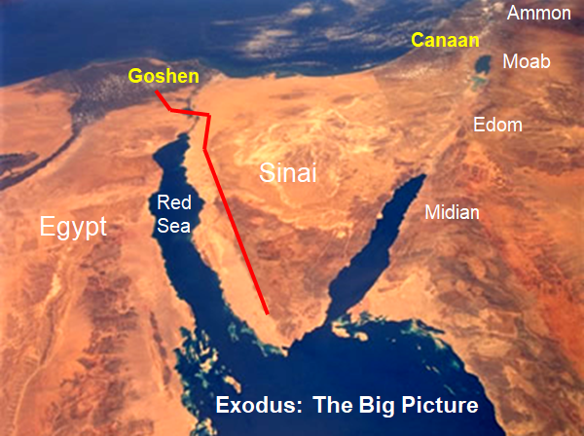
Law & Grace: Lesson 9 Gods Talking to You but that’s Not Good - Part I

Slide 25
Law & Grace: Lesson 9 Gods Talking to You but that’s Not Good - Part I

Slide 26
Law & Grace: Lesson 9 Gods Talking to You but that’s Not Good - Part I

Slide 27
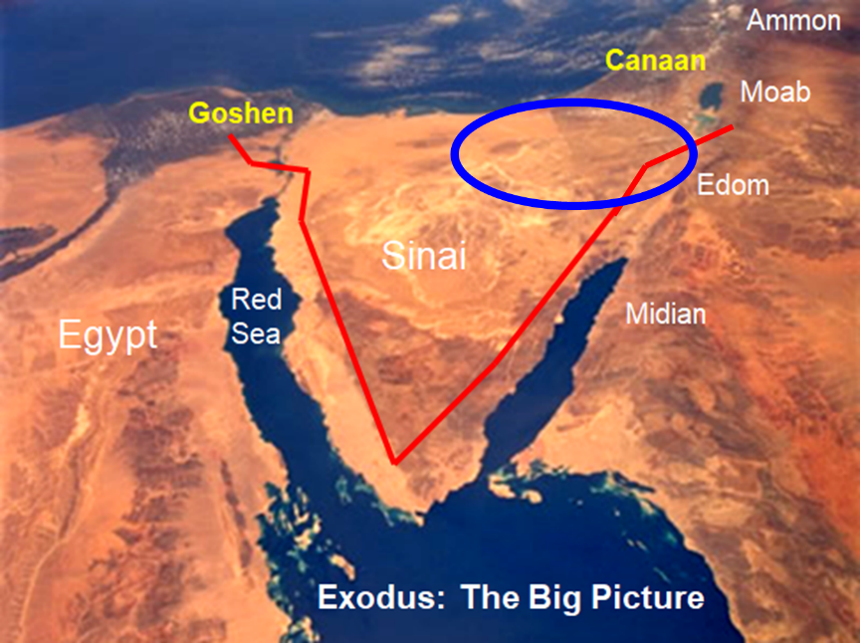
Law & Grace: Lesson 9 Gods Talking to You but that’s Not Good - Part I

Slide 28
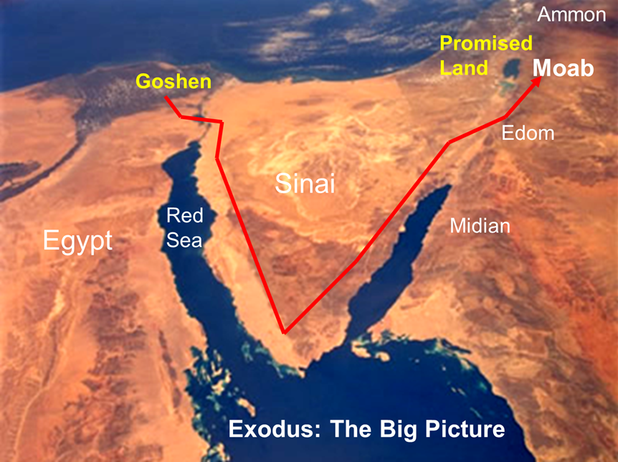
Law & Grace: Lesson 9 Gods Talking to You but that’s Not Good - Part I

Slide 29
A Troubled Family Reunion
Law & Grace: Lesson 9 Gods Talking to You but that’s Not Good - Part I
As the Children of Israel move toward the place where they will enter the land that God promised to them, they are about to cross paths with some distant relatives with whom they have a lot of history in common – the seminomadic Moabites and Midianites.
The Midianites were descended from Abraham and Keturah (Gen. 25:1–6) and the Moabites were descended from Moab, the son of Lot (Abraham’s nephew), born of an incestuous relationship with his oldest daughter (Gen. 19:37).

Slide 30
Session 9 Outline
Review
Purpose, Aim, and Objective
Session 8
Gods Talking to You but that’s Not Good - Part I (Numbers 22)
General Information
Comments & Commentary
Concluding Observations

Slide 31
Numbers 22:1–4
¹ Then the sons of Israel journeyed, and camped in the plains of Moab beyond the Jordan opposite Jericho. ² Now Balak the son of Zippor saw all that Israel had done to the Amorites. ³ So Moab was in great fear because of the people, for they were numerous; and Moab was in dread of the sons of Israel. ⁴ Moab said to the elders of Midian, “Now this horde will lick up all that is around us, as the ox licks up the grass of the field.” And Balak the son of Zippor was king of Moab at that time.

Slide 32
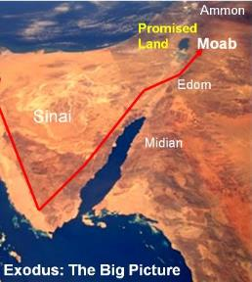
FEAR NOT? OR FEAR A LOT?
Law & Grace: Lesson 9 Gods Talking to You but that’s Not Good - Part I
By this time, the Children of Israel defeated Sihon, King of the Amorites, (who had previously defeated Moab - Num. 21:26), and another nearby ruler, Og the king of Bashan (Num. 21:33-35).
The Moabites were most likely counting on Sihon, to take care of Israel too, so, Balak, king of Moab, took notice.

Slide 33
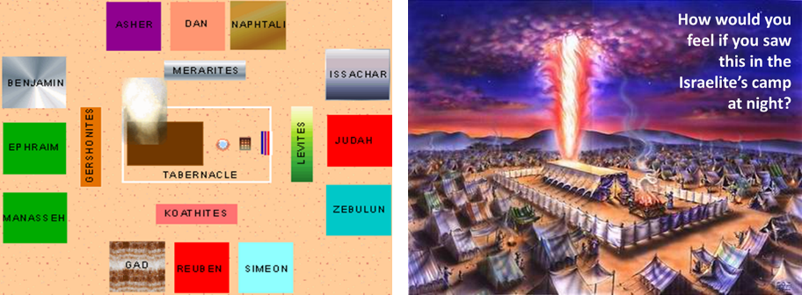
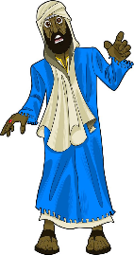
Law & Grace: Lesson 9 Gods Talking to You but that’s Not Good - Part I
FEAR NOT? OR FEAR A LOT?

Slide 34
Law & Grace: Lesson 9 Gods Talking to You but that’s Not Good - Part I
Balak is deeply concerned
Numbers 22:1-6
Having seen that the neighboring Amorites are so severely beaten, Balak is concerned that he, as king of the tribal kingdom of Moab, will likewise be defeated by the Children of Israel.
You can hear the hopelessness in his declaration in v.4, “Now this horde will lick up all that is around us, as the ox licks up the grass of the field.”

Slide 35
Numbers 22:5–6
⁵ So he sent messengers to Balaam the son of Beor, at Pethor, which is near the River, in the land of the sons of his people, to call him, saying, “Behold, a people came out of Egypt; behold, they cover the surface of the land, and they are living opposite me. ⁶ “Now, therefore, please come, curse this people for me since they are too mighty for me; perhaps I may be able to defeat them and drive them out of the land. For I know that he whom you bless is blessed, and he whom you curse is cursed.”

Slide 36
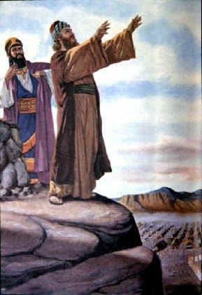
Law & Grace: Lesson 9 Gods Talking to You but that’s Not Good - Part I
Balak is deeply concerned
Numbers 22:1-6
Balak the king of the tribal kingdom of Moab hires the best pagan soothsayer in the business to place a curse on the Children of Israel, so that he can hope to overpower them: Balaam, son of Beor.
* Note that the Old Testament never calls Balaam a prophet or seer but a diviner or soothsayer (Josh. 13:22), a title never used to describe true prophets of Yahweh.

Slide 37
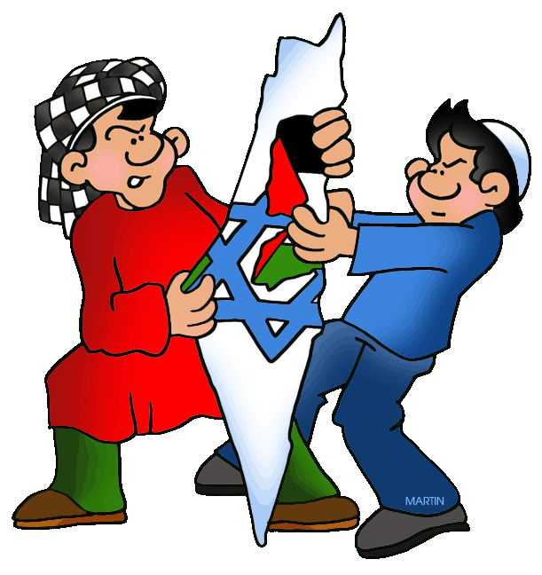
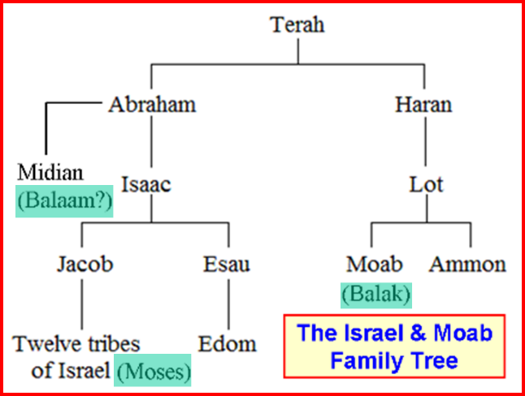
Law & Grace: Lesson 9 Gods Talking to You but that’s Not Good - Part I
Who is Balaam?
Numbers 22:1-6

Slide 38
Law & Grace: Lesson 9 Gods Talking to You but that’s Not Good - Part I
Who is Balaam?
Numbers 22:1-6
Balaam the son of Beor was a very well-known pagan soothsayer in his day, and even for some centuries afterward.
Evidence for his existence in 1967 was found in Jordan at an excavation site known as Tell Deir Alla, on the east side of the Jordan River.
There, in a nearby temple the inscription “Balaam, son of Beor” was found written three times.

Slide 39
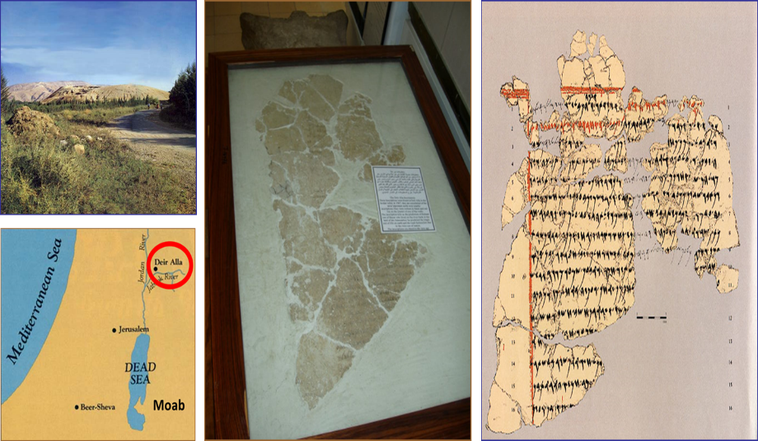
Law & Grace: Lesson 9 Gods Talking to You but that’s Not Good - Part I
Who is Balaam?
Numbers 22:1-6

Slide 40
Law & Grace: Lesson 9 Gods Talking to You but that’s Not Good - Part I
Balaam a relative of Abraham - Probably
Numbers 22:1-6
Some believe and teach that Balaam is from Mesopotamia, but:
The Moabites and the Midianites are the only people groups mentioned. Mesopotamia is not mentioned anywhere in the account.
Fetching Balaam from Mesopotamia, 400 miles away, and bringing him back to the region of Midian/Moab would have taken a minimum of several weeks. The urgency of Balak’s request does not allow for this.
Balaam is killed among the Midianites (Num. 31:1-12), not in Mesopotamia.

Slide 41
Law & Grace: Lesson 9 Gods Talking to You but that’s Not Good - Part I
Balaam a relative of Abraham - Probably
Numbers 22:1-6
The location of the temple at Deir Alla, Jordan is consistent with a Moab/Midianite location and the Balaam script is Ammonite by language and by location.
The Deir Alla inscription is associated with a Moabite deity not Mesopotamian. (Zondervan Handbook of Biblical Archaeology (Price and House), 2017, pg. 101). The deity was not Egyptian or a primary Mesopotamian deity (Zondervan Illustrated Bible Backgrounds Commentary Old Testament, pgs. 385-6).
There is no mention of Balaam, son of Beor in the archaeology or literature of Mesopotamia.

Slide 42
Law & Grace: Lesson 9 Gods Talking to You but that’s Not Good - Part I
Balaam a relative of Abraham - Probably
Numbers 22:1-6
Because it seems a bit unlikely that the Moabite king Balak sent all the way to Assyria for a prophet, and that Balaam hence came all the way to Canaan on a donkey (although there was plenty traffic between these locations) scholars have been looking for ways to place him closer.
In 1989 a tablet was found at the same location (Tell Deir Alla), which seemed to bear the name Pethor. Many conclude that the Two Rivers mentioned in Deuteronomy 23:4 may very well refer to the Jabbok and the Jordan. (http://www.abarim-publications.com/Meaning/Pethor.html#.Wy_NkSBOnD5)

Slide 43
Numbers 22:7–21
⁷ So the elders of Moab and the elders of Midian departed…and they came to Balaam…¹² God said to Balaam, “Do not go with them; you shall not curse the people, for they are blessed.” ¹³ So Balaam arose in the morning and said to Balak’s leaders, “Go back to your land, for the Lord has refused to let me go with you.”… ¹⁵ Then Balak again sent leaders, more numerous and more distinguished than the former… ²⁰ God came to Balaam at night and said to him, “If the men have come to call you, rise up and go with them; but only the word which I speak to you shall you do.” ²¹ So Balaam arose in the morning, and saddled his donkey and went with the leaders of Moab.

Slide 44
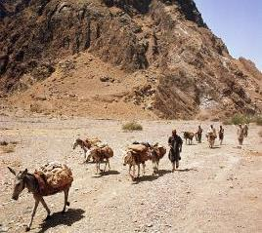
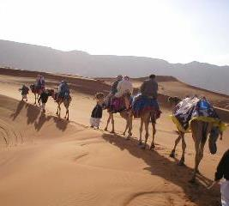
Law & Grace: Lesson 9 Gods Talking to You but that’s Not Good - Part I
Balak sends messengers to Balaam
Numbers 22:7-21
Balak sends one set of messengers to Balaam, asking Balaam to curse the Children of Israel, but God tells Balaam not to go, and not to curse the people because they are blessed [by God].
When Balaam refuses to go Balak sends another set of messengers, and God permits Balaam to go, but tells him to say only what the Lord directs Him to say, and nothing else. (v. 20)

Slide 45
Law & Grace: Lesson 9 Gods Talking to You but that’s Not Good - Part I
God is angry at Balaam for going!
Numbers 22:22-35
Why is God angry at Balaam for going when God told Balaam he to go?
We will offer more insight into this in our next session, but here is a spoiler, Balaam had bad motives.

Slide 46
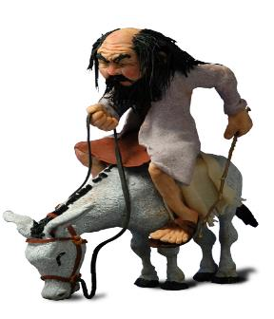
Law & Grace: Lesson 9 Gods Talking to You but that’s Not Good - Part I
God is angry at Balaam for going!
Numbers 22:22-35
The Lord intervenes as Balaam travels and it starts with Balaam’s donkey taking a detour into a nearby field, and we see why in v. 22…

Slide 47
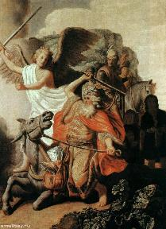
Numbers 22:22
But God was angry because he was going, and the angel of the LORD took his stand in the way as an adversary against him. Now he was riding on his donkey and his two servants were with him.

Slide 48
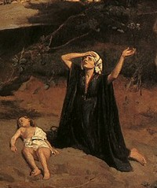
Law & Grace: Lesson 9 Gods Talking to You but that’s Not Good - Part I
“the angel of the Lord”
Numbers 22:22-35
The “angel of the Lord” speaks as God and does things that God does (Genesis 16:7-12; 21:17-18; 22:11-18; Exodus 3:2; Judges 2:1-4; 5:23; 6:11-24; 13:3-22; 2 Samuel 24:16; Zechariah 1:12; 3:1; 12:8).
In this account with Balaam, we see the angel of Lord speaking as God.

Slide 49
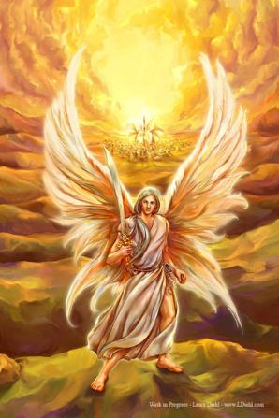
Law & Grace: Lesson 9 Gods Talking to You but that’s Not Good - Part I
“the angel of the Lord”
Numbers 22:22-35
Since appearances of the angel of the Lord end at Christ’s birth, we take the angel of the Lord to be the pre-incarnate Son of God.

Slide 50
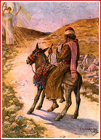
Numbers 22:23-24
²³ When the donkey saw the angel of the LORD standing in the way with his drawn sword in his hand, the donkey turned off from the way and went into the field; but Balaam struck the donkey to turn her back into the way. ²⁴ Then the angel of the LORD stood in a narrow path of the vineyards, with a wall on this side and a wall on that side.

Slide 51
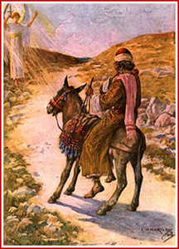
Law & Grace: Lesson 9 Gods Talking to You but that’s Not Good - Part I
“the angel of the Lord”
Numbers 22:22-35
The donkey sees the angel the Lord but Balaam, the soothsayer, does not!

Slide 52
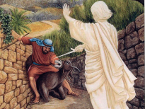
Numbers 22:25-28
²⁵ When the donkey saw the angel of the LORD, she pressed herself to the wall and pressed Balaam’s foot against the wall, so he struck her again. ²⁶ The angel of the LORD went further, and stood in a narrow place where there was no way to turn to the right hand or the left. ²⁷ When the donkey saw the angel of the LORD, she lay down under Balaam; so Balaam was angry and struck the donkey with his stick…

Slide 53
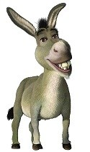
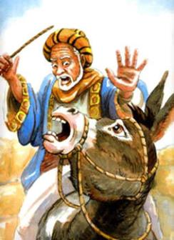
Numbers 22:28
…And the LORD opened the mouth of the donkey, and she said to Balaam, “What have I done to you, that you have struck me these three times?”

Slide 54
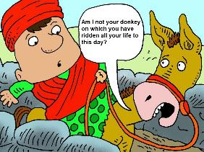
Numbers 22:29-30
²⁹ Then Balaam said to the donkey, “Because you have made a mockery of me! If there had been a sword in my hand, I would have killed you by now.” ³⁰ The donkey said to Balaam, “Am I not your donkey on which you have ridden all your life to this day? Have I ever been accustomed to do so to you?” And he said, “No.”

Slide 55
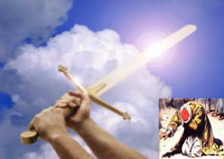
Numbers 22:31-32
³¹ Then the LORD opened the eyes of Balaam, and he saw the angel of the LORD standing in the way with his drawn sword in his hand; and he bowed all the way to the ground. ³² The angel of the LORD said to him, "Why have you struck your donkey these three times? Behold, I have come out as an adversary, because your way was contrary to me.

Slide 56
Numbers 22:33-35
³³ "But the donkey saw me and turned aside from me these three times. If she had not turned aside from me, I would surely have killed you just now, and let her live.” ³⁴ Balaam said to the angel of the LORD, "I have sinned, for I did not know that you were standing in the way against me. Now then, if it is displeasing to you, I will turn back." ³⁵ But the angel of the LORD said to Balaam, "Go with the men, but you shall speak only the word which I tell you." So Balaam went along with the leaders of Balak.

Slide 57
Law & Grace: Lesson 9 Gods Talking to You but that’s Not Good - Part I
Balaam Obeys the Lord!
Numbers 22:36-24:25
The Lord has made it abundantly clear that Balaam is to only bless these people.
Later, in Num. 23-25, Balak leads Balaam to various places where Israel’s camp is in view, in the hope that Balaam will curse Israel.
However, Balaam proceeds to speak blessings on Israel which was not at all what Balak had in mind. We’ll take a look at that in our next session.

Slide 58
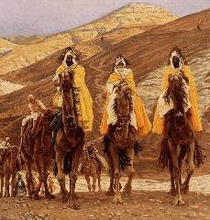
Law & Grace: Lesson 9 Gods Talking to You but that’s Not Good - Part I
Balaam Obeys the Lord!
Numbers 22:36-24:25
Balaam’s several prophecies include statements that are true about God’s character (God does not lie Numbers 23:19) and he even prophesies about the star and scepter (Numbers 24:17).
These prophesies were recorded and passed down to the New Testament where we find the Magi actually looking for the star that Balaam prophesied about.

Slide 59
Session 9 Outline
Review
Purpose, Aim, and Objective
Session 8
Gods Talking to You but that’s Not Good - Part I (Numbers 22)
General Information
Comments & Commentary
Concluding Observations

Slide 60
Law & Grace: Lesson 9 Gods Talking to You but that’s Not Good - Part I
Just because God allows it…
Numbers 22-24
God will allow us to do things that are not what He desires for us or intends for us.
But it is far better that we seek His will through prayer, His word, and by counsel and example in the church body.

Slide 61
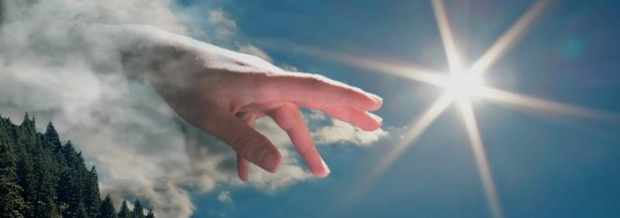
Law & Grace: Lesson 9 Gods Talking to You but that’s Not Good - Part I
Just because God allows it…
Numbers 22-24
Attempting to ‘force’ God’s hand or ‘expecting’ Him to intervene to stop us from doing the wrong thing or strong-arm us into doing the right thing shows a lack of understanding regarding His character and processes for our spiritual growth and maturity.

Slide 62
Law & Grace: Lesson 9 Gods Talking to You but that’s Not Good - Part I
At odds with God’s purposes
Numbers 22-24
Balak, the Moabite King, expected Balaam to curse the Children of Israel, but they were already under God’s clear promise to Abraham (Genesis 12:1-3).
Playing into King Balak’s expectations was a problem and in our next session we will see that it continues to be a problem for Balaam.

Slide 63
Genesis 12:1-3
¹ Now the Lord said to Abram, “Go forth from your country, And from your relatives And from your father’s house, To the land which I will show you; ² And I will make you a great nation, And I will bless you, And make your name great; And so you shall be a blessing; ³ And I will bless those who bless you, And, the one who curses you I will curse. And in you all the families of the earth will be blessed.”

Slide 64
Law & Grace: Lesson 9 Gods Talking to You but that’s Not Good - Part I
At odds with God’s purposes
Numbers 22-24
What expectations do others have of us? What do they expect us to do and not do? What spiritual and moral consequences might those expectations have in our lives?

Slide 65
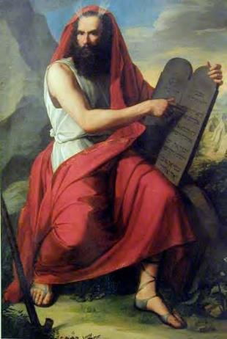
Law & Grace: Lesson 9 Gods Talking to You but that’s Not Good - Part I
At odds with God’s purposes
Numbers 22-24
Israel’s obedience to the Law of Moses would be the basis for them to be blessed or cursed – not the curse that Balaam was being expected to cast (Deuteronomy 28).
No man can curse Israel and go uncursed him/her self.

Slide 66
BLESSINGS UNDER THE LAW
Deuteronomy 28:1-11
¹ "Now it shall be, if you diligently obey the LORD your God, …² All these blessings will come upon you and overtake you if you obey the LORD your God: ³ Blessed shall you be in the city, and blessed shall you be in the country...⁸ “The LORD will command the blessing upon you…and He will bless you in the land which the LORD your God gives you…¹¹ “The LORD will make you abound in prosperity,…in the land which the LORD swore to your fathers to give you."

Slide 67
CURSES UNDER THE LAW
Deuteronomy 28:15-63
¹⁵ "But it shall come about, if you do not obey the LORD your God,…that all these curses will come upon you and overtake you: ¹⁶ Cursed shall you be in the city, and cursed shall you be in the country…²¹ “The LORD will make the pestilence cling to you until He has consumed you from the land where you are entering to possess it…⁶³ “It shall come about that as the LORD delighted over you to prosper you, and multiply you, so the LORD will delight over you to make you perish and destroy you; and you will be torn from the land where you are entering to possess it."

Slide 68
Law & Grace: Lesson 9 Gods Talking to You but that’s Not Good - Part I
Is the Church Blessed & Cursed in this Manner?
Ephesians 1:3
No! Israel’s blessings and curses are conditioned on “diligently obey[ing] the LORD” and “do[ing] all His commandments”! (28:1)
But the Apostle Paul wrote to the church at Ephesus, in Ephesians 1:3:

Slide 69
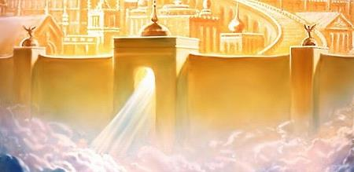
Ephesians 1:3
Blessed be the God and Father of our Lord Jesus Christ, who has blessed us with every spiritual blessing in the heavenly places in Christ…

Slide 70
Law & Grace: Lesson 9 Gods Talking to You but that’s Not Good - Part I
Is the Church Blessed & Cursed in this Manner?
Ephesians 1:3
The Apostle Paul explains what our blessings are in chapters 1-3. In chapters 4-6 he deals with issues of progressive sanctification.

Slide 71
Law & Grace: Lesson 9 Gods Talking to You but that’s Not Good - Part I
Contrasting Israel and the Church
On the one hand, blessings for the Church Age believer are fixed and certain now.
While on the other hand, blessings for Israel as expressed in Deut. 28:1-14, are always conditional.

Slide 72
Law & Grace: Lesson 9 Gods Talking to You but that’s Not Good - Part I
Contrasting Israel and the Church
On the one hand, the Children of Israel were blessed “if”.
While on the other hand, to the Church, “…all the promises of God in [Christ] are Yes, and in [Christ] Amen, to the glory of God…” (2 Cor. 1:20 NKJV)

Slide 73
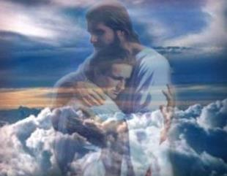
Law & Grace: Lesson 9 Gods Talking to You but that’s Not Good - Part I
Contrasting Israel and the Church
On the one hand, for Israel, the place of blessing is in the land.
While on the other hand, for the Church Age believer, it’s in the heavenly places in Christ, where you are right now! Where you have your citizenship. Where your heart’s home is…

Slide 74
Law & Grace: An Overview Jim McGowan, Th.D. Sugar Land Bible Church 06-24-2018
…but grace & truth were realized through Jesus Christ - John 1:17
For the Law was given through Moses…
Special thanks to Dr. Vern Peterman for access to his insights and resources.

