Slide 1
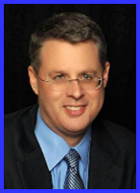
Dr. Andy Woods
Senior Pastor – Sugar Land Bible Church
President – Chafer Theological Seminary

Slide 2
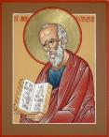
Answering Ten Questions
What is the title – Revelation of Jesus Christ
Who wrote it? – John
Where was it written from? – Patmos
To Whom was it written? – The Seven Churches
When was it written? – A.D. 95
How is it organized (outline)? – 3 part outline
How was it delivered – Seven steps
Why was it written? – Encouragement and holiness
What is it about? – Jesus’ final victory
What makes the book different? – OT relationship

Slide 3
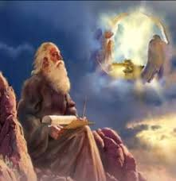
Prologue (Rev. 1:1-8)
Title (1a)
Chain of Communication (1b-2)
Blessing (3)
Author (4a)
Audience (4b)
Greeting (4c)
Source (4d-5a)
Subject (5b-8)

Slide 4
Revelation 1:19
“Therefore write the things which you have seen, and the things which are, and the things which will take place after these things [meta tauta].”

Slide 5
Revelation 1:19
Seen (Chapter 1)
Are (Chapters 2–3)
After these things (Chapters 4–22)

Slide 6
Revelation 1:19
Seen (Chapter 1)
Are (Chapters 2–3)
After these things (Chapters 4–22)

Slide 7
The Things Which You Have Seen (Rev. 1:9-20)
Circumstances of the vision (1:9-11)
Content of the vision (1:12-16)
Communication from Christ to John (1:17-20)

Slide 8
The Things Which You Have Seen (Rev. 1:9-20)
Circumstances of the vision (1:9-11)
Content of the vision (1:12-16)
Communication from Christ to John (1:17-20)

Slide 9
I. Circumstances of the Vision (Rev. 1:9-11)
Place: Patmos (1:9)
Content: Day of the Lord (1:10)
Purpose: Communicate to the Churches (1:11)

Slide 10
I. Circumstances of the Vision (Rev. 1:9-11)
Place: Patmos (1:9)
Content: Day of the Lord (1:10)
Purpose: Communicate to the Churches (1:11)

Slide 11
Three Items in Which John is a Fellow Partaker (synkoinōnos) (Rev. 1:9)
Tribulation (thlipsis)
Kingdom (basileia)
Perseverance (hypomonē)

Slide 12
Three Items in Which John is a Fellow Partaker (synkoinōnos) (Rev. 1:9)
Tribulation (thlipsis)
Kingdom (basileia)
Perseverance (hypomonē)

Slide 13
Pretribulationism is not Escapism
Trials (John 16:33)
Man’s wrath (2 Tim. 3:12)
Satan’s wrath (Eph. 6:11-12)
World’s wrath (John 15:18-19)

Slide 14
Three Items in Which John is a Fellow Partaker (synkoinōnos) (Rev. 1:9)
Tribulation (thlipsis)
Kingdom (basileia)
Perseverance (hypomonē)

Slide 15
Revelation 5:10
“You have made them to be a kingdom and priests to our God; and they will reign [basileuō] upon the earth [gē].”

Slide 16
Revelation 11:15
¹⁵ “Then the seventh angel sounded; and there were loud voices in heaven, saying, ‘The kingdom of the world has become the kingdom of our Lord and of His Christ; and He will reign forever and ever.’”

Slide 17
Dr. Robert Thomas
Revelation 1 to 7: An Exegetical Commentary (Chicago: Moody Press, 1992), 87.
Dr. Robert Thomas observes that, "Little difference of opinion exists over the meaning of basileia [kingdom] in 1:9. It is the millennial kingdom described more fully in Revelation 20.”

Slide 18
Three Items in Which John is a Fellow Partaker (synkoinōnos) (Rev. 1:9)
Tribulation (thlipsis)
Kingdom (basileia)
Perseverance (hypomonē)

Slide 19
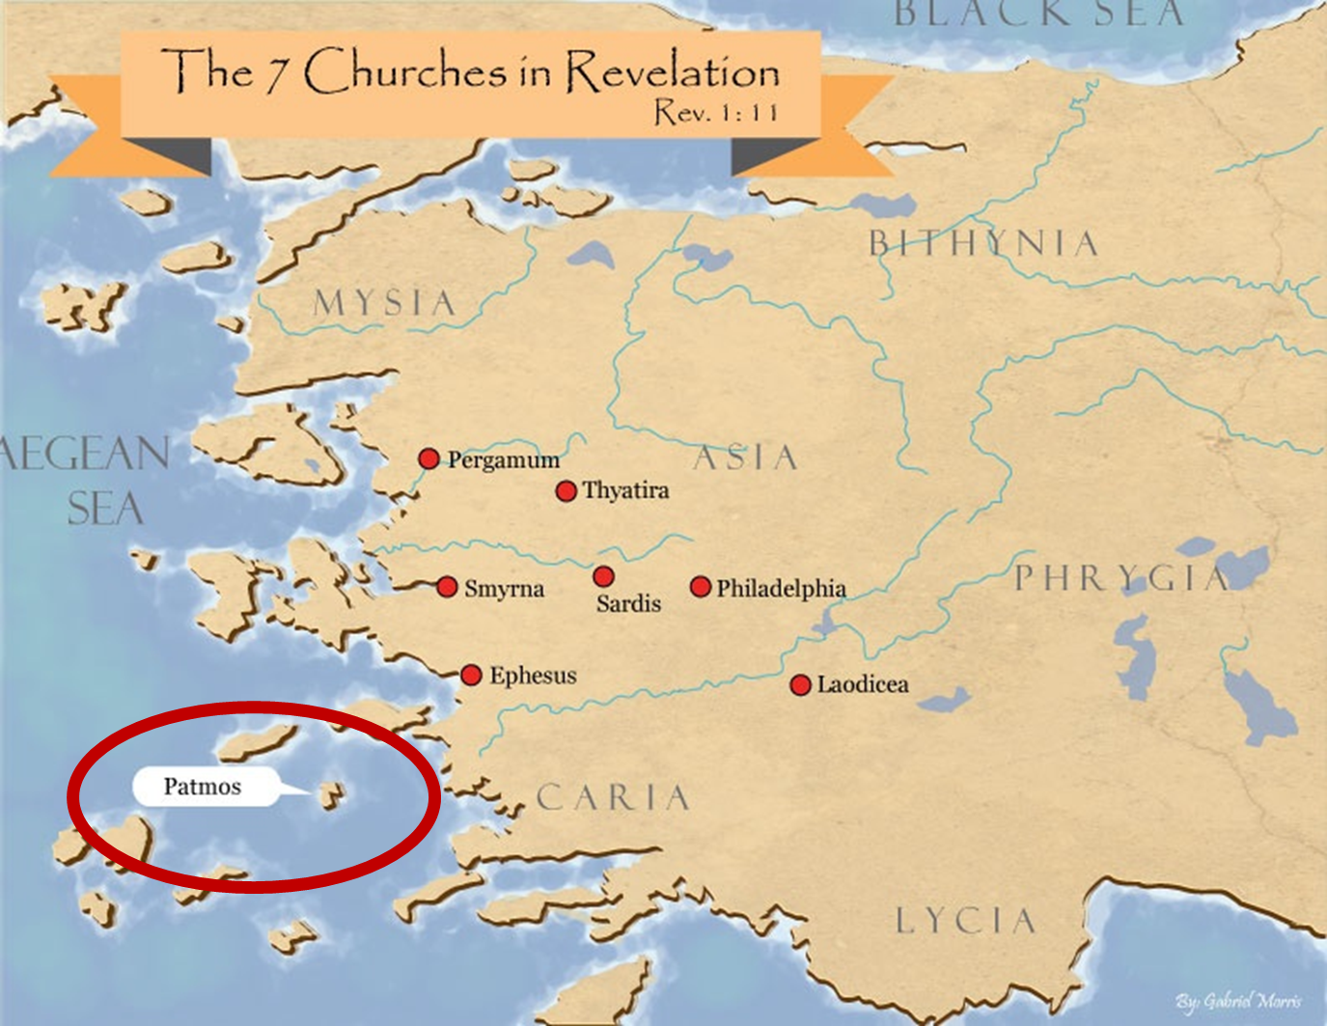

Slide 20
Literal Geography in Revelation Thomas, Revelation 8 to 22: An Exegetical Commentary, 206-207.
Asia | 1:4 | Sardis | 3:1
Patmos | 1:9 | Philadelphia | 3:7
Ephesus | 2:1 | Laodicea | 3:14
Smyrna | 2:8 | Euphrates | 9:14;16:12
Pergamum | 2:12 | Armageddon | 16:16
Thyatira | 2:18 | Babylon | 17:15

Slide 21
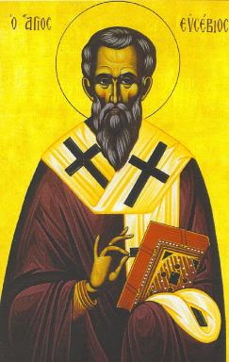
Eusebius Ecclesiastical History, 3.18.4
“…and they even indicated the time accurately, relating that in the fifteenth year of Domitian, Flavia Domitilla, who was the niece of Flavius Clemens, one of the many consuls at Rome at that time, was banished with many others to the island of Pontia as testimony to Christ.”

Slide 22
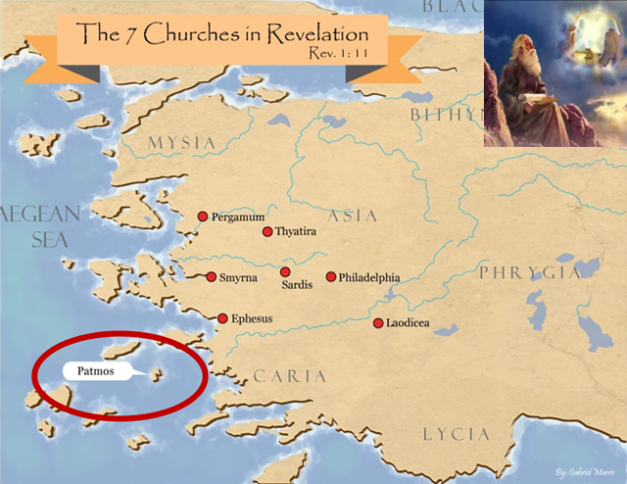
How John Got Exiled on Patmos (Rev. 1:9)
Word (logos)
Testimony (martyria)

Slide 23
I. Circumstances of the Vision (Rev. 1:9-11)
Place: Patmos (1:9)
Content: Day of the Lord (1:10)
Purpose: Communicate to the Churches (1:11)

Slide 24
INSPIRATION OF SCRIPTURE 2 Peter 1:20-21
Men Wrote as they were inspired by Holy Spirit
“phero” = to carry
Acts 27:15,17
Opposite of Knowledge of False Teachers
Which is their own imagination
Jer. 23:16

Slide 25
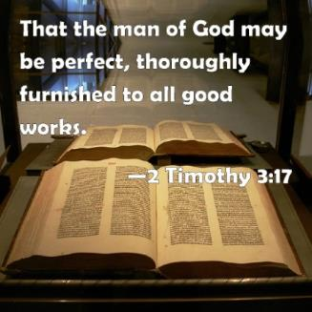
2 Timothy 3:16-17
“All Scripture is inspired by God [theopneustos] and profitable for teaching, for reproof, for correction, for training in righteousness; so that the man of God may be adequate, equipped for every good work.”

Slide 27
I. Circumstances of the Vision (Rev. 1:9-11)
Place: Patmos (1:9)
Content: Day of the Lord (1:10)
Purpose: Communicate to the Churches (1:11)

Slide 28
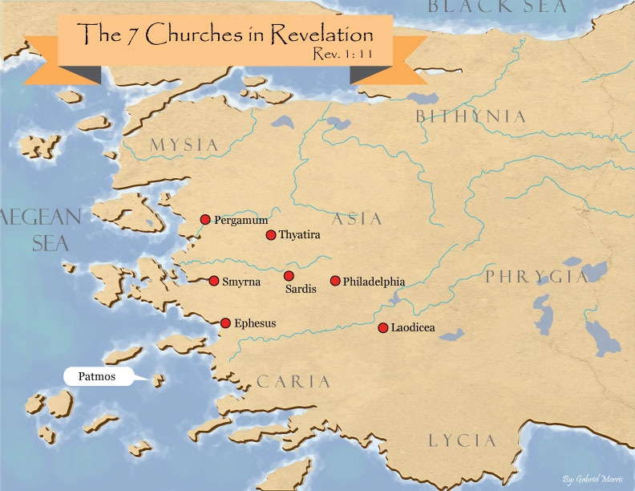

Slide 29
Literal Geography in Revelation Thomas, Revelation 8 to 22: An Exegetical Commentary, 206-207.
Asia | 1:4 | Sardis | 3:1
Patmos | 1:9 | Philadelphia | 3:7
Ephesus | 2:1 | Laodicea | 3:14
Smyrna | 2:8 | Euphrates | 9:14;16:12
Pergamum | 2:12 | Armageddon | 16:16
Thyatira | 2:18 | Babylon | 17:15

Slide 30
The Things Which You Have Seen (Rev. 1:9-20)
Circumstances of the vision (1:9-11)
Content of the vision (1:12-16)
Communication from Christ to John (1:17-20)

Slide 31
II. Content of the Vision (Rev. 1:12-16)
His appearance among the churches (1:12-13a)
His clothing (1:13b-c)
His body (1:14-16)

Slide 32
II. Content of the Vision (Rev. 1:12-16)
His appearance among the churches (1:12-13a)
His clothing (1:13b-c)
His body (1:14-16)

Slide 33
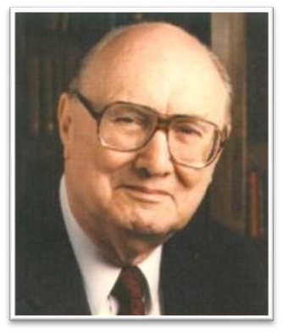
Two Rules of Interpretation
Search the immediate context
Walvoord: 26X
Search the remote context
Old Testament
Thomas: 278 / 404 verses

Slide 35
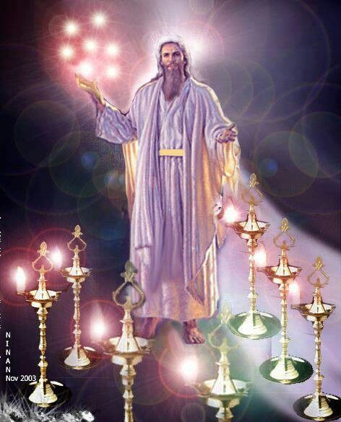

Slide 36
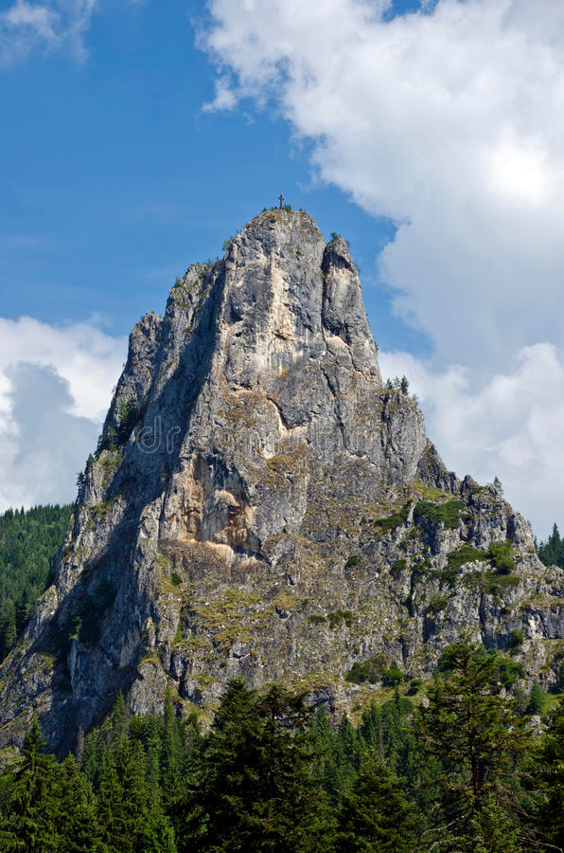
Matthew 16:18
I also say to you that you are Peter, and upon this rock I will build [oikodomeō] My church; and the gates of Hades will not overpower it.

Slide 37
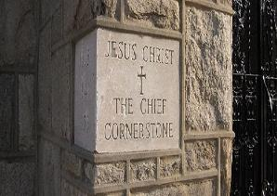
Ephesians 2:20
“having been built on the foundation of the apostles and prophets, Christ Jesus Himself being the corner stone,”

Slide 39
II. Content of the Vision (Rev. 1:12-16)
His appearance among the churches (1:12-13a)
His clothing (1:13b-c)
His body (1:14-16)

Slide 40
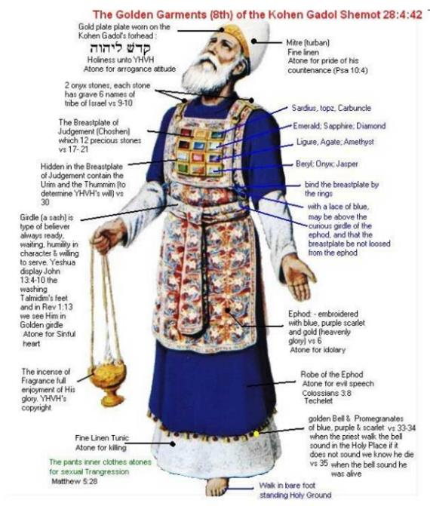

Slide 41
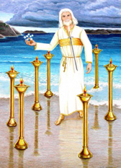
B. His Clothing (Rev. 1:13b-c)
His robe (13b)
His sash (13c)

Slide 42
B. His Clothing (Rev. 1:13b-c)
His robe (13b)
His sash (13c)

Slide 43
B. His Clothing (Rev. 1:13b-c)
His robe (13b)
His sash (13c)

Slide 44
II. Content of the Vision (Rev. 1:12-16)
His appearance among the churches (1:12-13a)
His clothing (1:13b-c)
His body (1:14-16)

Slide 45
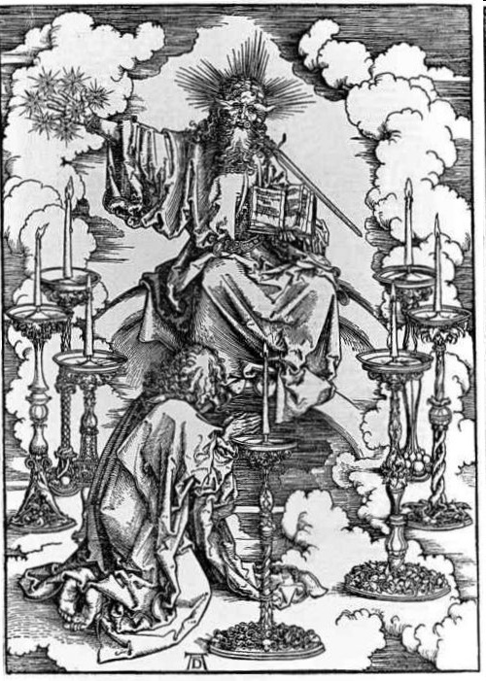
C. His Body (Rev. 1:14-16)
His hair (14a)
His eyes (14b)
His feet (15a)
His voice (15b)
His right hand (16a)
His mouth (16b)
His face (16c)

Slide 46
C. His Body (Rev. 1:14-16)
His hair (14a)
His eyes (14b)
His feet (15a)
His voice (15b)
His right hand (16a)
His mouth (16b)
His face (16c)

Slide 48
Two Rules of Interpretation
Search the immediate context
Walvoord: 26X
Search the remote context
Old Testament
Thomas: 278 / 404 verses

Slide 49
Method of Communication
From the Father
to Christ the Son
to an angel
to John
to a book
to a reader or preacher
to a listener or the seven churches

Slide 50
C. His Body (Rev. 1:14-16)
His hair (14a)
His eyes (14b)
His feet (15a)
His voice (15b)
His right hand (16a)
His mouth (16b)
His face (16c)

Slide 51
The Things Which You Have Seen (Rev. 1:9-20)
Circumstances of the vision (1:9-11)
Content of the vision (1:12-16)
Communication from Christ to John (1:17-20)

Slide 52
III. Communication from Christ to John (Rev. 1:17-20)
John’s reaction to Jesus (1:17a)
Jesus’s comfort of John (1:17b-18)
Jesus’s command to John (1:19-20)

Slide 53
III. Communication from Christ to John (Rev. 1:17-20)
John’s reaction to Jesus (1:17a)
Jesus’s comfort of John (1:17b-18)
Jesus’s command to John (1:19-20)

Slide 54
III. Communication from Christ to John (Rev. 1:17-20)
John’s reaction to Jesus (1:17a)
Jesus’s comfort of John (1:17b-18)
Jesus’s command to John (1:19-20)

Slide 55
B. Jesus’s Comfort to John (Rev. 1:17b-18)
Do not be afraid (1:17b)
I am the first (prōtos) and the last (eschatos) (1:17c)
I have conquered the grave (1:18a)
I have the keys of death and hades (1:18b)

Slide 56
III. Communication from Christ to John (Rev. 1:17-20)
John’s reaction to Jesus (1:17a)
Jesus’s comfort of John (1:17b-18)
Jesus’s command to John (1:19-20)

Slide 57
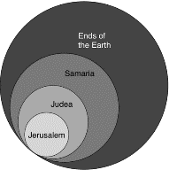
Acts 1:8
“but you will receive power when the Holy Spirit has come upon you; and you shall be My witnesses both in Jerusalem, and in all Judea and Samaria, and even to the remotest part of the earth.”

Slide 58
Revelation 1:19
“Therefore write the things which you have seen, and the things which are, and the things which will take place after these things [meta tauta].”

Slide 59
Revelation 1:19
Seen (Chapter 1)
Are (Chapters 2–3)
After these things (Chapters 4–22)

Slide 60
Revelation 4:1
“After these things [meta tauta] I looked, and behold, a door standing open in heaven, and the first voice which I had heard, like the sound of a trumpet speaking with me, said, ‘Come up here, and I will show you what must take place after these things [meta tauta].’”

Slide 61
“Mystery” Defined
“In the N.T, it [mystērion] denotes, not the mysterious (as with the Eng. word), but that which, being outside the range of unassisted natural apprehension, can be made known only by Divine revelation, and is made known in a manner and at a time appointed by God, and to those who are illumined by His Spirit.”
W. E. Vine, Merrill F. Unger, and William White, Vine's Complete Expository Dictionary of the Old and New Testament Words (Nashville: Nelson, 1996), 424.

Slide 62
Ephesians 3:3-6
“that by revelation there was made known to me the mystery, as I wrote before in brief. ⁴ By referring to this, when you read you can understand my insight into the mystery of Christ, ⁵ which in other generations was not made known to the sons of men, as it has now been revealed to His holy apostles and prophets in the Spirit; ⁶ to be specific, that the Gentiles are fellow heirs and fellow members of the body, and fellow partakers of the promise in Christ Jesus through the gospel”.

Slide 63
Ephesians 3:9
“and to bring to light what is the administration of the mystery which for ages has been hidden in God who created all things.”

Slide 64
Two Rules of Interpretation
Search the immediate context
Walvoord: 26X
Search the remote context
Old Testament
Thomas: 278 / 404 verses

Slide 65
Method of Communication
From the Father
to Christ the Son
to an angel
to John
to a book
to a reader or preacher
to a listener or the seven churches

Slide 66
Conclusion

Slide 67
The Things Which You Have Seen (Rev. 1:9-20)
Circumstances of the vision (1:9-11)
Content of the vision (1:12-16)
Communication from Christ to John (1:17-20)

Slide 68
“The Lord bless you and keep you; the Lord make his face shine on you and be gracious to you; the Lord turn his face toward you and give you peace.” (NIV)

