Slide 1
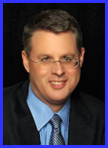
Dr. Andy Woods
Senior Pastor – Sugar Land Bible Church
President – Chafer Theological Seminary

Slide 2
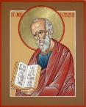
Answering Ten Questions
What is the title – Revelation of Jesus Christ
Who wrote it? – John
Where was it written from? – Patmos
To Whom was it written? – The Seven Churches
When was it written? – A.D. 95
How is it organized (outline)? – 3 part outline
How was it delivered – Seven steps
Why was it written? – Encouragement and holiness
What is it about? – Jesus’ final victory
What makes the book different? – OT relationship

Slide 3
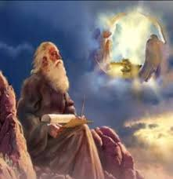
Prologue (Rev. 1:1-8)
Title (1a)
Chain of Communication (1b-2)
Blessing (3)
Author (4a)
Audience (4b)
Greeting (4c)
Source (4d-5a)
Subject (5b-8)

Slide 4
Prologue (Rev. 1:1-8)
Title (1a)
Chain of Communication (1b-2)
Blessing (3)
Author (4a)
Audience (4b)
Greeting (4c)
Source (4d-5a)
Subject (5b-8)

Slide 5
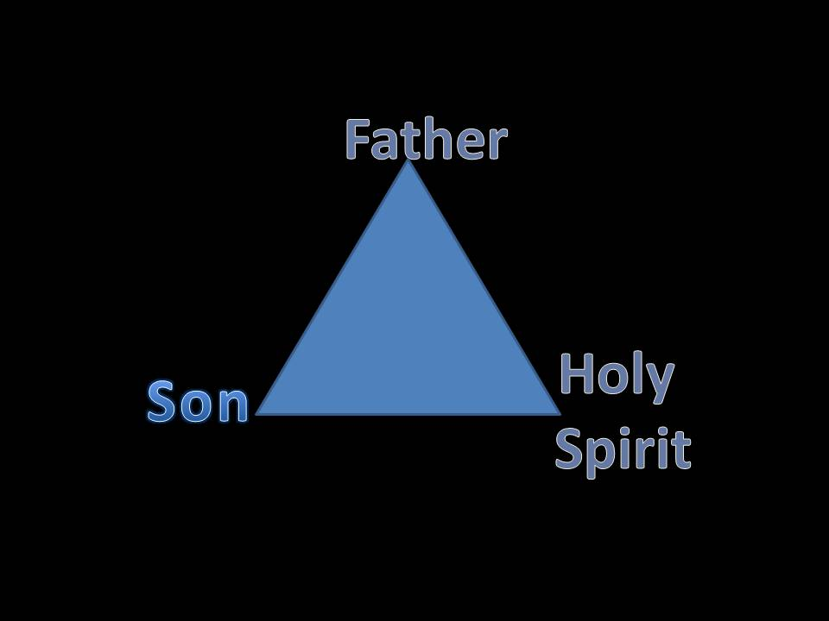
VII. Source of the Message (Rev. 1:4d-5a)
From the Father (4d)
From the Spirit (4e)
From the Son (5a)

Slide 6
VII. Source of the Message (Rev. 1:4d-5a)
From the Father (4d)
From the Spirit (4e)
From the Son (5a)

Slide 7
VII. Source of the Message (Rev. 1:4d-5a)
From the Father (4d)
From the Spirit (4e)
From the Son (5a)

Slide 8
VII. Source of the Message (Rev. 1:4d-5a)
From the Father (4d)
From the Spirit (4e)
From the Son (5a)

Slide 9
Revelation 1:1
“The Revelation of Jesus Christ, which God gave Him to show to His bond-servants, the things which must soon take place; and He sent and communicated it by His angel to His bond-servant John.”

Slide 10
Revelation 19:10
“Then I fell at his feet to worship him. But he said to me, ‘Do not do that; I am a fellow servant of yours and your brethren who hold the testimony of Jesus; worship God. For the testimony of Jesus is the spirit of prophecy.’”

Slide 11
Prologue (Rev. 1:1-8)
Title (1a)
Chain of Communication (1b-2)
Blessing (3)
Author (4a)
Audience (4b)
Greeting (4c)
Source (4d-5a)
Subject (5b-8)

Slide 12
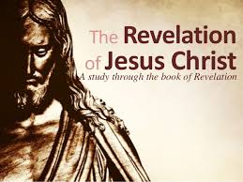
VII. Subject of the Message (Rev. 1:5b-8)
Who He is (5d-e)
His past work (5f-6)
His future work (7)
His sovereignty (8)

Slide 13
VII. Subject of the Message (Rev. 1:5b-8)
Who He is (5d-e)
His past work (5f-6)
His future work (7)
His sovereignty (8)

Slide 14
A. Who He is (Rev. 1:5b-e)
Faithful witness (5b)
First born from the dead (5c)
Ruler of the Kings of the Earth (5d)
The One who loves us (5e)

Slide 15
A. Who He is (Rev. 1:5b-e)
Faithful witness (5b)
First born from the dead (5c)
Ruler of the Kings of the Earth (5d)
The One who loves us (5e)

Slide 16
A. Who He is (Rev. 1:5b-e)
Faithful witness (5b)
First born from the dead (5c)
Ruler of the Kings of the Earth (5d)
The One who loves us (5e)

Slide 17
A. Who He is (Rev. 1:5b-e)
Faithful witness (5b)
First born from the dead (5c)
Ruler of the Kings of the Earth (5d)
The One who loves us (5e)

Slide 18
Names & Titles Demonstrating Satan’s Post-Fall, Earthly Authority (Job 1:7; 2:2; Luke 4:5-8; Rom. 8:19-22)
Prince of this world (John 12:31; 14:30; 16:11)
God of this age (2 Cor. 4:4)
Prince and power of the air (Eph. 2:2)
Who the believer wrestles with (Eph. 6:12)
Roaring lion (1 Pet. 5:8)
Whole world lies in his power (1 John 5:19)

Slide 19
A. Who He is (Rev. 1:5b-e)
Faithful witness (5b)
First born from the dead (5c)
Ruler of the Kings of the Earth (5d)
The One who loves us (5e)

Slide 20
VII. Subject of the Message (Rev. 1:5b-8)
Who He is (5d-e)
His past work (5f-6)
His future work (7)
His sovereignty (8)

Slide 21
B. His Past Work (Rev. 1:5f-6)
Released us from our sins by His blood (5f)
Made us into a Kingdom of Priests (6)

Slide 22
B. His Past Work (Rev. 1:5f-6)
Released us from our sins by His blood (5f)
Made us into a Kingdom of Priests (6)

Slide 23
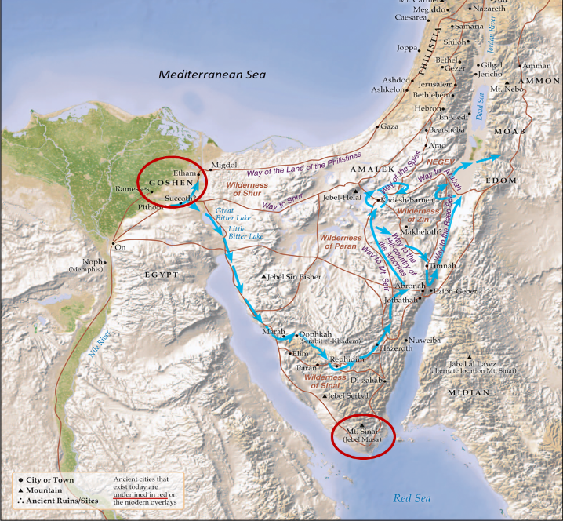

Slide 24
Christ’s Atoning Death
Role of Christ’s blood in the atonement
Acts 20:28
Rom 5:9; Eph 1:7; 2:13; Col 1:20
Heb 9:12, 22; 1 Pet 1:2; 1 John 1:7
Rev 1:5; 5:9; 12:11
Free to us but expensive to Him
Significance of the Lord’s Table (1 Cor 11:23-26)

Slide 25
B. His Past Work (Rev. 1:5f-6)
Released us from our sins by His blood (5f)
Made us into a Kingdom of Priests (6)

Slide 26
Revelation 5:10
“You have made them to be a kingdom and priests to our God; and they will reign [basileuō] upon the earth [gē].”

Slide 27
Revelation 11:15
¹⁵ “Then the seventh angel sounded; and there were loud voices in heaven, saying, ‘The kingdom of the world has become the kingdom of our Lord and of His Christ; and He will reign forever and ever.’”

Slide 28
VII. Subject of the Message (Rev. 1:5b-8)
Who He is (5d-e)
His past work (5f-6)
His future work (7)
His sovereignty (8)

Slide 29
C. His Future Work (Rev. 1:7)
His coming in the clouds (7a)
His revelation to the Gentiles (7b)
His revelation to the Jews (7c)

Slide 30
C. His Future Work (Rev. 1:7)
His coming in the clouds (7a)
His revelation to the Gentiles (7b)
His revelation to the Jews (7c)

Slide 31
Rapture Distinct from Second Advent
Rapture (1 Thess 4:13-17; 1 Cor 15:51-57) | Second Coming (Rev 19:11-16)
Christ comes in the air (1 Thess 4:16) | Christ comes to the earth (Zech 14:4)
For His saints (1 Thess 4:15-17) | With His saints (Rev 19:14)
Blessing (1 Thess 4:18) | Judgment (Rev 19:15)
Effects only believers (1 Thess 4:16) | Effects both believers and unbelievers (Rev 19:15)
Invisible (1 Thess 4:16) | Visible to all (Rev 1:7)
Announced only by an archangel (1 Thess 4:16) | Involves myriads of angels (Jude 14)
Resurrection (1 Cor15: 51) | No resurrection
Rescue of the church (1 Thess 1:10) | Rescue of Israel (Matt 23:37-39)

Slide 32
C. His Future Work (Rev. 1:7)
His coming in the clouds (7a)
His revelation to the Gentiles (7b)
His revelation to the Jews (7c)

Slide 33
C. His Future Work (Rev. 1:7)
His coming in the clouds (7a)
His revelation to the Gentiles (7b)
His revelation to the Jews (7c)

Slide 34
God’s Work Through Israel
Revelation 7 – 144,000 Jews
Revelation 11 – Two Jewish witnesses
Revelation 12 – Israel flees
Revelation 20:9 – Jerusalem in the kingdom
Revelation 21:12 – 13-Gates of the eternal city

Slide 35
VII. Subject of the Message (Rev. 1:5b-8)
Who He is (5d-e)
His past work (5f-6)
His future work (7)
His sovereignty (8)

Slide 36
C. His Sovereignty (Rev. 1:8)
He is the Alpha and Omega (8a)
He is the Eternally Existent One (8b)

Slide 37
C. His Sovereignty (Rev. 1:8)
He is the Alpha and Omega (8a)
He is the Eternally Existent One (8b)

Slide 38
C. His Sovereignty (Rev. 1:8)
He is the Alpha and Omega (8a)
He is the Eternally Existent One (8b)

Slide 39
Conclusion

Slide 40
Prologue (Rev. 1:1-8)
Title (1a)
Chain (1b-2)
Blessing (3)
Author (4a)
Audience (4b)
Greeting (4c)
Source (4d-5a)
Subject (5b-8)

Slide 41
“The Lord bless you and keep you; the Lord make his face shine on you and be gracious to you; the Lord turn his face toward you and give you peace.” (NIV)

