Slide 1

Ecclesiology
Session 25
Dr. Andy Woods
Senior Pastor – Sugar Land Bible Church
President – Chafer Theological Seminary

Slide 2
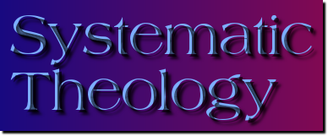

Areas of Systematic Theology
Prolegomena – Introduction
Theology – Study of God
Christology – Study of Christ
Pneumatology – Study of the Holy Spirit
Anthropology – Study of Man
Hamartiology – Study of sin
Soteriology – Study of salvation
Angelology – Study of angels
Ecclesiology – Study of the Church
Eschatology – Study of the end

Slide 3
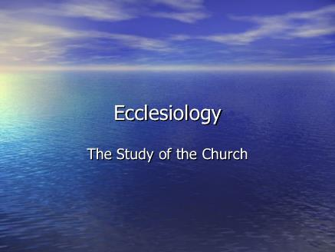
Ecclesiology Overview
Definition
Universal vs. local
Word pictures
Origin
Israel – Church differences
Intercalation
Purposes
Activities
Government
Officers
Ordinances
Purity

Slide 4

VII. Purposes of the Local Church
Glorify God (Eph 3:21)
Edify the saints (Eph 4:11-16)
Fulfill the Great Commission (Matt 28:18-20)

Slide 5
VII. Purposes of the Local Church
Glorify God (Eph 3:21)
Edify the saints (Eph 4:11-16)
Fulfill the Great Commission (Matt 28:18-20)

Slide 6


2 Timothy 3:16-17
“¹⁶ All Scripture is inspired by God and profitable for teaching, for reproof, for correction, for training in righteousness; ¹⁷ so that the man of God may be adequate, equipped for every good work.”

Slide 7
Ephesians 4:11-16
“¹¹ And He gave some as apostles, and some as prophets, and some as evangelists, and some as pastors and teachers, ¹² for the equipping of the saints for the work of service, to the building up of the body of Christ;”

Slide 8

Spiritual Gifts

Slide 9
Areas of Systematic Theology
Prolegomena – Introduction
Theology – Study of God
Christology – Study of Christ
Pneumatology – Study of the Holy Spirit
Anthropology – Study of Man
Hamartiology – Study of sin
Soteriology – Study of salvation
Angelology – Study of angels
Ecclesiology – Study of the Church
Eschatology – Study of the end

Slide 10
Four Questions
What are some general observations about spiritual gifts?
Are all the spiritual gifts for today?
What are the spiritual gifts?
How do we discover our own unique area of gifting?

Slide 11
Four Questions
What are some general observations about spiritual gifts?
Are all the spiritual gifts for today?
What are the spiritual gifts?
How do we discover our own unique area of gifting?

Slide 12
Four Questions
What are some general observations about spiritual gifts?
Are all the spiritual gifts for today?
What are the spiritual gifts?
How do we discover our own unique area of gifting?

Slide 13
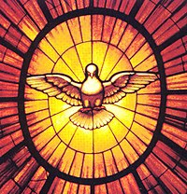
The Case for Selective Cessationism
Preliminary thoughts
Four categories of gifts
  Foundational (Eph 2:20)
  Confirmatory (Heb 2:3-4)
  Revelatory (Jude 3)
  Edificatory gifts continue (Eph. 4:11-16)
Church history and selective cessationism
Proper operation of the Sign & Revelatory gifts
True source of the charismatic movement
Explanation of the Charismatic movement's popularity

Slide 14
The Case for Selective Cessationism
Preliminary thoughts
Four categories of gifts
  Foundational (Eph 2:20)
  Confirmatory (Heb 2:3-4)
  Revelatory (Jude 3)
  Edificatory gifts continue (Eph. 4:11-16)
Church history and selective cessationism
Proper operation of the Sign & Revelatory gifts
True source of the charismatic movement
Explanation of the Charismatic movement's popularity

Slide 15
12/12/4/4
Romans 12
1 Corinthians 12
1 Peter 4
Ephesians 4

Slide 16
The 6 Disputed Gifts
Apostle
Prophet
Worker of Miracles
Tongues
Interpretation of tongues
Healing

Slide 17
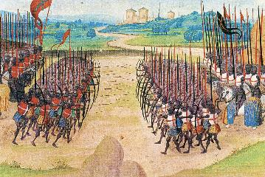
Two Camps
Charismatics – All the spiritual gifts are in operation today
Cessationists (selective)– Most of the spiritual gifts are in operation today

Slide 18
Preamble to Position Statements of SLBC Constitution
“Although agreement with the POSITION STATEMENTS is not required for membership, they are taught in this church. The POSITION STATEMENTS are not meant to prohibit honest and healthy discussions concerning what the Bible teaches about these issues; however, we believe that such discussions must be conducted under the guiding principle that believers are to strive to maintain unity.”

Slide 19
SLBC Position Statement No. 7
“TEMPORARY SPIRITUAL GIFTS – This church teaches that the miraculous sign gifts, including the gift of tongues, (always the ability to speak in a previously unlearned, known language) along with the gift of healings were temporal gifts, given by the Holy Spirit solely to authenticate both the apostles and their message before the close of the canon of Scripture (1 Cor. 13:8-10). We do not believe that these are active as gifts today. However, we affirm that God is sovereign and may heal and/or give someone the ability to speak in a tongue (foreign language) today. We believe that the majority of what is termed ‘miraculous’ within the contemporary charismatic movement is something other than the Biblical gifts of tongues or healing.”

Slide 20
The Case for Selective Cessationism
Preliminary thoughts
Four categories of gifts
  Foundational (Eph 2:20)
  Confirmatory (Heb 2:3-4)
  Revelatory (Jude 3)
  Edificatory gifts continue (Eph. 4:11-16)
Church history and selective cessationism
Proper operation of the Sign & Revelatory gifts
True source of the charismatic movement
Explanation of the Charismatic movement's popularity

Slide 21
The Case for Selective Cessationism
Preliminary thoughts
Four categories of gifts
  Foundational (Eph 2:20)
  Confirmatory (Heb 2:3-4)
  Revelatory (Jude 3)
  Edificatory gifts continue (Eph. 4:11-16)
Church history and selective cessationism
Proper operation of the Sign & Revelatory gifts
True source of the charismatic movement
Explanation of the Charismatic movement's popularity

Slide 22
The 6 Disputed Gifts
Apostle
Prophet
Worker of Miracles
Tongues
Interpretation of tongues
Healing

Slide 23
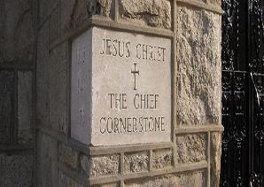
Ephesians 2:20
“having been built on the foundation of the apostles and prophets, Christ Jesus Himself being the corner stone,”

Slide 24
The Case for Selective Cessationism
Preliminary thoughts
Four categories of gifts
  Foundational (Eph 2:20)
  Confirmatory (Heb 2:3-4)
  Revelatory (Jude 3)
  Edificatory gifts continue (Eph. 4:11-16)
Church history and selective cessationism
Proper operation of the Sign & Revelatory gifts
True source of the charismatic movement
Explanation of the Charismatic movement's popularity

Slide 25
The 6 Disputed Gifts
Apostle
Prophet
Worker of Miracles
Tongues
Interpretation of tongues
Healing

Slide 26
Miracle Clusters In Scripture
NUM. | ERA | AUTHENTICATION
1. | Moses | Law
2. | Joshua | Conquest
3. | Elijah-Elisha | Prophet
4. | Christ | Kingdom offer
5. | Apostles | Church
6. | Tribulation & Millennium | Kingdom establishment

Slide 27
The 6 Disputed Gifts
Apostle
Prophet
Worker of Miracles
Tongues
Interpretation of tongues
Healing

Slide 28
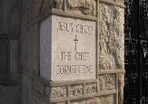
Hebrews 2:3-4
“³ how will we escape if we neglect so great a salvation? After it was at the first spoken through the Lord, it was confirmed to us by those who heard, ⁴ God also testifying with them, both by signs and wonders and by various miracles and by gifts of the Holy Spirit according to His own will.”

Slide 29
2 Corinthians 12:12
“The signs of a true apostle were performed among you with all perseverance, by signs and wonders and miracles.”

Slide 30
Acts 2:43
“Everyone kept feeling a sense of awe; and many wonders and signs were taking place through the apostles.”

Slide 31
The 6 Disputed Gifts
Apostle
Prophet
Worker of Miracles
Tongues
Interpretation of tongues
Healing

Slide 32
Revelation 9:11
“And they had a king over them, which is the angel of the bottomless pit, whose name in the Hebrew tongue is Abaddon, but in the Greek tongue hath his name Apollyon.” (KJV)

Slide 33
1 Corinthians 12:10
“To another the working of miracles; to another prophecy; to another discerning of spirits; to another divers kinds of tongues [glōssa]; to another the interpretation of tongues [glōssa].”

Slide 34
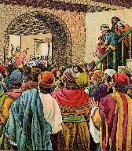
Acts 2:6
“Now when this was noised abroad, the multitude came together, and were confounded, because that every man heard them speak in his own language [dialektos].”

Slide 35
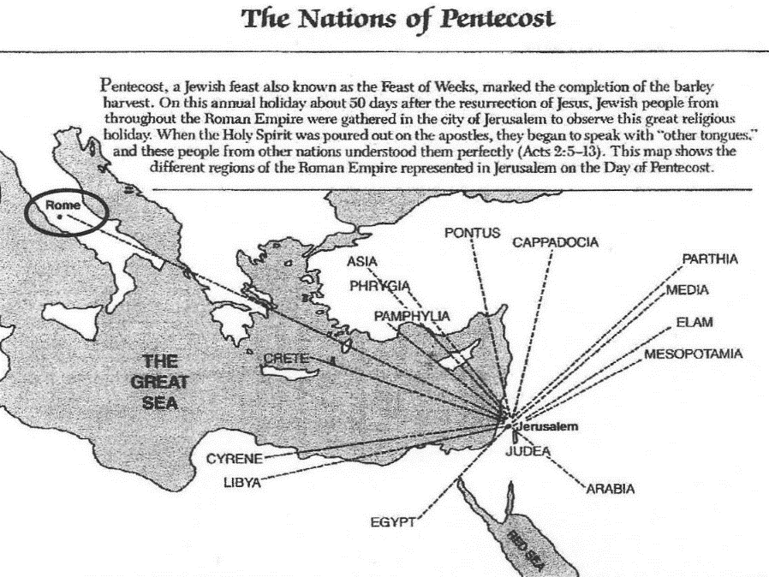

Slide 36
1 Corinthians 14:21-22
“²¹ In the Law it is written, ‘By men of strange tongues and by the lips of strangers I will speak to this people, and even so they will not listen to Me,’ says the Lord. ²² So then tongues are for a sign, not to those who believe but to unbelievers; but prophecy is for a sign, not to unbelievers but to those who believe.”

Slide 37
The 6 Disputed Gifts
Apostle
Prophet
Worker of Miracles
Tongues
Interpretation of tongues
Healing

Slide 38

Acts 3:1-10
No prayer
No faith
Indirect
By an apostle
Instantaneous
Automatic
Undeniable
No geographical barriers
Spontaneous
Common
Universal

Slide 39
Acts 20:7-10
“⁷ On the first day of the week, when we were gathered together to break bread, Paul began talking to them, intending to leave the next day, and he prolonged his message until midnight. ⁸ There were many lamps in the upper room where we were gathered together. ⁹ And there was a young man named Eutychus sitting on the window sill, sinking into a deep sleep; and as Paul kept on talking, he was overcome by sleep and fell down from the third floor and was picked up dead. ¹⁰ But Paul went down and fell upon him, and after embracing him, he said, “Do not be troubled, for his life is in him.”

Slide 40
Acts 5:12, 15-16
“¹² At the hands of the apostles many signs and wonders were taking place among the people; and they were all with one accord in Solomon’s portico…¹⁵ to such an extent that they even carried the sick out into the streets and laid them on cots and pallets, so that when Peter came by at least his shadow might fall on any one of them. ¹⁶ Also the people from the cities in the vicinity of Jerusalem were coming together, bringing people who were sick or afflicted with unclean spirits, and they were all being healed.”

Slide 41
Acts 4:30
“while You extend Your hand to heal, and signs and wonders take place through the name of Your holy servant Jesus.”

Slide 42
Acts 5:12, 15-16
“¹² At the hands of the apostles many signs and wonders were taking place among the people; and they were all with one accord in Solomon’s portico…¹⁵ to such an extent that they even carried the sick out into the streets and laid them on cots and pallets, so that when Peter came by at least his shadow might fall on any one of them. ¹⁶ Also the people from the cities in the vicinity of Jerusalem were coming together, bringing people who were sick or afflicted with unclean spirits, and they were all being healed.”

Slide 43
Acts 20:7-10
“⁷ On the first day of the week, when we were gathered together to break bread, Paul began talking to them, intending to leave the next day, and he prolonged his message until midnight. ⁸ There were many lamps in the upper room where we were gathered together. ⁹ And there was a young man named Eutychus sitting on the window sill, sinking into a deep sleep; and as Paul kept on talking, he was overcome by sleep and fell down from the third floor and was picked up dead. ¹⁰ But Paul went down and fell upon him, and after embracing him, he said, “Do not be troubled, for his life is in him.”

Slide 44
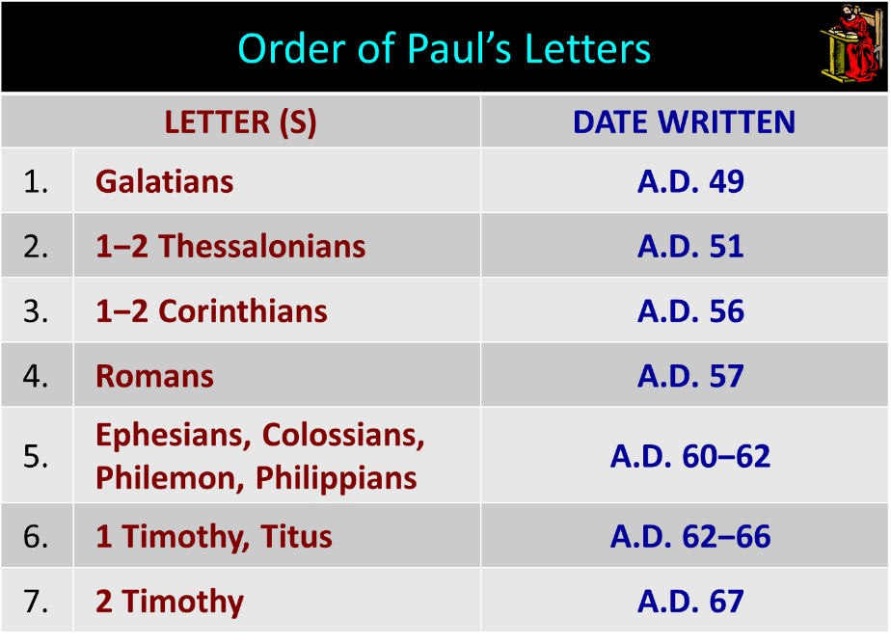

Slide 45
1 Timothy 5:23
“No longer drink water exclusively, but use a little wine for the sake of your stomach and your frequent ailments.”

Slide 46
2 Timothy 4:20
“Erastus remained at Corinth, but Trophimus I left sick at Miletus.”

Slide 47
SLBC Position Statement No. 7
“TEMPORARY SPIRITUAL GIFTS – This church teaches that the miraculous sign gifts, including the gift of tongues, (always the ability to speak in a previously unlearned, known language) along with the gift of healings were temporal gifts, given by the Holy Spirit solely to authenticate both the apostles and their message before the close of the canon of Scripture (1 Cor. 13:8-10). We do not believe that these are active as gifts today. However, we affirm that God is sovereign and may heal and/or give someone the ability to speak in a tongue (foreign language) today. We believe that the majority of what is termed ‘miraculous’ within the contemporary charismatic movement is something other than the Biblical gifts of tongues or healing.”

Slide 48
James 5:14-15
“¹⁴ Is anyone among you sick? Then he must call for the elders of the church and they are to pray over him, anointing him with oil in the name of the Lord; ¹⁵ and the prayer offered in faith will restore the one who is sick, and the Lord will raise him up, and if he has committed sins, they will be forgiven him.”

Slide 49
APOSTOLIC GIFT OF HEALING | HEALING TODAY
No prayer | Prayer
Indirect | Direct
Apostles | Physicians
Instantaneous | Gradual
Common | Less common
Automatic | Non-automatic

Slide 50
Automatic Healing Today?
Scripture – Gal. 4:13; 2 Cor. 12:7-9; 1 Tim. 5:23; 2 Tim. 4:20
False guilt
False view of God
Sickness is sometimes caused by sin – John 5:14; 1 Cor. 11:30
Sickness is not always caused by sin – Job 1:1-2, 5; 2:7-8; Ps. 34:19
Theology of suffering
Healing is only guaranteed (Isa. 53:4; 1 Pet. 2:24-25) in the Eternal State – Rom. 8:22-23; Isa. 65:20; Rev. 21:4

Slide 51
Automatic Healing Today?
Scripture – Gal. 4:13; 2 Cor. 12:7-9; 1 Tim. 5:23; 2 Tim. 4:20
False guilt
False view of God
Sickness is sometimes caused by sin – John 5:14; 1 Cor. 11:30
Sickness is not always caused by sin – Job 1:1-2, 5; 2:7-8; Ps. 34:19
Theology of suffering
Healing is only guaranteed (Isa. 53:4; 1 Pet. 2:24-25) in the Eternal State – Rom. 8:22-23; Isa. 65:20; Rev. 21:4

Slide 52
Theology of Suffering
Sympathy – 2 Cor. 1:3-4
Christ-like character – Jas. 1:2-4
Testimony to unbelievers – John 11:4; 12:10-11
Dependence upon God – Deut. 6:10-12; 8:3; 2 Cor. 12:6-9
Prayer – Acts 12:5

Slide 53
Automatic Healing Today?
Scripture – Gal. 4:13; 2 Cor. 12:7-9; 1 Tim. 5:23; 2 Tim. 4:20
False guilt
False view of God
Sickness is sometimes caused by sin – John 5:14; 1 Cor. 11:30
Sickness is not always caused by sin – Job 1:1-2, 5; 2:7-8; Ps. 34:19
Theology of suffering
Healing is only guaranteed (Isa. 53:4; 1 Pet. 2:24-25) in the Eternal State – Rom. 8:22-23; Isa. 65:20; Rev. 21:4

Slide 54
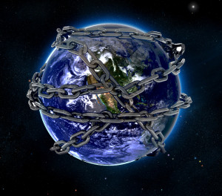

Slide 55
Romans 8:19-23
¹⁹ “For the anxious longing of the creation waits eagerly for the revealing of the sons of God. ²⁰ For the creation was subjected to futility, not willingly, but because of Him who subjected it, in hope ²¹ that the creation itself also will be set free from its slavery to corruption into the freedom of the glory of the children of God. ²² For we know that the whole creation groans and suffers the pains of childbirth together until now. ²³ And not only this, but also we ourselves, having the first fruits of the Spirit, even we ourselves groan within ourselves, waiting eagerly for our adoption as sons, the redemption of our body.”

Slide 56
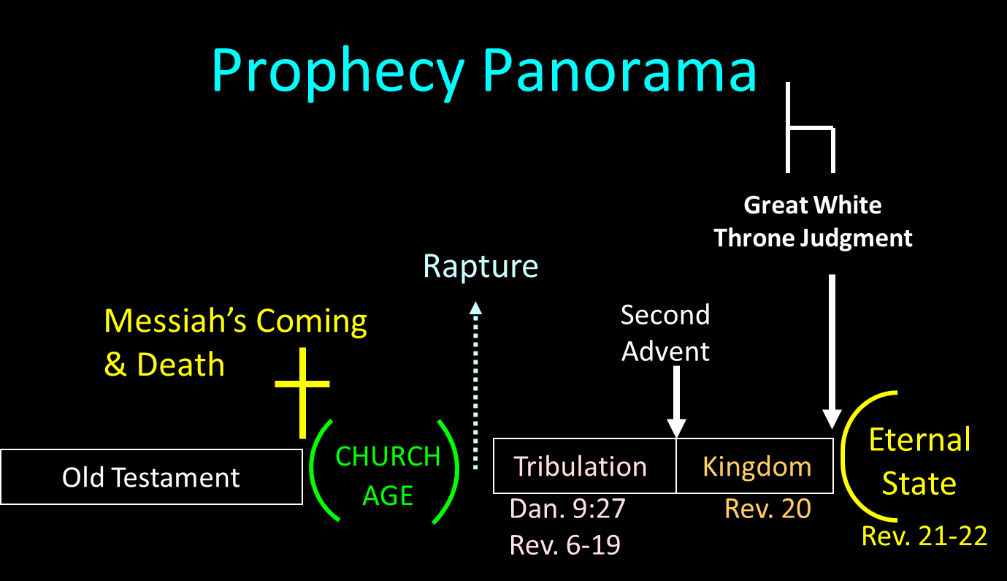

Slide 57
Millennium and Eternal State
Millennium Rev.20 | Eternal State Rev.21-22
Sin restrained | Sin removed
Curse restrained | Curse removed
Death | No death
Mortals / resurrected | Resurrected only
Destinies undecided | Destinies sealed
Renovation | Recreation
Temporary | Eternal
Transitional | Non-transitional

Slide 58
Millennium and Eternal State
 | Millennium | Eternal State
Passage | Rev 20:1-10 | Rev 21–22
Time | 20:4 | 22:5
Luminaries | Isa 30:26 | 21:23; 22:5
Temple | Ezek 40–48 | 21:22
Death | Isa 65:20 | 21:4
Satanic activity | 20:7 | 20:10
Rebellion | 20:8-9 | 21:27

Slide 59

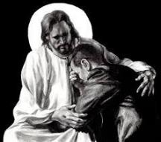
Revelation 21:4
“and He will wipe away every tear from their eyes; and there will no longer be any death; there will no longer be any mourning, or crying, or pain; the first things have passed away.”

Slide 60
The Case for Selective Cessationism
Preliminary thoughts
Four categories of gifts
  Foundational (Eph 2:20)
  Confirmatory (Heb 2:3-4)
  Revelatory (Jude 3)
  Edificatory gifts continue (Eph. 4:11-16)
Church history and selective cessationism
Proper operation of the Sign & Revelatory gifts
True source of the charismatic movement
Explanation of the Charismatic movement's popularity

Slide 61
Conclusion

Slide 62
Ecclesiology Overview
Definition
Universal vs. local
Word pictures
Origin
Israel – Church differences
Intercalation
Purposes
Activities
Government
Officers
Ordinances
Purity

