Slide 1
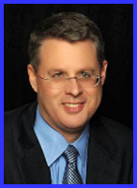
Dr. Andy Woods
Senior Pastor – Sugar Land Bible Church
President – Chafer Theological Seminary

Slide 2
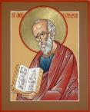
Answering Ten Questions
What is the title – Revelation of Jesus Christ
Who wrote it? – John
Where was it written from? – Patmos
To Whom was it written? – The Seven Churches
When was it written? – A.D. 95
How is it organized (outline)? – 3 part outline
How was it delivered – Seven steps
Why was it written? – Encouragement and holiness
What is it about? – Jesus’ final victory
What makes the book different? – OT relationship

Slide 3
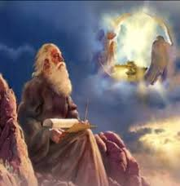
Prologue (Rev. 1:1-8)
Title (1a)
Chain (1b-2)
Blessing (3)
Author (4a)
Audience (4b)
Greeting (4c)
Source (4d-5a)
Subject (5b-8)

Slide 4
Prologue (Rev. 1:1-8)
Title (1a)
Chain (1b-2)
Blessing (3)
Author (4a)
Audience (4b)
Greeting (4c)
Source (4d-5a)
Subject (5b-8)

Slide 5
Revelation 1:1
“The Revelation [apokalypsis] of Jesus Christ, which God gave Him to show to His bond-servants, the things which must soon take place; and He sent and communicated it by His angel to His bond-servant John.”

Slide 6
Henry Morris
The Revelation Record, 323
“At the very least, it would be confusing to John’s first century readers, as well as to later generations, for him to write so much about Babylon when he really meant Rome (Paul was not afraid to speak directly against Rome in his writings, so why should John be?) or ‘the false church’ (all the apostles , including John, wrote plainly and scathingly about false teachers and false doctrines in the church and would not hide their teachings by symbols). It must be stressed that Revelation means “unveiling,” not “veiling.” In the absence of any statement in the text to the contrary, therefore, we must assume that the term Babylon applies to the real city of Babylon…”

Slide 7
BOOK OF DANIEL
CHAP. & VERSE | CHRONOLOGICAL DATE | BIBLICAL DATE
1:1 | 605 | 3rd year of Jehoiakim
2:1 | 603 | 2nd year of Nebuchadnezzar
5 | Sat. night 10/12/539 (Hoehner)
7:1 | 553 | 1st year of Belshazzar
8:1 | 551 | 3rd year of Belshazzar
9:1 | 538 | 1st year of Darius
10:1 | 536 | 3rd year of Cyrus

Slide 8
Daniel’s Age
CHAP. | EVENTS | AGE
1 | Taken to Babylonian captivity | 15
2 | Interpreting Nebuchadnezzar’s 1st dream (huge image) | 17
3 | Daniel’s 3 friends cast into the fiery furnace | 19 or 20
4 | Interpreting Nebuchadnezzar’s 2nd dream (huge tree) | 45-50
5 | Interpreting handwriting of the wall at Belshazzar’s feast | Early 80’s
6 | Delivered from the den of lions | c.83
7-8 | Daniel’s visions and dreams | Mid-60’s
9 | Daniel’s seventy “sevens” prophecy | Early-80’s
10-12 | Final dreams and visions | Mid-80’s

Slide 9
Revelation 1:1
“The Revelation of Jesus Christ, which God gave Him to show to His bond-servants, the things which must soon take place; and He sent and communicated it by His angel to His bond-servant John.”

Slide 10
Revelation 19:10
“Then I fell at his feet to worship him. But he said to me, ‘Do not do that; I am a fellow servant of yours and your brethren who hold the testimony of Jesus; worship God. For the testimony of Jesus is the spirit of prophecy.’”

Slide 11
Prologue (Rev. 1:1-8)
Title (1a)
Chain (1b-2)
Blessing (3)
Author (4a)
Audience (4b)
Greeting (4c)
Source (4d-5a)
Subject (5b-8)

Slide 12
Method of Communication
From the Father
to Christ the Son
to an angel
to John
to a book
to a reader or preacher
to a listener or the seven churches

Slide 13
Revelation 1:1
“The Revelation [apokalypsis] of Jesus Christ, which God gave Him to show to His bond-servants, the things which must soon take place; and He sent and communicated it by His angel to His bond-servant John.”

Slide 14
“TIME-TEXTS” IN REVELATION R.C. Sproul, The Last Days According to Jesus, p.139
SHORTLY, QUICKLY “Tacos”
1:1 | …Things which must shortly take place
2:16 | Repent, or else I will come to you quickly.
3:11 | Behold, I come quickly!
22:6 | …Which must shortly take place.
22:7 | Behold, I come quickly!
22:12 | Behold, I am coming quickly!
22:20 | Surely, I am coming quickly!
NEAR, AT HAND “Engys”
1:3 | The time is near.
22:10 | The time is at hand.
ABOUT TO, ON THE POINT OF “Mellō”
1:19 | Write…the things that are about to take place.
3:10 | …the hour of trial…is about to come upon the whole world.

Slide 15
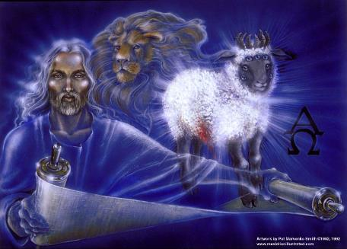
“Time Texts”
Preterist = chronological
Futurist = adverbial, qualitative, imminent

Slide 16
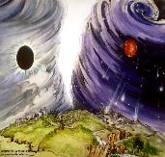
Chronological vs. Adverbial Use of Tacos
“I hope to come to you soon” (1 Tim 3:14) vs. “Leave Jerusalem quickly” (Acts 22:18)
LXX
Isaiah 13:22: “Her fateful time also will soon come”
Isaiah 51:5: “My righteous is near, My salvation has gone forth, And my arms will judge the peoples; The coastlands will wait upon me, And on My arms they will trust.”
Thomas Ice, End Times Controversy, pp.102-108

Slide 17
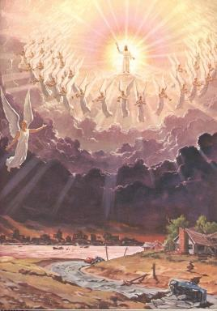
Imminency
Engys: “The Lord is near” (Phil 4:5)
Mellō: “and one who will share in the glory to be revealed” (1 Pet 5:1)

Slide 18
Method of Communication
From the Father
to Christ the Son
to an angel
to John
to a book
to a reader or preacher
to a listener or the seven churches

Slide 19
Revelation 19:10
“Then I fell at his feet to worship him. But he said to me, ‘Do not do that; I am a fellow servant of yours and your brethren who hold the testimony of Jesus; worship God. For the testimony of Jesus is the spirit of prophecy.’”

Slide 20
Method of Communication
From the Father
to Christ the Son
to an angel
to John
to a book
to a reader or preacher
to a listener or the seven churches

Slide 21
Prologue (Rev. 1:1-8)
Title (1a)
Chain (1b-2)
Blessing (3)
Author (4a)
Audience (4b)
Greeting (4c)
Source (4d-5a)
Subject (5b-8)

Slide 22
Revelation 1:3
“Blessed [makarios] is he who reads and those who hear the words of the prophecy, and heed the things which are written in it; for the time is near.”

Slide 23
Revelation’s Seven Beatitudes [makarios]
Revelation 1:3 – Reader
Revelation 14:13 – Dead
Revelation 16:15 – Those looking for JC’s return
Revelation 19:9 – Marriage Supper participants
Revelation 20:6 – First resurrection
Revelation 22:7 – Reader
Revelation 22:14 – Partakers of the Tree of Life

Slide 24
Revelation 1:3
“Blessed [makarios] is he who reads and those who hear the words of the prophecy, and heed the things which are written in it; for the time is near.”

Slide 25
Method of Communication
From the Father
to Christ the Son
to an angel
to John
to a book
to a reader or preacher
to a listener or the seven churches

Slide 26
Revelation 1:3
“Blessed [makarios] is he who reads and those who hear the words of the prophecy, and heed the things which are written in it; for the time is near.”

Slide 27
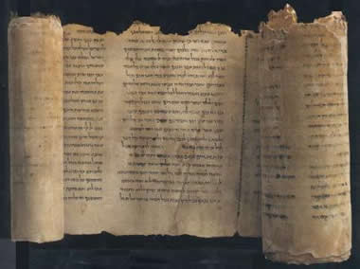
Apocalyptic Books
Enoch
Apocalypse of Baruch
Jubilees
Assumption of Moses
Psalms of Solomon
Testament of the Twelve Patriarchs
Sibylline Oracles

Slide 28
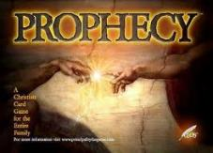
Emergent Eschatology and Genre
“The book of Revelation is an example of popular literary genre of ancient Judaism, known today as Jewish apocalyptic. Trying to read it without understanding its genre would be like watching Star Trek or some other science fiction show thinking it was a historical documentary…instead of being a book about the distant future, it becomes a way of talking about the challenges of the immediate present.”
Brian McLaren, The Secret Message of Jesus, 175-76

Slide 29
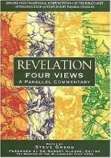
Steve Gregg
Revelation: Four Views, 11
“Another obvious similarity between the Apocalypse and its uninspired counterparts is the use of vivid images and symbols…in depicting the conflict between good and evil. A failure to take in to account this feature has led some to the most outlandish teachings on this book by some whose rule of interpretation is ‘literal unless absurd.’ Though this is a good rule when dealing with literature written in a literal genre, it is the exact opposite in the case of apocalyptic literature, where symbolism is the rule and literalism is the exception.”

Slide 30
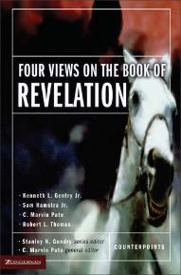
Kenneth Gentry
Four Views of Revelation, p. 38.
“…the preterist view does understand Revelation’s prophecies as strongly reflecting actual historical events in John’s near future, though they are set in apocalyptic drama and clothed in poetic hyperbole.”

Slide 31
Robert Thomas
“A Classical Dispensationalist View of Revelation,” in Four Views of the Book of Revelation, p.181.
“A Preterist approach must assume an apocalyptic genre in which the language only faintly and indirectly reflects the actual events. This extreme allegorical interpretation allows for finding fulfillments in the first-century Roman Empire prior to the destruction of Jerusalem in A.D. 70.”

Slide 32
Apocalyptic Genre Versus Revelation Adapted from Thomas, Evangelical Hermeneutics, 338
APOCALYPTIC GENRE | REVELATION
Pseudonymous | Not pseudonymous
Pessimistic about the present | Not pessimistic about the present
No epistolary framework | Epistolary framework
Limited admonitions for moral compliance | Repeated admonitions for moral compliance
Messiah’s coming exclusively future | Basis for Messiah’s coming is past
Does not call itself prophecy | Calls itself prophecy
Vaticina ex eventu | Futuristic prediction
Primarily concerns a future generation (1 Enoch 1:2) | Concerns both the present generation of the author (Rev 2–3) and a future generation (Rev 4–22)

Slide 33
Revelation 1:3
“Blessed [makarios] is he who reads and those who hear the words of the prophecy, and heed the things which are written in it; for the time is near [engys].”

Slide 34
Imminency
Engys: “The Lord is near” (Phil 4:5)
Mellō: “and one who will share in the glory to be revealed” (1 Pet 5:1)

Slide 35
Prologue (Rev. 1:1-8)
Title (1a)
Chain (1b-2)
Blessing (3)
Author (4a)
Audience (4b)
Greeting (4c)
Source (4d-5a)
Subject (5b-8)

Slide 36
Johannine Authorship
Named 5x
Revelation 1:1, 4, 9; 21:2; 22:8
Wrote five New Testament books

Slide 37
Prologue (Rev. 1:1-8)
Title (1a)
Chain (1b-2)
Blessing (3)
Author (4a)
Audience (4b)
Greeting (4c)
Source (4d-5a)
Subject (5b-8)

Slide 38
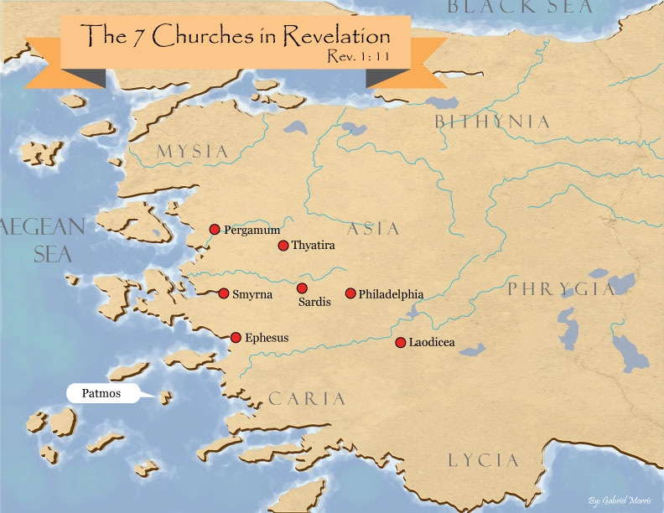

Slide 39
Literal Geography in Revelation Thomas, Revelation 8 to 22: An Exegetical Commentary, 206-207.
Asia | 1:4 | Sardis | 3:1
Ephesus | 2:1 | Philadelphia | 3:7
Smyrna | 2:8 | Laodicea | 3:14
Pergamum | 2:12 | Euphrates | 9:14;16:12
Thyatira | 2:18 | Armageddon | 16:16

Slide 40
Prologue (Rev. 1:1-8)
Title (1a)
Chain (1b-2)
Blessing (3)
Author (4a)
Audience (4b)
Greeting (4c)
Source (4d-5a)
Subject (5b-8)

Slide 41
Prologue (Rev. 1:1-8)
Title (1a)
Chain (1b-2)
Blessing (3)
Author (4a)
Audience (4b)
Greeting (4c)
Source (4d-5a)
Subject (5b-8)

Slide 42
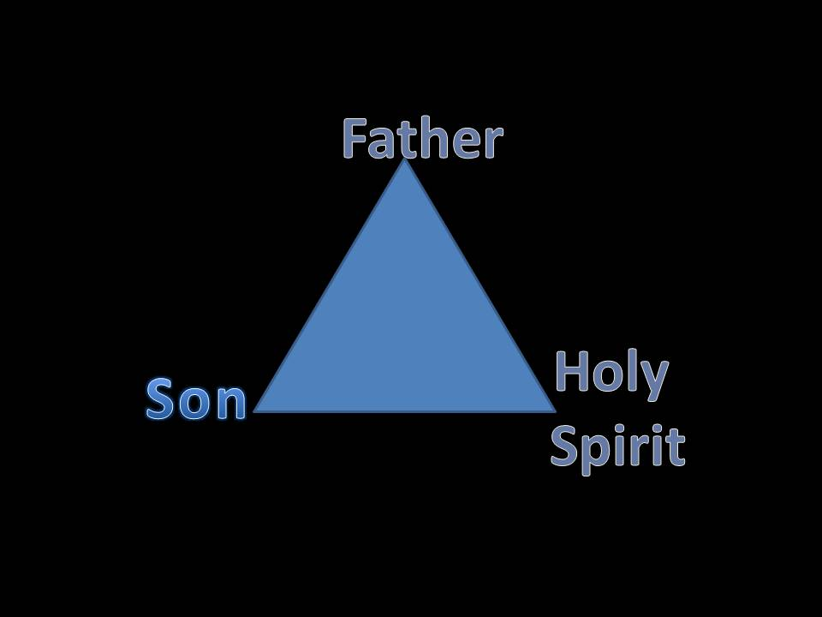
VII. Source of the Message (Rev. 1:4d-5a)
From the Father (4d)
From the Spirit (4e)
From the Son (5a)

Slide 43
VII. Source of the Message (Rev. 1:4d-5a)
From the Father (4d)
From the Spirit (4e)
From the Son (5a)

Slide 44
VII. Source of the Message (Rev. 1:4d-5a)
From the Father (4d)
From the Spirit (4e)
From the Son (5a)

Slide 45
VII. Source of the Message (Rev. 1:4d-5a)
From the Father (4d)
From the Spirit (4e)
From the Son (5a)

Slide 46
Prologue (Rev. 1:1-8)
Title (1a)
Chain (1b-2)
Blessing (3)
Author (4a)
Audience (4b)
Greeting (4c)
Source (4d-5a)
Subject (5b-8)

Slide 47
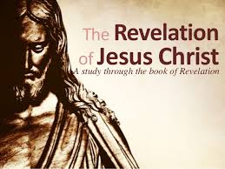
VII. Subject of the Message (Rev. 1:5b-8)
Who He is (5d-e)
His past work (5f-6)
His future work (7)
His sovereignty (8)

Slide 48
VII. Subject of the Message (Rev. 1:5b-8)
Who He is (5d-e)
His past work (5f-6)
His future work (7)
His sovereignty (8)

Slide 49
A. Who He is (Rev. 1:5b-e)
Faithful witness (5b)
First born from the dead (5c)
Ruler of the Kings of the Earth (5d)
The One who loves us (5e)

Slide 50
A. Who He is (Rev. 1:5b-e)
Faithful witness (5b)
First born from the dead (5c)
Ruler of the Kings of the Earth (5d)
The One who loves us (5e)

Slide 51
A. Who He is (Rev. 1:5b-e)
Faithful witness (5b)
First born from the dead (5c)
Ruler of the Kings of the Earth (5d)
The One who loves us (5e)

Slide 52
A. Who He is (Rev. 1:5b-e)
Faithful witness (5b)
First born from the dead (5c)
Ruler of the Kings of the Earth (5d)
The One who loves us (5e)

Slide 53
Names & Titles Demonstrating Satan’s Post-Fall, Earthly Authority (Job 1:7; 2:2; Luke 4:5-8; Rom. 8:19-22)
Prince of this world (John 12:31; 14:30; 16:11)
God of this age (2 Cor. 4:4)
Prince and power of the air (Eph. 2:2)
Who the believer wrestles with (Eph. 6:12)
Roaring lion (1 Pet. 5:8)
Whole world lies in his power (1 John 5:19)

Slide 54
A. Who He is (Rev. 1:5b-e)
Faithful witness (5b)
First born from the dead (5c)
Ruler of the Kings of the Earth (5d)
The One who loves us (5e)

Slide 55
VII. Subject of the Message (Rev. 1:5b-8)
Who He is (5d-e)
His past work (5f-6)
His future work (7)
His sovereignty (8)

Slide 56
B. His Past Work (Rev. 1:5f-6)
Released us from our sins by His blood (5f)
Made us into a Kingdom of Priests (6)

Slide 57
B. His Past Work (Rev. 1:5f-6)
Released us from our sins by His blood (5f)
Made us into a Kingdom of Priests (6)

Slide 58
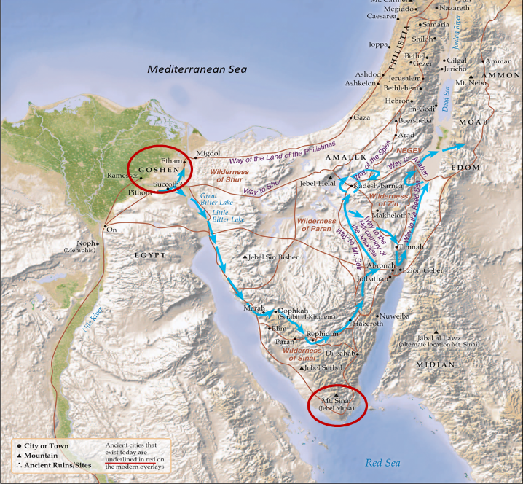

Slide 59
Christ’s Atoning Death
Role of Christ’s blood in the atonement
Acts 20:28
Rom 5:9; Eph 1:7; 2:13; Col 1:20
Heb 9:12, 22; 1 Pet 1:2; 1 John 1:7
Rev 1:5; 5:9; 12:11
Free to us but expensive to Him
Significance of the Lord’s Table (1 Cor 11:23-26)

Slide 60
B. His Past Work (Rev. 1:5f-6)
Released us from our sins by His blood (5f)
Made us into a Kingdom of Priests (6)

Slide 61
Revelation 5:10
“You have made them to be a kingdom and priests to our God; and they will reign [basileuō] upon the earth [gē].”

Slide 62
Revelation 11:15
¹⁵ “Then the seventh angel sounded; and there were loud voices in heaven, saying, ‘The kingdom of the world has become the kingdom of our Lord and of His Christ; and He will reign forever and ever.’”

Slide 63
VII. Subject of the Message (Rev. 1:5b-8)
Who He is (5d-e)
His past work (5f-6)
His future work (7)
His sovereignty (8)

Slide 64
C. His Future Work (Rev. 1:7)
His coming in the clouds (7a)
His revelation to the Gentiles (7b)
His revelation to the Jews (7c)

Slide 65
C. His Future Work (Rev. 1:7)
His coming in the clouds (7a)
His revelation to the Gentiles (7b)
His revelation to the Jews (7c)

Slide 66
Rapture Distinct from Second Advent
Rapture (1 Thess 4:13-17; 1 Cor 15:51-57) | Second Coming (Rev 19:11-16)
Christ comes in the air (1 Thess 4:16) | Christ comes to the earth (Zech 14:4)
For His saints (1 Thess 4:15-17) | With His saints (Rev 19:14)
Blessing (1 Thess 4:18) | Judgment (Rev 19:15)
Effects only believers (1 Thess 4:16) | Effects both believers and unbelievers (Rev 19:15)
Invisible (1 Thess 4:16) | Visible to all (Rev 1:7)
Announced only by an archangel (1 Thess 4:16) | Involves myriads of angels (Jude 14)
Resurrection (1 Cor15: 51) | No resurrection
Rescue of the church (1 Thess 1:10) | Rescue of Israel (Matt 23:37-39)

Slide 67
C. His Future Work (Rev. 1:7)
His coming in the clouds (7a)
His revelation to the Gentiles (7b)
His revelation to the Jews (7c)

Slide 68
C. His Future Work (Rev. 1:7)
His coming in the clouds (7a)
His revelation to the Gentiles (7b)
His revelation to the Jews (7c)

Slide 69
God’s Work Through Israel
Revelation 7 – 144,000 Jews
Revelation 11 – Two Jewish witnesses
Revelation 12 – Israel flees
Revelation 20:9 – Jerusalem in the kingdom
Revelation 21:12 – 13-Gates of the eternal city

Slide 70
VII. Subject of the Message (Rev. 1:5b-8)
Who He is (5d-e)
His past work (5f-6)
His future work (7)
His sovereignty (8)

Slide 71
C. His Sovereignty (Rev. 1:8)
He is the Alpha and Omega (8a)
He is the Eternally Existent One (8b)

Slide 72
C. His Sovereignty (Rev. 1:8)
He is the Alpha and Omega (8a)
He is the Eternally Existent One (8b)

Slide 73
C. His Sovereignty (Rev. 1:8)
He is the Alpha and Omega (8a)
He is the Eternally Existent One (8b)

Slide 74
Conclusion

Slide 75
Prologue (Rev. 1:1-8)
Title (1a)
Chain (1b-2)
Blessing (3)
Author (4a)
Audience (4b)
Greeting (4c)
Source (4d-5a)
Subject (5b-8)

Slide 76
“The Lord bless you and keep you; the Lord make his face shine on you and be gracious to you; the Lord turn his face toward you and give you peace.” (NIV)

