Slide 1
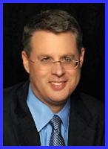
Ecclesiology
Session 25
Dr. Andy Woods
Senior Pastor – Sugar Land Bible Church
President – Chafer Theological Seminary

Slide 2

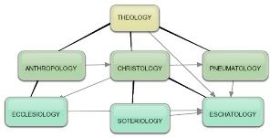
Areas of Systematic Theology
Prolegomena – Introduction
Theology – Study of God
Christology – Study of Christ
Pneumatology – Study of the Holy Spirit
Anthropology – Study of Man
Hamartiology – Study of sin
Soteriology – Study of salvation
Angelology – Study of angels
Ecclesiology – Study of the Church
Eschatology – Study of the end

Slide 3

Ecclesiology Overview
Definition
Universal vs. local
Word pictures
Origin
Israel – Church differences
Intercalation
Purposes
Activities
Government
Officers
Ordinances
Purity

Slide 4
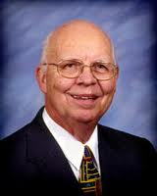
VII. Purposes of the Local Church
Glorify God (Eph 3:21)
Edify the saints (Eph 4:11-16)
Fulfill the Great Commission (Matt 28:18-20)

Slide 5
VII. Purposes of the Local Church
Glorify God (Eph 3:21)
Edify the saints (Eph 4:11-16)
Fulfill the Great Commission (Matt 28:18-20)

Slide 6

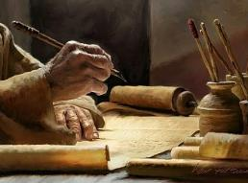
2 Timothy 3:16-17
“¹⁶ All Scripture is inspired by God and profitable for teaching, for reproof, for correction, for training in righteousness; ¹⁷ so that the man of God may be adequate, equipped for every good work.”

Slide 7
Ephesians 4:11-16
“¹¹ And He gave some as apostles, and some as prophets, and some as evangelists, and some as pastors and teachers, ¹² for the equipping of the saints for the work of service, to the building up of the body of Christ;”

Slide 8

Spiritual Gifts

Slide 9
Areas of Systematic Theology
Prolegomena – Introduction
Theology – Study of God
Christology – Study of Christ
Pneumatology – Study of the Holy Spirit
Anthropology – Study of Man
Hamartiology – Study of sin
Soteriology – Study of salvation
Angelology – Study of angels
Ecclesiology – Study of the Church
Eschatology – Study of the end

Slide 10
Four Questions
What are some general observations about spiritual gifts?
Are all the spiritual gifts for today?
What are the spiritual gifts?
How do we discover our own unique area of gifting?

Slide 11
Four Questions
What are some general observations about spiritual gifts?
Are all the spiritual gifts for today?
What are the spiritual gifts?
How do we discover our own unique area of gifting?

Slide 12
Four Questions
What are some general observations about spiritual gifts?
Are all the spiritual gifts for today?
What are the spiritual gifts?
How do we discover our own unique area of gifting?

Slide 13
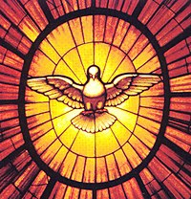
The Case for Selective Cessationism
Preliminary thoughts
Four categories of gifts
  Foundational (Eph 2:20)
  Confirmatory (Heb 2:3-4)
  Revelatory (Jude 3)
  Edificatory gifts continue (Eph. 4:11-16)
Church history and selective cessationism
Proper operation of the Sign & Revelatory gifts
True source of the charismatic movement
Explanation of the Charismatic movement's popularity

Slide 14
The Case for Selective Cessationism
Preliminary thoughts
Four categories of gifts
  Foundational (Eph 2:20)
  Confirmatory (Heb 2:3-4)
  Revelatory (Jude 3)
  Edificatory gifts continue (Eph. 4:11-16)
Church history and selective cessationism
Proper operation of the Sign & Revelatory gifts
True source of the charismatic movement
Explanation of the Charismatic movement's popularity

Slide 15
12/12/4/4
Romans 12
1 Corinthians 12
1 Peter 4
Ephesians 4

Slide 16
The Disputed Gifts
Apostle
Prophet
Worker of Miracles
Tongues
Interpretation of tongues
Healing

Slide 17
Two Camps
Charismatics – All the spiritual gifts are in operation today
Cessationists – Most of the spiritual gifts are in operation today

Slide 18
Preamble to Position Statements of SLBC Constitution
“Although agreement with the POSITION STATEMENTS is not required for membership, they are taught in this church. The POSITION STATEMENTS are not meant to prohibit honest and healthy discussions concerning what the Bible teaches about these issues; however, we believe that such discussions must be conducted under the guiding principle that believers are to strive to maintain unity.”

Slide 19
SLBC Position Statement No. 7
“TEMPORARY SPIRITUAL GIFTS – This church teaches that the miraculous sign gifts, including the gift of tongues, (always the ability to speak in a previously unlearned, known language) along with the gift of healings were temporal gifts, given by the Holy Spirit solely to authenticate both the apostles and their message before the close of the canon of Scripture (1 Cor. 13:8-10). We do not believe that these are active as gifts today. However, we affirm that God is sovereign and may heal and/or give someone the ability to speak in a tongue (foreign language) today. We believe that the majority of what is termed ‘miraculous’ within the contemporary charismatic movement is something other than the Biblical gifts of tongues or healing.”

Slide 20
The Case for Selective Cessationism
Preliminary thoughts
Four categories of gifts
  Foundational (Eph 2:20)
  Confirmatory (Heb 2:3-4)
  Revelatory (Jude 3)
  Edificatory gifts continue (Eph. 4:11-16)
Church history and selective cessationism
Proper operation of the Sign & Revelatory gifts
True source of the charismatic movement
Explanation of the Charismatic movement's popularity

Slide 21
The Case for Selective Cessationism
Preliminary thoughts
Four categories of gifts
  Foundational (Eph 2:20)
  Confirmatory (Heb 2:3-4)
  Revelatory (Jude 3)
  Edificatory gifts continue (Eph. 4:11-16)
Church history and selective cessationism
Proper operation of the Sign & Revelatory gifts
True source of the charismatic movement
Explanation of the Charismatic movement's popularity

Slide 22
The Case for Selective Cessationism
Preliminary thoughts
Four categories of gifts
  Foundational (Eph 2:20)
  Confirmatory (Heb 2:3-4)
  Revelatory (Jude 3)
  Edificatory gifts continue (Eph. 4:11-16)
Church history and selective cessationism
Proper operation of the Sign & Revelatory gifts
True source of the charismatic movement
Explanation of the Charismatic movement's popularity

Slide 23
The Disputed Gifts
Apostle
Prophet
Worker of Miracles
Tongues
Interpretation of tongues
Healing

Slide 24
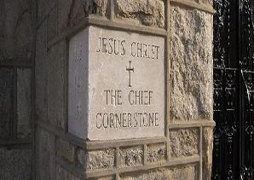
Ephesians 2:20
“having been built on the foundation of the apostles and prophets, Christ Jesus Himself being the corner stone,”

Slide 25
Ephesians 2:20
“having been built on the foundation of the apostles and prophets, Christ Jesus Himself being the corner stone,”

Slide 26
Acts 1:21-25
“²¹ Therefore it is necessary that of the men who have accompanied us all the time that the Lord Jesus went in and out among us— ²² beginning with the baptism of John until the day that He was taken up from us—one of these must become a witness with us of His resurrection.” ²³ So they put forward two men, Joseph called Barsabbas (who was also called Justus), and Matthias. ²⁴ And they prayed and said, “You, Lord, who know the hearts of all men, show which one of these two You have chosen ²⁵ to occupy this ministry and apostleship from which Judas turned aside to go to his own place.” ²⁶ And they drew lots for them, and the lot fell to Matthias; and he was added to the eleven apostles.”

Slide 27
1 Corinthians 9:1
“Am I not free? Am I not an apostle? Have I not seen Jesus our Lord? Are you not my work in the Lord?”

Slide 28
1 Corinthians 15:8-9
“⁸ and last of all, as to one untimely born, He appeared to me also. ⁹ For I am the least of the apostles, and not fit to be called an apostle, because I persecuted the church of God.”

Slide 29
Ephesians 2:20
“having been built on the foundation of the apostles and prophets, Christ Jesus Himself being the corner stone,”

Slide 30
The Case for Selective Cessationism
Preliminary thoughts
Four categories of gifts
  Foundational (Eph 2:20)
  Confirmatory (Heb 2:3-4)
  Revelatory (Jude 3)
  Edificatory gifts continue (Eph. 4:11-16)
Church history and selective cessationism
Proper operation of the Sign & Revelatory gifts
True source of the charismatic movement
Explanation of the Charismatic movement's popularity

Slide 31
The Disputed Gifts
Apostle
Prophet
Worker of Miracles
Tongues
Interpretation of tongues
Healing

Slide 32
Miracle Clusters In Scripture
NUM. | ERA | AUTHENTICATION
1. | Moses | Law
2. | Joshua | Conquest
3. | Elijah-Elisha | Prophet
4. | Christ | Kingdom offer
5. | Apostles | Church
6. | Tribulation & Millennium | Kingdom establishment

Slide 33
Luke 4:25-27
“²⁵ But I say to you in truth, there were many widows in Israel in the days of Elijah, when the sky was shut up for three years and six months, when a great famine came over all the land; ²⁶ and yet Elijah was sent to none of them, but only to Zarephath, in the land of Sidon, to a woman who was a widow. ²⁷ And there were many lepers in Israel in the time of Elisha the prophet; and none of them was cleansed, but only Naaman the Syrian.”

Slide 34
Luke 4:25-27
“²⁵ But I say to you in truth, there were many widows in Israel in the days of Elijah, when the sky was shut up for three years and six months, when a great famine came over all the land; ²⁶ and yet Elijah was sent to none of them, but only to Zarephath, in the land of Sidon, to a woman who was a widow. ²⁷ And there were many lepers in Israel in the time of Elisha the prophet; and none of them was cleansed, but only Naaman the Syrian.”

Slide 35
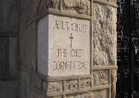
Hebrews 2:3-4
“³ how will we escape if we neglect so great a salvation? After it was at the first spoken through the Lord, it was confirmed to us by those who heard, ⁴ God also testifying with them, both by signs and wonders and by various miracles and by gifts of the Holy Spirit according to His own will.”

Slide 36
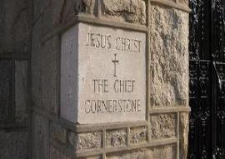
John 14:12
“Truly, truly, I say to you, he who believes in Me, the works that I do, he will do also; and greater works than these he will do; because I go to the Father.”

Slide 37
The Disputed Gifts
Apostle
Prophet
Worker of Miracles
Tongues
Interpretation of tongues
Healing

Slide 38
Hebrews 2:3-4
“³ how will we escape if we neglect so great a salvation? After it was at the first spoken through the Lord, it was confirmed to us by those who heard, ⁴ God also testifying with them, both by signs and wonders and by various miracles and by gifts of the Holy Spirit according to His own will.”

Slide 39
2 Corinthians 12:12
“The signs of a true apostle were performed among you with all perseverance, by signs and wonders and miracles.”

Slide 40
Acts 2:43
“Everyone kept feeling a sense of awe; and many wonders and signs were taking place through the apostles.”

Slide 41
Acts 4:30
“while You extend Your hand to heal, and signs and wonders take place through the name of Your holy servant Jesus.”

Slide 42
Acts 5:12
“At the hands of the apostles many signs and wonders were taking place among the people; and they were all with one accord in Solomon’s portico.”

Slide 43
Acts 14:3-4
“³ Therefore they spent a long time there speaking boldly with reliance upon the Lord, who was testifying to the word of His grace, granting that signs and wonders be done by their hands. ⁴ But the people of the city were divided; and some sided with the Jews, and some with the apostles.”

Slide 44
Romans 15:18-20
“¹⁸ For I will not presume to speak of anything except what Christ has accomplished through me, resulting in the obedience of the Gentiles by word and deed, ¹⁹ in the power of signs and wonders, in the power of the Spirit; so that from Jerusalem and round about as far as Illyricum I have fully preached the gospel of Christ. ²⁰ And thus I aspired to preach the gospel, not where Christ was already named, so that I would not build on another man’s foundation.”

Slide 45
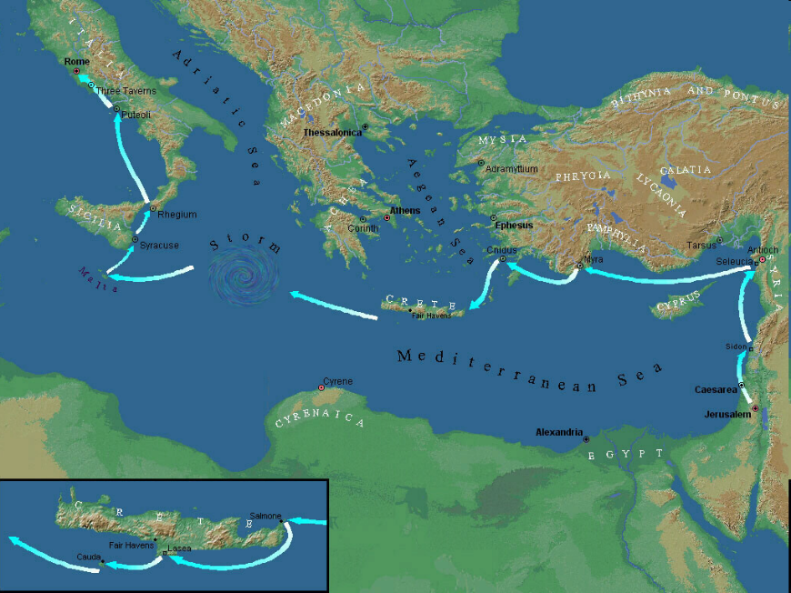

Slide 46
Acts 20:7-10
“⁷ On the first day of the week, when we were gathered together to break bread, Paul began talking to them, intending to leave the next day, and he prolonged his message until midnight. ⁸ There were many lamps in the upper room where we were gathered together. ⁹ And there was a young man named Eutychus sitting on the window sill, sinking into a deep sleep; and as Paul kept on talking, he was overcome by sleep and fell down from the third floor and was picked up dead. ¹⁰ But Paul went down and fell upon him, and after embracing him, he said, “Do not be troubled, for his life is in him.”

Slide 47
Order of Paul’s Letters
Galatians (A.D. 49)
1‒2 Thessalonians (A.D. 51)
1‒2 Corinthians (A.D. 56)
Romans (A.D. 57)
Ephesians, Colossians, Philemon, Philippians (A.D. 60‒62)
1 Timothy, Titus (A.D. 62‒66)
2 Timothy (A.D. 67)

Slide 48
1 Timothy 5:23
“No longer drink water exclusively, but use a little wine for the sake of your stomach and your frequent ailments.”

Slide 49
2 Timothy 4:20
“Erastus remained at Corinth, but Trophimus I left sick at Miletus.”

Slide 50
The Disputed Gifts
Apostle
Prophet
Worker of Miracles
Tongues
Interpretation of tongues
Healing

Slide 51
Revelation 9:11
“And they had a king over them, which is the angel of the bottomless pit, whose name in the Hebrew tongue is Abaddon, but in the Greek tongue hath his name Apollyon.” (KJV)

Slide 52
1 Corinthians 12:10
“To another the working of miracles; to another prophecy; to another discerning of spirits; to another divers kinds of tongues [glōssa]; to another the interpretation of tongues [glōssa].”

Slide 53
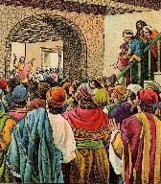
Acts 2:6
“Now when this was noised abroad, the multitude came together, and were confounded, because that every man heard them speak in his own language [dialektos].”

Slide 54
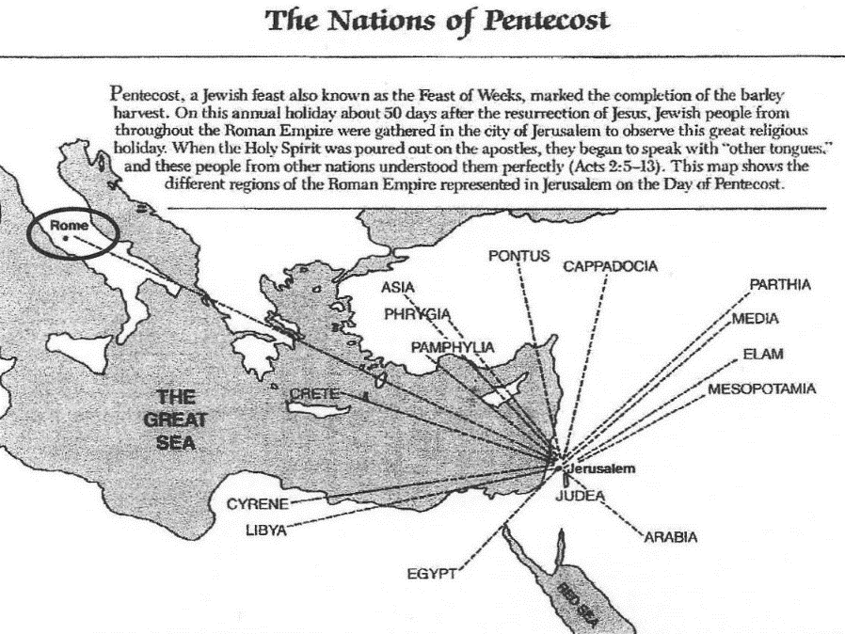

Slide 55
1 Corinthians 14:21-22
“²¹ In the Law it is written, ‘By men of strange tongues and by the lips of strangers I will speak to this people, and even so they will not listen to Me,’ says the Lord. ²² So then tongues are for a sign, not to those who believe but to unbelievers; but prophecy is for a sign, not to unbelievers but to those who believe.”

Slide 56
The Disputed Gifts
Apostle
Prophet
Worker of Miracles
Tongues
Interpretation of tongues
Healing

Slide 57

Acts 3:1-10
No prayer
No faith
Indirect
By an apostle
Instantaneous
Automatic
Undeniable
No geographical barriers
Spontaneous
Common
Universal

Slide 58

Acts 20:7-10
“⁷ On the first day of the week, when we were gathered together to break bread, Paul began talking to them, intending to leave the next day, and he prolonged his message until midnight. ⁸ There were many lamps in the upper room where we were gathered together. ⁹ And there was a young man named Eutychus sitting on the window sill, sinking into a deep sleep; and as Paul kept on talking, he was overcome by sleep and fell down from the third floor and was picked up dead. ¹⁰ But Paul went down and fell upon him, and after embracing him, he said, “Do not be troubled, for his life is in him.”

Slide 59
Acts 5:12, 15-16
“¹² At the hands of the apostles many signs and wonders were taking place among the people; and they were all with one accord in Solomon’s portico…¹⁵ to such an extent that they even carried the sick out into the streets and laid them on cots and pallets, so that when Peter came by at least his shadow might fall on any one of them. ¹⁶ Also the people from the cities in the vicinity of Jerusalem were coming together, bringing people who were sick or afflicted with unclean spirits, and they were all being healed.”

Slide 60
Acts 4:30
“while You extend Your hand to heal, and signs and wonders take place through the name of Your holy servant Jesus.”

Slide 61
Acts 5:12, 15-16
“¹² At the hands of the apostles many signs and wonders were taking place among the people; and they were all with one accord in Solomon’s portico…¹⁵ to such an extent that they even carried the sick out into the streets and laid them on cots and pallets, so that when Peter came by at least his shadow might fall on any one of them. ¹⁶ Also the people from the cities in the vicinity of Jerusalem were coming together, bringing people who were sick or afflicted with unclean spirits, and they were all being healed.”

Slide 62
Order of Paul’s Letters
Galatians (A.D. 49)
1‒2 Thessalonians (A.D. 51)
1‒2 Corinthians (A.D. 56)
Romans (A.D. 57)
Ephesians, Colossians, Philemon, Philippians (A.D. 60‒62)
1 Timothy, Titus (A.D. 62‒66)
2 Timothy (A.D. 67)

Slide 63
1 Timothy 5:23
“No longer drink water exclusively, but use a little wine for the sake of your stomach and your frequent ailments.”

Slide 64
2 Timothy 4:20
“Erastus remained at Corinth, but Trophimus I left sick at Miletus.”

Slide 65
James 5:14-15
“¹⁴ Is anyone among you sick? Then he must call for the elders of the church and they are to pray over him, anointing him with oil in the name of the Lord; ¹⁵ and the prayer offered in faith will restore the one who is sick, and the Lord will raise him up, and if he has committed sins, they will be forgiven him.”

Slide 66
Apostolic Gift of Healing | Healing Today
No prayer | Prayer
Indirect | Direct
Apostles | Physicians
Instantaneous | Gradual
Common | Less common
Automatic | Non-automatic

Slide 67
Automatic Healing Today?
Scripture – Gal. 4:13; 2 Cor. 12:7-9; 1 Tim. 5:23; 2 Tim. 4:20
False guilt
False view of God
Sickness is sometimes caused by sin – John 5:14; 1 Cor. 11:30
Sickness is not always caused by sin – Job 1:1-2, 5; 2:7-8; Ps. 34:19
Theology of suffering
Healing is only guaranteed (Isa. 53:4; 1 Pet. 2:24-25) in the Eternal State – Rom. 8:22-23; Isa. 65:20; Rev. 21:4

Slide 68
Theology of Suffering
Sympathy – 2 Cor. 1:3-4
Christ-like character – Jas. 1:2-4
Testimony to unbelievers – John 11:4; 12:10-11
Dependence upon God – Deut. 6:10-12; 8:3; 2 Cor. 12:6-9
Prayer – Acts 12:5

Slide 69
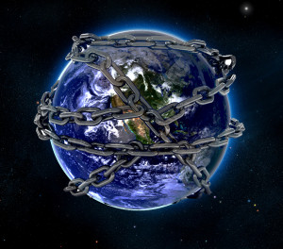

Slide 70

Romans 8:19-23
¹⁹ “For the anxious longing of the creation waits eagerly for the revealing of the sons of God. ²⁰ For the creation was subjected to futility, not willingly, but because of Him who subjected it, in hope ²¹ that the creation itself also will be set free from its slavery to corruption into the freedom of the glory of the children of God. ²² For we know that the whole creation groans and suffers the pains of childbirth together until now. ²³ And not only this, but also we ourselves, having the first fruits of the Spirit, even we ourselves groan within ourselves, waiting eagerly for our adoption as sons, the redemption of our body.”

Slide 71
Millennium Rev.20 | Eternal State Rev.21-22
Sin restrained | Sin removed
Curse restrained | Curse removed
Death | No death
Mortals / resurrected | Resurrected only
Destinies undecided | Destinies sealed
Renovation | Recreation
Temporary | Eternal
Transitional | Non-transitional

Slide 72
Millennium and Eternal State
 | Rev 20:1-10 | Rev 21–22
Time | 20:4 | 22:5
Luminaries | Isa 30:26 | 21:23; 22:5
Temple | Ezek 40–48 | 21:22
Death | Isa 65:20 | 21:4
Satanic activity | 20:7 | 20:10
Rebellion | 20:8-9 | 21:27

Slide 73

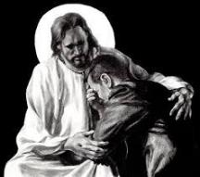
Revelation 21:4
“and He will wipe away every tear from their eyes; and there will no longer be any death; there will no longer be any mourning, or crying, or pain; the first things have passed away.”

Slide 74
Four Questions
What are some general observations about spiritual gifts?
Are all the spiritual gifts for today?
What are the spiritual gifts?
How do we discover our own unique area of gifting?

Slide 75
12/12/4/4
Romans 12
1 Corinthians 12
1 Peter 4
Ephesians 4

Slide 76
Spiritual Gifts: #1
Prophecy: the ability to proclaim God’s truth without compromise

Slide 77
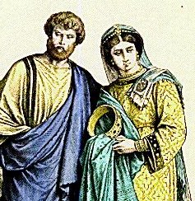
Spiritual Gifts: #2
Teaching: the ability to explain clearly what God has already revealed (1 Cor 12:28)

Slide 78
Spiritual Gifts: #3
Pastor-teacher: the ability to equip and mature the body of Christ (Eph 4:11-16)

Slide 79
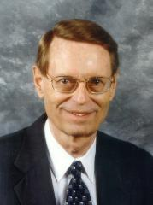
Pastor-Teacher (Eph 4:11)
“pastors and teachers. The two ministries are linked together here, though separated elsewhere (Rom 12:7; 1 Pet 5:2).”
Ryrie Study Bible, p. 1881

Slide 80
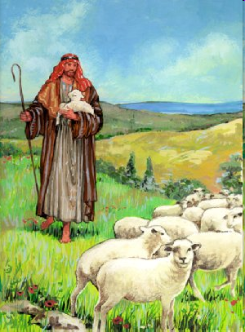
Shepherd/Pastor
Guide
Guard
Graze

Slide 81
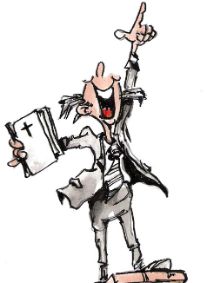
Spiritual Gifts: #4
Evangelism: the ability to share the good news of Jesus Christ with unbelievers

Slide 82
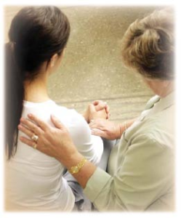
Spiritual Gifts: #5
Exhortation: the ability to encourage others in the body of Christ

Slide 83
Spiritual Gifts: #6
Discernment: the ability to detect moral or doctrinal error (Rev 2:2)

Slide 84
Spiritual Gifts: #7
Administration: the ability to effectively run or manage a church program

Slide 85
Spiritual Gifts: #8
Leadership: the ability to cast an organizational vision and motivate others toward the fulfillment of that vision

Slide 86
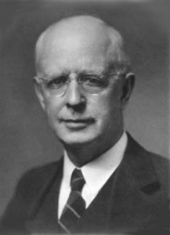
Spiritual Gifts: #9
Knowledge: the ability to understand complex biblical truths (1 Cor 8:1)

Slide 87
Spiritual Gifts: #10
Wisdom: the ability to find knowledge from the Scriptures and apply it to daily life (1 Cor 2:6-7)

Slide 88
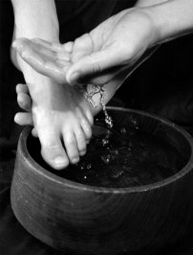
Spiritual Gifts: #11
Service: the ability to minister to others

Slide 89
Spiritual Gifts: #12
Giving: the ability to give material goods and financial resources with joy so that the needs of the Lord’s work are met

Slide 90

Spiritual Gifts: #13
Hospitality: the ability to make guests feel comfortable and at home (Rom 12:13)

Slide 91
Spiritual Gifts: #14
Mercy: the ability to devote energy toward helping those in pitiable conditions

Slide 92
Spiritual Gifts: #15
Helps: the ability to free up others from certain responsibilities so that they can exercise their gifts more effectively (Acts 6:1-4)

Slide 93
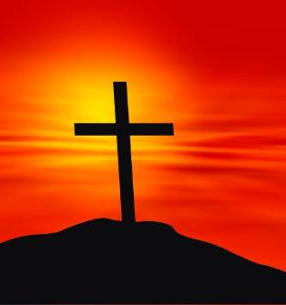
Spiritual Gifts: #16
Faith: the ability to trust God in the midst of life’s difficulties

Slide 94
Four Questions
What are some general observations about spiritual gifts?
Are all the spiritual gifts for today?
What are the spiritual gifts?
How do we discover our own unique area of gifting?

Slide 95
How Do We Discover Our Gifts?
Know what the gifts are and their purpose

Slide 96
How Do We Discover Our Gifts?
Obey the known or revealed will of God to all believers (Luke 16:10; Rom 12:1)

Slide 97
How Do We Discover Our Gifts?
What do you naturally gravitate toward?

Slide 98
How Do We Discover Our Gifts?
What ministry or ministries do you enjoy doing?

Slide 99
How Do We Discover Our Gifts?
Does anyone get especially blessed when you serve God in a particular way?

Slide 100
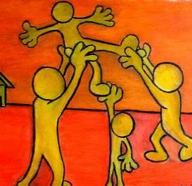
Spiritual Gifts: Observation #6
Spiritual gifts are given in order to edify the church (1 Cor 12:7; 14:12, 26; Eph 4:11-12; 1 Pet 4:10)

Slide 101

How Do We Discover Our Gifts?
What are you most critical of?

Slide 102
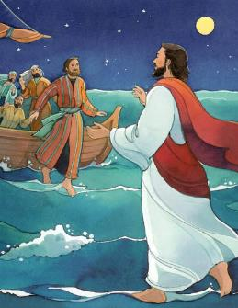
How Do We Discover Our Gifts?
Step out in faith (Rom 12:6)

Slide 103
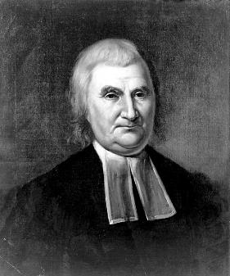
How Do We Discover Our Gifts?
Do not despise the day of small beginnings (Zech 4:10)

Slide 104
Conclusion

Slide 105
Ecclesiology Overview
Definition
Universal vs. local
Word pictures
Origin
Israel – Church differences
Intercalation
Purposes
Activities
Government
Officers
Ordinances
Purity

