Slide 1
Law & Grace: An Overview Jim McGowan, Th.D. Sugar Land Bible Church 05-27-2018
…but grace & truth were realized through Jesus Christ - John 1:17
For the Law was given through Moses…
Special thanks to Dr. Vern Peterman for access to his insights and resources.

Slide 2
Session 8 Outline
Review
Purpose, Aim, and Objective
Session 7
At Whom are you looking? (Numbers 21:4-9)
General Information
Comments & Commentary
Conclusion

Slide 3
Session 8 Outline
Review
Purpose, Aim, and Objective
Session 7
At Whom are you looking? (Numbers 21:4-9)
General Information
Comments & Commentary
Conclusion

Slide 4
OUR PURPOSE, AIM AND OBJECTIVE
Law & Grace
…is to Compare and Contrast Law and Grace so as to properly understand these two important themes and how they are related to the life of the New Testament Believer.

Slide 5
C. I. SCOFIELD, D. D.
The Grace of God, The Fundamentals Vol. 3, Chapter VII, p. 98
We have, most of us, been reared and now live under the influence of Galatianism. Protestant theology, alas, is for the most part, thoroughly Galatianized, in that neither law nor grace are given their distinct and separated places, as in the counsels of God, but are mingled together in one incoherent system.
The law is no longer, as in the Divine intent, a ministration of death (2 Cor. 3:7), of cursing (Gal. 3:10), of conviction (Rom. 3:19), because we are taught that we must try to keep it, and that by Divine help we may.
Nor, on the other hand, does grace bring us blessed deliverance from the dominion of sin, for we are kept under the law as a rule of life despite the plain declaration, “Sin shall not have dominion over you: for ye are not under the law, but under grace” (Rom. 6:14). (emphasis mine)

Slide 6
William R. Newell
Romans Verse-by-Verse (p. 274).
Grand Rapids, MI: Christian Classics Ethereal Library.
It is because Reformed theology has kept us Gentiles under the Law,—if not as a means of righteousness, then as “a rule of life,” that all the trouble has arisen. The Law is no more a rule of life than it is a means of righteousness. Walking in the Spirit has now taken the place of walking by ordinances. God has another principle under which He has put his saints: “Ye are not under law, but, under grace!” (italics mine)

Slide 7
Session 8 Outline
Review
Purpose, Aim, and Objective
Session 7
At Whom are you looking? (Numbers 21:4-9)
General Information
Comments & Commentary
Conclusion

Slide 8
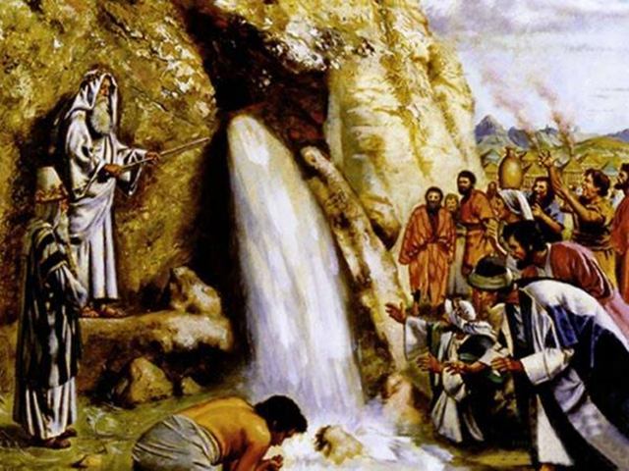
Whacking & Watering - Numbers 20:1-13
Law & Grace: Lesson 7 Review

Slide 9
Law & Grace: Lesson 7 Review
VERY IMPORTANT PRINCIPLE!
Wherever you are and wherever go on earth, you’re always passing through!

Slide 10
Law & Grace: Lesson 7 Review
VERY IMPORTANT PRINCIPLE!
Allowing our feelings and emotions to reinterpret God’s Word is never a good idea!

Slide 11
Law & Grace: Lesson 7 Review

Slide 12
Law & Grace: Lesson 7 Review
VERY IMPORTANT PRINCIPLE!
Our best efforts and good intentions, just aren’t good enough!

Slide 13
Law & Grace: Lesson 7 Review
VERY IMPORTANT PRINCIPLE!
Earthly disobedience now always has consequences

Slide 14
Law & Grace: Lesson 7 Review
VERY IMPORTANT PRINCIPLE!
The fact that the Lord may bless people does not mean that everything that they are doing is right!

Slide 15
1 Corinthians 10:11
Now these things happened to them as an example, and they were written for our instruction, upon whom the ends of the ages have come.

Slide 16
Law & Grace: Lesson 7 Review

Slide 17
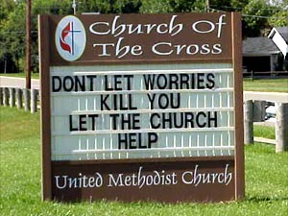
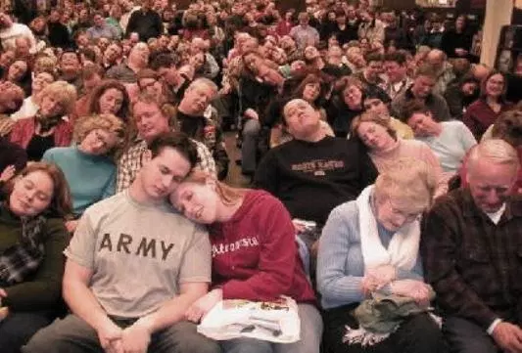
END OF REVIEW
FINALLY

Slide 18
Session 8 Outline
Review
Purpose, Aim, and Objective
Session 7
At Whom are you looking? (Numbers 21:4-9)
General Information
Comments & Commentary
Conclusion

Slide 19
Numbers 21:4–9
⁴ Then they set out from Mount Hor by the way of the Red Sea, to go around the land of Edom; and the people became impatient because of the journey. ⁵ The people spoke against God and Moses, “Why have you brought us up out of Egypt to die in the wilderness? For there is no food and no water, and we loathe this miserable food.” ⁶ The Lord sent fiery serpents among the people and they bit the people, so that many people of Israel died. ⁷ So the people came to Moses and said, “We have sinned, because we have spoken against the Lord and you; intercede with the Lord, that He may remove the serpents from us.” And Moses interceded for the people…

Slide 20
Numbers 21:4–9
... ⁸ Then the Lord said to Moses, “Make a fiery serpent, and set it on a standard; and it shall come about, that everyone who is bitten, when he looks at it, he will live.” ⁹ And Moses made a bronze serpent and set it on the standard; and it came about, that if a serpent bit any man, when he looked to the bronze serpent, he lived.

Slide 21
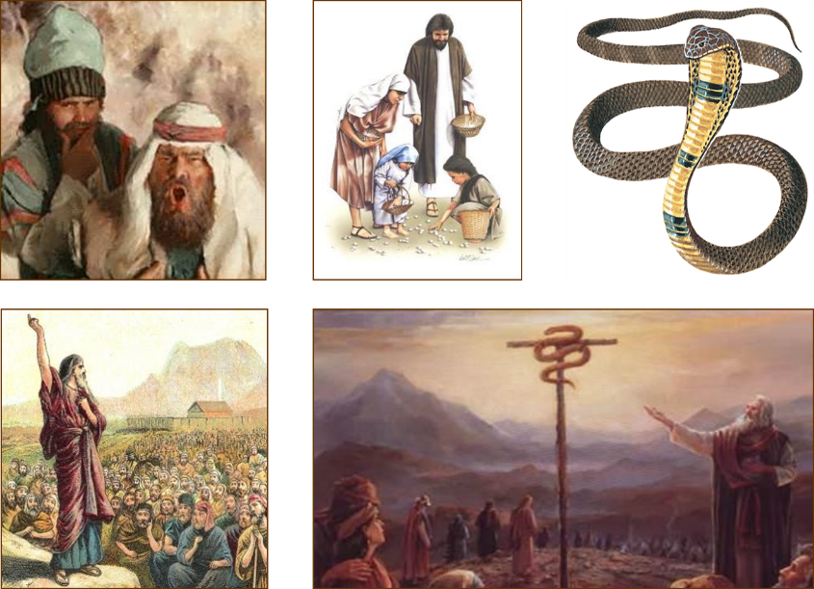
Law & Grace: Lesson 8 – At Whom are you looking?

Slide 22
Session 8 Outline
Review
Purpose, Aim, and Objective
Session 7
At Whom are you looking? (Numbers 21:4-9)
General Information
Comments & Commentary
Conclusion

Slide 23
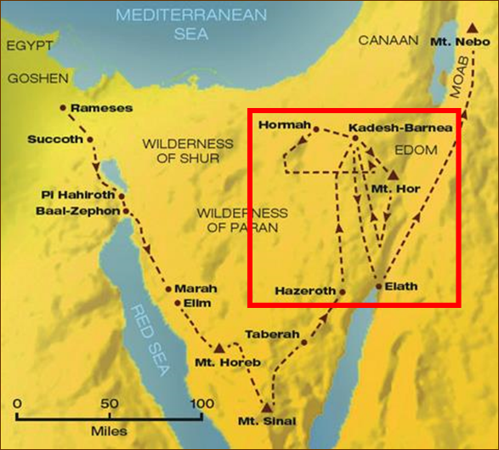
Law & Grace: Lesson 8 – At Whom are you looking?
The Israelites wilderness wanderings.

Slide 24
Numbers 21:4-9 - a brief, but pivotal account
Law & Grace: Lesson 8 – At Whom are you looking?
This is one of the shorter passages we’ve studied in our “Law & Grace” series so far.
But it is also a very pivotal passage, both for Israel and everyone else.

Slide 25
Numbers 21:4-9 - a brief, but pivotal account
Law & Grace: Lesson 8 – At Whom are you looking?
This is the last time that the Children of Israel griped and complained against God and Moses.

Slide 26
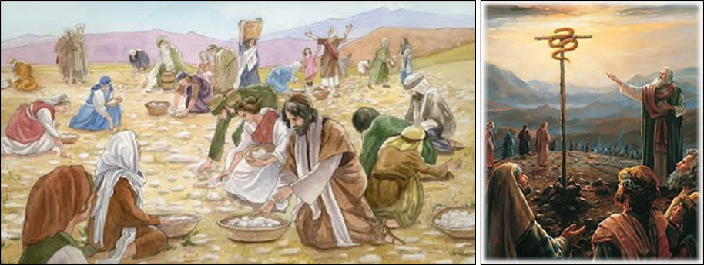
Numbers 21:4-9 - a brief, but pivotal account
Law & Grace: Lesson 8 – At Whom are you looking?
Both the manna God provided (v. 5: “this miserable food”) and the serpent pictured Christ.

Slide 27
Session 8 Outline
Review
Purpose, Aim, and Objective
Session 7
At Whom are you looking? (Numbers 21:4-9)
General Information
Comments & Commentary
Conclusion

Slide 28
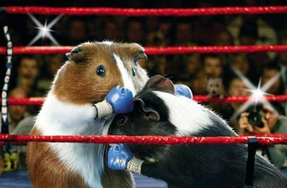
Law & Grace: Lesson 8 – At Whom are you looking?
Round 1: The Last Great Gripe
Numbers 21:4-5

Slide 29
Numbers 21:4–9
⁴ Then they set out from Mount Hor by the way of the Red Sea, to go around the land of Edom; and the people became impatient because of the journey. ⁵ The people spoke against God and Moses, “Why have you brought us up out of Egypt to die in the wilderness? For there is no food and no water, and we loathe this miserable food.” ⁶ The Lord sent fiery serpents among the people and they bit the people, so that many people of Israel died. ⁷ So the people came to Moses and said, “We have sinned, because we have spoken against the Lord and you; intercede with the Lord, that He may remove the serpents from us.” And Moses interceded for the people…

Slide 30
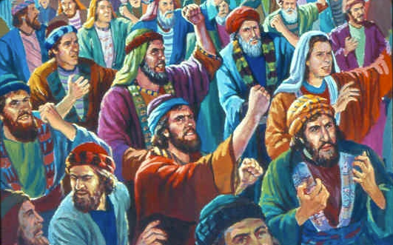
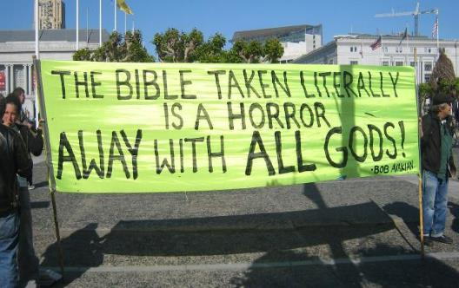
Law & Grace: Lesson 8 – At Whom are you looking?
Round 1: The Last Great Gripe
Numbers 21:4-5
The people come to Moses and pick up where they left off in the preceding chapter once again complaining about being hungry and thirsty and directing their ire against both God and Moses.

Slide 31
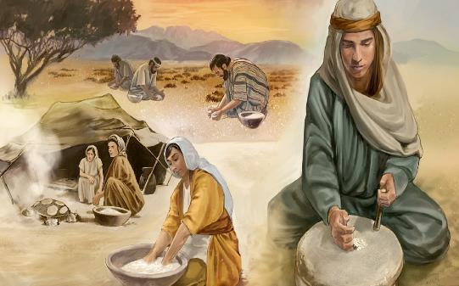
Law & Grace: Lesson 8 – At Whom are you looking?
Round 1: The Last Great Gripe
Numbers 21:4-5
By this time most of the people of Israel had grown up eating mostly manna, but now, they refer to it as “this miserable food”.

Slide 32
Law & Grace: Lesson 8 – At Whom are you looking?
Jesus: the Bread of Life

Slide 33
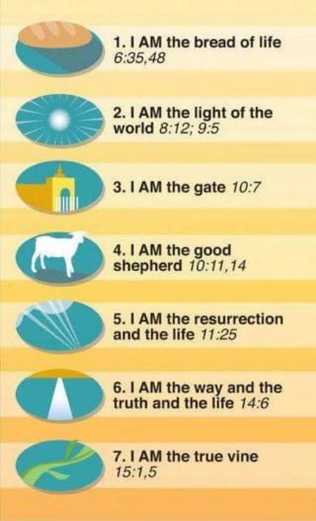
Law & Grace: Lesson 8 – At Whom are you looking?
7 ‘I AM’ Sayings of Christ
“I am the bread of life” is one of 7 ‘I AM’ declarations that Jesus makes in the Gospel of John. In each case Jesus is claiming deity, that He is in fact, God Himself.

Slide 34
Law & Grace: Lesson 8 – At Whom are you looking?
Jesus’ Resurrection Proves His Deity
“I know the resurrection is a fact, and Watergate proved it to me. How? Because 12 men testified they had seen Jesus raised from the dead, then they proclaimed that truth for 40 years, never once denying it. Every one was beaten, tortured, stoned and put in prison. They would not have endured that if it weren't true. Watergate embroiled 12 of the most powerful men in the world – and they couldn't keep a lie for three weeks. You're telling me 12 apostles could keep a lie for 40 years? Absolutely impossible.” Charles Colson

Slide 35
John 6:35–51
³⁵ Jesus said to them, “I AM the bread of life; he who comes to Me will not hunger, and he who believes in Me will never thirst. ³⁶ “But I said to you that you have seen Me, and yet do not believe. ³⁷ “All that the Father gives Me will come to Me, and the one who comes to Me I will certainly not cast out. ³⁸ “For I have come down from heaven, not to do My own will, but the will of Him who sent Me. ³⁹ “This is the will of Him who sent Me, that of all that He has given Me I lose nothing, but raise it up on the last day. ⁴⁰ “For this is the will of My Father, that everyone who beholds the Son and believes in Him will have eternal life, and I Myself will raise him up on …

Slide 36
John 6:35–51
…last day.” ⁴¹ Therefore the Jews were grumbling about Him, because He said, “I AM the bread that came down out of heaven.” ⁴² They were saying, “Is not this Jesus, the son of Joseph, whose father and mother we know? How does He now say, ‘I have come down out of heaven’?” ⁴³ Jesus answered and said to them, “Do not grumble among yourselves. ⁴⁴ “No one can come to Me unless the Father who sent Me draws him; and I will raise him up on the last day. ⁴⁵ “It is written in the prophets, ‘And they shall all be taught of God.’ Everyone who has heard and learned from the Father, comes to Me. ⁴⁶ “Not that anyone has seen the Father, …

Slide 37
John 6:35–51
…the One who is from God; He has seen the Father. ⁴⁷ “Truly, truly, I say to you, he who believes has eternal life. ⁴⁸ “I AM the bread of life. ⁴⁹ “Your fathers ate the manna in the wilderness, and they died. ⁵⁰ “This is the bread which comes down out of heaven, so that one may eat of it and not die. ⁵¹ “I AM the living bread that came down out of heaven; if anyone eats of this bread, he will live forever; and the bread also which I will give for the life of the world is My flesh.”

Slide 38
John 6:35–51
³⁵ Jesus said to them, “I AM the bread of life; he who comes to Me will not hunger, and he who believes in Me will never thirst. ³⁶ “But I said to you that you have seen Me, and yet do not believe. ³⁷ “All that the Father gives Me will come to Me, and the one who comes to Me I will certainly not cast out. ³⁸ “For I have come down from heaven, not to do My own will, but the will of Him who sent Me. ³⁹ “This is the will of Him who sent Me, that of all that He has given Me I lose nothing, but raise it up on the last day. ⁴⁰ “For this is the will of My Father, that everyone who beholds the Son and believes in Him will have eternal life, and I Myself will raise him up on …

Slide 39
John 6:35–51
…the One who is from God; He has seen the Father. ⁴⁷ “Truly, truly, I say to you, he who believes has eternal life. ⁴⁸ “I AM the bread of life. ⁴⁹ “Your fathers ate the manna in the wilderness, and they died. ⁵⁰ “This is the bread which comes down out of heaven, so that one may eat of it and not die. ⁵¹ “I AM the living bread that came down out of heaven; if anyone eats of this bread, he will live forever; and the bread also which I will give for the life of the world is My flesh.”

Slide 40
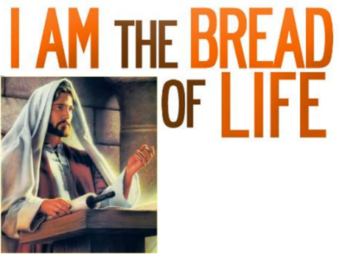
Law & Grace: Lesson 8 – At Whom are you looking?
The Manna & the Bread of Life
John 6:35-51
Jesus is the source of life and He made a significant contrast and comparison between ‘the manna’ and Himself, the ‘Bread of Life’.

Slide 41
Law & Grace: Lesson 8 – At Whom are you looking?
The Manna & the Bread of Life
John 6:35-51
One the one hand, those who ate the manna while certainly sustained by it, ultimately, all died.

Slide 42
Law & Grace: Lesson 8 – At Whom are you looking?
The Manna & the Bread of Life
John 6:35-51
Christ equated eating the ‘Bread of Life’ with the only way to have eternal life! ‘Eating the ‘Bread of Life’ is another way to express believing in Him.

Slide 43
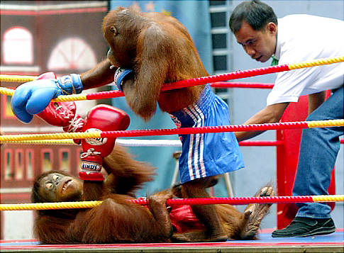
Round 2: The Serpents Numbers 21:6
Law & Grace: Lesson 8 – At Whom are you looking?

Slide 44
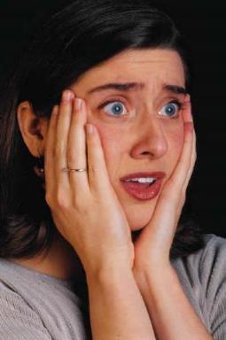
Warning to all those suffering with ophidiophobia!
Law & Grace: Lesson 8 – At Whom are you looking?
The Serpents Numbers 21:6

Slide 45
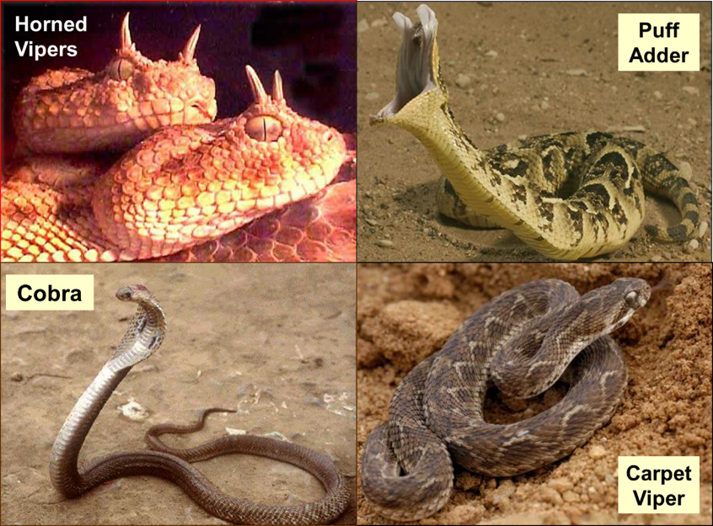
Law & Grace: Lesson 8 – At Whom are you looking?

Slide 46
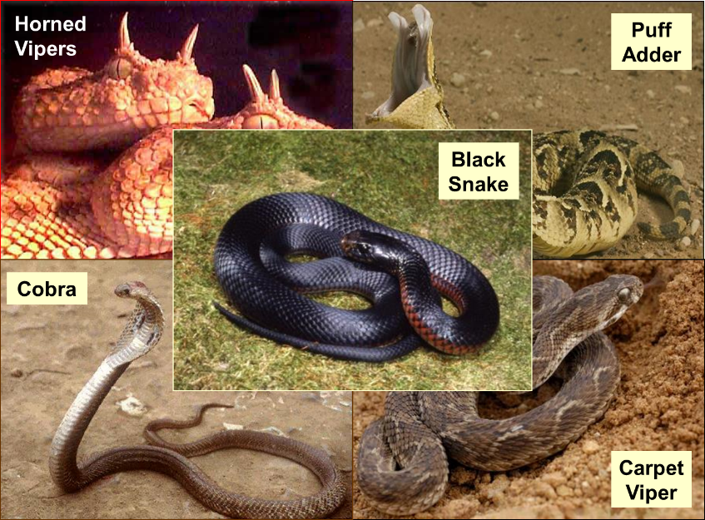
Law & Grace: Lesson 8 – At Whom are you looking?

Slide 47
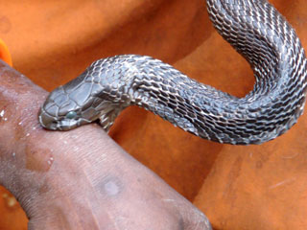
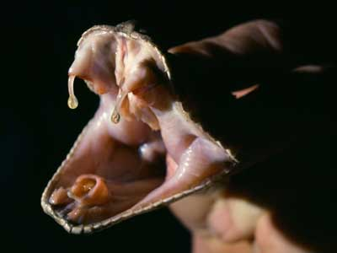
Law & Grace: Lesson 8 – At Whom are you looking?
The Serpents BITE! Numbers 21:6
These serpents were sent there by God to discipline the Israelites for complaining.

Slide 48
Law & Grace: Lesson 8 – At Whom are you looking?
The Serpents BITE! Numbers 21:6
The term ‘fiery’ most likely referred to the burning sensation of the venom but the bite wasn’t just very painful, but also fatal.

Slide 49
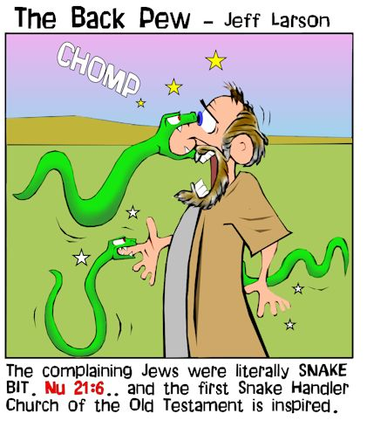
Law & Grace: Lesson 8 – At Whom are you looking?

Slide 50
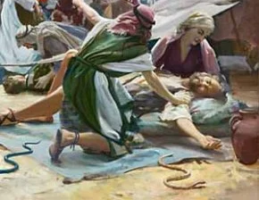
Law & Grace: Lesson 8 – At Whom are you looking?
Discipline, Then and Now
Hebrews 12:4-11
The Lord chose to send serpents with a fiery, burning bite to discipline the Israelites, costing many of them their very lives.

Slide 51
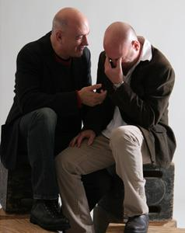
Law & Grace: Lesson 8 – At Whom are you looking?
Discipline, Then and Now
Hebrews 12:4-11
Though they were under Law, and we are under Grace, the Lord, who loves us, disciplines us in the Church also.
There are two reasons why believers to go through difficulties: discipline and trials.

Slide 52
Hebrews 12:4–11
⁴ You have not yet resisted to the point of shedding blood in your striving against sin; ⁵ and you have forgotten the exhortation which is addressed to you as sons, “My son, do not regard lightly the discipline of the Lord, Nor faint when you are reproved by Him; ⁶ For those whom the Lord loves He disciplines, And He scourges every son whom He receives.” ⁷ It is for discipline that you endure; God deals with you as with sons; for what son is there whom his father does not discipline? ⁸ But if you are without discipline, of which all have become partakers, then you are illegitimate children and not sons. ⁹ Furthermore, we had earthly fathers to discipline us, …

Slide 53
Hebrews 12:4–11
…and we respected them; shall we not much rather be subject to the Father of spirits, and live? ¹⁰ For they disciplined us for a short time as seemed best to them, but He disciplines us for our good, so that we may share His holiness. ¹¹ All discipline for the moment seems not to be joyful, but sorrowful; yet to those who have been trained by it, afterwards it yields the peaceful fruit of righteousness.

Slide 54
Law & Grace: Lesson 8 – At Whom are you looking?
Discipline, Then and Now
Hebrews 12:4-11
God has a purpose in both.
Discipline is primarily directed at getting us to walk in fellowship with him and back on the path of fellowship with him and other believers.
Trials are used by God in the lives of those who are walking in fellowship with Him, to induce growth and maturity.

Slide 55
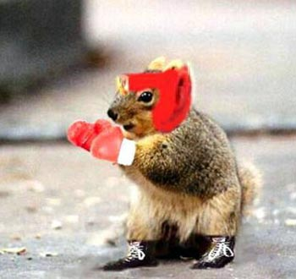
Law & Grace: Lesson 8 – At Whom are you looking?
Round 3: Now we get it! Numbers 21:7

Slide 56
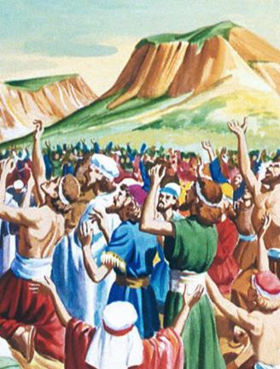
Law & Grace: Lesson 8 – At Whom are you looking?
Now we get it! Numbers 21:7
The Israelites responded appropriately, “So the people came to Moses and said,
“We have sinned, because we have spoken against the Lord and you”

Slide 57
Law & Grace: Lesson 8 – At Whom are you looking?
Now we get it! Numbers 21:7
They acknowledged that they had done wrong, and they went to Moses, to ask him to intercede with God for them.

Slide 58
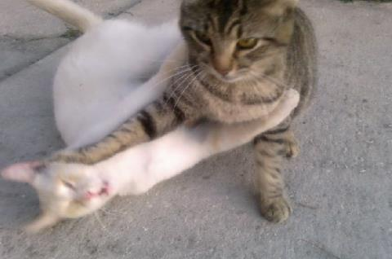
Law & Grace: Lesson 8 – At Whom are you looking?
Round 4: What to do…? Numbers 21:8-9

Slide 59
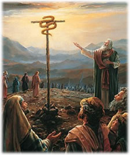
Numbers 21:8–9
... ⁸ Then the Lord said to Moses, “Make a fiery serpent, and set it on a standard; and it shall come about, that everyone who is bitten, when he looks at it, he will live.” ⁹ And Moses made a bronze serpent and set it on the standard; and it came about, that if a serpent bit any man, when he looked to the bronze serpent, he lived.

Slide 60
Law & Grace: Lesson 8 – At Whom are you looking?
What to do…? Numbers 21:8-9
God told Moses to set up a serpent on a standard, so that anyone who had been bitten by one of the serpents would live (a standard is a pole sometimes with a cross piece or platform).
Moses did exactly as God had commanded.
The result was that anyone who had been bitten by one of the serpents lived.

Slide 61
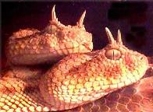
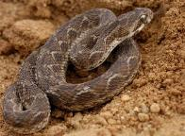
Why didn’t the Lord just remove the serpents? Numbers 21:8-9
Law & Grace: Lesson 8 – At Whom are you looking?

Slide 62
Why didn’t the Lord just remove the serpents? Numbers 21:8-9
Law & Grace: Lesson 8 – At Whom are you looking?
While the Lord certainly could have simply removed the serpents, He chose not to, for at least a couple of reasons:

Slide 63
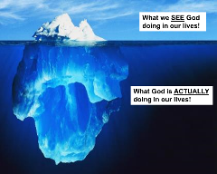
Why didn’t the Lord just remove the serpents? Numbers 21:8-9
Law & Grace: Lesson 8 – At Whom are you looking?
By having Moses place the serpent on a standard, the Children of Israel were confronted with their one and only requirement for deliverance and healing: faith in God’s provision.

Slide 64
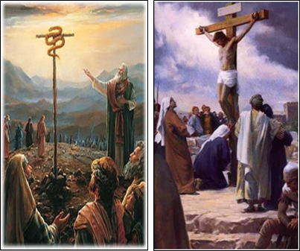
Why didn’t the Lord just remove the serpents? Numbers 21:8-9
Law & Grace: Lesson 8 – At Whom are you looking?
By having Moses place the serpent on a standard, God could use this even as an illustration that would point to Christ, God’s one and only provision for spiritual deliverance and healing.

Slide 65
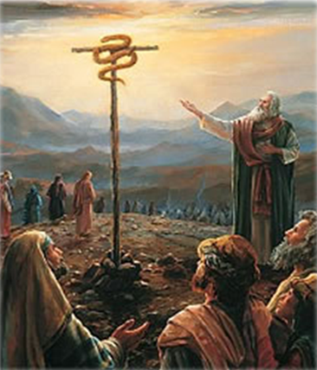
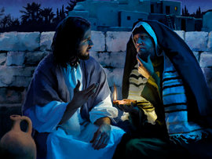
Jesus pictured by the serpent in the wilderness John 3:14-16
Law & Grace: Lesson 8 – At Whom are you looking?
Nicodemus & Jesus

Slide 66
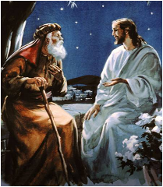
John 3:14–16
¹⁴ “As Moses lifted up the serpent in the wilderness, even so must the Son of Man be lifted up; ¹⁵ so that whoever believes will in Him have eternal life. ¹⁶ “For God so loved the world, that He gave His only begotten Son, that whoever believes in Him shall not perish, but have eternal life.

Slide 67
1 Corinthians 10:11
Now these things happened to them as an example, and they were written for our instruction, upon whom the ends of the ages have come.

Slide 68
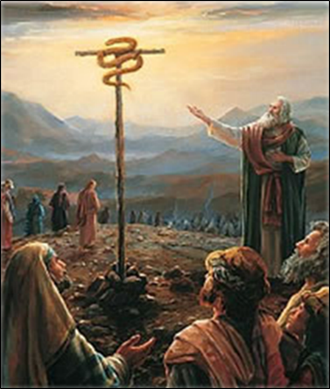
Law & Grace: Lesson 8 – At Whom are you looking?
Serpent on a standard – Christ on a cross Numbers 21:8-9
As the serpent was lifted up, so was Christ lifted up.
As the Israelites who were bitten were saved physically by looking in faith at God’s provision…

Slide 69
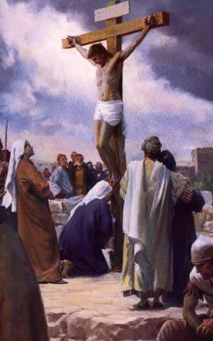
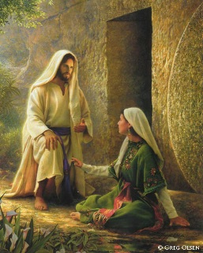
Law & Grace: Lesson 8 – At Whom are you looking?
Serpent on a standard – Christ on a cross Numbers 21:8-9
…likewise, people who have been bitten by sin, are saved spiritually by looking in faith to God’s provision in Christ, who died for our sins, was buried, and rose again, so that we might live eternally.

Slide 70
Law & Grace: Lesson 8 – At Whom are you looking?
Something to consider… Numbers 21:8-9
The Children of Israel could have said, “No, looking at a serpent on a standard wasn’t what I asked for!”
Likewise, unbelievers today can say, “No, Christ’s death isn’t what I asked for”.

Slide 71
Law & Grace: Lesson 8 – At Whom are you looking?
Something to consider… Numbers 21:8-9
The Children of Israel could have said, “Look at that serpent on the standard? No, that’s just too easy”!
Likewise, unbelievers today often say, “All I have to do is ‘just believe’ in Christ? No, that’s just too easy.”

Slide 72
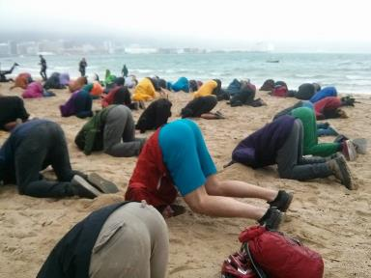
Law & Grace: Lesson 8 – At Whom are you looking?
Something to consider… Numbers 21:8-9
The Children of Israel could have denied having a serpent problem…that it wasn’t that bad…until they died.
Similarly, there are unbelievers today who tell themselves that they don’t have a sin problem, that it isn’t all that bad…until they die.

Slide 73
Law & Grace: Lesson 8 – At Whom are you looking?
Something to consider… Numbers 21:8-9
Some unbelievers tell themselves that they’re not as bad as some and not as good as some, but as long as God grades on a curve, I’ll be just fine.

Slide 74
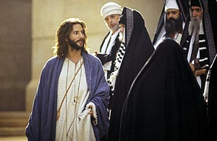
Law & Grace: Lesson 8 – At Whom are you looking?
Something to consider… Numbers 21:8-9
Some unbelievers say, “I don’t really believe in that God stuff,” and that might seem to them to work for a while… until they die.
John 8:24
“…unless you believe… you will die in your sins.”

Slide 75
Law & Grace: Lesson 8 – At Whom are you looking?
It’s always about looking Numbers 21:8-9; John 3:14-16; 2 Corinthians 3:18
The person who looks to God’s provision through Christ, in faith, will be saved eternally.

Slide 76
John 6:40
“For this is the will of My Father, that everyone who beholds the Son and believes in Him will have eternal life, and I Myself will raise him up on the last day.”

Slide 77
Law & Grace: Lesson 8 – At Whom are you looking?
It’s always about looking Numbers 21:8-9; John 3:14-16; 2 Corinthians 3:18
The one who has looked to Christ for salvation is transformed into Christ’s image.
The one who has believed unto salvation continues to look to Christ to be changed!

Slide 78
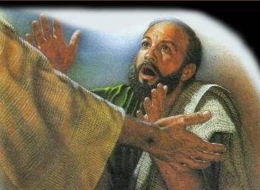
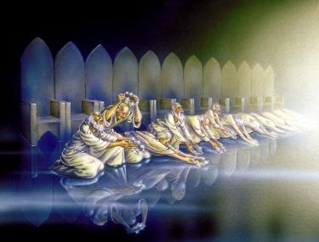
Law & Grace: Lesson 8 – At Whom are you looking?
It’s always about looking Numbers 21:8-9; John 3:14-16; 2 Corinthians 3:18
Then those who had been looking in faith will one day see Him face to face:
“We know that when He appears, we will be like Him, because we will see Him just as He is.” 1 John 3:2

Slide 79
Session 8 Outline
Review
Purpose, Aim, and Objective
Session 7
At Whom are you looking? (Numbers 21:4-9)
General Information
Comments & Commentary
Conclusion

Slide 80
Law & Grace: Lesson 8 – Whacking & Watering
Conclusion

Slide 81
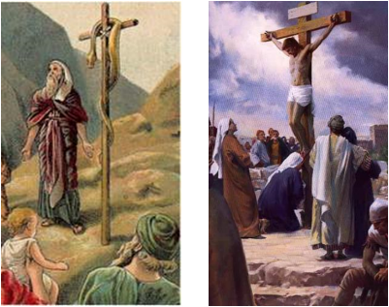
Law & Grace: Lesson 8 – At Whom are you looking?
Then there’s a contrast Numbers 21:4-9
While we’ve been comparing the Serpent on the Standard with Christ, there is also a very sharp contrast we should not overlook:
The bronze serpent didn’t love the Israelites.

Slide 82
Law & Grace: Lesson 8 – At Whom are you looking?
Then there’s a contrast Numbers 21:4-9
But in contrast, God’s word tells us that:
God loved and He gave (John 3:16).
Christ loved and He gave (Galatians 2:20; Ephesians 5:2; 25).

Slide 83
John 3:16
“For God so loved the world, that He gave His only begotten Son, that whoever believes in Him shall not perish, but have eternal life.
Galatians 2:20
I have been crucified with Christ; and it is no longer I who live, but Christ lives in me; and the life which I now live in the flesh I live by faith in the Son of God, who loved me and gave Himself up for me.
Ephesians 5:2
²…walk in love, just as Christ also loved you and gave Himself up for us, an offering and a sacrifice to God as a fragrant aroma…²⁵ Husbands, love your wives, just as Christ also loved the church and gave Himself up for her…

Slide 84
Law & Grace: Lesson 8 – At Whom are you looking?
Then there’s a contrast Numbers 21:4-9
Unlike the serpent, Christ loved and gave this is why in Hebrews 12:1-2 it says, “for the joy set before Him endured the cross, despising the shame…”
Why? Because Christ’s love compelled Him to give. Christ loved and loves those He died for every single one.

Slide 85
Law & Grace: An Overview Jim McGowan, Th.D. Sugar Land Bible Church 05-27-2018
…but grace & truth were realized through Jesus Christ - John 1:17
For the Law was given through Moses…
Special thanks to Dr. Vern Peterman for access to his insights and resources.

