Slide 1
REVELATION INTRODUCTION
Dr. Andy Woods

Slide 2
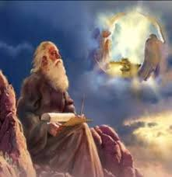
Answering Ten Questions
What is the book’s title?
Who wrote it?
From where was it written?
To whom was it written?
When was it written?

Slide 3
Answering Ten Questions
How is the book organized?
How was the book delivered?
What is the book about?
Why was the book written?
What makes the book different?

Slide 4
Answering Ten Questions
What is the book’s title?
Who wrote it?
From where was it written?
To whom was it written?
When was it written?

Slide 5
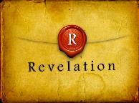
Revelation 1:1
“The Revelation [apokalypsis] of Jesus Christ, which God gave Him to show to His bond-servants, the things which must soon take place; and He sent and communicated it by His angel to His bond-servant John.”

Slide 6
Henry Morris
The Revelation Record, 323
“At the very least, it would be confusing to John’s first century readers, as well as to later generations, for him to write so much about Babylon when he really meant Rome (Paul was not afraid to speak directly against Rome in his writings, so why should John be?) or ‘the false church’ (all the apostles , including John, wrote plainly and scathingly about false teachers and false doctrines in the church and would not hide their teachings by symbols). It must be stressed that Revelation means “unveiling,” not “veiling.” In the absence of any statement in the text to the contrary, therefore, we must assume that the term Babylon applies to the real city of Babylon…”

Slide 7
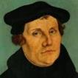
Martin Luther
Preface to the New Testament, 1522.
"I miss more than one thing in this book, and this makes me hold it to be neither apostolic nor prophetic…I think of it almost as I do of the Fourth Book of Esdras, and can in no way detect that the Holy Spirit produced it…It is just the same as if we did not have it, and there are many far better books for us to keep. Finally, let everyone think of it [Revelation] as his own spirit gives him to. My spirit cannot fit itself into this book. There is one sufficient reason for me not to think highly of it — Christ is not taught or known in it; but to teach Christ is the thing which an apostle is bound, above all else, to do, as He says in Acts 1, ‘Ye shall be my witnesses.’ Therefore I stick to the books which give me Christ, clearly and purely." In 1545, Luther printed the Book of Revelation with Hebrews, James and Jude as an appendix to the New Testament.
Notes:
Outline

Slide 8
Revelation 1:1
“The Revelation of Jesus Christ, which God gave Him to show to His bond-servants, the things which must soon take place; and He sent and communicated it by His angel to His bond-servant John.”

Slide 9
Revelation
The Revelation of Jesus Christ
Not John’s Revelation
Unveils the final phase of Christ’s redemptive program
Single vision

Slide 10
Revelation 19:10
“Then I fell at his feet to worship him. But he said to me, ‘Do not do that; I am a fellow servant of yours and your brethren who hold the testimony of Jesus; worship God. For the testimony of Jesus is the spirit of prophecy.’”

Slide 11
Revelation 1:1
“The Revelation [apokalypsis] of Jesus Christ, which God gave Him to show to His bond-servants, the things which must soon take place; and He sent and communicated it by His angel to His bond-servant John.”

Slide 12
BOOK OF DANIEL
CHAP. & VERSE | CHRONOLOGICAL DATE | BIBLICAL DATE
1:1 | 605 | 3rd year of Jehoiakim
2:1 | 603 | 2nd year of Nebuchadnezzar
5 | Sat. night 10/12/539 (Hoehner)
7:1 | 553 | 1st year of Belshazzar
8:1 | 551 | 3rd year of Belshazzar
9:1 | 538 | 1st year of Darius
10:1 | 536 | 3rd year of Cyrus

Slide 13
Daniel’s Age
CHAP. | EVENTS | AGE
1 | Taken to Babylonian captivity | 15
2 | Interpreting Nebuchadnezzar’s 1st dream (huge image) | 17
3 | Daniel’s 3 friends cast into the fiery furnace | 19 or 20
4 | Interpreting Nebuchadnezzar’s 2nd dream (huge tree) | 45-50
5 | Interpreting handwriting of the wall at Belshazzar’s feast | Early 80’s
6 | Delivered from the den of lions | c.83
7-8 | Daniel’s visions and dreams | Mid-60’s
9 | Daniel’s seventy “sevens” prophecy | Early-80’s
10-12 | Final dreams and visions | Mid-80’s

Slide 14
Answering Ten Questions
What is the book’s title?
Who wrote it?
From where was it written?
To whom was it written?
When was it written?

Slide 15
Revelation 1:1
“The Revelation of Jesus Christ, which God gave Him to show to His bond-servants, the things which must soon take place; and He sent and communicated it by His angel to His bond-servant John.”

Slide 16
Johannine Authorship
Named 5x
Revelation 1:1, 4, 9; 21:2; 22:8
Wrote five New Testament books

Slide 17
Answering Ten Questions
What is the book’s title?
Who wrote it?
From where was it written?
To whom was it written?
When was it written?

Slide 18
Revelation 1:9
“I, John, your brother and fellow partaker in the tribulation and kingdom and perseverance which are in Jesus, was on the island called Patmos because of the word of God and the testimony of Jesus.”

Slide 19
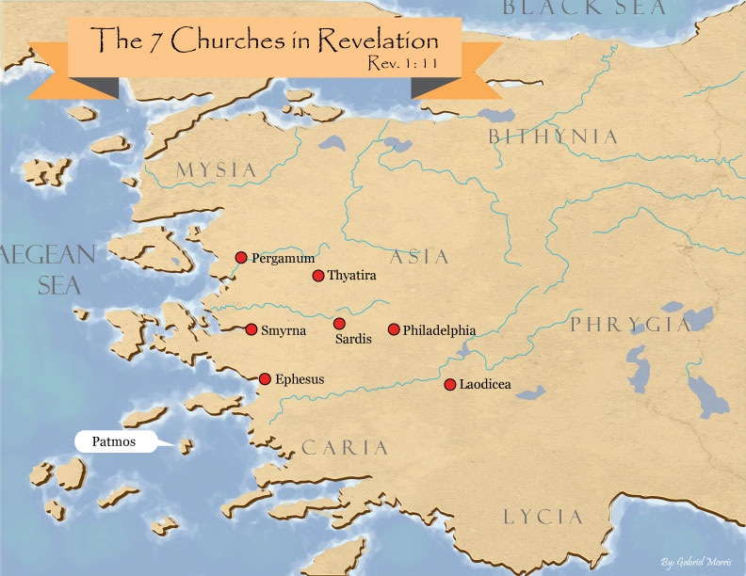

Slide 20
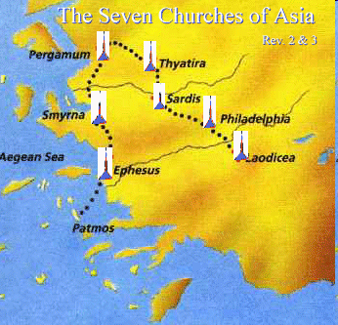

Slide 21
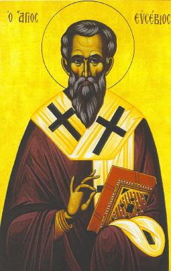
Eusebius Ecclesiastical History, 3.18.4
“…and they even indicated the time accurately, relating that in the fifteenth year of Domitian, Flavia Domitilla, who was the niece of Flavius Clemens, one of the many consuls at Rome at that time, was banished with many others to the island of Pontia as testimony to Christ.”

Slide 22
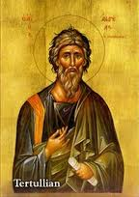
Tertullian Prescription Against Heretics, 36
“…where the Apostle John was first plunged, unhurt, into boiling oil, and thence remitted to his island-exile!”

Slide 23
Answering Ten Questions
What is the book’s title?
Who wrote it?
From where was it written?
To whom was it written?
When was it written?

Slide 24
Revelation 1:11
“saying, ‘Write in a book what you see, and send it to the seven churches: to Ephesus and to Smyrna and to Pergamum and to Thyatira and to Sardis and to Philadelphia and to Laodicea.’”

Slide 26
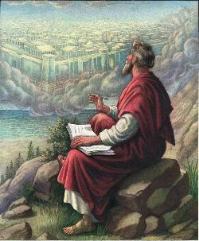
John 20:30-31
“Therefore many other signs Jesus also performed in the presence of the disciples, which are not written in this book; but these have been written so that you may believe that Jesus is the Christ, the Son of God; and that believing you may have life in His name.”

Slide 27
Revelation 1:9
“I, John, your brother and fellow partaker in the tribulation and kingdom and perseverance which are in Jesus, was on the island called Patmos because of the word of God and the testimony of Jesus.”

Slide 28
Answering Ten Questions
What is the book’s title?
Who wrote it?
From where was it written?
To whom was it written?
When was it written?

Slide 29
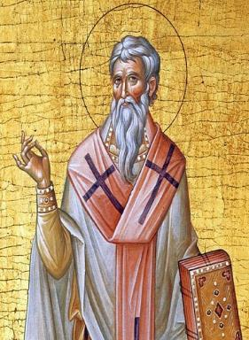
Late Date (A.D. 95) Irenaeus Against Heresies 5.30.3
“But if it had been necessary to announce his name plainly at the present time, it would have been spoken by him who saw the apocalypse. For it was not seen long ago, but almost in our own time, at the end of the reign of Domitian.”

Slide 30
Late Date (A.D. 95)
Internal evidence
Ephesus is different (Revelation 2:4, 6)
Laodicean earthquake (Revelation 3:17)

Slide 31
Answering Ten Questions
How is the book organized?
How was the book delivered?
What is the book about?
Why was the book written?
What makes the book different?

Slide 32
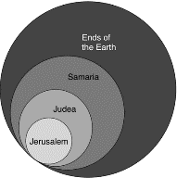
Acts 1:8
“but you will receive power when the Holy Spirit has come upon you; and you shall be My witnesses both in Jerusalem, and in all Judea and Samaria, and even to the remotest part of the earth.”

Slide 33
Revelation 1:19
“Therefore write the things which you have seen, and the things which are, and the things which will take place after these things [meta tauta].”

Slide 34
Revelation 1:19
Seen (1)
Are (2–3)
After these things (4–22)

Slide 35
Revelation 4:1
“After these things [meta tauta] I looked, and behold, a door standing open in heaven, and the first voice which I had heard, like the sound of a trumpet speaking with me, said, ‘Come up here, and I will show you what must take place after these things [meta tauta].’”

Slide 36
Answering Ten Questions
How is the book organized?
How was the book delivered?
What is the book about?
Why was the book written?
What makes the book different?

Slide 37
Revelation 1:1, 11; 2:1
“¹ The Revelation of Jesus Christ, which God gave Him to show to His bond-servants, the things which must soon take place; and He sent and communicated it by His angel to His bond-servant John, …¹¹saying, ‘Write in a book what you see, and send it to the seven churches: to Ephesus and to Smyrna and to Pergamum and to Thyatira and to Sardis and to Philadelphia and to Laodicea.’…¹To the angel of the church in Ephesus.”

Slide 38
Method of Communication
From the Father
to Christ the Son
to an angel
to John
to a book
to a reader or preacher
to a listener or the seven churches

Slide 39
Answering Ten Questions
How is the book organized?
How was the book delivered?
What is the book about?
Why was the book written?
What makes the book different?

Slide 40
Message
Christ’s ultimate victory over evil provides comfort to Christians of all ages as well as a stimulus for holy living because when God fulfills His covenants with Israel He will gain victory over evil as well as punish it.

Slide 42
Evidence of Abrahamic Covenant’s Unconditional Nature
ANE covenant ratification ceremony (Gen 15)
Lack of stated conditions for Israel’s obedience (Gen 15)
Covenant's eternality (Gen 17:7, 13, 19; Ps. 90:2)
Covenant's immutability (Heb 6:13-18; Mal. 3:6)
Trans-generational reaffirmation despite perpetual national disobedience (Jer 31:35-37)
Walvoord, The Millennial Kingdom, 149-52

Slide 43
Land Promises Fulfilled in the Time of Joshua (Josh. 11:23; 21:43-45) or Solomon (1 Kgs. 4:21)?
Extended context (Josh 13:1-7; Judges 1:19, 21, 27, 29, 30-36)
Land gained in conquest was only a fraction of what was promised (1 Kgs. 4:25)
Jerusalem not conquered in Joshua’s day (Josh 15:63; 2 Sam 5)
Solomon’s reign extended to the border of Egypt (1 Kgs. 4:21) and not the River of Egypt (Gen. 15:18)
Solomon’s reign was tributary only (1 Kgs. 4:21)
Forever? (Gen 17:7-8, 13, 19)
Reaffirmation of land promises long after Joshua and Solomon’s time (Amos 9:11-15)
Fruchtenbaum, Israelology, 521-22, 631-32

Slide 44
Jeremiah 31:35-37
³⁵ “Thus says the Lord, Who gives the sun for light by day And the fixed order of the moon and the stars for light by night, Who stirs up the sea so that its waves roar; The Lord of hosts is His name: ³⁶ “If this fixed order departs From before Me,” declares the Lord, “Then the offspring of Israel also will cease From being a nation before Me forever.” ³⁷ Thus says the Lord, “If the heavens above can be measured And the foundations of the earth searched out below, Then I will also cast off all the offspring of Israel For all that they have done,” declares the Lord.”

Slide 45
God’s Work Through Israel
Revelation 7-144,000 Jews
Revelation 11-Two Jewish witnesses
Revelation 12-Israel flees
Revelation 20:9-Jerusalem in the kingdom
Revelation 21:12-13-Gates of the eternal city

Slide 46
Answering Ten Questions
How is the book organized?
How was the book delivered?
What is the book about?
Why was the book written?
What makes the book different?

Slide 47
Purpose
To comfort the oppressed churches of Asia Minor and stimulate them to practical holiness through a future reminder of God’s conquest and punishment of evil.

Slide 49
Answering Ten Questions
How is the book organized?
How was the book delivered?
What is the book about?
Why was the book written?
What makes the book different?

Slide 50
Unique Characteristics
Blessing to hearers and heeders (1:3; 22:7)
Curse to subtractors (22:18-19)
OT allusions
Recurring numbers
God’s vindication
Lamb and lion
Praises to God (4:2-5; 7:9-12; 15:2-8; 19:1-7)
Symbols, visions, imagery
Chronological organization
Interconnected with other biblical material

Slide 54
Revelation 11:15
¹⁵ “Then the seventh angel sounded; and there were loud voices in heaven, saying, ‘The kingdom of the world has become the kingdom of our Lord and of His Christ; and He will reign forever and ever.’”

Slide 55
Conclusion

Slide 56
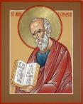
Answering Ten Questions
What is the title – Revelation of Jesus Christ
Who wrote it? – John
Where was it written from? – Patmos
To Whom was it written? – The Seven Churches
When was it written? – A.D. 95
How is it organized (outline)? – 3 part outline
How was it delivered – Seven steps
Why was it written? – Encouragement and holiness
What is it about? – Jesus’ final victory
What makes the book different? – OT relationship

Slide 57
“The Lord bless you and keep you; the Lord make his face shine on you and be gracious to you; the Lord turn his face toward you and give you peace.” (NIV)

