Slide 1
THE BOOK OF DANIEL
Dr. Andy Woods

Slide 2
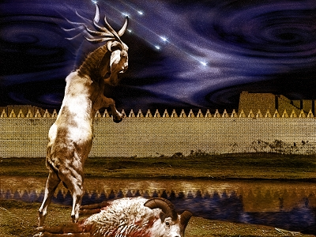
DANIEL 10-12 THE FINAL VISION

Slide 3
CHAPTER AND VERSE IN DANIEL | CHRONOLOGICAL DATE | BIBLICAL DATE
1:1 | 605 | 3rd year of Jehoiakim
2:1 | 603 | 2nd year of Nebuchadnezzar
5 | Sat. night 10/12/539 (Hoehner)
7:1 | 553 | 1st year of Belshazzar
8:1 | 551 | 3rd year of Belshazzar
9:1 | 538 | 1st year of Darius
10:1 | 536 | 3rd year of Cyrus

Slide 4
Chapter 10–12 Outline
The Setting (10:1-3)
Arrival of the Heavenly Messenger (10:4-9)
Explanation of the Heavenly Messenger (10:10–11:1)
The Prophecy of the Heavenly Messenger (11:2–12:13)

Slide 5
IV. The Prophecy of the Heavenly Messenger (11:2–12:13)
Persia (11:2)
Greece (11:3-4)
Ptolemies & Seleucids (11:5-20)
Antiochus IV (11:21-35)
Antichrist (11:36-45)
Tribulation & Millennium (12:1-13)

Slide 7
IV. The Prophecy of the Heavenly Messenger (11:2–12:13)
Persia (11:2)
Greece (11:3-4)
Ptolemies & Seleucids (11:5-20)
Antiochus IV (11:21-35)
Antichrist (11:36-45)
Tribulation & Millennium (12:1-13)

Slide 8
IV. The Prophecy of the Heavenly Messenger (11:2–12:13)
Persia (11:2)
Greece (11:3-4)
Ptolemies & Seleucids (11:5-20)
Antiochus IV (11:21-35)
Antichrist (11:36-45)
Tribulation & Millennium (12:1-13)

Slide 9
The Tribulation & Millennium Daniel 12:1-13
Description of the End Times (1-4)
The Suffering (1)
The Separation (2)
The Shining (3)
The Sealing (4)
Harold Wilmington, The Outline Bible, pp. 418-19

Slide 10
The Tribulation & Millennium Daniel 12:1-13
Duration of the End Times (5-13)
Round 1 (5-7)
Question (5-6)
Answer (7)
Round 2 (8-13)
Question (8)
Answer (9-13)
Harold Wilmington, The Outline Bible, pp. 418-19

Slide 11
The Tribulation & Millennium Daniel 12:1-13
Duration of the End Times (5-13)
Round 1 (5-7)
Question (5-6)
Answer (7)
Round 2 (8-13)
Question (8)
Answer (9-13)
Harold Wilmington, The Outline Bible, pp. 418-19

Slide 12
The Tribulation & Millennium Daniel 12:1-13
Duration of the End Times (5-13)
Round 1 (5-7)
Question (5-6)
Answer (7)
Round 2 (8-13)
Question (8)
Answer (9-13)
Harold Wilmington, The Outline Bible, pp. 418-19

Slide 13
Two Basic Truths of Daniel 12:7
Duration of the Time Period (7a)
The Conversion of Israel (7b)

Slide 14
The Tribulation & Millennium Daniel 12:1-13
Duration of the End Times (5-13)
Round 1 (5-7)
Question (5-6)
Answer (7)
Round 2 (8-13)
Question (8)
Answer (9-13)
Harold Wilmington, The Outline Bible, pp. 418-19

Slide 15
The Tribulation & Millennium Daniel 12:1-13
Duration of the End Times (5-13)
Round 1 (5-7)
Question (5-6)
Answer (7)
Round 2 (8-13)
Question (8)
Answer (9-13)
Harold Wilmington, The Outline Bible, pp. 418-19

Slide 16
The Tribulation & Millennium Daniel 12:1-13
Duration of the End Times (5-13)
Round 1 (5-7)
Question (5-6)
Answer (7)
Round 2 (8-13)
Question (8)
Answer (9-13)
Harold Wilmington, The Outline Bible, pp. 418-19

Slide 17
Answer Daniel 12:9-13
Progressive illumination (9)
Contrast between the righteous & wicked (10)
Preparation for the Millennial Temple (11)
Preparation for the Millennial Kingdom (12)
Daniel’s predicted inheritance (13)

Slide 18
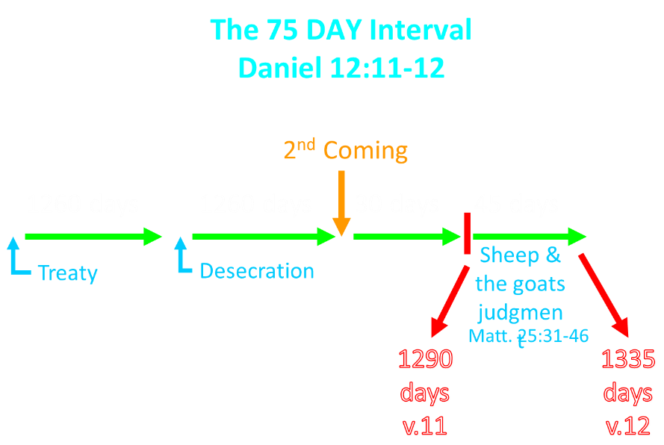

Slide 19
The 75 DAY Interval Daniel 12:11-12
The Beast cast into the Lake of Fire (Rev. 19:20)
The False Prophet cast into the Lake of Fire (Rev. 19:20)
The binding of Satan (Rev. 20:1-3)
The Judgment of the Jews (Ezek. 20:33-44)
The Judgment of the Gentiles (Matt. 25:31-46)
Resurrection of OT saints (Dan. 12:2) & Tribulation martyrs (Rev. 20:4-5)
Rewarding of OT saints & Tribulation martyrs (Dan. 12:3)
Fruchtenbaum, Footsteps of the Messiah, 367-78

Slide 20
Answer Daniel 12:9-13
Progressive illumination (9)
Contrast between the righteous & wicked (10)
Preparation for the Millennial Temple (11)
Preparation for the Millennial Kingdom (12)
Daniel’s predicted inheritance (13)

Slide 21
Daniel 12:13
“But as for you, go your way to the end; then you will enter into rest and rise again for your allotted portion at the end of the age.”

Slide 22
Daniel 12:13
“But as for you, go your way to the end; then you will enter into rest and rise again for your allotted portion at the end of the age.”

Slide 23
Daniel 12:13
“But as for you, go your way to the end; then you will enter into rest and rise again for your allotted portion at the end of the age.”

Slide 24
Daniel 12:4, 9
“But as for you, Daniel, conceal these words and seal up the book until the end of time; many will go back and forth, and knowledge will increase...Go your way, Daniel, for these words are concealed and sealed up until the end time.”
Notes:
‘to and fro‘ – refers to the increase in knowledge through searching out the scriptures; progressive illumination

Slide 25
Mark Twain, Autobiography, 2:37
“A myriad of men are born; they labor and sweat and struggle for bread; they squabble and scold and fight; they scramble for little mean advantages over each other. Age creeps upon them and infirmities follow; shames and humiliations bring down their prides and their vanities. Those they love are taken from them, and the joy of life is turned to aching grief. The burden of pain, care, and misery grows heavier year by year. At length ambition is dead, pride is dead, vanity is dead; longing for release is in their place. It comes at last-the only un-poisoned gift earth ever had for them-and they vanish from a world where they were of no consequence; where they achieved nothing, where they were a mistake and a failure and a foolishness; where they left no sign that they have existed-a world that will lament them a day and forget them forever.”

Slide 26
Daniel 12:13
“But as for you, go your way to the end; then you will enter into rest and rise again for your allotted portion at the end of the age.”

Slide 27
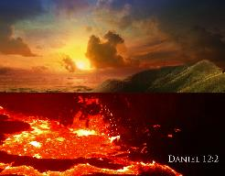
Daniel 12:2
“Many of those who sleep in the dust of the ground will awake, these to everlasting life, but the others to disgrace and everlasting contempt.”

Slide 28
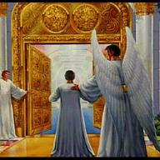
John 5:24
“Truly, truly, I say to you, he who hears My word, and believes Him who sent Me, has eternal life, and does not come into judgment, but has passed out of death into life.”

Slide 29
DTS Doctrinal Statement Article XI—Assurance
We believe it is the privilege, not only of some, but of all by the Spirit through faith who are born again in Christ as revealed in the Scriptures, to be assured of their salvation from the very day they take Him to be their Savior and that this assurance is not founded upon any fancied discovery of their own worthiness or fitness, but wholly upon the testimony of God in His written Word, exciting within His children filial love...

Slide 30
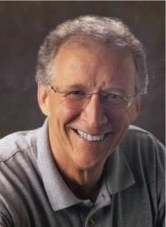
John Piper
“No Christian can be sure that he is a true believer. Hence, there is an ongoing need to be dedicated to the Lord and to deny ourselves so that we might make it.”
John Piper and Pastoral Staff, TULIP: What We Believe about the Five Points of Calvinism: Position Paper of the Pastoral Staff (Desiring God Ministries, 1997), 25, cited in Dave Hunt, What Love is This?, 379.

Slide 31
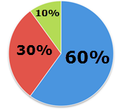
Assurance of Salvation in Lordship Salvation?

Slide 32
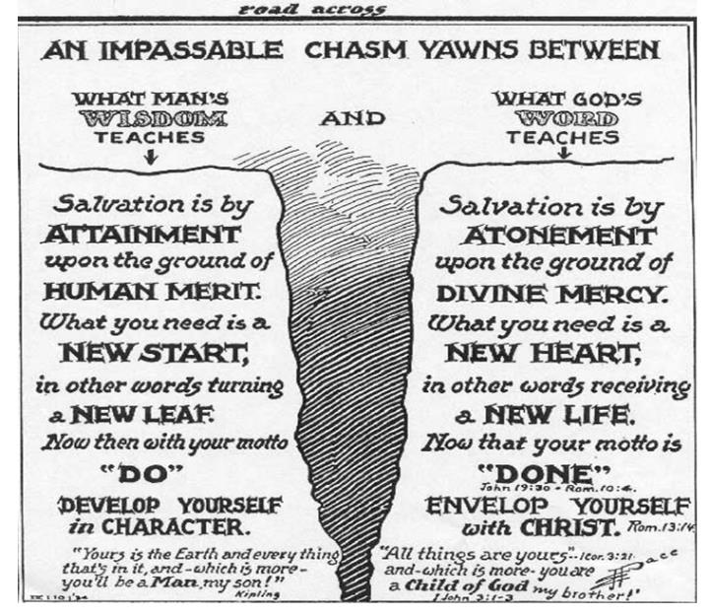
From the Middletown Bible Church Website

Slide 33
Daniel 12:13
“But as for you, go your way to the end; then you will enter into rest and rise again for your allotted portion at the end of the age.”

Slide 34
Daniel 12:3
“Those who have insight will shine brightly like the brightness of the expanse of heaven, and those who lead the many to righteousness, like the stars forever and ever.”

Slide 35
Daniel 12:3
“Those who have insight will shine brightly like the brightness of the expanse of heaven, and those who lead the many to righteousness, like the stars forever and ever.”

Slide 36
Daniel 12:3
“Those who have insight will shine brightly like the brightness of the expanse of heaven, and those who lead the many to righteousness, like the stars forever and ever.”

Slide 37
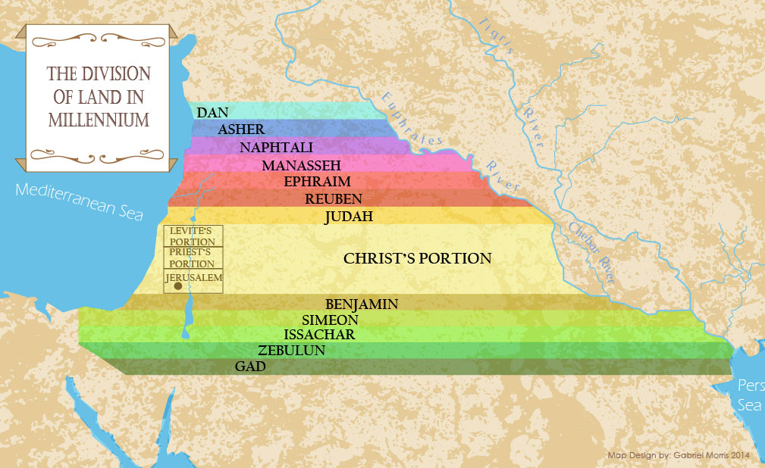

Slide 38
Daniel 12:13
“But as for you, go your way to the end; then you will enter into rest and rise again for your allotted portion at the end of the age.”

Slide 39
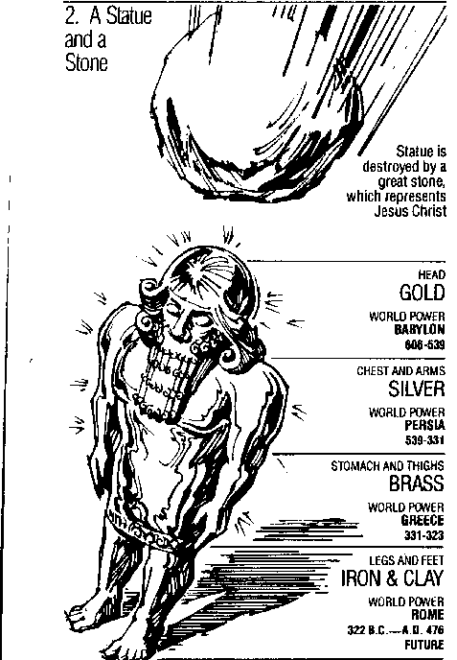
Statue
&
Stone

Slide 40
Daniel 2:44
“In the days of those kings the God of heaven will set up a kingdom which will never be destroyed, and that kingdom will not be left for another people; it will crush and put an end to all these kingdoms, but it will itself endure forever.”

Slide 41
2 Timothy 2:13
“If we are faithless, He remains faithful, for He cannot deny Himself.”

Slide 42
Conclusion

Slide 43
Message
Times of the Gentiles are revealed prophetically (2, 7, 8-12) and ethically (1, 3-6)

Slide 44
Purpose
To encourage Judah by emphasizing the sovereignty of God during the Babylonian captivity and to teach Judah how to live while outside the land

Slide 45
Diversity of Topics in Daniel
Prophecy
Eschatology
Confidence that the Bible is God’s word
Knowledge of Intertestamental Period
Angelology
Spiritual Warfare
Living for God in a Pagan Society
God’s Sovereignty Over Empires

Slide 46
“The Lord bless you and keep you; the Lord make his face shine on you and be gracious to you; the Lord turn his face toward you and give you peace.” (NIV)

