Slide 1

Ecclesiology
Session 23
Dr. Andy Woods
Senior Pastor – Sugar Land Bible Church
President – Chafer Theological Seminary

Slide 2


Areas of Systematic Theology
Prolegomena – Introduction
Theology – Study of God
Christology – Study of Christ
Pneumatology – Study of the Holy Spirit
Anthropology – Study of Man
Hamartiology – Study of sin
Soteriology – Study of salvation
Angelology – Study of angels
Ecclesiology – Study of the Church
Eschatology – Study of the end

Slide 3

Ecclesiology Overview
Definition
Universal vs. local
Word pictures
Origin
Israel – Church differences
Intercalation
Purposes
Activities
Government
Officers
Ordinances
Purity

Slide 4

VII. Purposes of the Local Church
Glorify God (Eph 3:21)
Edify the saints (Eph 4:11-16)
Fulfill the Great Commission (Matt 28:18-20)

Slide 5
VII. Purposes of the Local Church
Glorify God (Eph 3:21)
Edify the saints (Eph 4:11-16)
Fulfill the Great Commission (Matt 28:18-20)

Slide 6


2 Timothy 3:16-17
“¹⁶ All Scripture is inspired by God and profitable for teaching, for reproof, for correction, for training in righteousness; ¹⁷ so that the man of God may be adequate, equipped for every good work.”

Slide 7
Ephesians 4:11-16
“¹¹ And He gave some as apostles, and some as prophets, and some as evangelists, and some as pastors and teachers, ¹² for the equipping of the saints for the work of service, to the building up of the body of Christ;”

Slide 8

Spiritual Gifts

Slide 9
Areas of Systematic Theology
Prolegomena – Introduction
Theology – Study of God
Christology – Study of Christ
Pneumatology – Study of the Holy Spirit
Anthropology – Study of Man
Hamartiology – Study of sin
Soteriology – Study of salvation
Angelology – Study of angels
Ecclesiology – Study of the Church
Eschatology – Study of the end

Slide 10
Four Questions
What are some general observations about spiritual gifts?
Are all the spiritual gifts for today?
What are the spiritual gifts?
How do we discover our own unique area of gifting?

Slide 11
Four Questions
What are some general observations about spiritual gifts?
Are all the spiritual gifts for today?
What are the spiritual gifts?
How do we discover our own unique area of gifting?

Slide 12
Four Questions
What are some general observations about spiritual gifts?
Are all the spiritual gifts for today?
What are the spiritual gifts?
How do we discover our own unique area of gifting?

Slide 13
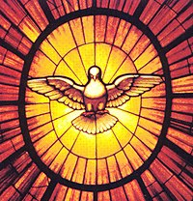
The Case for Selective Cessationism
Preliminary thoughts
Four categories of gifts
  Foundational (Eph 2:20)
  Confirmatory (Heb 2:3-4)
  Revelatory (Jude 3)
  Edificatory gifts continue (Eph. 4:11-16)
Church history and selective cessationism
Proper operation of the Sign & Revelatory gifts
True source of the charismatic movement
Explanation of the Charismatic movement's popularity

Slide 14
The Case for Selective Cessationism
Preliminary thoughts
Four categories of gifts
  Foundational (Eph 2:20)
  Confirmatory (Heb 2:3-4)
  Revelatory (Jude 3)
  Edificatory gifts continue (Eph. 4:11-16)
Church history and selective cessationism
Proper operation of the Sign & Revelatory gifts
True source of the charismatic movement
Explanation of the Charismatic movement's popularity

Slide 15
12/12/4/4
Romans 12
1 Corinthians 12
1 Peter 4
Ephesians 4

Slide 16
The Disputed Gifts
Apostle
Prophet
Worker of Miracles
Tongues
Interpretation of tongues
Healing

Slide 17
Two Camps
Charismatics – All the spiritual gifts are in operation today
Cessationists – Most of the spiritual gifts are in operation today

Slide 18
Preamble to Position Statements of SLBC Constitution
“Although agreement with the POSITION STATEMENTS is not required for membership, they are taught in this church. The POSITION STATEMENTS are not meant to prohibit honest and healthy discussions concerning what the Bible teaches about these issues; however, we believe that such discussions must be conducted under the guiding principle that believers are to strive to maintain unity.”

Slide 19
SLBC Position Statement No. 7
“TEMPORARY SPIRITUAL GIFTS – This church teaches that the miraculous sign gifts, including the gift of tongues, (always the ability to speak in a previously unlearned, known language) along with the gift of healings were temporal gifts, given by the Holy Spirit solely to authenticate both the apostles and their message before the close of the canon of Scripture (1 Cor. 13:8-10). We do not believe that these are active as gifts today. However, we affirm that God is sovereign and may heal and/or give someone the ability to speak in a tongue (foreign language) today. We believe that the majority of what is termed ‘miraculous’ within the contemporary charismatic movement is something other than the Biblical gifts of tongues or healing.”

Slide 20
The Case for Selective Cessationism
Preliminary thoughts
Four categories of gifts
  Foundational (Eph 2:20)
  Confirmatory (Heb 2:3-4)
  Revelatory (Jude 3)
  Edificatory gifts continue (Eph. 4:11-16)
Church history and selective cessationism
Proper operation of the Sign & Revelatory gifts
True source of the charismatic movement
Explanation of the Charismatic movement's popularity

Slide 21
The Case for Selective Cessationism
Preliminary thoughts
Four categories of gifts
  Foundational (Eph 2:20)
  Confirmatory (Heb 2:3-4)
  Revelatory (Jude 3)
  Edificatory gifts continue (Eph. 4:11-16)
Church history and selective cessationism
Proper operation of the Sign & Revelatory gifts
True source of the charismatic movement
Explanation of the Charismatic movement's popularity

Slide 22
The Case for Selective Cessationism
Preliminary thoughts
Four categories of gifts
  Foundational (Eph 2:20)
  Confirmatory (Heb 2:3-4)
  Revelatory (Jude 3)
  Edificatory gifts continue (Eph. 4:11-16)
Church history and selective cessationism
Proper operation of the Sign & Revelatory gifts
True source of the charismatic movement
Explanation of the Charismatic movement's popularity

Slide 23
The Disputed Gifts
Apostle
Prophet
Worker of Miracles
Tongues
Interpretation of tongues
Healing

Slide 24
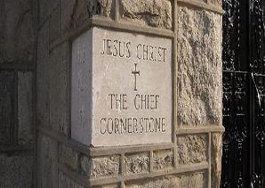
Ephesians 2:20
“having been built on the foundation of the apostles and prophets, Christ Jesus Himself being the corner stone,”

Slide 25
Ephesians 2:20
“having been built on the foundation of the apostles and prophets, Christ Jesus Himself being the corner stone,”

Slide 26
Acts 1:21-25
“²¹ Therefore it is necessary that of the men who have accompanied us all the time that the Lord Jesus went in and out among us— ²² beginning with the baptism of John until the day that He was taken up from us—one of these must become a witness with us of His resurrection.” ²³ So they put forward two men, Joseph called Barsabbas (who was also called Justus), and Matthias. ²⁴ And they prayed and said, “You, Lord, who know the hearts of all men, show which one of these two You have chosen ²⁵ to occupy this ministry and apostleship from which Judas turned aside to go to his own place.” ²⁶ And they drew lots for them, and the lot fell to Matthias; and he was added to the eleven apostles.”

Slide 27
1 Corinthians 9:1
“Am I not free? Am I not an apostle? Have I not seen Jesus our Lord? Are you not my work in the Lord?”

Slide 28
1 Corinthians 15:8-9
“⁸ and last of all, as to one untimely born, He appeared to me also. ⁹ For I am the least of the apostles, and not fit to be called an apostle, because I persecuted the church of God.”

Slide 29
Ephesians 2:20
“having been built on the foundation of the apostles and prophets, Christ Jesus Himself being the corner stone,”

Slide 30
The Case for Selective Cessationism
Preliminary thoughts
Four categories of gifts
  Foundational (Eph 2:20)
  Confirmatory (Heb 2:3-4)
  Revelatory (Jude 3)
  Edificatory gifts continue (Eph. 4:11-16)
Church history and selective cessationism
Proper operation of the Sign & Revelatory gifts
True source of the charismatic movement
Explanation of the Charismatic movement's popularity

Slide 31
The Disputed Gifts
Apostle
Prophet
Worker of Miracles
Tongues
Interpretation of tongues
Healing

Slide 32
Miracle Clusters In Scripture
Num. | Era | Authentication
1. | Moses | Law
2. | Joshua | Conquest
3. | Elijah-Elisha | Prophet
4. | Christ | Kingdom offer
5. | Apostles | Church
6. | Tribulation & Millennium | Kingdom establishment

Slide 33
Luke 4:25-27
“²⁵ But I say to you in truth, there were many widows in Israel in the days of Elijah, when the sky was shut up for three years and six months, when a great famine came over all the land; ²⁶ and yet Elijah was sent to none of them, but only to Zarephath, in the land of Sidon, to a woman who was a widow. ²⁷ And there were many lepers in Israel in the time of Elisha the prophet; and none of them was cleansed, but only Naaman the Syrian.”

Slide 34
Luke 4:25-27
“²⁵ But I say to you in truth, there were many widows in Israel in the days of Elijah, when the sky was shut up for three years and six months, when a great famine came over all the land; ²⁶ and yet Elijah was sent to none of them, but only to Zarephath, in the land of Sidon, to a woman who was a widow. ²⁷ And there were many lepers in Israel in the time of Elisha the prophet; and none of them was cleansed, but only Naaman the Syrian.”

Slide 35
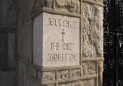
Hebrews 2:3-4
“³ how will we escape if we neglect so great a salvation? After it was at the first spoken through the Lord, it was confirmed to us by those who heard, ⁴ God also testifying with them, both by signs and wonders and by various miracles and by gifts of the Holy Spirit according to His own will.”

Slide 36
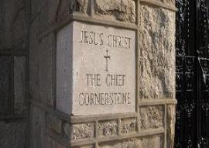
John 14:12
“Truly, truly, I say to you, he who believes in Me, the works that I do, he will do also; and greater works than these he will do; because I go to the Father.”

Slide 37
The Disputed Gifts
Apostle
Prophet
Worker of Miracles
Tongues
Interpretation of tongues
Healing

Slide 38
Hebrews 2:3-4
“³ how will we escape if we neglect so great a salvation? After it was at the first spoken through the Lord, it was confirmed to us by those who heard, ⁴ God also testifying with them, both by signs and wonders and by various miracles and by gifts of the Holy Spirit according to His own will.”

Slide 39
2 Corinthians 12:12
“The signs of a true apostle were performed among you with all perseverance, by signs and wonders and miracles.”

Slide 40
Acts 2:43
“Everyone kept feeling a sense of awe; and many wonders and signs were taking place through the apostles.”

Slide 41
Acts 5:12
“At the hands of the apostles many signs and wonders were taking place among the people; and they were all with one accord in Solomon’s portico.”

Slide 42
Acts 14:3-4
“³ Therefore they spent a long time there speaking boldly with reliance upon the Lord, who was testifying to the word of His grace, granting that signs and wonders be done by their hands. ⁴ But the people of the city were divided; and some sided with the Jews, and some with the apostles.”

Slide 43
Romans 15:18-20
“¹⁸ For I will not presume to speak of anything except what Christ has accomplished through me, resulting in the obedience of the Gentiles by word and deed, ¹⁹ in the power of signs and wonders, in the power of the Spirit; so that from Jerusalem and round about as far as Illyricum I have fully preached the gospel of Christ. ²⁰ And thus I aspired to preach the gospel, not where Christ was already named, so that I would not build on another man’s foundation.”

Slide 44
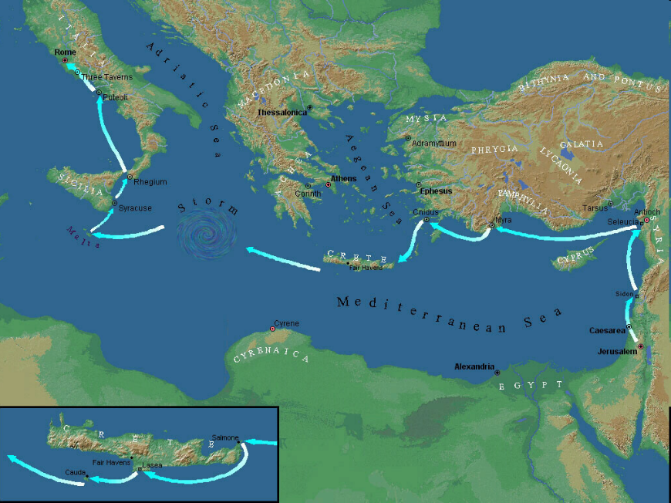

Slide 45

Acts 20:7-10
“⁷ On the first day of the week, when we were gathered together to break bread, Paul began talking to them, intending to leave the next day, and he prolonged his message until midnight. ⁸ There were many lamps in the upper room where we were gathered together. ⁹ And there was a young man named Eutychus sitting on the window sill, sinking into a deep sleep; and as Paul kept on talking, he was overcome by sleep and fell down from the third floor and was picked up dead. ¹⁰ But Paul went down and fell upon him, and after embracing him, he said, “Do not be troubled, for his life is in him.”

Slide 46
Order of Paul’s Letters
Galatians (A.D. 49)
1‒2 Thessalonians (A.D. 51)
1‒2 Corinthians (A.D. 56)
Romans (A.D. 57)
Ephesians, Colossians, Philemon, Philippians (A.D. 60‒62)
1 Timothy, Titus (A.D. 62‒66)
2 Timothy (A.D. 67)

Slide 47
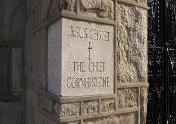
Philippians 2:25-27
“²⁵ But I thought it necessary to send to you Epaphroditus, my brother and fellow worker and fellow soldier, who is also your messenger and minister to my need; ²⁶ because he was longing for you all and was distressed because you had heard that he was sick. ²⁷ For indeed he was sick to the point of death, but God had mercy on him, and not on him only but also on me, so that I would not have sorrow upon sorrow.”

Slide 48
1 Timothy 5:23
“No longer drink water exclusively, but use a little wine for the sake of your stomach and your frequent ailments.”

Slide 49
2 Timothy 4:20
“Erastus remained at Corinth, but Trophimus I left sick at Miletus.”

