Slide 1

Ecclesiology
Session 22
Dr. Andy Woods
Senior Pastor – Sugar Land Bible Church
President – Chafer Theological Seminary

Slide 2


Areas of Systematic Theology
Prolegomena – Introduction
Theology – Study of God
Christology – Study of Christ
Pneumatology – Study of the Holy Spirit
Anthropology – Study of Man
Hamartiology – Study of sin
Soteriology – Study of salvation
Angelology – Study of angels
Ecclesiology – Study of the Church
Eschatology – Study of the end

Slide 3
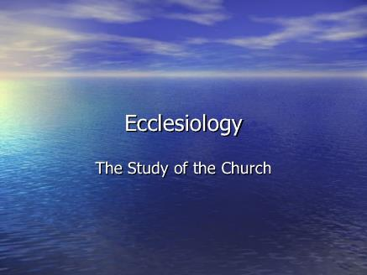
Ecclesiology Overview
Definition
Universal vs. local
Word pictures
Origin
Israel – Church differences
Intercalation
Purposes
Activities
Government
Officers
Ordinances
Purity

Slide 4

VII. Purposes of the Local Church
Glorify God (Eph 3:21)
Edify the saints (Eph 4:11-16)
Fulfill the Great Commission (Matt 28:18-20)

Slide 5
VII. Purposes of the Local Church
Glorify God (Eph 3:21)
Edify the saints (Eph 4:11-16)
Fulfill the Great Commission (Matt 28:18-20)

Slide 6


2 Timothy 3:16-17
“¹⁶ All Scripture is inspired by God and profitable for teaching, for reproof, for correction, for training in righteousness; ¹⁷ so that the man of God may be adequate, equipped for every good work.”

Slide 7
Ephesians 4:11-16
“¹¹ And He gave some as apostles, and some as prophets, and some as evangelists, and some as pastors and teachers, ¹² for the equipping of the saints for the work of service, to the building up of the body of Christ;”

Slide 8

Spiritual Gifts

Slide 9
Areas of Systematic Theology
Prolegomena – Introduction
Theology – Study of God
Christology – Study of Christ
Pneumatology – Study of the Holy Spirit
Anthropology – Study of Man
Hamartiology – Study of sin
Soteriology – Study of salvation
Angelology – Study of angels
Ecclesiology – Study of the Church
Eschatology – Study of the end

Slide 10
1 Corinthians 12:1
“¹¹ Now concerning spiritual gifts, brethren, I do not want you to be unaware.”

Slide 11
Ephesians 4:7-8
“⁷ But to each one of us grace was given according to the measure of Christ’s gift. ⁸ Therefore it says, ‘When He ascended on high, He led captive a host of captives, And He gave gifts to men.’”

Slide 12
Four Questions
What are some general observations about spiritual gifts?
Are all the spiritual gifts for today?
What are the spiritual gifts?
How do we discover our own unique area of gifting?

Slide 13
Four Questions
What are some general observations about spiritual gifts?
Are all the spiritual gifts for today?
What are the spiritual gifts?
How do we discover our own unique area of gifting?

Slide 14
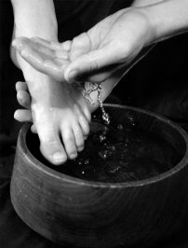
Spiritual Gifts: Observation #1
Spiritual gifts are Spirit empowered abilities for service (John 13:15)

Slide 15
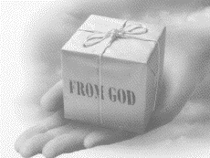
Spiritual Gifts: Observation #2
God sovereignly bestows all the Spiritual gifts (1 Cor 12:11; Heb 2:4)

Slide 16
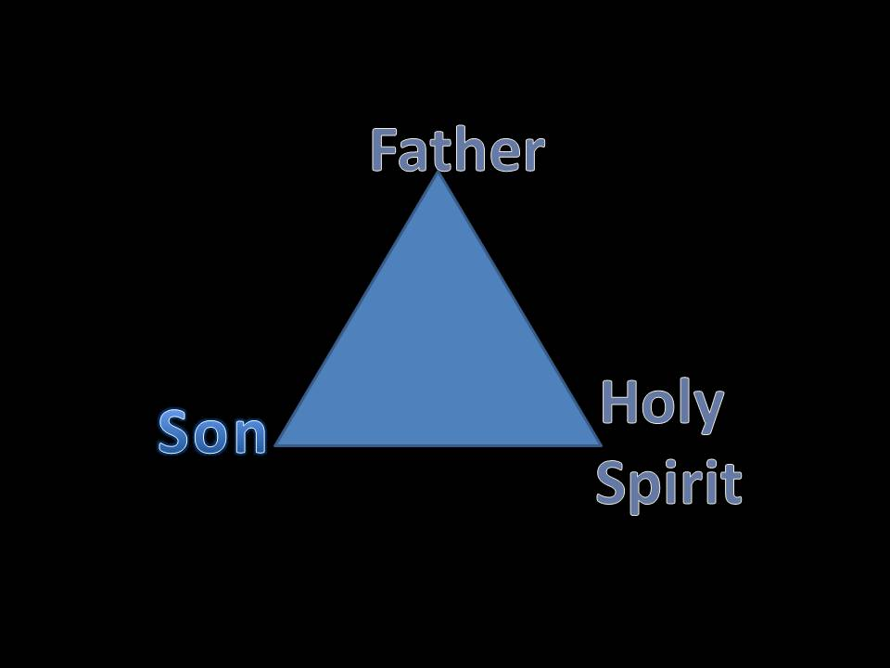
Trinity

Slide 17
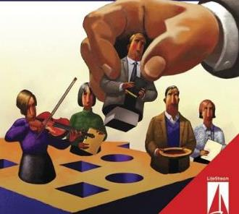
Spiritual Gifts: Observation #3
Every believer has at least one Spiritual gift (1 Cor 12:7; Eph 4:7; 1 Pet 4:10)

Slide 18
Ephesians 4:7-8
“⁷ But to each one of us grace was given according to the measure of Christ’s gift. ⁸ Therefore it says, “When He ascended on high, He led captive a host of captives, And He gave gifts to men.”

Slide 19

Spiritual Gifts: Observation #4
Believers obtain their Spiritual gifts at the point of salvation (Heb 2:4; Rom 8:9)

Slide 20
Spiritual Gifts: Observation #5
Spiritual gifts are not the same as natural abilities or talents

Slide 21
Talents vs. Spiritual Gifts
 | NATURAL TALENTS | SPIRITUAL GIFTS
Source | From God Through Parents | From God Independent of Parents
Possessed | From birth | From conversion
Purpose | To benefit mankind in general | To edify the church

Slide 22
Talents vs. Spiritual Gifts
“The natural abilities of the unsaved are not spiritual gifts. This much is certain. However, it is likely that sometimes the Holy Spirit transforms a purely natural ability by channeling it into God’s work after conversion to Christ. In other cases, the Holy Spirit probably bestows brand new aptitudes, interests, and abilities.”
Steven Waterhouse, Not By Bread Alone, 291

Slide 23
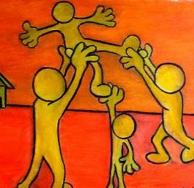
Spiritual Gifts: Observation #6
Spiritual gifts are given in order to edify the church (1 Cor 12:7; 14:12, 26; Eph 4:11-12; 1 Pet 4:10)

Slide 24
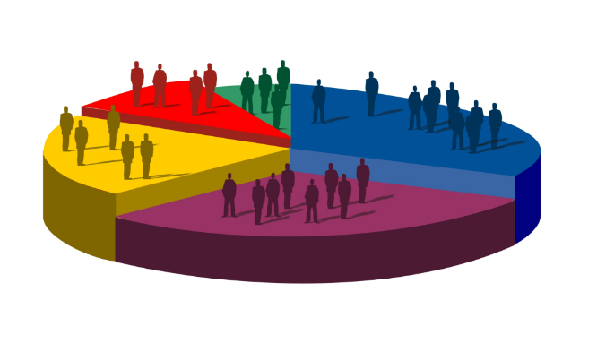
Spiritual Gifts: Observation #7
Spiritual gifts are diverse (1 Cor 12:4-6)

Slide 25
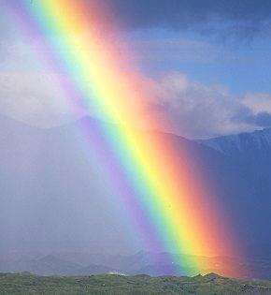
Spiritual Gifts: Observation #8
Spiritual gifts represent differing manifestations of God’s grace (1 Pet 4:10)

Slide 26
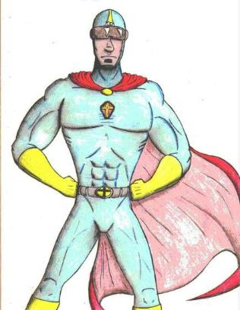
Spiritual Gifts: Observation #9
No single person possesses all of the Spiritual gifts (1 Cor 12:29-30)

Slide 27

Spiritual Gifts: Observation #10
God uses Spiritual gifts to promote unity in His church (1 Cor 12)

Slide 28

Spiritual Gifts: Observation #11
Spiritual gifts are not to be confused with the fruit of the Spirit (1 Cor 1:7)

Slide 29
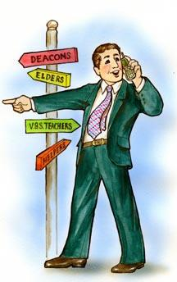
Spiritual Gifts: Observation #12
Spiritual gifts are not always the same as an office

Slide 30
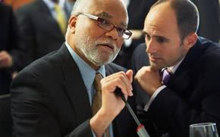
Spiritual Gifts: Observation #13
Spiritual gifts are not always the same as a sphere of influence

Slide 31

Spiritual Gifts: Observation #14
Spiritual gifts are irrevocable this side of eternity (Rom 11:29)

Slide 32
Spiritual Gifts: Observation #15
Spiritual gifts do not cancel the basic duties of all believers

Slide 33

Spiritual Gifts: Observation #16
Spiritual gifts need development (2 Tim 1:6)

Slide 34
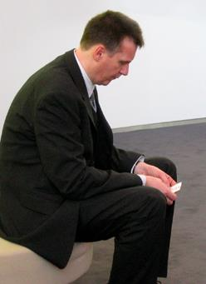
Spiritual Gifts: Observation #17
Spiritual gifts can be neglected
  1 Tim 4:14
  Matt 25:25-26

Slide 35
Spiritual Gifts: Observation #18
Spiritual gifts can be abused
  1 Cor. 13

Slide 36

Spiritual Gifts: Observation #19
Awareness of our Spiritual gifts render us accountable to each (1 Cor. 14:12) other and to God (Matt 25:19; Rom 14:12)

Slide 37
Conclusion

Slide 38
Four Questions
What are some general observations about spiritual gifts?
Are all the spiritual gifts for today?
What are the spiritual gifts?
How do we discover our own unique area of gifting?

Slide 39
Ecclesiology Overview
Definition
Universal vs. local
Word pictures
Origin
Israel – Church differences
Intercalation
Purposes
Activities
Government
Officers
Ordinances
Purity

