Slide 1
Law & Grace: An Overview Jim McGowan, Th.D. Sugar Land Bible Church 04-29-2018
…but grace & truth were realized through Jesus Christ - John 1:17
For the Law was given through Moses…
Special thanks to Dr. Vern Peterman for access to his insights and resources.

Slide 2
Session 7 Outline
Review
Purpose, Aim, and Objective
Session 6
Whacking & Watering (Numbers 20:1-13)
General Information
Comments & Commentary
Conclusion

Slide 3
Session 7 Outline
Review
Purpose, Aim, and Objective
Session 6
Whacking & Watering (Numbers 20:1-13)
General Information
Comments & Commentary
Conclusion

Slide 4
OUR PURPOSE, AIM AND OBJECTIVE
Law & Grace
…is to Compare and Contrast Law and Grace so as to properly understand these two important themes and how they are related to the life of the New Testament Believer.

Slide 5
C. I. SCOFIELD, D. D.
The Grace of God, The Fundamentals Vol. 3, Chapter VII, p. 98
We have, most of us, been reared and now live under the influence of Galatianism. Protestant theology, alas, is for the most part, thoroughly Galatianized, in that neither law nor grace are given their distinct and separated places, as in the counsels of God, but are mingled together in one incoherent system. The law is no longer, as in the Divine intent, a ministration of death (2 Cor. 3:7), of cursing (Gal. 3:10), of conviction (Rom. 3:19), because we are taught that we must try to keep it, and that by Divine help we may. Nor, on the other hand, does grace bring us blessed deliverance from the dominion of sin, for we are kept under the law as a rule of life despite the plain declaration, “Sin shall not have dominion over you: for ye are not under the law, but under grace” (Rom. 6:14).

Slide 6
TEACHINGS OF LAW | TEACHINGS OF GRACE
Written with ink. | Written with the Spirit of the living God.
In tables of stone. | In fleshy tables of the heart.
The letter killeth. | The Spirit giveth life.
The ministration of death. | The ministration of the Spirit.
Was glorious. | Is rather glorious.
Done away. | Remaineth.
Abolished. | We have such hope.
L. S. CHAFER, Systematic theology (Vol. 4, p. 242). (1993). Grand Rapids, MI: Kregel Publications.

Slide 7
Session 7 Outline
Review
Purpose, Aim, and Objective
Session 6
Whacking & Watering (Numbers 20:1-13)
General Information
Comments & Commentary
Conclusion

Slide 8
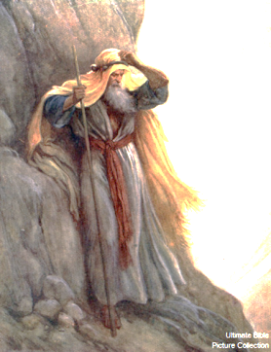
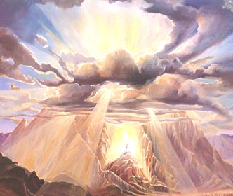
Law & Grace: Lesson 6 Review
A Mountaintop Experience

Slide 9
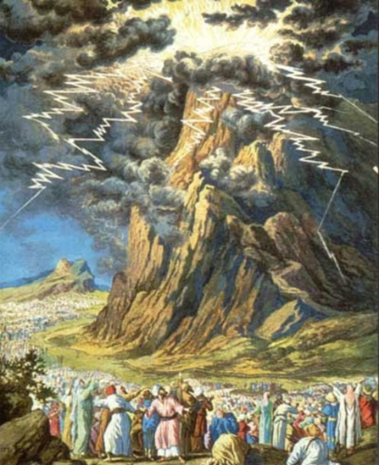
Law & Grace: Lesson 6 Review
Keep Your Distance!

Slide 10
Law & Grace: Lesson 6 Review
DIVISION OF THE 10 COMMANDMENTS BY RELIGION/DENOMINATION
Commandment | Jewish (Talmudic) | Anglican, Reformed, & others | Orthodox & others | Roman Catholic & Lutheran
I am the LORD your God | 1 | preface | 1 | 1
You shall have no other gods before Me |  | 1
You shall not make for yourself an idol | 2 | 2 | 2
You shall not take the name of the LORD in vain | 3 | 3 | 3 | 2
Remember the sabbath day, to keep it holy | 4 | 4 | 4 | 3
Honor your father and your mother | 5 | 5 | 5 | 4
You shall not murder | 6 | 6 | 6 | 5
You shall not commit adultery | 7 | 7 | 7 | 6
You shall not steal | 8 | 8 | 8 | 7
You shall not bear false witness against your neighbor | 9 | 9 | 9 | 8
You shall not covet your neighbor’s wife | 10 | 10 | 10 | 9
You shall not covet anything that belongs to your neighbor |  |  |  | 10
http://www.sundaysoftware.com/ten/number.htm
Notes:
Chart and notes are from Wikipedia and are for general reference. Use of this chart does not mean that all sources referenced or included in the article are recommended or endorsed.
The "Talmudic Division" is the breakdown held by modern Judaism, and dates to at least the Third Century. The "Philonic Division", which dates to the first century, is found in the writings of Philo and Josephus. They ended the first commandment after verse 3 and list the second commandment as verses 4-6, similar to most Protestants (non-Lutheran) and the Eastern Orthodox Church.
Some Lutheran churches use a slightly different division of the Ninth and Tenth Commandments (9. Thou shalt not covet thy neighbor's house; 10. You shall not covet your neighbor’s wife, or his workers, or his cattle, or anything that is your neighbor’s).
Sources within Judaism assert that this is a reference to kidnapping, whereas Leviticus 19:11 is the Biblical reference banning the stealing of property. This understanding is based on the Talmudical hermeneutic known as דבר הלמד מעניינו/ / davar ha-lamed me-inyano (literally 'something proved by the context'), by which this must refer to a capital offense just as the previous two commandments refer to capital offenses.
More recent scholarship suggests that "take" may be better for chamad than "covet.“

Slide 11
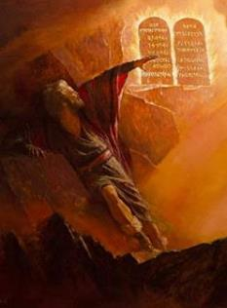
The 10 Commandments
Law & Grace: Lesson 6 Review
Exodus 20:1-21 presents what has come to be called ‘The 10 Commandments’.
There were additional spoken instructions, at the end of chapter, after V. 21.
‘The 10 Commandments’ were later called (literally) ‘The 10 words’ (cf. Exo. 34:28; Deu. 4:13; 10:4).
In Exodus 20:1-21 ‘The 10’ were not given any special name.

Slide 12
The 10 Commandments
Law & Grace: Lesson 6 Review
The 1st tablets of stone were broken by Moses, but new tablets of stone were written again by God and placed in the Ark.
Deuteronomy 5:4–25 consists of God's re-telling of the Ten Commandments to the younger generation who were to enter the Promised Land, before they crossed the Jordan River.

Slide 13
The 10 Commandments
Law & Grace: Lesson 6 Review
‘The 10 Commandments’ were clarified with additional laws. (i.e., how those presumed guilty were to be presented, charged, proven guilty, and punished)
All of the additional laws were to be followed with equal attention to detail and ‘weight’.

Slide 14
The 10 Commandments
Law & Grace: Lesson 6 Review
‘The 10’ were not the first commands in the Bible. (cf. Gen. 1:28; 9:1, 7; being fruitful and multiplying; Gen. 17:1-14 male circumcision; Exo. 12:1 observing Passover), were all given beforehand.
Much of the Law of Moses was revealed through the agency of angels. (c.f. Acts 7:53; Gal. 3:19; Heb. 2:2).

Slide 15
Contrast & Comparison
Law & Grace: Lesson 6 Review
‘The 10 Commandments’ as given are holy and righteous and good (Rom. 7:12-16).
The Law demands obedience but provides no power to comply with those demands so, the Law becomes fatal.
That is why Paul called even ‘The 10 Commandments’ (2 Cor. 3:7-11: ‘tablets’ and ‘letters engraved in stone’) a ministry of death and condemnation.

Slide 16
Contrast & Comparison
Law & Grace: Lesson 6 Review
We have died in relationship to the entire Law of Moses (Rom. 7:4; Gal. 2:19).
We have been released from the Law to be joined to Christ (Rom. 7:4, 6).
The singular reigning principal or rule of life during the Church Age, is GRACE (Rom. 5:20-21).

Slide 17
Contrast & Comparison
Law & Grace: Lesson 6 Review
Salvation by grace through faith was, and is, and will always be, the means of salvation…from the Garden of Eden until the very end of this present heaven and earth.
But Grace is not just the means of our salvation, but also the motive for living, as well as the means for living and the source of opportunity, within the church body.

Slide 18
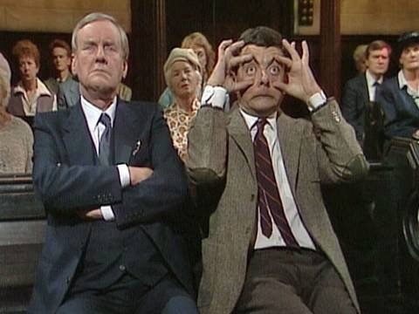
END OF REVIEW
FINALLY

Slide 19
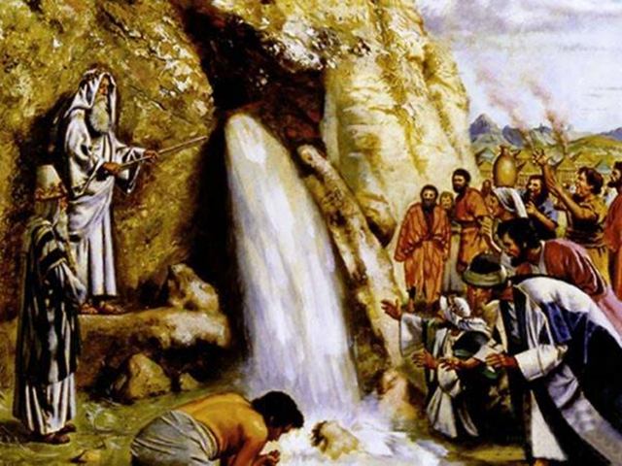
Whacking & Watering - Numbers 20:1-13
Law & Grace: Lesson 7 – Whacking & Watering

Slide 20
Session 7 Outline
Review
Purpose, Aim, and Objective
Session 6
Whacking & Watering (Numbers 20:1-13)
General Information
Comments & Commentary
Conclusion

Slide 21
Numbers 20:1–13
¹ Then the sons of Israel, the whole congregation, came to the wilderness of Zin in the first month; and the people stayed at Kadesh. Now Miriam died there and was buried there. ² There was no water for the congregation, and they assembled themselves against Moses and Aaron. ³ The people thus contended with Moses and spoke, saying, “If only we had perished when our brothers perished before the Lord! ⁴ “Why then have you brought the Lord’s assembly into this wilderness, for us and our beasts to die here? ⁵ “Why have you made us come up from Egypt, to bring us in to this wretched place? It is not a place of grain or figs or vines or…

Slide 22
Numbers 20:1–13
…pomegranates, nor is there water to drink.” ⁶ Then Moses and Aaron came in from the presence of the assembly to the doorway of the tent of meeting and fell on their faces. Then the glory of the Lord appeared to them; ⁷ and the Lord spoke to Moses, saying, ⁸ “Take the rod; and you and your brother Aaron assemble the congregation and speak to the rock before their eyes, that it may yield its water. You shall thus bring forth water for them out of the rock and let the congregation and their beasts drink.” ⁹ So Moses took the rod from before the Lord, just as He had commanded him; ¹⁰ and Moses and Aaron gathered the assembly before the rock…

Slide 23
Numbers 20:1–13
…And he said to them, “Listen now, you rebels; shall we bring forth water for you out of this rock?” ¹¹ Then Moses lifted up his hand and struck the rock twice with his rod; and water came forth abundantly, and the congregation and their beasts drank. ¹² But the Lord said to Moses and Aaron, “Because you have not believed Me, to treat Me as holy in the sight of the sons of Israel, therefore you shall not bring this assembly into the land which I have given them.” ¹³ Those were the waters of Meribah, because the sons of Israel contended with the Lord, and He proved Himself holy among them.

Slide 24
Session 7 Outline
Review
Purpose, Aim, and Objective
Session 6
Whacking & Watering (Numbers 20:1-13)
General Information
Comments & Commentary
Conclusion

Slide 25
2nd Account of Bringing Water from a Rock.
Law & Grace: Lesson 7 – Whacking & Watering
Exodus 17:1-7, right after the people of Israel leave Egypt.
2) Numbers 20:1-13, almost 40 years later, just before the people of Israel enter the land God promised to them.

Slide 26
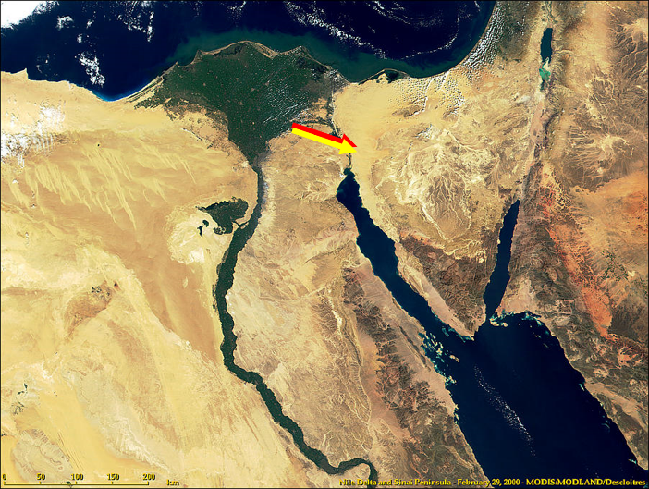
Law & Grace: Lesson 7 – Whacking & Watering
Geographical Overview

Slide 27
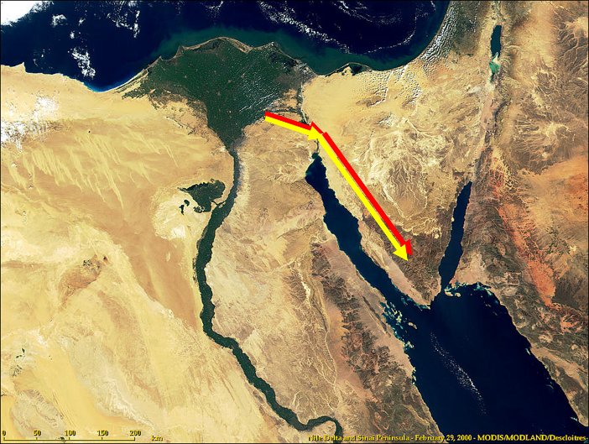
Law & Grace: Lesson 7 – Whacking & Watering
Geographical Overview

Slide 28
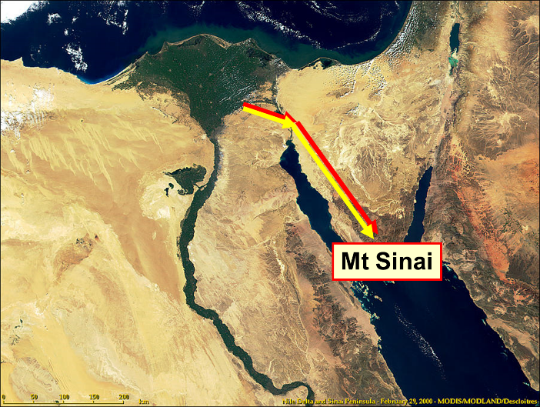
Law & Grace: Lesson 7 – Whacking & Watering
Geographical Overview

Slide 29
Law & Grace: Lesson 7 – Whacking & Watering
Geographical Overview

Slide 30
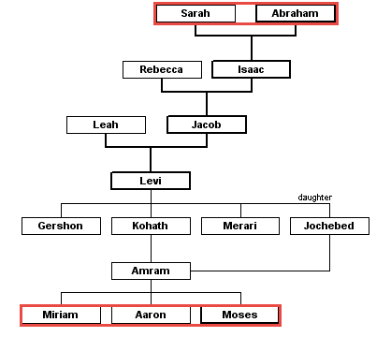
Law & Grace: Lesson 7 – Whacking & Watering
Family Tree
Sarah & Abraham to Miriam, Aaron & Moses

Slide 31
Session 7 Outline
Review
Purpose, Aim, and Objective
Session 6
Whacking & Watering (Numbers 20:1-13)
General Information
Comments & Commentary
Conclusion

Slide 32
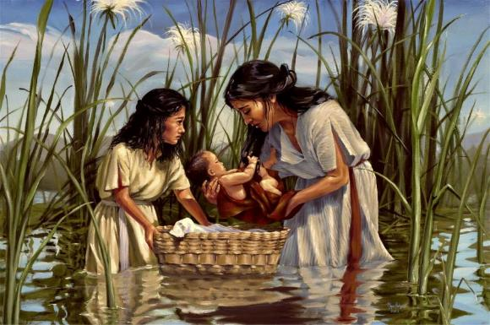
Law & Grace: Lesson 7 – Whacking & Watering
Miriam dies - Numbers 20:1
Then the sons of Israel, the whole congregation, came to the wilderness of Zin in the first month; and the people stayed at Kadesh. Now Miriam died there and was buried there.

Slide 33
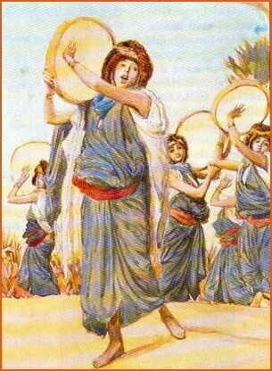
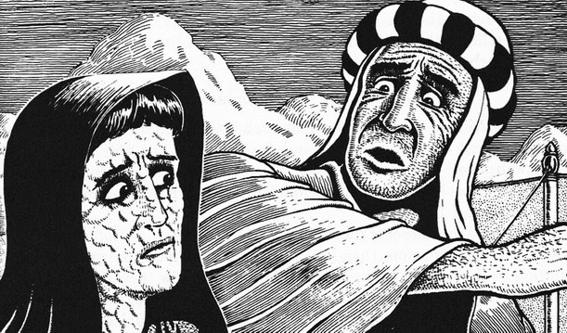
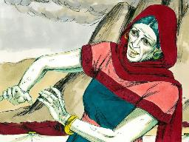
Law & Grace: Lesson 7 – Whacking & Watering
Miriam dies - Numbers 20:1
Miriam, the “prophetess”, had been the one who led the singing and dancing when the Israelites passed through the sea (Exodus 15:20).
Miriam also led Aaron in sibling rivalry against Moses (Numbers 12).

Slide 34
Law & Grace: Lesson 7 – Whacking & Watering
Miriam dies - Numbers 20:1
Miriam was among those who died without entering the promised land due to unbelief (Numbers 14:22-38).

Slide 35
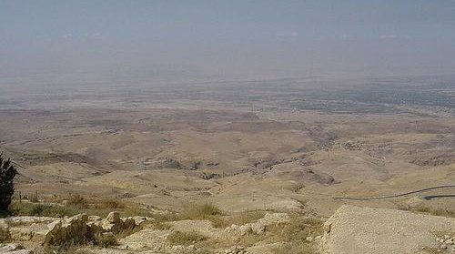
Law & Grace: Lesson 7 – Whacking & Watering
The Wilderness of Zin
Stretching from Kadesh-barnea to the Dead Sea

Slide 36
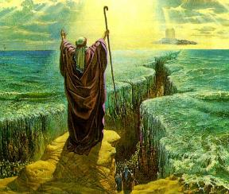
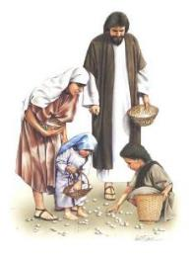
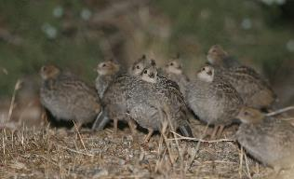
Law & Grace: Lesson 7 – Whacking & Watering
Faithless complaining - Numbers 20:2-5
In spite of many miraculous events since just before leaving Egypt, over a period of almost 40 years, the people of Israel come again to complain against Moses and Aaron.

Slide 37
Law & Grace: Lesson 7 – Whacking & Watering
Faithless complaining - Numbers 20:2-5
The Israelites were often either afraid to die or wished they had died.
They had rejoiced that God, Himself had brought them out of Egypt, but now they blame Moses because they are hungry and thirsty!

Slide 38
Law & Grace: Lesson 7 – Whacking & Watering
VERY IMPORTANT PRINCIPLE!
Wherever you are and wherever go on earth, you’re always passing through!

Slide 39
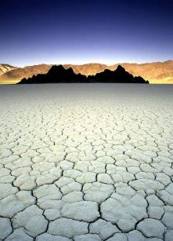
Law & Grace: Lesson 7 – Whacking & Watering
You’re always passing through!
We will indeed find some places and some circumstances on this earth better than others.
But wherever God has you now, you won’t be there forever.

Slide 40
Law & Grace: Lesson 7 – Whacking & Watering
You’re always passing through!
Planet Earth – “a getting ready kind of place”.
So we ought not to get so wrapped up in God’s process of getting us ready that we lose sight of where we’re headed.

Slide 41
Law & Grace: Lesson 7 – Whacking & Watering
Before the Lord - Numbers 20:6-8
Aaron and Moses leave the presence of the assembly and enter the presence of the Lord, at the doorway of the tent of meeting otherwise known as the Tabernacle. There the glory of the LORD appears, and He speaks to them.

Slide 42
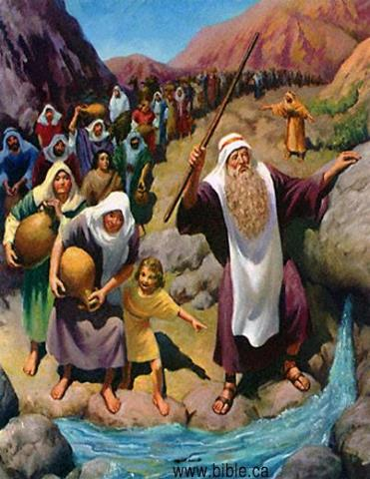
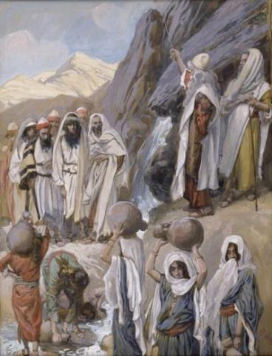
Law & Grace: Lesson 7 – Whacking & Watering
Before the Lord - Numbers 20:6-8
They were to take Moses’ rod, gather the people, speak to the rock, and the water would flow, so that the people and their animals could drink.

Slide 43
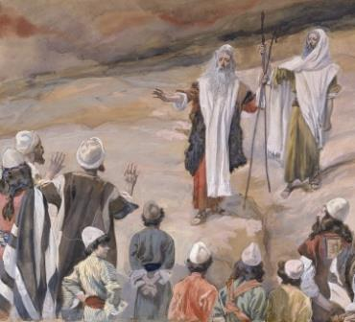
Law & Grace: Lesson 7 – Whacking & Watering
Moses starts well - Numbers 20:9-11
Moses did take his rod, just as the Lord said for him to do.
And Moses gathered the people of Israel, just as the Lord had said for him to do.

Slide 44
Law & Grace: Lesson 7 – Whacking & Watering
It’s not just how you start - Numbers 20:9-11
But Moses started to ‘ad lib’ after that.
Instead of speaking to the rock as God had said…
Moses spoke to the people –

Slide 45
Law & Grace: Lesson 7 – Whacking & Watering
It’s not just how you start - Numbers 20:9-11
– in anger!
“Listen now, you rebels” (v. 10)

Slide 46
Law & Grace: Lesson 7 – Whacking & Watering
VERY IMPORTANT PRINCIPLE!
Allowing our feelings and emotions to reinterpret God’s Word is never a good idea!

Slide 47
Law & Grace: Lesson 7 – Whacking & Watering

Slide 48
Law & Grace: Lesson 7 – Whacking & Watering
It’s not just how you start - Numbers 20:9-11
Instead of speaking to the rock as God had said…Moses struck the rock – twice!

Slide 49
Law & Grace: Lesson 7 – Whacking & Watering
Moses misrepresents God - Numbers 20:9-11
Not only did Moses not do exactly what God had said, but he also spoke as if bringing the water from the rock was his and Aaron’s accomplishment, instead of God’s.
"…shall we bring forth water
for you out of this rock?" (v. 10)

Slide 50
Law & Grace: Lesson 7 – Whacking & Watering
VERY IMPORTANT PRINCIPLE!
Our best efforts and good intentions, just aren’t good enough!

Slide 51
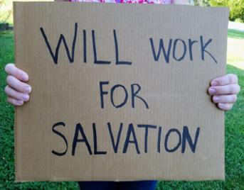
Law & Grace: Lesson 7 – Whacking & Watering
Our best efforts won’t get the job done!
Many people believe that they are “good” enough to get into Heaven on their own.
We have to realize our own best efforts just won’t get the job done.

Slide 52
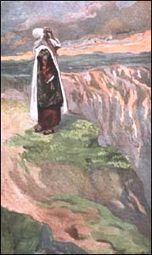
Law & Grace: Lesson 7 – Whacking & Watering
Severe Consequences - Numbers 20:12-13
For Moses’ errors in this one event, after almost 40 years of leading the Israelites in the wilderness, would have rather severe consequences:
He would not be allowed to lead the Israelites into nor even enter the promised land.
He would only be allowed to view the land from afar.

Slide 53
Law & Grace: Lesson 7 – Whacking & Watering
VERY IMPORTANT PRINCIPLE!
Earthly disobedience now always has consequences

Slide 54
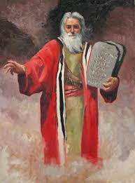
Law & Grace: Lesson 7 – Whacking & Watering
Resurrected Moses will yet enter
and walk the land!

Slide 55
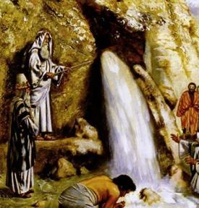
Law & Grace: Lesson 7 – Whacking & Watering
What Went Wrong? - Numbers 20:12-13
Moses ignored God’s instructions thinking that doing what he had done previously would be acceptable.
But that was not what God had in mind at all – God intended for Moses to glorify Him.

Slide 56
Law & Grace: Lesson 7 – Whacking & Watering
What Went Wrong? - Numbers 20:12-13
Moses calls God, the ‘Rock’, five 5 times in Deuteronomy 32 (4, 15, 18, 30, 31),…the Rock was a picture of God.

Slide 57
Deuteronomy 32:4, 15, 18, 30, 31
⁴ “The Rock! His work is perfect, For all His ways are just; A God of faithfulness and without injustice, Righteous and upright is He… ¹⁵ “But Jeshurun grew fat and kicked— You are grown fat, thick, and sleek— Then he forsook God who made him, And scorned the Rock of his salvation… ¹⁸ “You neglected the Rock who begot you, And forgot the God who gave you birth…³⁰ “How could one chase a thousand, And two put ten thousand to flight, Unless their Rock had sold them, And the Lord had given them up? ³¹ “Indeed their rock is not like our Rock, Even our enemies themselves judge this.

Slide 58
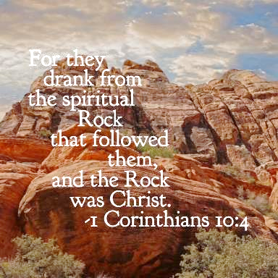
Law & Grace: Lesson 7 – Whacking & Watering
What Went Wrong? - Numbers 20:12-13
The Rock was also a picture of Christ, Himself! (1st Cor. 10:1-4).

Slide 59
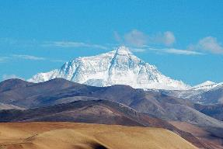
1 Corinthians 10:1-4
¹ For I do not want you to be unaware, brethren, that our fathers were all under the cloud and all passed through the sea; ² and all were baptized into Moses in the cloud and in the sea; ³ and all ate the same spiritual food; ⁴ and all drank the same spiritual drink, for they were drinking from a spiritual rock which followed them; and the rock was Christ.

Slide 60
Law & Grace: Lesson 7 – Whacking & Watering
What Went Wrong? - Numbers 20:12-13
Since the rock was a picture of God and of Christ Himself, striking the rock twice in anger was not respectful of Him.
God wants to use us as His instruments. He doesn’t want us acting on our own or taking the credit.

Slide 61
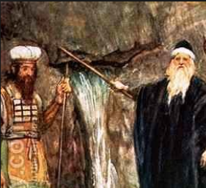
Law & Grace: Lesson 7 – Whacking & Watering
Both Moses and Aaron receive the consequences - Numbers 20:12-13
Why did Aaron also receive the consequences when it was Moses who had said and done what was wrong in the way that the water was brought out from the rock?
Or is it?

Slide 62
Law & Grace: Lesson 7 – Whacking & Watering
Both Moses and Aaron receive the consequences - Numbers 20:12-13
Aaron had been there all along, when God spoke to Moses, and knew what God had said and had stood by silently while Moses erred, rather than correcting Moses in his errors.

Slide 63
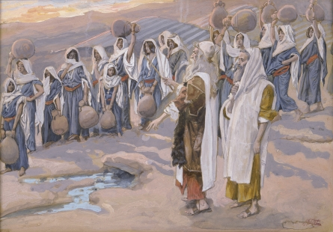
Law & Grace: Lesson 7 – Whacking & Watering
God’s mercy and grace depend upon Him
In spite of both Moses’ and Aaron’s errors, and the people’s murmuring and complaining, God mercifully and graciously caused the water flow from the rock.

Slide 64
Law & Grace: Lesson 7 – Whacking & Watering
VERY IMPORTANT PRINCIPLE!
The fact that the Lord may bless people does not mean that everything that they are doing is right!

Slide 65
Session 7 Outline
Review
Purpose, Aim, and Objective
Session 6
Whacking & Watering (Numbers 20:1-13)
General Information
Comments & Commentary
Conclusion

Slide 66
Law & Grace: Lesson 7 – Whacking & Watering

Slide 67
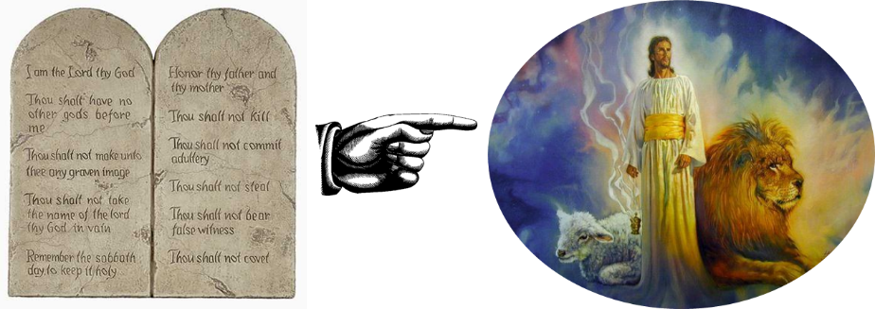
Law & Grace: Lesson 7 – Whacking & Watering
This event ‘under Law’ points to Christ
Numbers 20:1-13
The Law isn’t the same as Grace but this event, ‘under the Law’ reveals God’s grace and points to Christ.

Slide 68
Law & Grace: Lesson 7 – Whacking & Watering
This event ‘under Law’ points to Christ
Numbers 20:1-13
The Apostle Paul in 1 Cor. 10:4 states that the Exodus generation was ‘baptized into Moses.’ This is referring to their having been identified and joined to the Mosaic Law….they were under the Law!

Slide 69
1 Corinthians 10:1-4
¹ For I do not want you to be unaware, brethren, that our fathers were all under the cloud and all passed through the sea; ² and all were baptized into Moses in the cloud and in the sea; ³ and all ate the same spiritual food; ⁴ and all drank the same spiritual drink, for they were drinking from a spiritual rock which followed them; and the rock was Christ.

Slide 70
Law & Grace: Lesson 7 – Whacking & Watering
This event ‘under Law’ points to Christ
Numbers 20:1-13
The Apostle Paul also states that the rock from which the water flowed was to represent Christ, God’s merciful and gracious provision of life for us all.

Slide 71
1 Corinthians 10:1-4
¹ For I do not want you to be unaware, brethren, that our fathers were all under the cloud and all passed through the sea; ² and all were baptized into Moses in the cloud and in the sea; ³ and all ate the same spiritual food; ⁴ and all drank the same spiritual drink, for they were drinking from a spiritual rock which followed them; and the rock was Christ.

Slide 72
Law & Grace: Lesson 7 – Whacking & Watering
This event ‘under Law’ points to Christ
Numbers 20:1-13
Did Moses and Aaron or any of the Children of Israel, realize even for a moment, that they would become living examples for us today?

Slide 73
1 Corinthians 10:11
Now these things happened to them as an example, and they were written for our instruction, upon whom the ends of the ages have come.

Slide 74
Law & Grace: Lesson 7 – Whacking & Watering
This event ‘under Law’ points to Christ
Numbers 20:1-13
As we reflect upon the Children of Israel in this event, we can take away something of great importance!

Slide 75
Law & Grace: Lesson 7 – Whacking & Watering

Slide 76
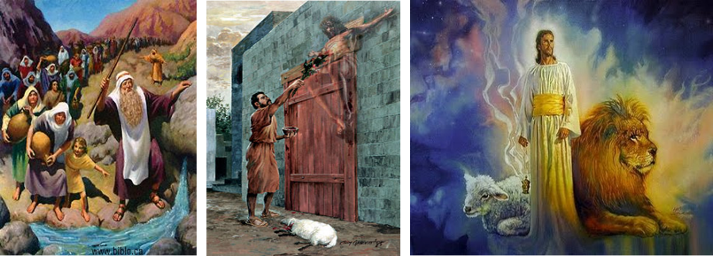
Law & Grace: Lesson 7 – Whacking & Watering
Therefore the Law has become our tutor to lead us to Christ…Galatians 3:24

Slide 77
Law & Grace: An Overview Jim McGowan, Th.D. Sugar Land Bible Church 04-29-2018
…but grace & truth were realized through Jesus Christ - John 1:17
For the Law was given through Moses…
Special thanks to Dr. Vern Peterman for access to his insights and resources.

