Slide 1
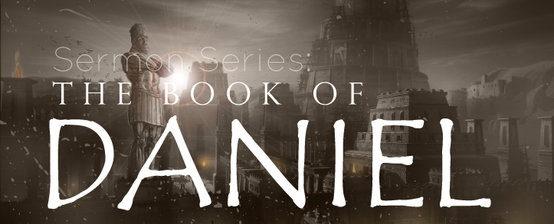
THE BOOK OF DANIEL
Dr. Andy Woods

Slide 2
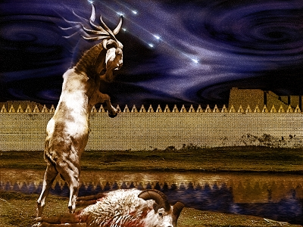
DANIEL 10-12 THE FINAL VISION

Slide 3
CHAPTER AND VERSE IN DANIEL | CHRONOLOGICAL DATE | BIBLICAL DATE
1:1 | 605 | 3rd year of Jehoiakim
2:1 | 603 | 2nd year of Nebuchadnezzar
5 | Sat. night 10/12/539 (Hoehner)
7:1 | 553 | 1st year of Belshazzar
8:1 | 551 | 3rd year of Belshazzar
9:1 | 538 | 1st year of Darius
10:1 | 536 | 3rd year of Cyrus

Slide 4
Chapter 10–12 Outline
The Setting (10:1-3)
Arrival of the Heavenly Messenger (10:4-9)
Explanation of the Heavenly Messenger (10:10–11:1)
The Prophecy of the Heavenly Messenger (11:2–12:13)

Slide 5
IV. The Prophecy of the Heavenly Messenger (11:2–12:13)
Persia (11:2)
Greece (11:3-4)
Ptolemies & Seleucids (11:5-20)
Antiochus IV (11:21-35)
Antichrist (11:36-45)
Tribulation & Millennium (12:1-13)

Slide 7
IV. The Prophecy of the Heavenly Messenger (11:2–12:13)
Persia (11:2)
Greece (11:3-4)
Ptolemies & Seleucids (11:5-20)
Antiochus IV (11:21-35)
Antichrist (11:36-45)
Tribulation & Millennium (12:1-13)

Slide 8
IV. The Prophecy of the Heavenly Messenger (11:2–12:13)
Persia (11:2)
Greece (11:3-4)
Ptolemies & Seleucids (11:5-20)
Antiochus IV (11:21-35)
Antichrist (11:36-45)
Tribulation & Millennium (12:1-13)

Slide 9
The Tribulation & Millennium Daniel 12:1-13
Description of the End Times (1-4)
The Suffering (1)
The Separation (2)
The Shining (3)
The Sealing (4)
Harold Wilmington, The Outline Bible, pp. 418-19

Slide 10
The Tribulation & Millennium Daniel 12:1-13
Duration of the End Times (5-13)
Round 1 (5-7)
Question (5-6)
Answer (7)
Round 2 (8-13)
Question (8)
Answer (9-13)
Harold Wilmington, The Outline Bible, pp. 418-19

Slide 11
The Tribulation & Millennium Daniel 12:1-13
Duration of the End Times (5-13)
Round 1 (5-7)
Question (5-6)
Answer (7)
Round 2 (8-13)
Question (8)
Answer (9-13)
Harold Wilmington, The Outline Bible, pp. 418-19

Slide 12
The Tribulation & Millennium Daniel 12:1-13
Duration of the End Times (5-13)
Round 1 (5-7)
Question (5-6)
Answer (7)
Round 2 (8-13)
Question (8)
Answer (9-13)
Harold Wilmington, The Outline Bible, pp. 418-19

Slide 13
The Tribulation & Millennium Daniel 12:1-13
Duration of the End Times (5-13)
Round 1 (5-7)
Question (5-6)
Answer (7)
Round 2 (8-13)
Question (8)
Answer (9-13)
Harold Wilmington, The Outline Bible, pp. 418-19

Slide 14
The Tribulation & Millennium Daniel 12:1-13
Duration of the End Times (5-13)
Round 1 (5-7)
Question (5-6)
Answer (7)
Round 2 (8-13)
Question (8)
Answer (9-13)
Harold Wilmington, The Outline Bible, pp. 418-19

Slide 15
The Tribulation & Millennium Daniel 12:1-13
Duration of the End Times (5-13)
Round 1 (5-7)
Question (5-6)
Answer (7)
Round 2 (8-13)
Question (8)
Answer (9-13)
Harold Wilmington, The Outline Bible, pp. 418-19

Slide 16
Answer Daniel 12:9-13
Progressive illumination (9)
Contrast between the righteous & wicked (10)
Preparation for the Millennial Temple (11)
Preparation for the Millennial Kingdom (12)
Daniel’s predicted inheritance (13)

Slide 17
Answer Daniel 12:9-13
Progressive illumination (9)
Contrast between the righteous & wicked (10)
Preparation for the Millennial Temple (11)
Preparation for the Millennial Kingdom (12)
Daniel’s predicted inheritance (13)

Slide 18
Daniel 12:4, 9
“But as for you, Daniel, conceal these words and seal up the book until the end of time; many will go back and forth, and knowledge will increase...Go your way, Daniel, for these words are concealed and sealed up until the end time.”
Notes:
‘to and fro‘ – refers to the increase in knowledge through searching out the scriptures; progressive illumination

Slide 19
Amos 8:12
“People will stagger from sea to sea And from the north even to the east; They will go to and fro to seek the word of the Lord, But they will not find it.”
Notes:
‘to and fro‘ – refers to the increase in knowledge through searching out the scriptures; progressive illumination
Inspiration – not today (2 Tim. 3:16-17; 2 Pet. 1:21)
Revelation – not today (Jude 3; Rev. 22:18-19)
Illumination – for today (Eph. 1:18; 1 Cor. 2:14-15; 1 John 2:27)

Slide 20
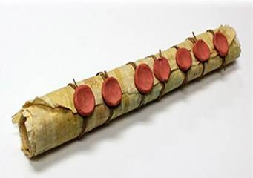
Revelation 22:10
“And he said to me, “Do not seal up the words of the prophecy of this book, for the time is near.”
Notes:
‘to and fro‘ – refers to the increase in knowledge through searching out the scriptures; progressive illumination
Inspiration – not today (2 Tim. 3:16-17; 2 Pet. 1:21)
Revelation – not today (Jude 3; Rev. 22:18-19)
Illumination – for today (Eph. 1:18; 1 Cor. 2:14-15; 1 John 2:27)

Slide 21
1 Peter 1:10-11
¹⁰ As to this salvation, the prophets who prophesied of the grace that would come to you made careful searches and inquiries, ¹¹ seeking to know what person or time the Spirit of Christ within them was indicating as He predicted the sufferings of Christ and the glories to follow.

Slide 22
History of Doctrine
Canon (A.D. 180)
Christology (A.D. 500)
Atonement (A.D. 1100)
Salvation (A.D. 1500)
Eschatology (A.D. 1800)

Slide 23
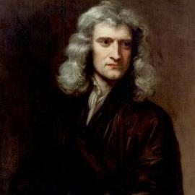
Sir Isaac Newton (1642–1727)
"About the time of the end, a body of men will be raised up who will turn their attention to the Prophecies, and insist upon their literal interpretation, in the midst of much clamor and opposition."
Isaac Newton cited in Nathaniel West, The Thousand Years in Both Testaments, 462.

Slide 24
Answer Daniel 12:9-13
Progressive illumination (9)
Contrast between the righteous & wicked (10)
Preparation for the Millennial Temple (11)
Preparation for the Millennial Kingdom (12)
Daniel’s predicted inheritance (13)

Slide 25
John Walvoord Daniel Commentary, Page 294
“The understanding of prophecy peculiarly requires spiritual insight and the teaching of the Holy Spirit. Even though the Scriptures describe in great detail the time of the end, it is obvious that the wicked will not avail themselves of this divine revelation; but it will be a source of comfort and direction to those who are true believers in God. Divine revelation is often given in such a way that it is hid to the wicked even though it is understandable by those spiritually minded.”

Slide 26
Answer Daniel 12:9-13
Progressive illumination (9)
Contrast between the righteous & wicked (10)
Preparation for the Millennial Temple (11)
Preparation for the Millennial Kingdom (12)
Daniel’s predicted inheritance (13)

Slide 27
Daniel 9:27
And he will make a firm covenant with the many for one week, but in the middle of the week he will put a stop to sacrifice and grain offering; and on the wing of abominations will come one who makes desolate, even until a complete destruction, one that is decreed, is poured out on the one who makes desolate.

Slide 29
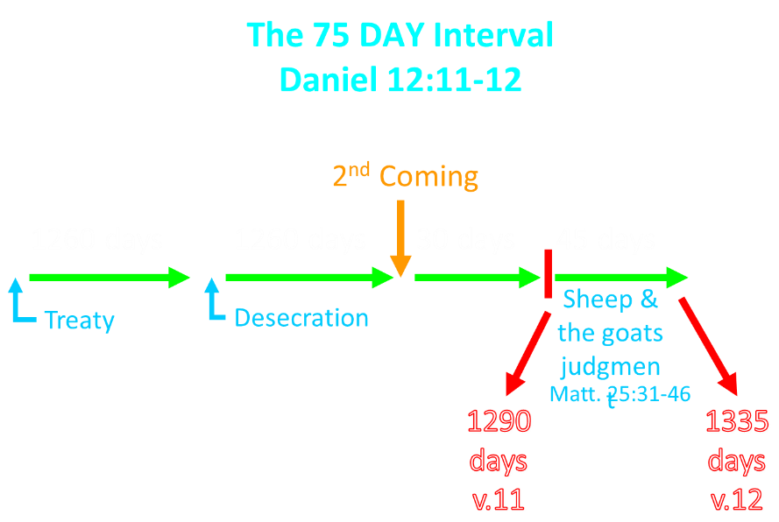

Slide 30
Israel’s Four Temples
Solomon’s pre exilic temple (Kings and Chronicles)
Zerubbabel’s post exilic temple (Ezra 1-6; John 2:20)
Antichrist's temple (Dan 9:27; Matt 24:15; 2 Thess 2:4; Rev 11:1-2)
Millennial temple (Ezek 40-48)

Slide 31
Israel’s Four Temples
Solomon’s pre exilic temple (Kings and Chronicles)
Zerubbabel’s post exilic temple (Ezra 1-6; John 2:20)
Antichrist's temple (Dan 9:27; Matt 24:15; 2 Thess 2:4; Rev 11:1-2)
Millennial temple (Ezek 40-48)

Slide 32
Israel’s Four Temples
Solomon’s pre exilic temple (Kings and Chronicles)
Zerubbabel’s post exilic temple (Ezra 1-6; John 2:20)
Antichrist's temple (Dan 9:27; Matt 24:15; 2 Thess 2:4; Rev 11:1-2)
Millennial temple (Ezek 40-48)

Slide 33
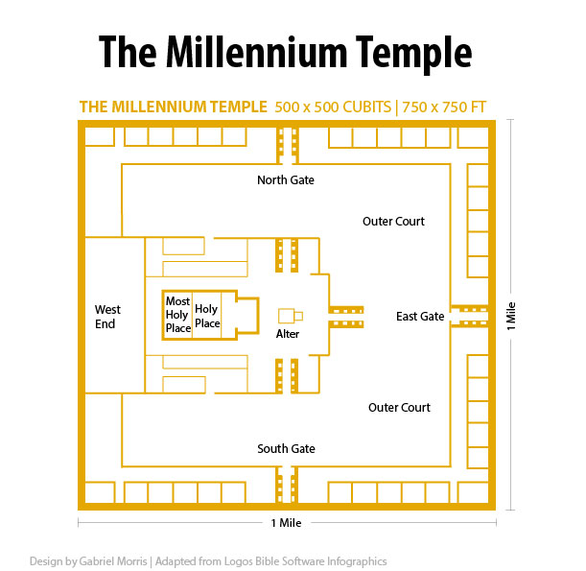

Slide 34
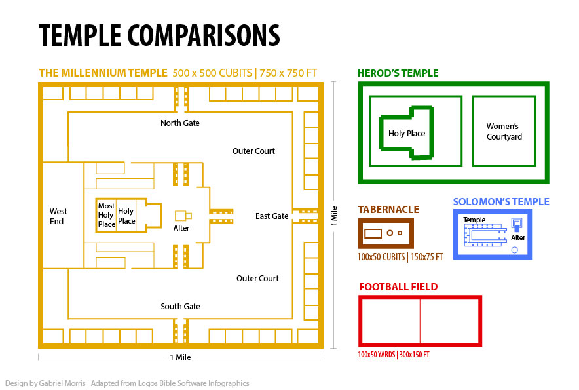

Slide 36
HANUKKAH
The Maccabean revolt
December 25th 164 BC : the temple is liberated and rededicated
1 & 2 Maccabees
The miracle of the lamp oil
Hanukkah “Feast of Dedication” (festival of lights).
Christmas / Jewish Holiday
John 10:22-24

Slide 37
Answer Daniel 12:9-13
Progressive illumination (9)
Contrast between the righteous & wicked (10)
Preparation for the Millennial Temple (11)
Preparation for the Millennial Kingdom (12)
Daniel’s predicted inheritance (13)

Slide 39
Arnold Fruchtenbaum (2003). The Footsteps of the Messiah: a study of the sequence of prophetic events (Rev. ed., p. 367). Tustin, CA: Ariel Ministries.
“The Millennium will not begin the day immediately following the last day of the Great Tribulation because there will be a seventy-five day interval. During this time between the Great Tribulation and the start of the Messianic Age, a number of events will occur. The existence of this interval is demonstrated in Daniel 12:11-12.”

Slide 40
The 75 DAY Interval Daniel 12:11-12
The Beast cast into the Lake of Fire (Rev. 19:20)
The False Prophet cast into the Lake of Fire (Rev. 19:20)
The binding of Satan (Rev. 20:1-3)
The Judgment of the Jews (Ezek. 20:33-44)
The Judgment of the Gentiles (Matt. 25:31-46)
Resurrection of OT saints (Dan. 12:2) & Tribulation martyrs (Rev. 20:4-5)
Rewarding of OT saints & Tribulation martyrs (Dan. 12:3)
Fruchtenbaum, Footsteps of the Messiah, 367-78

Slide 41
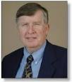
Paul Benware Daniel Commentary (p. 275)
“Time will be needed to set up the governing administration of His kingdom after the rewarding has taken place. Once the judgments determining who can enter the kingdom have been concluded, it may take another forty-five days to form the government structure necessary to operate in the kingdom…After the saints and unbelievers have been separated, it will take time to appoint saints to different government posts and to inform them of their various responsibilities.”

Slide 42
Answer Daniel 12:9-13
Progressive illumination (9)
Contrast between the righteous & wicked (10)
Preparation for the Millennial Temple (11)
Preparation for the Millennial Kingdom (12)
Daniel’s predicted inheritance (13)

Slide 43
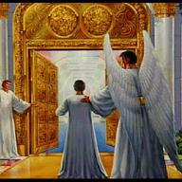
John 5:24
“Truly, truly, I say to you, he who hears My word, and believes Him who sent Me, has eternal life, and does not come into judgment, but has passed out of death into life.”

Slide 44
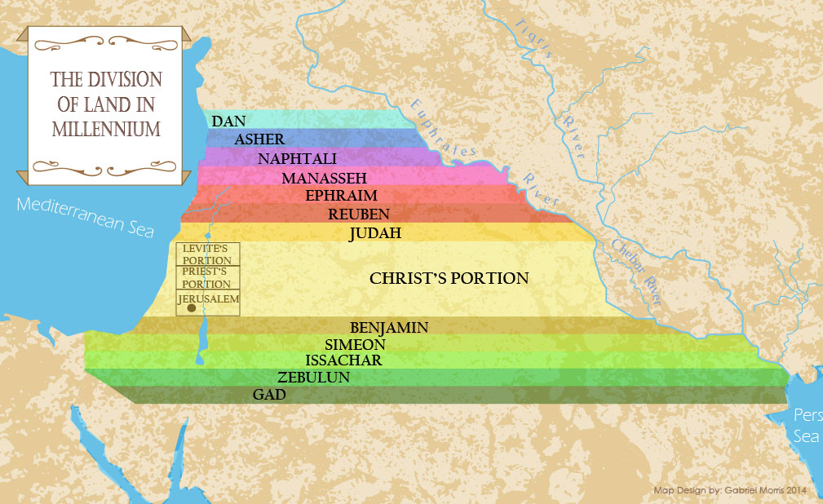

Slide 45
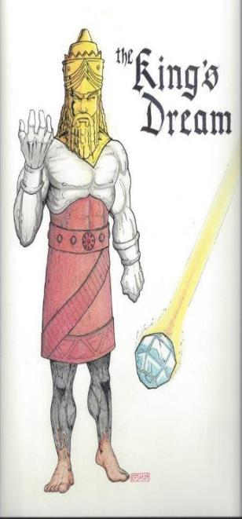
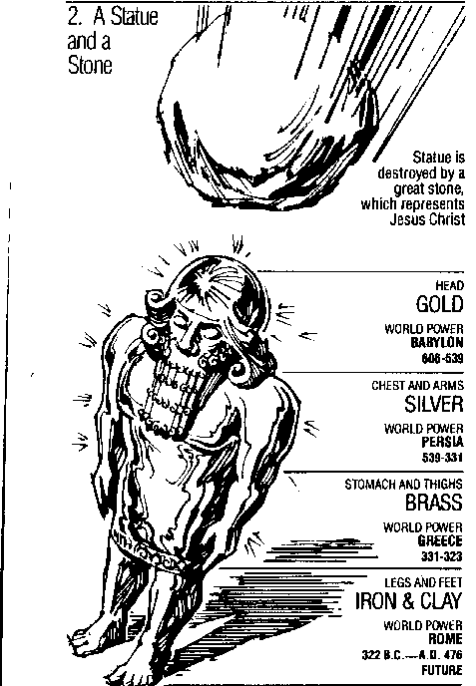
Statue
&
Stone

Slide 46
Daniel 2:44
“In the days of those kings the God of heaven will set up a kingdom which will never be destroyed, and that kingdom will not be left for another people; it will crush and put an end to all these kingdoms, but it will itself endure forever.”

Slide 47
Conclusion

Slide 48
Message
Times of the Gentiles are revealed prophetically (2, 7, 8-12) and ethically (1, 3-6)

Slide 49
Purpose
To encourage Judah by emphasizing the sovereignty of God during the Babylonian captivity and to teach Judah how to live while outside the land

Slide 50
Diversity of Topics in Daniel
Prophecy
Eschatology
Confidence that the Bible is God’s word
Knowledge of Intertestamental Period
Angelology
Spiritual Warfare
Living for God in a Pagan Society
God’s Sovereignty Over Empires

Slide 51
“The Lord bless you and keep you; the Lord make his face shine on you and be gracious to you; the Lord turn his face toward you and give you peace.” (NIV)

