Slide 1

Ecclesiology
Session 21
Dr. Andy Woods
Senior Pastor – Sugar Land Bible Church
President – Chafer Theological Seminary

Slide 2


Areas of Systematic Theology
Prolegomena – Introduction
Theology – Study of God
Christology – Study of Christ
Pneumatology – Study of the Holy Spirit
Anthropology – Study of Man
Hamartiology – Study of sin
Soteriology – Study of salvation
Angelology – Study of angels
Ecclesiology – Study of the Church
Eschatology – Study of the end

Slide 3
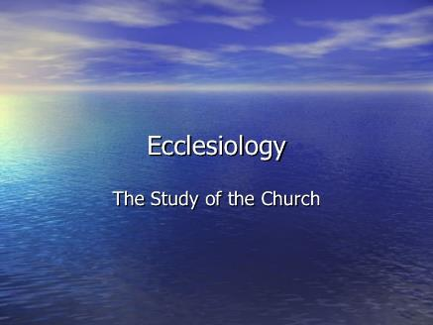
Ecclesiology Overview
Definition
Universal vs. local
Word pictures
Origin
Israel – Church differences
Intercalation
Purposes
Activities
Government
Officers
Ordinances
Purity

Slide 4

VII. Purposes of the Local Church
Glorify God (Eph 3:21)
Edify the saints (Eph 4:11-16)
Fulfill the Great Commission (Matt 28:18-20)

Slide 5

Three Misdirected Church Purposes
Holistic Redemption
Social Gospel
Bringing in the Kingdom

Slide 6
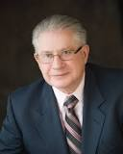
The Church & the Social Gospel
“Ward recruited pupils, associates and disciples to his crusade to produce, in his words: ‘…a changed attitude on the part of many church members concerning the purpose and function both of the Church and Christianity.’”
John A. Stormer, None Dare Call It Treason: The Carefully Documented Story of America's Retreat from Victory (Florissant, MO: Liberty Bell Press, 1964), 126.

Slide 7
VII. Purposes of the Local Church
Glorify God (Eph 3:21)
Edify the saints (Eph 4:11-16)
Fulfill the Great Commission (Matt 28:18-20)

Slide 8


2 Timothy 3:16-17
“¹⁶ All Scripture is inspired by God and profitable for teaching, for reproof, for correction, for training in righteousness; ¹⁷ so that the man of God may be adequate, equipped for every good work.”

Slide 9
Ephesians 4:11-16
“¹¹ And He gave some as apostles, and some as prophets, and some as evangelists, and some as pastors and teachers, ¹² for the equipping of the saints for the work of service, to the building up of the body of Christ;”

Slide 10

Spiritual Gifts

Slide 11
Areas of Systematic Theology
Prolegomena – Introduction
Theology – Study of God
Christology – Study of Christ
Pneumatology – Study of the Holy Spirit
Anthropology – Study of Man
Hamartiology – Study of sin
Soteriology – Study of salvation
Angelology – Study of angels
Ecclesiology – Study of the Church
Eschatology – Study of the end

Slide 12
1 Corinthians 12:1
“¹¹ Now concerning spiritual gifts, brethren, I do not want you to be unaware.”

Slide 13
Four Questions
What are some general observations about spiritual gifts?
Are all the spiritual gifts for today?
What are the spiritual gifts?
How do we discover our own unique area of gifting?

Slide 14
Four Questions
What are some general observations about spiritual gifts?
Are all the spiritual gifts for today?
What are the spiritual gifts?
How do we discover our own unique area of gifting?

Slide 15
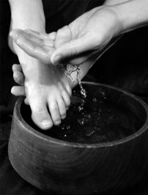
Spiritual Gifts: Observation #1
Spiritual gifts are Spirit empowered abilities for service (John 13:15)

Slide 16

Spiritual Gifts: Observation #2
God sovereignly bestows all the Spiritual gifts (1 Cor 12:11; Heb 2:4)

Slide 17
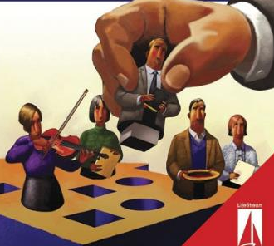
Spiritual Gifts: Observation #3
Every believer has at least one Spiritual gift (1 Cor 12:7; Eph 4:7; 1 Pet 4:10)

Slide 18

Spiritual Gifts: Observation #4
Believers obtain their Spiritual gifts at the point of salvation (Heb 2:4; Rom 8:9)

Slide 19
Spiritual Gifts: Observation #5
Spiritual gifts are not the same as natural abilities or talents

Slide 20
Talents vs. Spiritual Gifts
 | NATURAL TALENTS | SPIRITUAL GIFTS
Source | From God Through Parents | From God Independent of Parents
Possessed | From birth | From conversion
Purpose | To benefit mankind in general | To edify the church

Slide 21
Talents vs. Spiritual Gifts
“The natural abilities of the unsaved are not spiritual gifts. This much is certain. However, it is likely that sometimes the Holy Spirit transforms a purely natural ability by channeling it into God’s work after conversion to Christ. In other cases, the Holy Spirit probably bestows brand new aptitudes, interests, and abilities.”
Steven Waterhouse, Not By Bread Alone, 291

Slide 22
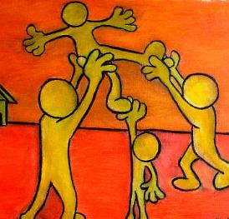
Spiritual Gifts: Observation #6
Spiritual gifts are given in order to edify the church (1 Cor 12:7; 14:12, 26; Eph 4:11-12; 1 Pet 4:10)

Slide 23
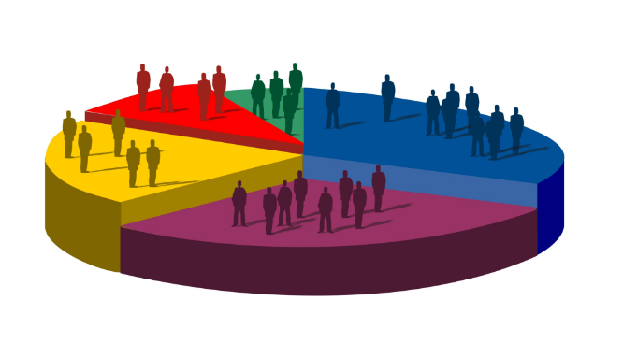
Spiritual Gifts: Observation #7
Spiritual gifts are diverse (1 Cor 12:4-6)

Slide 24

Spiritual Gifts: Observation #8
Spiritual gifts represent differing manifestations of God’s grace (1 Pet 4:10)

Slide 25

Spiritual Gifts: Observation #9
No single person possesses all of the Spiritual gifts (1 Cor 12:29-30)

Slide 26

Spiritual Gifts: Observation #10
God uses Spiritual gifts to promote unity in His church (1 Cor 12)

Slide 27

Spiritual Gifts: Observation #11
Spiritual gifts are not to be confused with the fruit of the Spirit (1 Cor 1:7)

Slide 28
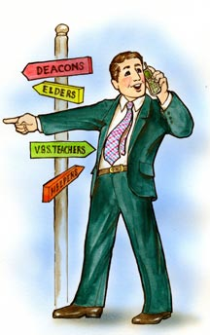
Spiritual Gifts: Observation #12
Spiritual gifts are not always the same as an office

Slide 29

Spiritual Gifts: Observation #13
Spiritual gifts are not always the same as a sphere of influence

Slide 30
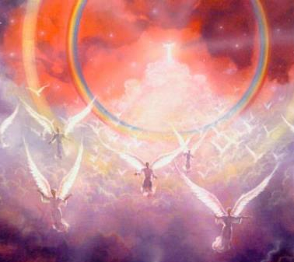
Spiritual Gifts: Observation #14
Spiritual gifts are irrevocable this side of eternity (Rom 11:29)

Slide 31
Spiritual Gifts: Observation #15
Spiritual gifts do not cancel the basic duties of all believers

Slide 32

Spiritual Gifts: Observation #16
Spiritual gifts need development (2 Tim 1:6)

Slide 33
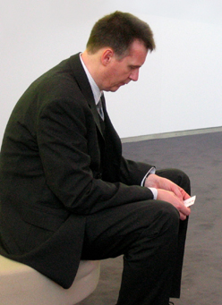
Spiritual Gifts: Observation #17
Spiritual gifts can be neglected
  1 Tim 4:14
  Matt 25:25-26

Slide 34

Spiritual Gifts: Observation #18
Awareness of our Spiritual gifts render us accountable (Matt 25:19; Rom 14:12)

Slide 35
Conclusion

Slide 36
Areas of Systematic Theology
Prolegomena – Introduction
Theology – Study of God
Christology – Study of Christ
Pneumatology – Study of the Holy Spirit
Anthropology – Study of Man
Hamartiology – Study of sin
Soteriology – Study of salvation
Angelology – Study of angels
Ecclesiology – Study of the Church
Eschatology – Study of the end

Slide 37
Ecclesiology Overview
Definition
Universal vs. local
Word pictures
Origin
Israel – Church differences
Intercalation
Purposes
Activities
Government
Officers
Ordinances
Purity

